Slide 1
Overview of Cyberinfrastructure and the Breadth of Its Application
Howard University
Cyberinfrastructure Day
April 16 2010
Geoffrey Fox
gcf@indiana.edu
http://www.infomall.org http://www.futuregrid.org
Director, Digital Science Center, Pervasive Technology Institute
Associate Dean for Research and Graduate Studies, School of Informatics and Computing
Indiana University Bloomington
Notes:
SALSA is
Service Aggregated Linked Sequential Activities

Slide 2
What is Cyberinfrastructure
Cyberinfrastructure is (from NSF) infrastructure that supports distributed research and learning (e-Science, e-Research, e-Education)
Links data, people, computers
Exploits Internet technology (Web2.0 and Clouds) adding (via Grid technology) management, security, supercomputers etc.
It has two aspects: parallel – low latency (microseconds) between nodes and distributed – highish latency (milliseconds) between nodes
Parallel needed to get high performance on individual large simulations, data analysis etc.; must decompose problem
Distributed aspect integrates already distinct components – especially natural for data (as in biology databases etc.)
2
Notes:
2

Slide 3
e-moreorlessanything
‘e-Science is about global collaboration in key areas of science, and the next generation of infrastructure that will enable it.’ from inventor of term John Taylor Director General of Research Councils UK, Office of Science and Technology
e-Science is about developing tools and technologies that allow scientists to do ‘faster, better or different’ research
Similarly e-Business captures the emerging view of corporations as dynamic virtual organizations linking employees, customers and stakeholders across the world.
This generalizes to e-moreorlessanything including e-DigitalLibrary, e-SocialScience, e-HavingFun and e-Education
A deluge of data of unprecedented and inevitable size must be managed and understood.
People (virtual organizations), computers, data (including sensors and instruments) must be linked via hardware and software networks
3
Notes:
3

Slide 4
Important Trends
Data Deluge in all fields of science
Also throughout life e.g. web!
Multicore implies parallel computing important again
Performance from extra cores – not extra clock speed
Clouds – new commercially supported data center model replacing compute grids

Slide 6
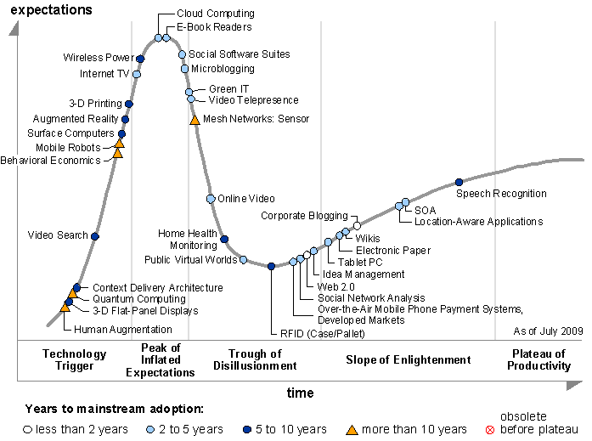
Gartner 2009 Hype Curve
Clouds, Web2.0
Service Oriented Architectures

Slide 7
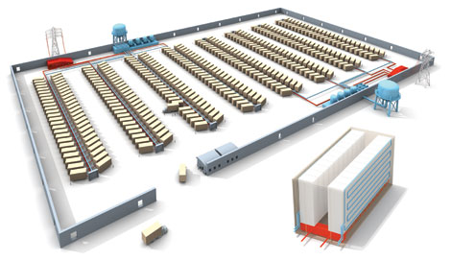
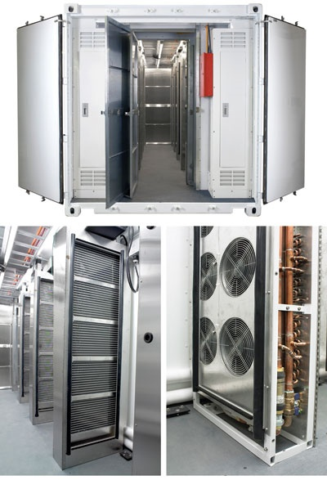
Clouds as Cost Effective Data Centers
Builds giant data centers with 100,000’s of computers; ~ 200 -1000 to a shipping container with Internet access
“Microsoft will cram between 150 and 220 shipping containers filled with data center gear into a new 500,000 square foot Chicago facility. This move marks the most significant, public use of the shipping container systems popularized by the likes of Sun Microsystems and Rackable Systems to date.”

Slide 8
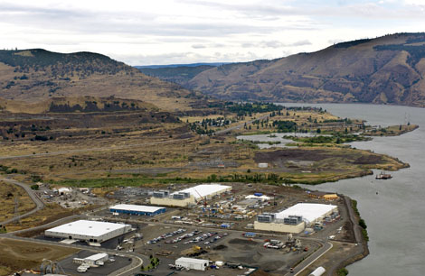
Clouds hide Complexity
SaaS: Software as a Service
IaaS: Infrastructure as a Service or HaaS: Hardware as a Service – get your computer time with a credit card and with a Web interaface
PaaS: Platform as a Service is IaaS plus core software capabilities on which you build SaaS
Cyberinfrastructure is “Research as a Service”
SensaaS is Sensors as a Service
2 Google warehouses of computers on the banks of the Columbia River, in The Dalles, Oregon
Such centers use 20MW-200MW
(Future) each
150 watts per core
Save money from large size, positioning with cheap power and access with Internet

Slide 9
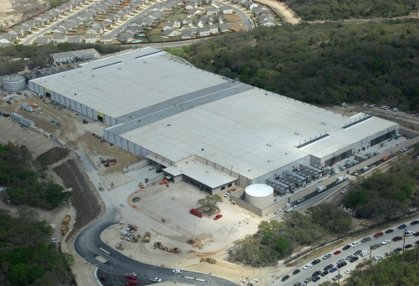
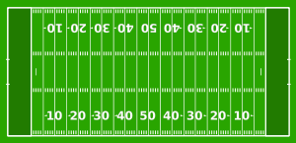
The Data Center Landscape
Range in size from “edge” facilities to megascale.
Economies of scale
Approximate costs for a small size center (1K servers) and a larger, 50K server center.
Technology | Cost in small-sized Data Center | Cost in Large Data Center | Ratio
Network | $95 per Mbps/ month | $13 per Mbps/ month | 7.1
Storage | $2.20 per GB/ month | $0.40 per GB/ month | 5.7
Administration | ~140 servers/ Administrator | >1000 Servers/ Administrator | 7.1
Each data center is
11.5 times
the size of a football field

Slide 10
Clouds hide Complexity
Cyberinfrastructure
Is “Research as a Service”
SaaS: Software as a Service
(e.g. CFD or Search documents/web are services)
PaaS: Platform as a Service
IaaS plus core software capabilities on which you build SaaS
(e.g. Azure is a PaaS; MapReduce is a Platform)
IaaS (HaaS): Infrastructure as a Service
(get computer time with a credit card and with a Web interface like EC2)

Slide 11
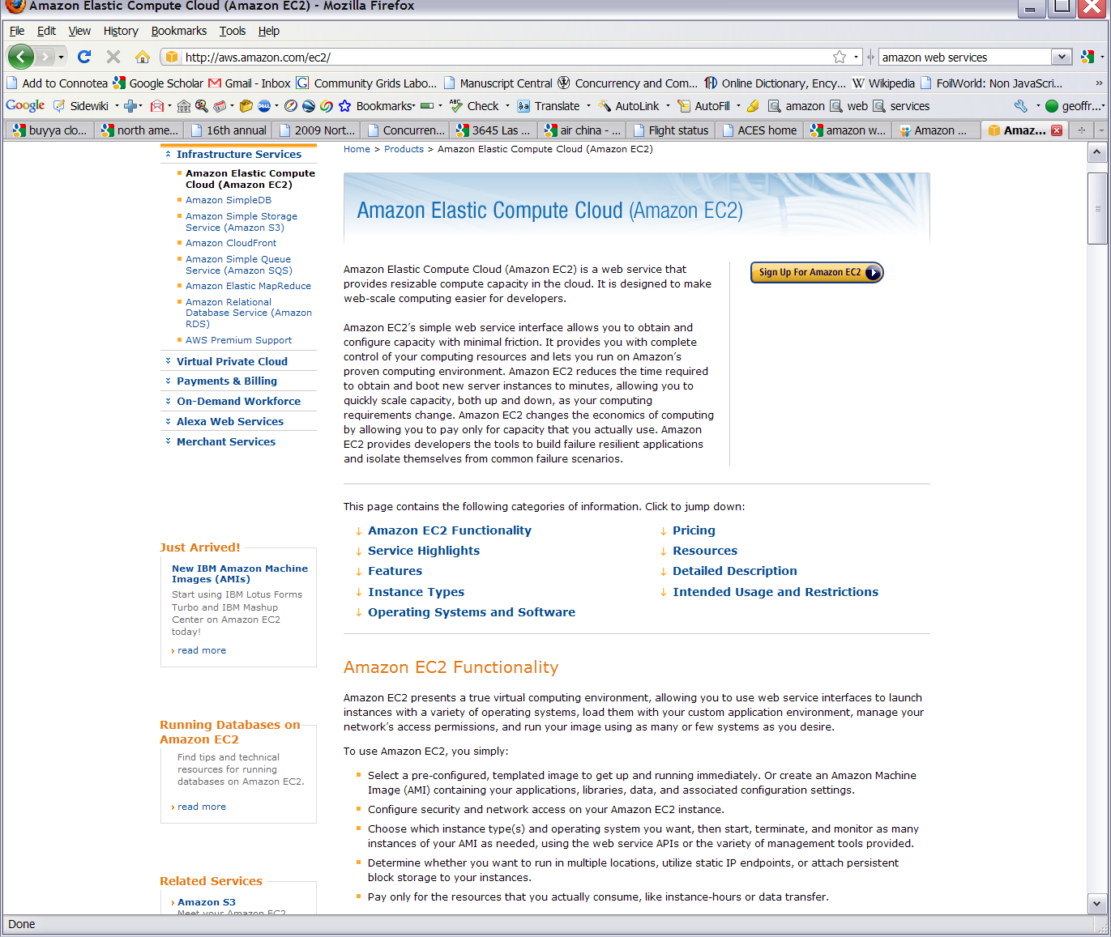
Commercial Cloud
Software

Slide 12
Philosophy of Clouds and Grids
Clouds are (by definition) commercially supported approach to large scale computing
So we should expect Clouds to replace Compute Grids
Current Grid technology involves “non-commercial” software solutions which are hard to evolve/sustain
Maybe Clouds ~4% IT expenditure 2008 growing to 14% in 2012 (IDC Estimate)
Public Clouds are broadly accessible resources like Amazon and Microsoft Azure – powerful but not easy to optimize and perhaps data trust/privacy issues
Private Clouds run similar software and mechanisms but on “your own computers”
Services still are correct architecture with either REST (Web 2.0) or Web Services
Clusters still critical concept

Slide 13
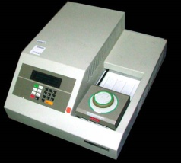
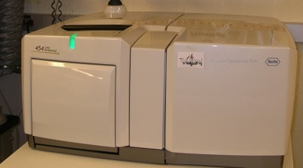
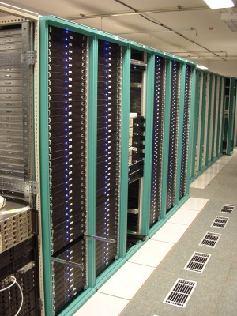
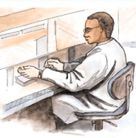
MapReduce “File/Data Repository” Parallelism
Map = (data parallel) computation reading and writing data
Reduce = Collective/Consolidation phase e.g. forming multiple global sums as in histogram
Instruments
Iterative MapReduce
Map Map Map Map
Reduce Reduce Reduce
Communication
Reduce
Portals /Users
Disks
Map₁
Map₂
Map₃

Slide 14
Cloud Computing: Infrastructure and Runtimes
Cloud infrastructure: outsourcing of servers, computing, data, file space, utility computing, etc.
Handled through Web services that control virtual machine lifecycles.
Cloud runtimes: tools (for using clouds) to do data-parallel computations.
Apache Hadoop, Google MapReduce, Microsoft Dryad, and others
Designed for information retrieval but are excellent for a wide range of science data analysis applications
Can also do much traditional parallel computing for data-mining if extended to support iterative operations
Not usually on Virtual Machines

Slide 15
MapReduce
A parallel Runtime coming from Information Retrieval
Data Partitions
Map(Key, Value)
A hash function maps the results of the map tasks to r reduce tasks
Reduce(Key, List<Value>)
Reduce Outputs
Implementations support:
Splitting of data
Passing the output of map functions to reduce functions
Sorting the inputs to the reduce function based on the intermediate keys
Quality of services

Slide 16
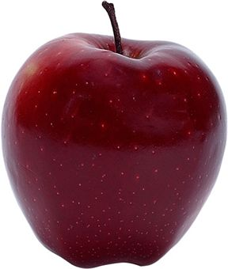
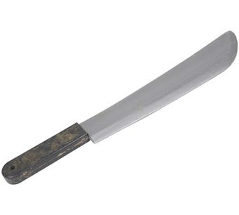
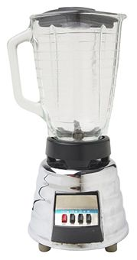
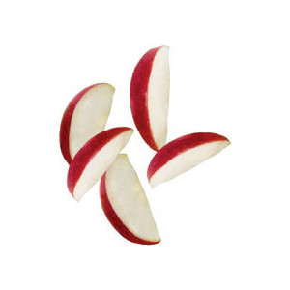
Sam’s Problem http://www.slideshare.net/esaliya/mapreduce-in-simple-terms
Sam thought of “drinking” the apple
He used a to cut the and a to make juice.

Slide 17
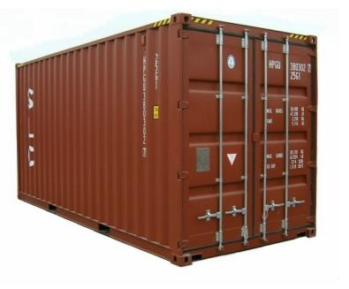
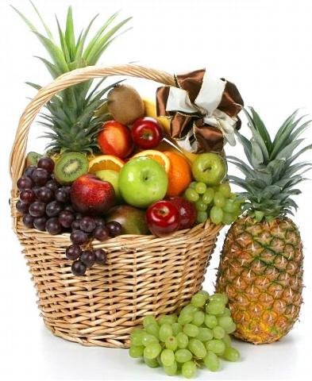
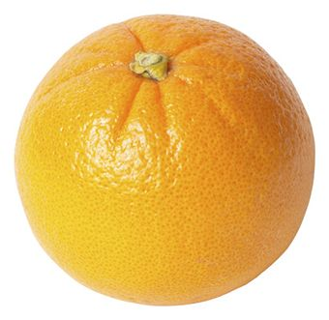
Creative Sam
Implemented a parallel version of his innovation
Fruits
Each input to a map is a list of <key, value> pairs
A list of <key, value> pairs mapped into another list of <key, value> pairs which gets grouped by the key and reduced into a list of values
(<a, > , <o, > , <p, > , …)
Each output of slice is a list of <key, value> pairs
(<a’, > , <o’, > , <p’, > )
Grouped by key
The idea of Map Reduce in Data Intensive Computing
Each input to a reduce is a <key, value-list> (possibly a list of these, depending on the grouping/hashing mechanism)
e.g. <ao, ( …)>
Reduced into a list of values

Slide 18
Cost of Clouds
4096 Cap3 data files : 1.06 GB / 1875968 reads (458 readsX4096)..
Following is the cost to process 4096 CAP3 files..
Cost to process 4096 FASTA files (~1GB) on EC2 (58 minutes)
Amortized compute cost = 10.41 $ (0.68$ per high CPU extra large instance per hour) 10000 SQS messages = 0.01 $ Storage per 1GB per month = 0.15 $ Data transfer out per 1 GB = 0.15 $ Total = 10.72 $
Cost to process 4096 FASTA files (~1GB) on Azure (59 minutes)
Amortized compute cost = 15.10 $ (0.12$ per small instance per hour) 10000 queue messages = 0.01 $ Storage per 1GB per month = 0.15 $ Data transfer in/out per 1 GB =0.10 $ + 0.15 $ Total = 15.51 $
Amortized cost in Tempest (24 core X 32 nodes, 48 GB per node) = 9.43$
(Assume 70% utilization, write off over 3 years, include support)

Slide 19
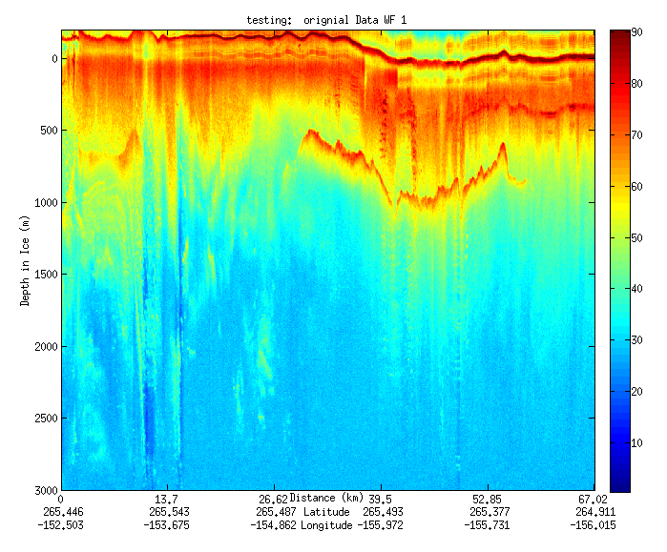
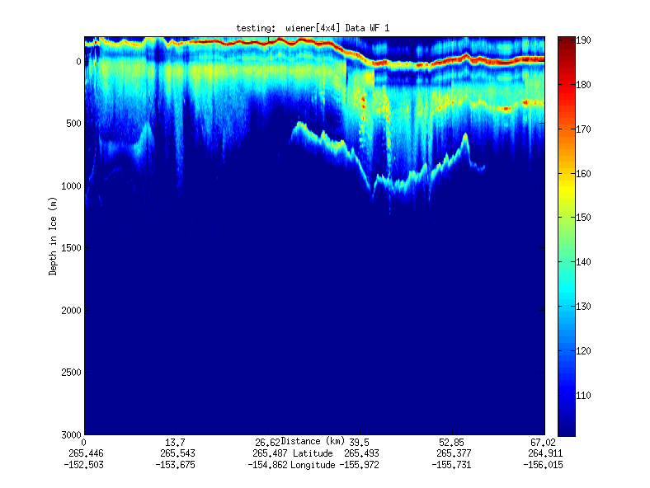
Geospatial Examples on Cloud Infrastructure
Image processing and mining
SAR Images from Polar Grid (Matlab)
Apply to 20 TB of data
Could use MapReduce
Flood modeling
Chaining flood models over a geographic area.
Parameter fits and inversion problems.
Deploy Services on Clouds – current models do not need parallelism
Real time GPS processing (QuakeSim)
Services and Brokers (publish subscribe Sensor Aggregators) on clouds
Performance issues not critical
Filter

Slide 20
Lightweight Cyberinfrastructure to support mobile Data gathering expeditions plus classic central resources (as a cloud)

Slide 21
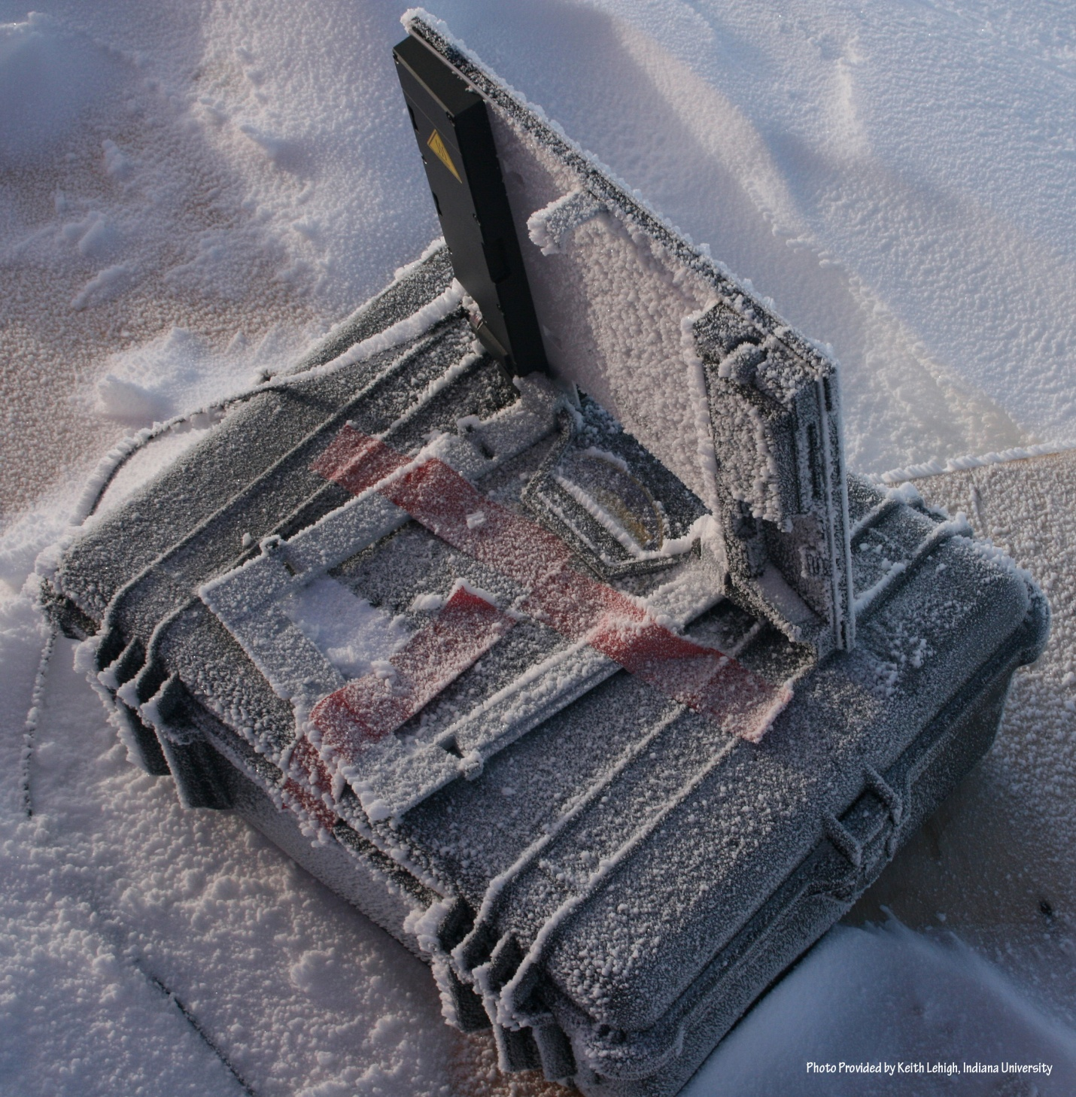
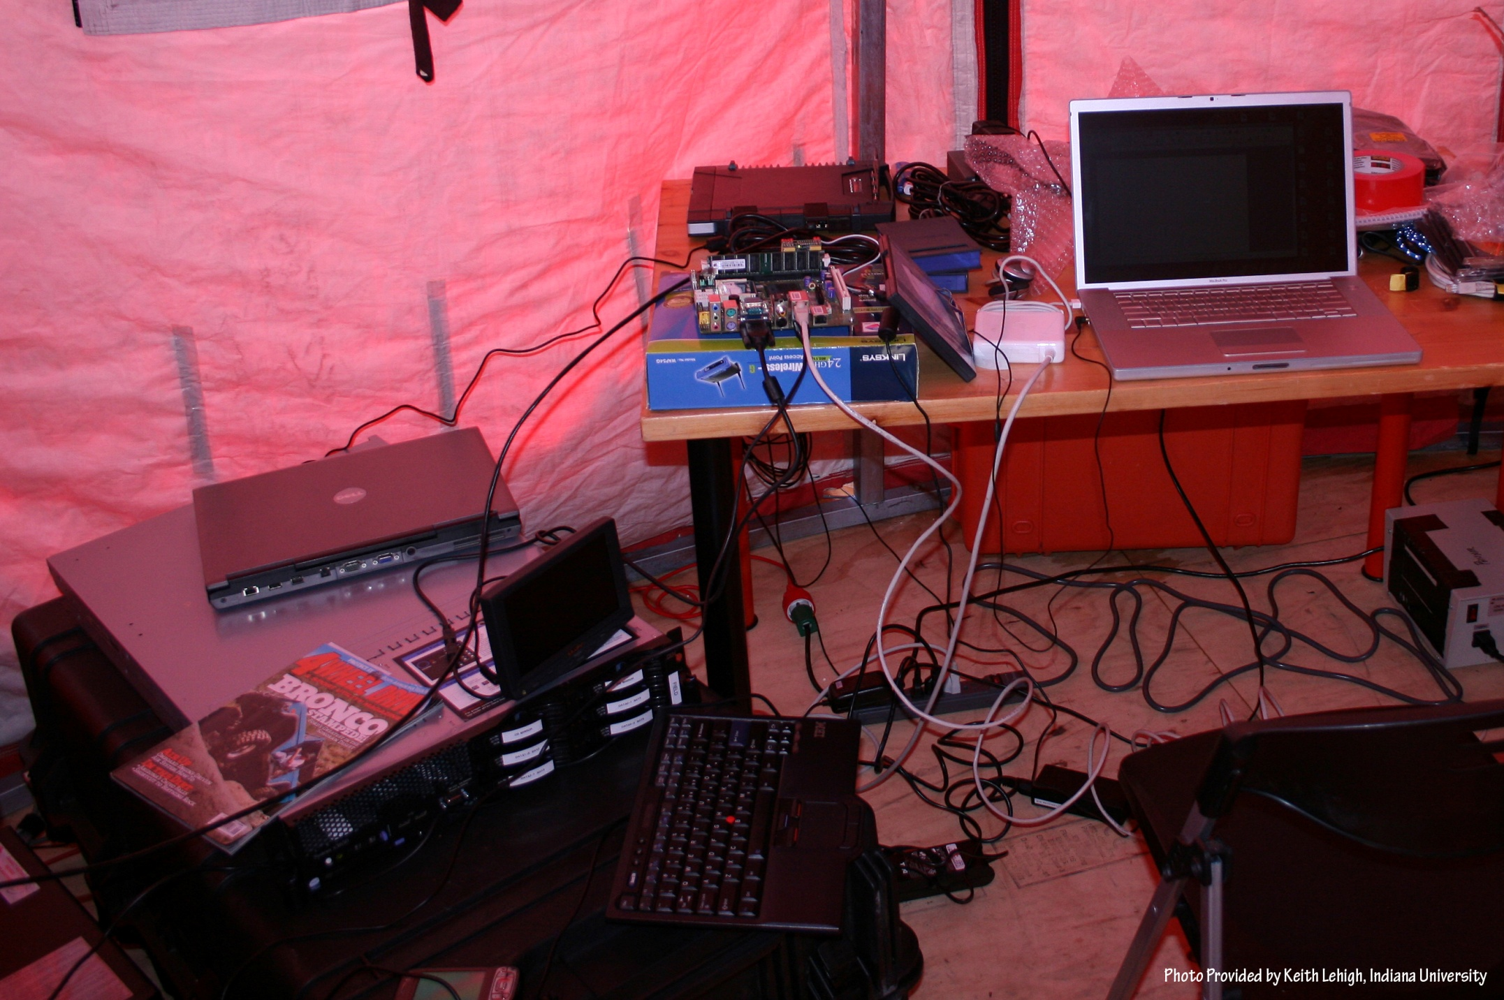
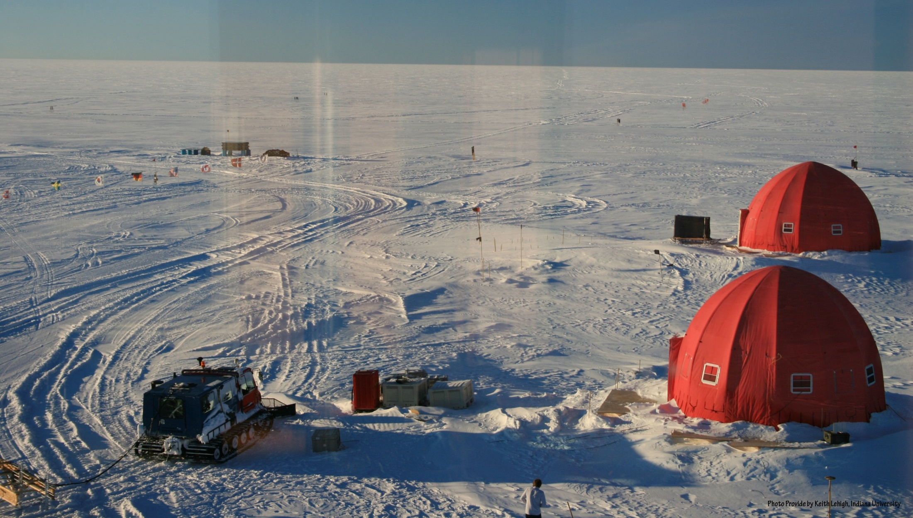
NEEM 2008 Base Station

Slide 22
Data Sources
Common Themes of Data Sources
Focus on geospatial, environmental data sets
Data from computation and observation.
Rapidly increasing data sizes
Data and data processing pipelines are inseparable.

Slide 23
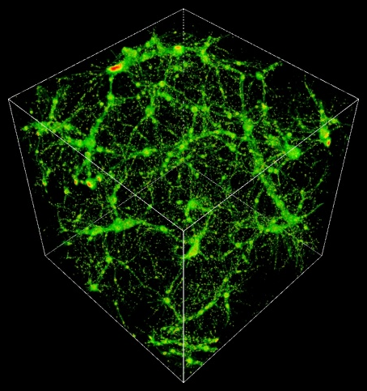
TeraGrid Example: Astrophysics
Science: MHD and star formation; cosmology at galactic scales (6-1500 Mpc) with various components: star formation, radiation diffusion, dark matter
Application: Enzo (loosely similar to: GASOLINE, etc.)
Science Users: Norman, Kritsuk (UCSD), Cen, Ostriker, Wise (Princeton), Abel (Stanford), Burns (Colorado), Bryan (Columbia), O’Shea (Michigan State), Kentucky, Germany, UK, Denmark, etc.
Notes:
The StarGate demo at SC09 combined steps 5 and 6, using 10 Gbps ESnet connection and 10 Gbps Dynamic Circuit Network (DCN) – 150 TB was moved from NICS to ANL for rendering on GPU cluster, results were streamed to OptiPortal at SC – our network tradeoffs include similar options.
The full simulation takes 3 months real time at NICS, moving data to ANL takes 3 nights – moving the data is practical, if it can be made simple and reliable.
http://www.lbl.gov/cs/Archive/news112009.html

Slide 24
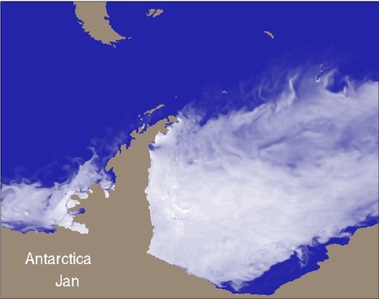
TeraGrid Example: Petascale Climate Simulations
Science: Climate change decision support requires high-resolution, regional climate simulation capabilities, basic model improvements, larger ensemble sizes, longer runs, and new data assimilation capabilities. Opening petascale data services to a widening community of end users presents a significant infrastructural challenge.
2008 WMS: We need faster higher resolution models to resolve important features, and better software, data management, analysis, viz, and a global VO that can develop models and evaluate outputs
Applications: many, including: CCSM (climate system, deep), NRCM (regional climate, deep), WRF (meteorology, deep), NCL/NCO (analysis tools, wide), ESG (data, wide)
Science Users: many, including both large (e.g., IPCC, WCRP) and small groups;
ESG federation includes >17k users, 230 TB data, 500 journal papers (2 years)
Realistic Antarctic sea-ice coverage generated from century-scale high resolution coupled climate simulation performed on Kraken (John Dennis, NCAR)
Notes:
TeraGrid has had a modest impact on the advancement of climate science thus far -- XROADS plans for XD to have a much larger impact on the advancement of climate science. The XROADS team we've assembled includes individuals (Apps, tools, viz, data, AUSS including Gateways, TEOS) working at the forefront of petascale climate simulation, climate science gateways, climate workflows, analysis and visualization of climate, and global data and knowledge sharing. A solid Deep & Wide foundation for advancing climate science.
WMS – 2008 World Modeling Summit
WCRP – World Climate Research Program
WMS and community says models need to be 1 km or less resolution
Lots of users for each tool, hundreds for CCSM, WRF, tens of thousands for NCL/NCO, ESG

Slide 25
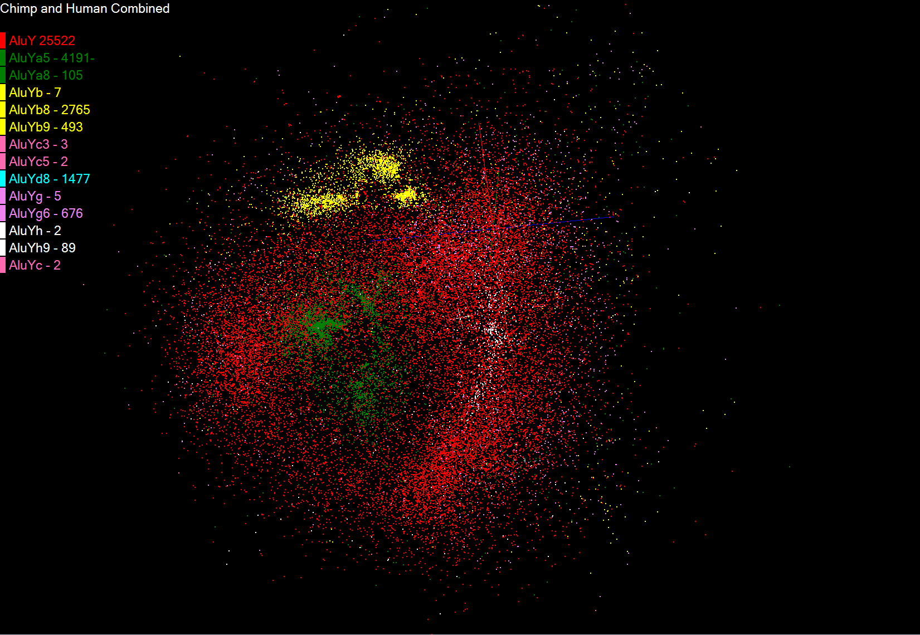
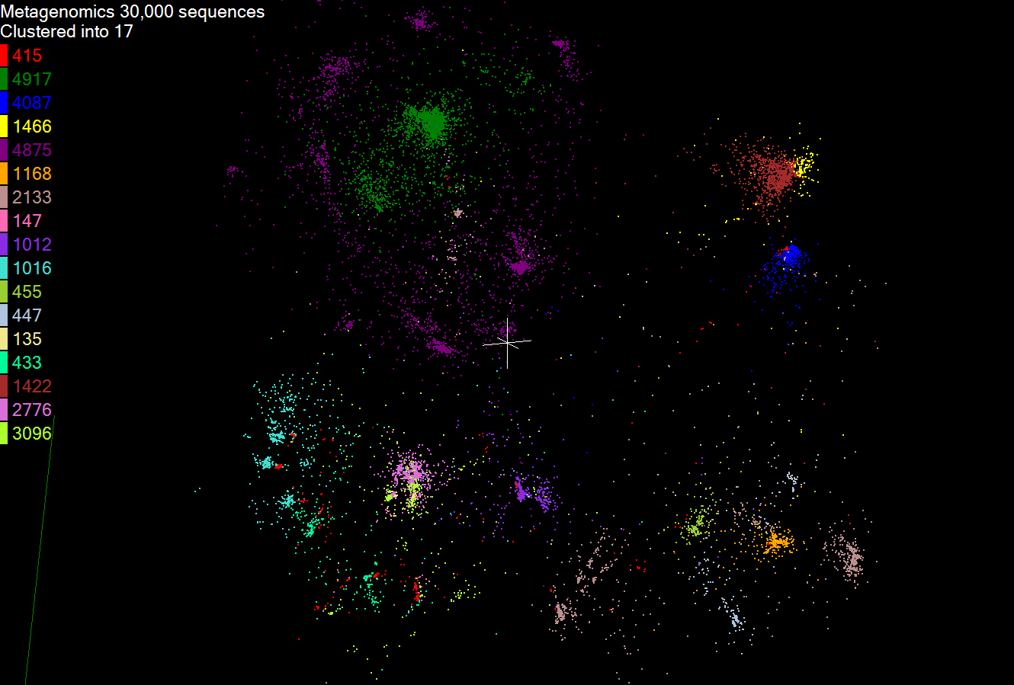
TeraGrid Example: Genomic Sciences
Science: many, ranging from de novo sequence analysis to resequencing, including: genome sequencing of a single organism; metagenomic studies of entire populations of microbes; study of single base-pair mutations in DNA
Applications: e.g. ANL’s Metagenomics RAST server catering to hundreds of groups, Indiana’s SWIFT aiming to replace BLASTX searches for many bio groups, Maryland’s CLOUDburst, BioLinux
PIs: thousands of users and developers, e.g. Meyer (ANL), White (U. Maryland), Dong (U. North Texas), Schork (Scripps), Nelson, Ye, Tang, Kim (Indiana)
Results of Smith-Waterman distance computation, deterministic annealing clustering, and Sammon’s mapping visualization pipeline for 30,000 metagenomics sequences: (a) 17 clusters for full sample; (b) 10 sub-clusters found from purple and green clusters in (a). (Nelson and Ye, Indiana)
Map sequence
clusters to 3D
Notes:
Simon Twigger (UMD) example: CloVR, a tool that can be used to build pipelines that use cloud resources: http://clovr.igs.umaryland.edu/
Porting/developing pipelines can make use of clouds; on XD, will use XROADS services, e.g., job execution, metascheduling
Sharing digital products includes supporting standard data formats: e.g., Metagenome Transport Format from Genomics Standards Consortium’s M5 working group, coming in other fields following the MTF model according to Eugene Kolker, Seattle Children’s Hospital – see “‘Omics Data Sharing,” Science 9 Oct 2009
XROADS Wide follows successful TG gateways model – build general tools that communities can use to build specific tools for their members

Slide 26
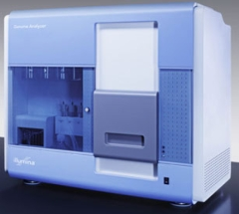
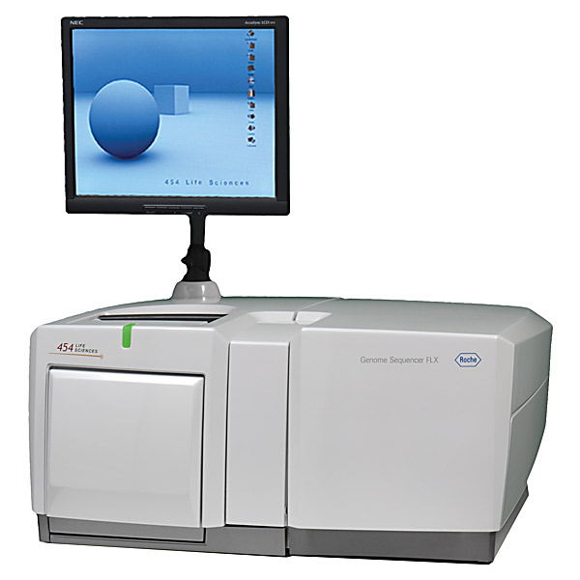
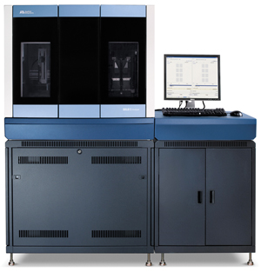
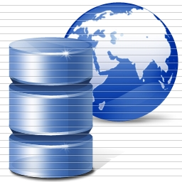
DNA Sequencing Pipeline
Illumina/Solexa Roche/454 Life Sciences Applied Biosystems/SOLiD
Internet
~300 million base pairs per day leading to
~3000 sequences per day per instrument
? 500 instruments at ~0.5M$ each
Read Alignment
Pairwise
clustering
Form block
Pairings
Sequence
alignment
Dissimilarity
Matrix
N(N-1)/2 values
Visualization
Plotviz
FASTA File N Sequences
Blocking
MPI
MDS
MapReduce

Slide 27
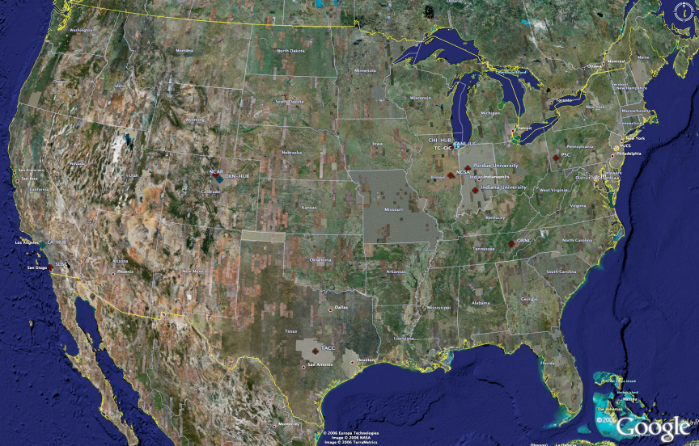
TeraGrid High Performance Computing Systems 2007-8
UC/ANL
PSC
PU
NCAR
NCSA
IU
2008
(~1PF)
ORNL
Tennessee
SDSC
(504TF)
LONI/LSU
TACC
Computational Resources
(size approximate - not to scale)
Slide Courtesy Tommy Minyard, TACC

Slide 28
TeraGrid User Areas

Slide 29
80% of Users, 20% of Computing
Nearly 80% of TeraGrid users in FY09 never ran a job larger than 256 cores.
Usage by all those users accounted for less than 20% of TeraGrid usage in the same period.
96% of users and 66% of usage needed 4,096 or fewer cores.

Slide 30
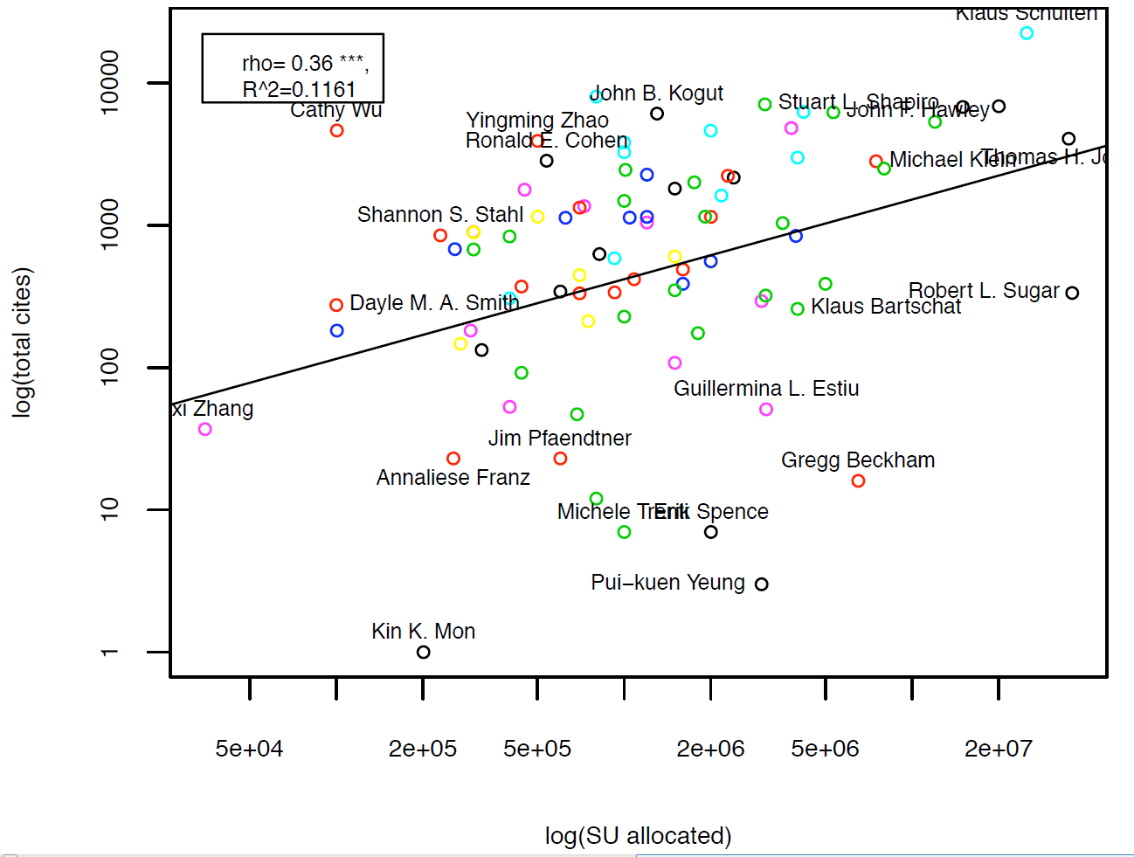
Science Impact Occurs Throughout the Branscomb Pyramid

Slide 31
FutureGrid
The goal of FutureGrid is to support the research on the future of distributed, grid, and cloud computing.
FutureGrid will build a robustly managed simulation environment or testbed to support the development and early use in science of new technologies at all levels of the software stack: from networking to middleware to scientific applications.
The environment will mimic TeraGrid and/or general parallel and distributed systems – FutureGrid is part of TeraGrid and one of two experimental TeraGrid systems (other is GPU)
This test-bed will succeed if it enables major advances in science and engineering through collaborative development of science applications and related software.
FutureGrid is a (small >5000 core) Science/Computer Science Cloud but it is more accurately a virtual machine based simulation environment

Slide 32
FutureGrid is a new part of TeraGrid

Slide 33
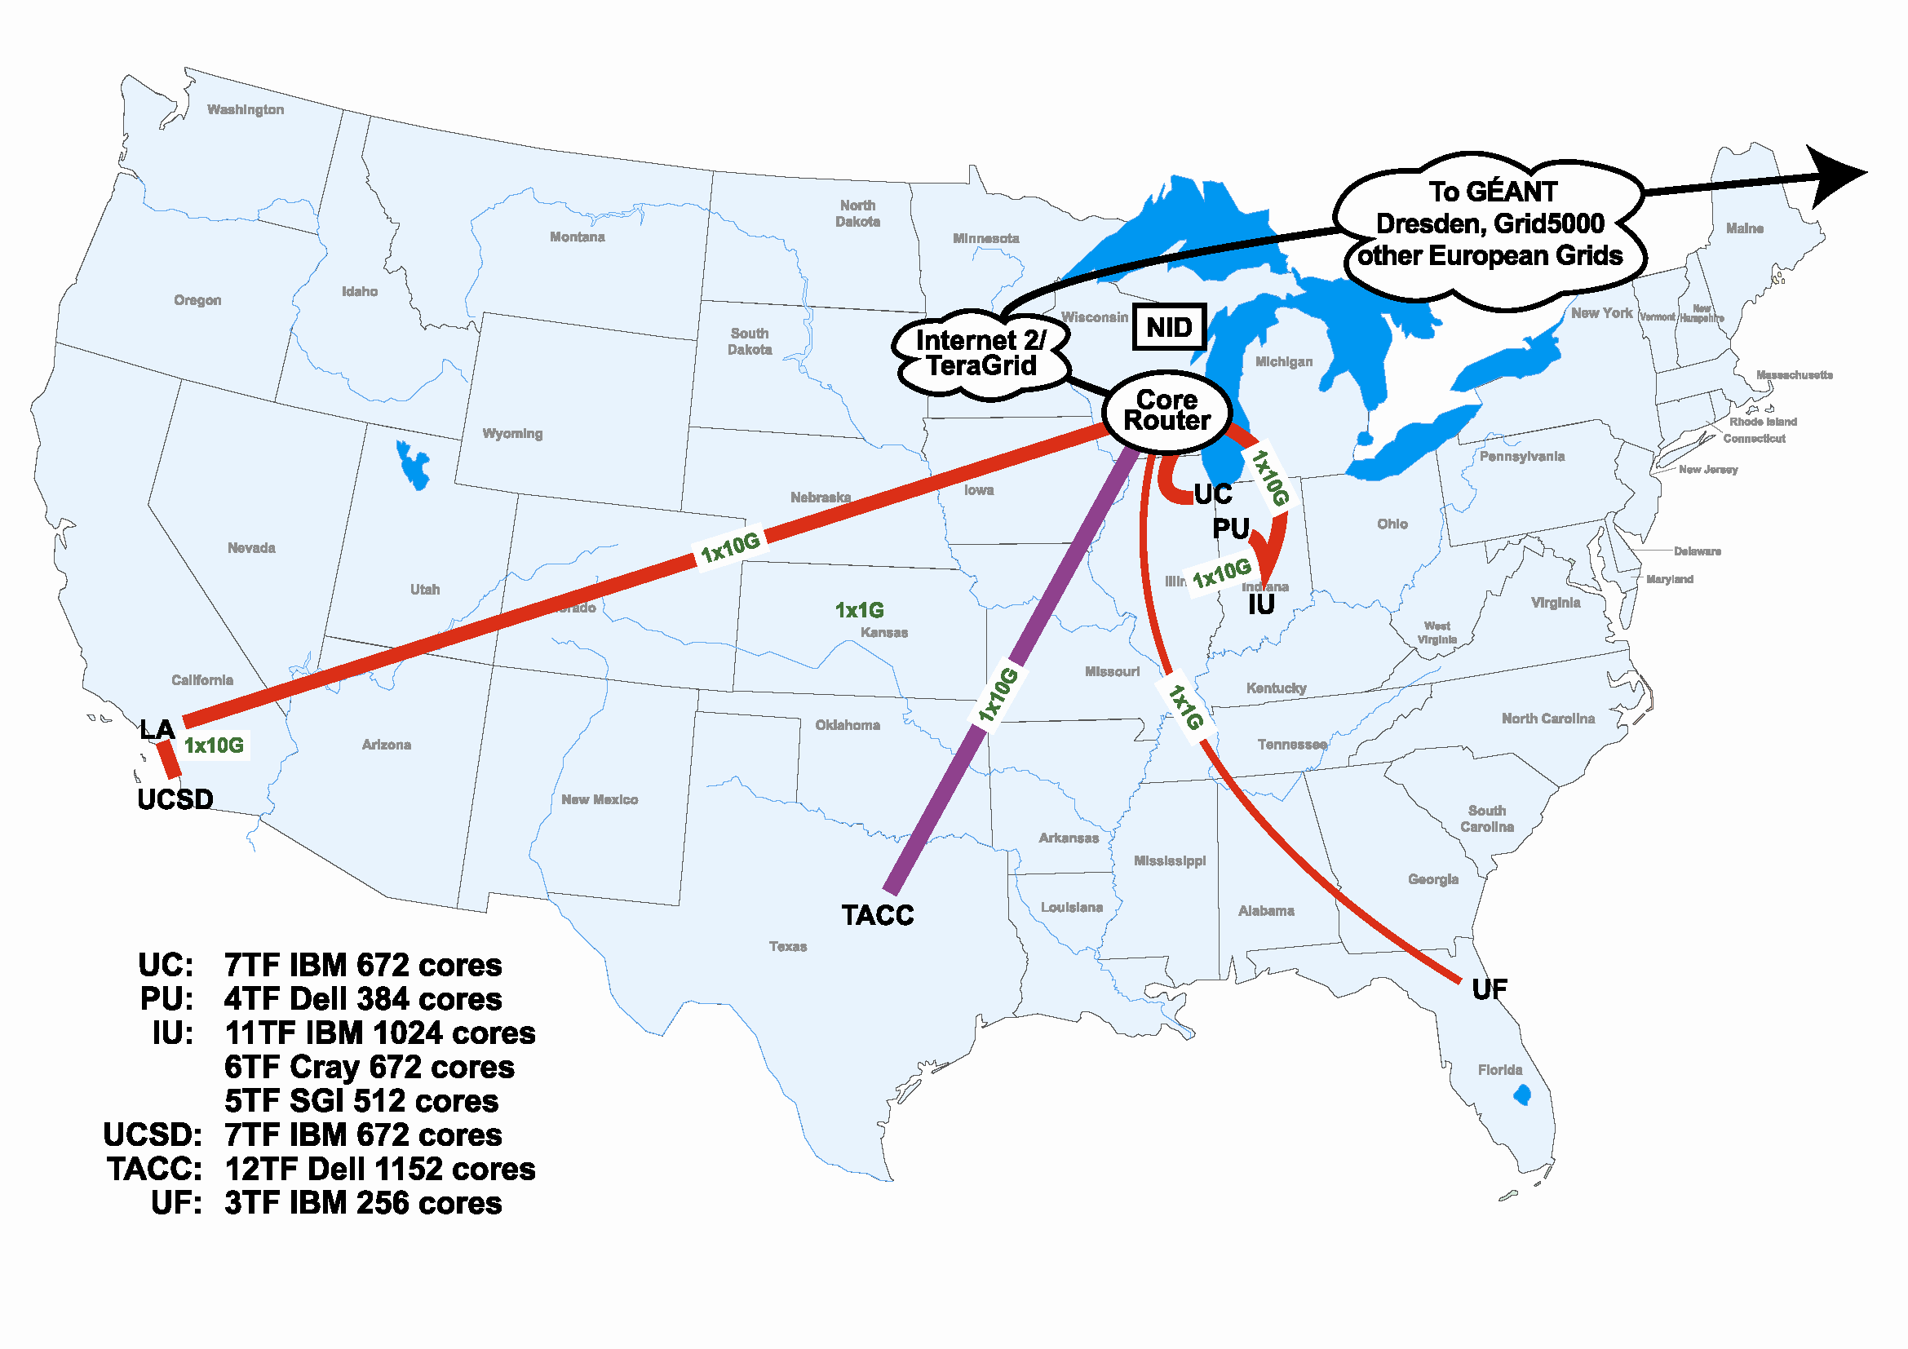
FutureGrid Hardware

Slide 34
FutureGrid Usage Scenarios
Developers of end-user applications who want to develop new applications in cloud or grid environments, including analogs of commercial cloud environments such as Amazon or Google.
Is a Science Cloud for me? Is my application secure?
Developers of end-user applications who want to experiment with multiple hardware environments.
Grid/Cloud middleware developers who want to evaluate new versions of middleware or new systems.
Networking researchers who want to test and compare different networking solutions in support of grid and cloud applications and middleware. (Some types of networking research will likely best be done via through the GENI program.)
Education as well as research
Interest in performance requires that bare metal important

Slide 35
Some critical Concepts as text I
Computational thinking is set up as e-Research and often characterized by a Data Deluge from sensors, instruments, simulation results and the Internet. Curating and managing this data involves digital library technology and possible new roles for libraries. Interdisciplinary Collaboration across continents and fields implies virtual organizations that are built using Web 2.0 technology. VO’s link people, computers and data.
Portals or Gateways provide access to computational and data set up as Cyberinfrastructure or e-Infrastructure made up of multiple Services
Intense computation on individual problems involves Parallel Computing linking computers with high performance networks that are packaged as Clusters and/or Supercomputers. Performance improvements now come from Multicore architectures implying parallel computing important for commodity applications and machines.

Slide 36
Some critical Concepts as text II
Cyberinfrastructure also involves distributed systems supporting data and people that are naturally distributed as well as pleasingly parallel computations. Grids were initial technology approach but these failed to get commercial support and in many cases being replaced by Clouds.
Clouds are highly cost-effective user friendly approaches to large (~100,000 node) data centers originally pioneered by Web 2.0 applications. They tend to use Virtualization technology and offer new MapReduce approach
These developments have implications for Education as well as Research but there is less agreement and success in using cyberinfrastructure in education as with research. “Appliances” allow one to package a course module (run CFD with MPI) as a download to run on a virtual machine.
Group video conferencing enables virtual organizations

