Slide 1
Geoinformatics and Data Intensive Applications on Clouds
International Collaborative Center for Geo-computation Study (ICCGS)
The 1st Biennial Advisory Board Meeting
State Key Lab of Information Engineering in Surveying Mapping and Remote Sensing LIESMARS Wuhan
December 19 2011
Geoffrey Fox
gcf@indiana.edu
http://www.infomall.org http://www.salsahpc.org
Director, Digital Science Center, Pervasive Technology Institute
Associate Dean for Research and Graduate Studies, School of Informatics and Computing
Indiana University Bloomington

Slide 2
Topics Covered
Broad Overview: Trends from Data Deluge to Clouds
Clouds, Grids and Supercomputers: Infrastructure and Applications that work on clouds
MapReduce and Iterative MapReduce for non trivial parallel applications on Clouds
Internet of Things: Sensor Grids supported as pleasingly parallel applications on clouds
Polar Science and Earthquake Science: From GPU to Cloud
Architecture of Data-Intensive Clouds
FutureGrid in a Nutshell

Slide 3
Some Trends
The Data Deluge is clear trend from Commercial (Amazon, e-commerce) , Community (Facebook, Search) and Scientific applications
Light weight clients from smartphones, tablets to sensors
Exascale initiatives will continue drive to high end with a simulation orientation
  China is a major player
Clouds with cheaper, greener, easier to use IT for (some) applications
New jobs associated with new curricula
  Clouds as a distributed system (classic CS courses)
  Data Analytics

Slide 4
Some Data sizes
~40 10⁹ Web pages at ~300 kilobytes each = 10 Petabytes
Youtube 48 hours video uploaded per minute;
  in 2 months in 2010, uploaded more than total NBC ABC CBS
  ~2.5 petabytes per year uploaded?
LHC 15 petabytes per year
Radiology 69 petabytes per year
Square Kilometer Array Telescope will be 100 terabits/second
Earth Observation becoming ~4 petabytes per year
Earthquake Science – few terabytes total today
PolarGrid – 100’s terabytes/year
Exascale simulation data dumps – terabytes/second
Not very quantitative

Slide 5
Clouds Offer From different points of view
Features from NIST:
  On-demand service (elastic);
  Broad network access;
  Resource pooling;
  Flexible resource allocation;
  Measured service
Economies of scale in performance and electrical power (Green IT)
Powerful new software models
  Platform as a Service is not an alternative to Infrastructure as a Service – it is an incredible valued added

Slide 6
The Google gmail example
http://www.google.com/green/pdfs/google-green-computing.pdf
Clouds win by efficient resource use and efficient data centers
Business Type | Number of users | # servers | IT Power per user | PUE (Power Usage effectiveness) | Total Power per user | Annual Energy per user
Small | 50 | 2 | 8W | 2.5 | 20W | 175 kWh
Medium | 500 | 2 | 1.8W | 1.8 | 3.2W | 28.4 kWh
Large | 10000 | 12 | 0.54W | 1.6 | 0.9W | 7.6 kWh
Gmail (Cloud) | ∞ | ∞ | < 0.22W | 1.16 | < 0.25W | < 2.2 kWh

Slide 7
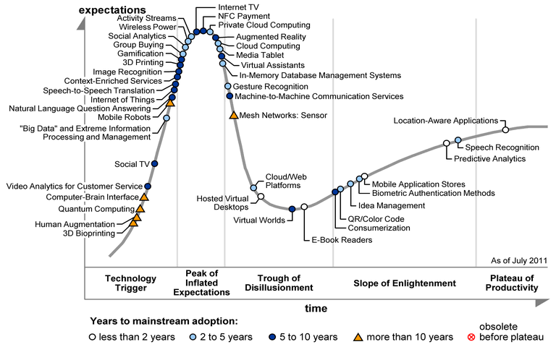

Slide 8
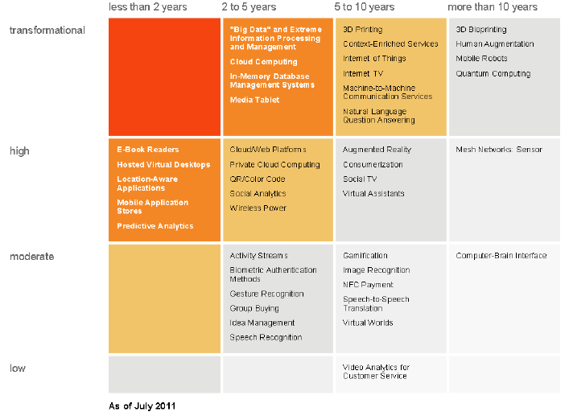
Transformational
High
Moderate
Low
“Big Data” and Extreme
Information Processing and Management
Cloud Computing
In-memory Database Management Systems
Media Tablet
3D Printing
Content enriched Services
Internet of Things
Internet TV
Machine to Machine Communication Services
Natural Language Question Answering
Cloud/Web Platforms
Private Cloud Computing
QR/Color Bar Code
Social Analytics
Wireless Power

Slide 9
Clouds and Jobs
Clouds are a major industry thrust with a growing fraction of IT expenditure that IDC estimates will grow to $44.2 billion direct investment in 2013 while 15% of IT investment in 2011 will be related to cloud systems with a 30% growth in public sector.
Gartner also rates cloud computing high on list of critical emerging technologies with for example in 2010 “Cloud Computing” and “Cloud Web Platforms” rated as transformational (their highest rating for impact) in the next 2-5 years.
Correspondingly there is and will continue to be major opportunities for new jobs in cloud computing with a recent European study estimating there will be 2.4 million new cloud computing jobs in Europe alone by 2015.
Cloud computing spans research and economy and so attractive component of curriculum for students that mix “going on to PhD” or “graduating and working in industry” (as at Indiana University where most CS Masters students go to industry)
GIS also lots of jobs?

Slide 10
Clouds Grids and Supercomputers: Infrastructure and Applications

Slide 11
Clouds and Grids/HPC
Synchronization/communication Performance
Grids > Clouds > HPC Systems
Clouds appear to execute effectively Grid workloads but are not easily used for closely coupled HPC applications
Service Oriented Architectures and workflow appear to work similarly in both grids and clouds
Assume for immediate future, science supported by a mixture of
  Clouds – data analytics (and pleasingly parallel)
  Grids/High Throughput Systems (moving to clouds as convenient)
  Supercomputers (“MPI Engines”) going to exascale

Slide 12
2 Aspects of Cloud Computing:
Infrastructure and Runtimes (aka Platforms)
Cloud infrastructure: outsourcing of servers, computing, data, file space, utility computing, etc..
Cloud runtimes or Platform: tools to do data-parallel (and other) computations. Valid on Clouds and traditional clusters
  Apache Hadoop, Google MapReduce, Microsoft Dryad, Bigtable, Chubby and others
  MapReduce designed for information retrieval but is excellent for a wide range of science data analysis applications
  Can also do much traditional parallel computing for data-mining if extended to support iterative operations
  Data Parallel File system as in HDFS and Bigtable
Grids introduced workflow and services but otherwise didn’t have many new programming models

Slide 13
What Applications work in Clouds
Pleasingly parallel applications of all sorts analyzing roughly independent data or spawning independent simulations
  Long tail of science
  Integration of distributed sensor data
Science Gateways and portals
Workflow federating clouds and classic HPC
Commercial and Science Data analytics that can use MapReduce (some of such apps) or its iterative variants (most analytic apps)

Slide 14
Clouds in Geoinformatics
You can either use commercial clouds – Amazon or Azure
  Note Shandong has a shared Chinese Cloud
Or you can build your own private cloud
  Put Eucalyptus, Nimbus, OpenStack or OpenNebula on a cluster. These manage Virtual Machines. Place OS and Applications on hypervisor
  Experiment with this on FutureGrid
Go a long way just using services and workflow supporting sensors (Internet of Things) and GIS Services
R has been ported to cloud
MapReduce good for large scale parallel datamining

Slide 15
MapReduce and Iterative MapReduce for non trivial parallel applications on Clouds

Slide 16






MapReduce “File/Data Repository” Parallelism
Map = (data parallel) computation reading and writing data
Reduce = Collective/Consolidation phase e.g. forming multiple global sums as in histogram
Instruments
MPI or Iterative MapReduce
Map Reduce Map Reduce Map
Communication
Reduce
Portals
/Users
Disks
Map₁
Map₂
Map₃

Slide 17

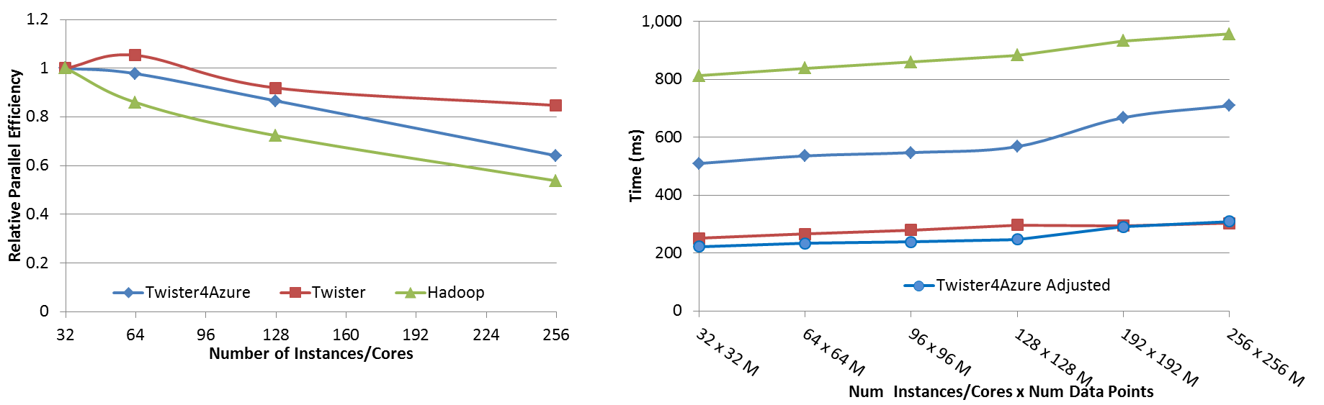




Performance – Kmeans Clustering
Task Execution Time Histogram
Number of Executing Map Task Histogram
Strong Scaling with 128M Data Points
Weak Scaling
Performance with/without
data caching
Speedup gained using data cache
Scaling speedup
Increasing number of iterations
Notes:
Right(c): Twister4Azure executing Map Task histogram for 128 million data points in 128 Azure small instances
Figure 5. KMeansClustering Scalability. Left(a): Relative parallel efficiency of strong scaling using 128 million data points.
Center(b): Weak scaling. Workload per core is kept constant (ideal is a straight horizontal line).

Slide 18
Kmeans Speedup from 32 cores

Slide 19
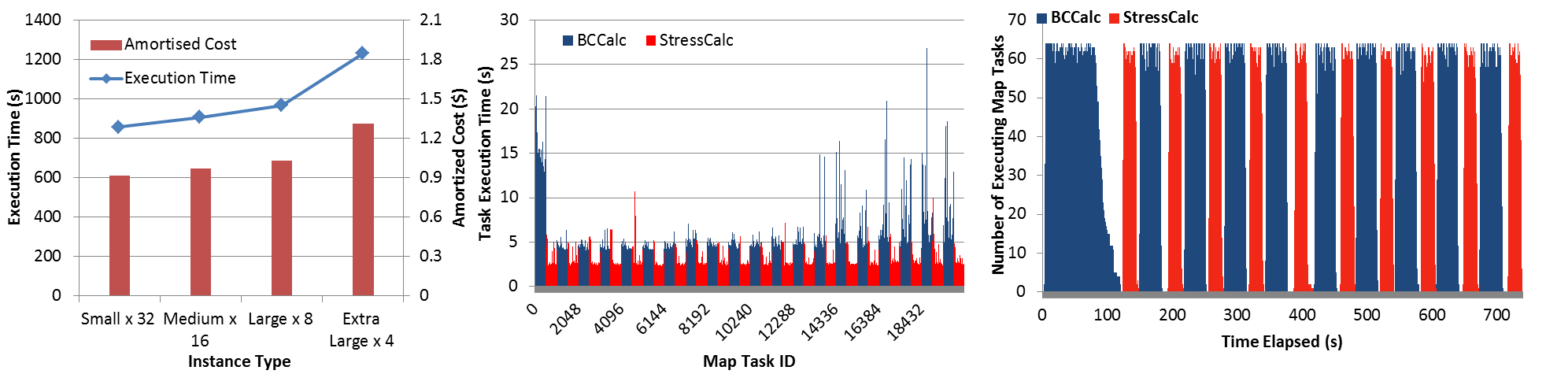
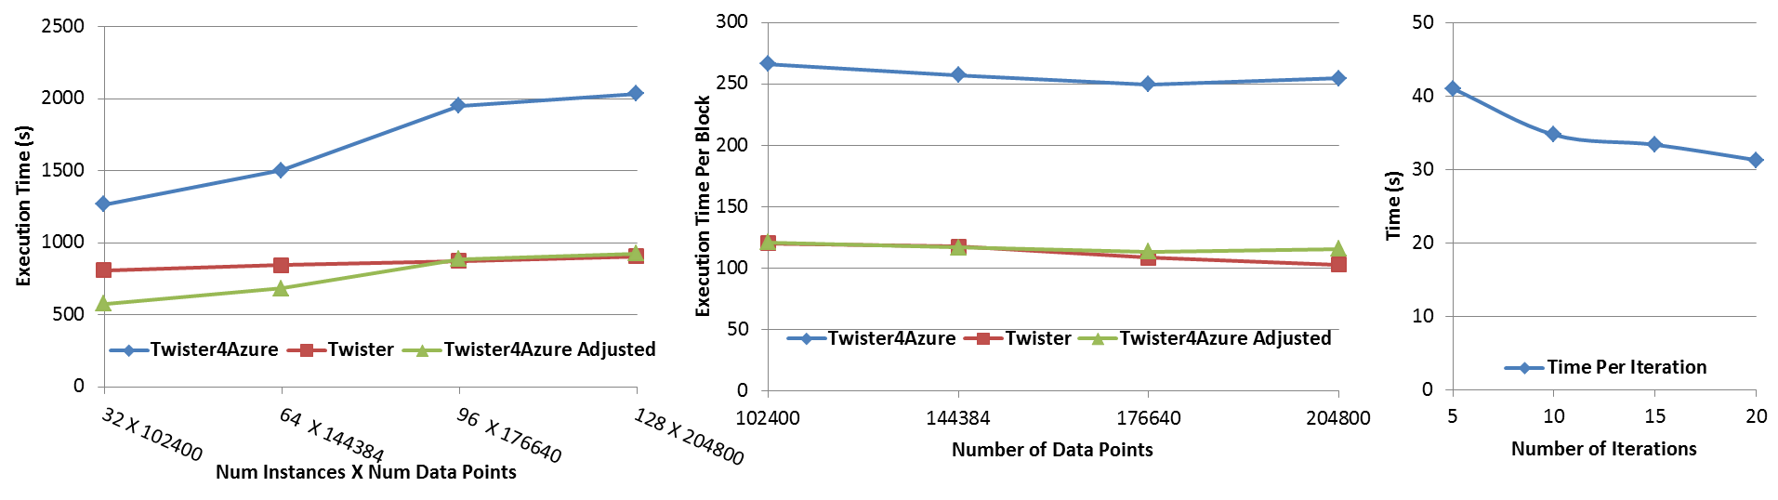
Performance – Multi Dimensional Scaling
Azure Instance Type Study
Task Execution Time Histogram
Number of Executing Map Task Histogram
Weak Scaling
Data Size Scaling
Increasing Number of Iterations
Performance with/without
data caching
Speedup gained using data cache
Scaling speedup
Increasing number of iterations
Notes:
Figure 6. Twister4Azure MDS performance Left: Instance type study using 76800 data points, 32 instances, 20 iterations. Center: Twister4Azure MDS individual task execution time histogram for 144384 x144384 distance matrix in 64 Azure small instances, 10 iterations Right: Twister4Azure executing Map Task histogram for 144384 x144384 distance matrix in 64 Azure small instances, 10 iterations
Figure 7. Left: Weak scaling where workload per core is ~constant. Ideal is a straight horizontal line. Center : Data size scaling with 128 Azure small instances/cores, 20 iterations. Right: Time per iteration with increasing number of iterations 30k x 30k distance matrix, 15 instances.

Slide 20
Internet of Things: Sensor Grids supported as pleasingly parallel applications on clouds

Slide 21
Internet of Things/Sensors and Clouds
A sensor is any source or sink of time series
  In the thin client era, smart phones, Kindles, tablets, Kinects, web-cams are sensors
  Robots, distributed instruments such as environmental measures are sensors
  Web pages, Googledocs, Office 365, WebEx are sensors
  Ubiquitous/Smart Cities/Homes are full of sensors
  Things are Sensors with an IP address
Sensors/Things – being intrinsically distributed are Grids
However natural implementation uses clouds to consolidate and control and collaborate with sensors
Things/Sensors are typically small and have pleasingly parallel cloud implementations

Slide 22
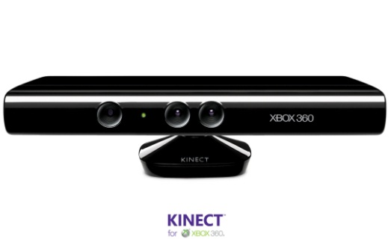





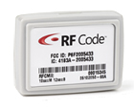
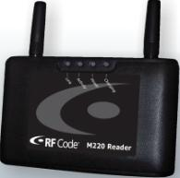

Sensors as a Service
RFID Tag
RFID Reader
Sensors as a Service
A larger sensor ………
Sensor Processing as a Service (MapReduce)

Slide 23
Sensor Grid supported by IoT Cloud
Sensor Grid
Sensor
Client Application Enterprise App
Notify
Publish
Publish
IoT Cloud
Control
Subscribe()
Notify()
Unsubscribe()
Sensor
Notify
Client Application Desktop Client
Sensor
Publish
Notify
Client Application Web Client
Pub-Sub Brokers are cloud interface for sensors
Filters subscribe to data from Sensors
Naturally Collaborative
Rebuilding software from scratch as Open Source – collaboration welcome

Slide 24
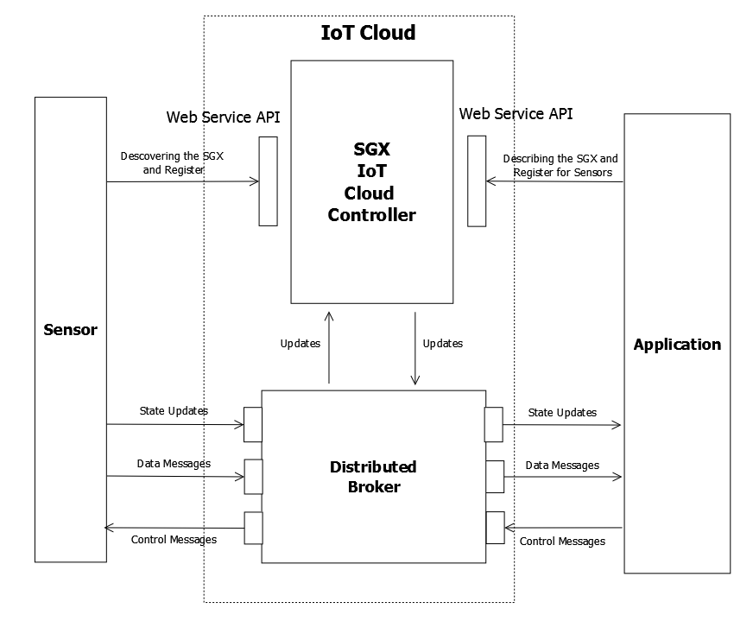
Sensor/IoT Cloud Architecture
Originally brokers were from NaradaBrokering
Replace with ActiveMQ and Netty for streaming

Slide 25
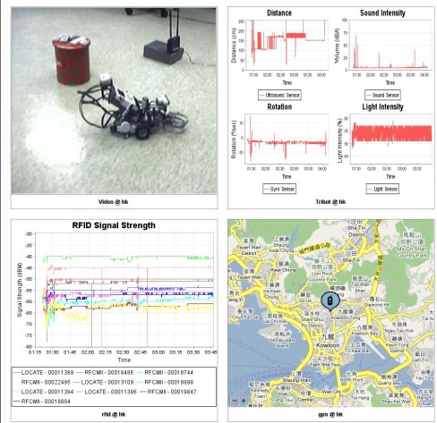
IoT Cloud
Client Outputs
Video
4 Tribot
RFID
GPS

Slide 26
Performance of Pub-Sub Cloud Brokers
High end sensors equivalent to Kinect or MPEG4 TRENDnet TV-IP422WN camera at about 1.8Mbps per sensor instance
OpenStack hosted sensors and middleware

Slide 27
Polar Science and Earthquake Science
From GPU to Cloud

Slide 28
Lightweight Cyberinfrastructure to support mobile Data gathering expeditions plus classic central resources (as a cloud)
Sensors are airplanes here!

Slide 29
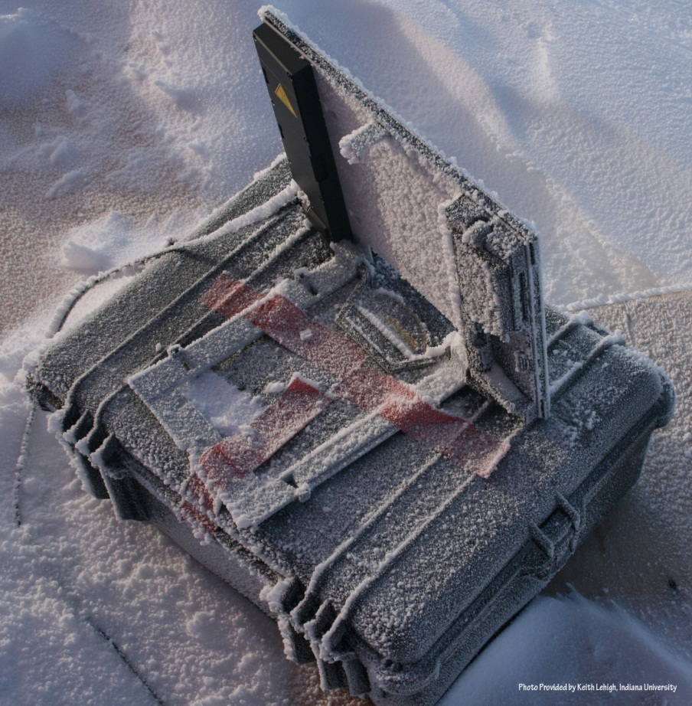
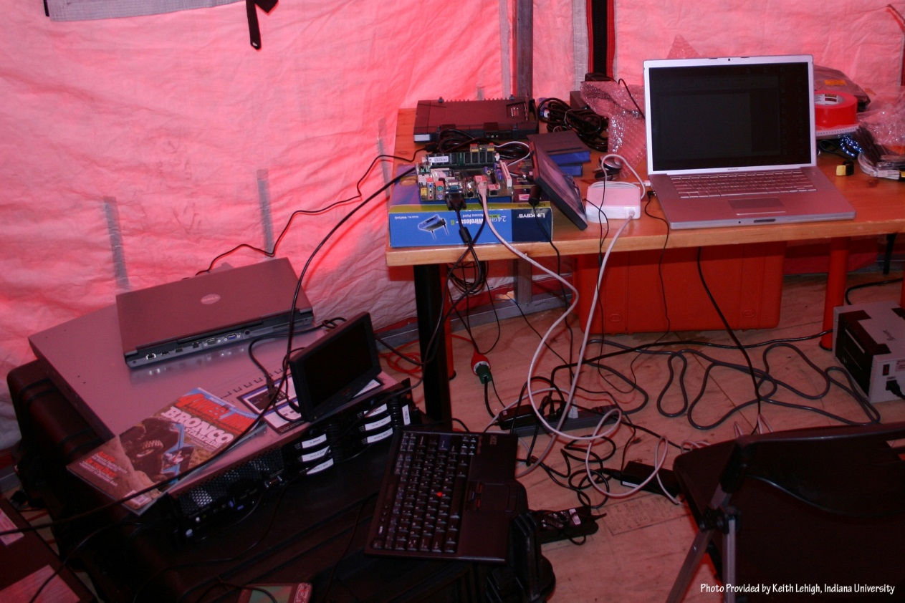
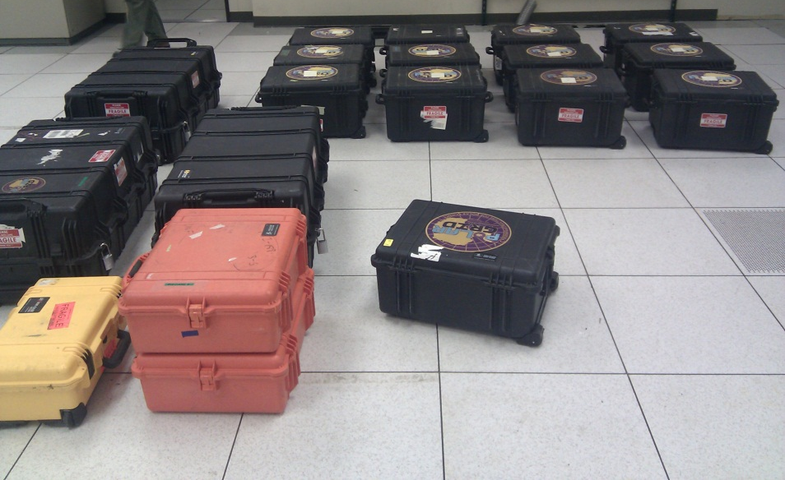
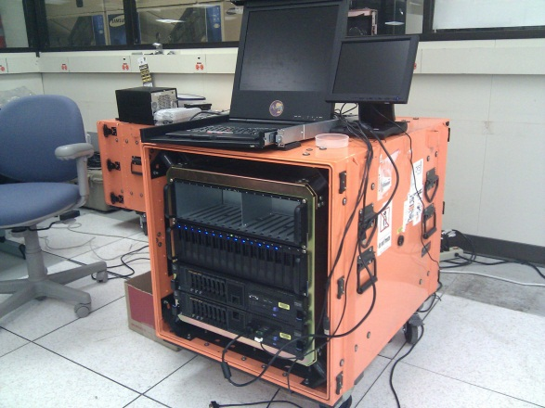

Slide 30
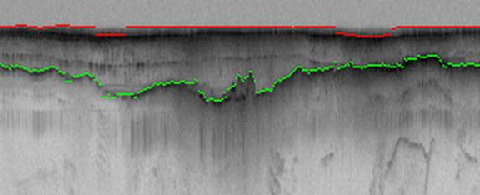
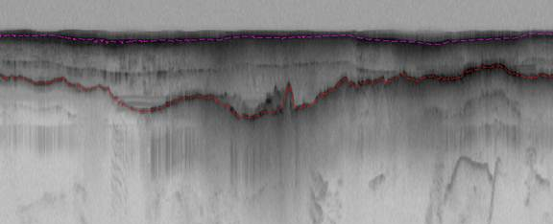
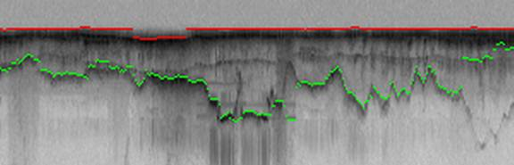
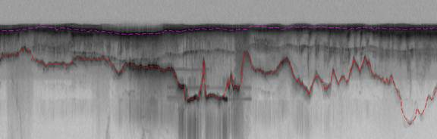
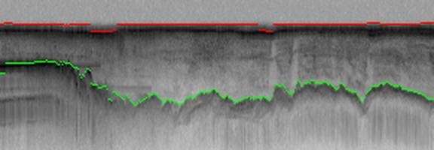
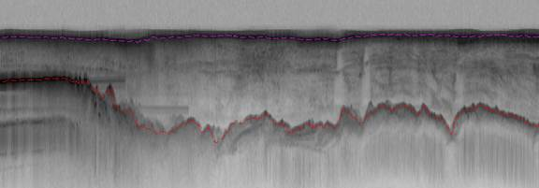
Hidden Markov Method based Layer Finding
P. Felzenszwalb, O. Veksler, Tiered Scene Labeling with Dynamic Programming, IEEE Conference on Computer Vision and Pattern Recognition (CVPR), 2010
Automatic
Manual

Slide 31
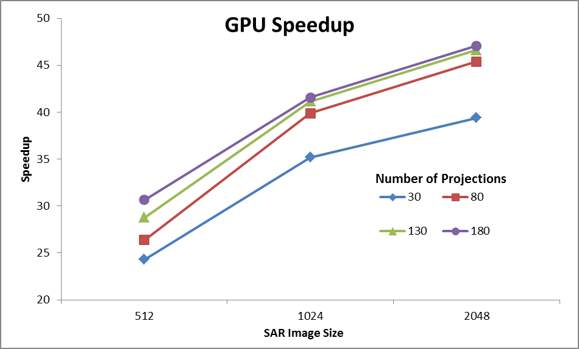
Back Projection
Speedup of GPU wrt Matlab 2 processor Xeon CPU
Wish to replace field hardware by GPU’s to get better power-performance characteristics
Testing environment:
GPU: Geforce GTX 580, 4096 MB, CUDA toolkit 4.0
CPU: 2 Intel Xeon X5492 @ 3.40GHz with 32 GB memory

Slide 32
Cloud-GIS Architecture
Cloud Service
User Access
GeoServer
Web-Service Layer
Web Service Interface
WMS
WCS
REST API
WFS
WPS
Google Map/Google Earth
GIS Software: ArcGIS etc.
Matlab/Mathematica
Cloud Geo-spatial Database Service
Geo-spatial Analysis Tools
Mobile Platform
Private Cloud in the field and Public Cloud back home
SpatiaLite: http://www.gaia-gis.it/spatialite/
Quantum GIS: http://www.qgis.org/

Slide 33
GIS Service Protocols
Web Map Service (WMS) is a standard for generating maps on the web for both vector and raster data, and outputsing images in a number of possible formats: jpeg/png, geotiff, georss, kml/kmz
The Web Coverage Service (WCS) provides a standard interface for requesting the raster source (raw images)
The Web Feature Service (WFS): the interface for vector data source, works in a similar way as WCS
Web Processing Service (WPS) provides rules for standardizing inputs and outputs (requests and responses) for geospatial processing services. It is an efficient way to turn GIS processing tools into Software as a Service for cloud environment.

Slide 34
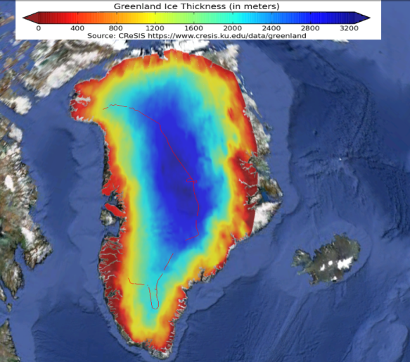
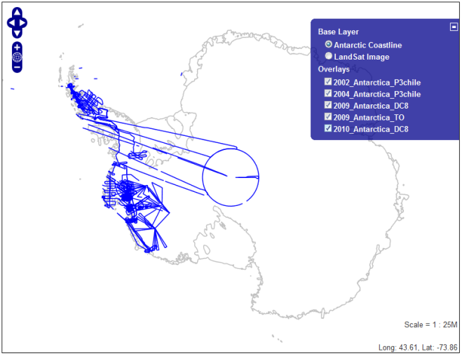
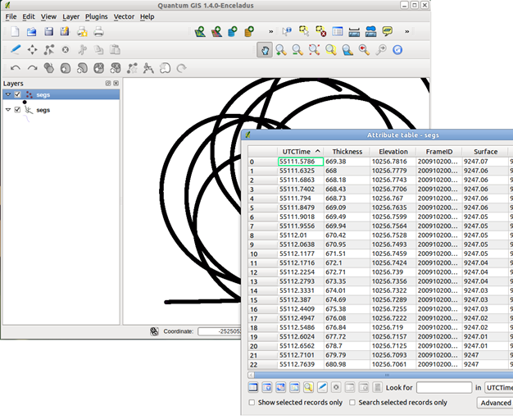
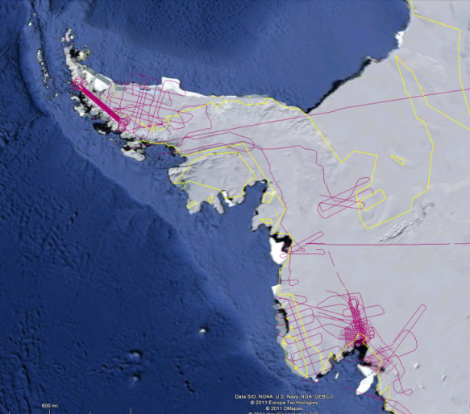
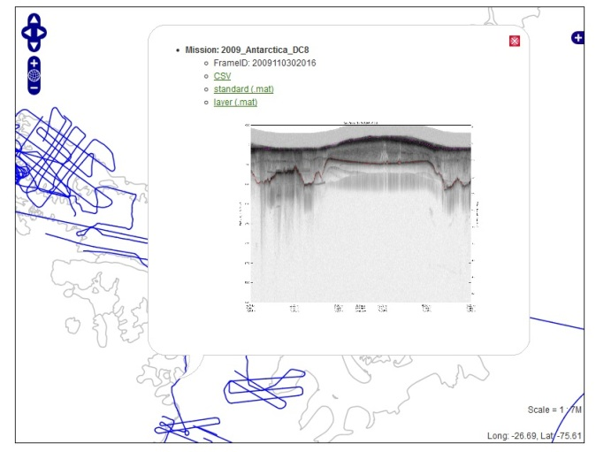
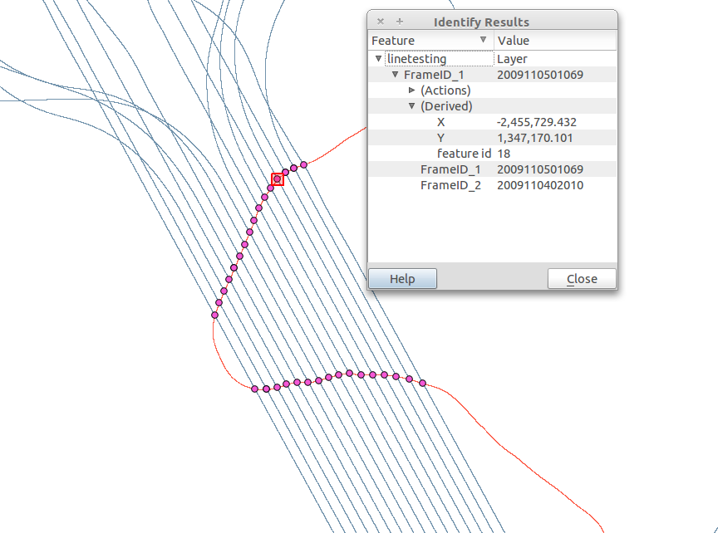
Data Distribution Example: PolarGrid
Google Earth
Web Data Browser
GIS Software

Slide 35
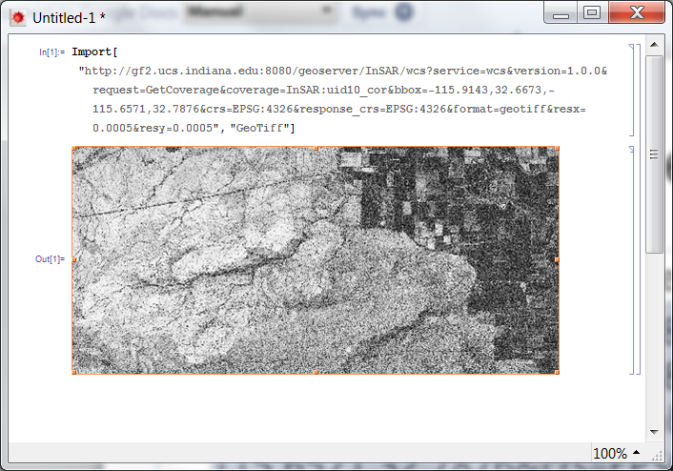
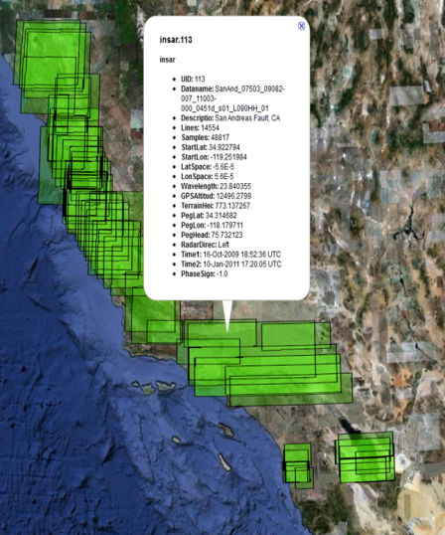
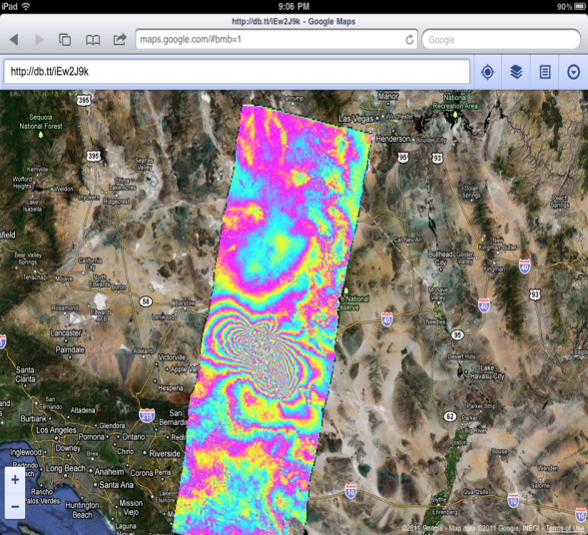
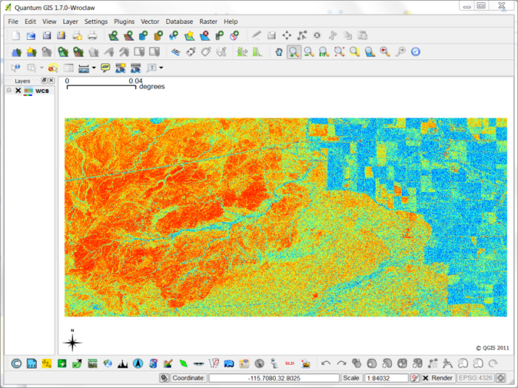
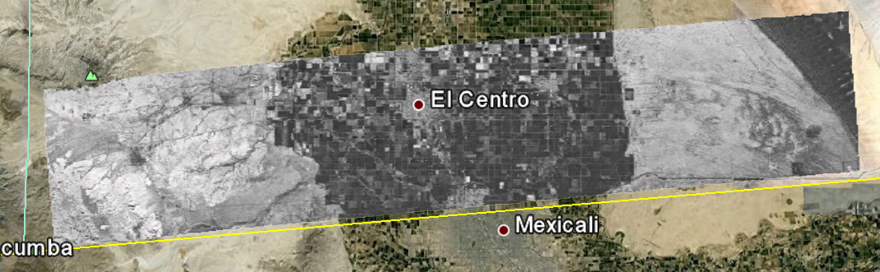
Data Distribution Example: QuakeSim
Google Map/Earth (WMS)
Image on-demand (WCS)

Slide 36
Architecture of Data-Intensive Clouds

Slide 37
Architecture of Data Repositories?
Traditionally governments set up repositories for data associated with particular missions
  For example EOSDIS (Earth Observation), GenBank (Genomics), NSIDC (Polar science), IPAC (Infrared astronomy)
  LHC/OSG computing grids for particle physics
This is complicated by volume of data deluge, distributed instruments as in gene sequencers (maybe centralize?) and need for intense computing like Blast
  i.e. repositories need HPC?

Slide 38
Clouds as Support for Data Repositories?
The data deluge needs cost effective computing
  Clouds are by definition cheapest
  Need data and computing co-located
Shared resources essential (to be cost effective and large)
  Can’t have every scientists downloading petabytes to personal cluster
Need to reconcile distributed (initial source of ) data with shared computing
  Can move data to (disciple specific) clouds
  How do you deal with multi-disciplinary studies
Data repositories of future will have cheap data and elastic cloud analysis support?

Slide 39
FutureGrid in a Nutshell

Slide 40
What is FutureGrid?
The FutureGrid project mission is to enable experimental work that advances:
  Innovation and scientific understanding of distributed computing and parallel computing paradigms,
  The engineering science of middleware that enables these paradigms,
  The use and drivers of these paradigms by important applications, and,
  The education of a new generation of students and workforce on the use of these paradigms and their applications.
The implementation of mission includes
  Distributed flexible hardware with supported use
  Identified IaaS and PaaS “core” software with supported use
    Expect growing list of software from FG partners and users
  Outreach

Slide 41
FutureGrid key Concepts I
FutureGrid is an international testbed modeled on Grid5000
Supporting international Computer Science and Computational Science research in cloud, grid and parallel computing (HPC)
  Industry and Academia
  Note much of current use Education, Computer Science Systems and Biology/Bioinformatics
The FutureGrid testbed provides to its users:
  A flexible development and testing platform for middleware and application users looking at interoperability, functionality, performance or evaluation
  Each use of FutureGrid is an experiment that is reproducible
  A rich education and teaching platform for advanced cyberinfrastructure (computer science) classes

Slide 42

FutureGrid key Concepts II
Rather than loading images onto VM’s, FutureGrid supports Cloud, Grid and Parallel computing environments by dynamically provisioning software as needed onto “bare-metal” using Moab/xCAT
  Image library for MPI, OpenMP, Hadoop, Dryad, gLite, Unicore, Globus, Xen, ScaleMP (distributed Shared Memory), Nimbus, Eucalyptus, OpenNebula, KVM, Windows …..
Growth comes from users depositing novel images in library
FutureGrid has ~4000 (will grow to ~5000) distributed cores with a dedicated network and a Spirent XGEM network fault and delay generator
Image1
Image2
…
ImageN
Choose
Load
Run

Slide 43

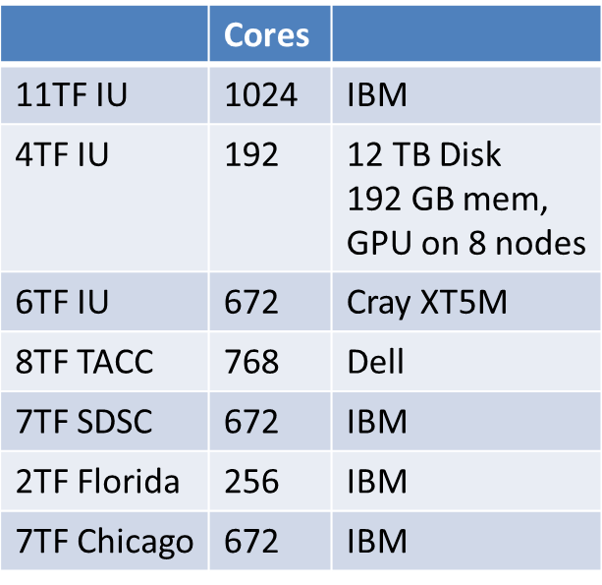
FutureGrid: a Grid/Cloud/HPC Testbed
 | Cores
11TF IU | 1024 | IBM
4TF IU | 192 | 12 TB Disk 192 GB mem, GPU on 8 nodes
6TF IU | 672 | Cray XT5M
8TF TACC | 768 | Dell
7TF SDSC | 672 | IBM
2TF Florida | 256 | IBM
7TF Chicago | 672 | IBM
NID: Network Impairment Device
Private
Public
FG Network

Slide 44
5 Use Types for FutureGrid
~122 approved projects over last 10 months
Training Education and Outreach (11%)
  Semester and short events; promising for non research intensive universities
Interoperability test-beds (3%)
  Grids and Clouds; Standards; Open Grid Forum OGF really needs
Domain Science applications (34%)
  Life sciences highlighted (17%)
  Computer science (41%)
  Largest current category
Computer Systems Evaluation (29%)
  TeraGrid (TIS, TAS, XSEDE), OSG, EGI, Campuses
Clouds are meant to need less support than other models; FutureGrid needs more user support …….

