Slide 1
Future of Intelligent Edge and Intelligent Cloud
Judy Qiu, Indiana University
Plenary Panel : From Edge to Cloud, Thursday July 11
Some Important Issues?
Some
Use Cases
Some Challenges?
Architect and build systems that make timely and safe decisions in increasingly unpredictable environments.
Continual Learning for Real-Time Edge and Cloud Systems
Process time-series
Anomaly detection for autonomous driving, Medical surgery, Fraud detection, Disaster (e.g. earthquake, tsunami) and emergency management, Scientific experiments, Social media monitoring

Slide 2
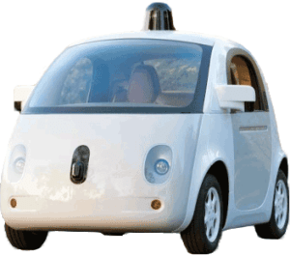
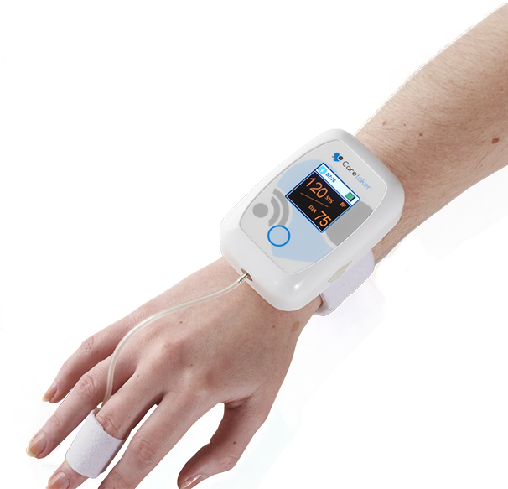
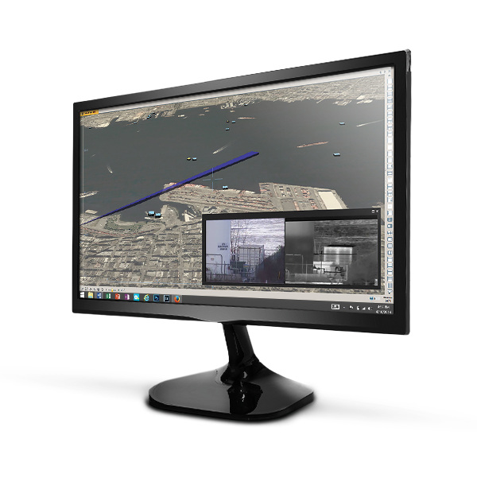
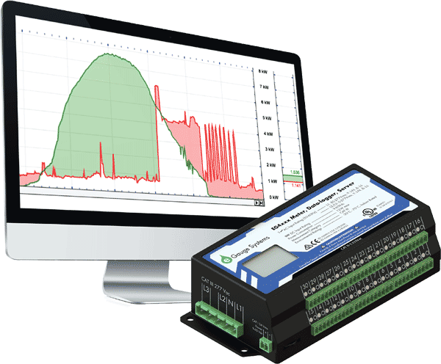
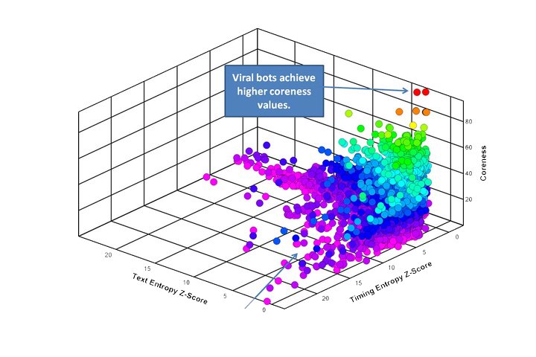
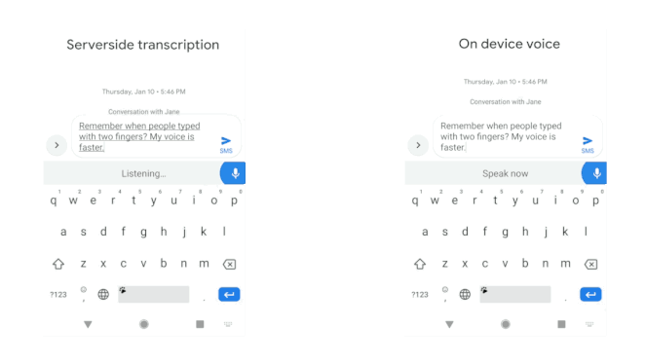
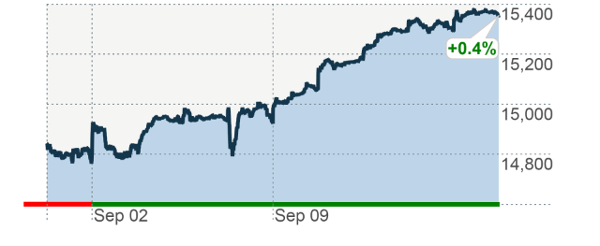
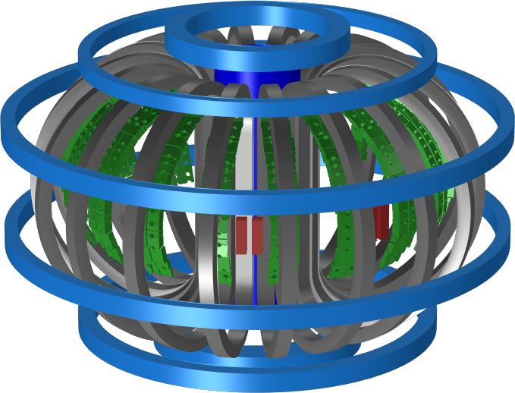
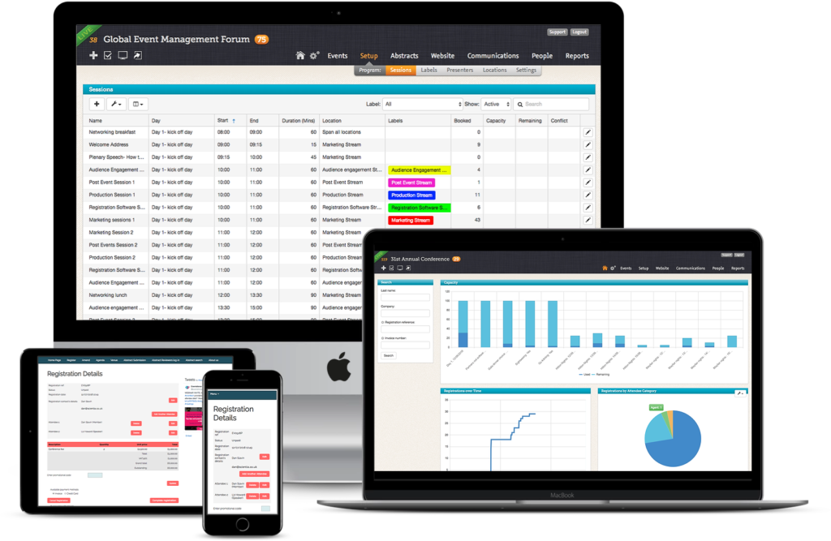
MLPerf: Key Use Cases for Time Series Machine Learning Algorithms
Areas | Applications | Model | Data sets
Transportation | Cars, Taxis, Freeway Detectors | TT-RNN , BNN, LSTM | Caltrans highway traffic,Taxi/Uber trips
Medical | Wearables, Medical instruments: EEG, ECG, ERP, Patient Data | LSTM, RNN | OPPORTUNITY, EEG,MIMIC
Cybersecurity | Intrusion, classify traffic, anomaly detection | LSTM | GPL loop dataset , SherLock
General Social Statistics | Household electric use, Economic, Finance, Demographics, Industry | CNN, RNN | Household electric M4Competition
Social media | Twitter | Online Clustering | Available from Twitter
Google Speech | All-Neural On-Device Speech Recognizer | RNN-T
Finance | Stock Prices versus time | CNN, RNN | Available academically from Wharton
Science | Earthquake, Climate, Tokamak | Markov, RNN | USHCN climate
Software Systems | Events | LSTM | Enterprise SW system
MLPerf
Notes:
http://jeffnolan.com/wp/2015/11/23/the-fascinating-implications-for-autonomous-vehicles/
https://www.comsol.com/blogs/analyzing-a-component-of-the-iter-tokamak-with-simulation/
https://www.oreilly.com/ideas/identifying-viral-bots-and-cyborgs-in-social-media
https://www.caretakermedical.net/
https://www.eventsforce.com/
https://money.cnn.com/2013/09/13/investing/stocks-markets/index.html
https://www.stickpng.com/img/icons-logos-emojis/tech-companies/twitter-logo
https://www.flir.com/products/cameleon-tactical/
https://www.androidpolice.com/2019/03/12/google-bringing-faster-on-device-speech-recognition-to-gboard-starting-with-pixel-phones/

Slide 3
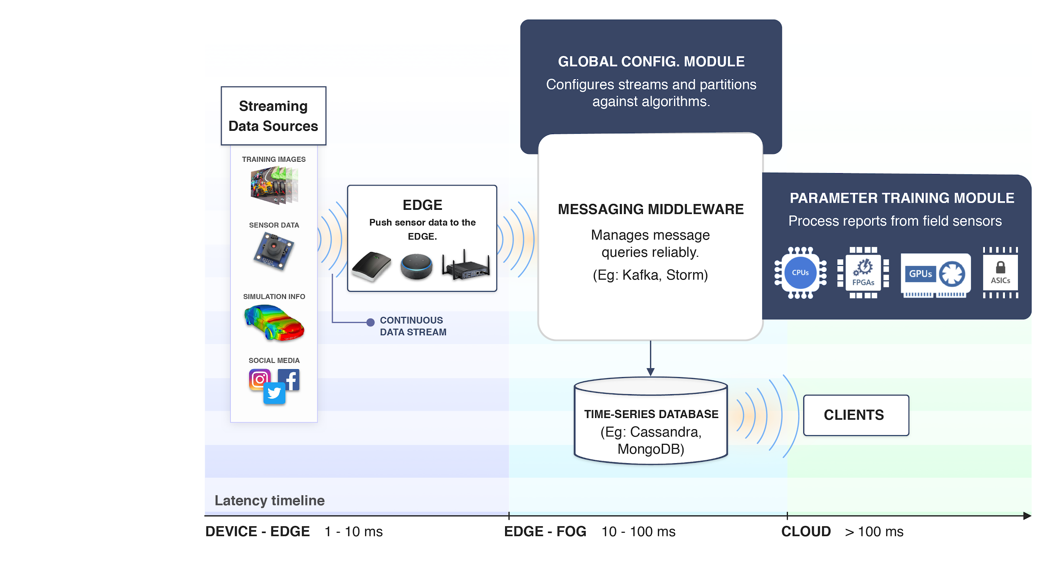
Research Issues on Dynamic and Distributed Real-Time Machine Learning for Edge and Cloud
ML for Systems
Use ML to optimize dynamic system (on the cloud, on the edge, between edge and cloud) as well as to analyze data

Slide 4
Real-Time Analysis for Indy500 Racing Cars

Slide 5
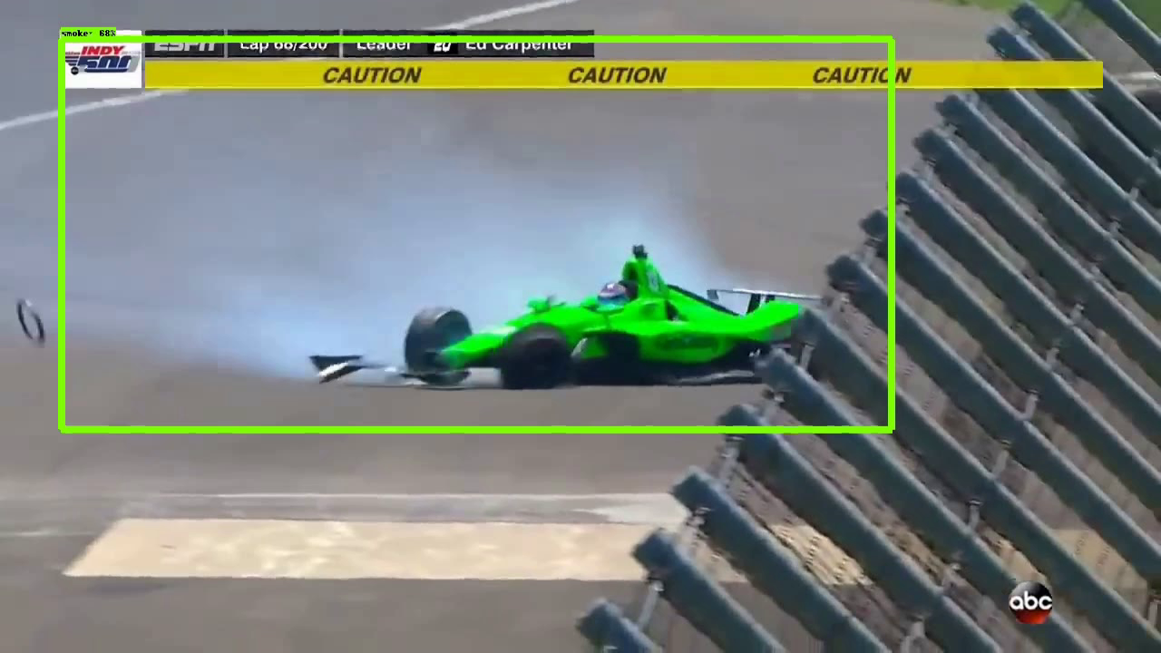
Real-Time Anomaly Detection: Speed vs. Accuracy
Racing Cars with HTM (online) vs. LSTM-AD (training offline; inference online)
HTM Car #1 SPEED Metric
LSTM-AD
Summary
Time Constraint (1~2 seconds)
Continuous Learning vs. offline
Availability of labeled data
High Speed rate, Various sources (sensors and video/images), Missing data, total of 33 cars
IndyCar May 2018 Racing Event
Anomaly Event: Red Triangle
Crash: Red vertical bar (Danica Patrick deliberately chose #13 in her final race)
PitStop: Blue vertical bar
HTM: fast 3~5 milliseconds; unsupervised; model continuously updates
LSTM: multivariate; 75 seconds for training; needs labeled data
Car #13 Crashes

