Slide 1
Real-Time Anomaly Detection
from Edge to HPC-Cloud
Judy Qiu, Indiana University
IEEE Cloud Computing 2019. Thursday July 11. Milan, Italy.

Slide 2
Research Problem
Real-Time Anomaly Detection on Sensor and Image Data
Demand online learning with time constraints
update the model with new observed data (e.g. HTM)
adaptive to pattern shifts requires continuous learning and inference (e.g. LSTM)
latency for service level of objective
Trade-offs between performance and accuracy
model update frequency
neural network architecture search
Clarifications
prediction not equivalent to anomaly detection (patterns not the same as normal)
time series not equivalent to real-time (could be milliseconds as here, seconds as in Uber, ~infinite as in Amazon logistics)

Slide 3
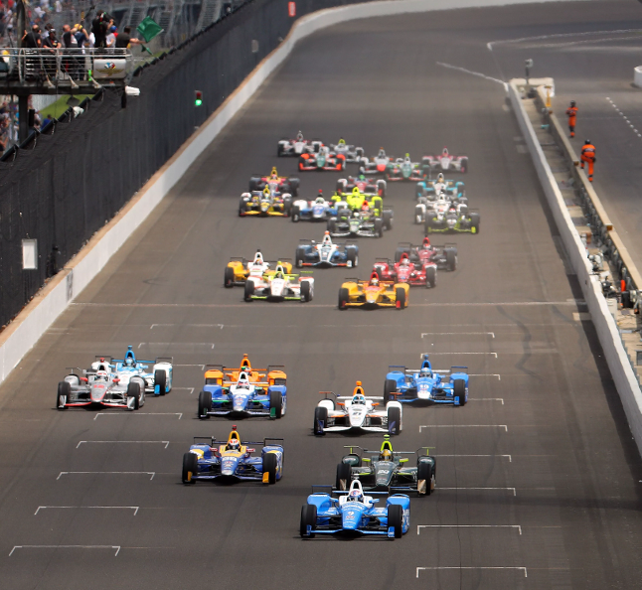
IndyCar
Real-time applications are challenging, due to strict time constraints and complex computation.
The IndyCar Series is a major open-wheel racing format in North America. The series' premier event is the Indianapolis 500, held each May.
Data analytics is critical to the sport, both in improving the performance of the team to make it faster and in helping the race control to make it safer. It can also make more interesting for viewers

Slide 4
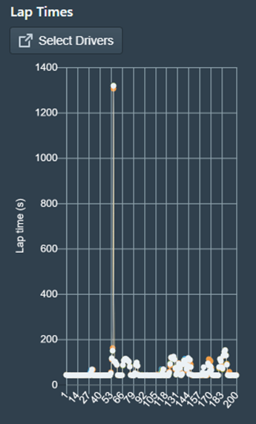
Simulation Streaming Analytics
https://goo.gl/WRet7Q

Slide 5
IndyCar Data

Slide 6
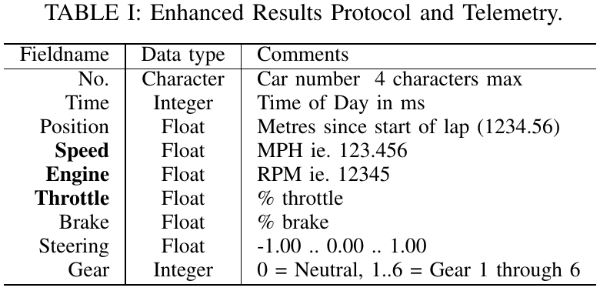
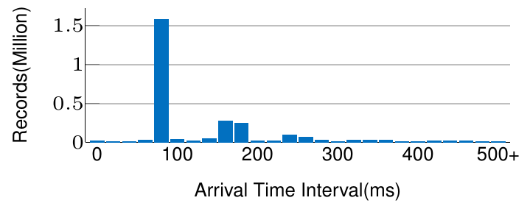
IndyCar Sensor’s Dataset
Speed
Throttle
RPM
Indy500 final on the 27th of May 2018 (3.5 hours)
4,871,355 records in total
2,373,400 records for 33 cars in actual race
Track sensor data and 150 sensors per car
Transmitter
Distribution of time gap between two consecutive events.
Most of the records arrive in the range [80,90] ms, less than 0.05% of the records delay more than one second.
Notes:
Characteristics:
LargCharacteristics:
Large-Scale Streaming Data: 33 cars each with over 150 sensors
Heterogeneity: Sensors data from different cars, the tracks, GPS, 36 video cameras and racing information like weather and wind.
Velocity: Variable data arrival interval, at an average rate of 8 records/second. VSPEED [0,238.95] miles/hr, RPM: Engine Speed [0,12920], RPM and GEAR: discrete in the range of [0,6], THROTTLE: [0,100].
NoisCharacteristics:
Large-Scale Streaming Data: 33 cars each with over 150 sensors
Heterogeneity: Sensors data from different cars, the tracks, GPS, 36 video cameras and racing information like weather and wind.
Velocity: Variable data arrival interval, at an average rate of 8 records/second. VSPEED [0,238.95] miles/hr, RPM: Engine Speed [0,12920], RPM and GEAR: discrete in the range of [0,6], THROTTLE: [0,100].
Noisy data: errors during acquisition and transmission. Missing or delayed events for all the cars.
y data: errors during acquisition and transmission. Missing or delayed events for all the cars.
e-Scale Streaming Data: 33 cars each with over 150 sensors
Heterogeneity: Sensors data from different cars, the tracks, GPS, 36 video cameras and racing information like weather and wind.
Velocity: Variable data arrival interval, at an average rate of 8 records/second. VSPEED [0,238.95] miles/hr, RPM: Engine Speed [0,12920], RPM and GEAR: discrete in the range of [0,6], THROTTLE: [0,100].
Noisy data: errors during acquisition and transmission. Missing or delayed events for all the cars.

Slide 7
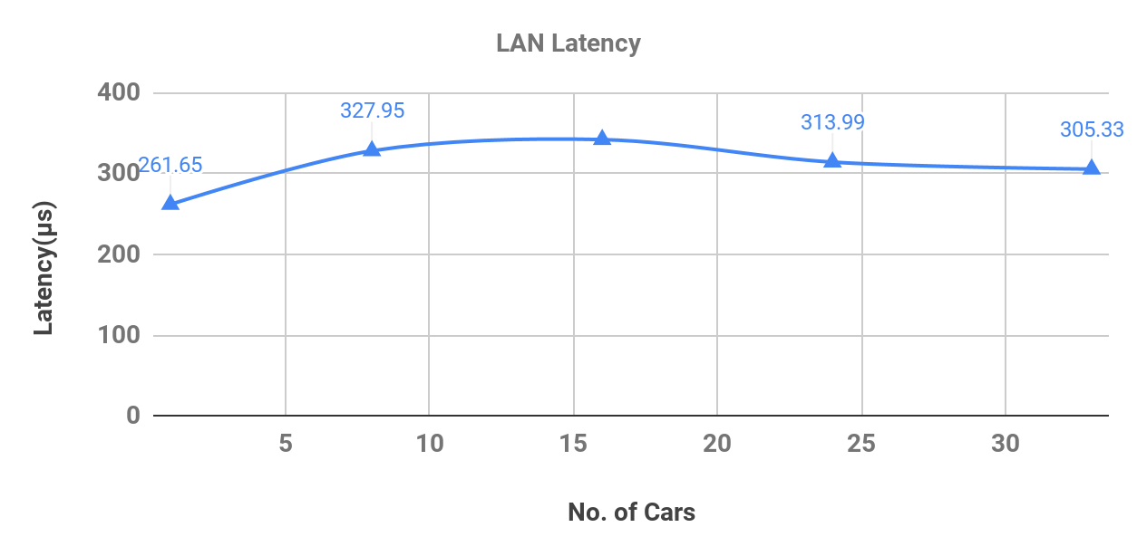
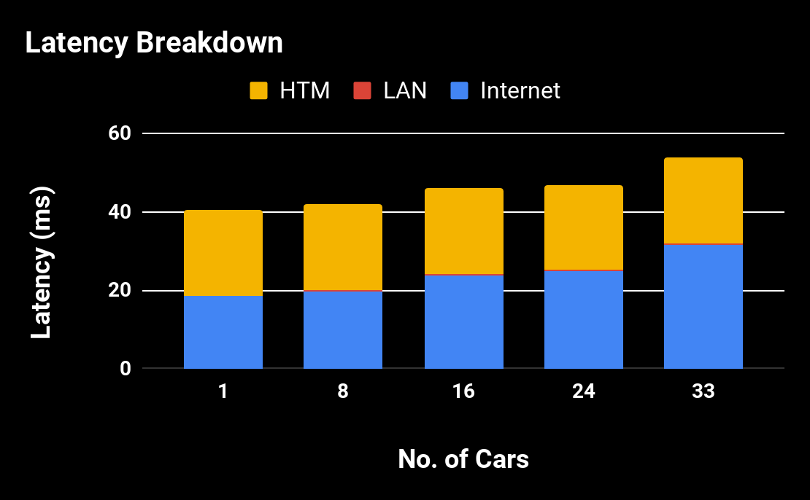
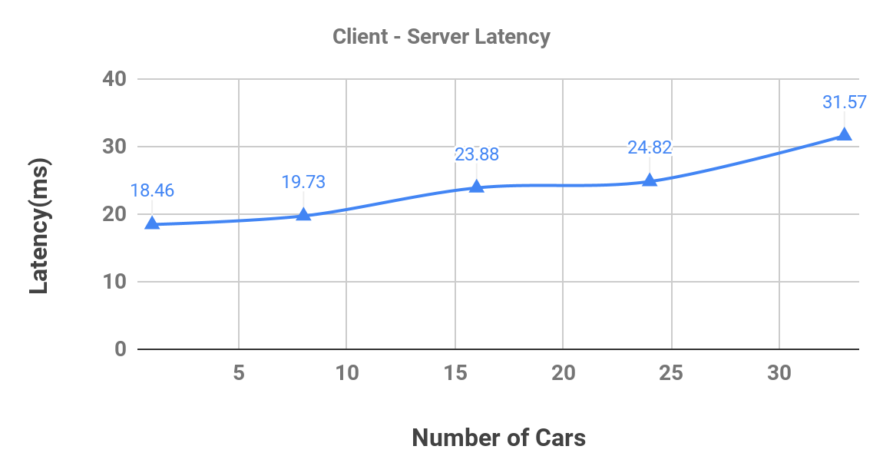
Latency Evaluation
Network Latency
Our streaming topology works over two networks.
From Data source to the WebSocket server communicates over intranet (in microseconds).
WebSocket server to Client communicates over internet.

Slide 8
Streaming Architecture

Slide 9
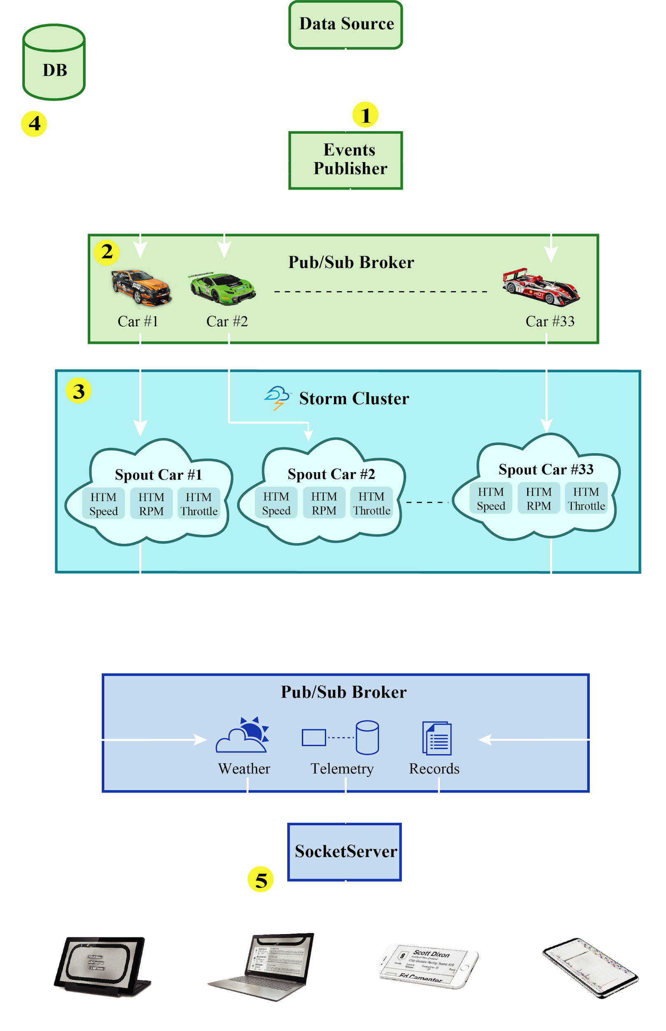
Streaming Architecture
Events Publisher
Telemetry records are grouped based on the car# and published to message broker
Persists all the records to a MongoDB database(4) for offline analysis.
Pub/Sub Broker
Apache ActiveMQ is the message broker for streaming services.
Storm Cluster
Storm cluster consists of 33 spouts, each running 3 HTM networks internally to handle a single car (e.g. speed, rpm and throttle).
Backup Database
Socket Server
Socket Server subscribes to Storm and broadcasts results to the clients
Storm, Heron, Twister2 have same Streaming API and differ in use of high performance technologies and batch capabilities

Slide 10
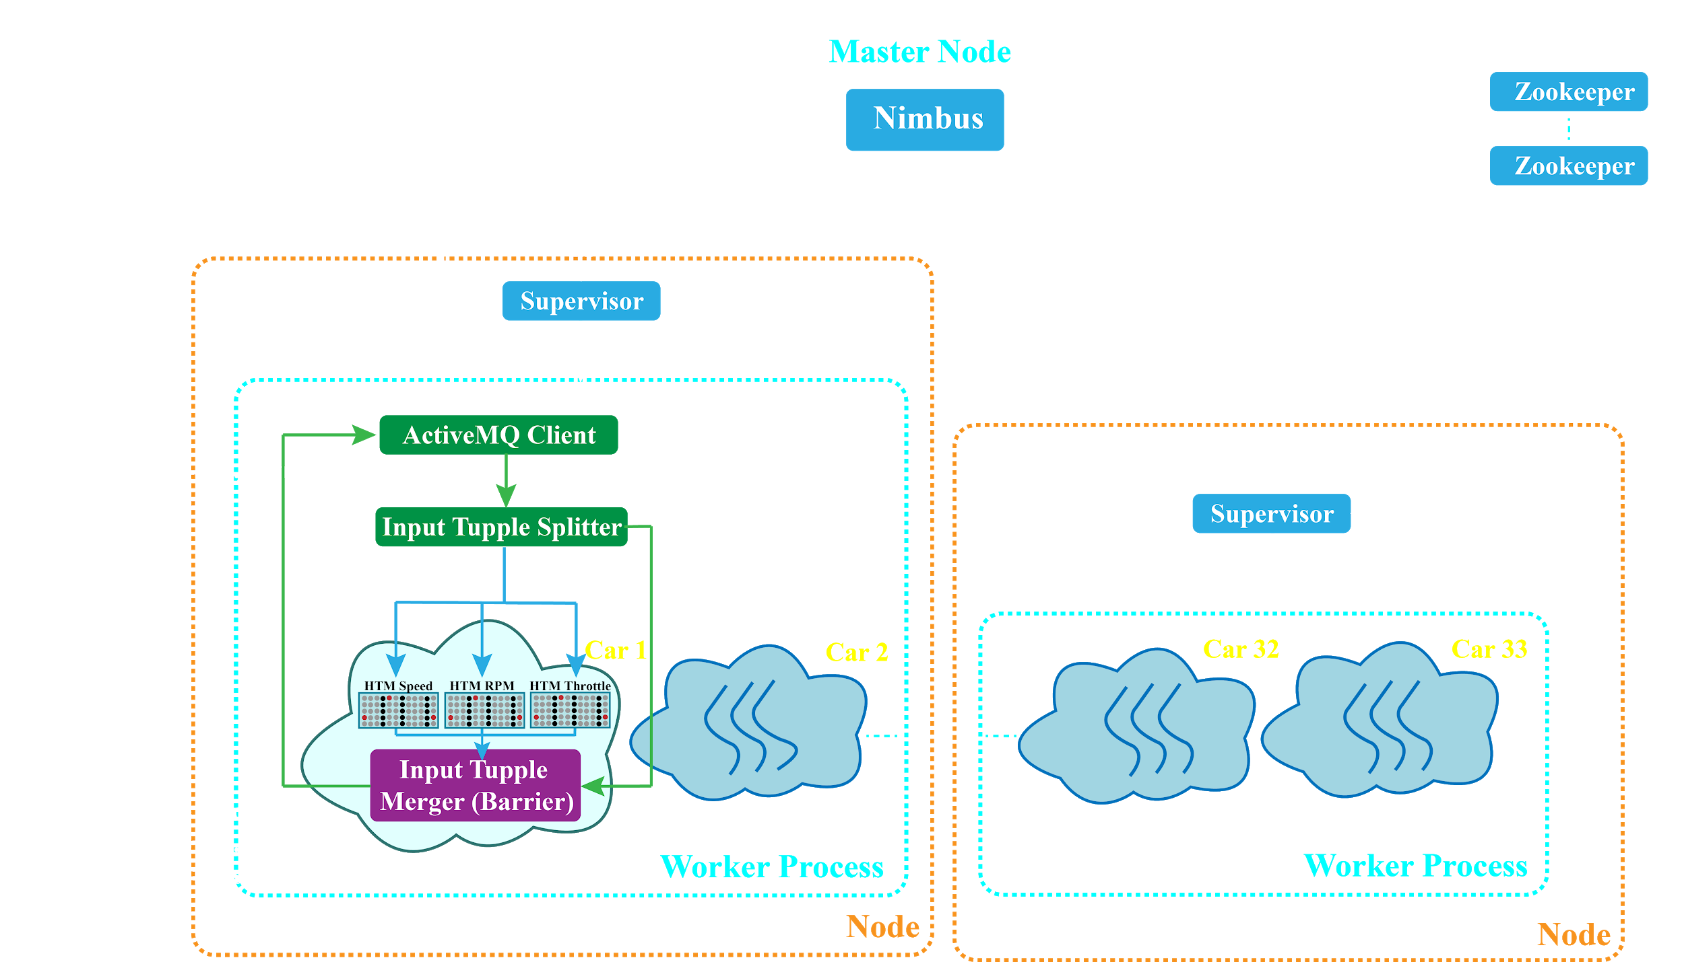
Storm Architecture for Parallel Streaming HTM and Synchronization

Slide 11
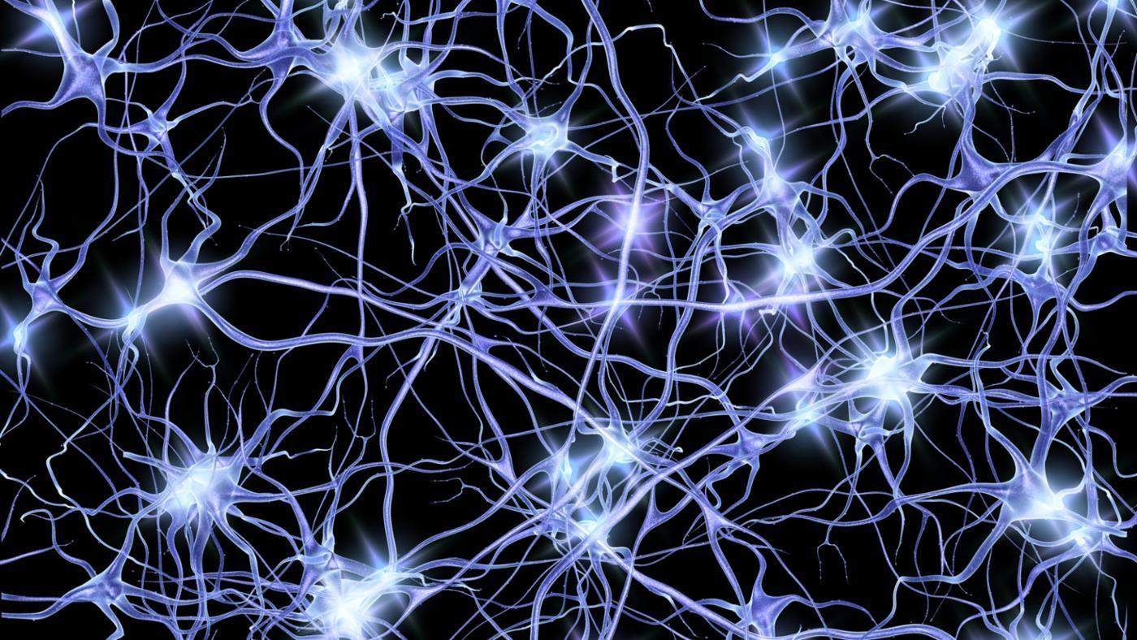
Real-Time Anomaly Detection

Slide 12
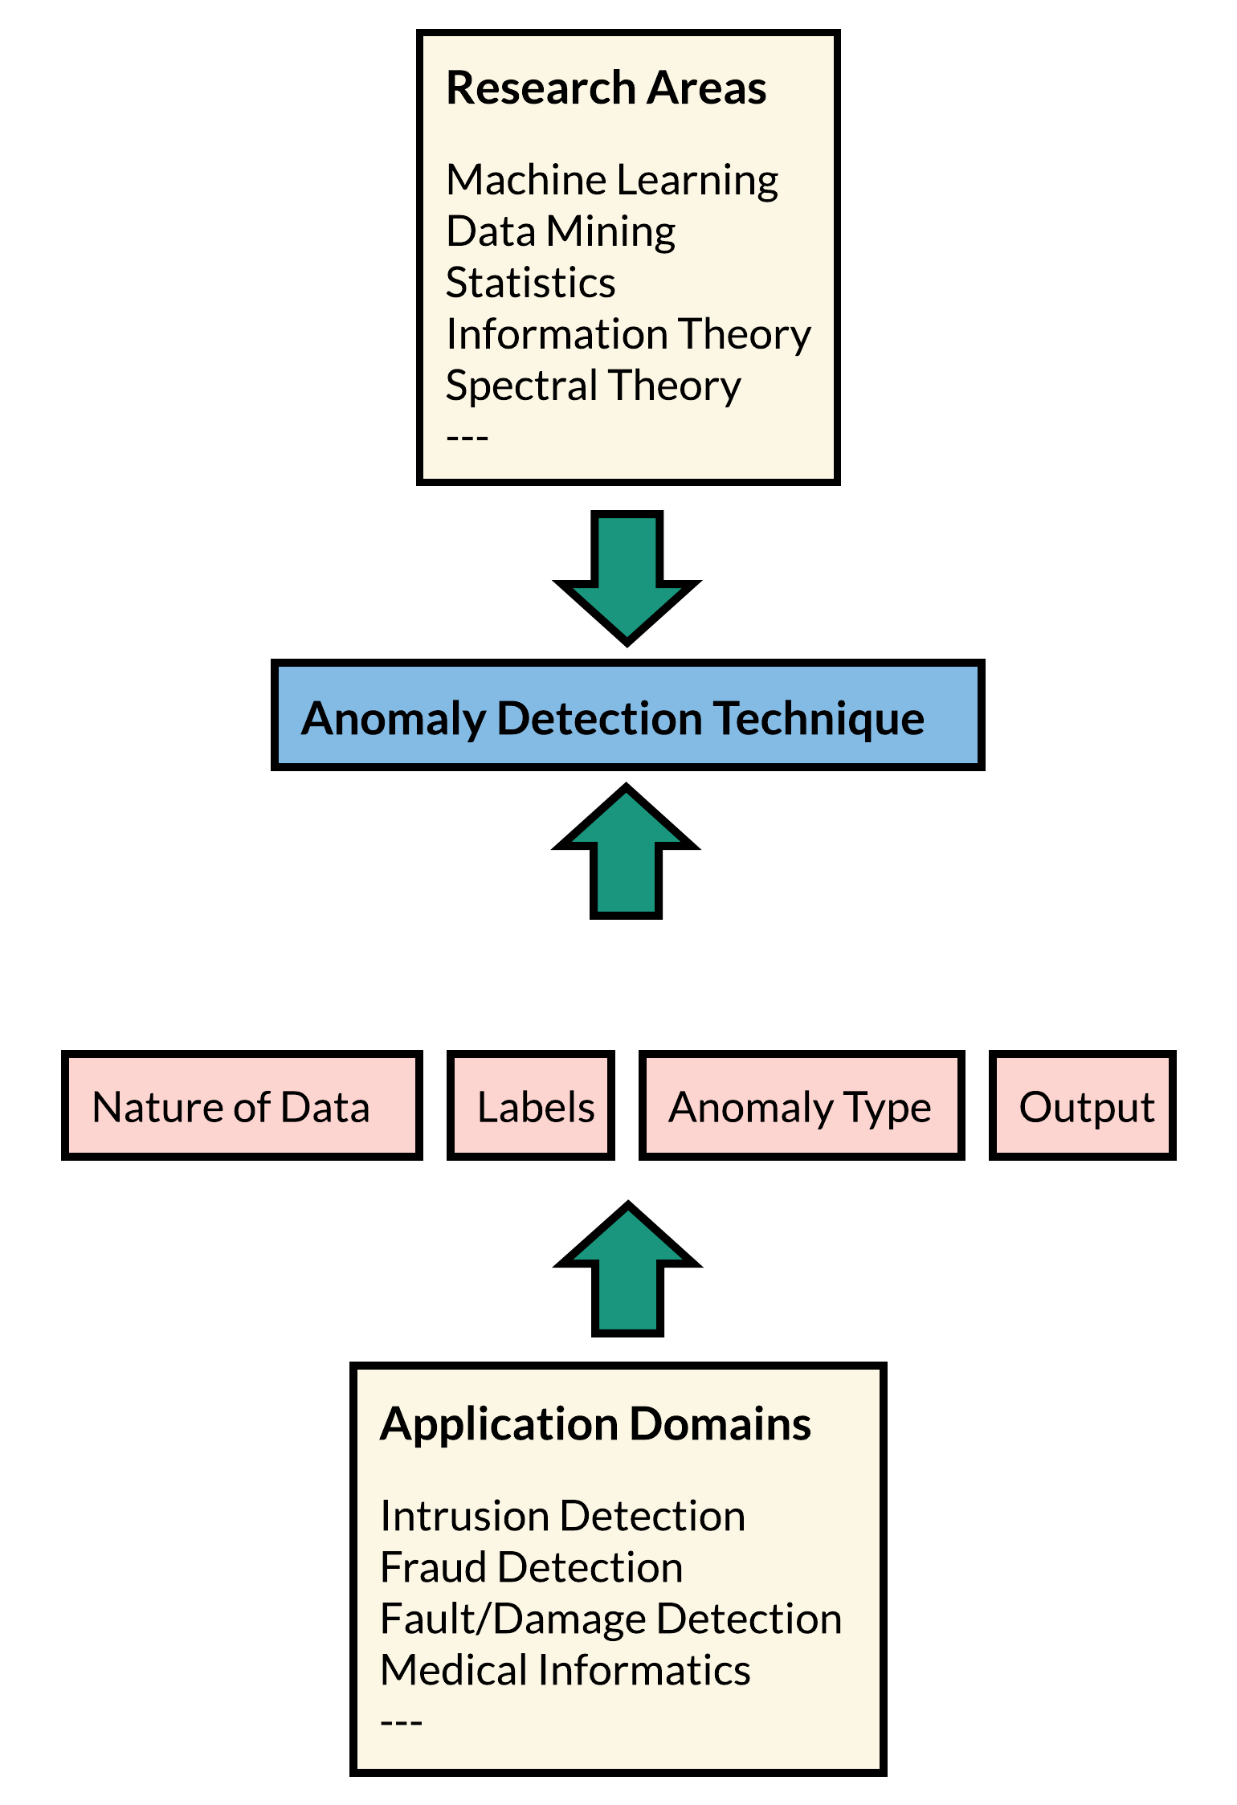
Anomaly Detection Technique
“Anomalies” are patterns in data that do not conform to a well defined notion of normal behavior.
Labeling: obtaining labeled data that is accurate as well as representative of all types of behaviors, is often prohibitively expensive.
Supervised: training data with labeled instances
Semi-supervised
Unsupervised

Slide 13
Existing Work on Real-time Anomaly Detection Algorithms
Approach | Model | Features | Examples
Machine Learning | Deep Neural Network | generative and predictive | LSTM-AD [1] SVM+DBN [2]
 | Neuromorphic Algorithm | continuous learning | HTM-AD [3]
 | Unsupervised | distance-based | KNN CAD [4] RandomCutForest [5]
 |  | clustering | SOM [6]
 | Supervised | predictive | OC-SVM [7][8]
Statistic | Dynamic Linear Models Autoregressive Integrated Moving average(ARIMA), Exponential Smoothing, | computational flexibility | Skyline [9], EXPoSE [10] Bayesian Changepoint [11]
Notes:
[1] Skyline, "It’ll detect your anomalies! Part of the Kale stack.: etsy/skyline", Available: https://github.com/etsy/skyline
[2] M. Schneider, W. Ertel, and F. Ramos, “Expected Similarity Estimation for Large-Scale Batch and Streaming Anomaly Detection,” Mach Learn, vol. 105, no. 3, pp. 305–333, Dec. 2016.
[3] R. P. Adams and D. J. C. MacKay, “Bayesian Online Changepoint Detection,” arXiv:0710.3742 [stat], Oct. 2007.
[4] E. Burnaev and V. Ishimtsev, “Conformalized density- and distance-based anomaly detection in time-series data,” arXiv:1608.04585 [cs, stat], Aug. 2016.
[5] S. Guha, N. Mishra, G. Roy, and O. Schrijvers, “Robust Random Cut Forest Based Anomaly Detection on Streams,” in International Conference on Machine Learning, 2016, pp. 2712–2721.
[6] Yin, C., Zhang, S., & Kim, K.-j. (2017). Mobile anomaly detection based on improved self-organizing maps. Mobile Information Systems, 2017, 9.
[7] W. Feng, Q. Zhang, G. Hu, and J. X. Huang, “Mining network data for intrusion detection through combining SVMs with ant colony networks,” Future Generation Computer Systems, vol. 37, pp. 127–140, Jul. 2014.
[8] S. M. Erfani, S. Rajasegarar, S. Karunasekera, and C. Leckie, “High-dimensional and large-scale anomaly detection using a linear one-class SVM with deep learning,” Pattern Recognition, vol. 58, pp. 121–134, Oct. 2016.
[9] S. M. Erfani, S. Rajasegarar, S. Karunasekera, and C. Leckie, “High-dimensional and large-scale anomaly detection using a linear one-class SVM with deep learning,” Pattern Recognition, vol. 58, pp. 121–134, Oct. 2016.
[10] P. Malhotra, L. Vig, G. Shroff, and P. Agarwal, “Long short term memory networks for anomaly detection in time series,” in Proceedings, 2015, p. 89.
[11] S. Ahmad, A. Lavin, S. Purdy, and Z. Agha, “Unsupervised real-time anomaly detection for streaming data,” Neurocomputing, vol. 262, pp. 134–147, Nov. 2017.

Slide 14
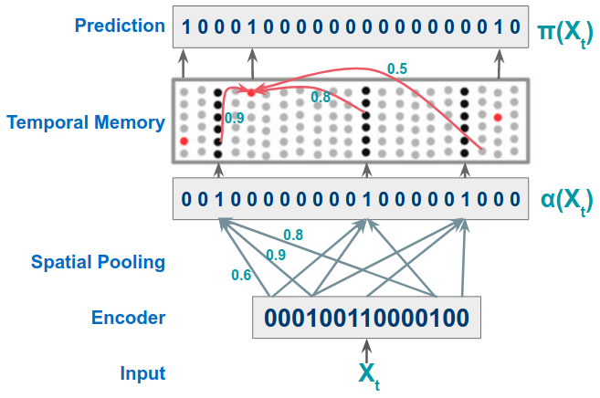
Hierarchical Temporal Memory (HTM-AD) for IndyCar
HTM Algorithm
HTM (cell, column, connection) works as biological neocortex.
Encoder: transform input to Sparse Distributed Representations(SDR):
Learning: (Hebbian-style)
The permanence values of synapses aligned with active input bits or predicted cells are increased, otherwise decreased.
Prediction by the union of SDRs:
SDR store a set of patterns in a single fixed representation by taking the OR of all the vectors
HTM Layer and Computation
1 x 2048
32 x 2048
1 x 2048
1 x (54 + 400)
= (timestamp, speed)
Continuous Learning and Prediction in HTM

Slide 15
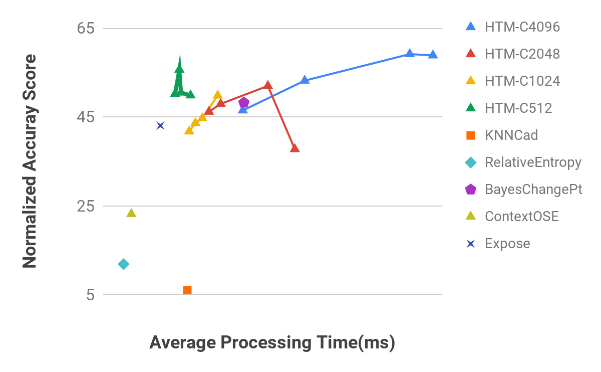
Accuracy vs. Speed (HTM-Anomaly Detection)
Anomaly Detection
Prediction Error S_{t}
as a rolling normal distribution (continuously updated)
Parameter tuning and Evaluation
HTM demonstrates relative higher accuracy comparing with other algorithms, and trade-offs between time and accuracy can be tuned with the parameters of the network architecture.
Detection accuracy is not linearly related to the size of the network. A too large 'cellsPerColumn' may degrade the performance for a small network, as shown by HTM-C512 and HTM-C2048.
Test on Car#1 VSPEED of IndyCar dataset. Speed measured by average processing time(ms) for each incoming record. A run with default parameter ’columnCount’ N=2048 and ’cellsPerColumn’ M=32, segmentsPerCell K=40.

Slide 16
HTM Anomaly Detection Evaluation
UNKNOWN Anomaly
False negative
Missing data
Anomaly Detection Result for Car#1 of the IndyCar dataset.
The horizontal green/yellow bar represents the flag status during the race. Vertical bars represent the three anomalies types from annotations, including 7 GreenFlagUp,6 PitStop, and 7 Crashes. System report anomalies are red triangles.
Notes:
Observations:
Detection on SPEED and RPM are accurate
stable performance when the missing data present, 16:50:15 and 17:27:00
false negatives exist in the results for each metric, need a fine-tuned anomaly threshold to improve
THROTTLE detects more subtle anomalies that the other two metrics failed to report, as UNKNOWN-G, UNKNOWN-H and UNKNOWN-C indicates

Slide 17
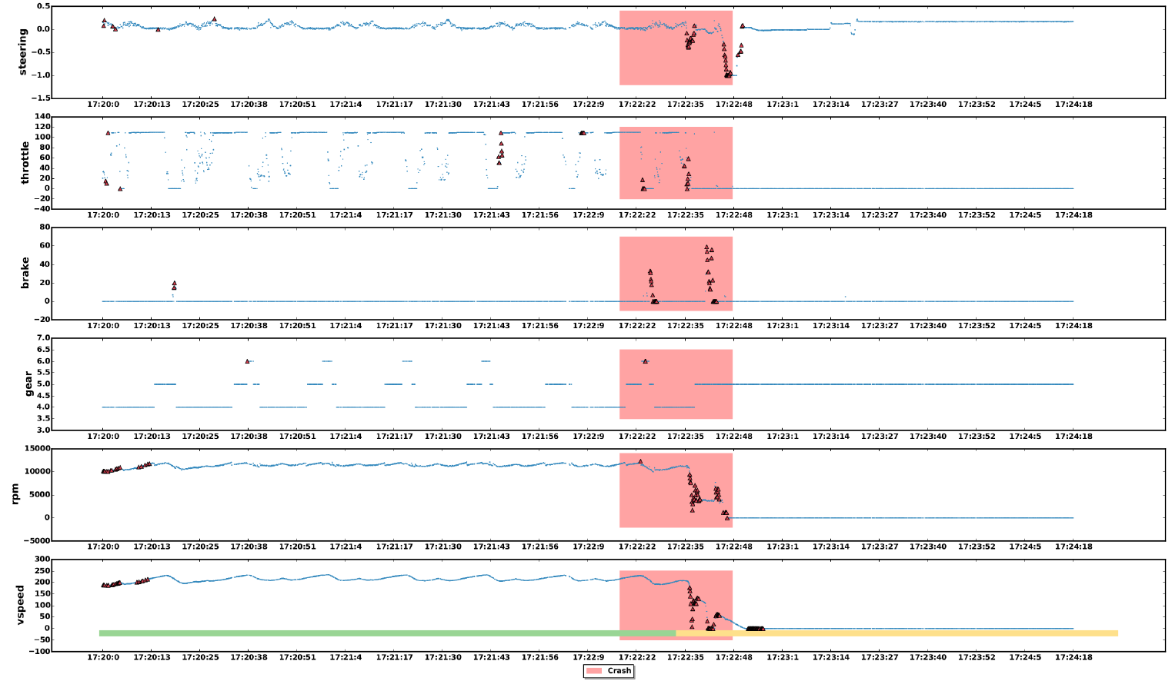
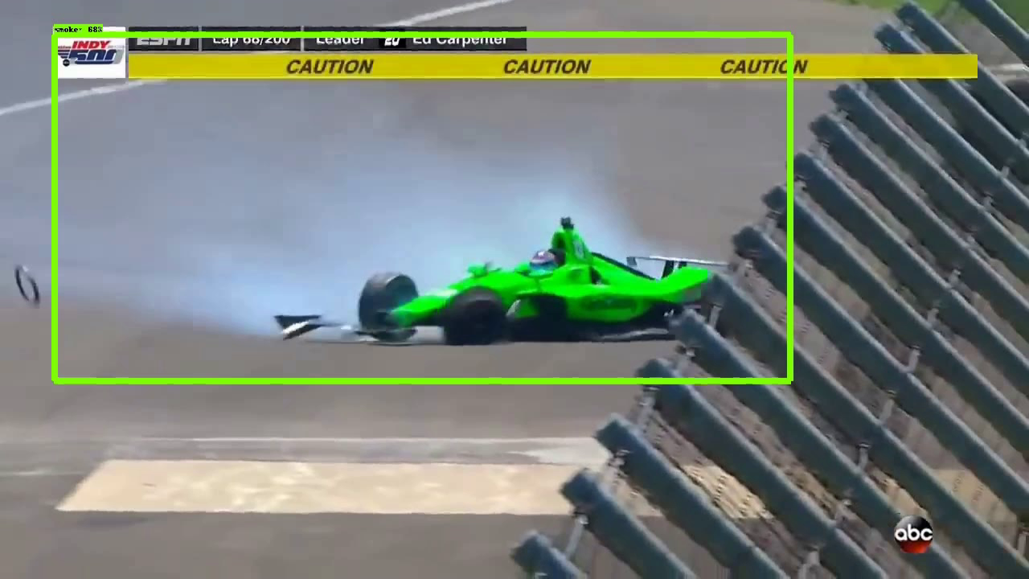
Case Study of Crash Event
Car 13 crashed at 17:22
(Danica Patrick deliberately chose #13 in her final race)
Notes:
Observations:
Within the vertical red time window of the Crash event, all metrics can report a few anomalies.
SPEED, RPM, and STEERING response mostly after the event, which indicates that the variance of the behavior of these metrics is the results of the crash.
GEAR is not as sensitive as the other metrics.
THROTTLE and BRAKE are interesting that some anomalies are detected at the left side of the center, before the collision.
To verify these (unknown) anomalies as a means to provide a warning to severe events need further collaboration with domain experts on the IndyCar data.

Slide 18
LSTM Anomaly Detection
Racing Cars with HTM (online) vs. LSTM (training offline; inference online)
HTM: fast 3~5 milliseconds; unsupervised; model continuously updates
LSTM: multivariate; 75 seconds for training; needs labeled data
HTM Car #1 SPEED Metric
LSTM-AD
False negative
UNKNOWN Anomaly
Anomaly Event: Red Triangle
Crash: Red vertical bar
PitStop: Blue vertical bar
Car #13 Crashes
Notes:
Settings:
GPU: K80
dataset:indycar2018-car1-vspeed(67370 records), Trainset: 15% (10105 records), ValidationSet: 5000
loss-function: mean-squared-error, optimizer: adam
Single layer LSTM, prediction step L=1, SlidingWindowSize=8, Train time per epoch=75s, converge in 10 epochs
Observations
lstm-ad report lot of false negatives which htm-ad detectes, denoted as in blue circles
more unknown anomalies detected in lstm-ad, denoted as in green circles
update model frequently is prohibitive

Slide 19
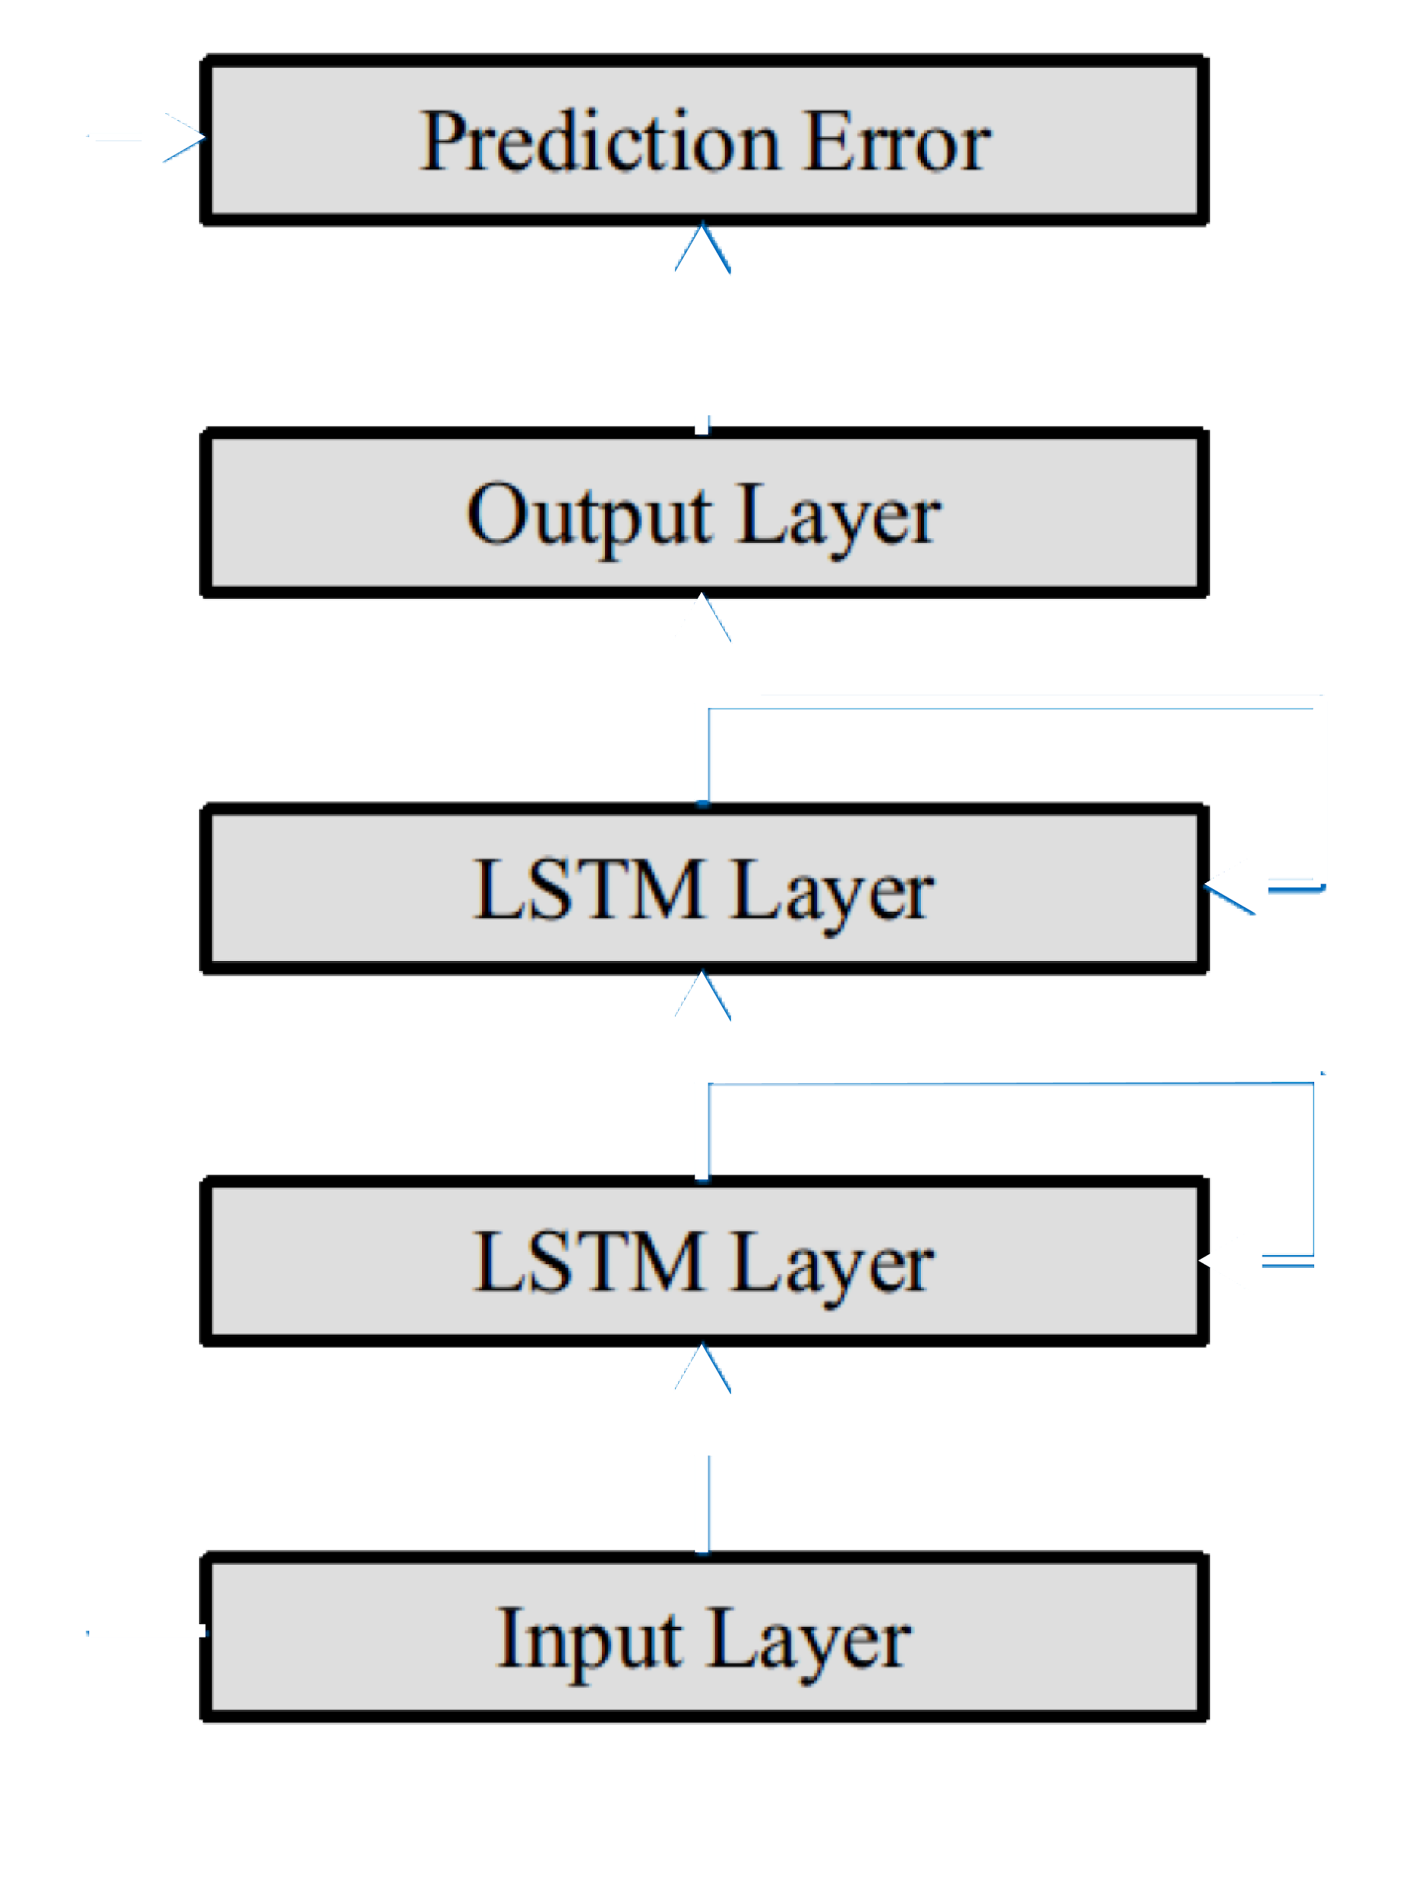
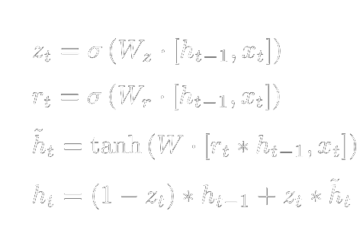
Long Short Term Memory Based Detection(LSTM-AD)
LSTM Cell
Model Error with Multivariate Gaussian Distribution
LSTM-AD
Architecture
Anomaly likelihood
1 - p^{error(x)}
https://colah.github.io/posts/2015-08-Understanding-LSTMs/
Predictive Method:
Sliding Window with size B, input with X_{t} and previous data instances with the total length as B
L steps prediction by LSTM, output sequence with length as L
Application to IndyCar
example: B=20, L=2, input dimension=3(3 metrics:speed, rpm, throttle)
use current and previous 20 values to predict the next 2 values in time series for the 3 metric

Slide 20
Online Learning vs. Offline Training and Online Inference
Features | HTM-AD | LSTM－AD
Online | online learning(continuously updates model) | offline training(requires large volume of labeled data) and online inference
Labeled data | NO (unsupervised and predictive method) | YES (supervised setting) NO (predictive methods or encoder-decoder setting)
Multivariate | support by concatenate output of multiple encoders | support
Real-time | 3~5 milliseconds for single sensor’s data | realtime inference + offline model training

Slide 21
IndyCar Video/Image Analytics
demo: http://indycar.demo.2.s3-website-us-east-1.amazonaws.com/

Slide 22
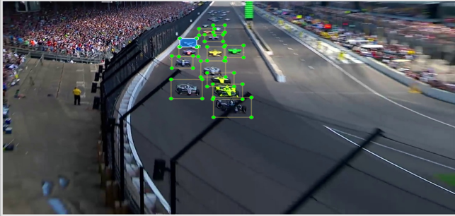
Example of a labelled image for Sports Cars - new labeled data
Notes:
Labelling images
We have used label_img tool for labelling the cars. The job was to put the object in the center of the rectangle box.
We have found different Indianapolis 500 event videos from youtube and generated images from them. We have labelled 1800 images so far and in process of making more.
Challenges
Putting boxes around cars when they are over taking or very close to each other.
Putting boxes around the objects(or excluding the entire image) while there are text information displayed(not including) .
Putting boxes while the image is blurry/pixelated.

Slide 24
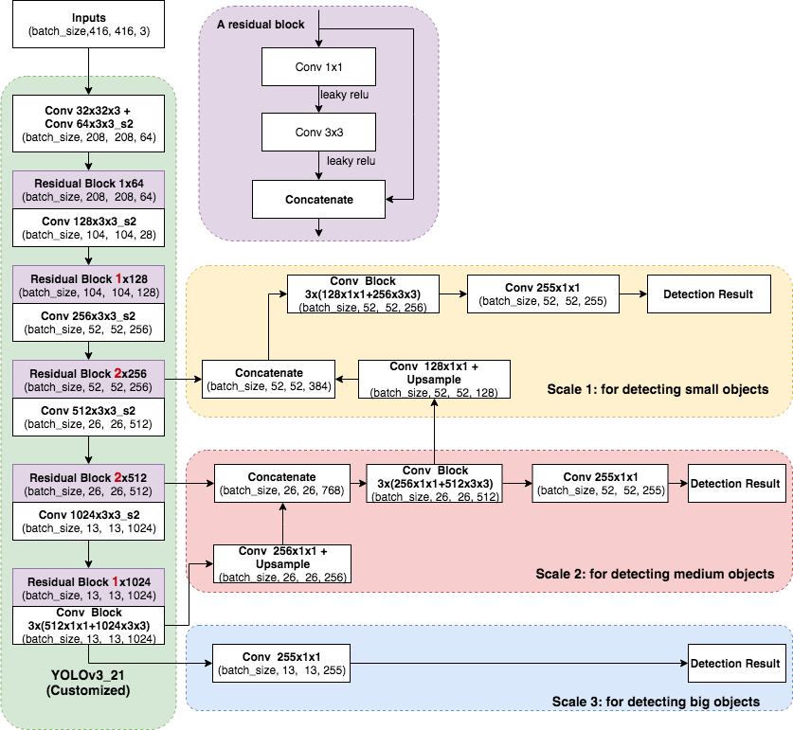
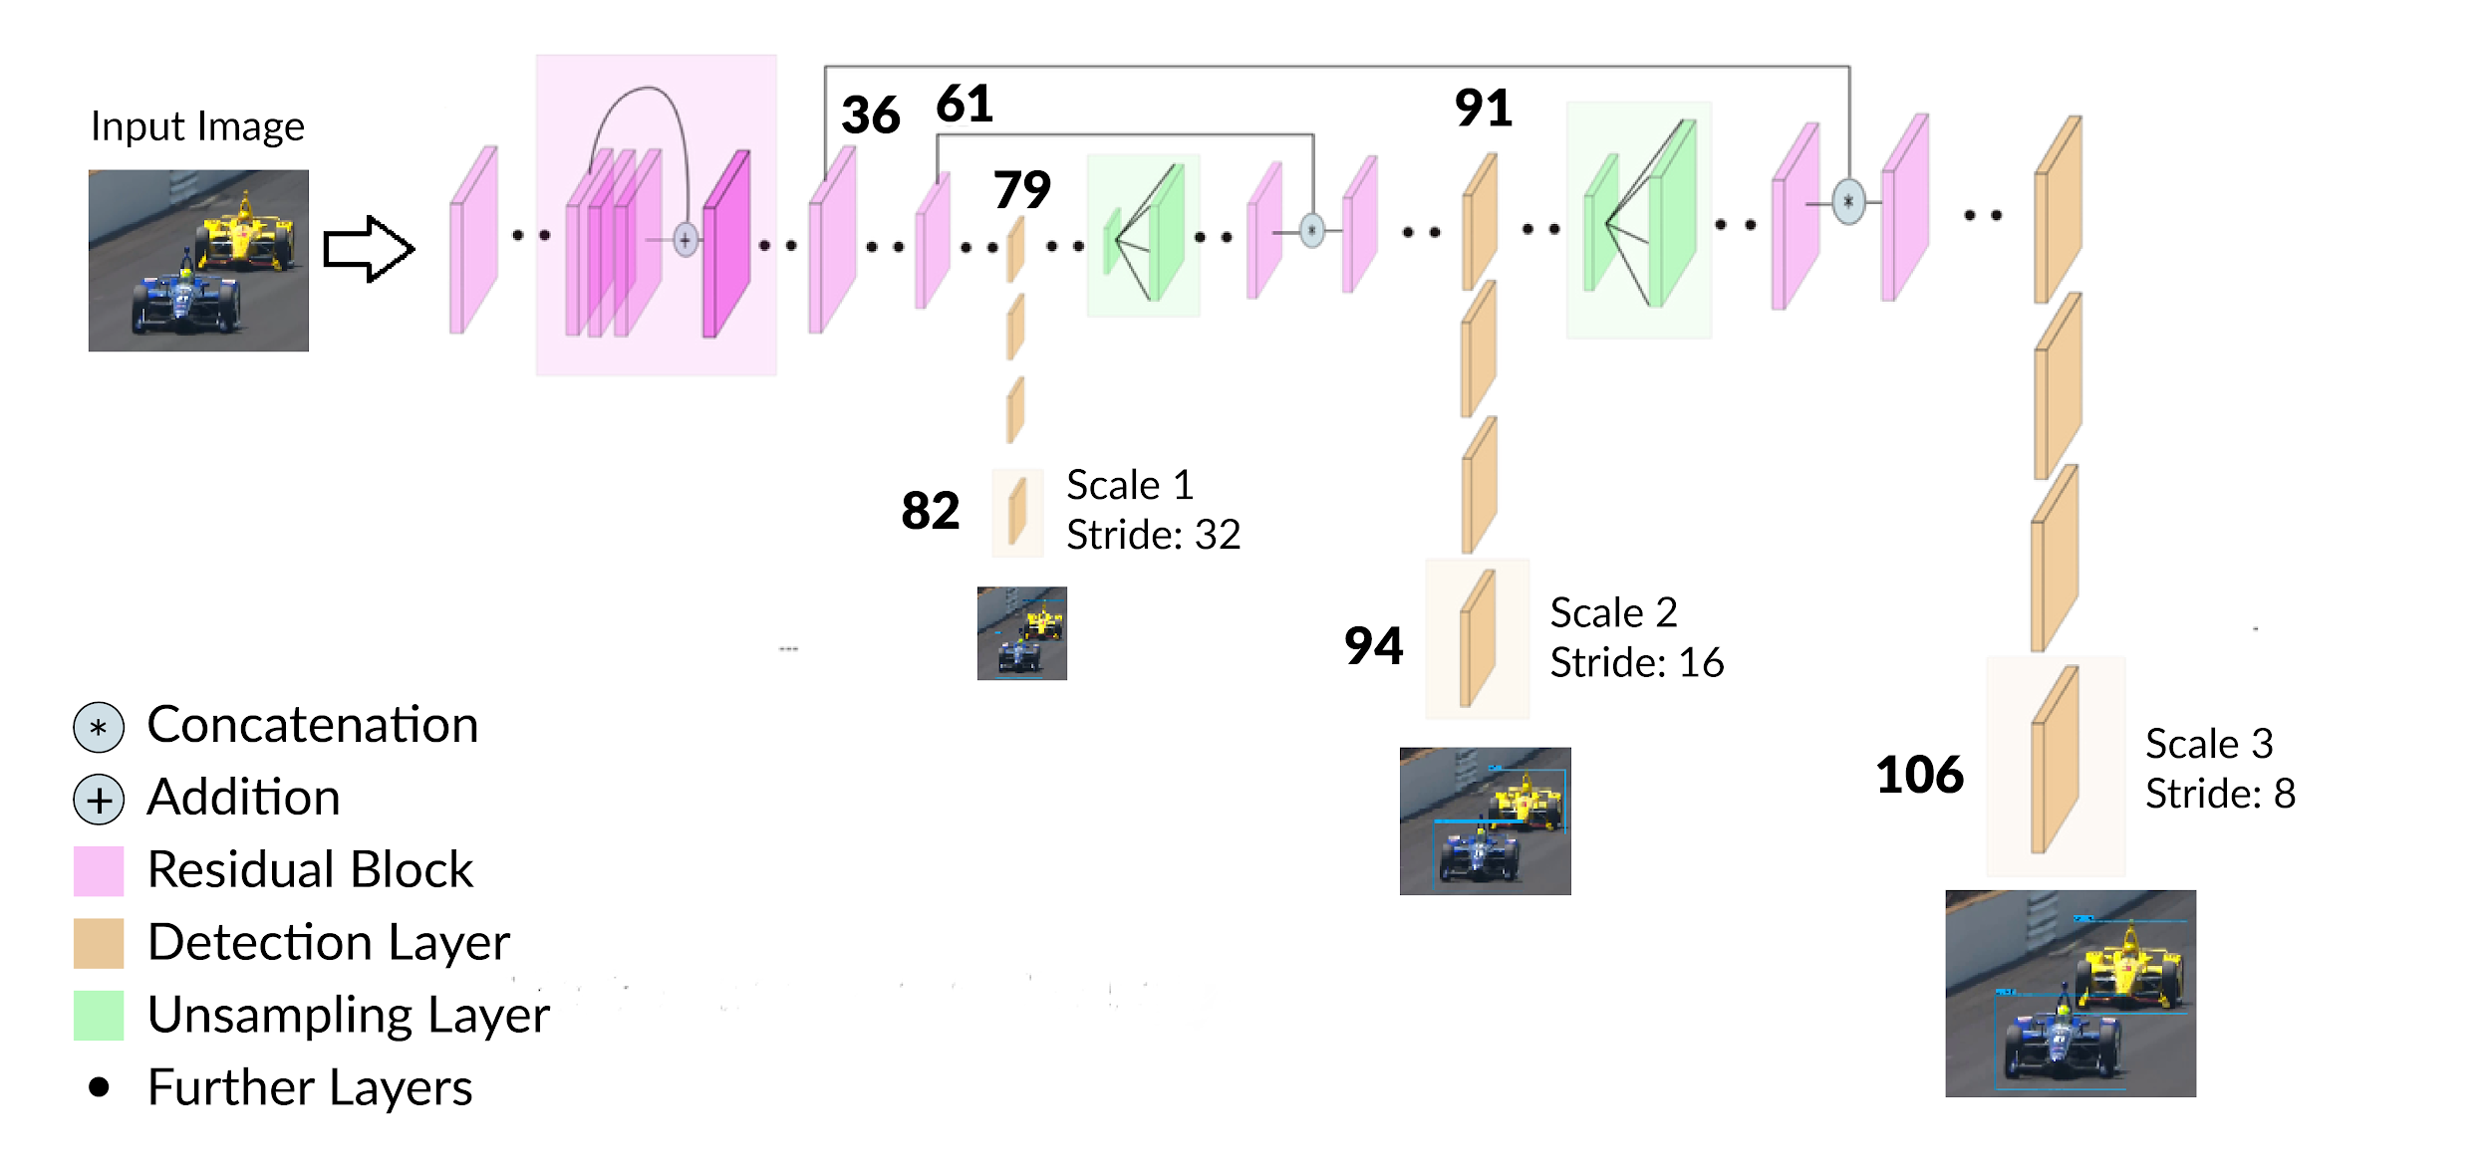
Convolutional Network Architecture
Conv: Convolutional layer
Concatenate: concatenate two inputs
-s2: with stride of 2
batch_size: the output size of this layer/block
Residual Block: repeated convolutional layers with ResNet structure (red numbers shows repeating count)
YoloV3 :
Input image is divided into a grid of cells and prediction is made for each cell
Fed with input images to predict 3D tensors that correspond to 3 scales.
If the center of the object’s ground truth bounding box lies in a particular grid cell, then that cell is used to predict the bounding box of the object.

Slide 25
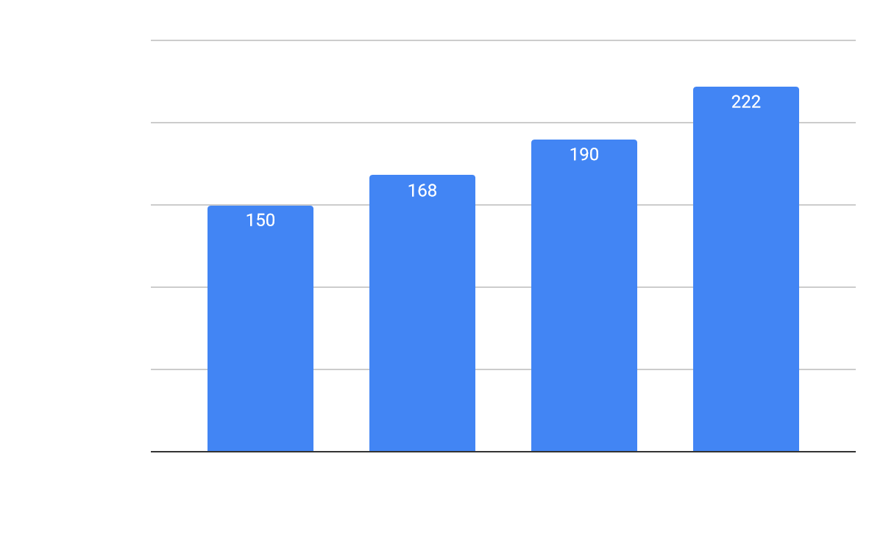
Model and Training Offline
We use Yolo_v3 as base model for car detection as it gives good accuracy and inference time. Pretrained models do not detect racing cars well as lacking of publicly available datasets. We created our own race car dataset.
Experiment Setting:
CPU node: 2x12-core Intel(R) Xeon(R) E5-2670 v3 processors and 128 GB memory; GPU node: 8 x Nvidia Tesla K80 GPU with 12GB of memory
TensorFlow version 1.12.0
4 different models: Yolo_v3 (53 CNN layers) and three custom models created by removing the repeated parts in Yolo_v3 (21, 31, 43 CNN layers).
batch size: 6, epoch: 30, training data size: 1841, test data size: 80
The loss function used in the given model is a sum of object confidence loss, class prediction loss and GIOU loss.
Optimizer: ADAM
Yolo_v3 architecture: it has 53 convolutional layers https://pjreddie.com/media/files/papers/YOLOv3.pdf

Slide 26
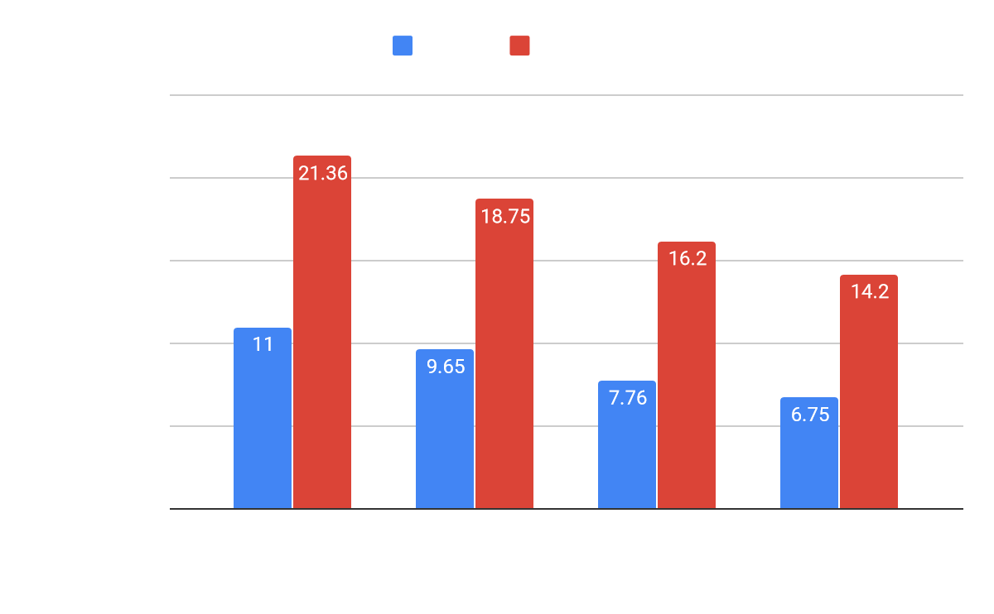
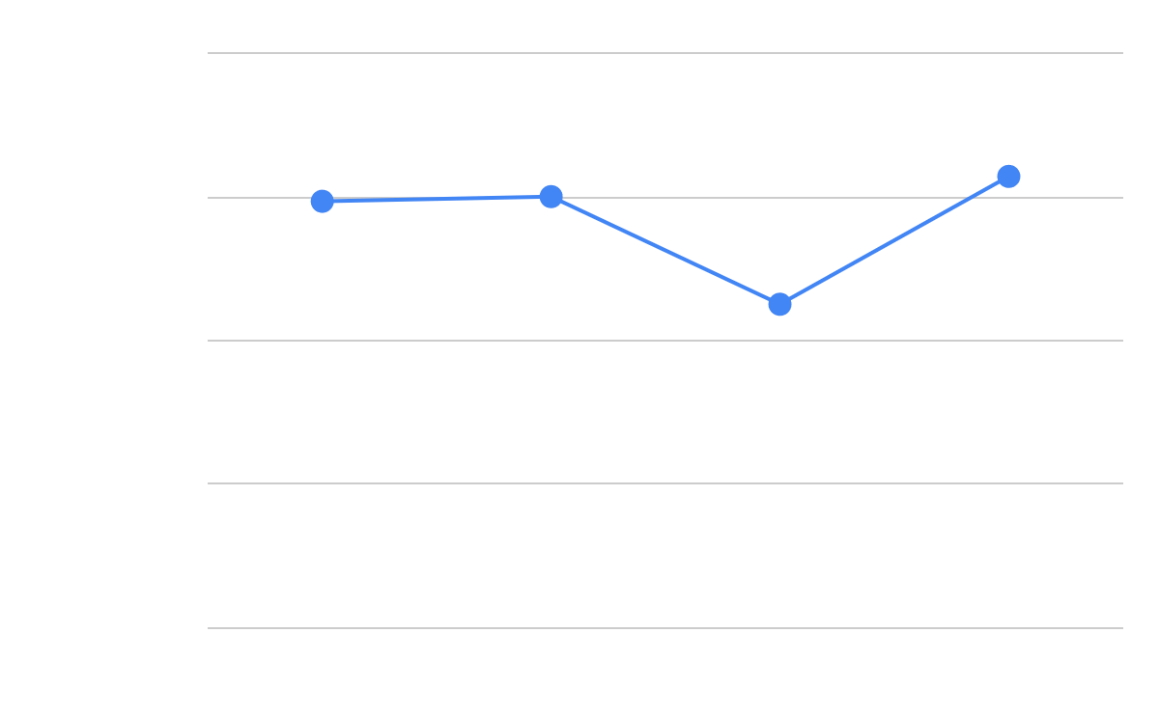
Inference on a Video Stream
We used TensorFlow-MKL for the CPU inference
Observations:
Video is processed at 20 images/second.
Test losses are similar due to small dataset size.
Customized models perform better on GPU.
Future Improvements:
For real race, we will infer from multiple video streams.
We need a highly optimized model for the edge devices.
We will use evolutionary algorithms to automatically find a good model with high accuracy and low inference time.

Slide 27
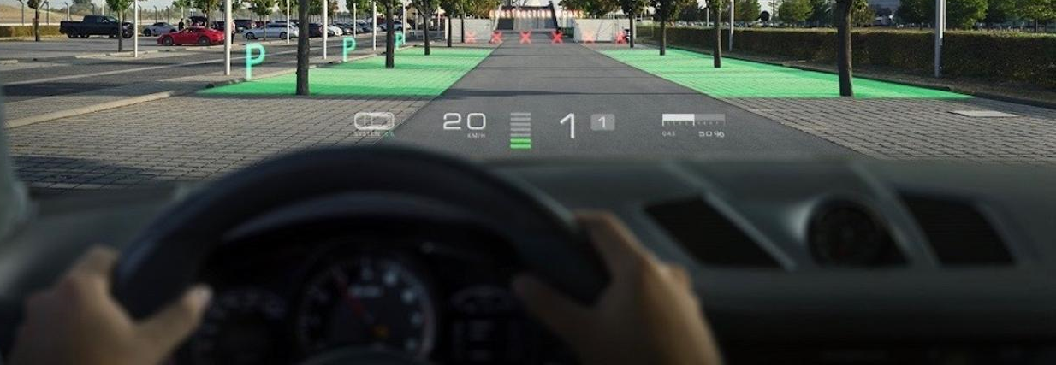
Future Visual data Analysis
With the possibility of Aeroscreen being included in IndyCar, holographic projections on the screen can be made to show cars in the front along with speed, timing, ranking, etc. with a push of a button, along with anomaly detection and identification results.

Slide 28
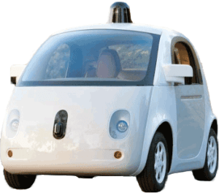
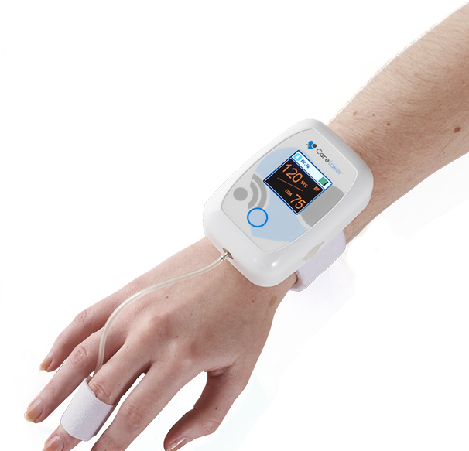
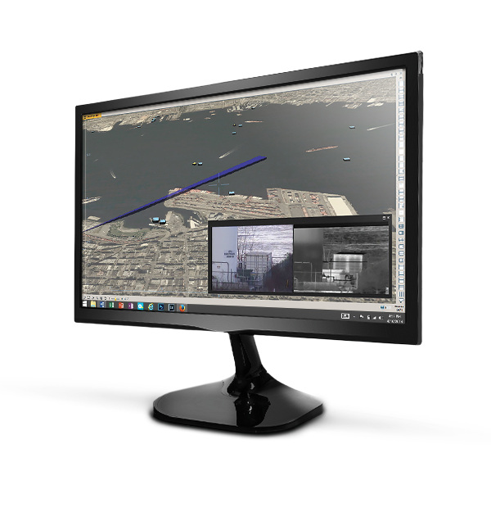
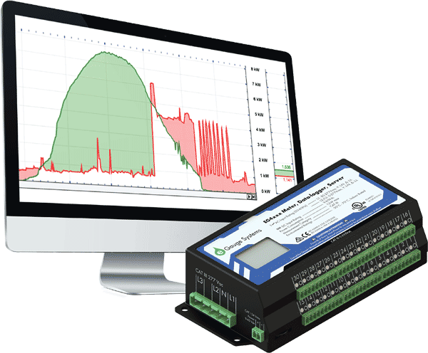
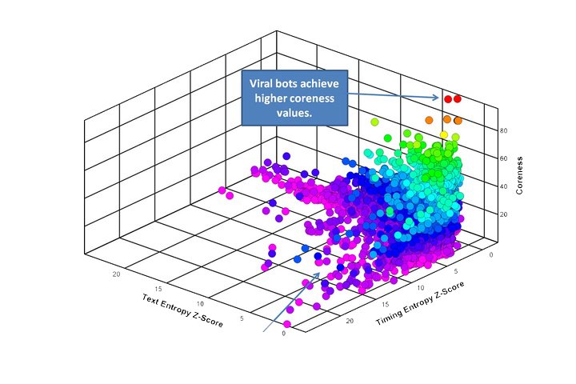
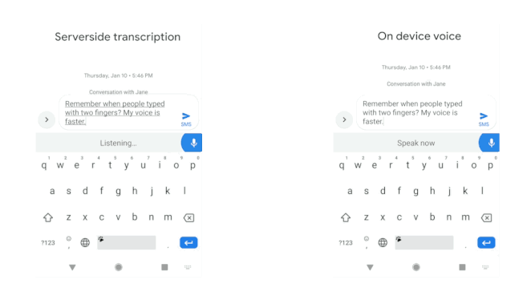
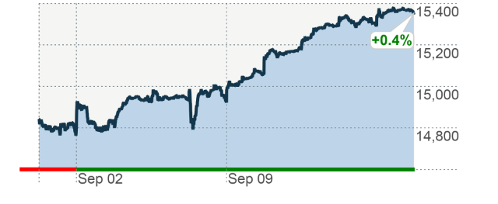
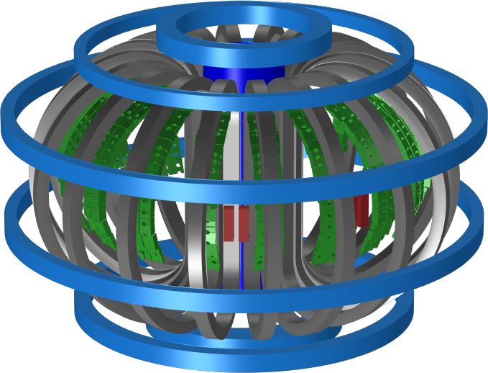
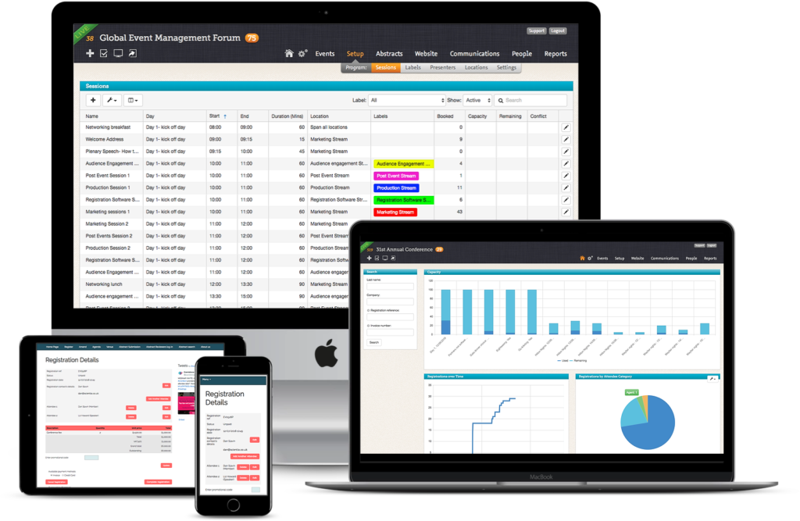
MLPerf: Use Cases for Time Series Machine Learning Algorithms
Areas | Applications | Model | Data sets
Transportation | Cars, Taxis, Freeway Detectors | TT-RNN , BNN, LSTM | Caltrans highway traffic,Taxi/Uber trips
Medical | Wearables, Medical instruments: EEG, ECG, ERP, Patient Data | LSTM, RNN | OPPORTUNITY, EEG,MIMIC
Cybersecurity | Intrusion, classify traffic, anomaly detection | LSTM | GPL loop dataset , SherLock
General Social Statistics | Household electric use, Economic, Finance, Demographics, Industry | CNN, RNN | Household electric M4Competition
Social media | Twitter | Online Clustering | Available from Twitter
Google Speech | All-Neural On-Device Speech Recognizer | RNN-T
Finance | Stock Prices versus time | CNN, RNN | Available academically from Wharton
Science | Earthquake, Climate, Tokamak | Markov, RNN | USHCN climate
Software Systems | Events | LSTM | Enterprise SW system
MLPerf
Notes:
http://jeffnolan.com/wp/2015/11/23/the-fascinating-implications-for-autonomous-vehicles/
https://www.comsol.com/blogs/analyzing-a-component-of-the-iter-tokamak-with-simulation/
https://www.oreilly.com/ideas/identifying-viral-bots-and-cyborgs-in-social-media
https://www.caretakermedical.net/
https://www.eventsforce.com/
https://money.cnn.com/2013/09/13/investing/stocks-markets/index.html
https://www.stickpng.com/img/icons-logos-emojis/tech-companies/twitter-logo
https://www.flir.com/products/cameleon-tactical/
https://www.androidpolice.com/2019/03/12/google-bringing-faster-on-device-speech-recognition-to-gboard-starting-with-pixel-phones/

