Slide 1
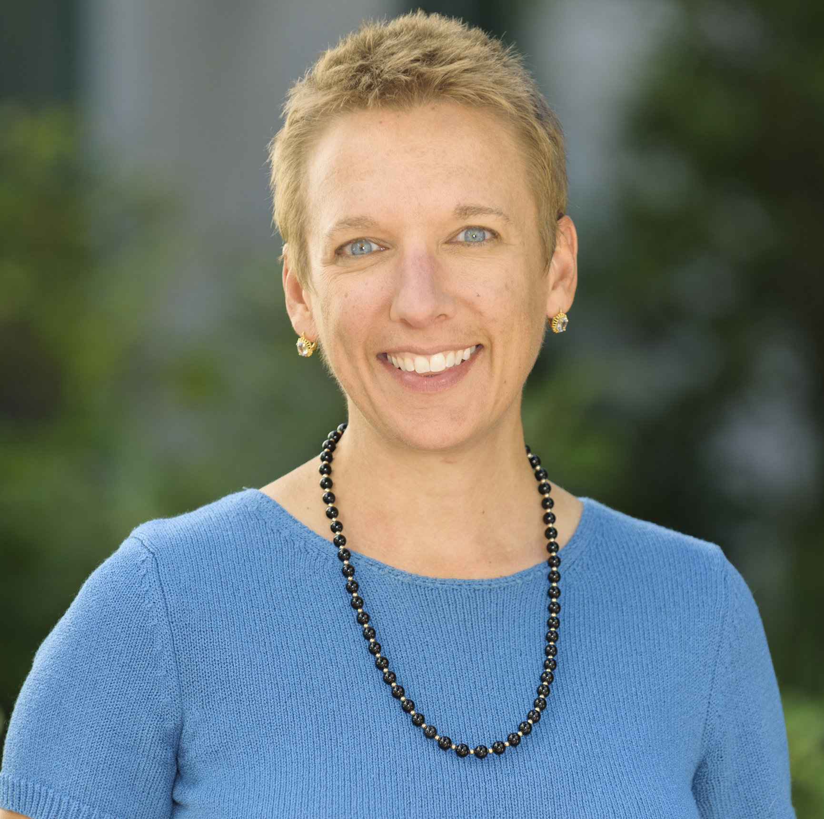
The Future of Cloud ...
Chandra Krintz
Professor
Dept. of Computer Science
UC Santa Barbara
ckrintz@cs.ucsb.edu
Cloud Computing Status and Future Panel
IEEE Services Conference Federation (SCF)
June 26th, 2017

Slide 2
The First Decade of Cloud Technologies
The Good
Self service, low-cost access
Scalable utility computing
Configuration mgmt
API and service oriented

Slide 3
The First Decade of Cloud Technologies
The Good
Self service, low-cost access
Scalable utility computing
Configuration mgmt
API and service oriented
The Bad
Your credit card, pricing models
Availability SLAs only + outages
Learning curve
Code and data gravity
DevOps vs NoOps

Slide 4
The Future of Cloud (Unsolved Challenges)
The Good
Self service, low-cost access
Scalable utility computing
Configuration mgmt
API and service oriented
The Bad
Your credit card, pricing models
Availability SLAs only + outages
Learning curve
Code and data gravity
DevOps vs NoOps
The Ugly
Image/instance/service sprawl
No incentive to reach across aisle
Resources are increasingly heterogeneous
Lacks debugging/opt/anomaly support
Used for things it was NOT designed for

Slide 5
Some Potential Directions (Back to the Future?)
Program components are smaller & increasingly functional!
Functions-as-a-service and event-driven systems
Execution contexts: Containerized env w/ quality control
Cross-cloud programming systems
API-driven & geo-distributed services (higher-level abstraction)
Platform management of heterogeneity: from small to tall
Autonomous management (subject to the SLA!)
Degraded and disconnected: execution and resiliency
Privacy guards, security response
Programming language/runtime support for the best of above

