Slide 1

Streaming Applications in NIST Public Big Data Working Group
IoTDAY April 9, 2015
Geoffrey Fox
gcf@indiana.edu
http://www.infomall.org
School of Informatics and Computing
Digital Science Center
Indiana University Bloomington

Slide 2
NIST Big Data Interoperability Framework
Led by Chaitin Baru, Bob Marcus, Wo Chang

Slide 3
NBD-PWG (NIST Big Data Public Working Group) Subgroups & Co-Chairs
There were 5 Subgroups
  Note mainly industry
Requirements and Use Cases Sub Group
  Geoffrey Fox, Indiana U.; Joe Paiva, VA; Tsegereda Beyene, Cisco
Definitions and Taxonomies SG
  Nancy Grady, SAIC; Natasha Balac, SDSC; Eugene Luster, R2AD
Reference Architecture Sub Group
  Orit Levin, Microsoft; James Ketner, AT&T; Don Krapohl, Augmented Intelligence
Security and Privacy Sub Group
  Arnab Roy, CSA/Fujitsu Nancy Landreville, U. MD Akhil Manchanda, GE
Technology Roadmap Sub Group
  Carl Buffington, Vistronix; Dan McClary, Oracle; David Boyd, Data Tactics
See http://bigdatawg.nist.gov/usecases.php
And http://bigdatawg.nist.gov/V1_output_docs.php

Slide 4
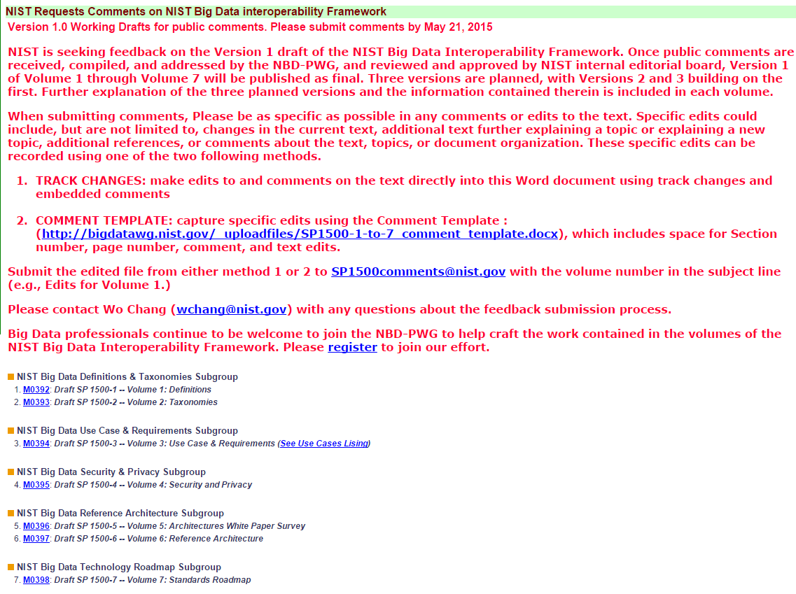
http://bigdatawg.nist.gov/V1_output_docs.php

Slide 5
51 Detailed Use Cases: Contributed July-September 2013
Covers goals, data features such as 3 V’s, software, hardware
Government Operation(4): National Archives and Records Administration, Census Bureau
Commercial(8): Finance in Cloud, Cloud Backup, Mendeley (Citations), Netflix, Web Search, Digital Materials, Cargo shipping (as in UPS)
Defense(3): Sensors, Image surveillance, Situation Assessment
Healthcare and Life Sciences(10): Medical records, Graph and Probabilistic analysis, Pathology, Bioimaging, Genomics, Epidemiology, People Activity models, Biodiversity
Deep Learning and Social Media(6): Driving Car, Geolocate images/cameras, Twitter, Crowd Sourcing, Network Science, NIST benchmark datasets
The Ecosystem for Research(4): Metadata, Collaboration, Language Translation, Light source experiments
Astronomy and Physics(5): Sky Surveys including comparison to simulation, Large Hadron Collider at CERN, Belle Accelerator II in Japan
Earth, Environmental and Polar Science(10): Radar Scattering in Atmosphere, Earthquake, Ocean, Earth Observation, Ice sheet Radar scattering, Earth radar mapping, Climate simulation datasets, Atmospheric turbulence identification, Subsurface Biogeochemistry (microbes to watersheds), AmeriFlux and FLUXNET gas sensors
Energy(1): Smart grid
26 Features for each use case; Biased to science

Slide 6

Use Case Template
26 fields completed for 51 areas
Government Operation: 4
Commercial: 8
Defense: 3
Healthcare and Life Sciences: 10
Deep Learning and Social Media: 6
The Ecosystem for Research: 4
Astronomy and Physics: 5
Earth, Environmental and Polar Science: 10
Energy: 1

Slide 7

Table 4: Characteristics of 6 Distributed Applications
Application Example | Execution Unit | Communication | Coordination | Execution Environment
Montage | Multiple sequential and parallel executable | Files | Dataflow (DAG) | Dynamic process creation, execution
NEKTAR | Multiple concurrent parallel executables | Stream based | Dataflow | Co-scheduling, data streaming, async. I/O
Replica-Exchange | Multiple seq. and parallel executables | Pub/sub | Dataflow and events | Decoupled coordination and messaging
Climate Prediction (generation) | Multiple seq. & parallel executables | Files and messages | Master-Worker, events | @Home (BOINC)
Climate Prediction (analysis) | Multiple seq. & parallel executables | Files and messages | Dataflow | Dynamics process creation, workflow execution
SCOOP | Multiple Executable | Files and messages | Dataflow | Preemptive scheduling, reservations
Coupled Fusion | Multiple executable | Stream-based | Dataflow | Co-scheduling, data streaming, async I/O
Part of Property Summary Table

Slide 8
Features of 51 Use Cases I
PP (26) “All” Pleasingly Parallel or Map Only
MR (18) Classic MapReduce MR (add MRStat below for full count)
MRStat (7) Simple version of MR where key computations are simple reduction as found in statistical averages such as histograms and averages
MRIter (23) Iterative MapReduce or MPI (Spark, Twister)
Graph (9) Complex graph data structure needed in analysis
Fusion (11) Integrate diverse data to aid discovery/decision making; could involve sophisticated algorithms or could just be a portal
Streaming (41) Some data comes in incrementally and is processed this way – includes IoT
Classify (30) Classification: divide data into categories
S/Q (12) Index, Search and Query

Slide 9
Features of 51 Use Cases II
CF (4) Collaborative Filtering for recommender engines
LML (36) Local Machine Learning (Independent for each parallel entity) – application could have GML as well
GML (23) Global Machine Learning: Deep Learning, Clustering, LDA, PLSI, MDS,
  Large Scale Optimizations as in Variational Bayes, MCMC, Lifted Belief Propagation, Stochastic Gradient Descent, L-BFGS, Levenberg-Marquardt . Can call EGO or Exascale Global Optimization with scalable parallel algorithm
Workflow (51) Universal
GIS (16) Geotagged data and often displayed in ESRI, Microsoft Virtual Earth, Google Earth, GeoServer etc.
HPC (5) Classic large-scale simulation of cosmos, materials, etc. generating (visualization) data
Agent (2) Simulations of models of data-defined macroscopic entities represented as agents

Slide 10
13 Image-based Use Cases
13-15 Military Sensor Data Analysis/ Intelligence PP, LML, GIS, MR
7:Pathology Imaging/ Digital Pathology: PP, LML, MR for search becoming terabyte 3D images, Global Classification
18&35: Computational Bioimaging (Light Sources): PP, LML Also materials
26: Large-scale Deep Learning: GML Stanford ran 10 million images and 11 billion parameters on a 64 GPU HPC; vision (drive car), speech, and Natural Language Processing
27: Organizing large-scale, unstructured collections of photos: GML Fit position and camera direction to assemble 3D photo ensemble
36: Catalina Real-Time Transient Synoptic Sky Survey (CRTS): PP, LML followed by classification of events (GML)
43: Radar Data Analysis for CReSIS Remote Sensing of Ice Sheets: PP, LML to identify glacier beds; GML for full ice-sheet
44: UAVSAR Data Processing, Data Product Delivery, and Data Services: PP to find slippage from radar images
45, 46: Analysis of Simulation visualizations: PP LML ?GML find paths, classify orbits, classify patterns that signal earthquakes, instabilities, climate, turbulence

Slide 11
Internet of Things and Streaming Apps
It is projected that there will be 24 (Mobile Industry Group) to 50 (Cisco) billion devices on the Internet by 2020.
The cloud natural controller of and resource provider for the Internet of Things.
Smart phones/watches, Wearable devices (Smart People), “Intelligent River” “Smart Homes and Grid” and “Ubiquitous Cities”, Robotics.
Majority of use cases are streaming – experimental science gathers data in a stream – sometimes batched as in a field trip. Below is sample
10: Cargo Shipping Tracking as in UPS, Fedex PP GIS LML
13: Large Scale Geospatial Analysis and Visualization PP GIS LML
28: Truthy: Information diffusion research from Twitter Data PP MR for Search, GML for community determination
39: Particle Physics: Analysis of LHC Large Hadron Collider Data: Discovery of Higgs particle PP Local Processing Global statistics
50: DOE-BER AmeriFlux and FLUXNET Networks PP GIS LML
51: Consumption forecasting in Smart Grids PP GIS LML

Slide 12
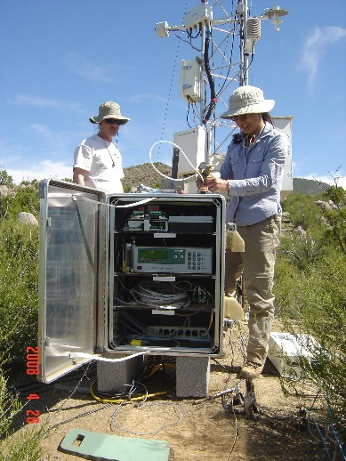
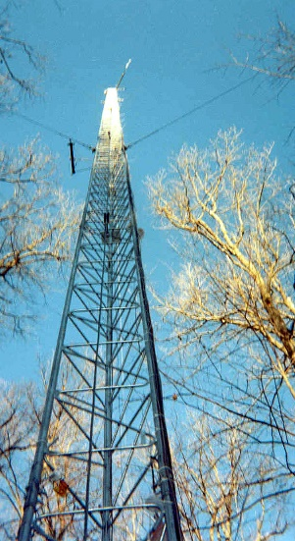
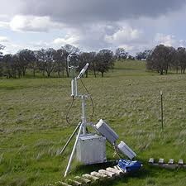
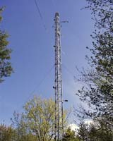
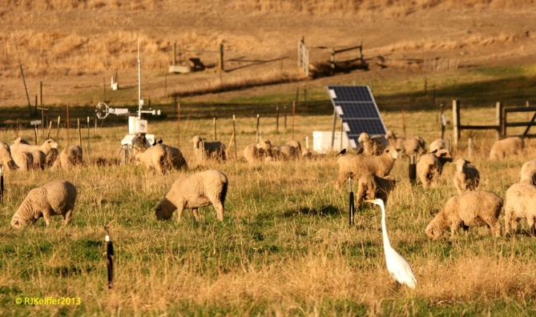
50: DOE-BER AmeriFlux and FLUXNET Networks
Earth, Environmental and Polar Science
Application: AmeriFlux and FLUXNET are US and world collections
respectively of sensors that observe trace gas fluxes (CO₂,
water vapor) across a broad spectrum of times (hours, days,
seasons, years, and decades) and space. Moreover, such datasets provide the crucial linkages among organisms, ecosystems, and process-scale studies—at climate-relevant scales of landscapes, regions, and continents—for incorporation into biogeochemical and climate models.
Current Approach: Software includes EddyPro, Custom analysis software, R, python, neural networks, Matlab. There are ~150 towers in AmeriFlux and over 500 towers distributed globally collecting flux measurements.
Futures: Field experiment data taking would be improved by access to existing data and automated entry of new data via mobile devices. Need to support interdisciplinary study integrating diverse data sources.
Fusion, PP, GIS
Streaming
Parallelism over Sensors

Slide 13
NIST Big Data Reference Architecture NBDRA

Slide 14
2. Perform real time analytics on data source streams and notify users when specified events occur
Specify filter
Filter Identifying Events
Fetch streamed Data
Post Selected Events
Streaming Data
Posted Data
Identified Events
Streaming Data
Streaming Data
Archive
Repository
Storm, Kafka, Hbase, Zookeeper

Slide 15
5A. Perform interactive analytics on observational scientific data
Science Analysis Code, Mahout, R
Grid or Many Task Software, Hadoop, Spark, Giraph, Pig …
Data Storage: HDFS, Hbase, File Collection
Direct Transfer
Transport batch of data to primary analysis data system
Streaming Twitter data for Social Networking
Local Accumulate and initial computing
NIST examples include LHC, Remote Sensing, Astronomy and Bioinformatics
Record Scientific Data in “field”

Slide 16
6 Data Analysis Architectures
Difficult to parallelize asynchronous
parallel
Graph Algorithms
Classic Hadoop in classes 1) 2) but not clearly best in class 1)
Many Task)
PP
MR MRStat
MRIter
Graph, HPC
Streaming
BLAST Analysis Local Machine Learning Pleasingly Parallel | High Energy Physics (HEP) Histograms Web search Recommender Engines | Expectation maximization Clustering Linear Algebra, PageRank | Classic MPI PDE Solvers and Particle Dynamics Graph | Streaming images from Synchrotron sources, Telescopes, IoT
MapReduce and Iterative Extensions (Spark, Twister) |  |  | MPI, Giraph | Apache Storm
Harp – Enhanced Hadoop
Maps are Bolts

Slide 17
IoT Activities at Indiana University
Parallel Clustering for Tweets: Judy Qiu, Emilio Ferrara, Xiaoming Gao
Parallel Cloud Control for Robots: Supun Kamburugamuve, Hengjing He, David Crandall

Slide 18
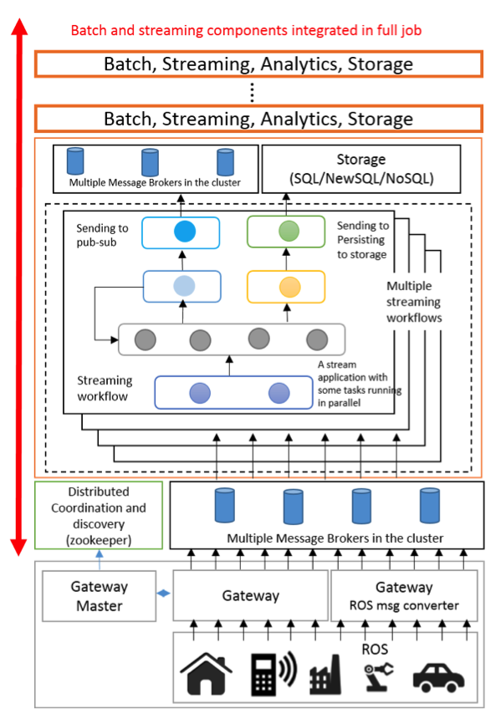
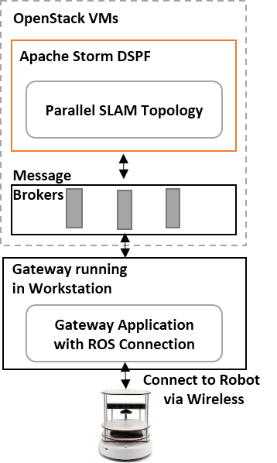
IoTCloud uses Zookeeper, Storm, Hbase, RabbitMQ for robot cloud control
Focus on high performance (parallel) control functions
Guaranteed real time response
Parallel
simultaneous localization and mapping
(SLAM) in the cloud

Slide 19
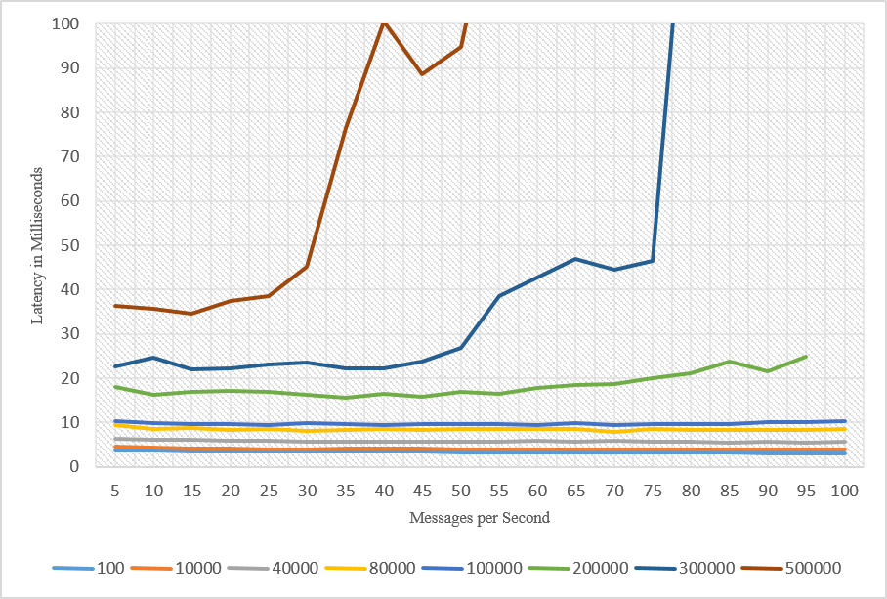
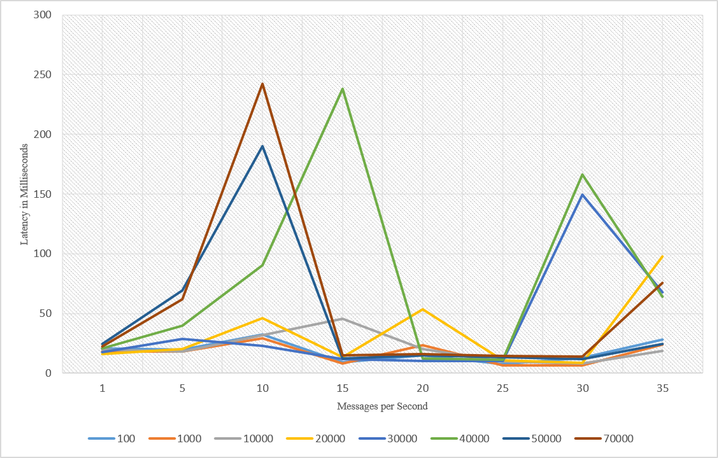
Latency with Kafka
Note change in scales for latency and message size
Latency with RabbitMQ
Different Message sizes in bytes

Slide 20
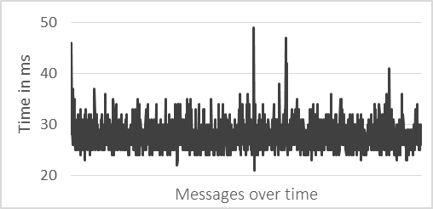
Robot Latency Kafka & RabbitMQ
RabbitMQ versus Kafka
Kinect with
Turtlebot and RabbitMQ

Slide 21
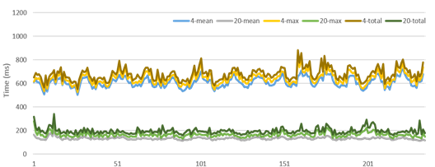
Parallel SLAM Simultaneous Localization and Mapping by Particle Filtering

Slide 22
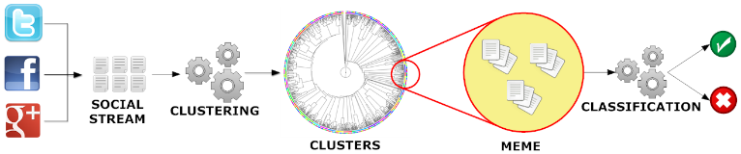
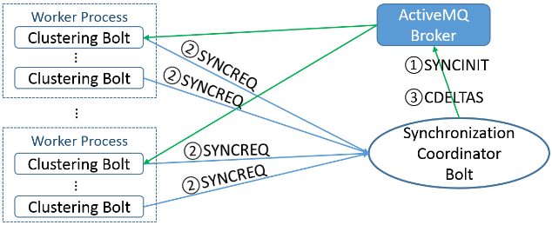
Parallel Tweet Clustering with Storm
Judy Qiu, Emilio Ferrara and Xiaoming Gao
Storm Bolts coordinated by ActiveMQ to synchronize parallel cluster center updates – add loops to Storm
2 million streaming tweets processed in 40 minutes; 35,000 clusters
Sequential
Parallel – eventually 10,000 bolts

Slide 23
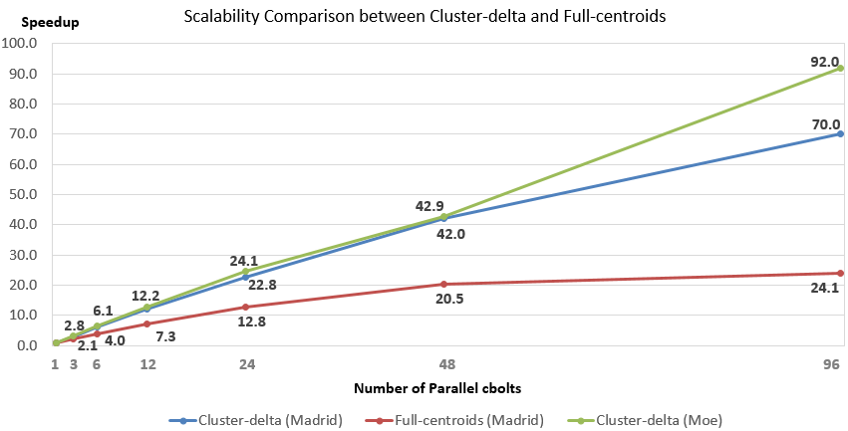
Parallel Tweet Clustering with Storm
Speedup on up to 96 bolts on two clusters Moe and Madrid
Red curve is old algorithm;
green and blue new algorithm
Full Twitter – 1000 way parallelism
Full Everything – 10,000 way parallelism

