Slide 1
Engineering Health and Medicine: An Intelligent Systems Approach
Faulty: Maria Bondesson-Bolin, James Glazier, Alexander Gumennik, Feng Guo
Vikram Jadhao, Greg Lewis, Paul Macklin, Endre Somogyi
Current Disease Treatment
Responds to Disease
Is Patient Initiated
Is Reactive
Is Slow
Is Expensive
Optimizes Population Outcomes
Is Prescriptive
Is Open-Loop
Engineered Health
Maintains Health
Is Continuous
Is Regulatory
Is Fast
Is Affordable
Optimizes Individual Outcomes
Is Response Oriented
If Closed Loop
Intelligent Systems Engineering

Slide 2
Intelligent Workflow for Engineering Health
To understand/regulate/fix/engineer we must be able to predict
Continuous Measurement
State Inference/ Diagnosis
Predictor/Corrector Evolver
Delivery of Intervention
Individual/Patient
Predictive Virtual Individual/Avatar
Forecast/Prognosis
Physician
Selection of Intervention
Evaluation of Possible Interventions/Treatments

Slide 3
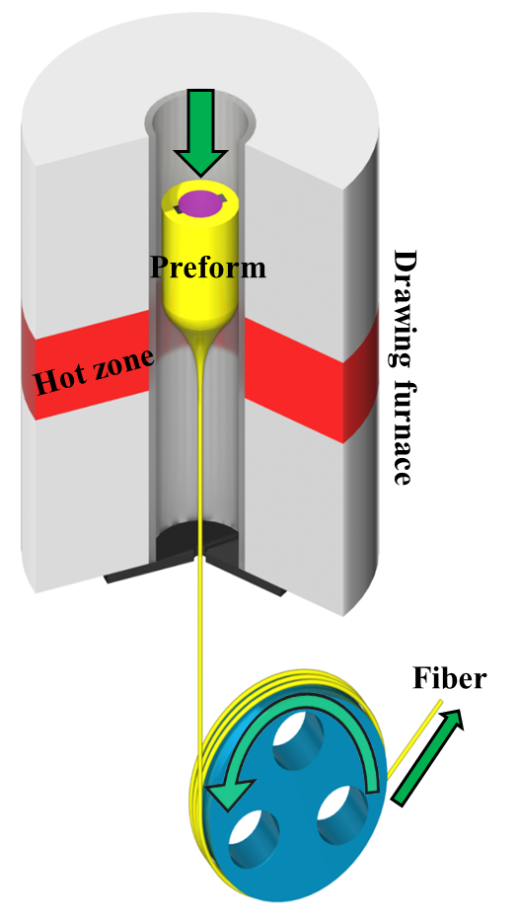
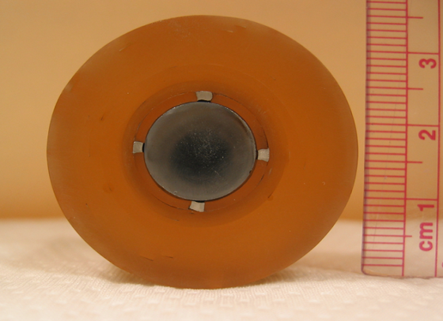
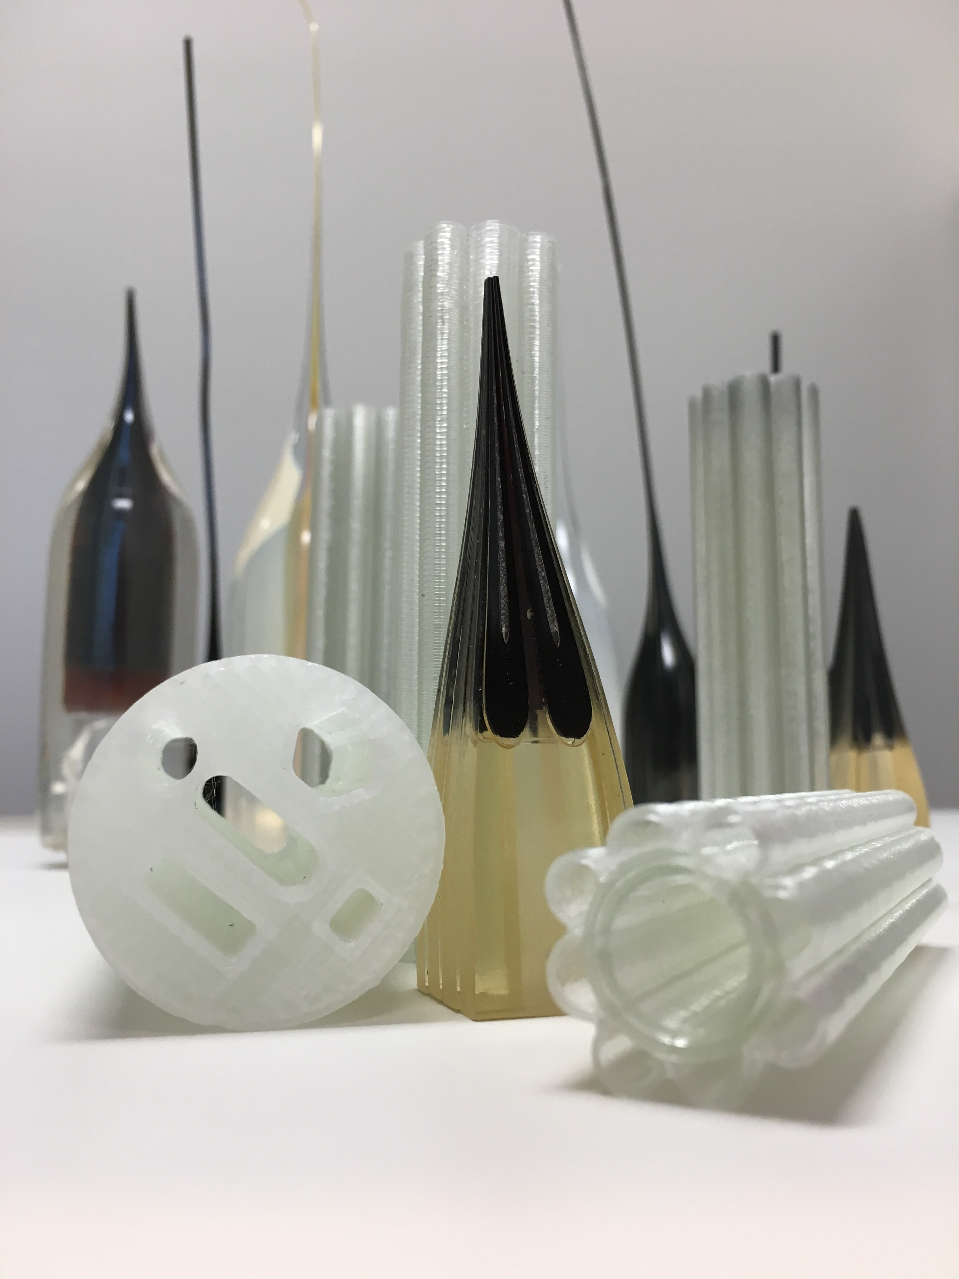
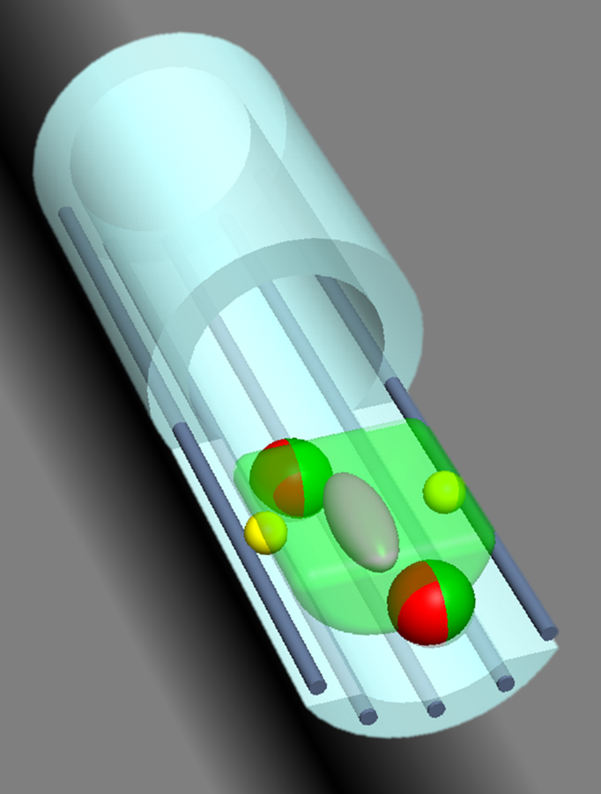
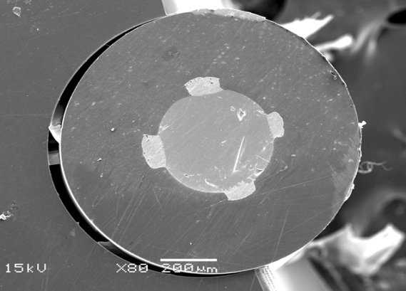
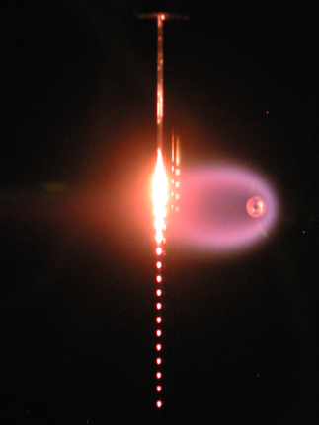
Alex Gumennik: Engineered Fiber Nanosensors
Recursive fiber-device 3D printing
Fiber-enabled tissue engineering
Preform cross section
Pervasive web systems
In-fiber fluid dynamics
Fiber cross section
Notes:
Research:
Pervasive web systems
Fibers are universally ubiquitous in manmade objects, such as clothes and furniture. They are often a base component of reinforced composites. Moreover, optical fibers wrap the Earth in a dense web of telecommunication cables, overall one billion miles long. We are transforming the fiber into a functional device, to make it not only pervasive, but also intelligent. Ability to incorporate functional materials and morphologies into a thermally drawn preform results in integrated nano-devices packed with micrometric pitch into a multiple-kilometers long fiber. Such fibers can listen, watch, palp, smell and taste their surroundings, communicating those sensations to a remote computer. Results of the research in the area of pervasive web systems is applicable to multiple technological areas, such as remote and distributed pollutants detection, psychophysiological monitoring and management, energy harvesting, ultrasonic imaging etc.
In-fiber fluid dynamics
Monolithic multimaterial fiber-device is a result of a sequence of liquid phase material processing steps, such as a thermal draw of a preform and an axial pattering of fiber cores by means of a controlled capillary instability. While control over the fluid dynamics is essential for a device fabrication, the vice-versa is true as well: the multimaterial fiber is a fascinating playground for generating a new knowledge in fluid dynamics. The most familiar of fluid dynamic phenomena is, likely, the jetting in a water tap stream: an intact stream of water emerging from the faucet eventually breaks up into a necklace of spheres, due to the tendency for the surface-area minimization. When promoted in a multimaterial fiber by its liquefaction at elevated temperatures, the dynamic behavior of fluids becomes much more complex than this basic phenomenon. Combination of materials of various viscosities and interfacial energies in a predefined complex architecture, where multiple threads, while axially uniform, greatly vary in their cross sectional dimensions and geometries, results in a multitude of coupled capillary instability processes. Evolution of these processes can be halted at any desired moment by cooling the fiber, and the captured geometrical configuration can be thoroughly investigated. Thus, multimaterial fiber is a powerful physical simulator for investigation of time-evolving Navier–Stokes equations.
Recursive fiber-device 3D printing
Functional complexity of the fiber device largely correlates the architectural flexibility of the fiber preform. Monolithic and precise Direct Digital Manufacturing of fiber preforms is a key factor for enabling Moor’s law dynamics in the realm of functional fibers and fabrics. Recent advances in additive manufacturing in silica glass enable for the first time taking a CAD-CAM approach to the fiber preform design and manufacturing. Taking a recursive manufacturing approach, the fiber resulting from a thermal draw of 3D printed preform embedding devices with active functionalities, can be used as a feedstock for 3D printing fiber-based scaffolds with active sensing and microfluidic modalities for biomedical and tissue engineering applications.
Fiber-enabled tissue engineering
Fibers made of biocompatible materials that have a thin and flexible form factor fit the metabolic and the mechanical properties of the living tissue. Thus, they can create intimate contact with living media without promoting a development of a scar tissue. Embedding stress and temperature sensors, such fiber-based scaffolds can monitor the “happiness” of the surrounding tissue. Moreover, spheres of noble metals, such as gold or platinum, created by capillary instability and contacted by electrodes running along the fiber inside the cladding, can serve as electrical attachment and stimulation ports, while semiconducting devices can sense the electrical and the optical response of the cells to such stimulation. Microfluidic channels in the fiber find their use in nutrition, drugs and growth agents’ delivery, and in enhancing the oxygen perfusion into the tissue. Fiber-tissue hybrids can find their use in multiple applications in biomedicine, bioelectronics, bio-printing, and tissue engineering.

Slide 4
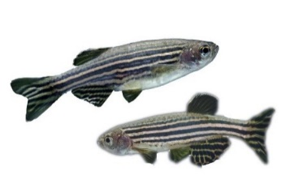
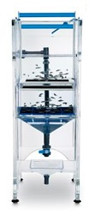
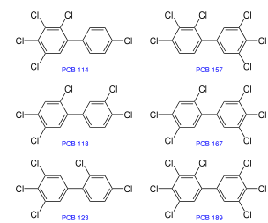
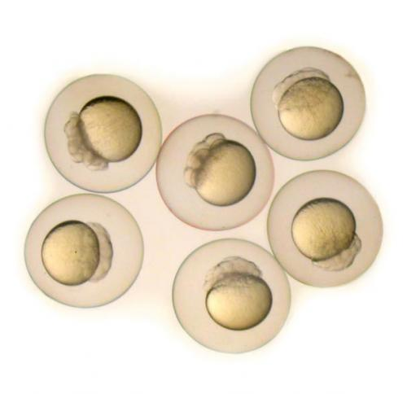
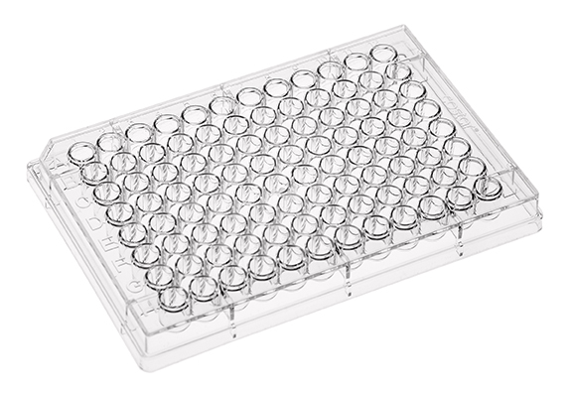
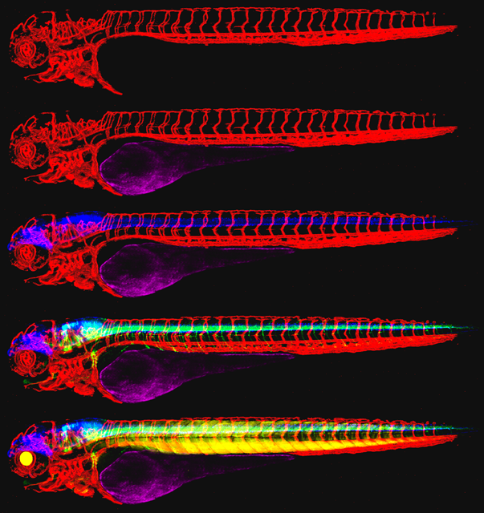
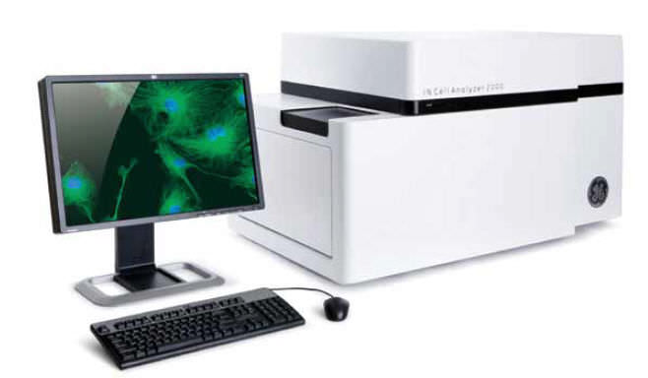
Maria Bondesson: Zebrafish as a Model Organism in Developmental Toxicology
Zebrafish:
Small size, small test volumes
Transparent embryos/fish
External rapid embryonic development
Hundreds of embryos weekly/pair
Genome almost sequenced
75% of genes have human orthologues
Conserved developmental processes and signaling pathways
Many mutants and transgenic fish available
Morpholino knockdown
CRISPR/CAS mutagenesis
Cost-efficient
Adaptable to high throughput screening
Tissue-specific fluorescent fish
Screen for environmental pollutants causing:
Vascular Toxicity
Neuronal Toxicity
Skeletal Toxicity
Obesity
Endocrine Disruption
HTS microscopy

Slide 5
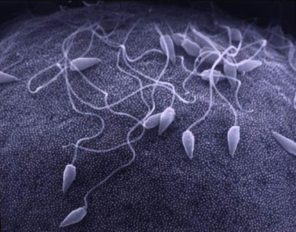
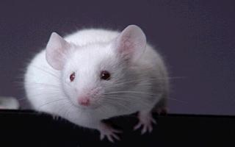
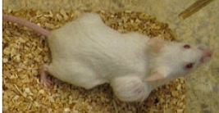


James Glazier—Virtual Tissues
Development: How does Fertilized Egg Self-Organize into an Organism?
Homeostasis: How does an Organism Maintain itself?
Disease: How does Failure of Homeostasis Lead to Pathology?
Bioengineering: How can we control, repair or create these processes?
http://www.stanford.edu/group/Urchin/LP/
[Lauren Palumbi]
http://www.kvarkadabra.net/images/articles/Regeneracija-organov_1_original.jpg
Themes:
Solving specific biomedical problems using virtual tissue computer simulations
Developing virtual tissue platforms to enable biomedical simulations
Developing workflows and standards for biomedical modeling
Applying animal models to understand human disease mechanisms

Slide 6
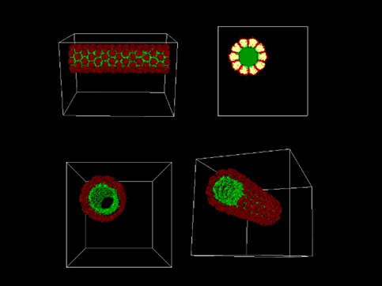
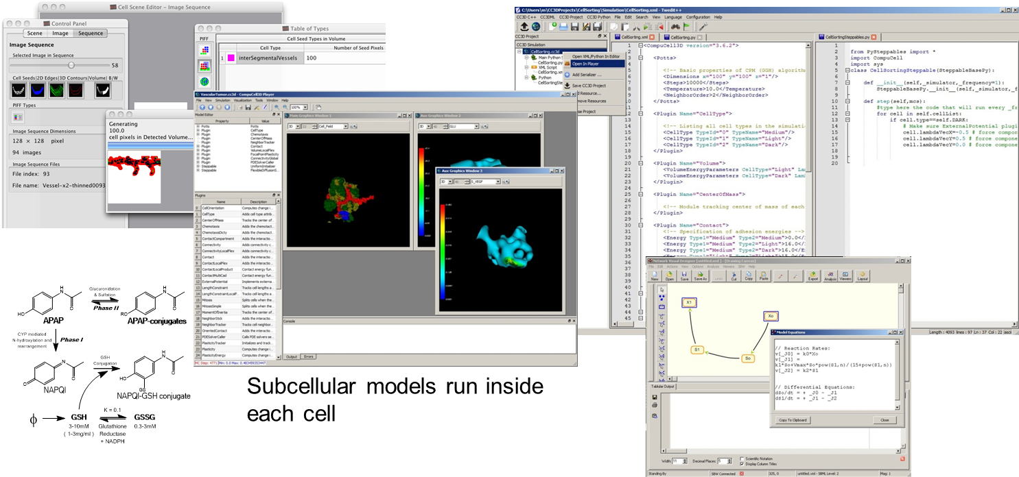
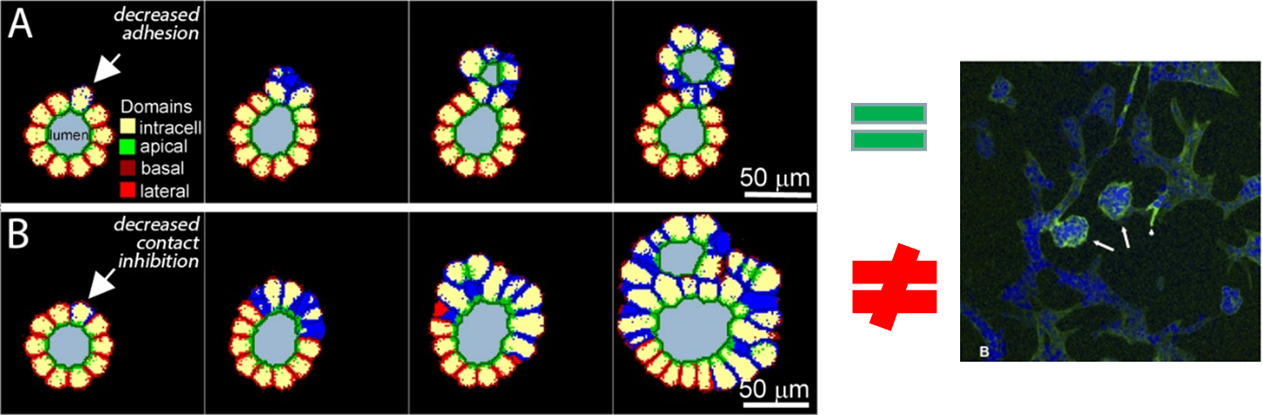
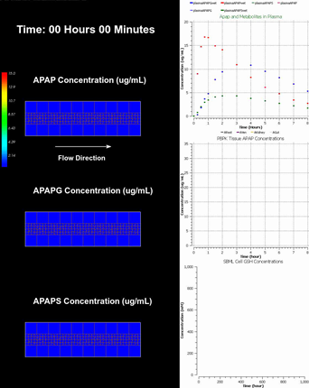
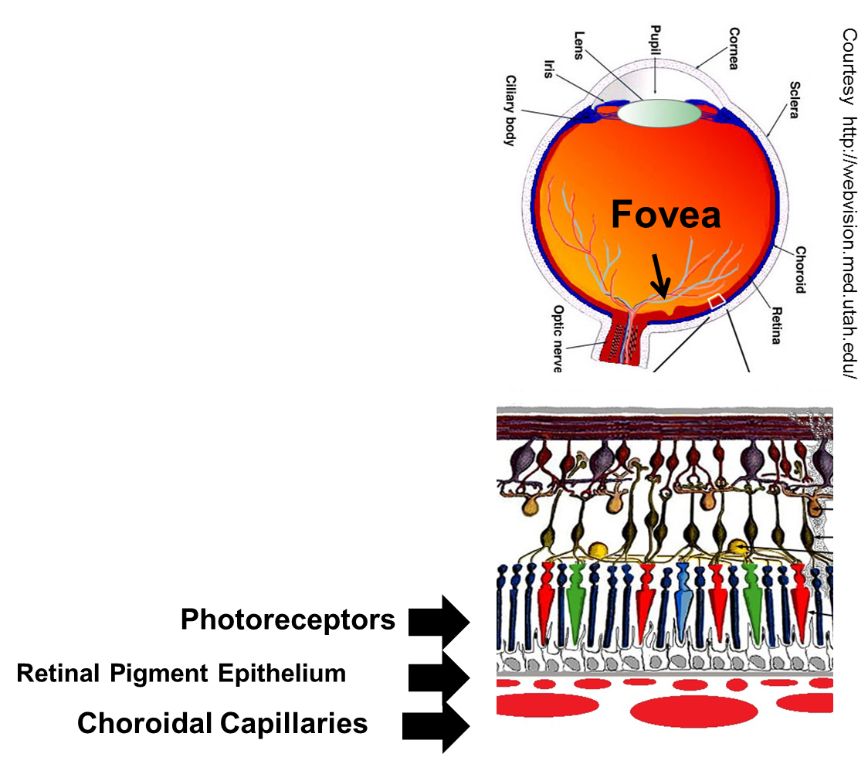
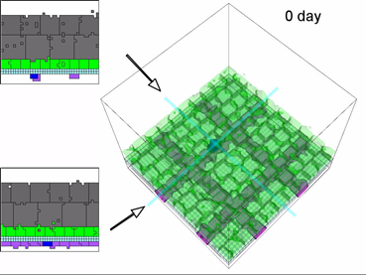
James Glazier—Simulation Tools and Models of Disease
CompuCell3D: Cross-platform, open-source environment for building and running Virtual-Tissue simulations
Models of Polycystic Kidney Disease for Drug Discovery
Virtual Liver Models of Drug Toxicity
Models of Retinopathies for Therapy Development

Slide 7
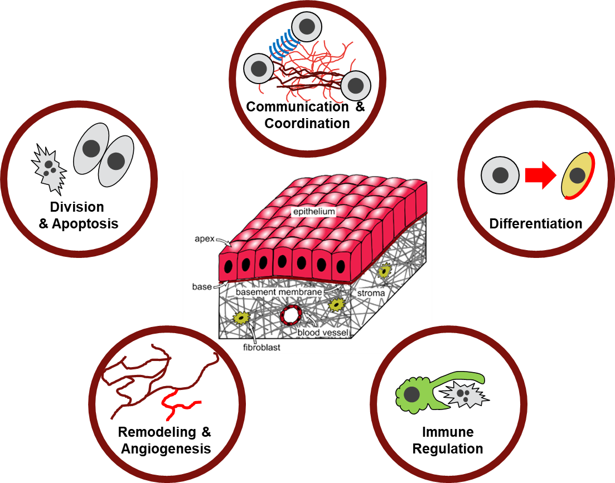
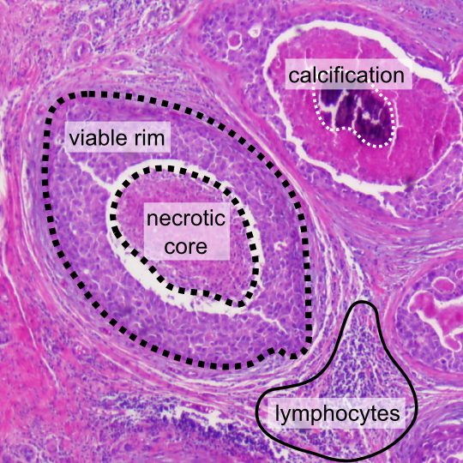
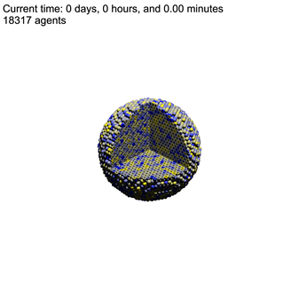
Paul Macklin: Cancer as Multicellular Systems Biology
Interconnected systems and processes:
Single-cell behaviors
Cell-cell communication
Physics-imposed constraints (e.g., diffusion)
Systems of systems (e.g., immune system)
In cancer many dysregulated
Treatments target one or more of these
Modeling can help understand this system
Cancer Immunology
Simulation
Notes:
Tissues, including cancer, are complex, self-organizing systems.
Cancer is a complex system – treatments perturb this complex system, results can be surprising
Classic example: anti-angiogenic therapy
Mechanistic simulations can help us get new insights

Slide 8
Paul Macklin: Tools for Multicellular Systems Biology
Simulate the biochemical microcroenvironment (BioFVM)
  10s to 100s of chemical substrates (O₂, glucose, drugs, signals, …)
  Primarily diffusion-dominated in tissues
Simulate interacting cells (PhysiCell)
  10⁵ or more cells
  Include signal-driven behaviors, subcell processes
Calibrate to and validate against data (CellPD)
Explore 100s or 1000s of simulations (EMEWS)
  Explore model behaviors
  See which hypotheses best match observations
  Test potential therapeutic strategies
  DESIGN cell modifications to ENGINEER multicellular behavior
Share data and knowledge (MultiCellDS)
  MultiCellDS for multicellular data (see MulticellDS.org)

Slide 9
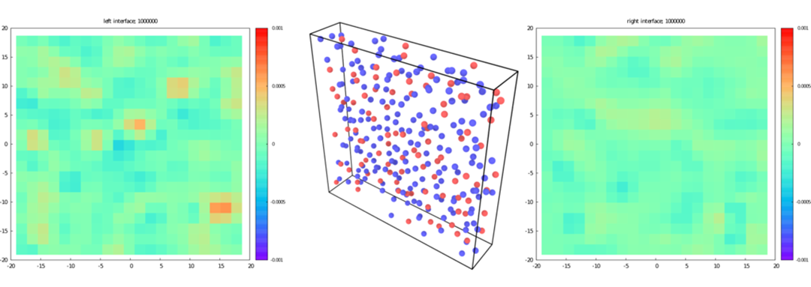
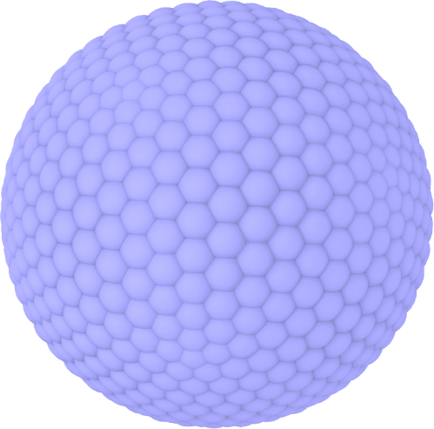
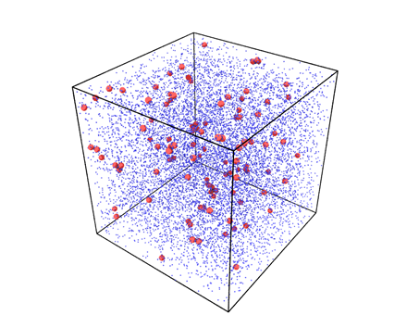
Self-Assembly of Ions in Nanoconfinement
Vikram Jadhao: Simulating Nanoscale Soft Materials
Jing, Jadhao, Zwanikken, and Olvera de la Cruz, JCP 143 194508 (2015)
20 nm
Self-Assembly of Virus NPs (Red) mediated by Dendrimer (Blue) Condensation
Jadhao, Thomas, and Olvera de la Cruz, PNAS 111, 12673 (2014)

Slide 10
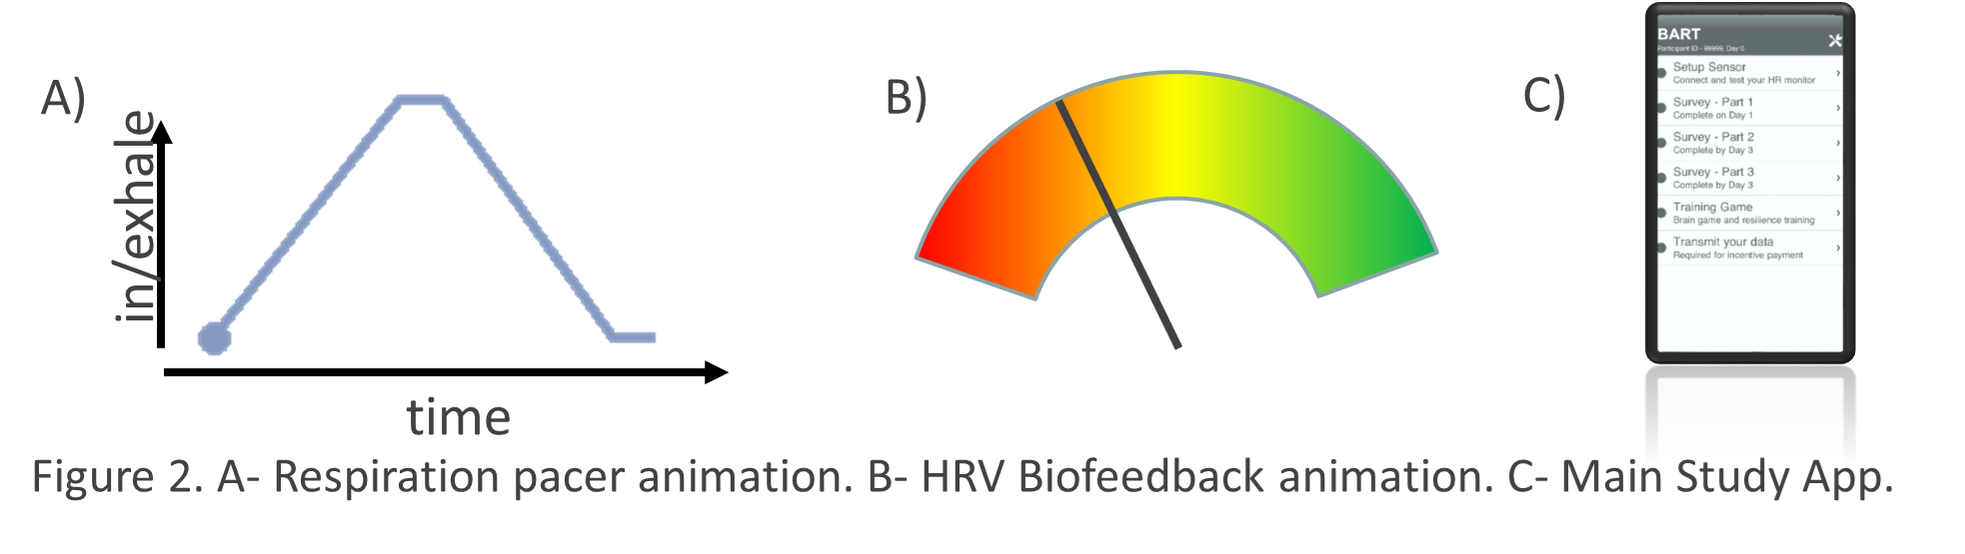
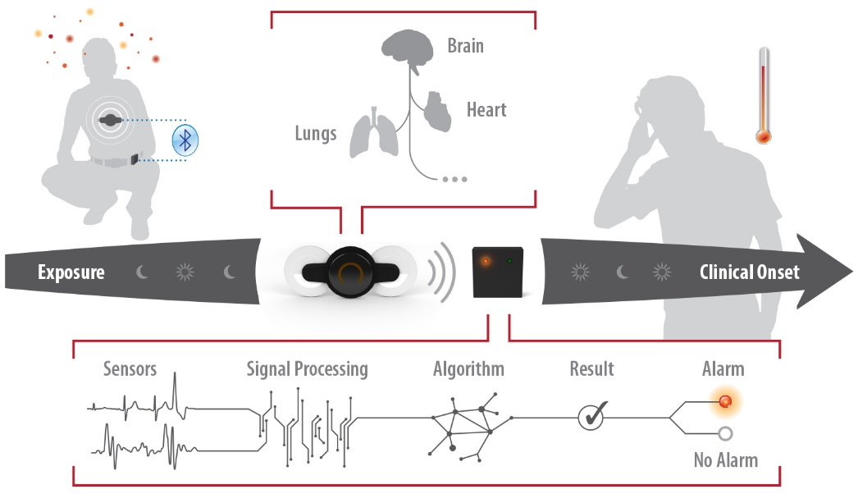
Gregory F. Lewis: Measuring the Brain-Body System
Heart rate variability reflects specific neurophysiological control mechanisms
I quantify dynamic cardiac regulation with wearable sensors in order to:
Train soldiers to increase their inhibitory (parasympathetic) control and improve psychological resilience
From the biofeedback app we give the soldiers
And diagnose infection through activity of the autonomic nervous system
Conceptual model of wearable platform performance

Slide 11
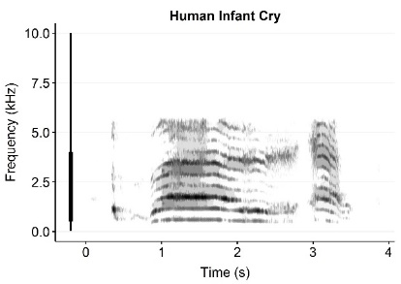
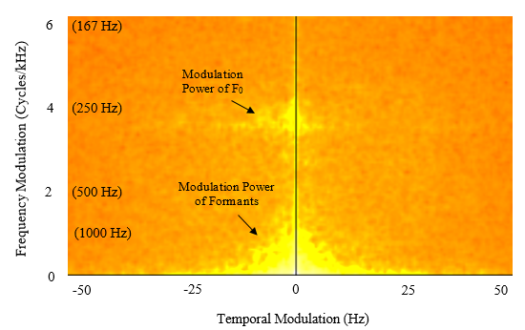
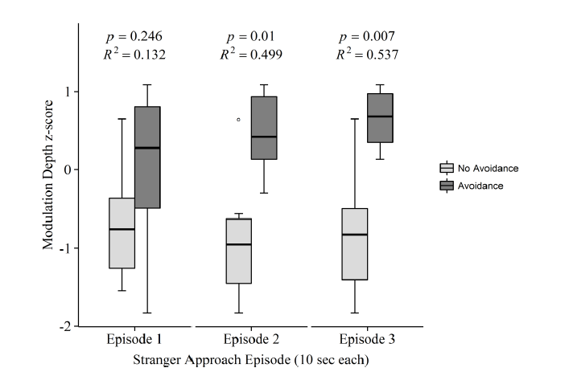
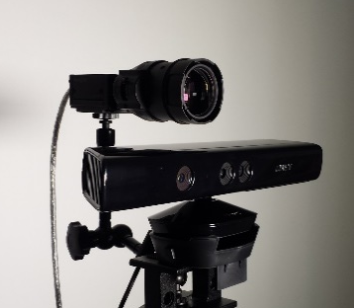
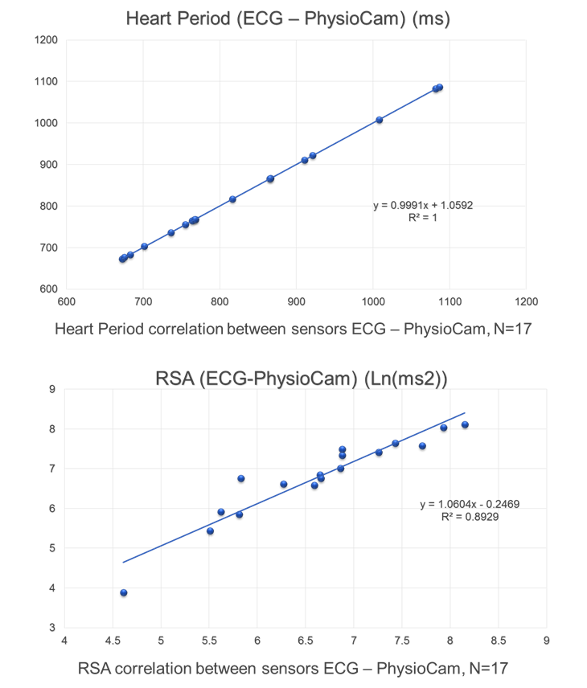

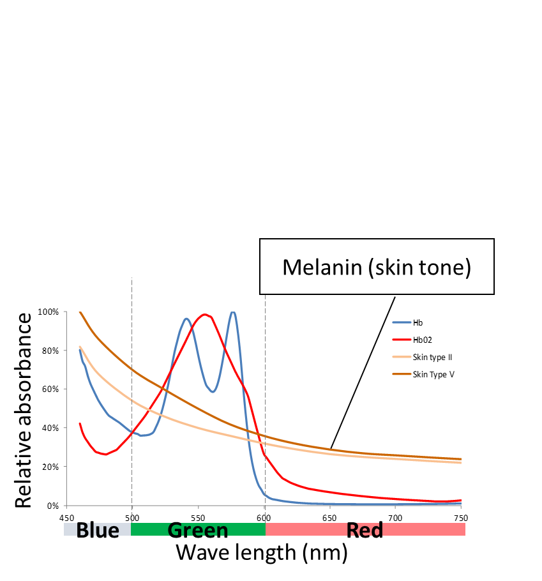
Gregory Lewis: Noncontact Measurement Techniques
Collaboration with Dr. Kolacz – postdoc at Kinsey Institute
Vagal regulation of vocalization
  Crying at 6-months → Social behavior at 24-months
Track health of the developing social nervous system
Vocalization
Feature Extraction
Behavioral Prediction
Methods adapted from Frederic Theunnisen (UC – Berkeley)
Modify operation of color video camera
Create real-time pulse monitor
Translational research at Kinsey Institute
www.kinseyinstitute.org
Our vision: To be the premier research institute on human sexuality and relationships
My goal: Use advances in sensing technologies to support the new Traumatic Stress Research Consortium (TSRC) at Kinsey. TSRC is an interdisciplinary and international group of scientists and clinicians who study the impact of trauma and abuse on mental health, physical health, relationships, and sexuality.
Lab based
Internet
Internet 2.0
Wearables
10s Subjects
Field based
100s Subjects
Voice
Camera
10,000s Subjects

Slide 12
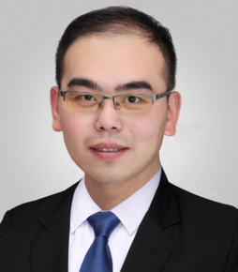
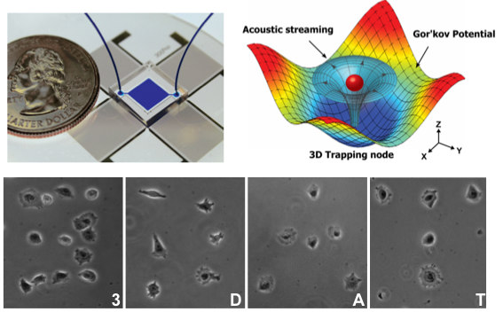
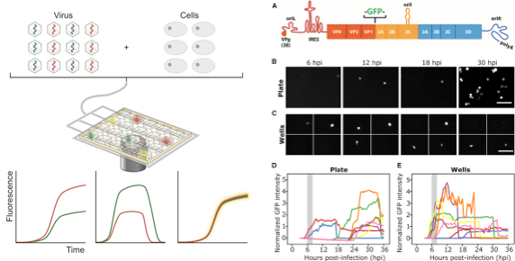

Feng Guo: Intelligent Biomedical Systems
Acoustic Tweezer Device
Mission----
Develop intelligent systems by integrating device, sensors, and robotics with informatics and computing to address problems in diagnostics and therapeutics.
Feng Guo, Ph.D.
17- : Assistant professor of Intelligent systems engineering, IU-Bloomington
16-17: Dean’s Postdoc Fellow
Stanford School of Medicine
11-15: PhD in Engineering Science Penn State University
Single Cell Virology Technology
Referenses:
F. Guo, et. al, Cell Reports, 2017
F. Guo, et. al, PNAS, 2016
F. Guo, et. al, PNAS, 2015
F. Guo, et. al, Small, 2015
F. Guo, et. al, Lab Chip, 2015

Slide 13
Endre Somogyi: Real-Time Interactive Simulation of Biological Materials and Processes
Cells: Dynamic Microenvironment
Cells interact via chemical and mechanical processes, create and respond to heterogeneous and dynamic environment
Components move, change shape and reorganize so cannot use standard FE mesh approaches—Solution: Dynamic finite-element data structure that supports runtime topological and structural mesh rearrangement
Model Description
https://mechanica.org

Slide 14
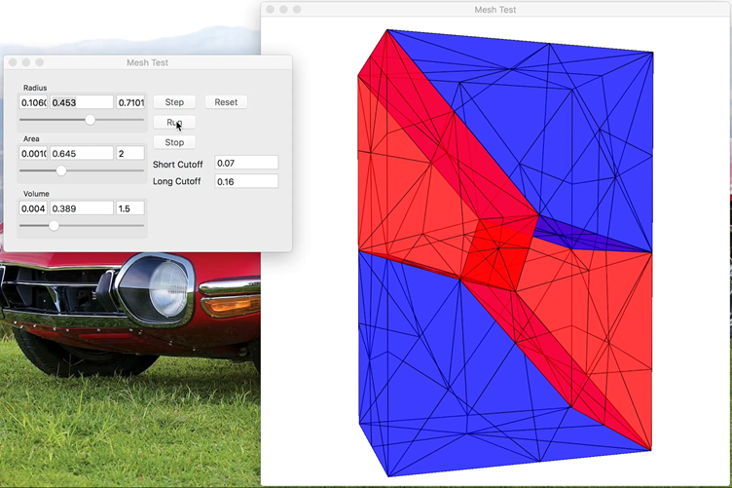
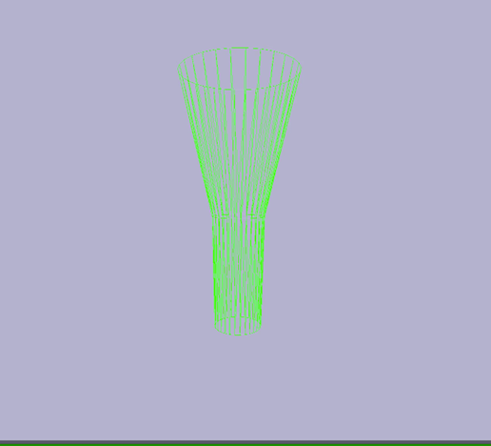
Endre Somogyi: Real-Time Simulation
Cells in tissues share geometric boundaries
Dynamic adaptive mesh refinement

Slide 15
Intelligent Workflow for Engineering Health
To understand/regulate/fix/engineer we must be able to predict
Continuous Measurement
State Inference/ Diagnosis
Predictor/Corrector Evolver
Delivery of Intervention
Individual/Patient
Predictive Virtual Individual/Avatar
Forecast/Prognosis
Physician
Selection of Intervention
Evaluation of Possible Interventions/Treatments

Slide 16
Possible Collaboration Areas
Health Monitoring—Imaging, Implantable and Wearable Sensors
Data Analysis and Reduction
Predictive Virtual Individuals (Simulations and in Vitro Tissue Samples/Organ on a Chip)
Health Delivery Workflows and Infrastructure for Delivery
Parallel Design of Intervention Analysis
Approaches to Evolving Simulations and Workflows to respond to experience in use
Improved delivery systems including tissue engineering, synthetic biology, implants,…

