Slide 1
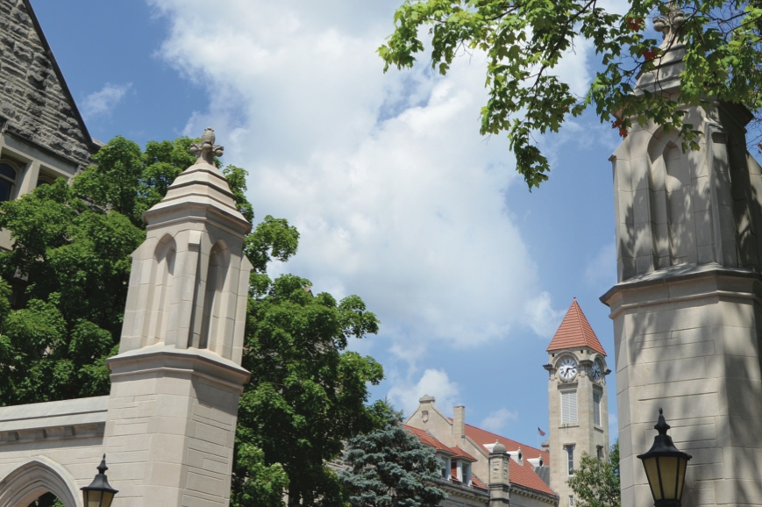
Indiana University School of Informatics, Computing and Engineering ISE: Intelligent Systems Engineering

Slide 2
What is Intelligent Systems Engineering?
We define “Intelligent Systems” as purpose-engineered systems
from the raw hardware and embedded systems,
through data acquisition and signal processing
to the transformation of data into decisions and/or knowledge.
Creating a new program ab initio offers us the opportunity to focus on a modern set of engineering topics:
those that involve intelligent systems
as realized with embedded, customizable computing components
combined with sophisticated data interpretation
This program will train students in the practical engineering of systems with an emphasis on hands-on designing, simulating (“digital twin”) and building systems. Graduates prepared with this core set of workforce-aligned skills will be in high demand for careers.

Slide 3
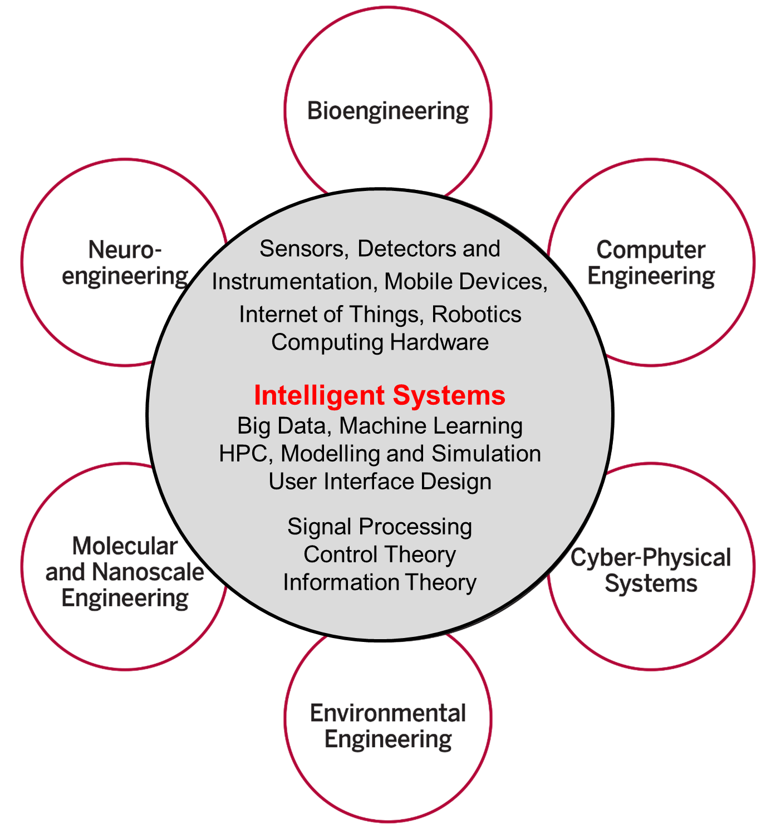
Intelligent Systems Engineering Structure

Slide 4
What is Intelligent Systems Engineering?
From the small to the large
Edge Computing: Embedded Systems and Nanoscale Sensors – computing and sensing will be ubiquitous as we move toward smart homes, smart cities and smart transportation, with computing and intelligent systems helping us lead healthier lives
Cloud and High-Performance computing – behind all of these edge devices are massive systems that analyze and manage the floods of data that are being produced
They also allow modeling and simulation of the engineered systems
All students have courses on edge, cloud, HPC systems, machine learning and modelling and simulation

Slide 5
Intelligent Systems ~ Artificial Intelligence ~ Machine Learning
2017 Headlines
The Race For AI: Google, Twitter, Intel, Apple In A Rush To Grab Artificial Intelligence Startups
Google, Facebook, And Microsoft Are Remaking Themselves Around AI
Google: The Full Stack AI Company
Bezos Says Artificial Intelligence to Fuel Amazon's Success
Microsoft CEO says artificial intelligence is the 'ultimate breakthrough'
Tesla’s New AI Guru Could Help Its Cars Teach Themselves
Netflix Is Using AI to Conquer the World... and Bandwidth Issues
How Google Is Remaking Itself As A “Machine Learning First” Company
If You Love Machine Learning, You Should Check Out General Electric
The trouble for all of these companies is that finding the talent needed to drive all this AI work can be difficult. (That is where ISE comes in!)
Notes:
until ISE came along

Slide 6
Intelligent Systems Engineering Areas of Study
Undergraduate and Graduate
Computer engineering
Cyber-physical systems
Bioengineering
Nano-engineering
Graduate (Masters, PhD) Only
Environmental engineering
Neuro-engineering
Intelligent systems (base ISE degree)

Slide 7
Structure of ISE Undergraduate Degree
Total 120 credits of which 69 are Engineering
University General Education: 21 credits
University Math and Science: 30 credits
Intelligent Systems Engineering core taken by all tracks: 30 credits
CE/CPS core taken in CE and CPS: 15 credits
CE Track: 18 Credits
CPS Track: 18 Credits
Engineering Electives: 6 Credits
Bio/Nano differ first in semester 4 with advanced Chemistry course
There are separate ISE Nano and ISE Bio cores of 15 credits in third year
There are separate Nano and Bio tracks of 18 credits in third and fourth year

Slide 8
Typical Degree Map - CE
Eng Innovation and Design (E101)
Eng Computer Architectures (E110)
Computer Systems Engineering (E201)
Eng Cyber-Physical Systems (E210)
English Comp
Software Systems Engineering (E111)
Intelligent Systems Engineering I (211)
Intelligent Systems Engineering II (E222)
Calculus I
Calculus II
Professionalization and Ethics (E299 & E395)
Signal Processing (E250)
Physics I
Physics II
Statistics
Differential Eqn
Science Elective
Arts&Humanities
Digital Design with FPGA’s (E315)
Intro to Modeling and Simuation(E332)
Eng Capstone Design (E490)
Eng Capstone Design (E491)
Advanced Eng Mathematics (E331)
Circuits and Digital Systems (E311)
Operating Systems (E316)
Cloud Computing Eng (E416)
Modern Computer Arch (E312)
High Performance Computing (E317)
Network Eng (E318)
Deep Learning (E433)
Math/Sci Elective
Engr Elective
Engr Elective
Sci&Humanities
Language/Culture
Language/Culture
Sci&Humanities
Arts&Humanities

Slide 9
Accreditation and Funding Opportunities
Accreditation Information
The curriculum has been designed to meet the ABET requirements.
SICE can apply for accreditation after the first graduating class, which means that the first cohort of graduates’ degrees will be accredited.
SICE will seek retroactive accreditation
The B.S. in Intelligent Systems Engineering is a degree from Indiana University; it is an accredited degree
IU holds North Central Association accreditation
Scholarship Information
IU/SICE/ISE
Other Funding Opportunities
Summer Camps
Summer and Academic Year Research

Slide 10
19 Faculty in ISE
Raj Acharya; CE, Intelligent Systems: Dean of SICE
Associate Dean for Engineering (advertised)
Geoffrey Fox; Chair, CPS, Intelligent Systems
Martin Swany; Associate Chair, CE, CPS
Katy Borner; Intelligent Systems
James Glazier; Bio-engineering, Bio-complexity
Judy Qiu; CE, Intelligent Systems
Thomas Sterling; CE, CPS
Clint Whaley; CE
Lei Jiang; CE
Minje Kim; Intelligent Systems
Vikram Jadhao; Computational Nanoengineering
Alexander Gumennik; Nanoengineering
Eleftherios Garyfallidis; Neuroengineering
Maria Bondesson-Bolin; Bioengineering
Paul Macklin, Bioengineering:
Lantao Liu; CPS, Env
Eatai Roth; Neuro, CPS
Greg Lewis; Bio, CPS:
Feng Guo; Bio, Nano

