Slide 1
Introduction to Intelligent Systems Engineering E500 - I
Cyberinfrastructure Clouds HPC and a little Physics
Geoffrey Fox August 28, 2017
gcf@indiana.edu
http://www.dsc.soic.indiana.edu/, http://spidal.org/ http://hpc-abds.org/kaleidoscope/
Department of Intelligent Systems Engineering
School of Informatics, Computing, and Engineering
Digital Science Center
Indiana University Bloomington

Slide 2
Introduction and History

Slide 3
My Motivation for Research
Try to understand things and in particular try to understand how and why computers are useful
Started as an undergraduate with summer research
As a beginning PhD student, my supervisor told me “Geoffrey: nobody looks at data”
So I learnt particle physics theory so I could do high quality data analysis
  Build models
  Collect together data
  Fit models to data
  Called Phenomenology in those days but today might be called Data Science

Slide 4
Phenomenology 1970
Note this branch of physics – like some but not all fields – produces data which is essentially impossible to calculate but there are many underlying ideas that need to be respected in interpretation.
Characteristic of much of today’s big data
The basic tool of the phenomenologist is, first, the construction of simple models that embody important theoretical ideas, and then, the critical comparison of these models with all relevant experimental data.
It follows that a phenomenologist must combine a broad understanding of theory with a complete knowledge of current and future feasible experiments in order to allow him or her to interact meaningfully with both major branches of a science.
The impact of phenomenology is felt in both theory and experiment. Thus it can pinpoint unexpected experimental observations and so delineate areas where new theoretical ideas are needed. Further, it can suggest the most useful experiments to be done to test the latest theories. This is especially important in these barren days where funds are limited, experiments take many "physicist-years" to complete, and theories are multitudinous and complicated.

Slide 5

Fermilab E110 Multiparticle Spectrometer
Highlights of the reaction π⁻p→π⁻π⁺n at 100 and 175 GeV/c
Nuclear Physics B232 (1984) 189-235 Cited by (only) 5

Slide 6
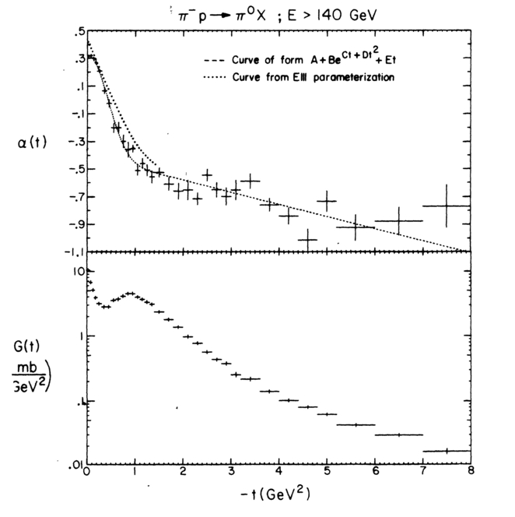
E350: Triple Regge Data
Data taken at Fermilab around 1976
Striking but not really understood
Lots of modest (100 - 10,000 data points) optimization problems (10-100 model parameters) to fit model and data

Slide 7
More Erratic Success in Projects
Success: Worked with Feynman on making models for particle physics experiments but left area
Success Worked with Wolfram on model-independent measures of “event shapes” but left area
  Observables for the analysis of event shapes in e+ e− annihilation and other processes 1259 citations
Worked with Wolfram on SMP – forerunner of Mathematica funded by my grant. A success for world but I left area
Realized parallel computers would work on computational physics after physics colloquium by Carver Mead explained why parallel hardware inevitable
Set up an application consortium developing codes and a collaboration with Caltech Computer Science and JPL to build machines
A success but funding such interdisciplinary work is a major challenge as is building hardware and software – still true!!

Slide 8
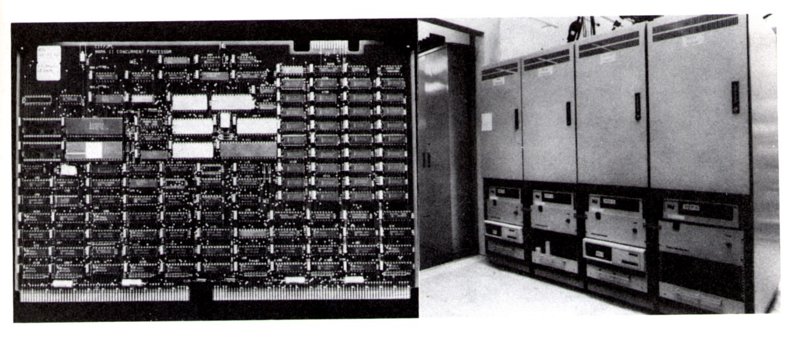
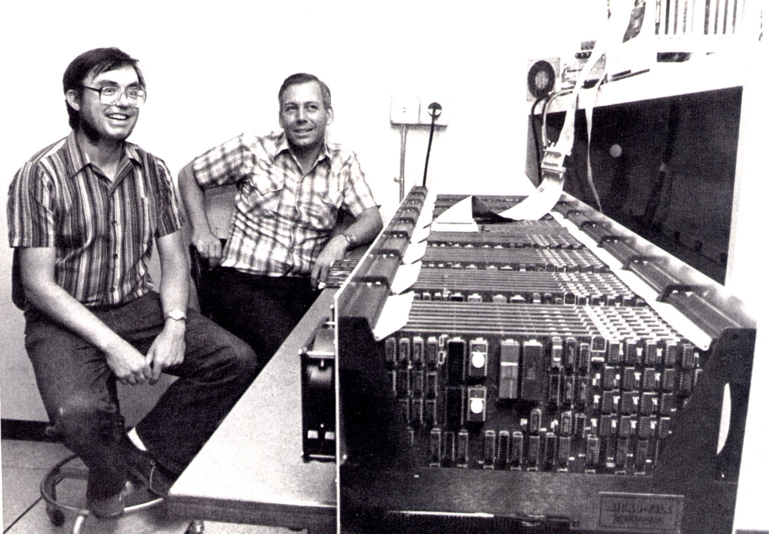
Caltech Hypercube
NASA JPL Mark II 1985
Chuck Seitz 1983
One of the first
successful
parallel
computers
(initially 64-128
simultaneous
CPU’s)

Slide 9
Principles of Interdisciplinary work?
It is essential
NSF never gives lots of money to one place (as I had at Caltech from DoE)
Need to work with ~best people in a given field
  Not so easy to identify
  Best people willing to work with you are rarely at your home institution so need lots of travel
We should try to build interdisciplinary collaborations in Intelligent Systems Engineering

Slide 10
Extending studies of Parallel Computing
Original work in parallel computing nationally was all simulation oriented
Study of industry identified need for data intensive applications
A ~failed project InfoMall tried to do this but probably before its time
Had similar structure to Internet / web 2.0 today
Did put a lot of effort into messaging systems (Naradabrokering.org) and applications to synchronous distance education
We built good collaboration technology but WebEx, Adobe Connect etc. now do this
  The quality of Internet around 1997 was not very good
I did correctly identify where good to use and built up strong contacts with Minority Serving Institutions
I taught many classes to MSI’s

Slide 11
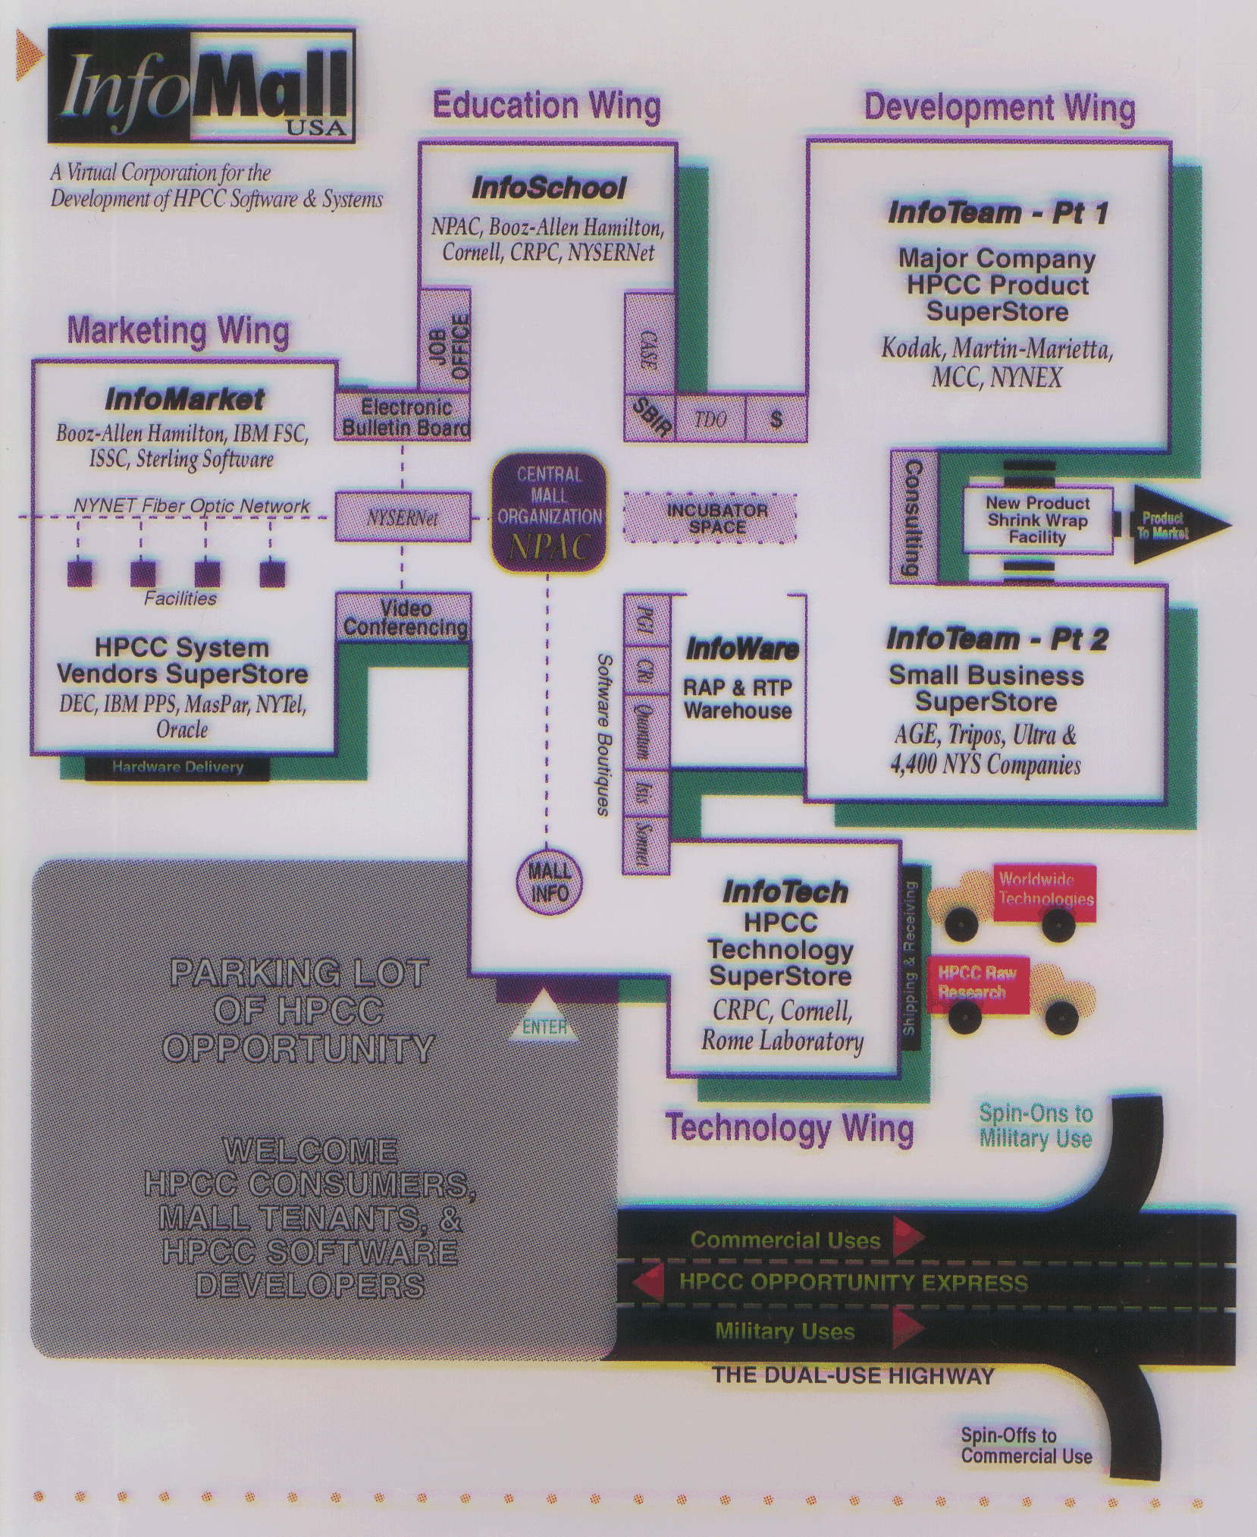
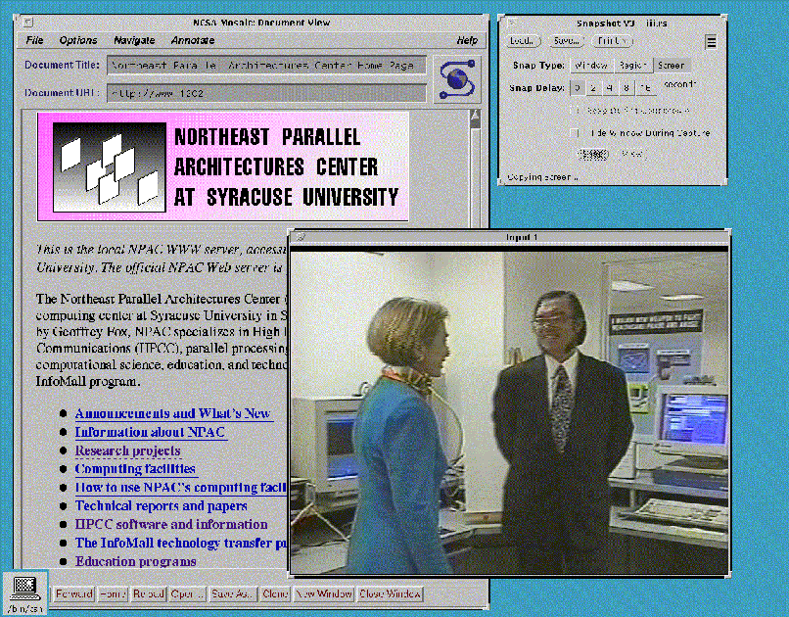
InfoMall and Partners 1995 virtual corporation
April 1994
Telemedicine

Slide 12
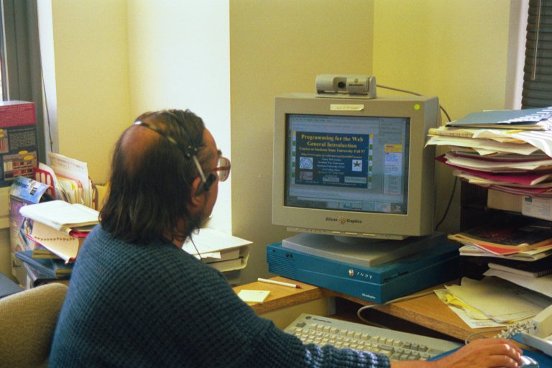
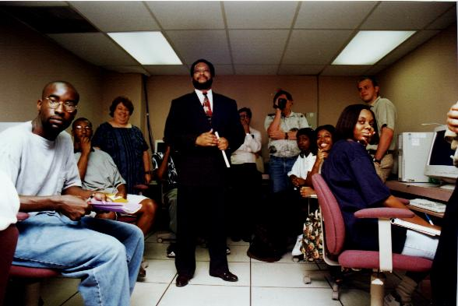
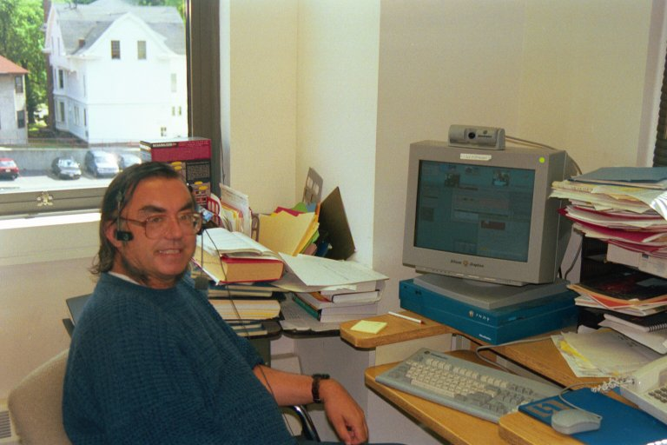
Teaching Jackson State Fall 97 to Fall 2001
JSU
Syracuse

Slide 13
What does ISE cover?
Intelligent Systems: Systems often present traditional
Data ….. Information ….. Knowledge pipeline
  where engineered hardware gathers data and they are converted to information. The intelligent system converts information to knowledge and is essential in a complete engineered system.
  An example is self driving cars (drones) where lidar, camera, ultrasonic sensors use deep learning (intelligent system) for auto-pilot
  Here ISE instruction includes machine-learning and clouds
Cyber-physical Systems: this refers to areas like robotics and the Internet of Things IoT where 50 billion things are predicted by 2020. Many reports on Smart X (X=Cities to vehicles) are built on IoT
  This includes embedded systems, streaming data driven control
Modelling and Simulation: Several ISE fields involve increasing use of modelling and simulation as in nano (materials genome), bio (virtual tissue, molecular dynamics), CE (new computer designs) ….
  Graduate and undergraduate modules being developed

Slide 14
Parallel and Distributed Computing as Systems I
ISE has “systems” part of computer science and usually systems are built of parts but those parts have different characteristics in different ISE areas
Parallel computing is very special – you make the parts from a problem specified as whole
  You divide world up into patches in order to simulate weather or climate
  You divide data and cluster centers into parts in order to do clustering of points
  The parts can be heterogenous in properties but are homogenous in style e.g. in weather, only has mesh points but the mesh points are much closer together and varying rapidly for the tornado
In distributed computing, the parts are given to you and as distributed are automatically separated; often parts have totally different functions
  The robot and the backend cloud have very different functions
Both parallel and distributed systems can be large (you are use billions of mesh points and there are 20 billion thing in IoT)

Slide 15
Parallel and Distributed Computing as Systems II
One is tempted to use same ideas and software for both parallel and distributed systems but often constraints are different
  Parallel computing needs microsecond latency but
  Distributed systems are milliseconds (light takes 5ms to travel 1000 miles) by construction
One can decompose by sharding (chopping up a set of data) or by function (clean up data, cluster, visualize)
  Sharded parts are closely connected; functional parts loosely connected/synchronized
Note on general principles, amount of communication (interaction) with outside world decreases as dimension decreases and as size increases (see next slide)
One typically optimizes performance or ease of use modulated by cost.

Slide 16
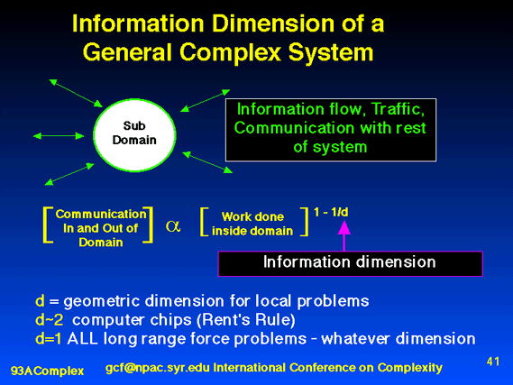

Slide 17
Systems Research Components
Applications
Algorithms
Systems Software
Hardware
These components have different characteristics
Wide range of application fields (hard to get data, very difficult to have field specific intuition)
Algorithms sometimes come from application people and sometimes from ISE; they can be application specific or generic
There is a software “stack”
Geography: Local (to a cluster), Distributed or Streaming Data/computing have different timing requirements and possibilities ranging from microseconds to many milliseconds
Problem structure affects software and hardware
Hardware is IoT style and/or Cluster and/or distributed

Slide 18
Cyberinfrastructure and Its Application
Cyberinfrastructure Day
Salish Kootenai College, Pablo MT
August 2 2011

Slide 19
Important Trends as of August 2011
Data Deluge in all fields of science
Multicore implies parallel computing important again
  Performance from extra cores – not extra clock speed
  GPU enhanced systems can give big power boost
Clouds – new commercially supported data center model replacing compute grids (and your general purpose computer center)
Light weight clients: Sensors, Smartphones and tablets accessing and supported by backend services in cloud
Commercial efforts moving much faster than academia in both innovation and deployment

Slide 20
Big Data in Many Domains
According to one estimate, we created 150 exabytes (billion gigabytes) of data in 2005. In 2010, we created 1,200 exabytes
Enterprise Storage sold in 2010 was 15 Exabytes; BUT total storage sold (including flash memory etc.) was 1500 Exabytes
Size of the web ~ 3 billion web pages: MapReduce at Google was on average processing 20PB per day in January 2008
During 2009, American drone aircraft flying over Iraq and Afghanistan sent back around 24 years’ worth of video footage
  http://www.economist.com/node/15579717
  New models being deployed this year will produce ten times as many data streams as their predecessors, and those in 2011 will produce 30 times as many
~108 million sequence records in GenBank in 2009, doubling in every 18 months
~20 million purchases at Wal-Mart a day
90 million Tweets a day
Astronomy, Particle Physics, Medical Records …
Most scientific task shows CPU:IO ratio of 10000:1 – Dr. Jim Gray
The Fourth Paradigm: Data-Intensive Scientific Discovery
Large Hadron Collider at CERN; 100 Petabytes to find Higgs Boson
Notes:
For each category, give examples, e.g. Astronomy solon 20 TB night,
http://www.datacenterknowledge.com/archives/2009/12/22/the-data-crunching-powerhouse-behind-avatar/

Slide 21
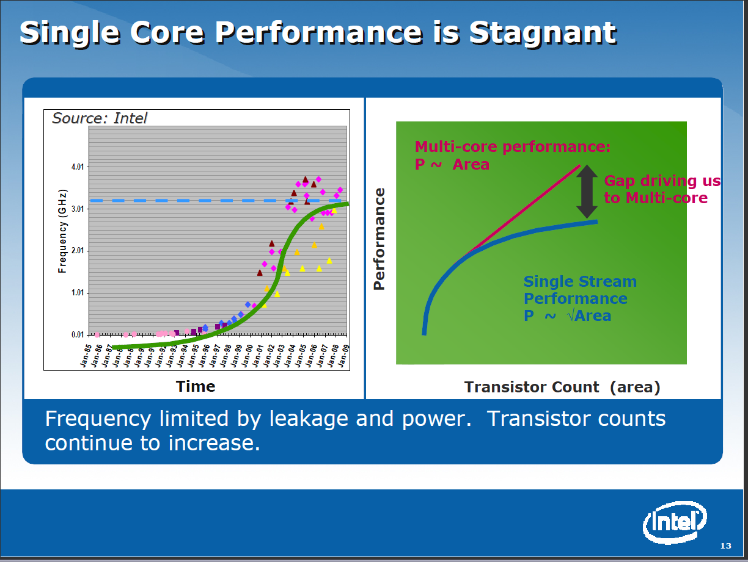

Slide 22
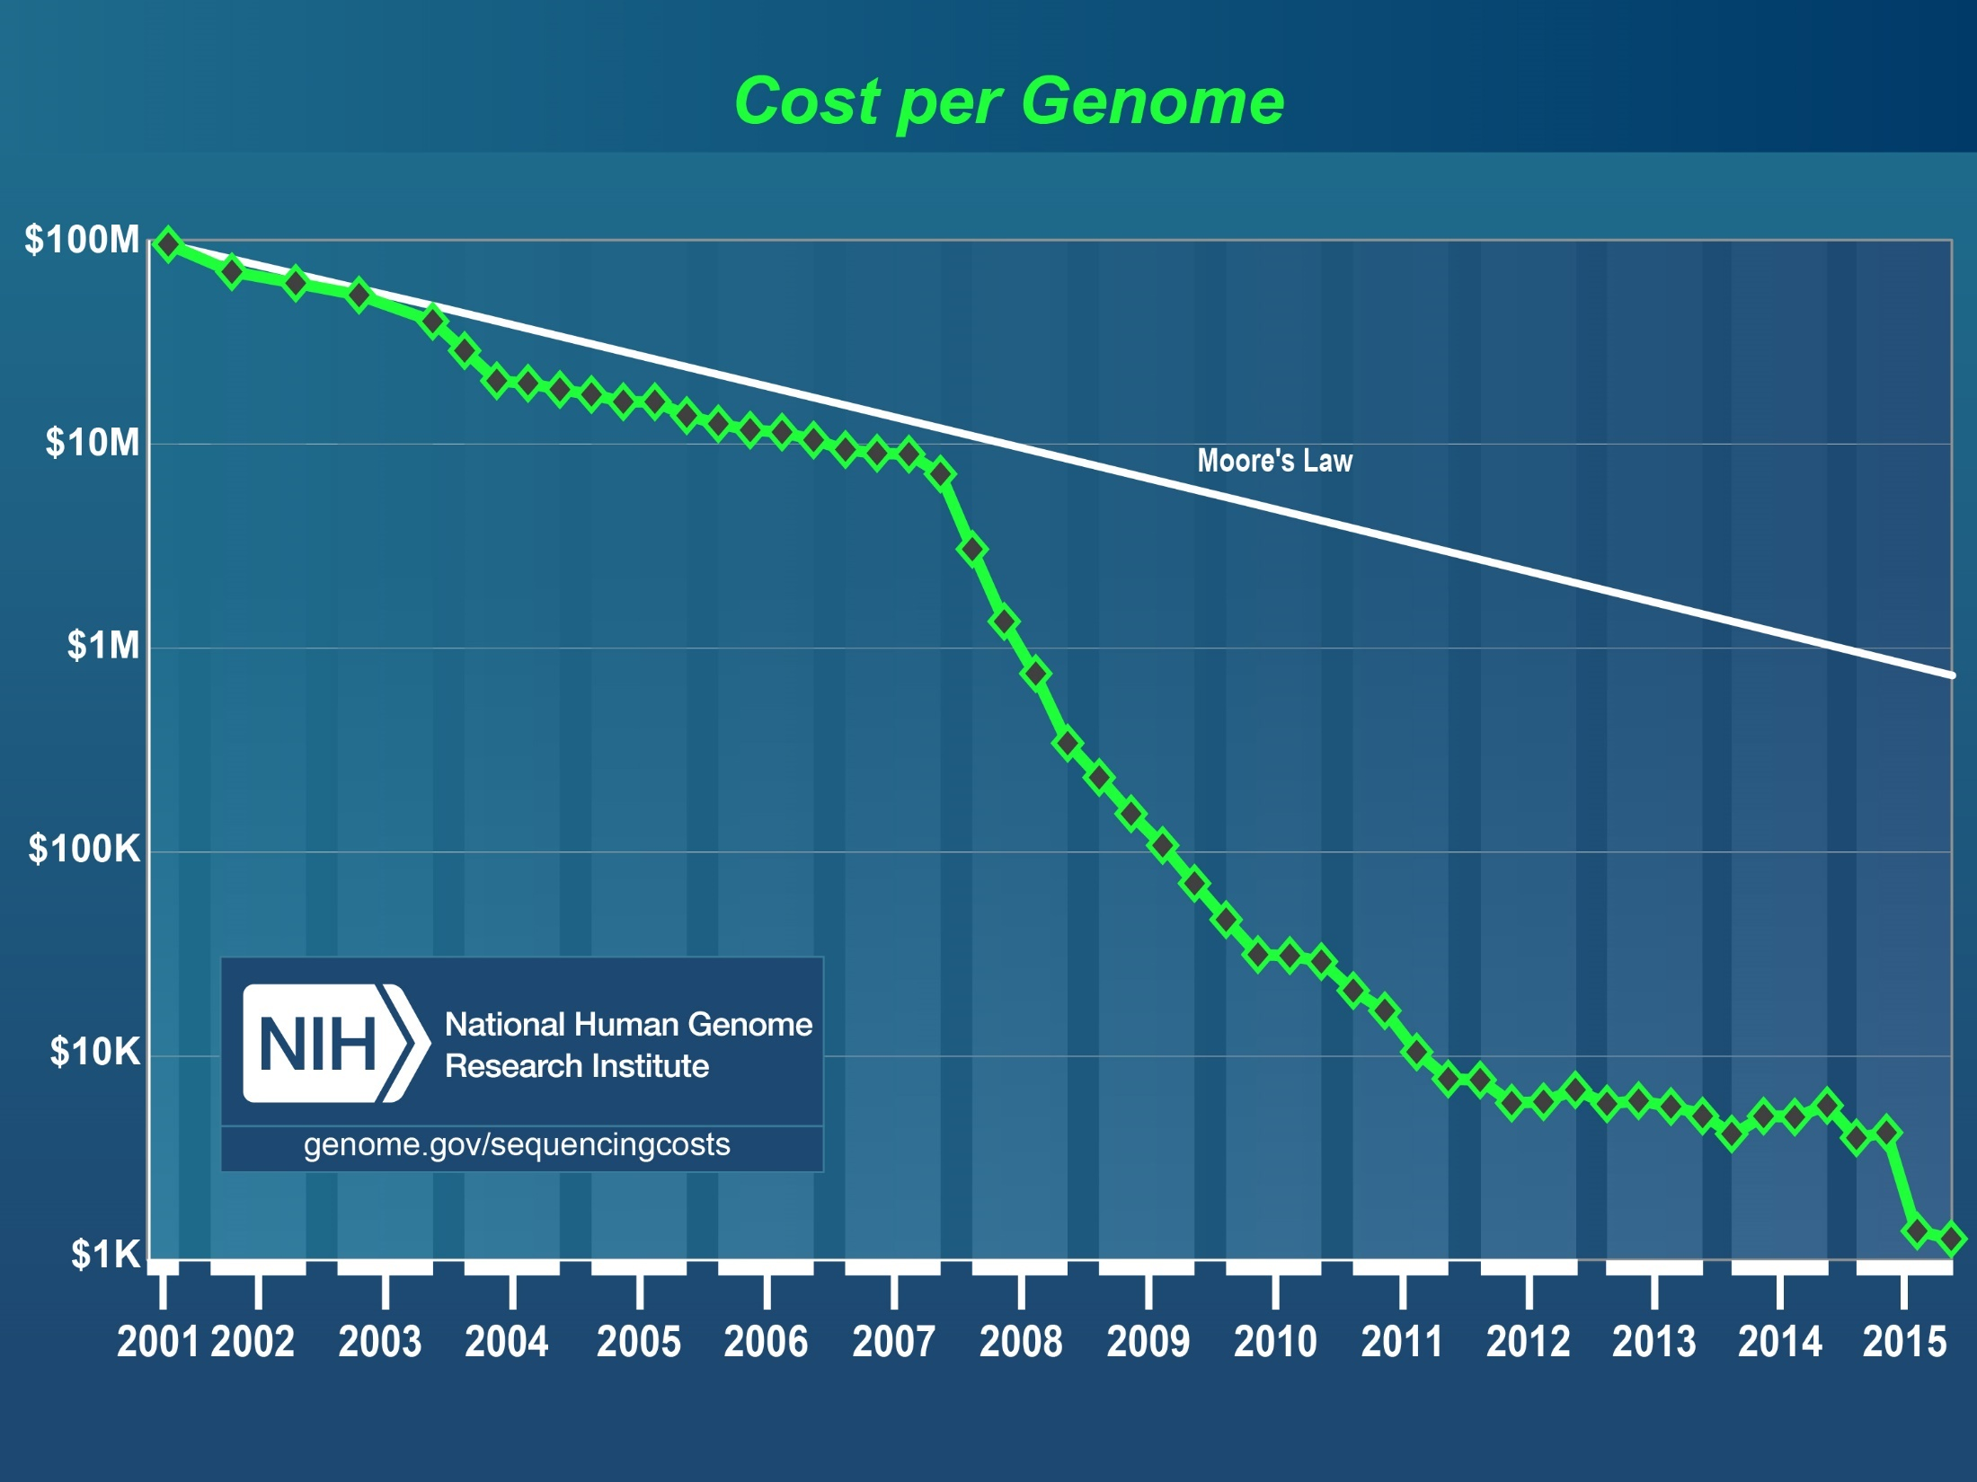

Slide 23
What is Cyberinfrastructure
Cyberinfrastructure is (from NSF) infrastructure that supports distributed research and learning (e-Science, e-Research, e-Education)
  Links data, people, computers
Exploits Internet technology (Web2.0 and Clouds) adding (via Grid technology) management, security, supercomputers etc.
It has two aspects: parallel – low latency (microseconds) between nodes and distributed – highish latency (milliseconds) between nodes
Parallel needed to get high performance on individual large simulations, data analysis etc.; must decompose problem
Distributed aspect integrates already distinct components – especially natural for data (as in biology databases etc.)
Notes:
23

Slide 24
e-moreorlessanything
‘e-Science is about global collaboration in key areas of science, and the next generation of infrastructure that will enable it.’ from inventor of term John Taylor Director General of Research Councils UK, Office of Science and Technology
e-Science is about developing tools and technologies that allow scientists to do ‘faster, better or different’ research
Similarly e-Business captures the emerging view of corporations as dynamic virtual organizations linking employees, customers and stakeholders across the world.
This generalizes to e-moreorlessanything including e-DigitalLibrary, e-FineArts, e-HavingFun and e-Education
A deluge of data of unprecedented and inevitable size must be managed and understood.
People (virtual organizations), computers, data (including sensors and instruments) must be linked via hardware and software networks
Notes:
24

Slide 25
The Span of Cyberinfrastructure
High definition videoconferencing linking people across the globe
Digital Library of music, curriculum, scientific papers
Flickr, Youtube, Amazon ….
Simulating a new battery design (exascale problem)
Sharing data from world’s telescopes
Using cloud to analyze your personal genome
Enabling all to be equal partners in creating knowledge and converting it to wisdom
Analyzing Tweets…documents to discover which stocks will crash; how disease is spreading; linguistic inference; ranking of institutions

Slide 26
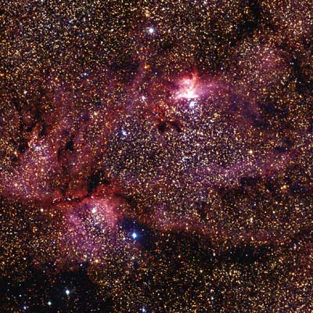
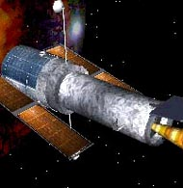
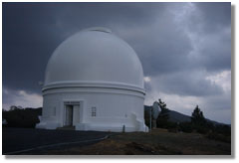
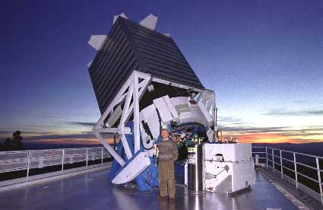
Tracking the Heavens
“The Universe is now being explored systematically, in a panchromatic way, over a range of spatial and temporal scales that lead to a more complete, and less biased understanding of its constituents, their evolution, their origins, and the physical processes governing them.”
Towards a National Virtual Observatory
Hubble Telescope
Palomar Telescope
Sloan Telescope

Slide 27
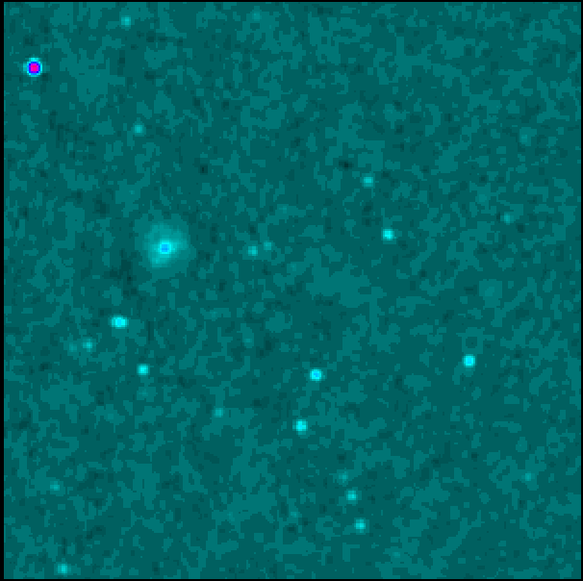
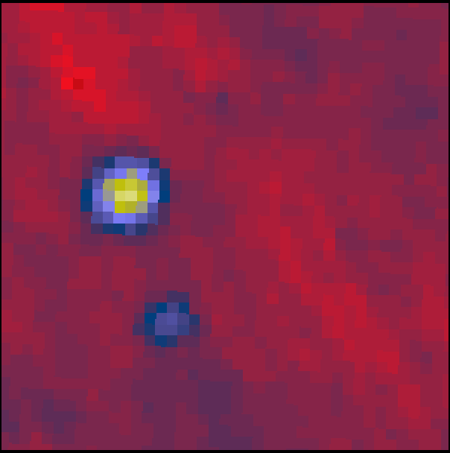
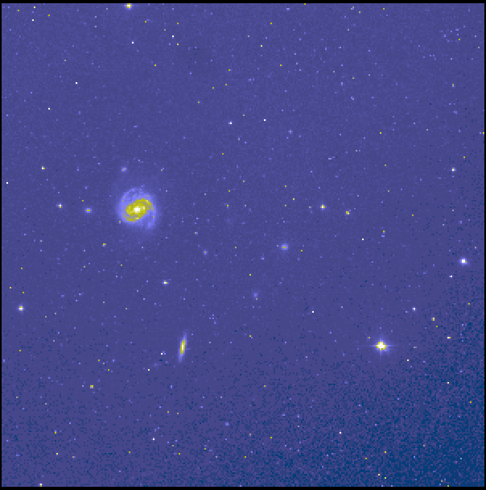
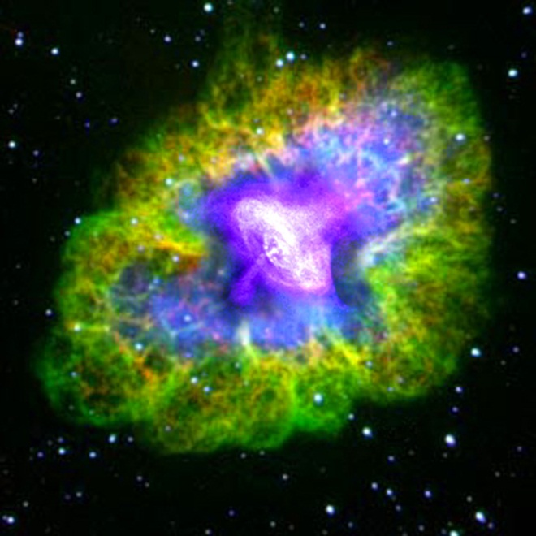
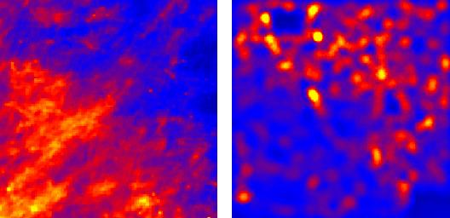
Virtual Observatory Astronomy Grid
Integrate Experiments
Radio
Far-Infrared
Visible
Dust Map
Visible + X-ray
Galaxy Density Map

Slide 28

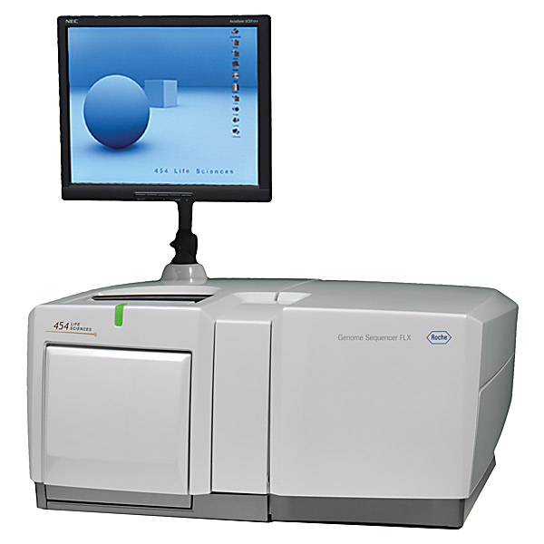
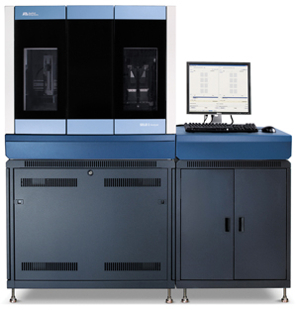
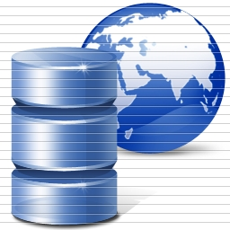
DNA Sequencing Pipeline
Illumina/Solexa Roche/454 Life Sciences Applied Biosystems/SOLiD
Internet
~300 million base pairs per day leading to
~3000 sequences per day per instrument
? 500 instruments at ~0.5M$ each
Read Alignment
Pairwise
clustering
Form block
Pairings
Sequence
alignment
Dissimilarity
Matrix
N(N-1)/2 values
Visualization
Plotviz
FASTA File
N Sequences
Blocking
MPI
MDS
MapReduce

Slide 29
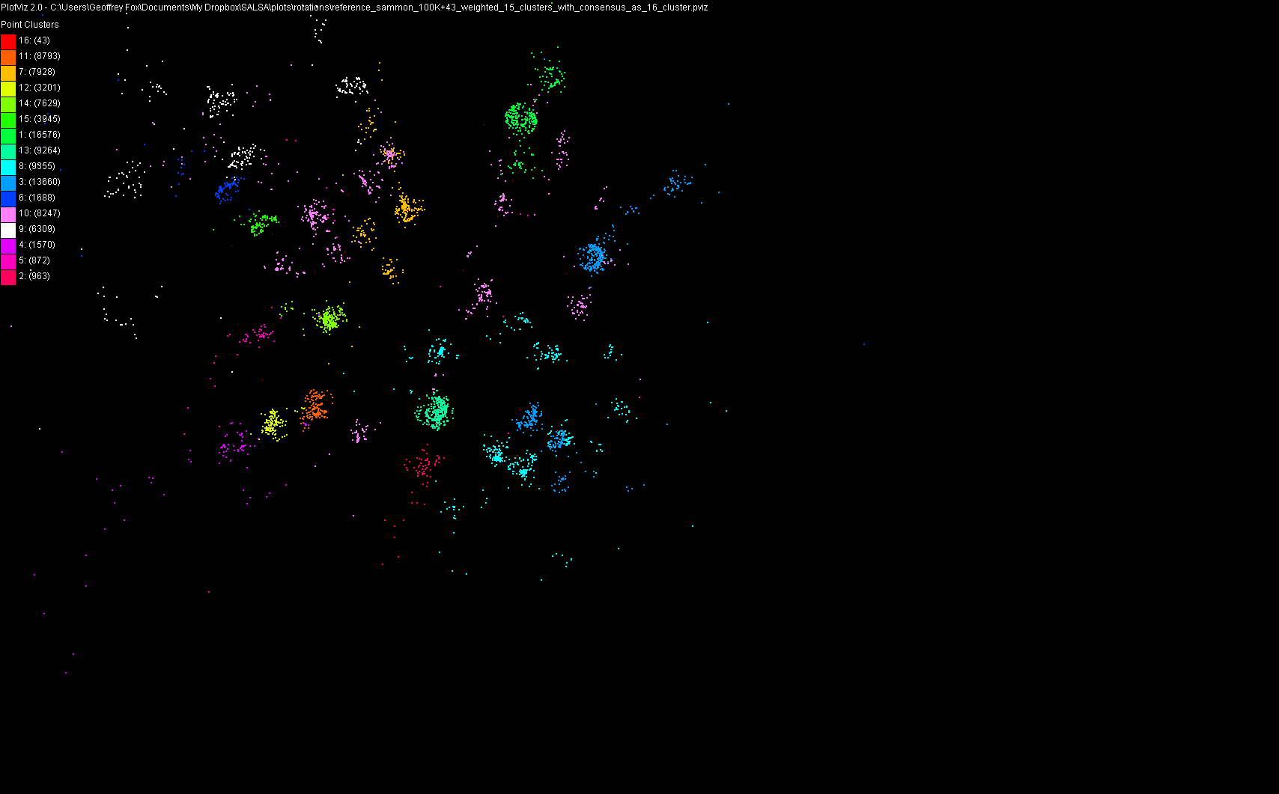
100,043 Metagenomics Sequences

Slide 30
Lightweight Cyberinfrastructure to support mobile Data gathering expeditions plus classic central resources (as a cloud)

Slide 31



Data Centers Clouds &
Economies of Scale I
Range in size from “edge” facilities to megascale.
Economies of scale
  Approximate costs for a small size center (1K servers) and a larger, 50K server center.
2 Google warehouses of computers on the banks of the Columbia River, in The Dalles, Oregon
Such centers use 20MW-200MW
(Future) each with 150 watts per CPU
Save money from large size, positioning with cheap power and access with Internet
Technology | Cost in small-sized Data Center | Cost in Large Data Center | Ratio
Network | $95 per Mbps/ month | $13 per Mbps/ month | 7.1
Storage | $2.20 per GB/ month | $0.40 per GB/ month | 5.7
Administration | ~140 servers/ Administrator | >1000 Servers/ Administrator | 7.1
Each data center is
11.5 times
the size of a football field

Slide 32


Data Centers, Clouds
& Economies of Scale II
Builds giant data centers with 100,000’s of computers;
~ 200-1000 to a shipping container with Internet access
“Microsoft will cram between 150 and 220 shipping containers filled with data center gear into a new 500,000 square foot Chicago facility. This move marks the most significant, public use of the shipping container systems popularized by the likes of Sun Microsystems and Rackable Systems to date.”

Slide 33
Grids MPI and Clouds
Grids are useful for managing distributed systems
  Pioneered service model for Science
  Developed importance of Workflow
  Performance issues – communication latency – intrinsic to distributed systems
  Can never run large differential equation based simulations or datamining
Clouds can execute any job class that was good for Grids plus
  More attractive due to platform plus elastic on-demand model
  MapReduce easier to use than MPI for appropriate parallel jobs
  Currently have performance limitations due to poor affinity (locality) for compute-compute (MPI) and Compute-data
  These limitations are not “inevitable” and should gradually improve as in July 13 2010 Amazon Cluster announcement
  Will probably never be best for most sophisticated parallel differential equation based simulations
Classic Supercomputers (MPI Engines) run communication demanding differential equation based simulations
  MapReduce and Clouds replaces MPI for other problems
  Much more data processed today by MapReduce than MPI (Industry Informational Retrieval ~50 Petabytes per day)

Slide 34
Clouds and Jobs
Clouds are a major industry thrust with a growing fraction of IT expenditure that IDC estimates will grow to $44.2 billion direct investment in 2013 while 15% of IT investment in 2011 will be related to cloud systems with a 30% growth in public sector.
Gartner also rates cloud computing high on list of critical emerging technologies with for example “Cloud Computing” and “Cloud Web Platforms” rated as transformational (their highest rating for impact) in the next 2-5 years.
Correspondingly there is and will continue to be major opportunities for new jobs in cloud computing with a recent European study estimating there will be 2.4 million new cloud computing jobs in Europe alone by 2015.
Cloud computing is an attractive for projects focusing on workforce development. Note that the recently signed “America Competes Act” calls out the importance of economic development in broader impact of NSF projects

Slide 35
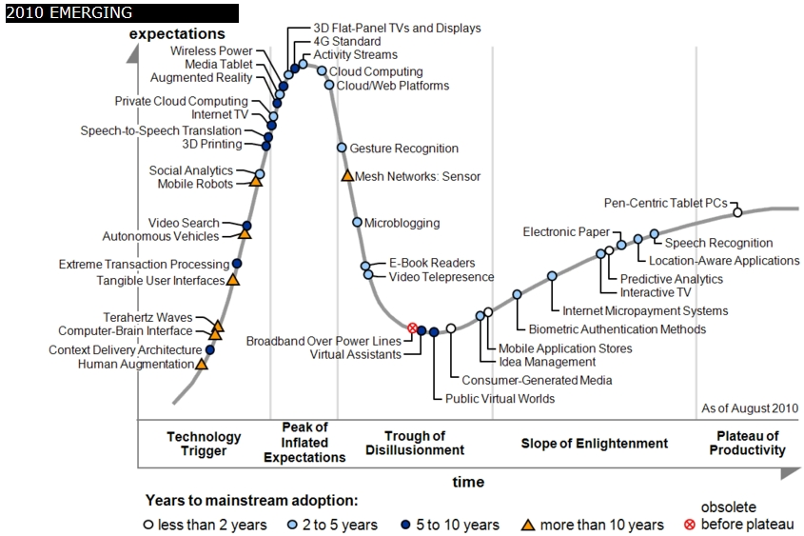
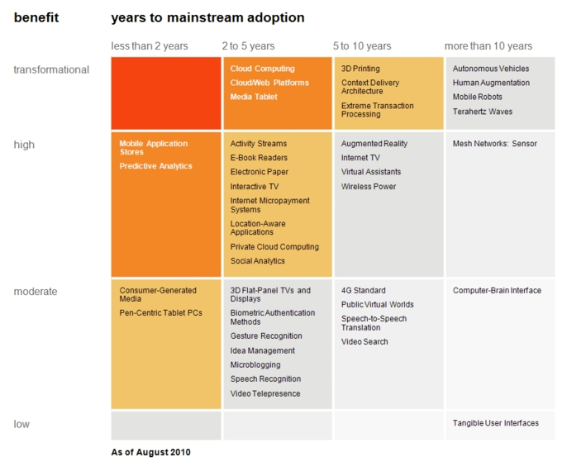

Transformational
High
Moderate
Low
Gartner 2009 Hype Curve
Clouds, Web2.0
Service Oriented Architectures
Cloud Computing
Cloud Web Platforms
Media Tablet

Slide 36
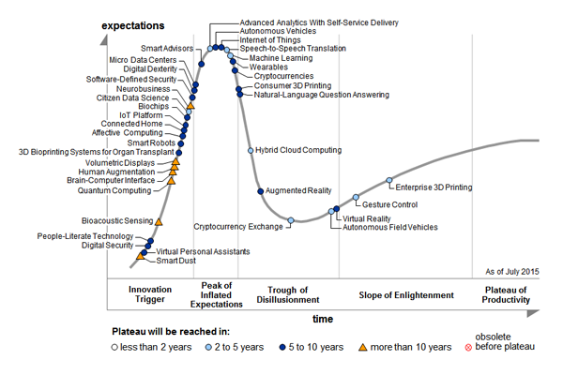
2015 Gartner Hype Curve

Slide 37
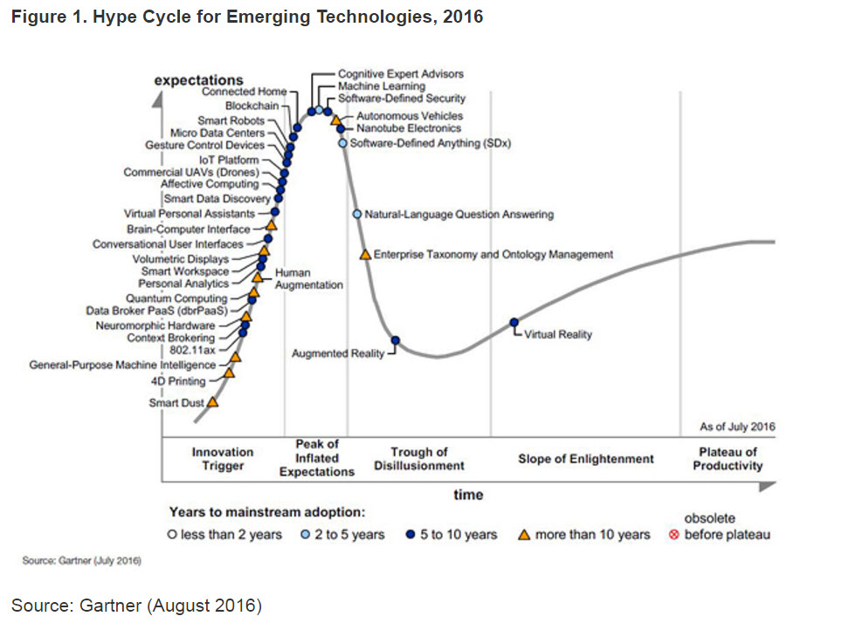

Slide 38
Changes from Hype Cycle 2015 to 2016
14 technologies were taken off the Hype Cycle this year including Hybrid Cloud Computing, Consumer 3D Printing, and Enterprise 3D Printing, Bioprinting Systems for Organ Transplant, Advanced Analytics With Self-Service Delivery, Bioacoustic Sensing, Citizen Data Science, Digital Dexterity, Digital Security, Internet of Things
16 new technologies included in the Hype Cycle for the first time this year. These technologies include 4D Printing, Blockchain, General-Purpose Machine Intelligence, 802.11ax, Context Brokering, Neuromorphic Hardware, Data Broker PaaS (dbrPaaS), Personal Analytics, Smart Workspace, Smart Data Discovery, Commercial UAVs (Drones), Connected Home, Machine Learning, Nanotube Electronics, Software-Defined Anything (SDx), and Enterprise Taxonomy and Ontology Management,
IoT
Big Data Analysis
Computing Systems

Slide 39
Gartner: 4 Business Megatrends
https://www.gartner.com//it/content/3377400/3377422/august_10_gartner_hype_cycles_2016_bburton_mwalker.pdf

Slide 40
2017 Gartner Hype Curve
Climbing the Slope
Virtual Reality
IoT
Big Data Analysis
Computing Systems
Sliding Into the Trough
Cognitive Expert Advisors
Enterprise Taxonomy and Ontology Management
Software-Defined Security
Augmented Reality
On the Rise
Smart Dust
4D Printing
Artificial General Intelligence
Deep Reinforcement Learning
Neuromorphic Hardware
Human Augmentation
5G
Serverless PaaS
Digital Twin (simulated reality)
Quantum Computing
Volumetric Displays
Brain-Computer Interface
Conversational User Interfaces
Smart Workspace
At the Peak
Augmented Data Discovery
Edge Computing
Smart Robots
IoT Platform
Virtual Assistants
Connected Home
Deep Learning
Machine Learning
Autonomous Vehicles
Nanotube Electronics
Cognitive Computing
Blockchain
Commercial UAVs (Drones)
https://www.gartner.com/doc/3768572/hype-cycle-emerging-technologies-

Slide 41
Clouds, HPC Clouds
Simulations, Big Data

Slide 42
2 Aspects of Cloud Computing:
Infrastructure and Runtimes
Cloud infrastructure: outsourcing of servers, computing, data, file space, utility computing, etc..
Cloud runtimes or Platform: tools to do data-parallel (and other) computations. Valid on Clouds and traditional clusters
  Apache Hadoop, Google MapReduce, Microsoft Dryad, Bigtable, Chubby and others
  MapReduce designed for information retrieval but is excellent for a wide range of science data analysis applications
  Can also do much traditional parallel computing for data-mining if extended to support iterative operations
  Data Parallel File system as in HDFS and Bigtable

Slide 43
Science Computing Environments
Large Scale Supercomputers – Multicore nodes linked by high performance low latency network
  Increasingly with GPU enhancement
  Suitable for highly parallel simulations
High Throughput Systems such as European Grid Initiative EGI or Open Science Grid OSG typically aimed at pleasingly parallel jobs
  Can use “cycle stealing”
  Classic example is LHC data analysis
Grids federate resources as in EGI/OSG or enable convenient access to multiple backend systems including supercomputers
Use Services (SaaS)
  Portals make access convenient and
  Workflow integrates multiple processes into a single job

Slide 44
Clouds HPC and Grids
Synchronization/communication Performance
Grids > Clouds > Classic HPC Systems
Clouds naturally execute effectively Grid workloads but are less clear for closely coupled HPC applications
Classic HPC machines as MPI engines offer highest possible performance on closely coupled problems
The 4 forms of MapReduce/MPI
  Map Only – pleasingly parallel
  Classic MapReduce as in Hadoop; single Map followed by reduction with fault tolerant use of disk
  Iterative MapReduce use for data mining such as Expectation Maximization in clustering etc.; Cache data in memory between iterations and support the large collective communication (Reduce, Scatter, Gather, Multicast) use in data mining
  Classic MPI! Support small point to point messaging efficiently as used in partial differential equation solvers

Slide 45
6 Forms of MapReduce
Describes Architecture of
- Problem (Model reflecting data)
- Machine
- Software
2 important variants (software) of Iterative MapReduce and Map-Streaming a) “In-place” HPC b) Flow for model and data

Slide 46
Classic Parallel Computing
HPC: Typically SPMD (Single Program Multiple Data) “maps” typically processing particles or mesh points interspersed with multitude of low latency messages supported by specialized networks such as Infiniband and technologies like MPI
  Often run large capability jobs with 100K (going to 1.5M) cores on same job
  National DoE/NSF/NASA facilities run 100% utilization
  Fault fragile and cannot tolerate “outlier maps” taking longer than others
Clouds: MapReduce has asynchronous maps typically processing data points with results saved to disk. Final reduce phase integrates results from different maps
  Fault tolerant and does not require map synchronization
  Map only useful special case
HPC + Clouds: Iterative MapReduce caches results between “MapReduce” steps and supports SPMD parallel computing with large messages as seen in parallel kernels (linear algebra) in clustering and other data mining

Slide 47
Considerations on Big Data v. Clouds/HPC
“High Performance” seems natural for Big Data as this needs a lot of processing and HPC could do it faster?
Cons: But much big data processing involves I/O of distributed data and this dominates over computing accelerated by HPC
  Other problems (such as LHC data processing) are compute dominated but this is pleasingly parallel and so parallel computing and nifty HPC algorithms irrelevant
  Other problems (like basic databases) are essentially MapReduce and also do not have tight synchronization constraints addressed by HPC
Pros: Andrew Ng notes that a leading machine learning group must have both deep learning and HPC excellence.
  Some machine learning like topic modelling (LDA), clustering, deep learning, dimension reduction, graph algorithms involve Map-Collective or Map-Point to Point iterative structure and benefit from HPC
  HPC (MPI) often large factors (10-100) faster than Hadoop, Spark, Flink, Storm

Slide 48
Why HPC Cloud architectures?
Exascale simulations needed as have differential equation based models that need small space and time steps and this leads to numerical formulations that need the memory and compute power of an exascale machine to solve individual problems (capability computing)
Big data problems do not have differential operators and it is not obvious that you need a full exascale system to address a single Big Data problem
Rather you will be running lots of jobs that are sometimes pleasingly parallel/MapReduce (Cloud) and sometimes small to medium size HPC jobs which in aggregate are exascale (HPC Cloud) (capacity computing)
  Deep learning doesn’t exhibit massive parallelism due to stochastic gradient descent using small mini-batches of training data
  But deep learning does use small accelerator enhanced HPC clusters.
Note modest size clusters need all the software, hardware and algorithm expertise of HPC.
Systems designed for exascale HPC simulations, should be well suited for HPC cloud if I/O handled correctly (as it is in traditional clouds)
HPCCloud 2.0 uses DevOps to automate deployment on cloud or HPC
HPCCloud 3.0 uses SaaS to deliver Wisdom/Insight as a Service

Slide 49
Comparison of Data Analytics with Simulation

Slide 50
Structure of Applications
Real-time (streaming) data is increasingly common in scientific and engineering research, and it is ubiquitous in commercial Big Data (e.g., social network analysis, recommender systems and consumer behavior classification)
  So far little use of commercial and Apache technology in analysis of scientific streaming data
Pleasingly parallel applications important in science (long tail) and data communities
Commercial-Science application differences: Search and recommender engines have different structure to deep learning, clustering, topic models, graph analyses such as subgraph mining
  Latter very sensitive to communication and can be hard to parallelize
  Search typically not as important in Science as in commercial use as search volume scales by number of users
Should discuss data and model separately
  Term data often used rather sloppily and often refers to model

Slide 51
Comparison of Data Analytics with Simulation I
Simulations (models) produce big data as visualization of results – they are data source
  Or consume often smallish data to define a simulation problem
  HPC simulation in (weather) data assimilation is data + model
Pleasingly parallel often important in both
Both are often SPMD and BSP
  Non-iterative MapReduce is major big data paradigm
  not a common simulation paradigm except where “Reduce” summarizes pleasingly parallel execution as in some Monte Carlos
Big Data often has large collective communication
  Classic simulation has a lot of smallish point-to-point messages
  Motivates MapCollective model
Simulations characterized often by difference or differential operators leading to nearest neighbor sparsity
Some important data analytics can be sparse as in PageRank and “Bag of words” algorithms but many involve full matrix algorithm

Slide 52


“Force Diagrams” for macromolecules and Facebook

Slide 53
Comparison of Data Analytics with Simulation II
There are similarities between some graph problems and particle simulations with a particular cutoff force.
  Both are MapPoint-to-Point problem architecture
Note many big data problems are “long range force” (as in gravitational simulations) as all points are linked.
  Easiest to parallelize. Often full matrix algorithms
  e.g. in DNA sequence studies, distance δ(i, j) defined by BLAST, Smith-Waterman, etc., between all sequences i, j.
  Opportunity for “fast multipole” ideas in big data. See NRC report
Current Ogres/Diamonds do not have facets to designate underlying hardware: GPU v. Many-core (Xeon Phi) v. Multi-core as these define how maps processed; they keep map-X structure fixed; maybe should change as ability to exploit vector or SIMD parallelism could be a model facet.

Slide 54
Comparison of Data Analytics with Simulation III
In image-based deep learning, neural network weights are block sparse (corresponding to links to pixel blocks) but can be formulated as full matrix operations on GPUs and MPI in blocks.
In HPC benchmarking, Linpack being challenged by a new sparse conjugate gradient benchmark HPCG, while I am diligently using non- sparse conjugate gradient solvers in clustering and Multi-dimensional scaling.
Simulations tend to need high precision and very accurate results – partly because of differential operators
Big Data problems often don’t need high accuracy as seen in trend to low precision (16 or 32 bit) deep learning networks
  There are no derivatives and the data has inevitable errors
Note parallel machine learning (GML not LML) can benefit from HPC style interconnects and architectures as seen in GPU-based deep learning
  So commodity clouds not necessarily best but modern clouds fine

Slide 55
Implications of Big Data Requirements
“Atomic” Job Size: Very large jobs are critical aspects of leading edge simulation, whereas much data analysis is pleasing parallel and involves many quite small jobs. The latter follows from event structure of much observational science.
  Accelerators produce a stream of particle collisions; telescopes, light sources or remote sensing a stream of images. The many events produced by modern instruments implies data analysis is a computationally intense problem but can be broken up into many quite small jobs.
  Similarly the long tail of science produces streams of events from a multitude of small instruments
Why use HPC machines to analyze data and how large are they? Some scientific data has been analyzed on HPC machines because the responsible organizations had such machines often purchased to satisfy simulation requirements. Whereas high end simulation requires HPC style machines, that is typically not true for data analysis; that is done on HPC machines because they are available

Slide 56
Who uses What Software
HPC/Science use of Big Data Technology now: Some aspects of the Big Data stack are being adopted by the HPC community: Docker and Deep Learning are two examples.
Big Data use of HPC: The Big Data community has used (small) HPC clusters for deep learning, and it uses GPUs and FPGAs for training deep learning systems
Docker v. OpenStack(hypervisor): Docker (or equivalent) is quite likely to be the virtualization approach of choice (compared to say OpenStack) for both data and simulation applications. OpenStack is more complex than Docker and only clearly needed if you share at core level whereas large scale simulations and data analysis seem to just need node level sharing.
  Parallel computing almost implies sharing at node not core level
Science use of Big Data: Some fraction of the scientific community uses Big Data style analysis tools (Hadoop, Spark, Cassandra, Hbase ….)

Slide 57
Choosing Languages
Language choice C++, Fortran, Java, Scala, Python, R, Matlab needs thought. This is a mixture of technical and social issues.
Java Grande was a 1997-2000 activity to make Java run fast and web site still there! http://www.javagrande.org/
Basic Java now much better but object structure, dynamic memory allocation and Garbage collection have their overheads
Java virtual machine JVM dominant Big Data environment?
One can mix languages quite efficiently
  Java MPI as binding to C++ version excellent
Scripting languages Python, R, Matlab address different requirements than Java, C++ ….

Slide 58
Clouds have highlighted SaaS PaaS IaaS
But equally valid for classic clusters
Software
(Application
Or Usage) SaaS
Education
Applications
CS Research Use e.g. test new compiler or storage model
Software Services are building blocks of applications
The middleware or computing environment including HPC, Grids …
Docker, OpenStack, plus Bare-metal
OpenFlow
Cloud e.g. MapReduce
HPC e.g. PETSc, SAGA
Computer Science e.g. Compiler tools, Sensor nets, Monitors
Platform
PaaS
Infra
structure
IaaS
Software Defined Computing (virtual Clusters)
Hypervisor, Bare Metal
Operating System
Network
NaaS
Software Defined Networks
OpenFlow GENI

Slide 59
HPC-ABDS

Slide 60
Components of Big Data Stack
Google likes to show a timeline
2002 Google File System GFS ~HDFS
2004 MapReduce Apache Hadoop
2006 Big Table Apache Hbase
2008 Dremel Apache Drill
2009 Pregel Apache Giraph
2010 FlumeJava Apache Crunch
2010 Colossus better GFS
2012 Spanner horizontally scalable NewSQL database ~CockroachDB
2013 F1 horizontally scalable SQL database
2013 MillWheel ~Apache Storm, Twitter Heron
2015 Cloud Dataflow Apache Beam with Spark or Flink (dataflow) engine
Functionalities not identified: Security, Data Transfer, Scheduling, serverless computing
All have Apache equivalents

Slide 61
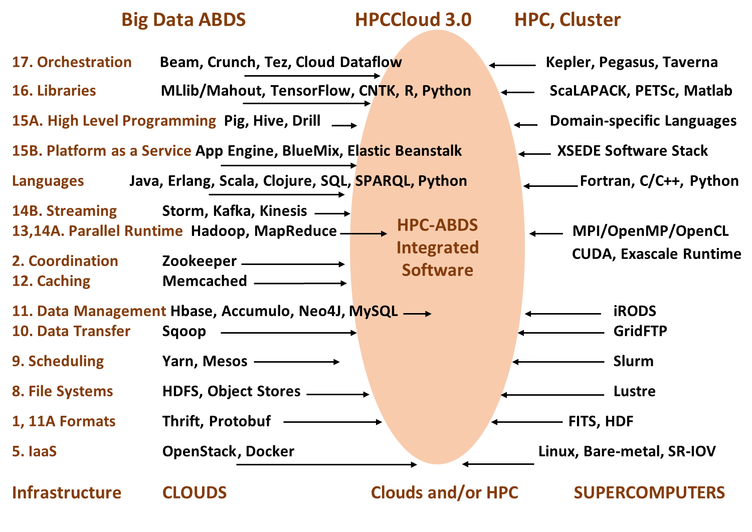

Slide 62
Functionality of 21 HPC-ABDS Layers
Message Protocols:
Distributed Coordination:
Security & Privacy:
Monitoring:
IaaS Management from HPC to hypervisors:
DevOps:
Interoperability:
File systems:
Cluster Resource Management:
Data Transport:
A) File management
B) NoSQL
C) SQL
In-memory databases & caches / Object-relational mapping / Extraction Tools
Inter process communication Collectives, point-to-point, publish-subscribe, MPI:
A) Basic Programming model and runtime, SPMD, MapReduce:
B) Streaming:
A) High level Programming:
B) Frameworks
Application and Analytics:
Workflow-Orchestration:
Lesson of large number (350). This is a rich software environment that must be re-used not re-built
Note level 13 Inter process communication added

Slide 63
Current Research
Geoffrey Fox, "Research in Digital Science Center", PTI All Hands Meeting, Indiana University Bloomington, August 25 2017 Summary of DSC research
Indiana University (Fox, Qiu, Crandall, von Laszewski, Rutgers (Jha), Virginia Tech (Marathe), Kansas (Paden), Stony Brook (Wang), Arizona State (Beckstein), Utah (Cheatham) “Datanet: CIF21 DIBBs: Middleware and High Performance Analytics Libraries for Scalable Data Science NSF14-43054 Progress Report” July 2016 http://dsc.soic.indiana.edu/publications/SPIDAL-DIBBSreport_July2016.pdf NSF Project 21 Month report
Supun Kamburugamuve and Geoffrey Fox, "Designing Twister2: Efficient Programming Environment Toolkit for Big Data" Digital Science Center, technical report August 6 2017 DOI Significant Research Activity
Geoffrey Fox,"Next Generation IoT and Data-based Grid" The 13th International Conference on Semantics, Knowledge and Grids SKG2017 Beijing, China August 15, 2017 Research status
Geoffrey C. Fox, Vatche Ishakian, Vinod Muthusamy, Aleksander Slominski, "Status of Serverless Computing and Function-as-a-Service(FaaS) in Industry and Research", Report from workshop and panel at the First International Workshop on Serverless Computing (WoSC) Atlanta, June 5 2017 DOI Status of Important Industry Developments
Fox, Geoffrey; Jha, Shantenu; Ramakrishnan, Lavanya; "STREAM2016: Streaming Requirements, Experience, Applications and Middleware Workshop", Final Report of Workshop March 22-23 2016 at Washington DC, Status of Streaming data (cloud-edge link)

Slide 64
A little bit in the past
Geoffrey Fox, "The High Performance Computing enhanced Apache Big Data Stack and Big Data Ogres", Workshop on Big Data and Data Science, Hartree Centre, Daresbury Laboratory, UK, May 4, 2017. Data-Simulation Convergence
Geoffrey Fox et al. “Tutorial Program”, BigDat 2017 MIDAS and SPIDAL Tutorial Bari Italy February 13-14 2017 Mainly NIST applications and Data Analytics
Geoffrey Fox Data Science and Clouds MURPA/QURPA Melbourne /Queensland/Brisbane Virtual Presentation August 23 2013 Good on use of clouds. Has aaS diagram
Geoffrey Fox Data Science and the Cloud; Centerpieces of the Future Economy June 14 2013 Indiana University Mini University. Updated on Slideshare Jan. 2014 and on Github Section 3.1.1 Aug. 2017 Mainly Commercial Big Data status
Geoffrey Fox Cyberinfrastructure and Its Application at MSI-CIEC Cyberinfrastructure Day at Salish Kootenai College, Pablo Montana, August 2 2011. Good general overview of cyberinfrastructure.
Geoffrey Fox Linking Programming models between Grids, Web 2.0 and Multicore Distributed Programming Abstractions Workshop NESC Edinburgh UK May 31 2007 Slideshare Comparison of Parallel Computing, Grids, Web 2.0

Slide 65
The Past
Geoffrey Fox Parallel Computing 2007: Lessons for a Multicore Future from the Past lectures at Microsoft February 26-March 1 2007 with two slideshare presentations Overview and Bring your own parallel application Classic Parallel Computing
Informatics Dean's Advisory Council Presentation, September 22 2001: Informatics and Pervasive Technology Laboratories Old work before coming to IU
Geoffrey Fox and Marlon Pierce Web 2.0 in a Web Services and Grid Context Part I: CTS2007 Web 2.0 Tutorial Part I of Tutorial at 2007 International Symposium on Collaborative Technologies and Systems (CTS 2007) May 21 2007 Slideshare Services, Web Services, mashups, portals
Marlon Pierce and Geoffrey Fox Web 2.0 Tutorial: Part 2 Part II of Tutorial at 2007 International Symposium on Collaborative Technologies and Systems (CTS 2007) May 21 2007 Slideshare Ajax, Json, microformats, GWT, REST, social tagging sites, Start Pages, Gadgets
Geoffrey Fox, The Past and the Future: This talk gives a broad overview, incl. role of hadrons, hadron reaction phenomenology, past achievements and future goals, 2015 International Summer Workshop on Reaction Theory, Indiana University Bloomington, June 8 2015 (What I did 35-45 years ago but it’s still state of art)
  Just added "Analyticity Constraints for Hadron Amplitudes: Going High to Heal Low Energy Issues", 25 August 2017, arXiv:1708.07779

