Slide 1
Research in Digital Science Center
Geoffrey Fox, August 15, 2017
Digital Science Center
Department of Intelligent Systems Engineering
gcf@indiana.edu, http://www.dsc.soic.indiana.edu/, http://spidal.org/
Judy Qiu, David Crandall, Gregor von Laszewski, Dennis Gannon
Supun Kamburugamuve, Pulasthi Wickramasinghe, Hyungro Lee, Jerome Mitchell
Bo Peng, Langshi Chen, Kannan Govindarajan, Fugang Wang
Internal collaboration. Biology, Physics, SOIC
Outside Collaborators in funded projects: Arizona, Kansas, NIST, Rutgers, San Diego Supercomputer Center, Stanford, SUNY Stony Brook, Virginia Tech, Univ. of Tennessee Knoxsville and Utah

Slide 2
Digital Science Center
Big Data Engineering (Data Science) research with technology and applied collaborators
  System architecture, performance
Run computer infrastructure for Cloud and HPC research
  64 node system Tango with high performance disks (SSD, NVRam = 5x SSD and 25xHDD) and Intel KNL (Knights Landing) manycore (68-72) chips. Omnipath interconnect
  128 node system Juliet with two 12-18 core Haswell chips, SSD and conventional HDD disks. Infiniband Interconnect
  16 GPU, 4 Haswell node deep learning system Romeo
  All can run HDFS and store data on nodes
  200 older nodes for Docker, OpenStack and general use
Teach basic and advanced Cloud Computing and bigdata courses
Supported by Gary Miksik, Allan Streib

Slide 3
Research Activities
Building SPIDAL Scalable HPC machine Learning Library
Applying current SPIDAL in Biology, Network Science, Pathology
Polar (Radar) Image Processing (Crandall)
Data analysis of experimental physics scattering results
Work with NIST on Big Data Standards and non-proprietary Frameworks
Integration of Clouds&HPC; Big Data&Simulations (international community)
Harp HPC Machine Learning Framework (Qiu)
Twister2 HPC Event Driven Distributed Programming model
IoTCloud. Cloud control of robots – licensed to C2RO (Montreal)
Cloud Research and DevOps for Software Defined Systems (von Laszewski)

Slide 4





NSF 1443054: CIF21 DIBBs: Middleware and High Performance Analytics Libraries for Scalable Data Science
Ogres Application Analysis
HPC-ABDS and HPC-FaaS Software
Harp and Twister2 Building Blocks
SPIDAL Data Analytics Library
Software: MIDAS
HPC-ABDS

Slide 5
Important Trends
Data gaining in importance compared to simulations
  Data analysis techniques changing with old and new applications
All forms of IT increasing in importance; both data and simulations increasing
Internet of Things and Edge Computing growing in importance
Exascale initiative driving large supercomputers
Use of public clouds increasing rapidly
  Clouds becoming diverse with subsystems containing GPU’s, FPGA’s, high performance networks, storage, memory …
  They have economies of scale; hard to compete with
Serverless (server hidden) computing attractive to user:
“No server is easier to manage than no server”
Notes:
Barga Edge and Serverless driving AWS

Slide 6
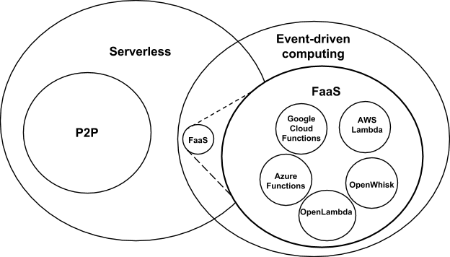
Event-Driven and Serverless Computing
Hopefully will change
Cloud-owner Provided Cloud-native platform for
Short-running, Stateless computation and
Event-driven applications which
Scale up and down instantly and automatically and
Charges for actual usage at a millisecond granularity
Note GridSolve was FaaS
Notes:
Short-running, Stateless computation may go away

Slide 7
Predictions/Assumptions
Supercomputers will be essential for large simulations and will run other applications
HPC Clouds or Next-Generation Commodity Systems will be a dominant force
  Merge Cloud HPC and (support of) Edge computing
  Federated Clouds running in multiple giant datacenters offering all types of computing
  Distributed data sources associated with device and Fog processing resources
  Server-hidden computing and Function as a Service FaaS for user pleasure
  Support a distributed event-driven serverless dataflow computing model covering batch and streaming data as HPC-FaaS
  Needing parallel and distributed (Grid) computing ideas
  Span Pleasingly Parallel to Data management to Global Machine Learning

Slide 8
Components of Big Data Stack
Google likes to show a timeline; we can build on (Apache version of) this
2002 Google File System GFS ~HDFS (Level 8)
2004 MapReduce Apache Hadoop (Level 14A)
2006 Big Table Apache Hbase (Level 11B)
2008 Dremel Apache Drill (Level 15A)
2009 Pregel Apache Giraph (Level 14A)
2010 FlumeJava Apache Crunch (Level 17)
2010 Colossus better GFS (Level 18)
2012 Spanner horizontally scalable NewSQL database ~CockroachDB (Level 11C)
2013 F1 horizontally scalable SQL database (Level 11C)
2013 MillWheel ~Apache Storm, Twitter Heron (Google not first!) (Level 14B)
2015 Cloud Dataflow Apache Beam with Spark or Flink (dataflow) engine (Level 17)
Functionalities not identified: Security(3), Data Transfer(10), Scheduling(9), DevOps(6), serverless computing (where Apache has OpenWhisk) (5)
HPC-ABDS Levels in ()

Slide 9



Implementing Twister2 to support a Grid linked to an HPC Cloud
Cloud
HPC
Cloud
HPC
Fog
Cloud
HPC
HPC Cloud can
be federated
Centralized HPC Cloud + IoT Devices
Centralized HPC Cloud + Edge = Fog + IoT Devices

Slide 10
Twister2: “Next Generation Grid - Edge – HPC Cloud”
Original 2010 Twister paper has 878 citations; it was a particular approach to MapCollective iterative processing for machine learning
Re-engineer current Apache Big Data and HPC software systems as a toolkit
Support a serverless (cloud-native) dataflow event-driven HPC-FaaS (microservice) framework running across application and geographic domains.
  Support all types of Data analysis from GML to Edge computing
Build on Cloud best practice but use HPC wherever possible to get high performance
Smoothly support current paradigms Hadoop, Spark, Flink, Heron, MPI, DARMA …
Use interoperable common abstractions but multiple polymorphic implementations.
  i.e. do not require a single runtime
Focus on Runtime but this implies HPC-FaaS programming and execution model
This defines a next generation Grid based on data and edge devices – not computing as in old Grid
See long paper http://dsc.soic.indiana.edu/publications/Twister2.pdf

