Slide 1
Research in Intelligent Systems Engineering
Geoffrey Fox, April 27, 2018
Department of Intelligent Systems Engineering
gcf@indiana.edu

Slide 2
Structure of ISE
ISE arranged as a collection of centers and laboratories with 18 faculty and support staff/infrastructure
Deep Learning Laboratory (Minje Kim): Supported by the Cluster Romeo with Nvidia K80 and Volta GPU's; Tensorflow, Caffe, other software; and diverse large-scale datasets.
Cloud Computing Laboratory (Gregor von Laszewski) see later
High-Performance Big Data Computing Laboratory (Judy Qiu) see later
Robotics and Internet of Things Laboratory (Lantao Liu): A smart network of a variety of small devices and robots. A large drone laboratory is being constructed for MESH.
Network Computing Laboratory (Martin Swany) focused on networked systems with embedded and reconfigurable computing elements for edge computing and the Internet of Things using a large cluster with FPGAs, network processors and software-defined network infrastructure. MESH and Luddy facilities
Visualization Laboratory (Katy Börner): Ultra-high resolution stereo display wall, HTC VIVE, and Microsoft HoloLens setups for data visualization, scientific visualization, and virtual/augmented/mixed reality R&D. Luddy facility
Medical Imaging Laboratory (Eleftherios Garyfallidis): Access to critical brain and other medical datasets. Provide software tools such as DIPY and NILEARN. Also training available for medical visualization and interactive tractography analysis. Major Open Source Software emphasis (also in HPBDC and nanoBIO)
Fibers & Additive Manufacturing Enabled Systems FAMES Laboratory (Alexander Gumennik) engineering of fibers and fabrics, embedding ensembles of nano-transducers and sensors. Major MESH Facility

Slide 3
Bio/Nano/Neuro Engineering Health
10 Faculty: Maria Bondesson, Eleftherios Garyfallidis, James A. Glazier, Alexander Gumennik, Feng Guo, Vikram Jadhao, Minje Kim, Gregory Lewis Paul Macklin, Eatai Roth. Also CE/IS for Big Data/Simulations
Laboratories mainly now in Simon moving to MESH: Bio, nano
Current medical care is reactive and open-loop, with long delays between onset of problems, diagnosis, treatment specification, treatment and outcome evaluation
Integration of sensor technology, informatics, modeling and delivery technologies will allow closed-loop continuous monitoring and prediction of health states of individuals to maintain health and respond more rapidly and effectively when problems do occur
Sensors and Background Data
Health State Inference
Prognosis/Diagnosis
Treatment Evaluations
Intervention Delivery
Core skills include:
Wearable sensors
Image and data analysis
Predictive modeling of medical states
Design of therapeutic strategies
Hardware for intervention delivery
Biomedical workflow design
Social/legal/economic approaches to health delivery
Patient
Physician

Slide 4
Intelligent System Engineering Computing Infrastructure
64-node FPGA+ARM + four 10G Ethernet Cluster (Swany) Proteus
  Collection of small Raspbery Pi Clusters with Docker Rubus
16 K80 GPU + 16 P100 Volta Deep Learning Cluster (Minje Kim, David Crandall) Romeo
128 node Haswell + Infiniband Machine Learning Testbed Juliet
64 node Intel Knights Landing + Omnipath Machine Learning Testbed Tango
32 node Xeon Platinum + Infiniband Cloud Computing Clusters (Docker, Openstack) Victor, Tempest

Slide 5


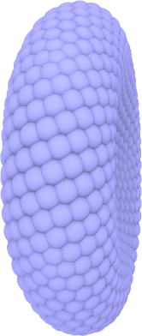
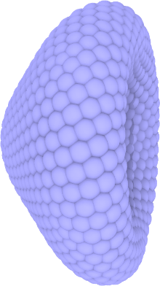
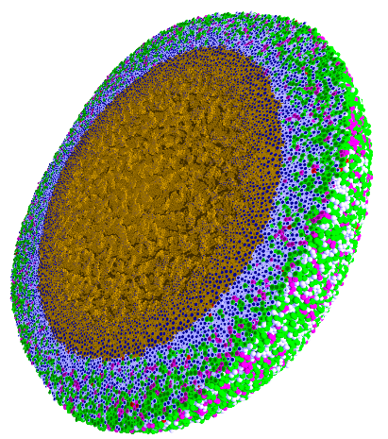
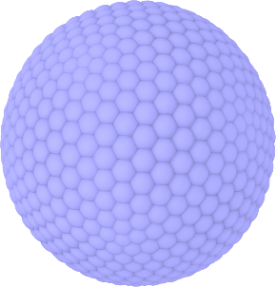
Engineered nanoBIO Node
Indiana University: Intelligent Systems Engineering, Chemistry, Science Gateways Community Institute
The Engineered nanoBIO node at Indiana University (IU) will develop a powerful set of integrated computational nanotechnology tools that facilitate the discovery of customized, efficient, and safe nanoscale devices for biological applications. Applications and Frameworks will be deployed and supported on nanoHUB.
Use in Undergraduate and masters programs in ISE for Nanoengineering and Bioengineering
  ISE (Intelligent Systems Engineering) as a new department developing courses from scratch (67 defined in first 2 years)
Research Experiences for Undergraduates throughout year
Annual engineered nanoBIO workshop
Summer Camps for Middle and High School Students
Online (nanoHUB and YouTube) courses with accessible content on nano and bioengineering
Research and Education tools build on existing simulations, analytics and frameworks: Physicell and CompuCell3D
PhysiCell
NP Shape Lab:

Slide 6
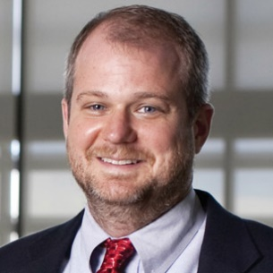

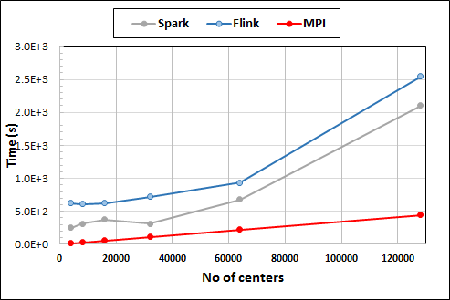
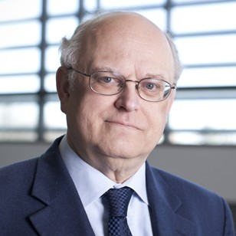

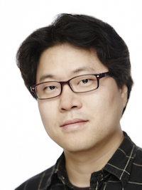

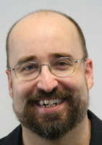

High Performance Computing HPC and Cyberinfrastructure in Department of Intelligent Systems Engineering
Martin Swany
Geoffrey Fox
Design of next generation of Supercomputers: Exascale Machines
  New memory, CPU and Software Systems
Parallel Big Data systems that are orders of magnitude faster than R, Spark, Flink
  30 optimized ML library codes
Embedded Edge systems: FPGA, Pi
Thomas Sterling
Lei Jiang
Gregor von Laszewski
Minje Kim
Integration of HPC, Cloud, parallel, networking, distributed and edge systems
  High-Performance Big Data Computing
Twister2 to subsume Hadoop, Kubernetes, Spark, MPI (958 cites)
Run optimized Big Data systems for research and teaching
Clint Whaley
Judy Qiu

Slide 7





Fox/ Qiu/Crandall NSF 1443054: CIF21 DIBBs: Middleware and High Performance Analytics Libraries for Scalable Data Science
Ogres Big Data Application Feature Analysis
Midas Middleware:
HPC-ABDS and HPC-FaaS Software
Harp and Twister2 Building Blocks
SPIDAL Data Analytics Library
Weekly Collaboration Meetings
NSF PI Meetings
Substantial Management Overhead
$1M a year for 5 years
Large Interdisciplinary Project – 7 institutions
Cyberinfrastructure – Algorithms - Applications
For major grants, need multi-institution approach ERC and I/UCRC
Software: MIDAS
HPC-ABDS

