Slide 1
Proteomics Metagenomics and Deterministic Annealing
Indiana University
October 5 2012
Geoffrey Fox
gcf@indiana.edu
http://www.infomall.org http://www.futuregrid.org
School of Informatics and Computing
Digital Science Center
Indiana University Bloomington

Slide 2
Some Motivation
Big Data requires high performance – achieve with parallel computing
Big Data requires robust algorithms as more opportunity to make mistakes
Deterministic annealing (DA) is one of better approaches to optimization
Tends to remove local optima
Addresses overfitting
Faster than simulated annealing
Return to my heritage (physics) with an approach I called Physical Computation (cf. also genetic algs) -- methods based on analogies to nature
Physics systems find true lowest energy state if you anneal i.e. you equilibrate at each temperature as you cool

Slide 3
Some Ideas
Deterministic annealing is better than many well-used optimization problems
Started as “Elastic Net” by Durbin for Travelling Salesman Problem TSP
Basic idea behind deterministic annealing is mean field approximation, which is also used in “Variational Bayes” and “Variational inference”
Markov chain Monte Carlo (MCMC) methods are roughly single temperature simulated annealing
Less sensitive to initial conditions
Avoid local optima
Not equivalent to trying random initial starts
Notes:
Color on right is stress from polarizing filters

Slide 4
(Our) Uses of Deterministic Annealing
Clustering
Vectors: Rose (Gurewitz and Fox)
Clusters with fixed sizes and no tails (Proteomics team at Broad)
No Vectors: Hofmann and Buhmann (Just use pairwise distances)
Dimension Reduction for visualization and analysis
Vectors: GTM Generative Topographic Mapping
No vectors: Multidimensional Scaling) MDS (Just use pairwise distances)
Can apply to HMM & general mixture models (less study)
Gaussian Mixture Models
Probabilistic Latent Semantic Analysis with Deterministic Annealing DA-PLSA as alternative to Latent Dirichlet Allocation for finding “hidden factors”

Slide 5
Basic Deterministic Annealing
Gibbs Distribution at Temperature T P(χ) = exp( - H(χ)/T) / ∫ dχ exp( - H(χ)/T)
Or P(χ) = exp( - H(χ)/T + F/T )
Minimize Free Energy combining Objective Function and Entropy F = < H - T S(P) > = ∫ dχ {P(χ)H + T P(χ) lnP(χ)}
H is objective function to be minimized as a function of parameters χ
Simulated annealing corresponds to doing these integrals by Monte Carlo
Deterministic annealing corresponds to doing integrals analytically (by mean field approximation) and is much faster than Monte Carlo
In each case temperature is lowered slowly – say by a factor 0.95 to 0.9999 at each iteration

Slide 6
Implementation of DA Central Clustering
Here points to cluster are in a metric space
Clustering variables are M_{i}(k) where this is probability that point i belongs to cluster k and ∑_{k=1}^{K} M_{i}(k) = 1
In Central or PW Clustering, take H₀ = ∑_{i=1}^{N} ∑_{k=1}^{K} M_{i}(k) ε_{i}(k)
Linear form allows DA integrals to be done analytically
Central clustering has ε_{i}(k) = (X(i)- Y(k))² and M_{i}(k) determined by Expectation step
H_{Central} = ∑_{i=1}^{N} ∑_{k=1}^{K} M_{i}(k) (X(i)- Y(k))²
<M_{i}(k)> = exp( -ε_{i}(k)/T ) / ∑_{k=1}^{K} exp( -ε_{i}(k)/T )
Centers Y(k) are determined in M step of EM method

Slide 7
Deterministic Annealing
F({y}, T)
Solve Linear Equations for each temperature
Nonlinear effects mitigated by initializing with solution at previous higher temperature
Configuration {y}
Minimum evolving as temperature decreases
Movement at fixed temperature going to false minima if not initialized “correctly

Slide 8
General Features of DA
In many problems, decreasing temperature is classic multiscale – finer resolution (√T is “just” distance scale)
We have factors like (X(i)- Y(k))² / T
In clustering, one then looks at second derivative matrix (can derive analytically) of Free Energy and as temperature is lowered this develops negative eigenvalue
Or have multiple clusters at each center and perturb
Trade-off depends on problem – high dimension takes time to find eigenvector
This is a phase transition and one splits cluster into two and continues EM iteration till desired resolution reached
One can start with just one cluster

Slide 9
Continuous Clustering
This is a subtlety introduced by Ken Rose but not widely known
Take a cluster k and split into 2 with centers Y(k)_{A} and Y(k)_{B} with initial values Y(k)_{A} = Y(k)_{B} at original center Y(k)
Then typically if you make this change and perturb the Y(k)_{A} Y(k)_{B}, they will return to starting position as F at stable minimum
But instability can develop and one finds
Implement by adding arbitrary number p(k) of centers for each cluster Z_{i} = ∑_{k=1}^{K} p(k) exp(-ε_{i}(k)/T) and M step gives p(k) = C(k)/N
Halve p(k) at splits; can’t split easily in standard case p(k) = 1
Free Energy F
Y(k)_{A} and Y(k)_{B}
Free Energy F
Free Energy F
Y(k)_{A} + Y(k)_{B}
Y(k)_{A} - Y(k)_{B}

Slide 10
Rose, K., Gurewitz, E., and Fox, G. C. ``Statistical mechanics and phase transitions in clustering,'' Physical Review Letters, 65(8):945-948, August 1990.
My #6 most cited article (425 cites including 15 in 2012)
System becomes unstable as Temperature lowered and there is a phase transition and one splits cluster into two and continues EM iteration
One can start with just one cluster and need NOT specify desired # clusters; rather specify cluster resolution

Slide 11
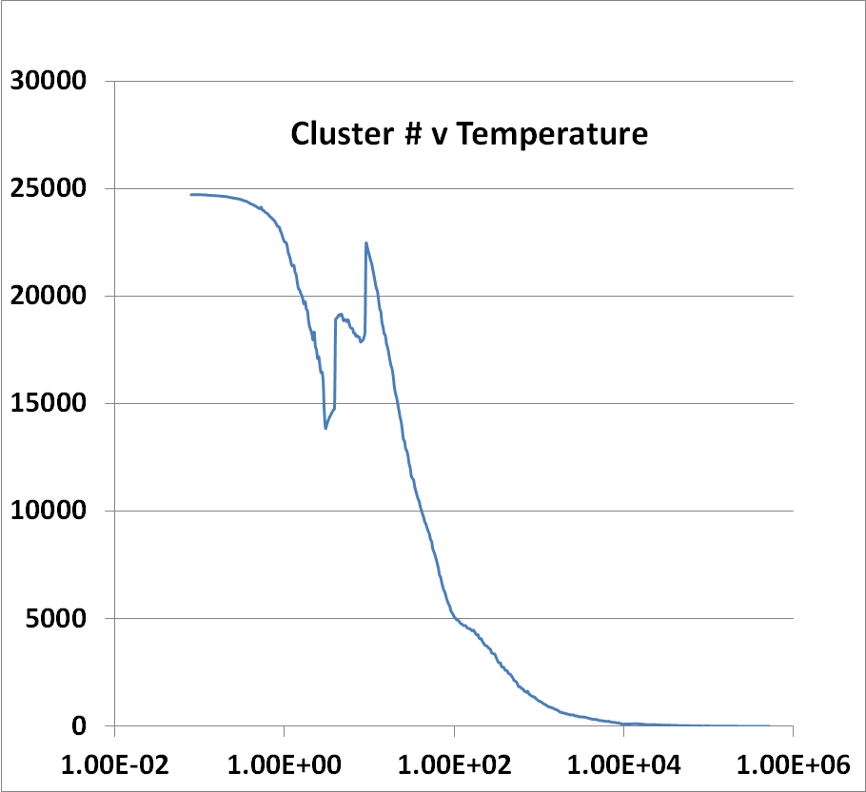
Introduce Sponge
Running on 8 nodes, 16 cores each
241605 Peaks
Complex Parallelization of
Peaks=points (usual) and Clusters (Switch on after # gets to 256)
Low Temperature -- End
High Temperature -- Start

Slide 12
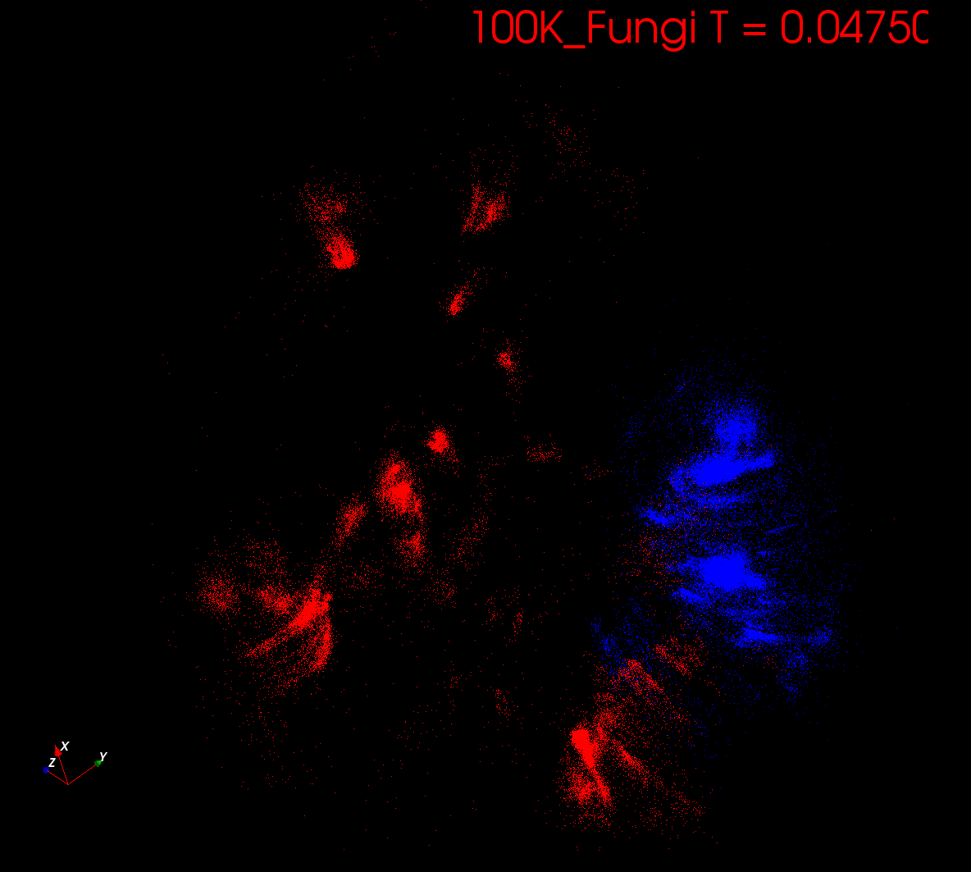
Start at T= “∞” with 1 Cluster
Decrease T, Clusters emerge at instabilities

Slide 13
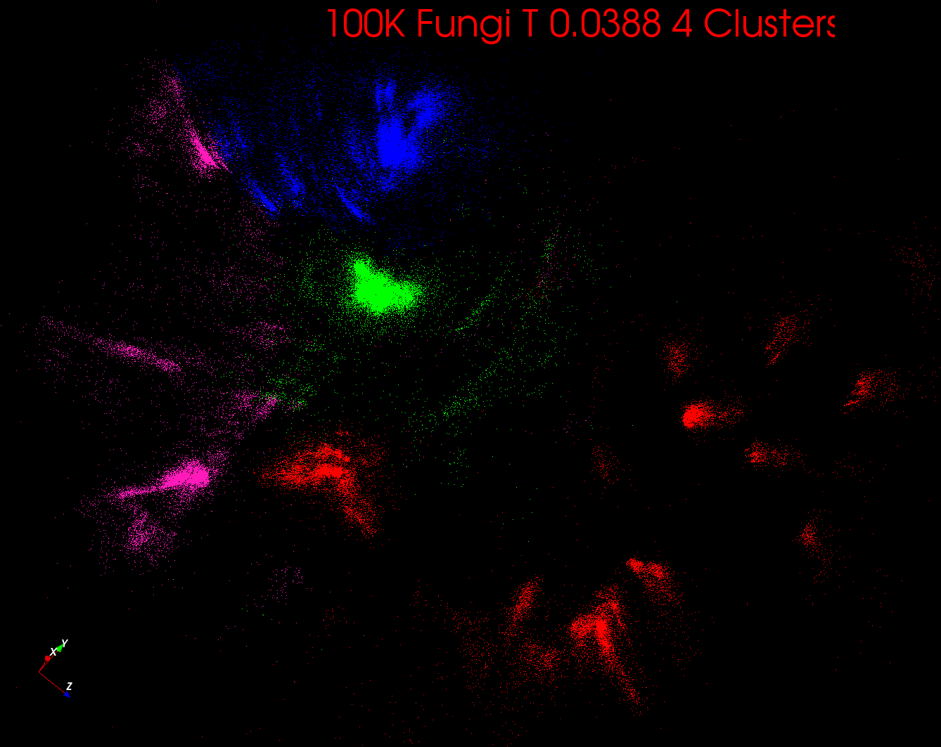

Slide 14
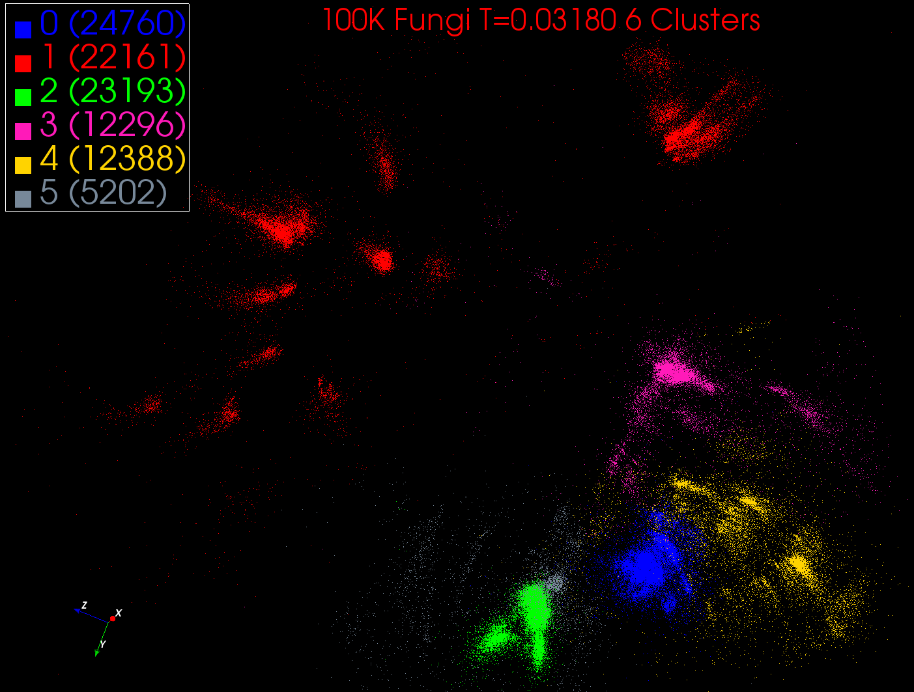

Slide 15
Some non-DA Ideas
Dimension reduction gives Low dimension mappings of data to both visualize and apply geometric hashing
No-vector (can’t define metric space) problems are O(N²)
Genes are no-vector unless multiply aligned
For no-vector case, one can develop O(N) or O(NlogN) methods as in “Fast Multipole and OctTree methods”
Map high dimensional data to 3D and use classic methods developed originally to speed up O(N²) 3D particle dynamics problems

Slide 16
Some Problems
Analysis of Mess Spectrometry data to find peptides by clustering peaks (Broad Institute)
~0.5 million points in 2 dimensions (one experiment) -- ~ 50,000 clusters summed over charges
Metagenomics – 0.5 million (increasing rapidly) points NOT in a vector space – hundreds of clusters per sample
Pathology Images (cf. Joel’s talk) 2 Dimensions
Social image analysis is in a highish dimension vector space
10-50 million images; 1000 features per image; million clusters
Finding communities from network graphs coming from Social media contacts etc.
No vector space; can be huge in all ways

Slide 17
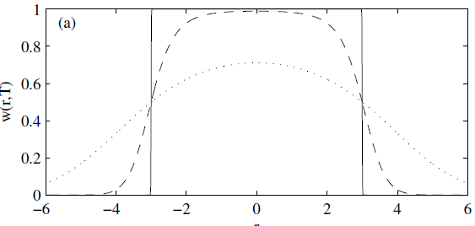
Trimmed Clustering
Clustering with position-specific constraints on variance: Applying redescending M-estimators to label-free LC-MS data analysis (Rudolf Frühwirth , D R Mani and Saumyadipta Pyne) BMC Bioinformatics 2011, 12:358
H_{TCC} = ∑_{k=0}^{K} ∑_{i=1}^{N} M_{i}(k) f(i,k)
f(i,k) = (X(i) - Y(k))²/2σ(k)² k > 0
f(i,0) = c² / 2 k = 0
The 0’th cluster captures (at zero temperature) all points outside clusters (background)
Clusters are trimmed (X(i) - Y(k))²/2σ(k)² < c² / 2
Applied to Proteomics Mass Spectrometry
T = 1
T ~ 0
T = 5
Distance from cluster center

Slide 18
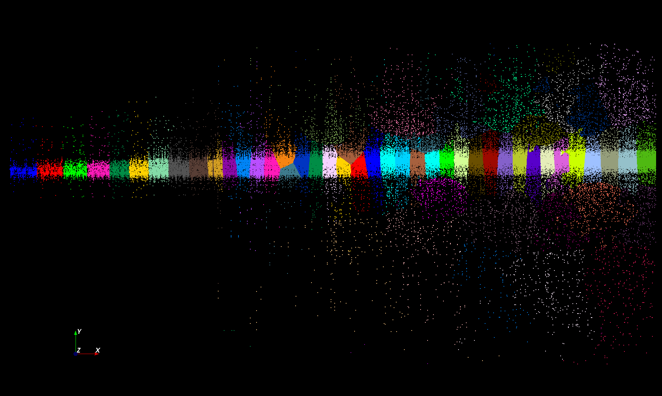
Proteomics 2D DA Clustering T= 25000 60 Clusters

Slide 19
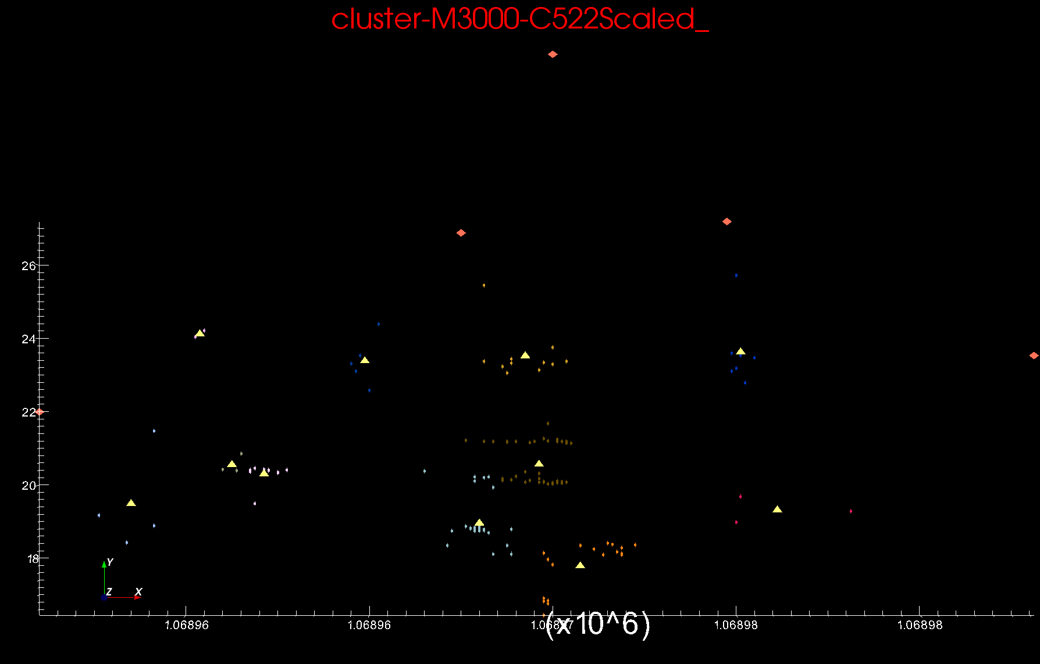
Proteomics 2D DA Clustering T=0.1 small sample of ~30,000 Clusters Count >=2
Sponge Peaks
Centers

Slide 20
Basic Equations
N Number of Points and K Clusters
NK Unknowns <M_{i}(k)> determined by
ε_{i}(k) = (X_{i}- Y(k))²
<M_{i}(k)> = p(k) exp( -ε_{i}(k)/T ) / ∑_{k=1}^{K} p(k) exp( -ε_{i}(k)/T )
C(k) = ∑_{i=1}^{N} <M_{i}(k)> Number of points in Cluster k
Y(k) = ∑_{i=1}^{N} <M_{i}(k)> X_{i} / C(k)
p(k) = C(k) / N
Iterate T = “∞” to 0.025
<M_{i}(k)> probability that point i in cluster k

Slide 21
Simple Parallelism
Decompose points i over processors
Equations either pleasingly parallel “maps” over i
Or “All-Reductions” summing over i for each cluster
Each process holds all clusters and calculates contributions to clusters from points in node
e.g. Y(k) = ∑_{i=1}^{N} <M_{i}(k)> X_{i} / C(k)
Runs well in MPI or MapReduce
See all the MapReduce k-means papers

Slide 22
Better Parallelism
This model is correct at start but each point does not really contribute to each cluster as damped exponentially by exp( - (X_{i}- Y(k))² /T )
For Proteomics problem, on average 6.45 clusters needed per point (X_{i}- Y(k))² /T ≤ ~40 (Average number of Clusters ~ 20,000)
A factor of ~3000
So only need to keep nearby clusters for each point
Further reductions are not global; they are nearest neighbor and calculated by parallelism over clusters

Slide 23
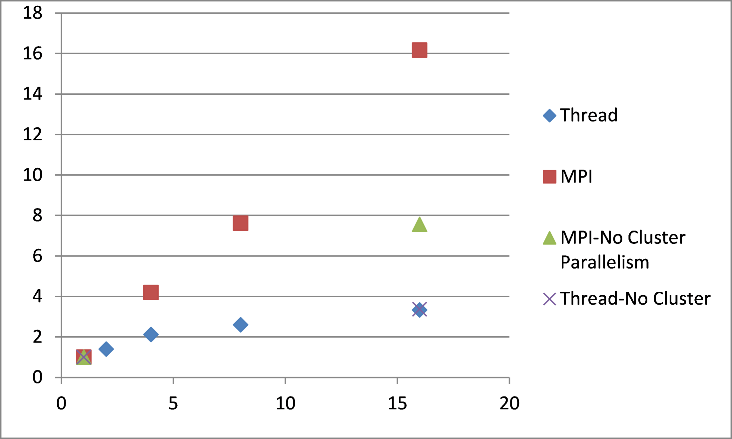
Speedup
Parallelism (#cores or nodes)

Slide 24
MDS Details
f chosen heuristically to increase the ratio of standard deviation to mean for and to increase the range of dissimilarity measures.
O(n²) complexity to map n sequences into 3D.
MDS can be solved using EM (SMACOF – fastest but limited) or directly by Newton's method (it’s just χ² )
Used robust implementation of nonlinear χ² minimization with Levenberg-Marquardt
3D projections visualized in PlotViz

Slide 25
MDS Details
Input Data: 100K sequences from well-characterized prokaryotic COGs.
Proximity measure: sequence alignment scores
Scores calculated using Needleman-Wunsch
Scores “sqrt 4D” transformed and fed into MDS
Analytic form for transformation to 4D
δ_{ij}^{n} decreases dimension n > 1; increases n < 1
“sqrt 4D” reduced dimension of distance data from 244 for δ_{ij} to14 for f(δ_{ij})
Hence more uniform coverage of Euclidean space

Slide 26
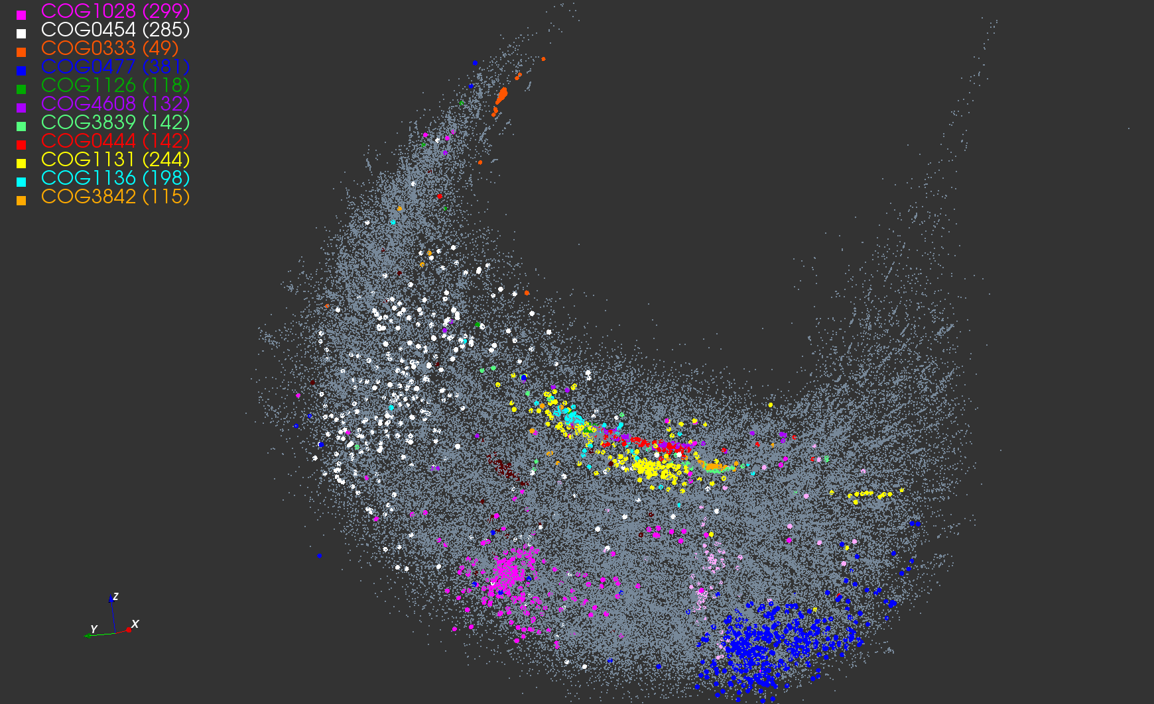
3D View of 100K COG Sequences

Slide 27
Implementation
NW computed in parallel on 100 node 8-core system.
Used Twister (IU) in the Reduce phase of MapReduce
MDS Calculations performed on 768 core MS HPC cluster (32 nodes)
Scaling, parallel MPI with threading intranode
Parallel efficiency of the code approximately 70%
Lost efficiency due memory bandwidth saturation
NW required 1 day, MDS job - 3 days.

Slide 28
Cluster Annotation
COG | Annotation | Uniref100
COG1131 | ABC-type multidrug transport system, ATPase component | 14406
COG1136 | ABC-type antimicrobial peptide transport system, ATPase component | 7306
COG1126 | ABC-type polar amino acid transport system, ATPase component | 4061
COG3839 | ABC-type sugar transport systems, ATPase component | 4121
COG0444 | ABC-type dipeptide/oligopeptide/nickel transport system ATPase comp | 3520
COG4608 | ABC-type oligopeptide transport system, ATPase component | 3074
COG3842 | ABC-type spermidine/putrescine transport systems, ATPase comp | 3665
COG0333 | Ribosomal protein L32 | 1148
COG0454 | Histone acetyltransferase HPA2 and Related acetyltransferases | 14085
COG0477 | Permeases of the major facilitator superfamily | 48590
COG1028 | Dehydrogenases with different specificities | 37461

Slide 29
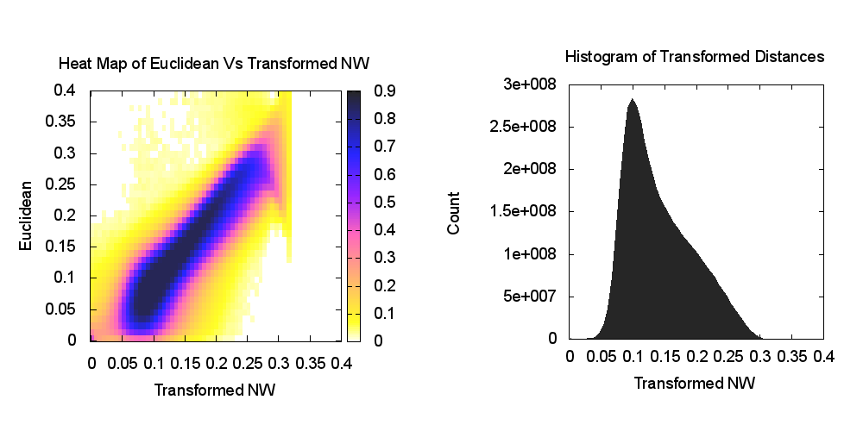
Heatmap of NW vs Euclidean Distances

Slide 30
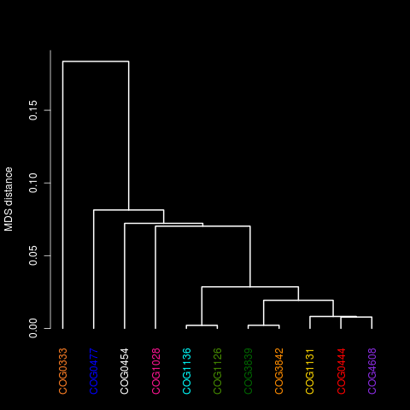
Dendrogram of Cluster Centroids

Slide 31
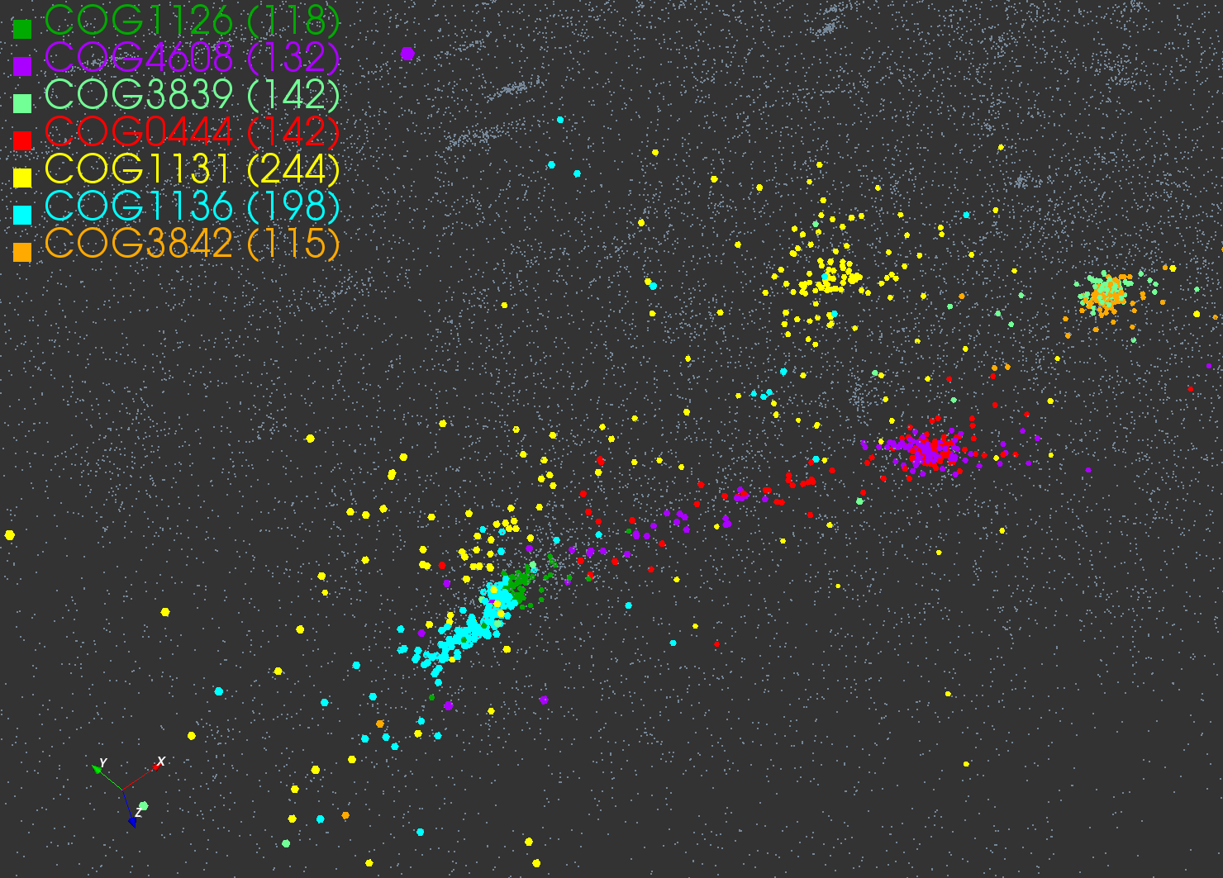
Selected Clusters

Slide 32
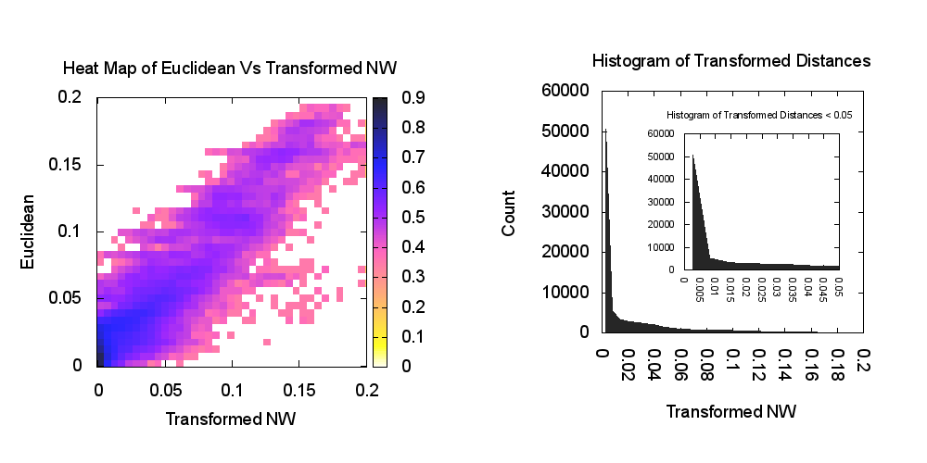
Heatmap for Selected Clusters

Slide 33
Future Steps
Comparison Needleman-Wunsch v. Blast v. PSIBlast
NW easier as complete; Blast has missing distances
Different Transformations distance → monotonic function(distance) to reduce formal starting dimension (increase sigma/mean)
Automate cluster consensus finding as sequence that minimizes maximum distance to other sequences
Improve O(N²) to O(N) complexity by interpolating new sequences to original set and only doing small regions with O(N²)
Successful in metagenomics
Can use Oct-tree from 3D mapping or set of consensus vectors
Some clusters diffuse?

Slide 34
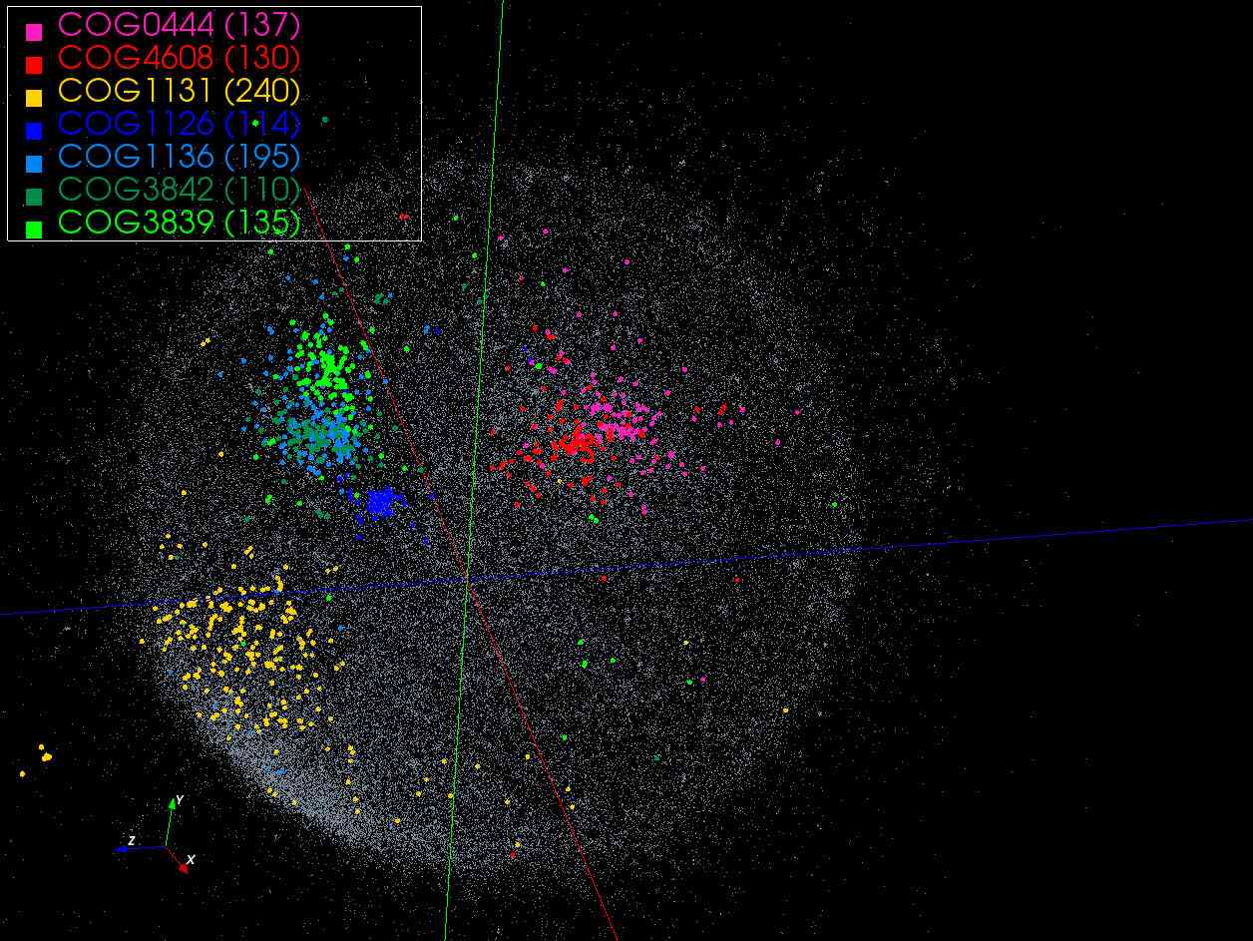
Blast⁶

Slide 35
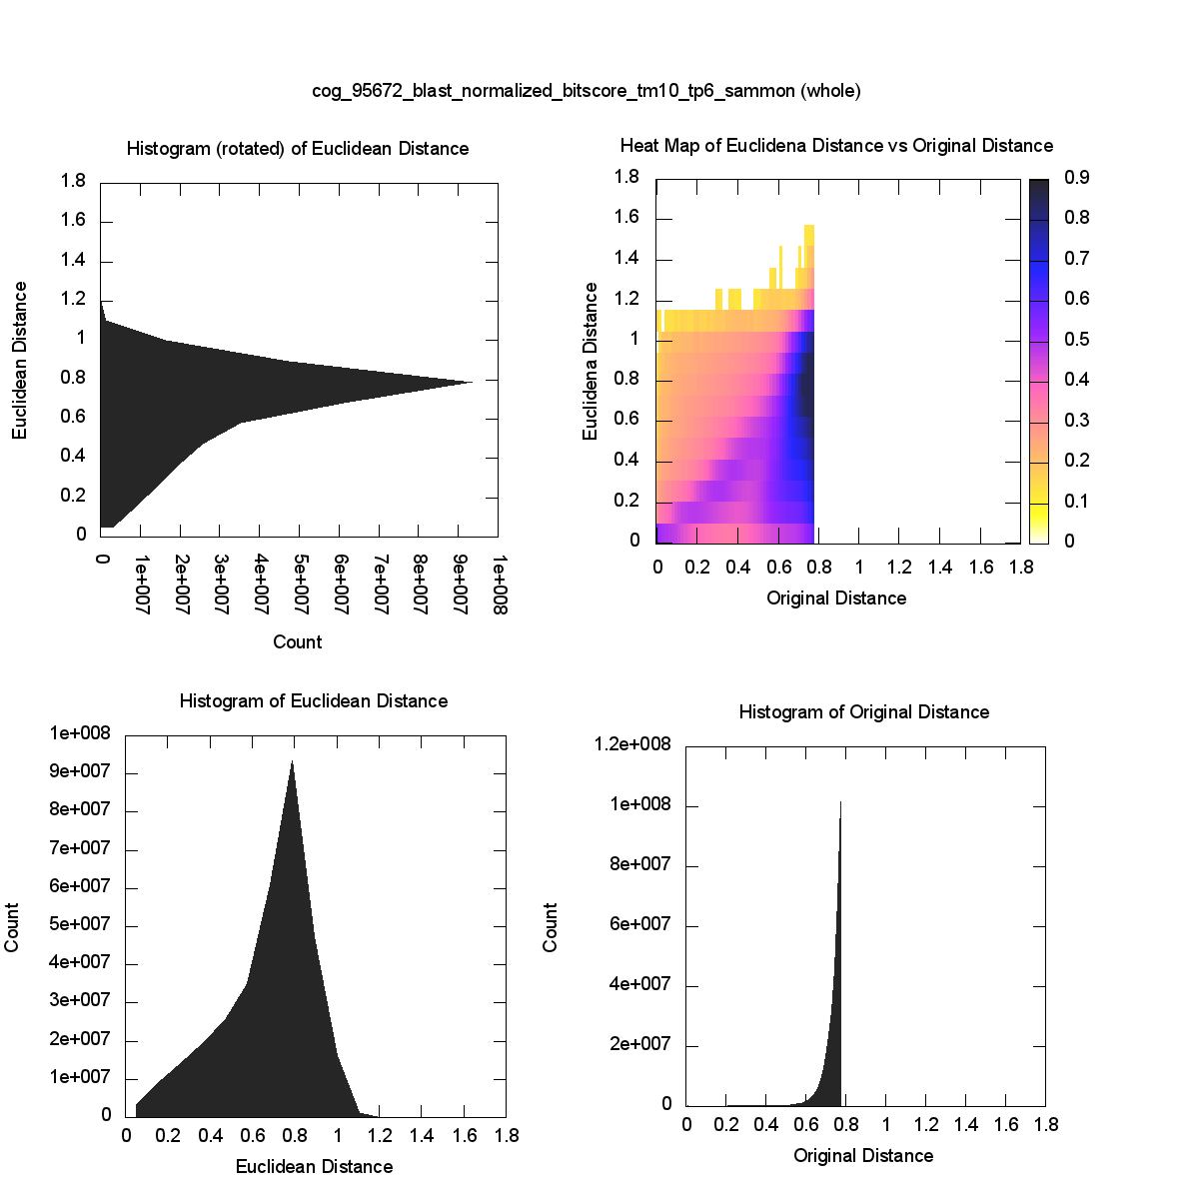
Full Data Blast⁶ Original run has 0.96 cut

Slide 36
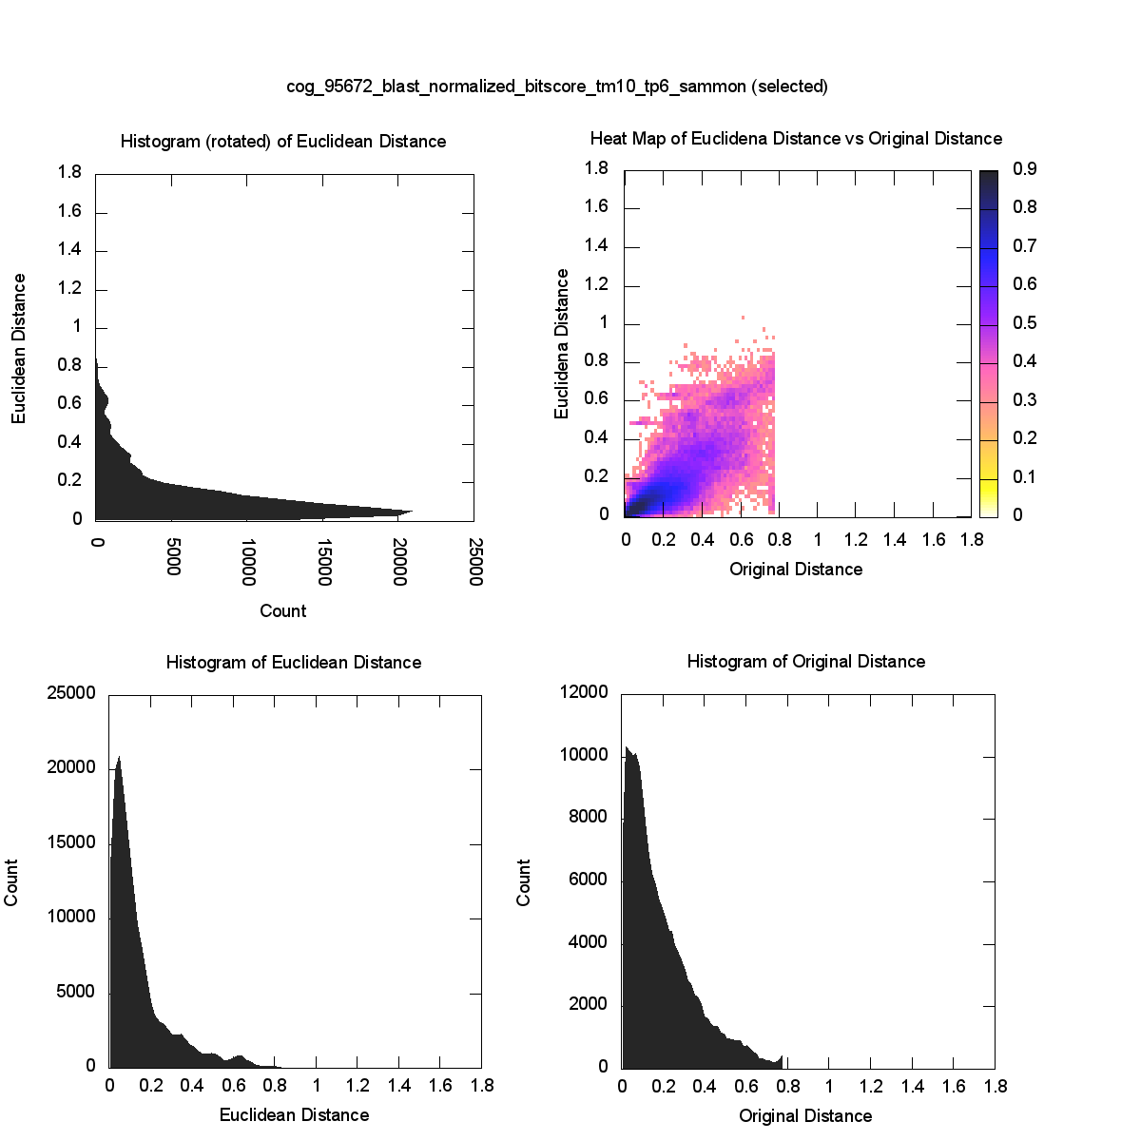
Cluster Data Blast⁶ Original run has 0.96 cut

Slide 37
DACIDR Flow Chart
16S rRNA Data
Sample Set
Out-sample Set
All-Pair Sequence Alignment
Pairwise Clustering
Dissimilarity Matrix
Multidimensional Scaling
Sample Clustering Result
Heuristic Interpolation
Further Analysis
Target Dimension Result
Visualization

Slide 38
Interpolation
Input: Sample Set Result/Out-sample Set FASTA File
Output: Full Set Result.
SMACOF uses O(N²) memory, which could be a limitation for million-scale dataset
MI-MDS finds k nearest neighbor (k-NN) points in the sample set for sequences in the out-sample set. Then use this k points to determine the out-sample dimension reduction result.
It doesn’t need O(N²) memory and can be pleasingly parallelized.

Slide 39
DACIDR Flow Chart
16S rRNA Data
Sample Set
Out-sample Set
All-Pair Sequence Alignment
Pairwise Clustering
Dissimilarity Matrix
Multidimensional Scaling
Sample Clustering Result
Heuristic Interpolation
Further Analysis
Target Dimension Result
Visualization

Slide 40
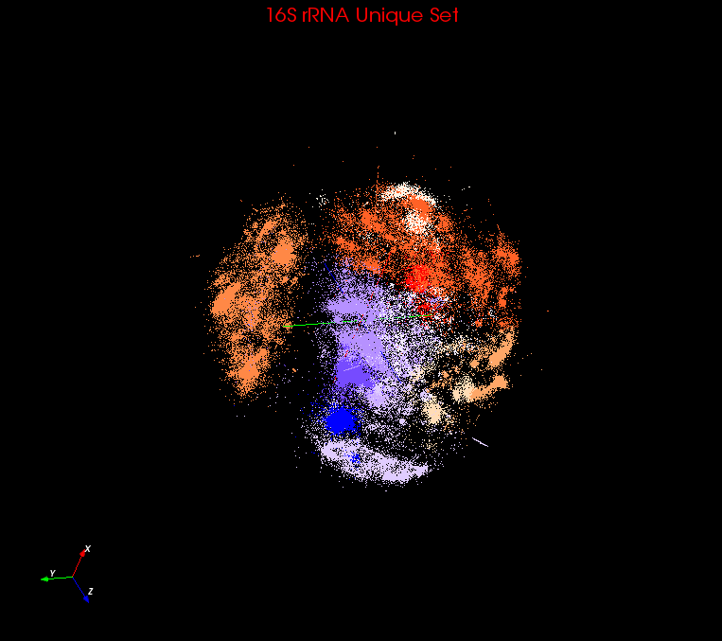
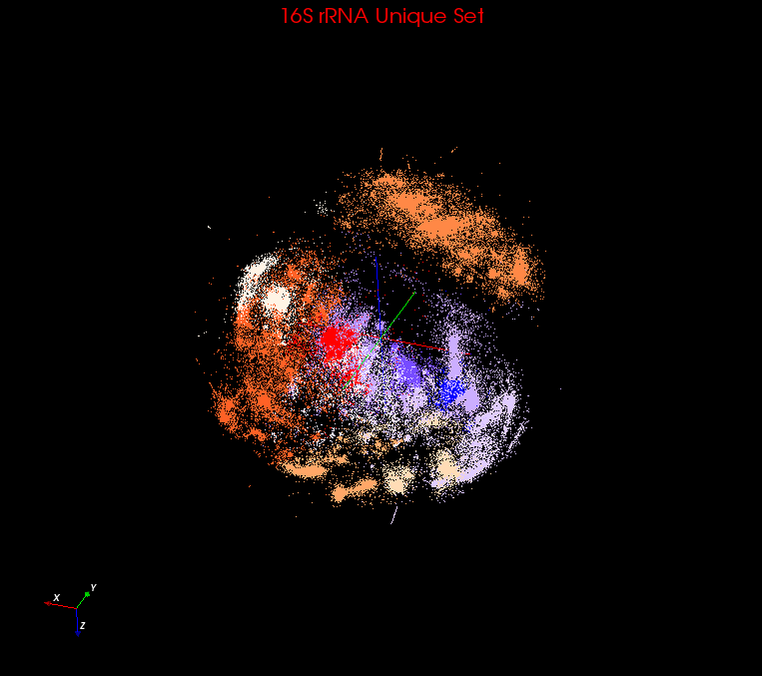
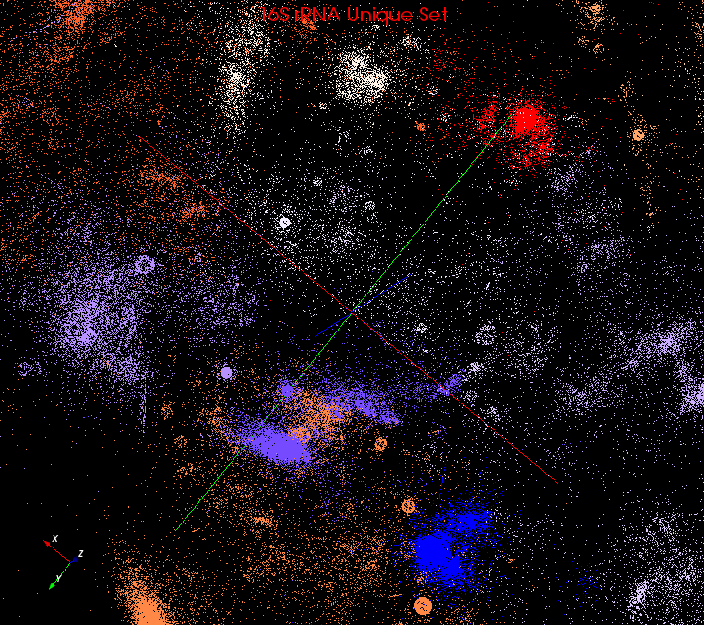
Visualization
Used PlotViz3 to visualize the 3D plot generated in previous step.
It can show the sequence name, highlight interesting points, even remotely connect to HPC cluster and do dimension reduction and streaming back result.
Rotate
Zoom in

Slide 41
SSP-Tree
Sample Sequence Partition Tree is a method inspired by Barnes-Hut Tree used in astrophysics simulations.
SSP-Tree is an octree to partition the sample sequence space in 3D.
i₀
i₁
e₄
e₅
i₂
E
F
e₀
e₁
e₂
e₃
e₆
e₇
A
B
C
D
G
H
a
An example for SSP-Tree in 2D with 8 points

Slide 42
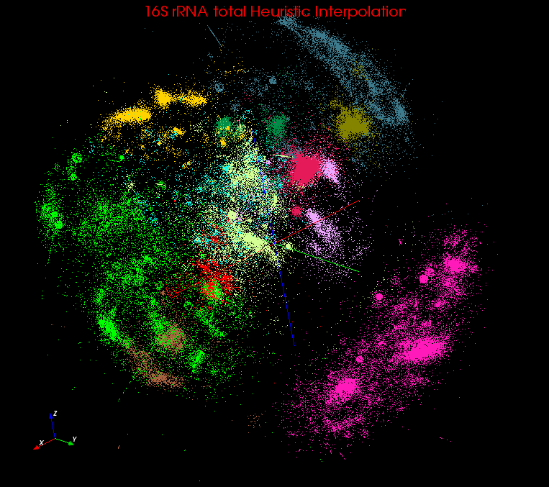
Heuristic Interpolation
MI-MDS has to compare every out-sample point to every sample point to find k-NN points
HI-MDS compare with each center point of each tree node, and searches k-NN points from top to bottom
HE-MDS directly search nearest terminal node and find k-NN points within that node or its nearest nodes.
Computation complexity
MI-MDS: O(NM)
HI-MDS: O(NlogM)
HE-MDS: O(N(N_{T} + M_{T}))
3D plot after HE-MI

Slide 43
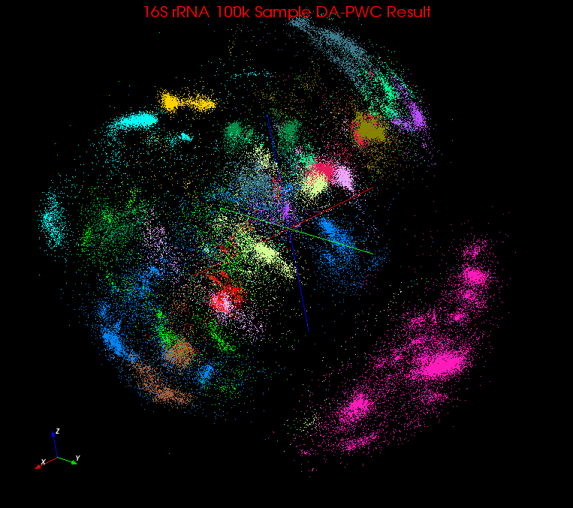
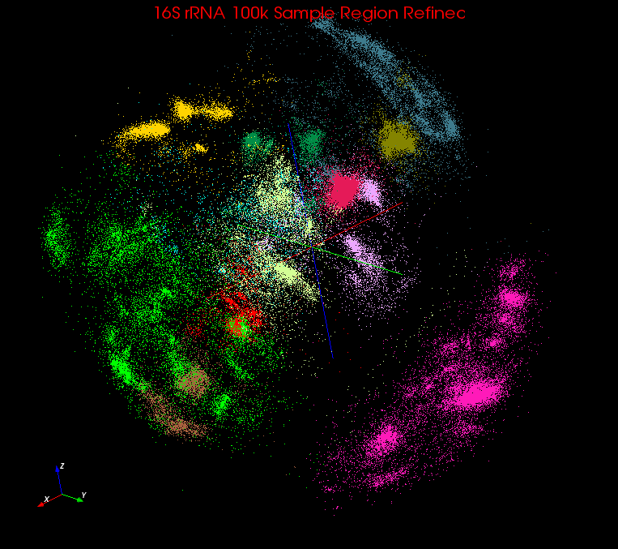
Region Refinement
Before
Terminal nodes can be divided into:
V: Inter-galactic void
U: Undecided node
G: Decided node
Take H(t) to determine if a terminal node t should be assigned to V
Take a fraction function F(t) to determine if a terminal node t should be assigned to G.
Update center points of each terminal node t at the end of each iteration.
After

Slide 44
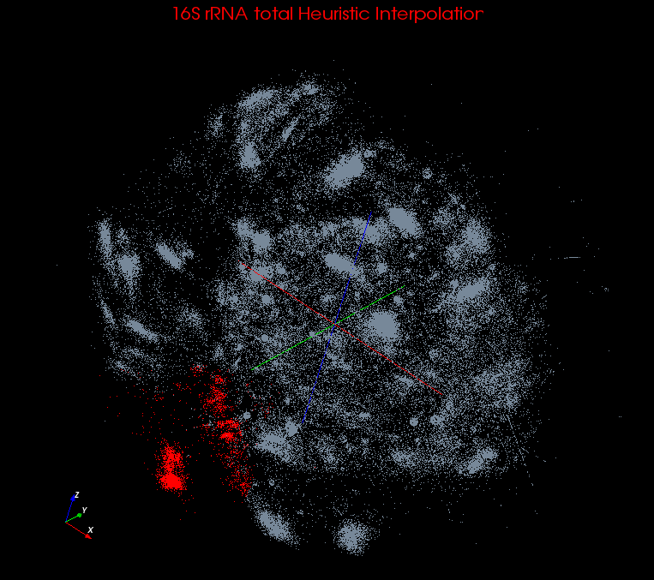
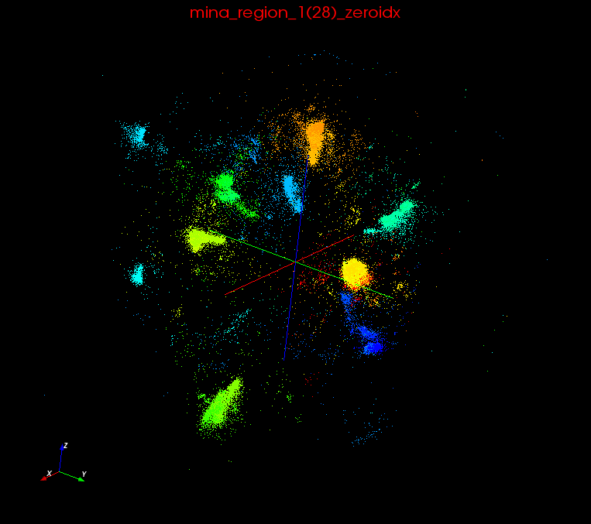
Recursive Clustering
DACIDR create an initial clustering result W = {w₁, w₂, w₃, … w_{r}}.
Possible Interesting Structures inside each mega region.
w₁ -> W₁’ = {w1₁’, w1₂’, w1₃’, …, w1_{r1}’};
w₂ -> W₂’ = {w2₁’, w2₂’, w2₃’, …, w2_{r2}’};
w₃ -> W₃’ = {w3₁’, w3₂’, w3₃’, …, w3_{r3}’};
…
w_{r} -> W_{r}’ = {wr₁’, wr₂’, wr₃’, …, wr_{rr}’};
Mega Region 1
Recursive Clustering

Slide 45
Experiments
Clustering and Visualization
Input Data: 1.1 million 16S rRNA data
Environment: 32 nodes (768 cores) of Tempest and 100 nodes (800 cores) of PolarGrid.
SW vs NW
PWC vs UCLUST/CDHIT
HE-MI vs MI-MDS/HI-MI

Slide 46
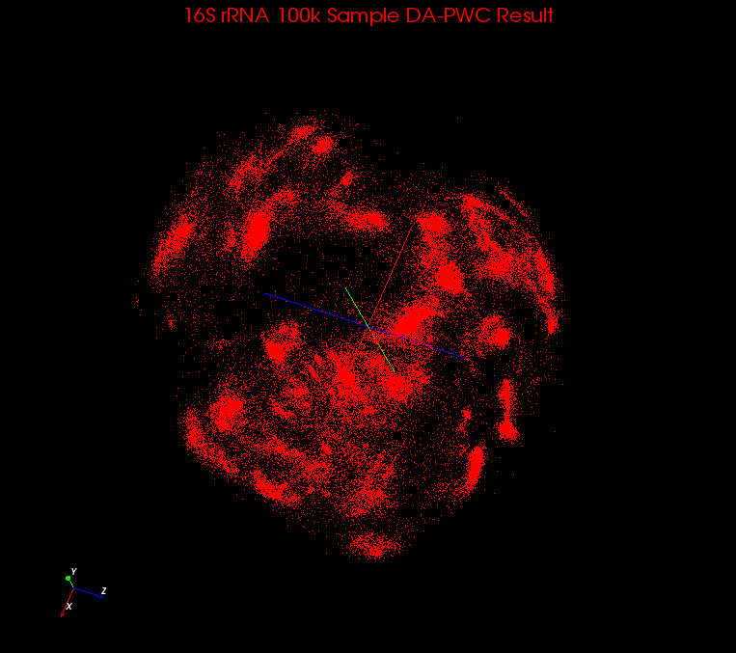
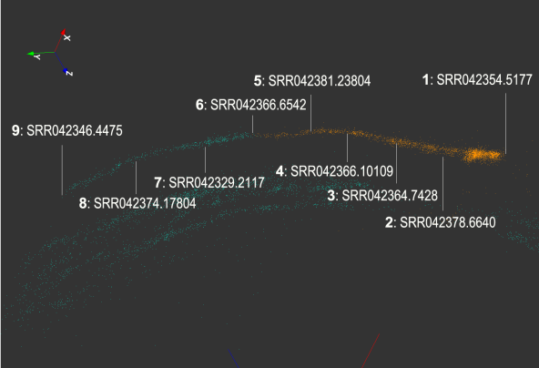
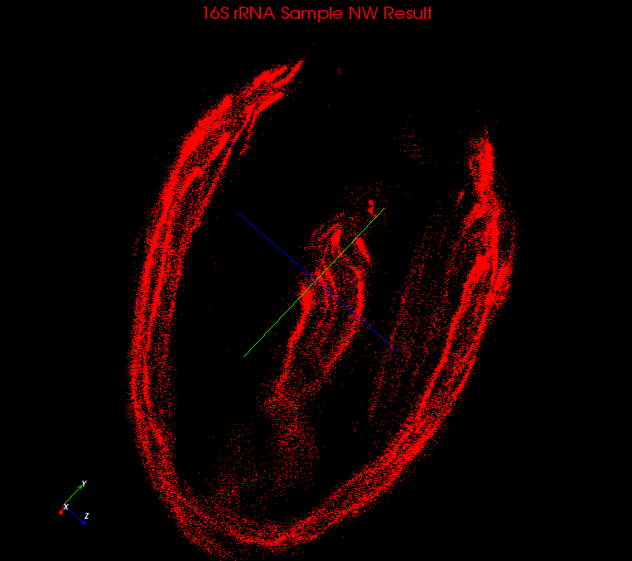
SW vs NW
SW
Smith Waterman performs local alignment while Needleman Wunsch performs global alignment.
Global alignment suffers problem from various lengths in this dataset
NW

Slide 47
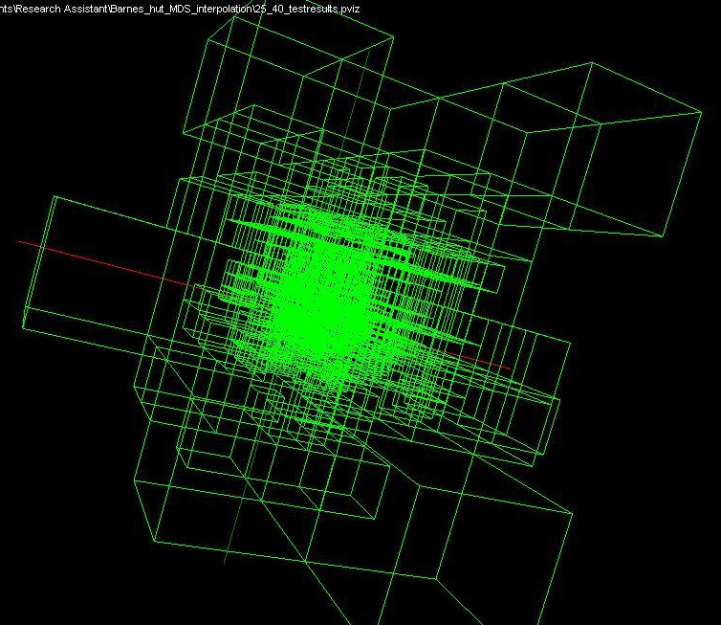
Use Barnes Hut OctTree originally developed to make O(N²) astrophysics O(NlogN)

Slide 48
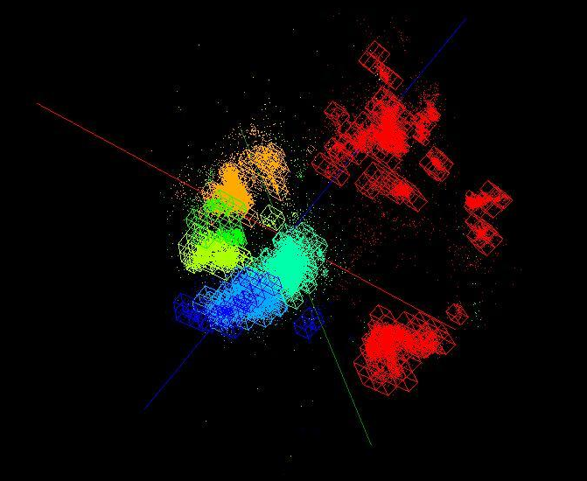
OctTree for 100K sample of Fungi
We use OctTree for logarithmic interpolation

Slide 49
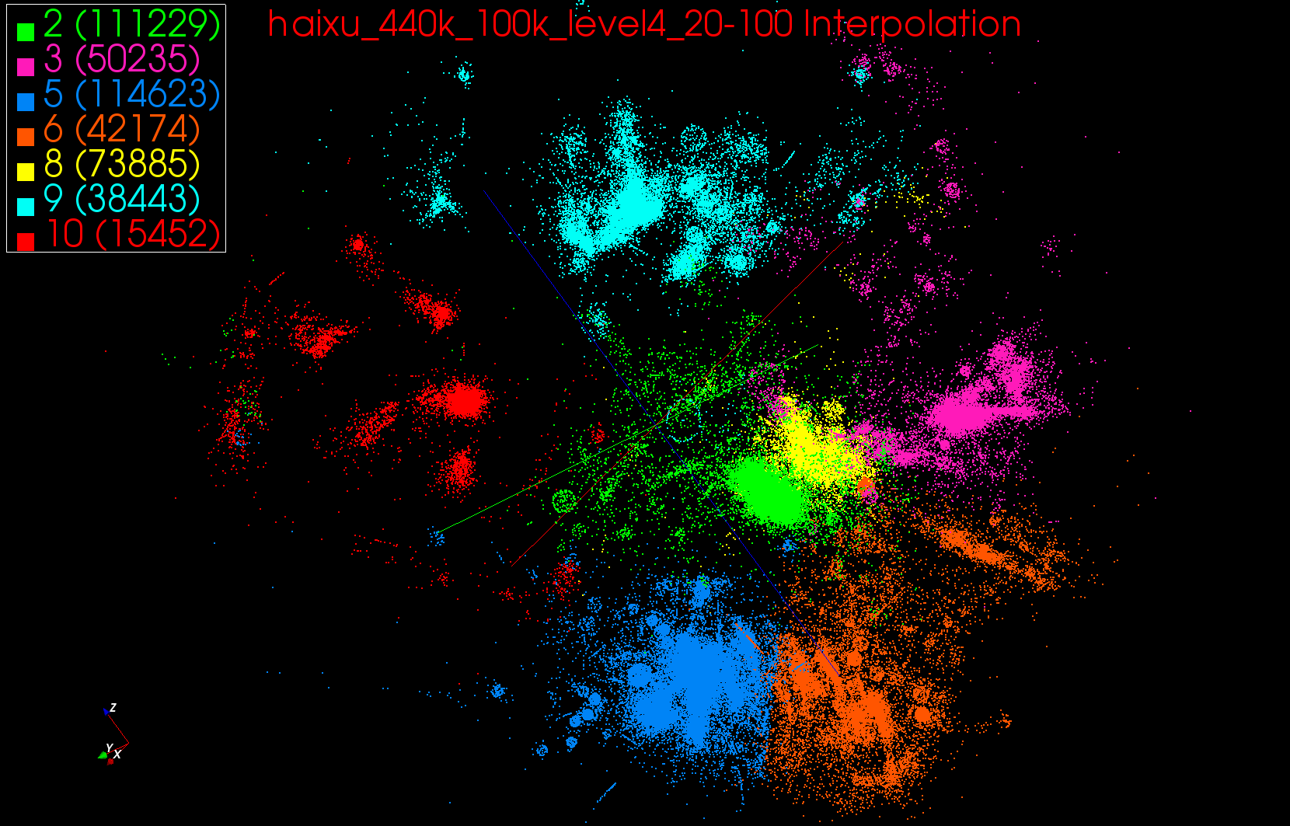
440K Interpolated

Slide 50
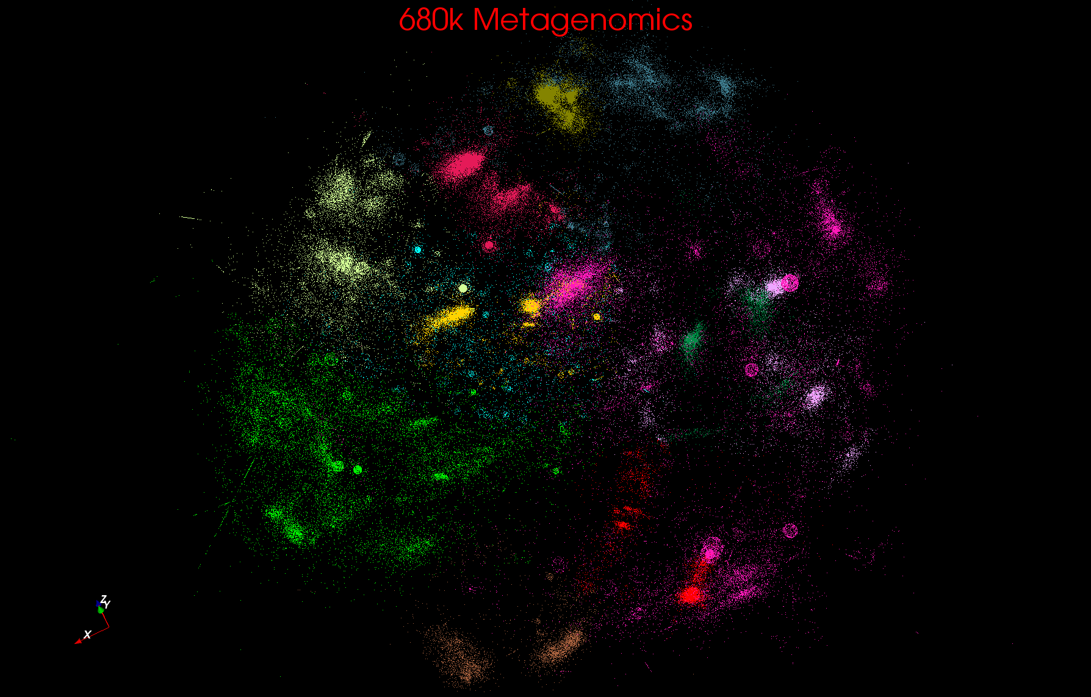
Metagenomics

Slide 51
Metagenomics with 3 Clustering Methods
DA-PWC 188 Clusters; CD-Hit 6000; UCLUST 8418
DA-PWC doesn’t need seeding like other methods – All clusters found by splitting
# Clusters

Slide 52
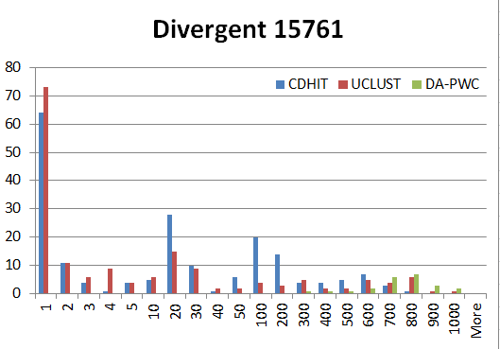
“Divergent” Data Sample 23 True Sequences
DA-PWC
UClust
CDhit
Divergent Data Set UClust (Cuts 0.65 to 0.95)
DAPWC 0.65 0.75 0.85 0.95 Total # of clusters 23 4 10 36 91 Total # of clusters uniquely identified 23 0 0 13 16 (i.e. one original cluster goes to 1 uclust cluster )
Total # of shared clusters with significant sharing 0 4 10 5 0 (one uclust cluster goes to > 1 real cluster)
Total # of uclust clusters that are just part of a real cluster 0 4 10 17(11) 72(62) (numbers in brackets only have one member)
Total # of real clusters that are 1 uclust cluster 0 14 9 5 0 but uclust cluster is spread over multiple real clusters
Total # of real clusters that have 0 9 14 5 7 significant contribution from > 1 uclust cluster

Slide 53
Conclusions and Next Steps
Clustering(and other DA) like a particle (or PIC) code with range of interaction (SQRT(T)) that varies during iteration
Spans long range force (T=∞) to nearest neighbor(T~0.1)
Data Intensive programs are not like simulations as they have large “reductions” (“collectives”) and do not have many small messages
Good for Clouds(MapReduce) and HPC(MPI)
Need an initiative to build SPIDAL scalable high performance data analytics library on top of interoperable cloud-HPC platform
Working with Saltz and others on this! Collaboration welcome
Many promising algorithms such as deterministic annealing not used as implementations not available in R/Matlab/Mahout etc. – DA clearly superior in theory and practice than well used systems
More software and runs longer but can be efficiently if nontrivially parallelized so runtime not a big issue
Current DA codes 3000-10,000 lines of (mainly) C# each

