Slide 1
IU QuakeSim/E-DECIDER Effort

Slide 2
QuakeSim Accomplishments (1)
Deployed, improved many QuakeSim gadgets for standalone integration into QuakeSim.org
  Disloc, RDAHMM, Seismicity movie generator (with ANSS data), LOS Tool
Deployed GeoServer instance that provides Open Geospatial Consortium programming interfaces to UAVSAR imagery.
  Included converting proprietary data formats to GeoTIFF.
  Allows us to extract data from imagery through online services, not just make nice pictures.
  Provides a solution for some data-centric problems: with subsetting, we don’t need to move large data around.
Extended GeoServer with several QuakeSim-specific REST interfaces
  Line of Sight services, Simplex input extraction services

Slide 3
QuakeSim Accomplishments (2)
Developed a Line of Sight tool for exploring UAVSAR data sets using GeoServer and QuakeTables on the backend.
Exploring GeoServer as an Amazon Cloud Service
  Need better networking for interactive interfaces
  Also integrate with other OGC service instances
Several upgrades to the RDAHMM and Simplex to incorporate more data sets.
  Access to UNAVCO data sets added to both RDAHMM (time series) and Simplex (velocities)
  Complete RDAHMM analysis to the data collected from over 1000 GPS ground stations in Japan during the 2011 Tohoku earthquake with Web front end.

Slide 4
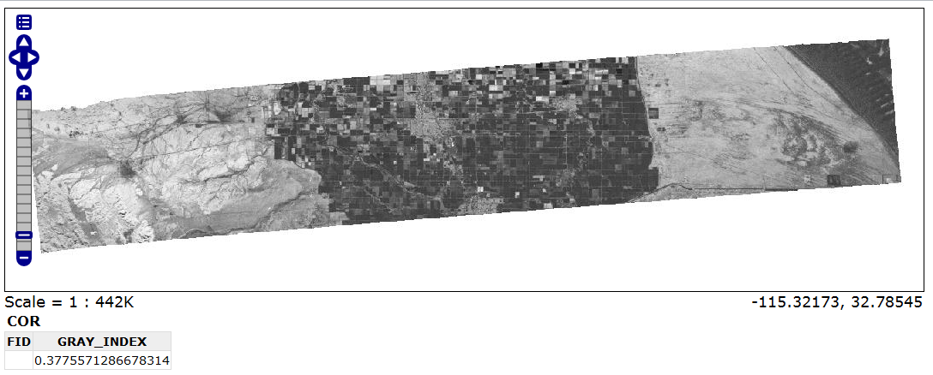
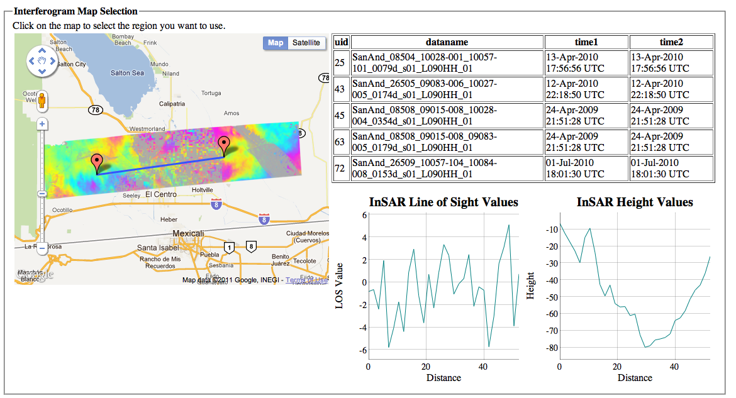
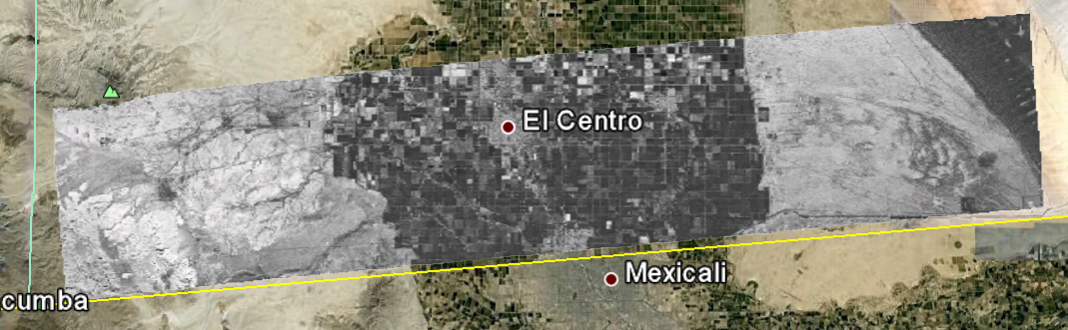
GeoServer and UAVSAR
Embed into interactive
user interfaces: LOS gadget
Open Layers Output
KML Output

Slide 5
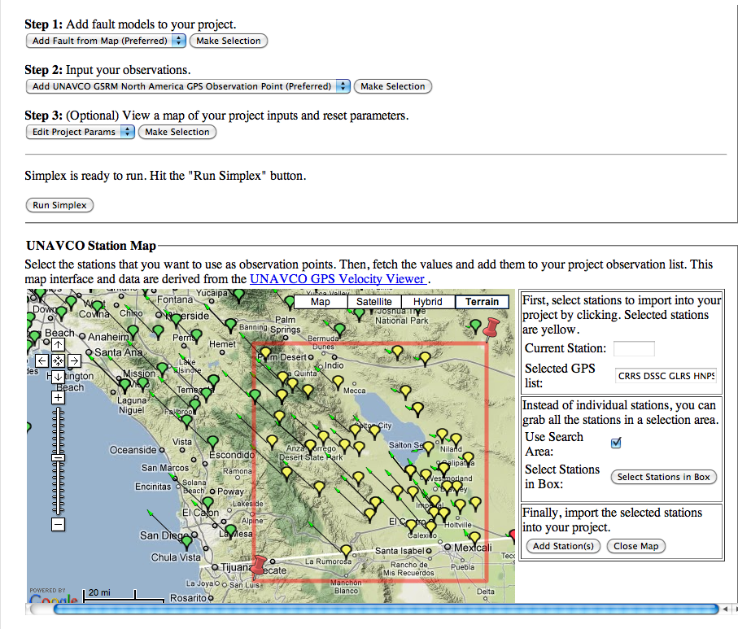
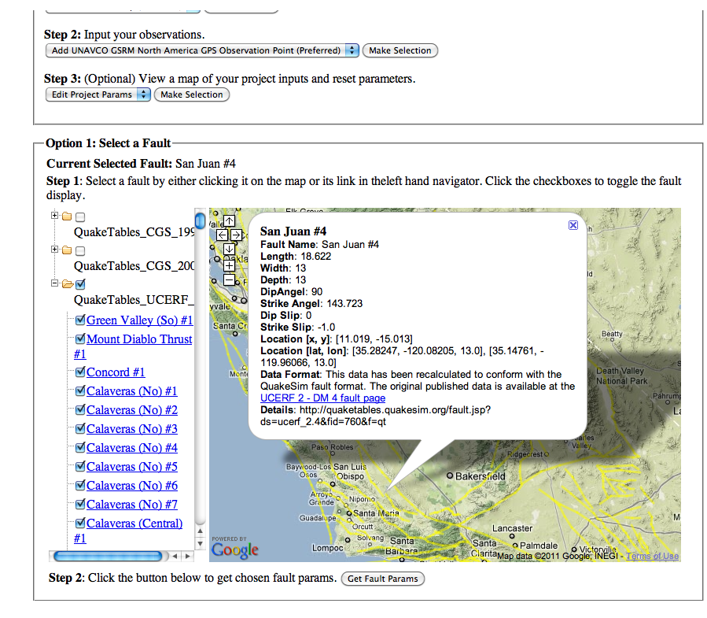
Fault Refinements with Simplex
Simplex uses GPS stations (left) and other surface observations to make refined fault models.
This could be used to make better inputs for HAZUS inputs.

Slide 6
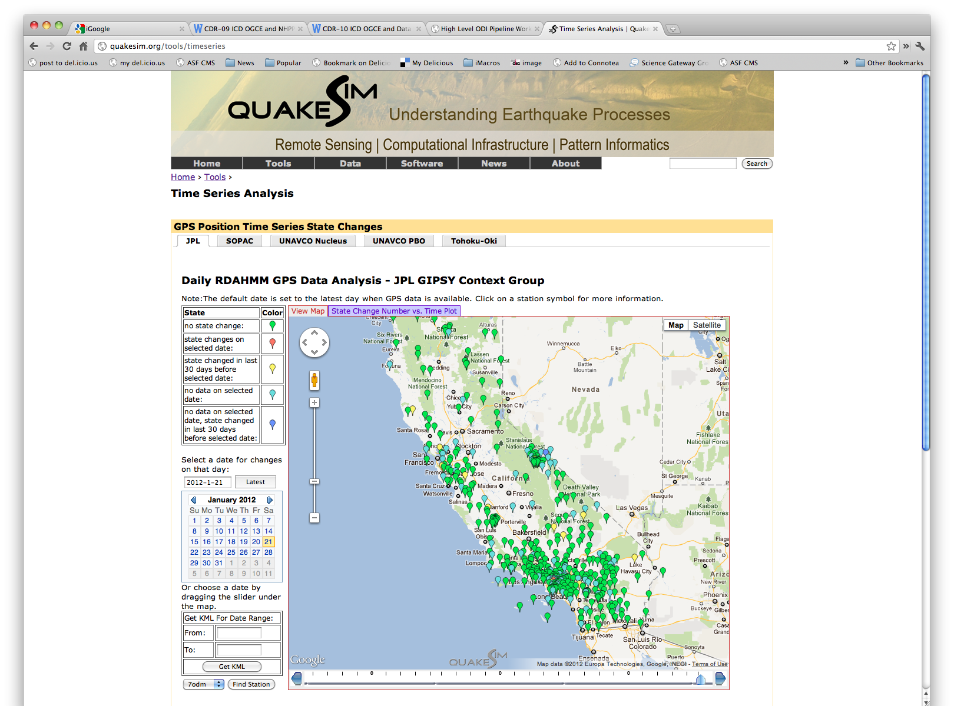
RDAHMM Integration with QuakeSim.org

Slide 7
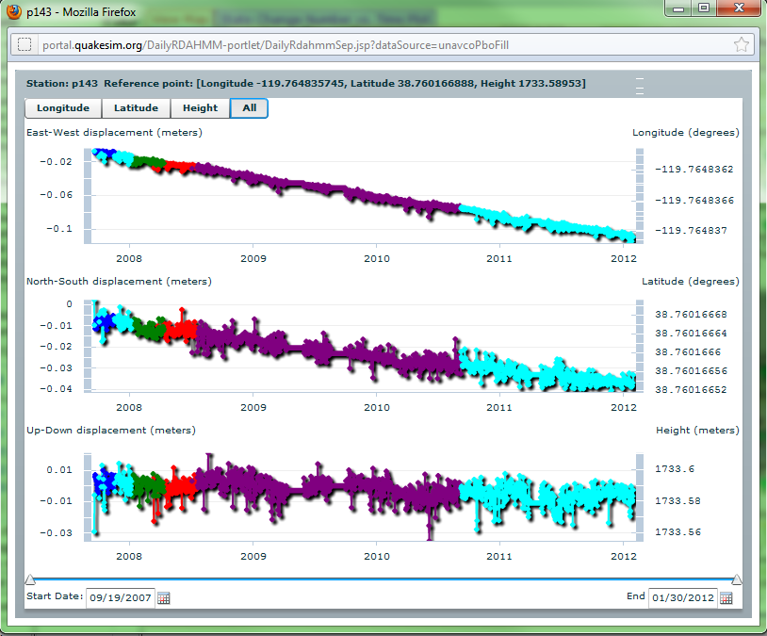
GPS Time Series Plot in Both Absolute Value and Displacements
For sustainability, we will convert this Flash interface to DyGraphs (pure JavaScript) before the project completes.

Slide 8
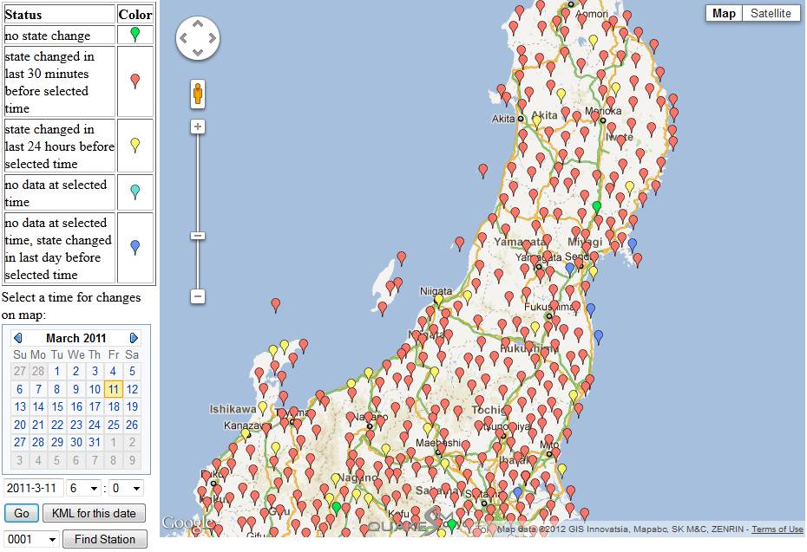
Appendix – web interface for Japan data analysis

Slide 9
Cloud Computing (1)
Our initial efforts were to develop a Virtual Block Store system.
  Reverse engineer Amazon’s EBS service.
  Provides virtual disks, RAID
Based on feedback from previous reviews, we focused more effort on practical deliverables.
Key problem: data for LOS and Simplex computations is too cumbersome to move around.
  We implemented prototypes of these use cases

Slide 10
Cloud Computing (2)
Our current GeoServer instance serves as a proof of concept for handling data collections of geophysical imagery data, providing APIs for data access, and demonstrating how to do basic computations near the data.
We are now moving GeoServer to Amazon’s cloud
  Investigate scalability strategies for cloud-GIS infrastructure on cloud-based data storage.
  Build ready-to-use cloud GIS server as a virtual machine instance for rapid distribution of large amount of images and other geo-spatial data
  Design and test work flow for geo-spatial data-chaining operations among multiple data distribution agencies.
We will evaluate network performance and compare to IU-based services before project completion.

Slide 11
What Applications work in Clouds
Pleasingly parallel applications of all sorts analyzing roughly independent data or spawning independent simulations
  Long tail of science
  Integration of distributed sensors (Internet of Things)
Science Gateways and portals
Workflow federating clouds and classic HPC
Commercial and Science Data analytics that can use MapReduce (some of such apps) or its iterative variants (most analytic apps)

Slide 12
Clouds and Grids/HPC
Synchronization/communication Performance
Grids > Clouds > Classic HPC Systems
Clouds appear to execute effectively Grid workloads but are not easily used for closely coupled HPC applications
Service Oriented Architectures and workflow appear to work similarly in both grids and clouds
Assume for immediate future, science supported by a mixture of
  Clouds – see previous application discussion
  Grids/High Throughput Systems (moving to clouds as convenient)
  Supercomputers (“MPI Engines”) going to exascale

Slide 13
Clouds and QuakeSim
Much of QuakeSim is very suitable for high throughput programming paradigm well supported by clouds
  e.g. running off many independent image or virtual California runs
  Supporting GPS sensors
We have researched the unclear data model clouds looking at open source Hbase and HDFS technologies
We have also significant work on improving MapReduce which is becoming in some areas dominant data analysis paradigm
  Better Scheduling
  Iterative Models

Slide 14
Never Hurts to Mention…
We (IU) use SourceForge SVN for all code. You can check activity of our code repository either through SourceForge or Ohloh.
We switched to JIRA from Bugzilla for task tracking, so you can follow along with what we are doing.
  Integrated with SVN: each task corresponds to one or more code check-ins.

Slide 15
E-DECIDER Augmentation Activities

Slide 16
Accomplishments
Integrated several QuakeSim tools into E-DECIDER interface.
  Simplex, HAZUS Gadget, RSS Disloc
Improved reliability, sustainability, and user interface of RSSDisloc
Converted desktop OpenSHA tools to online REST services
  This was a relatively time-consuming effort
  Need however better connections with OpenSHA group.
  Recommend Apache-style open processes

Slide 17
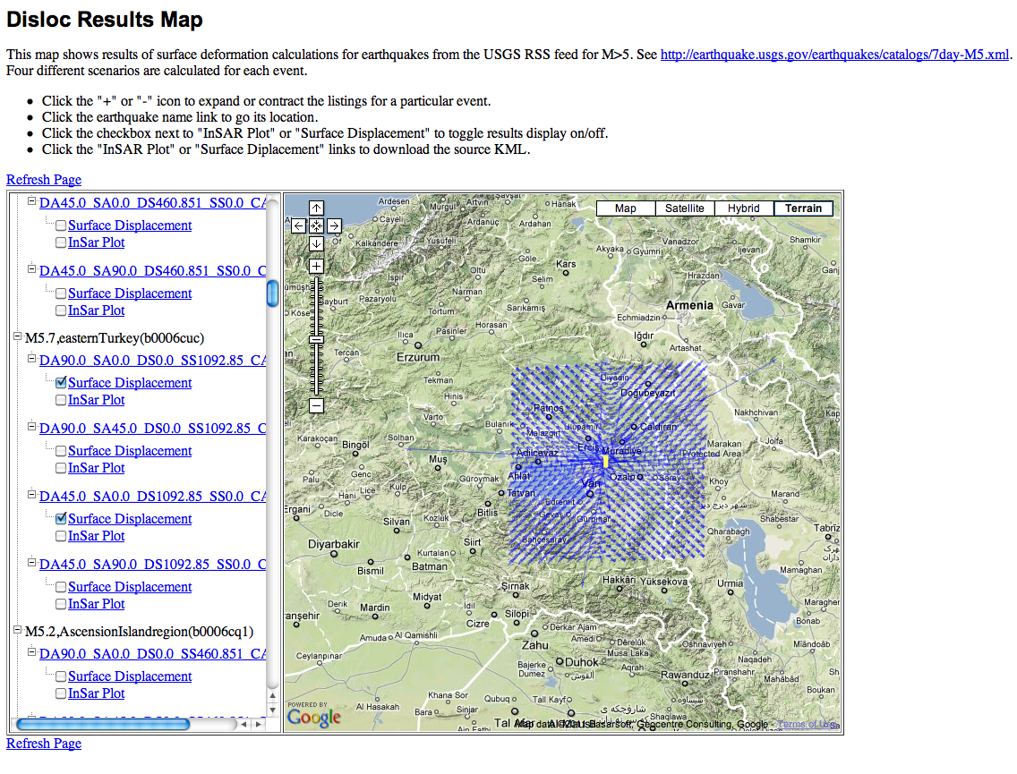
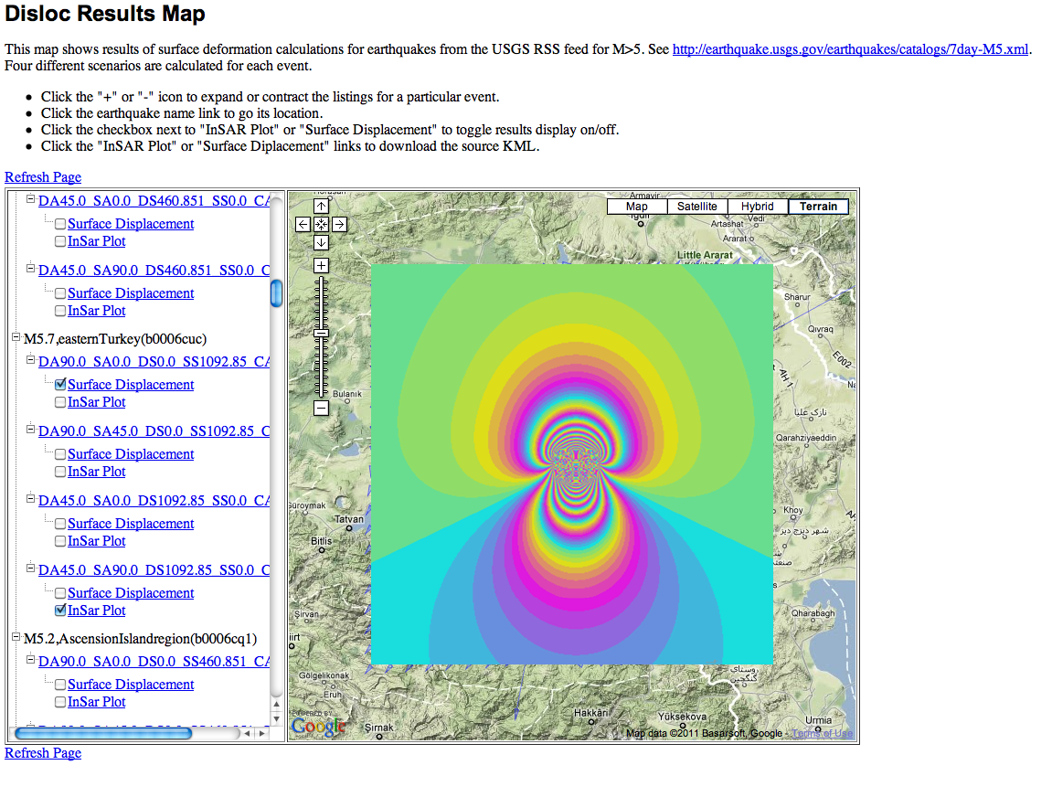
RSS Disloc
Calculates surface displacements, synthetic InSAR from the USGS M>5 Earthquake RSS feed.
Can by integrated with OpenSHA HAZUS input generation tools.

Slide 18
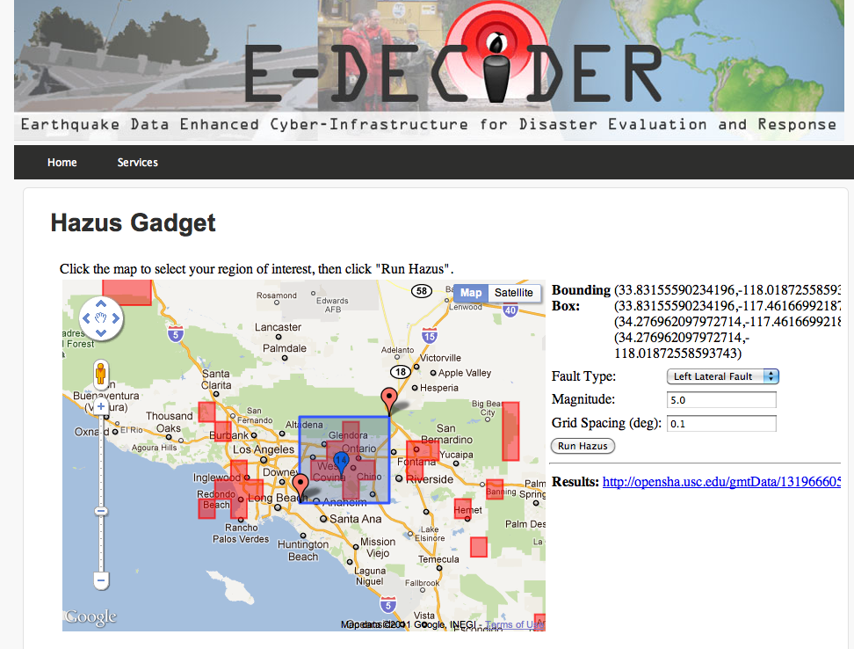
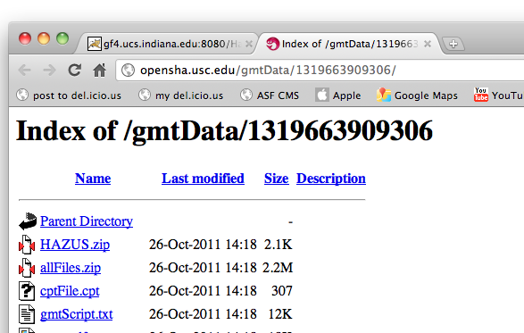
HAZUS Gadgets
Can generate HAZUS input files interactively.
Download results for now but could wrap in KML

Slide 19
Synergistic Work
From the E-DECIDER workshop (October 2011), it was clear that GIS tools to make imagery data available
  GeoServer + UAVSAR GeoTIFF data collections are a potential resource for the community.
  We have shown in QuakeSim how to extend with REST interfaces to make mash-ups.
Need cultural changes for better collaborations with other “open source” projects like OpenSHA.
  Open Community, not open source

