Slide 1
IU QuakeSim Updates
Co-PIs: Marlon Pierce, Geoffrey Fox
Students and Staff: Xiaoming Gao, Jun Ji, Jun Wang, Marie Ma, Josh Rosen

Slide 2
IU People
Xiaoming Gao: graduate student, developer of the RDAHMM-related Web interfaces and services.
Jun Ji: hourly staff, developer of deformation analysis (Disloc, Simplex, Geofest) Web interfaces and support.
Ji completed his M.S. in May 2010, is working on the project through OPT.
Jun Wang: full time staff, working on visualization services, GIS, and E-DECIDER related deliverables.
Josh Rosen: full time staff, developed the RDAHMM GPS flash viewer.
Josh worked part time to upgrade the viewer.

Slide 3
Disloc, Simplex Updates
Jun Ji, Andrea Donnellan, Jay Parker

Slide 4
Disloc-RSS Service and User Interface
Subscribes to USGS earthquake RSS feed, calculates Disloc deformations and InSAR interferograms for every earthquake in the world with M>5.
Uses previously developed Disloc services.

Slide 5
Interferogram plot of the same earthquake in previous slide.

Slide 6
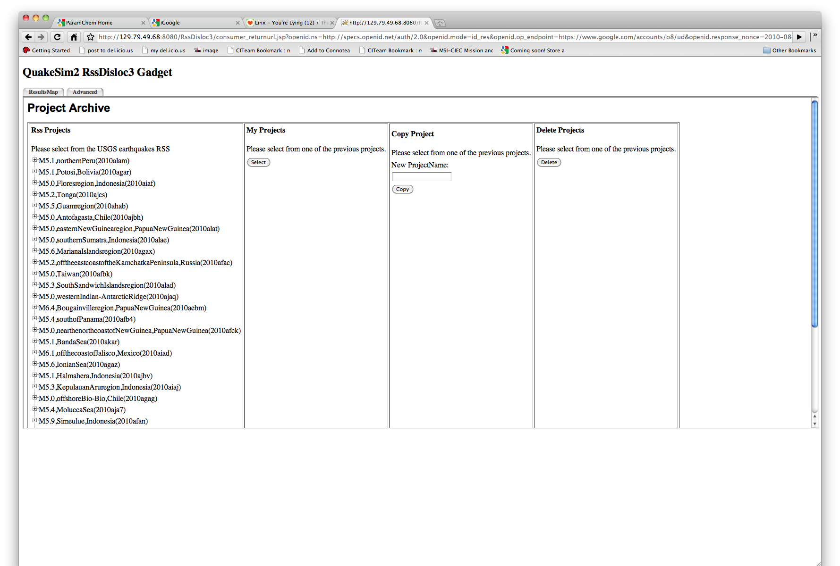
Users can also copy the earthquakes into their personal workspace to modify the default Disloc settings.

Slide 7
Simplex Updates
Simplex is an inversion code that determines best-fit fault models for a particular set of observed displacements or velocities.
We have added UNAVCO GPS station velocities to Simplex’s user interface.
Using a Web service provided by UNAVCO.
Supplements JPL GIPSY and Scripps GLOBK values from Yehuda Bock’s team’s GRWS service.
This is introduces a problem, since the services give different values.
Need an easy interface for selecting the ones you want.

Slide 8
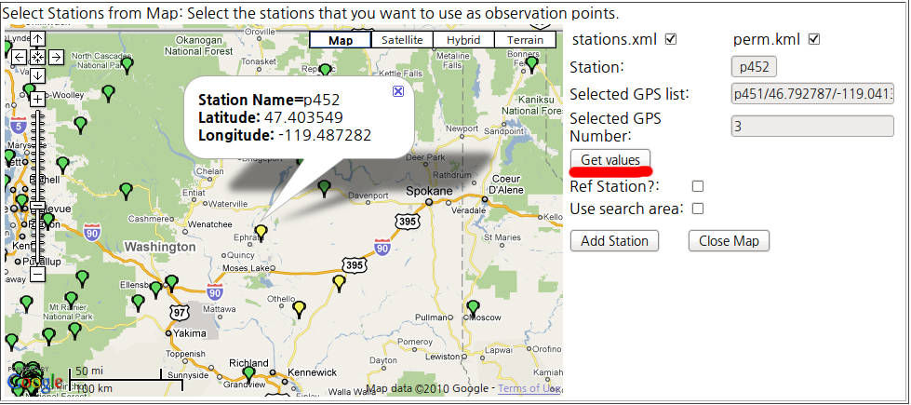
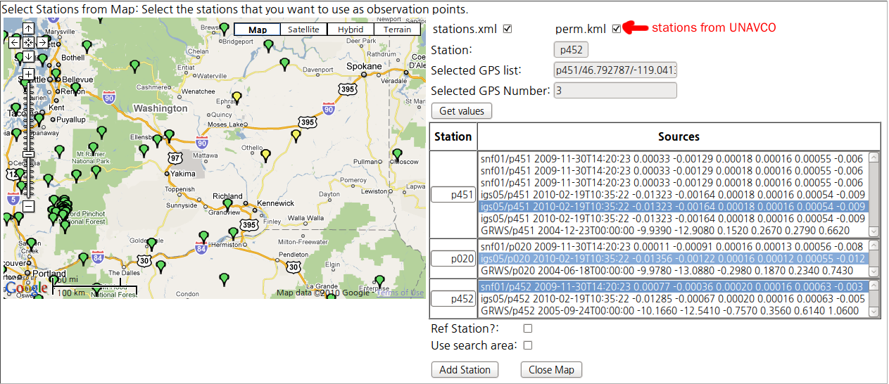
1. Select GPS stations with map interface. This may have multiple values.
2. View multiple values, select the data source that you want.

Slide 9
Update to RDAHMM Services and Interfaces
Xiaoming Gao, Robert Granat
This work is an outgrowth of Dr. Granat’s IU visit, 6/23-6/25

Slide 10
De-trend and de-noise options in daily RDAHMM service
GRWS invocation
GPS displacement data
Fill missing data with NaN
Implemented as separate services. Will be integrated into a workflow composer to allow developers to control pipeline.
De-trend
De-noise
Fill NaN with duplicated data
RDAHMM modeling or evaluation

Slide 11
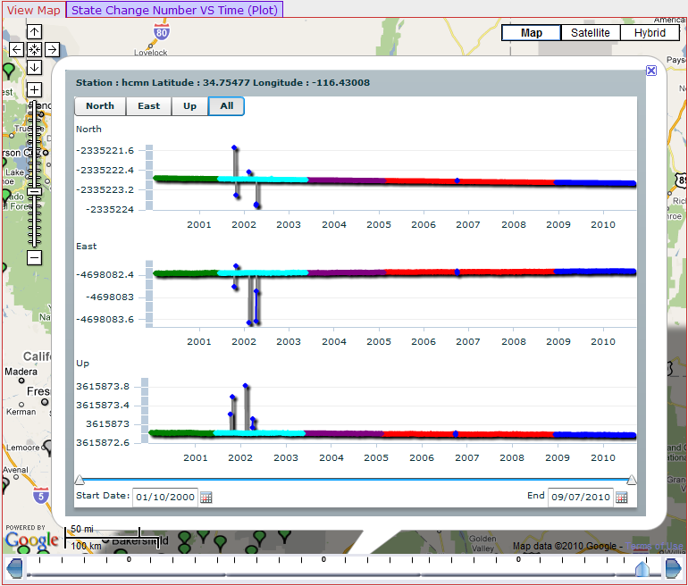
New Interactive Plotting Component (More Later)
- better point and line connections
- zoom-in and zoom-out in time scale
- slide-though along time axis

Slide 12
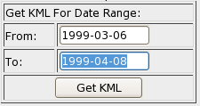
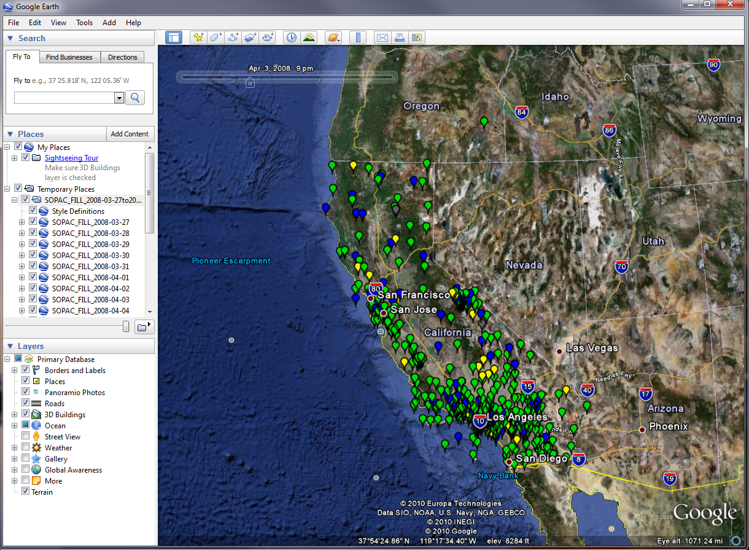
KML Creation Service for Date Range
Create and download KML of GPS-RDAHMM history with data range. Playable as a movie in Google Earth.

Slide 13
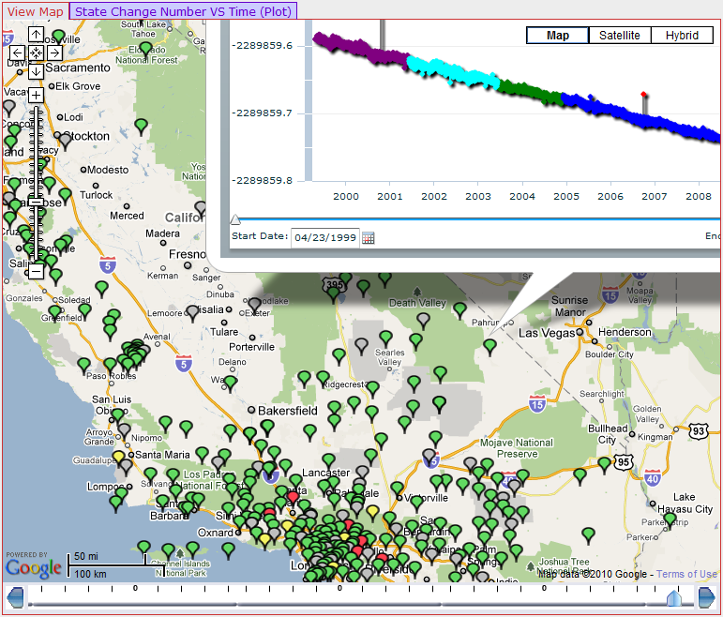
Google Map auto-center disabled

Slide 14
RDAHMM GPS Viewer Updates
Josh Rosen, Xiaoming Gao, and Robert Granat

Slide 15
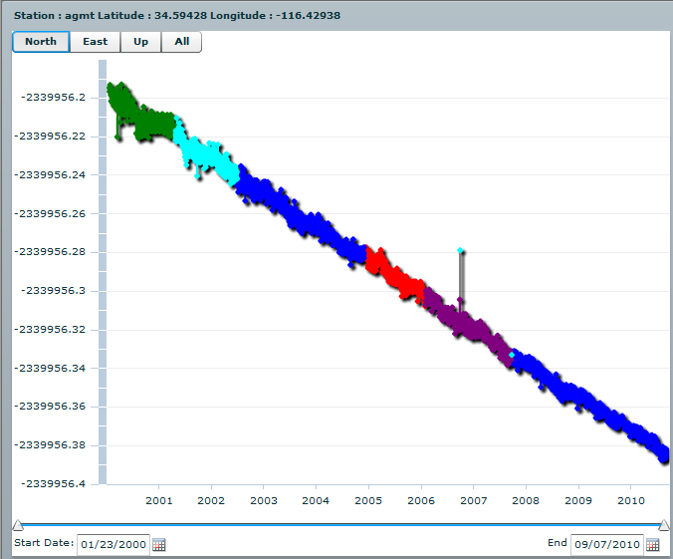
We made several updates to our interactive GPS viewer.

Slide 16
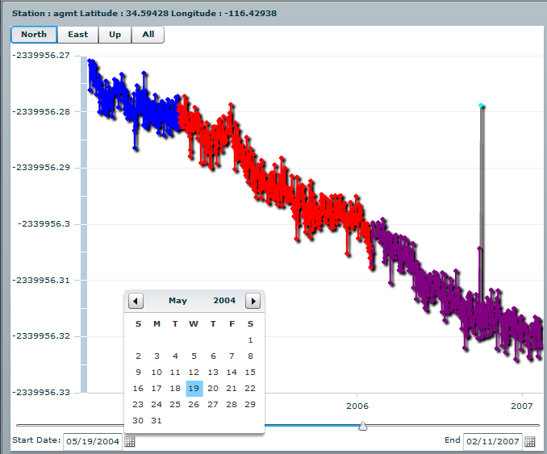
Specific Date Chooser

Slide 17
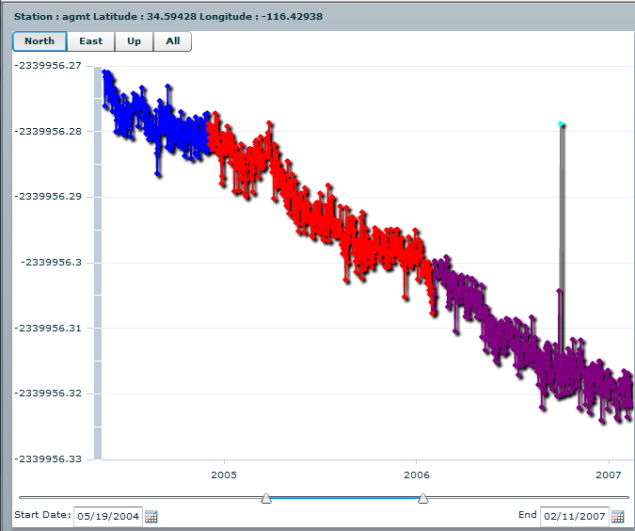
A dual slider allows you to navigate by hand. The slider also moves as a whole to keep the
Interval static.

Slide 18
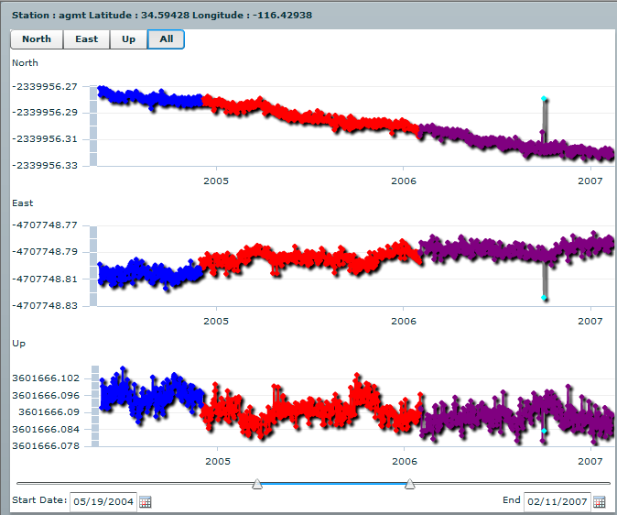
All three axes can be displayed simultaneously to see the whole picture. The
date filtering applies to each graph so the data lines up properly.

Slide 19
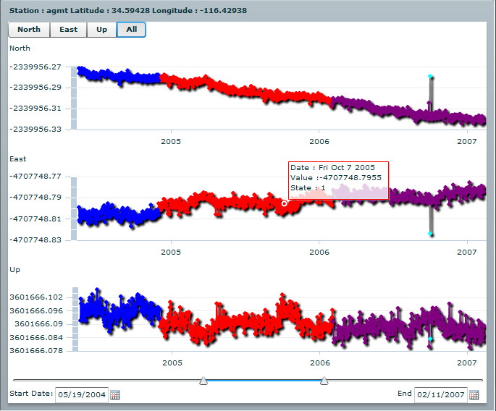
Pop-ups with detailed. point specific data can be found by moving the
mouse over the graphs.

Slide 20
Matlab Plotting and Plotting Services (In Development)
Jun Wang, Rami Al-Ghanmi, Jay Parker

Slide 21
Matplotlib Based Plotting Service
Many field-specific plots used in Earthquake studies are produced by various desktop applications, and it is difficult to seamlessly incorporate them into web portals.
We propose to develop an unified plotting service based on Matplotlib for QuakeSim, E-DECIDER and future related projects.
The goal of this plotting service is to produce the visualization products for multiple related projects with the same easy-to-access web service interface.

Slide 22
Matplotlib Based Plotting Service
Matplotlib is a Python 2D plotting library for scientific data visualization.
Pros
Python has a large library to handle many different types of scientific data formats used in earthquake study
Matplotlib can produce publication quality figures directly.
QuakeSim, E-DECIDER, and other related projects can use the same plotting service with the unified API.
The service modules are compact and portable and can be easily deployed on different computing platforms.
Cons
It may be time-consuming to port the existing plotting applications to Python for some complex visualization products.

Slide 23
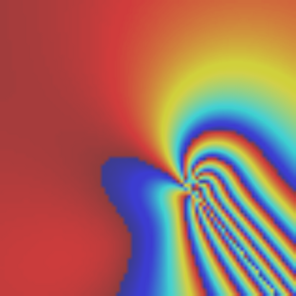
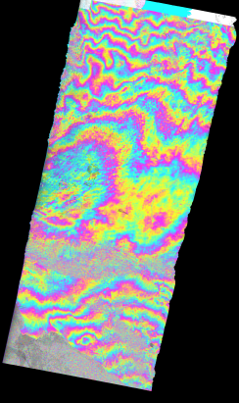
Matplotlib Based Plotting Service
Current development
Produce Disloc interferogram for the model produced by Simplex
Produce interferogram from ROI-PAC file directly
Disloc interferogram
ROI-PAC: phase, amplitude and interferogram

Slide 24
Matplotlib Based Plotting Service
Short term goal
Select a suitable web service model for plotting service
Design service API
Identify the current visualization needs from QuakeSim and E-DECIDER
Port codes from Matlab and other applications to Python
Develop tools to incorporate plotting service and Google Earth
Long term goal
Provide interactive plotting service on the portals based on the emerging HTML5 technology, without any plugins required on the client.
Develop new types of visualization products that help the decision maker and general public to understand the scientific results from research tools supplied by QuakeSim and E-DECIDER.

Slide 25
Earthquake Loss Estimation Service
Jun Wang, Maggi Glasscoe
This is a synergistic E-DECIDER activity in development

Slide 26
Earthquake Loss Estimation Web Service
Use the HAZUS-MH earthquake model for loss estimation on southern California region
Web-based service, support near real-time USGS earthquake feed and user-defined scenario study
Loss estimation on different scale: county, census tract and parcel
Multiple delivery methods for different type of users

Slide 27
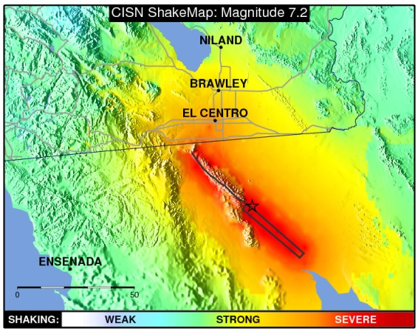
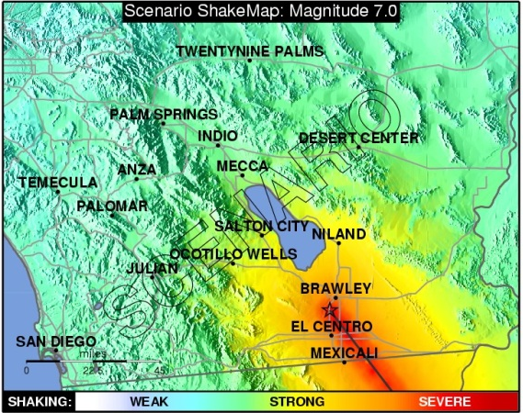
HAZUS-MH Earthquake Model
PESH (potential earth science hazards):
Peak ground acceleration (PGA)
peak ground velocity (PGV)
spectral acceleration at 1.0 sec (SA10)
spectral acceleration at 0.3 sec (SA03)
Real Earthquake
Scenario Earthquake

Slide 28
Earthquake Loss Estimation Web Service
Parcel Data*
USGS Real-time Earthquake RSS
Estimation Report
HAZUS-MH
County
Loss Map
Magnitude > threshold
Tract
Google Map
Parcel
Mobile Device
QuakeSim
Scenario Earthquake
Other Sources
*Parcel data is not included in HAZUS-MH data. Real estate service zillow.com can be used to update the market value.

Slide 29
Earthquake Loss Estimation Web Service
We propose this web service as part of E-DECIDER
Current goal
Work out the technic details to automate the HAZUS-MH process
Implement the web service to monitor USGS earthquake feed, and start loss estimation automatically
Generate scenario earthquake from QuakeSim

