Slide 1
Nano-Cell Activities Subunit
ENBCT7-9
James Glazier and Andy Somogyi

Slide 2

Nano-Cell Level Tools ENBCT7-9
Extravasation
Transport in Tissues
Cell, ECM, NP Interactions
Endocytosis
Action On Cells
Dossage
Circulation
The pathway and effects of nanoparticles in an organism depend on processes at a multitude of interacting scales
The Nano-Cell Tools focus on the boxed scales
Length

Slide 3
Nano-Cell Level Tools
Nanoparticle Tools
(< 100 nm)
Tissue Tools
(> 100𝜇m)
Nano-Cell Tools
(~500nm to 100𝜇m)
Consist of three components
  NP Biotransport, ENBCT8
    Generates micro scale models parameters from nano-scale simulation results
  Cell Simulator, ENBCT7
    Detailed simulation of a single motile cell to small clusters of cells
  Nanodevice-Cell Phenotype Link, ENBCT9
    Generates model parameters for tissue scale tools.
Length
Coupled ODE, Stochastic, MD,…

Slide 4
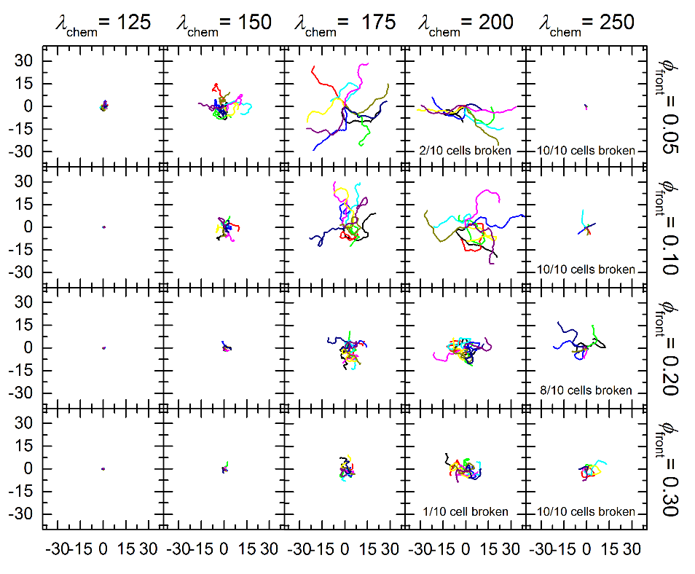
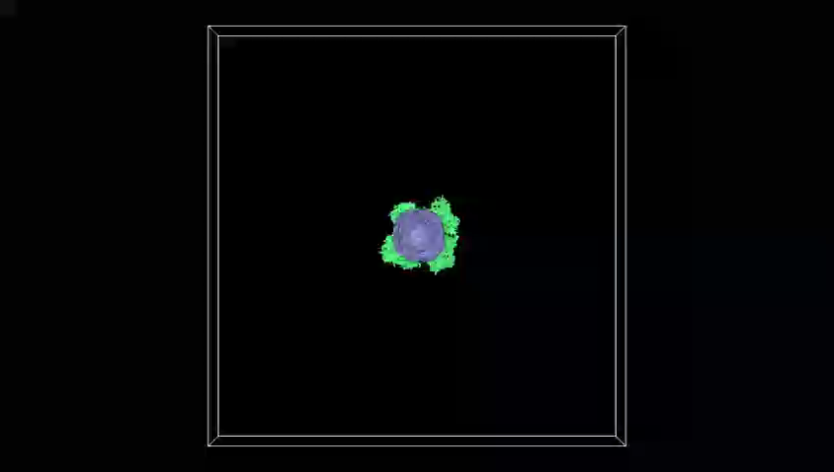
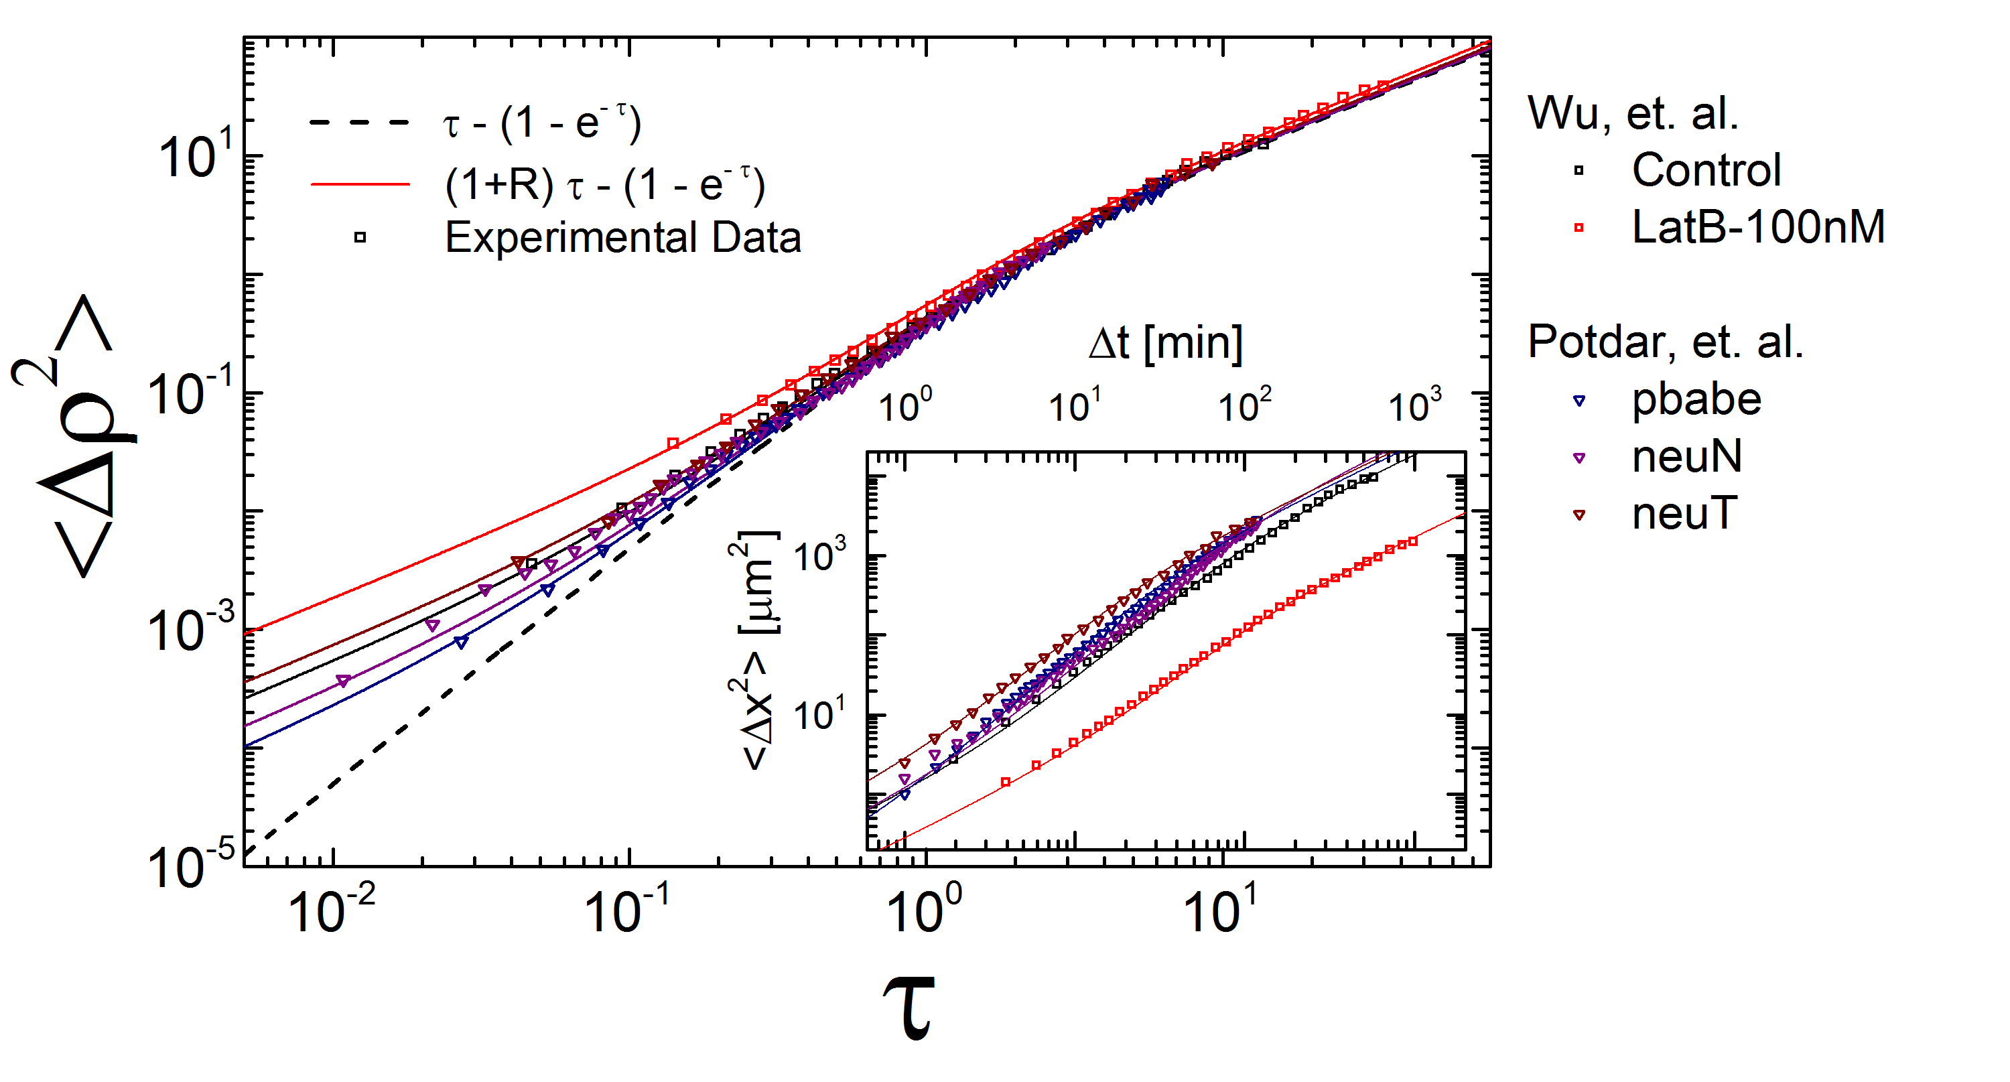
Use Case—Predict Cell Motility from Polymerization rates
Input Parameters: Actin and Myosin microscale behaviors
Output Parameters, diffusivity, timescales

Slide 5
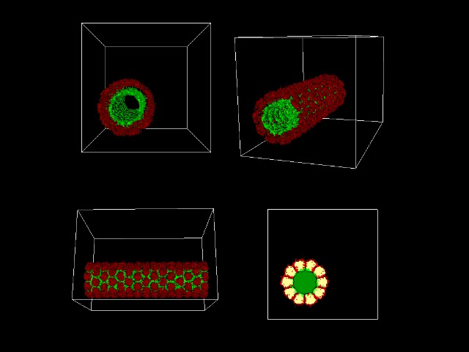
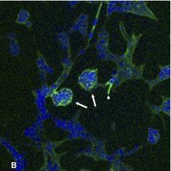
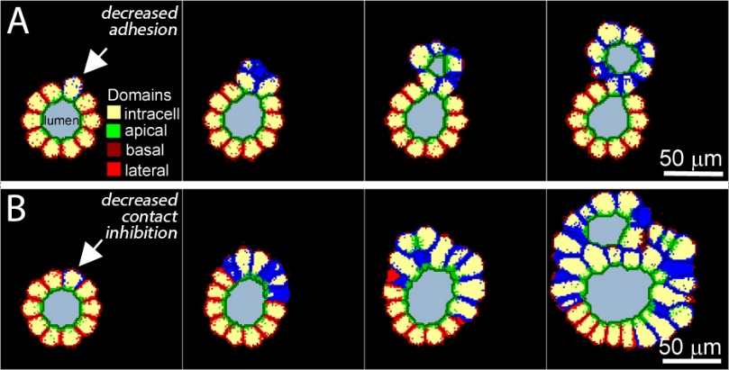
Use-Case: Predict Small-Scale Tissue Pathology from Cell Interactions and Design Therapy
Input Parameters, cell adhesion, contact inhibition thresholds
Output--Tissue Dynamics

Slide 6
Nano-Cell Level Tools
Tool Name | Overview | Status | Computing Resources
ENBCT7: Cell Simulator | Enables steerable, highly detailed simulations of a single cell to small clusters (~100) of cells, and the surrounding ECM | Active Development, planning for initial release in Q1 2018 | C++, currently single threaded. OpenGl graphics. Future GPU computation via OpenCL. Could run days for research even when parallel
ENBCT8: NP Biotransport | Generates parameterized cell-scale models of nanoparticles from nano-scale simulation results | Planned Y2 | C++, ~seconds run time
ENBCT9: Cell Phenotype Link | Generates parameterized tissue-scale models of cell-nanoparticle behaviors from cellular-scale simulations | Planned Y3 | C++, ~seconds run time

Slide 7
Cell-NP Interactions
Cells exist in a dynamic microenvironment of ECM and other cells
Cells interact via chemical and mechanical processes with their environment
Cells both create and respond to the environment that surrounds them
NPs must travel through ECM before interacting with cells
Membrane is heterogeneous and dynamic
Different membrane receptors react differently to NP and other chemical signals
Cells also respond to internalized NPs

Slide 8
Addressing Computational Challenges
Components move, change shape and reorganize so cannot use standard FE mesh approaches—Solution: Dynamic finite-element data structure that supports runtime topological and structural mesh rearrangement
Cell behaviors depend on and effect through both chemical and mechanical processes—Solution: FE elements support consistent treatment of chemical and mechanical properties
Metabolic, signaling and transport operate on a faster time scale than cell motion, which in slower than tissue scale—Solution: time evolution formally separates timescales

Slide 9
Deliverables – Finite Element Cell Sim
Y1—desktop version of our Finite Element cell dynamics simulator
Enables users to simulate one to hundreds of detailed interacting cells with NP interactions
Models can include complete reaction-transport processes within and between cell membranes, cytoplasm, cells and environment
Initially hard-coded NP descriptions, later import results of MD simulations
FEM cell simulator with interactive display via OpenGl, enables users to monitor, interact with, and steer running simulations
Models parameters displayed as ‘sliders’ in GUI, so users can tune values
Initial integrated rendering engine. Later remote rendering and display in Jupyter notebook

Slide 10
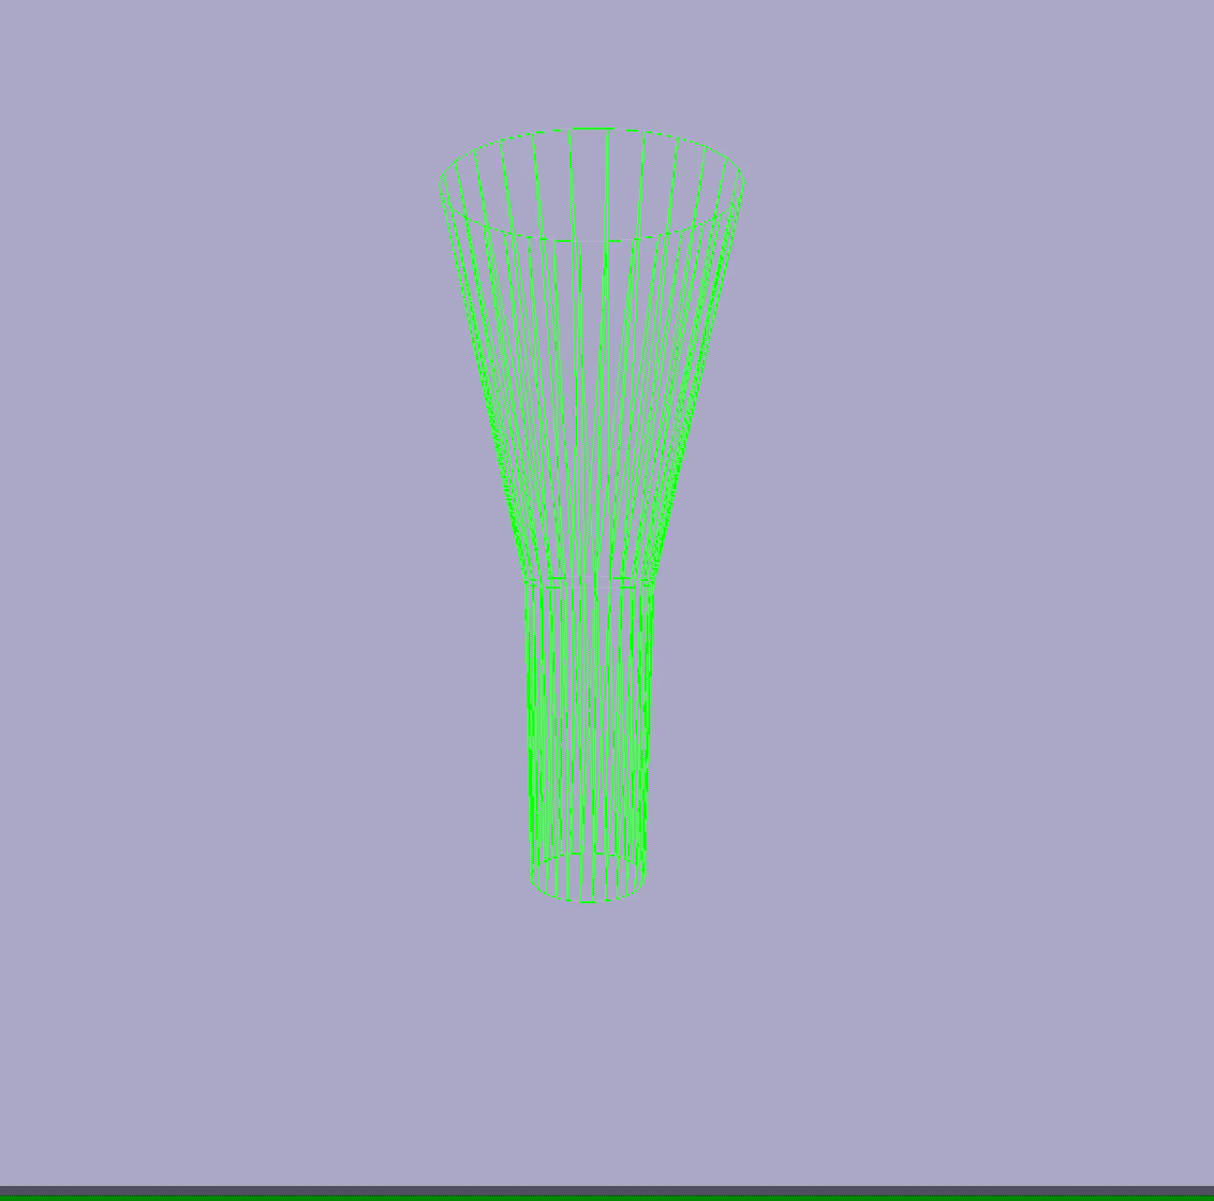
Cell Simulator Demonstration
Operates in real-time
Dynamic Adaptive Mesh Finite Element simulator – adaptively adjusts to level of detail, maximizes computational efficiency
Represents both chemical and mechanical processes in the data structure – maximizes consistency and efficiency, results in simpler and more maintainable code base with no ‘glue’

Slide 11
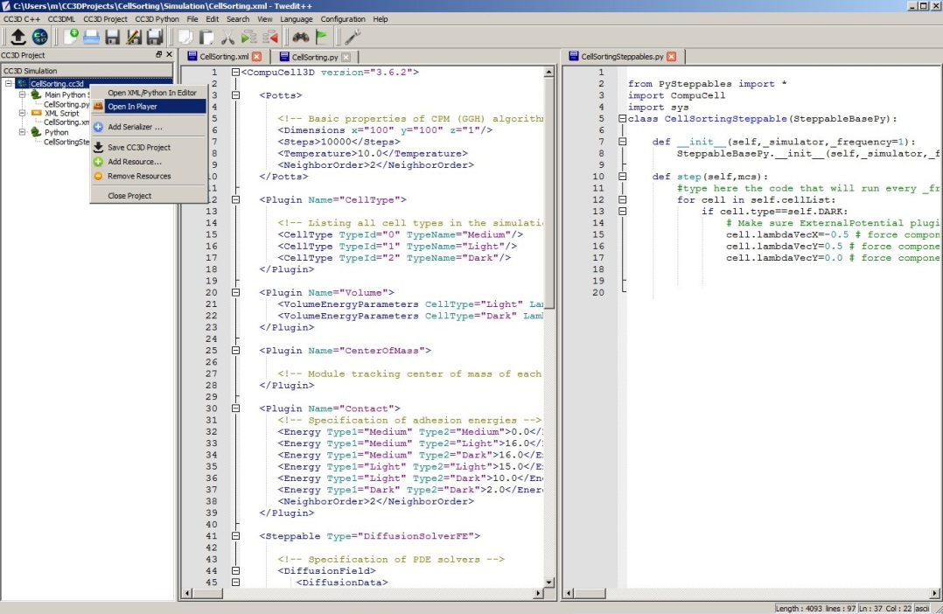
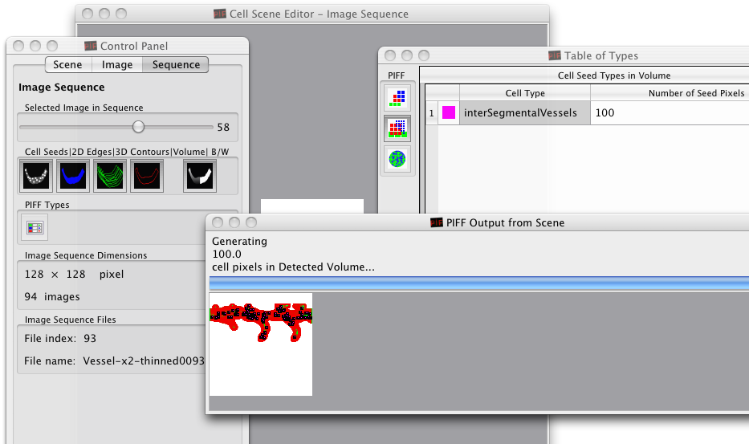
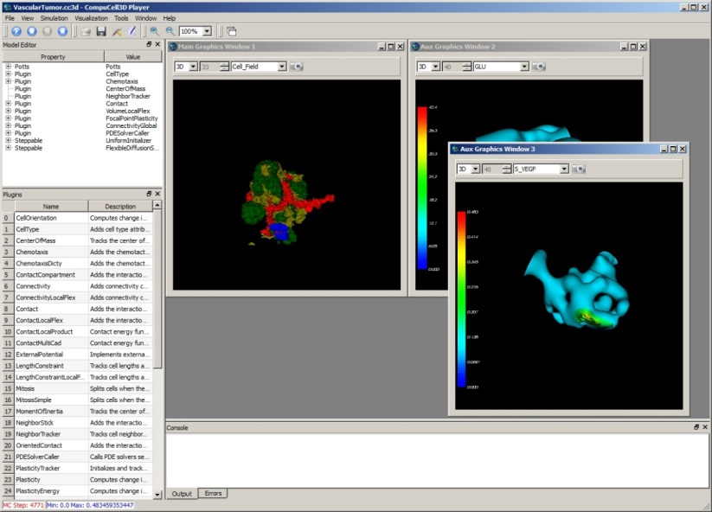
CompuCell3D
Open-source ecosystem for multiscale and simulation which integrates molecular to tissue-level scales
Describes models using SBML/CC3D-XML/Python (no compilation)
Desktop and batch cluster execution—not client server structured
Multicore and multithreaded but not MPI parallel
Evaluate porting CompuCell3D to the nanohub Rapture environment
Investigate porting core CompuCell3D libraries for Jupyter notebooks

Slide 12
Community Building / Outreach
CompuCell3D is widely used worldwide in both graduate and undergraduate courses in computational biology
Extend current annual CC3D workshops to new nanohub tools, and evaluate the need for bi-yearly workshops
Outreach for new tools to existing CC3D user community
Expand and update user documentation to include new tools
Active user community:
https://www.allanswered.com/community/s/compucell3d/
Current development takes place on github, extend to nanohub
https://github.com/CompuCell3D/CompuCell3D
Create and support developer community

