Slide 1
Engineered nanoBIO Node at Indiana University
October 17 2017
Washington DC
Geoffrey Fox, James Glazier, Vikram Jadhao, Paul Macklin, Laura Pettit, Andy Somogyi
Intelligent Systems Engineering Department, Indiana University Bloomington

Slide 2
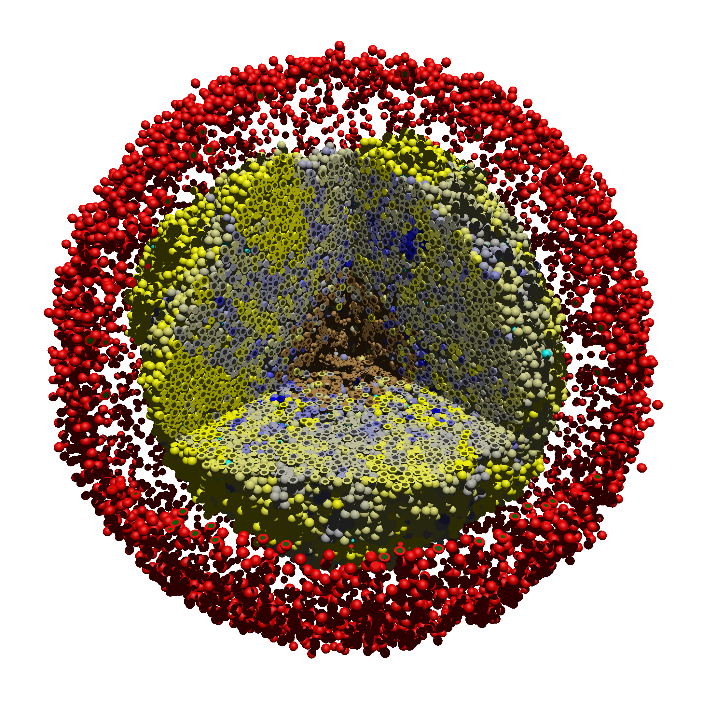
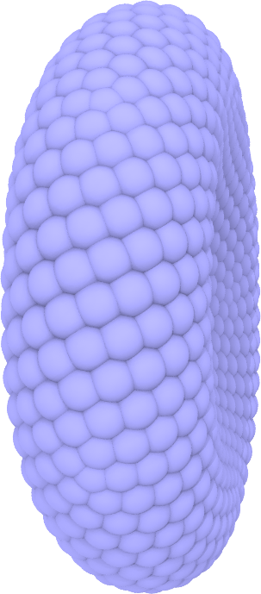
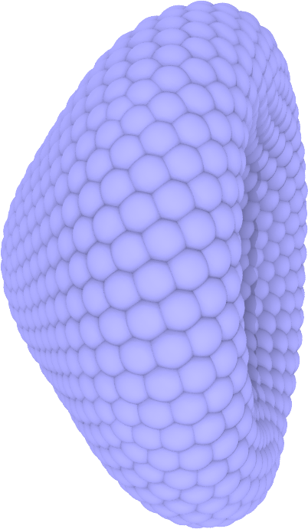
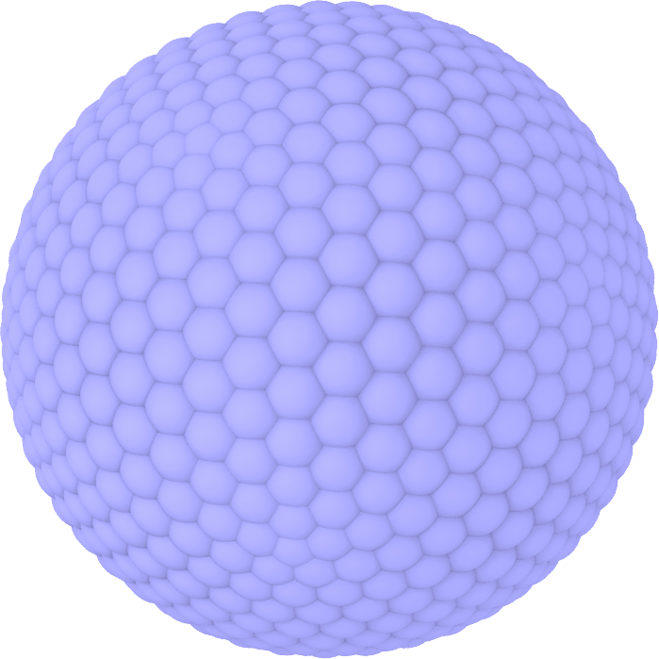
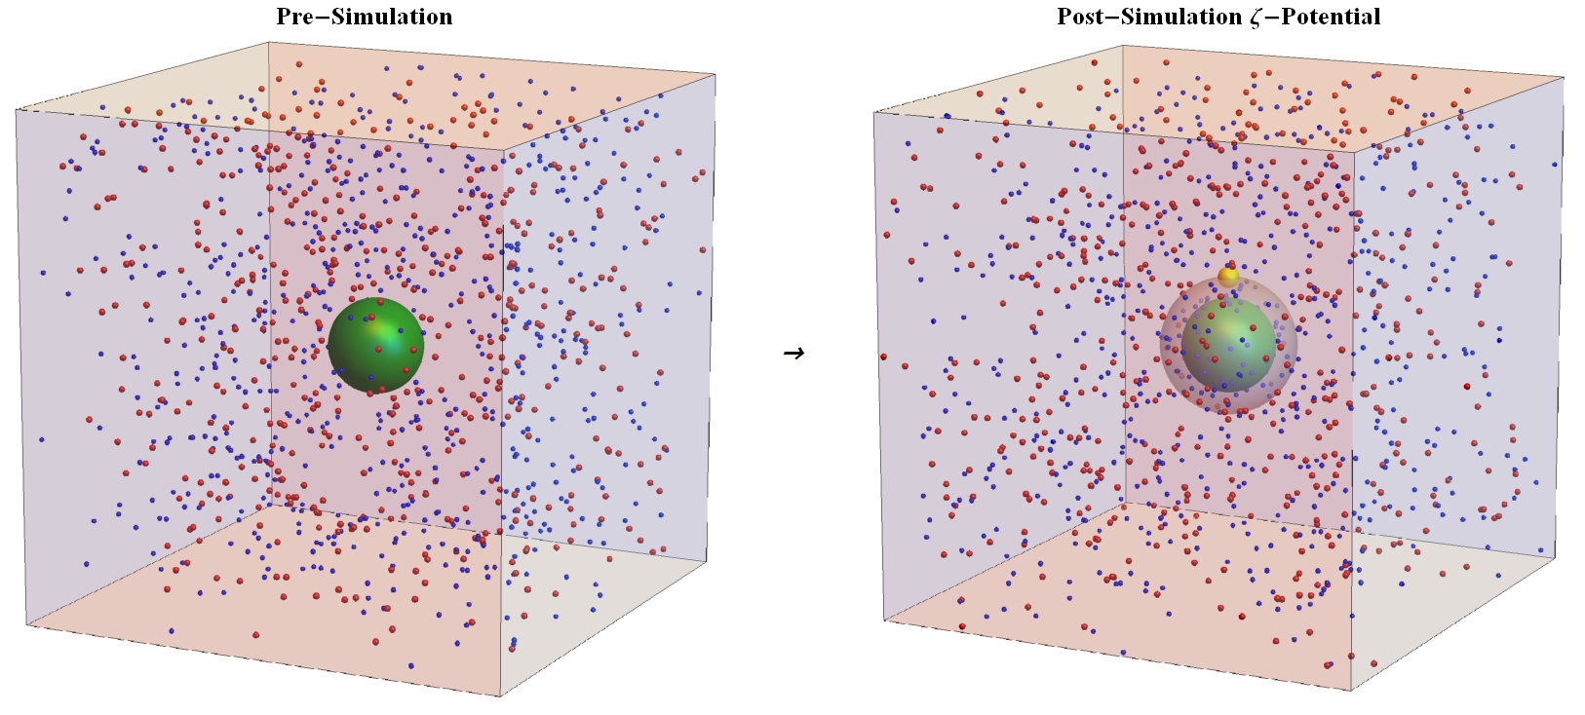
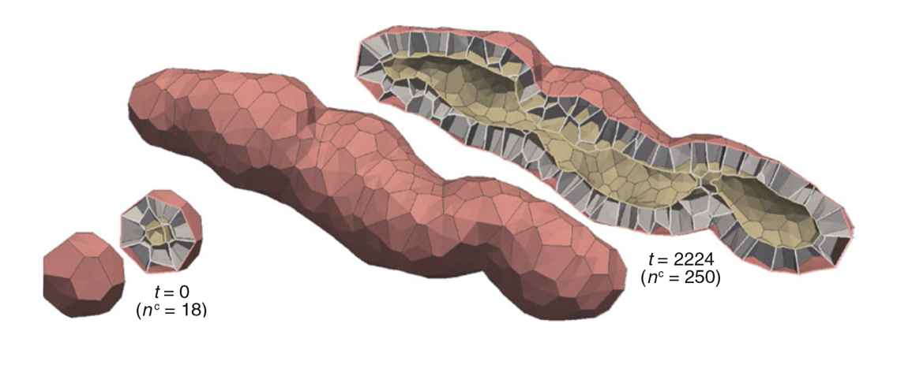

Slide 3
Vision for Engineered nanoBIO Node
In its original formulation due to Feynman almost six decades back, nanotechnology began around a simple but powerful vision of a device engineered to write the entire Encyclopedia Britannica on the head of a pin.
The safe and successful application of nanotechnology in the biological realm demands an advance in the original vision of Feynman due to the inherent multiscale nature of biology.
Advance with Validated Computational and Data Science
Engineering of these nanoBIO devices must be based on the knowledge of how nanotechnology-based devices interact with biological systems at the bioenvironment, cell, tissue, and organ levels.
The Engineered nanoBIO node at Indiana University (IU) will develop a powerful set of integrated computational nanotechnology tools that address this complex, multiscale problem and facilitate the discovery of customized, efficient, and safe nanoscale devices for biological applications.
Collaborate with other NCN nodes and build NCN Network

Slide 4
Name | Expertise | Role | Contributions in the Node
Geoffrey Fox | Cyberinfrastructure, parallel computing, high-performance computing, computational physics, high-performance data analysis | PI | Overall management, tools for large data-set analysis and visualization, providing scalable platforms
Vikram Jadhao | Soft matter at the nanoscale, simulation of soft materials, charged soft matter | Co-PI | Tools for nanoscale device design and assembly, engineered nanoparticle response, cell-nanodevice interactions
Paul Macklin | Computational models for multicellular systems, cancer modeling and simulation, bioengineering | Co-PI | Tools for cell-nanodevice interactions, nanoparticle-mediated multicellular engineering, cell phenotype libraries
James Glazier | Developmental biology, multicellular networks, multiscale simulation | Co-PI | Tools for cell-nanodevice interactions, multicellular simulation, community building
Trevor Douglas | Biomimetic materials design, virus nanoparticle assembly | Co-PI | Simulation tool-experiment linking, validation and improvement of computational tools
Andy Somogyi | Computational modeling of cells, active matter | Senior Personnel | Tools for mechanics of nanodevice-cell system, nanoparticle-cell interaction
Eleftherios Garyfallidis | Neuroimaging, scientific visualization, software community building | Senior Personnel | Building user community of the tools, tools for data visualization
Marlon Pierce | Science gateways, middleware platforms, | Senior Personnel | Integration of computational tools with nanoHUB
Suresh Marru | Software development, science gateways | Senior Personnel | Tool validation and delivery to nanoHUB
Sudhakar Pamidighantam | Science gateways, XSEDE integration, scientific outreach | Senior Personnel | Tool optimization on XSEDE, Science Outreach
Laura Pettit | Technical and Business Management | Staff | Lead nanoBIO Research Management

Slide 5
Computational Tools: Engineered nanoBIO Node
ENBCT1. Nanoparticle Stabilization Lab (Year 2)
ENBCT2. Ions in Nanoconfinement (Year 2)
ENBCT3. NP Shape Lab (Year 3)
ENBCT4. NP Self-Assembly Lab
ENBCT5. Ligand-NP Complex
ENBCT6. Faceted Nanoparticles
ENBCT7. Nanodevice and Cell Simulator (Year 2)
ENBCT8. NP Biotransport
ENBCT9. Nanodevice-Cell Phenotype Link
ENBCT10. BioFVM:nanoBIO (Year 2)
ENBCT11. PhysiCell: nanoBIO (Year 3)
ENBCT12. NP_MC Samples
ENBCT13. MultiCellular_nanoBIOlogy Suite
ENBCT14. mcnanoBIOS:Education Edition
ENBCT15. Web Visualizer Time Series (Year 2)
ENBCT16. Molecular Simulation Data Analysis
ENBCT17. Highly Interactive 3D/4D Visualization
Other tools under study such as bulk transport and those from community

Slide 6
Plan to Develop and Deploy the Computational Tool Deliverables to nanoHUB
Initial Tool Development, Experimental validation, and Applications (Units: Tools)
Initial Tool Deployment (Units: Tools, Infrastructure)
Application Interface Development (Units: Tools, Infrastructure)
Testing, Validation, and Community Development (Units: Infrastructure, Tools)
Unit testing and solver validation built in to tool development
Model validation harder and identified risk. So needs special attention
Deployment to HPC Systems and Benchmarking (Units: Infrastructure)
Development of Documentation and Curricula (Units: Tools, Infrastructure, Outreach)
Deployment on the nanoHUB (Units: Infrastructure, Tools)
Outreach, Community Development, and Ongoing Support (Units: Outreach, Tools)

Slide 7
Infrastructure Activities
Exploits Indiana University expertise in parallel computing and portal (Science Gateway) middleware.
We plan to deliver simulation tools that will run in two modes. In their education (E) mode, tools will run on the nanoHUB platform and will in general lead to output in seconds/minutes and will require minimal computing power. In intensive research (R) mode, the tools will access platforms such as XSEDE to receive adequate computing power and wallclock times.
Parallelization of codes; use of GPU, KNL etc.
XSEDE as backend using “Science Gateway Institute” Airavata; use experience of GridChem(SEAGrid) with codes like LAMMPS
Multiple job workflows including parameter searches
Database and File storage of Intermediate results

Slide 8
Major Outreach Activities: Engineered nanoBIO Node
ENBO1 - ENBO4. Engineered nanoBIO Workshop with Materials on nanoHUB from Years 1, 2, 3, and 4
ENBO5 - ENBO10. ISE Undergraduate and Graduate Summer Research Program with Reports (5 years)
ENBO11. Conference Posters, ISE Colloquia, General Presentations
ENBO12. Course Materials (Lectures, Online Videos) Developed In-house and by the Community
ENBO13. GitHub Contributions and Issues Activity, and User and Developer Community
ENBO14. Nucleating and Supporting Global Community of ENBCT Developers and Validators

Slide 9
Evaluation Metrics I
Explicit Community Resource NanoHUB deliverables ENBCT ENBO
Artifact available on NanoHUB
Validation of Artifact
Number of Users
User Input and Our Response
Reliability of Artifact
Number of Citations
Amount of Course Use (internal and external)
Professional Evaluation
(Other) Available Cyber Platform Metrics

Slide 10
Evaluation Metrics II
Management Deliverables
Review of Effectiveness of Management functions in implementing Mission, Vision, Goals from Team and External Valuation
Fulfillment of Values
Diversity
Advisory Board Function
Fulfillment of Data Management Plan and associated Software and Data Sharing plus Reproducibility
Incidental Deliverables
Team Papers Citing NCN-ENB
Team Presentations citing NCN-ENB
General Achievement of Team Members (awards, all papers, courses)

Slide 11
Engineered nanoBIO Node at Indiana University
nanoHUB
macro
Engineer Multicellular Systems Informed by NP design & NP-cell phenotype
Infrastructure:
ISE Labs + UITS
Fox
Macklin
nano-cell
Control Cell-Nanoparticle (NP) Interactions & Evaluate NP-Cell Phenotype
Glazier
nano
Engineer Functional Nanoparticles and Self-Assembled Nanodevices
Other Tools Visualization
Data Analytics
Validation
Experiment
Fox
Douglas Lab
Jadhao

Slide 12
Engineered nanoBIO node Management Structure
ENGINEERED nanoBIO NODE
Advisory
Committee
Community
PI
nano HUB
Community
Decision Making
Unit Committees
Full Technical Committee
Executive Committee (co-PI’s, unit leads)
PI
NSF, Advisory Committee, Collaborators
nanoMFG node
Tools
Infrastructure
HUB zero
Outreach
Research
Education
Cyber Platform
ISE Labs
UITS
Nanodevice Design
(nano)
Nano-Cell Interaction
(micro)
Nano-guided
Multicell Engr
(macro)
Computation
Software Testing/
Deployment
HPC Parallelism Performance
Gateway Institute
Gateway and Middleware
Experiments (Validation)
Research Tutorials
XSEDE
Education Resources

Slide 13
Funded Activity Areas
Major Computational Tool Areas
Nano
Nano-cell
Macro
Other Tools: Visualization and Data Analytics
Validation of tools
Infrastructure linking to NCN-CP and XSEDE
Research Administration and Technical Management
Outreach and Collaboration
Software Engineering

Slide 14
Objectives of Engineered nanoBIO Node
The successful application of nanotechnology in the biological realm requires the engineering of nanoBIO devices/particles based on the knowledge of how these interact with biological systems at the bioenvironment, cell, and tissue, and levels.
The Engineered nanoBIO node at Indiana University (IU) will develop a powerful set of integrated, parallelized, computational nanotechnology tools that address this complex, multiscale problem and facilitate the discovery of customized, efficient, and safe nanoscale devices/particles for biological applications.
The tools will be deployed on the online portal nanoHUB with computational codes on GitHub. The IU node will create and expand a vibrant community of nanotechnology users and developers.

