Slide 1
Cloud activities at Indiana University: Case studies in service hosting, storage, and computing
Marlon Pierce, Joe Rinkovsky, Geoffrey Fox, Jaliya Ekanayake, Xiaoming Gao, Mike Lowe, Craig Stewart, Neil Devadasan
mpierce@cs.indiana.edu

Slide 2
Cloud Computing: Infrastructure and Runtimes
Cloud infrastructure: outsourcing of servers, computing, data, file space, etc.
  Handled through Web services that control virtual machine lifecycles.
Cloud runtimes: tools for using clouds to do data-parallel computations.
  Apache Hadoop, Google MapReduce, Microsoft Dryad, and others
  Designed for information retrieval but are excellent for a wide range of machine learning and science applications.
    Apache Mahout
  Also may be a good match for 32-128 core computers available in the next 5 years.

Slide 3
Commercial Clouds
Cloud/ Service | Amazon | Microsoft Azure | Google (and Apache)
Data | S3, EBS, SimpleDB | Blob, Table, SQL Services | GFS, BigTable
Computing | EC2, Elastic Map Reduce (runs Hadoop) | Compute Service | MapReduce (not public, but Hadoop)
Service Hosting | None? | Web Hosting Service | AppEngine/AppDrop

Slide 4
Open Architecture Clouds
Amazon, Google, Microsoft, et al., don’t tell you how to build a cloud.
  Proprietary knowledge
Indiana University and others want to document this publically.
  What is the right way to build a cloud?
  It is more than just running software.
What is the minimum-sized organization to run a cloud?
  Department? University? University Consortium? Outsource it all?
  Analogous issues in government, industry, and enterprise.
Example issues:
  What hardware setups work best? What are you getting into?
  What is the best virtualization technology for different problems?
  What is the right way to implement S3- and EBS-like data services? Content Distribution Systems? Persistent, reliable SaaS hosting?

Slide 5
Open Source Cloud Software
Service | Nimbus (UC) | Eucalyptus (UCSB)
Arch. | Services manage VMs | Services manage VMs
Security | Uses Globus for authentication (GSI) | Authentication built in (PKI)
API | EC2 frontend is an add-on; primary API is very similar. Does not implement all of the EC2 operations | Only usable via ec2-tools. Implements most of the EC2 operations including elastic IP
Internals | Uses ssh to interface with worker nodes | Uses web services internally
Storage | EBS-like storage under development | Implements EBS and instance (scratch) storage (version 1.5)
File Mgmt. | Uses GridFTP | Has simple S3 interface (Walrus)
State Saving | Has easy mechanism for saving changes to a running VM | No good way to do this currently
Fancy | One-click cluster creation | Supports AppDrop

Slide 6
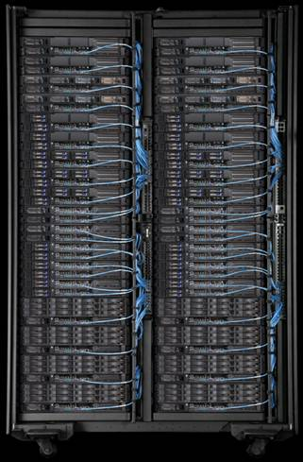
IU’s Cloud Testbed Host
Hardware:
  IBM iDataplex = 84 nodes
  32 nodes for Eucalyptus
  32 nodes for nimbus
  20 nodes for test and/or reserve capacity
  2 dedicated head nodes
Nodes specs:
  2 x Intel L5420 Xeon 2.50 (4 cores/cpu)
  32 gigabytes memory
  160 gigabytes local hard drive
Gigabit network
  No support in Xen for Infiniband or Myrinet (10 Gbps)

Slide 7
Challenges in Setting Up a Cloud
Images are around 10 GB each so disk space gets used quickly.
  Euc uses ATA over Ethernet for EBS, data mounted from head node.
  Need to upgrade iDataplex to handle Wetlands data set.
Configration of VLANs isn't dynamic.
  You have to "guess" how many users you will have and pre-configure your switches.
Learning curve for troubleshooting is steep at first.
  You are essentially throwing your instance over the wall and waiting for it to work or fail.
  If it fails you have to rebuild the image and try again
Software is new, and we are just learning how to run as a production system.
  Eucalyptus, for example, has frequent releases and does not yet accept contributed code.

Slide 8
Alternative Elastic Block Store Components
Volume Server
Virtual Machine Manager (Xen Dom 0)
VBD
Xen Dom U
ISCSI
Volume Delegate
Xen Delegate
Create Volume, Export Volume, Create Snapshot,
etc.
Import Volume, Attach Device, Detach Device, etc.
VBS Web Service
There’s more than one way to build Elastic Block Store. We need to find the best way to do this.
VBS Client

Slide 9
Case Study: Eucalyptus, GeoServer, and Wetlands Data

Slide 10
Running GeoServer on Eucalyptus
We’ll walk through the steps to create an image with GeoServer.
Not amenable to a live demo
  Command line tools.
  Some steps take several minutes.
  If everything works, it looks like any other GeoServer.
But we can do this offline if you are interested.

Slide 11
General Process: Image to Instance
Image Storage
Instance on a VM
(delay)

Slide 12
Workflow: Getting Setup
Download Amazon API command line tools
Download certificates package from your Euc installation
No Web interface for all of these things, but you can build one using the Amazon Java tools (for example).
Associate a public and private key pair
(ec2-add-keypair geoserver-key > geoserver.mykey)
Edit and source your eucarc file (various env variables)

Slide 13
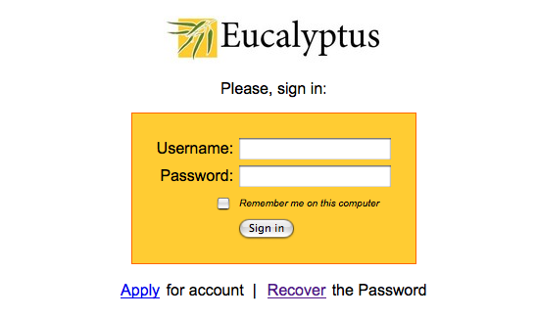
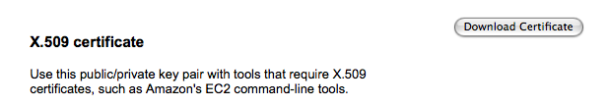
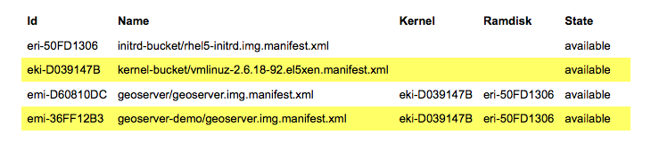
Get an account from your Euc admin.
Download certificates
View available images

Slide 14
Workflow: Getting an Instance
View Available Images
Create an Instance of Your Image (and Wait)
Instances are created from images. The commands are calls to Web services.
Terminate instance when you are done.
Login to your VM with regular ssh as root (!)

Slide 15
Viewing Images
euca2 $ ec2-describe-images
>IMAGE emi-36FF12B3
geoserver-demo/geoserver.img.manifest.xml
admin available public x86_64
machine eki-D039147B eri-50FD1306
IMAGE emi-D60810DC
geoserver/geoserver.img.manifest.xml
admin available public x86_64
machine eki-D039147B eri-50FD1306
…
We want the one in bold, so let’s make an instance

Slide 16
Create an Instance
euca2 $ ec2-run-instances -t c1.xlarge emi-36FF12B3 -k geoserver-key
> RESERVATION r-375F0740 mpierce mpierce-default INSTANCE i-4E8A0959 emi-36FF12B3 0.0.0.0 0.0.0.0 pending geoserver-key 0 c1.xlarge 2009-06-08T15:59:38+0000 eki-D039147B eri-50FD1306
We’ll create an emi-36FF12B3 image (i-4E8A0959 ) since that is the one with GeoServer installed.
We use the key that we associated with the server.
We create an Amazon c1.xlarge image to meet GeoServer meeting requirements.

Slide 17
Check on the Status of Your Images
euca2 $ ec2-describe-instances
> RESERVATION r-375F0740 mpierce default
INSTANCE i-4E8A0959 emi-36FF12B3 149.165.228.101 192.168.9.2 pending geoserver-key 0 c1.xlarge 2009-06-08T15:59:38+000eki-D039147B eri-50FD1306
It will take several minutes for Eucalyptus to create your image. Pending will become running when your image is ready. Euc dd’s an image from the repository to your host machine.
Your image will have a public IP address 149.165.228.101

Slide 18
Now Run GeoServer
We’ve created an instance with GeoServer pre-configured.
  We’ve also injected our public key.
Login: ssh –i mykey.pem root@149.165.228.101
Startup the server on your VM:
  /root/start.sh
Point your browser tohttp://149.165.228.101:8080/geoserver
Actual GeoServer public demo is 149.165.228.100

Slide 19
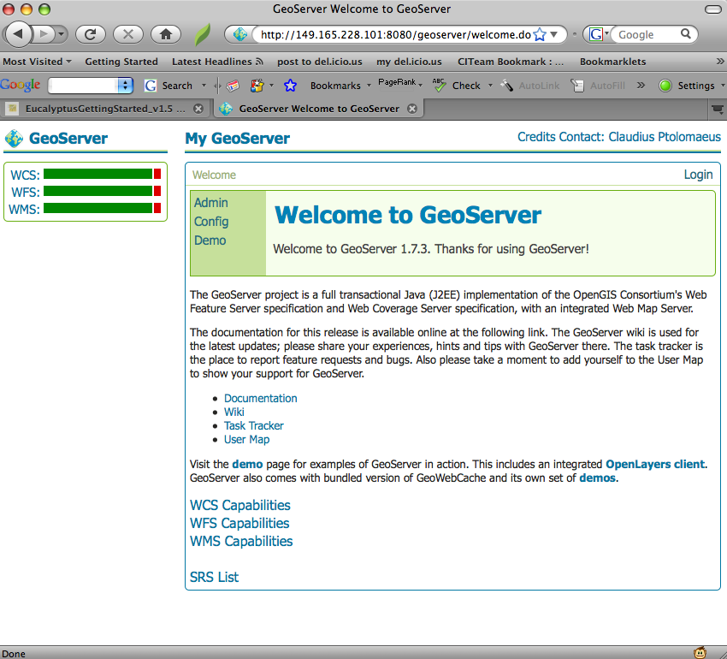
As advertised, it has the VM’s URL.

Slide 20
Now Attach Wetlands Data
Attach the Wetlands data volume.
  ec2-attach-volume vol-4E9E0612 -i i-546C0AAA -d /dev/sda5
Mount the disk image from your virtual machine.
  /root/mount-ebs.sh is a convenience script.
Fire up PostgreSQL on your virtual machine.
  /etc/init.d/postgres start
  Note our image updates the basic RHEL version that comes with the image.
Unlike Xen images, we only have one instance of the Wetlands EBS.
  Takes too much space.
  Only one Xen image can mount this at a time.

Slide 21
Experiences with the Installation
The Tomcat and GeoServer installations are identical to how they would be on a physical system.
The main challenge was handling persistent storage for PostGIS.
  We use an EBS volume for the data directory of Postgres.
  It adds two steps to the startup/tear down process but you gain the ability to retain database changes.
  This also allows you to overcome the 10 gigabyte root file system limit that both Eucalyptus and EC2 proper have.
Currently the database and GeoServer are running on the same instance.
  In the future it would probably be good to separate them.

Slide 22
IU Gateway Hosting Service
Users get OpenVZ virtual machines.
  All VMs run in same kernel, unlike Xen.
Images replicated between IU (Bloomington) and IUPUI (Indianapolis)
  Uses DRBD
Mounts Data Capacitor (~500 TB Lustre File System)
OpenVZ has no support yet for libvirt
  Would make it easy to integrate with Xen-based clouds
  Maybe some day from Enomaly

Slide 23
Summary: Clouds + GeoServer
Best Practices: We chose Eucalyptus open source software in part because it mimics faithfully Amazon.
  Better interoperability compared to Nimbus
  Eucalyptus.edu → Eucalyptus.com
Maturity Level: very early for Eucalyptus
  No fail-over, redundancy, load-balancing, etc.
  Not specifically designed for Web server hosting.
Impediments to adoption: not production software yet.
  Security issues: do you like Euc’s PKI? Do you mind handing out root?
  Hardware, networking requirements and configuration are not known
  No good support for high performance file systems.
  What level of government should run a cloud?

Slide 24
Science Clouds

Slide 25
Data-File Parallelism and Clouds
Now that you have a cloud, you may want to do large scale processing with it.
Classic problems are to perform the same (sequential) algorithm on fragments of extremely large data sets.
Cloud runtime engines manage these replicated algorithms in the cloud.
  Can be chained together in pipelines (Hadoop) or DAGs (Dryad).
  Runtimes manage problems like failure control.
We are exploring both scientific applications and classic parallel algorithms (clustering, matrix multiplication) using Clouds and cloud runtimes.

Slide 26
Clouds, Data and Data Pipelines
Data products are produced by pipelines.
Can’t separate data from the way they are produced.
  NASA CODMAC levels for data products
Clouds and virtualization give us a way to potentially serialize and preserve both data and their pipelines.

Slide 27
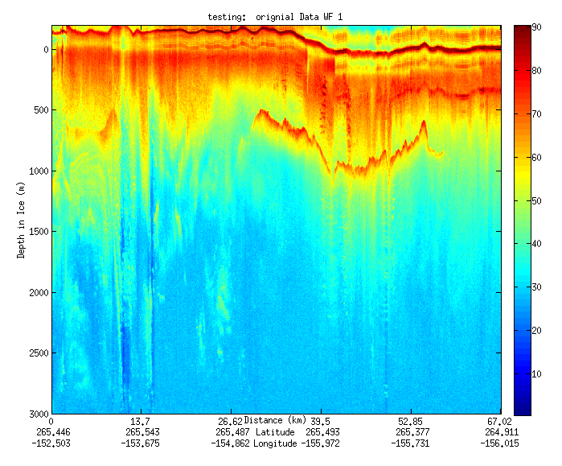
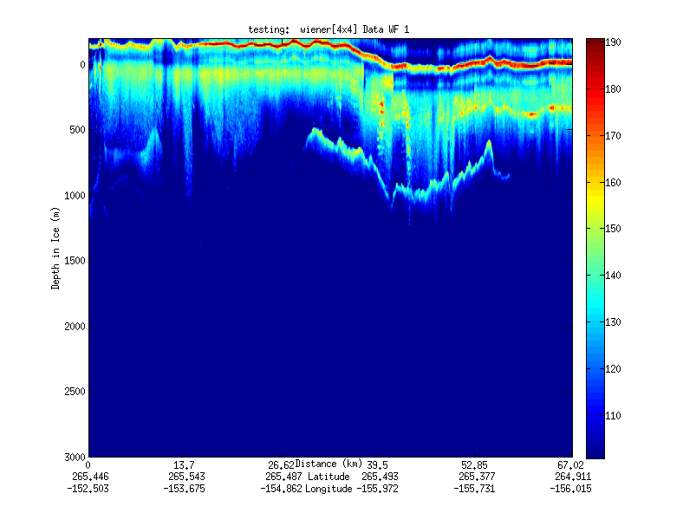
Geospatial Examples
Image processing and mining
  Ex: SAR Images from Polar Grid project (J. Wang)
  Apply to 20 TB of data
Flood modeling I
  Chaining flood models over a geographic area.
Flood modeling II
  Parameter fits and inversion problems.
Real time GPS processing
Filter

Slide 28
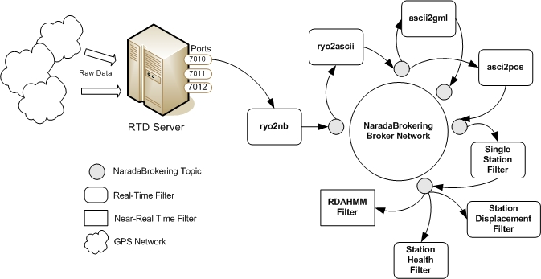
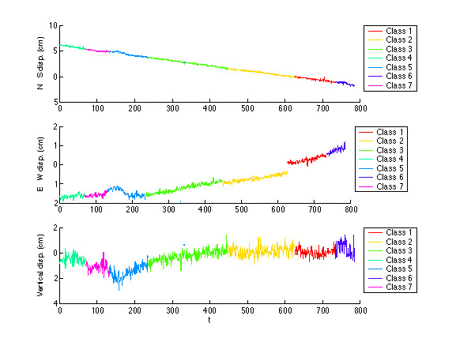
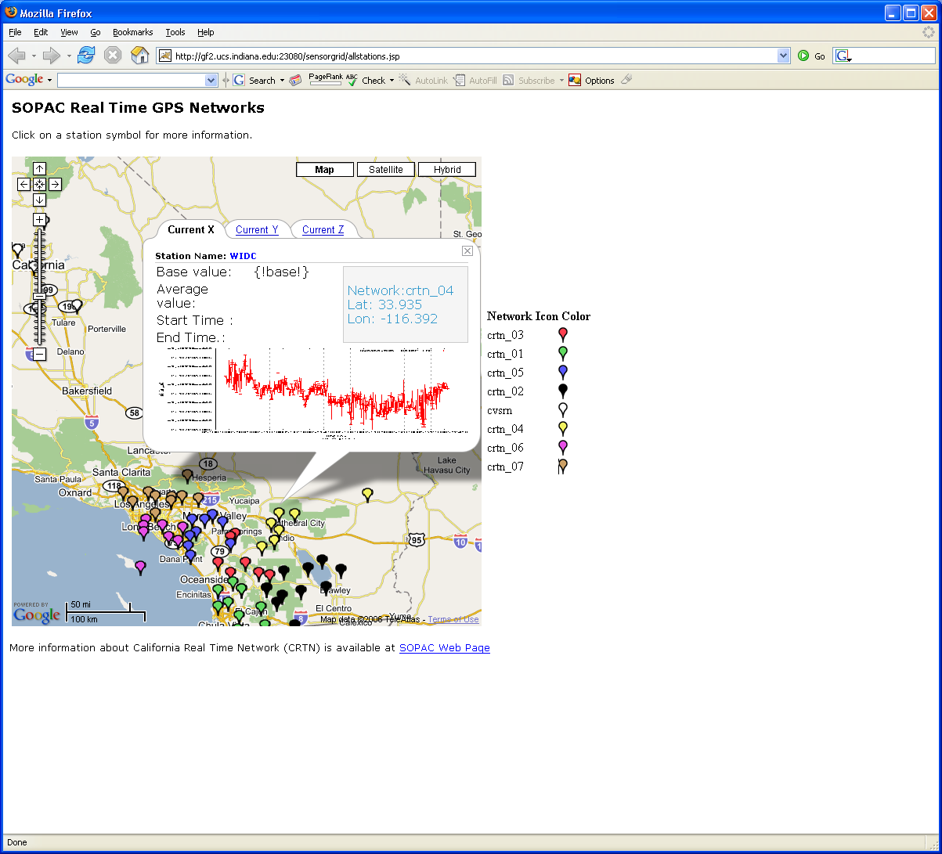
Real-Time GPS Sensor Data-Mining
Services controlled by workflow process real time data from ~70 GPS Sensors in Southern California
Earthquake
CRTN GPS
Streaming Data
Support
Archival
Transformations
Data Checking
Hidden Markov
Datamining (JPL)
Real Time
Display (GIS)
28
Notes:
28

Slide 29
Some Other File/Data Parallel Examples from Indiana University Biology Dept
EST (Expressed Sequence Tag) Assembly: (Dong) 2 million mRNA sequences generates 540000 files taking 15 hours on 400 TeraGrid nodes (CAP3 run dominates)
MultiParanoid/InParanoid gene sequence clustering: (Dong) 476 core years just for Prokaryotes
Population Genomics: (Lynch) Looking at all pairs separated by up to 1000 nucleotides
Sequence-based transcriptome profiling: (Cherbas, Innes) MAQ, SOAP
Systems Microbiology: (Brun) BLAST, InterProScan
Metagenomics (Fortenberry, Nelson) Pairwise alignment of 7243 16s sequence data took 12 hours on TeraGrid
All can use Dryad or Hadoop

Slide 30
Conclusion: Science Clouds
Cloud computing is more than infrastructure outsourcing.
It could potentially change (broaden) scientific computing.
  Traditional supercomputers support tightly coupled parallel computing with expensive networking.
  But many parallel problems don’t need this.
It can preserve data production pipelines.
Idea is not new.
  Condor, Pegasus and virtual data for example.
  But overhead is significantly higher.

Slide 31
Performance Analysis of High Performance Parallel Applications on Virtualized Resources
Jaliya Ekanayake and Geoffrey Fox
Indiana University
501 N Morton Suite 224
Bloomington IN 47404
{Jekanaya, gcf}@indiana.edu

Slide 32
Private Cloud Infrastructure
Eucalyptus and Xen based private cloud infrastructure
  Eucalyptus version 1.4 and Xen version 3.0.3
  Deployed on 16 nodes each with 2 Quad Core Intel Xeon processors and 32 GB of memory
  All nodes are connected via a 1 giga-bit connections
Bare-metal and VMs use exactly the same software environments
  Red Hat Enterprise Linux Server release 5.2 (Tikanga) operating system. OpenMPI version 1.3.2 with gcc version 4.1.2.

Slide 33
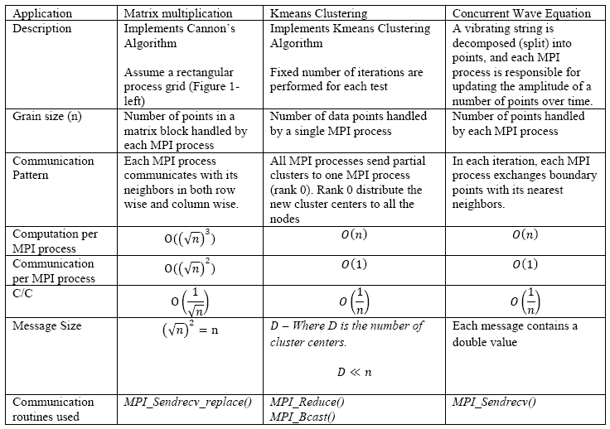
MPI Applications

Slide 34
Different Hardware/VM configurations
Ref | Description | Number of CPU cores accessible to the virtual or bare-metal node | Amount of memory (GB) accessible to the virtual or bare-metal node | Number of virtual or bare-metal nodes deployed
BM | Bare-metal node | 8 | 32 | 16
1-VM-8-core | 1 VM instance per bare-metal node | 8 | 30 (2GB is reserved for Dom0) | 16
2-VM-4- core | 2 VM instances per bare-metal node | 4 | 15 | 32
4-VM-2-core | 4 VM instances per bare-metal node | 2 | 7.5 | 64
8-VM-1-core | 8 VM instances per bare-metal node | 1 | 3.75 | 128
Invariant used in selecting the number of MPI processes
Number of MPI processes = Number of CPU cores used

Slide 35
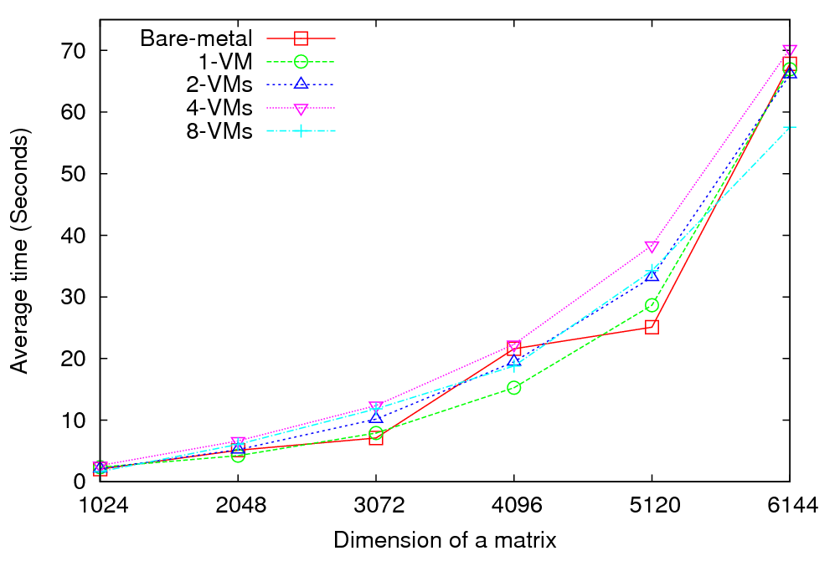
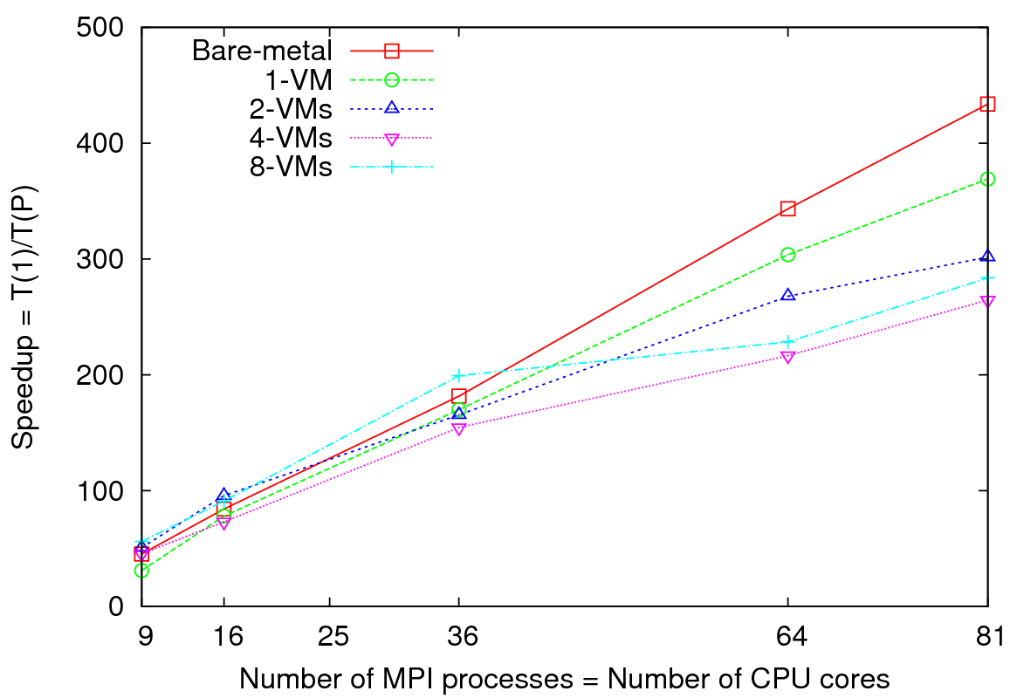
Matrix Multiplication
Performance - 64 CPU cores
Speedup – Fixed matrix size (5184x5184)
Implements Cannon’s Algorithm
Exchange large messages
More susceptible to bandwidth than latency
At 81 MPI processes, at least 14% reduction in speedup is noticeable

Slide 36
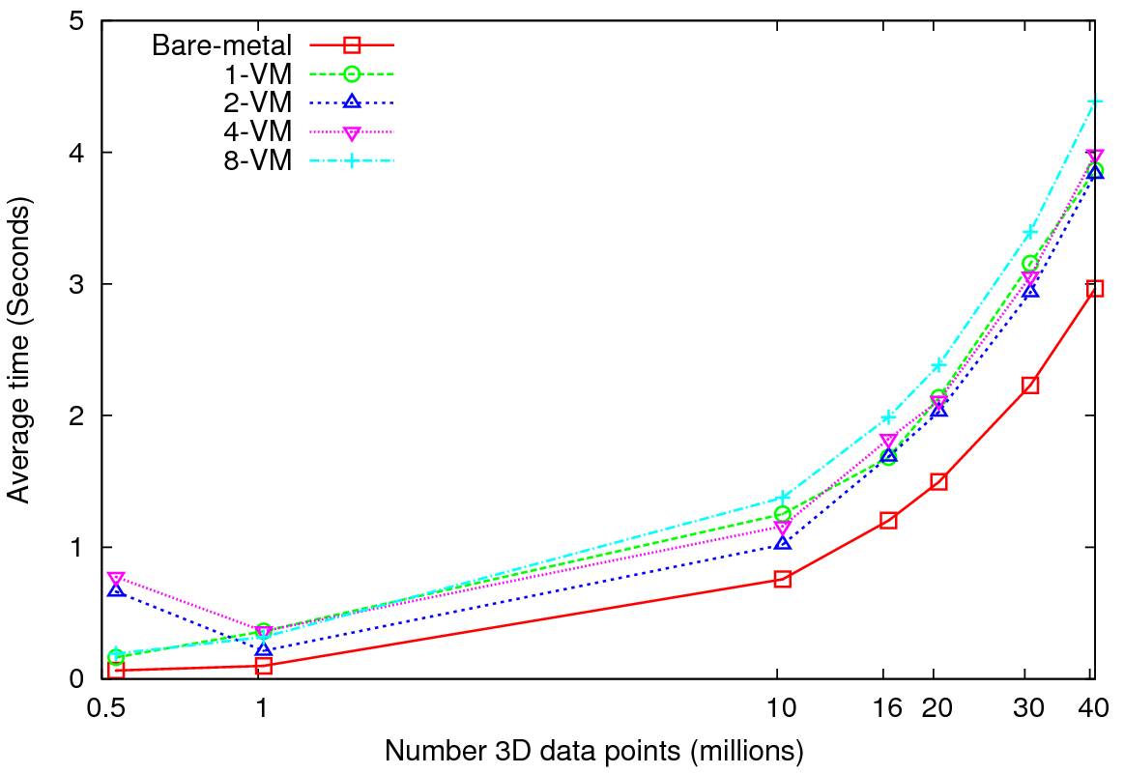
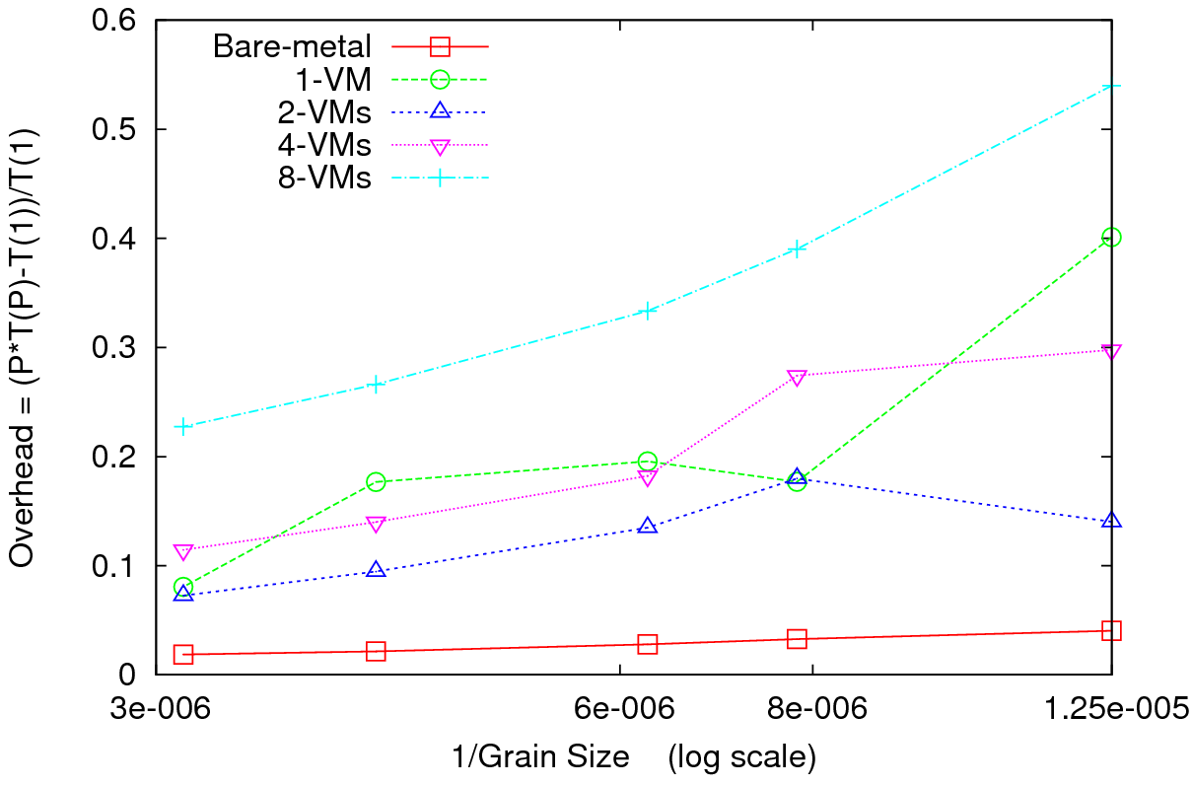
Kmeans Clustering
Performance – 128 CPU cores
Overhead
Perform Kmeans clustering for up to 40 million 3D data points
Amount of communication depends only on the number of cluster centers
Amount of communication << Computation and the amount of data processed
At the highest granularity VMs show at least 3.5 times overhead compared to bare-metal
Extremely large overheads for smaller grain sizes

Slide 37
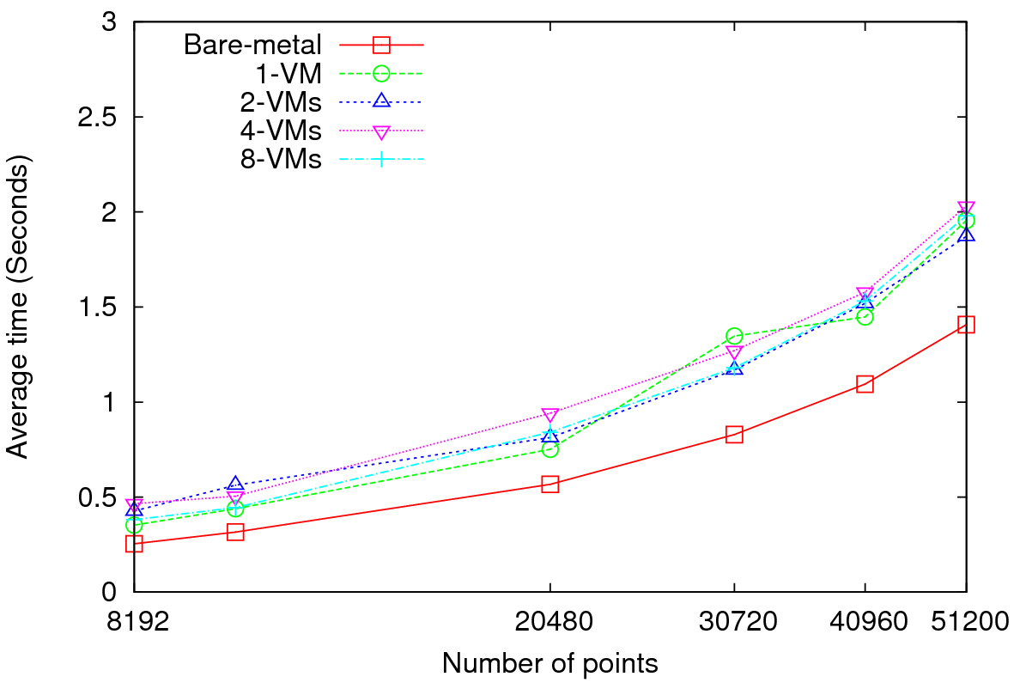
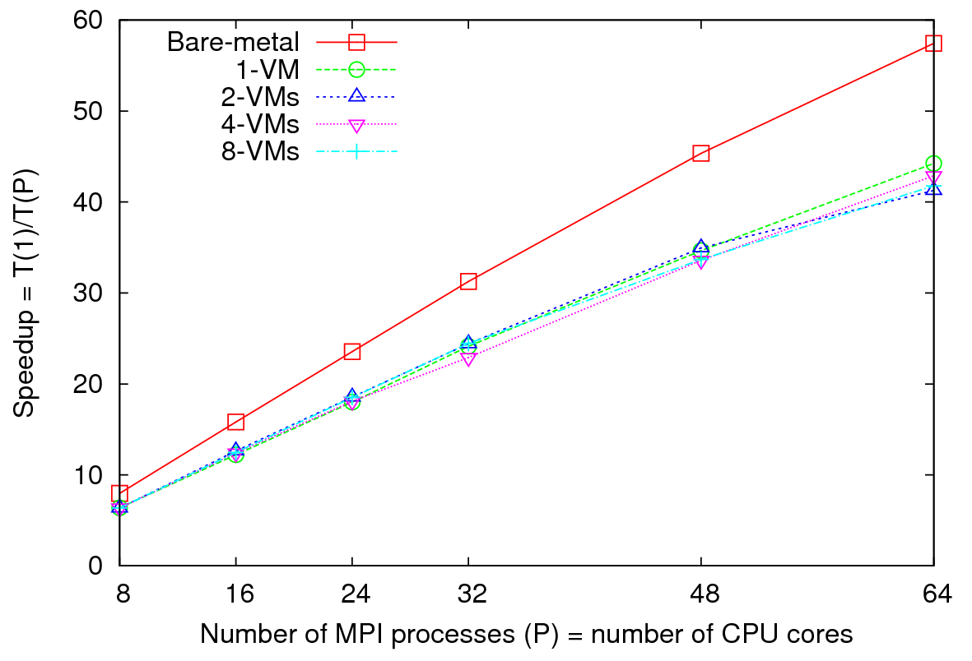
Concurrent Wave Equation Solver
Performance - 64 CPU cores
Total Speedup – 30720 data points
Clear difference in performance and speedups between VMs and bare-metal
Very small messages (the message size in each MPI_Sendrecv() call is only 8 bytes)
More susceptible to latency
At 51200 data points, at least 40% decrease in performance is observed in VMs

Slide 38
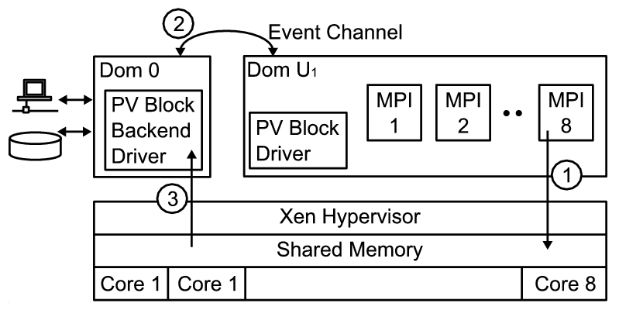
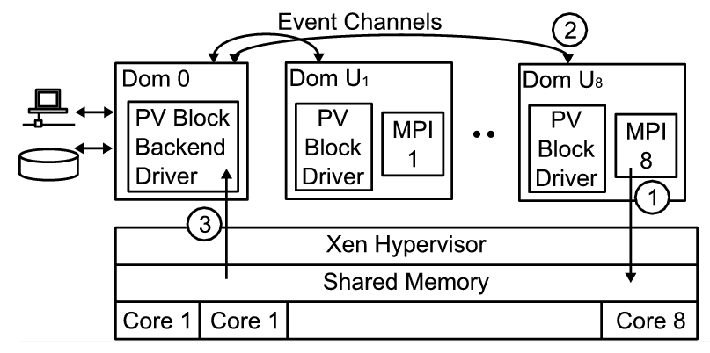
Higher latencies -1
Xen configuration for 1-VM per node
8 MPI processes inside the VM
Xen configuration for 8-VMs per node
1 MPI process inside each VM
domUs (VMs that run on top of Xen para-virtualization) are not capable of performing I/O operations
dom0 (privileged OS) schedules and executes I/O operations on behalf of domUs
More VMs per node => more scheduling => higher latencies

Slide 39
Higher latencies -2
Kmeans Clustering
Xen configuration for 1-VM per node
8 MPI processes inside the VM
Lack of support for in-node communication => “Sequentilizing” parallel communication
Better support for in-node communication in OpenMPI resulted better performance than LAM-MPI for 1-VM per node configuration
In 8-VMs per node, 1 MPI process per VM configuration, both OpenMPI and LAM-MPI perform equally well

Slide 40
Conclusions and Future Works
It is plausible to use virtualized resources for HPC applications
MPI applications experience moderate to high overheads when performed on virtualized resources
Applications sensitive to latencies experience higher overheads
Bandwidth does not seem to be an issue
More VMs per node => Higher overheads
In-node communication support is crucial when multiple parallel processes are run on a single VM
Applications such as MapReduce may perform well on VMs ?
  (milliseconds to seconds latencies they already have in communication may absorb the latencies of VMs without much effect)

Slide 41
More Measurements

Slide 42
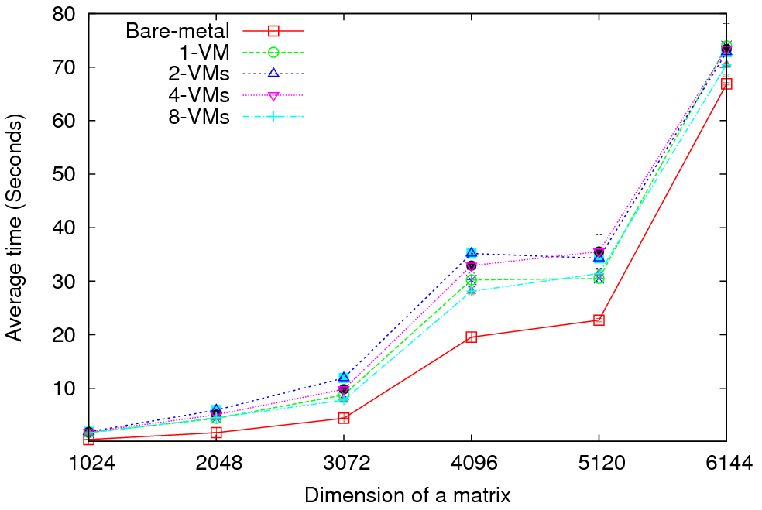
Matrix Multiplication - Performance
Eucalyptus (Xen) versus “Bare Metal Linux” on communication Intensive trivial problem (2D Laplace) and matrix multiplication
Cloud Overhead ~3 times Bare Metal; OK if communication modest
Notes:
MPI Cloud Overhead
1 VM = 1 VM in each node, each VM having access to all the CPU cores (8)
and all the memory (30 GB).
2 VMs = 2 VMs in each node, each VM having access to 4 CPU cores and 15 GB
of memory.
4 VMs = 4 VMs in each node, each VM having access to 2 CPU cores and 7.5 GB
of memory.
8 VMs = 8 VMs in each node, each VM having access to 1 CPU core and 3.75 GB
of memory.
Each node has the following hardware configuration.
2 Quad Core (Intel Xeon) processors (Total of 8 cores)
32 GB of memory.
Kmeans used all the 128 processors cores in 16 nodes.
Matrix multiplication uses only 64 cores in 8 nodes.

Slide 43
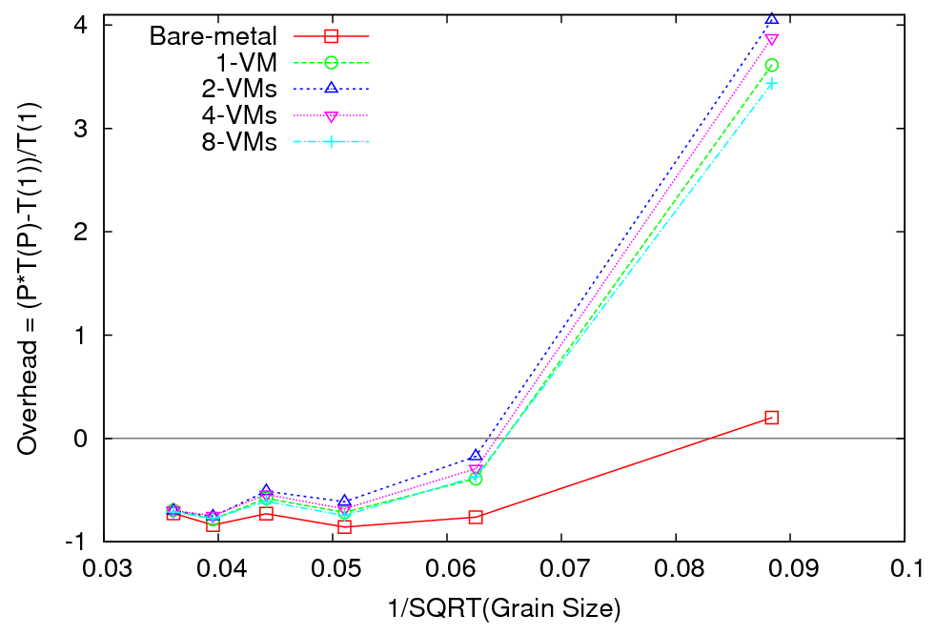
Matrix Multiplication - Overhead

Slide 44
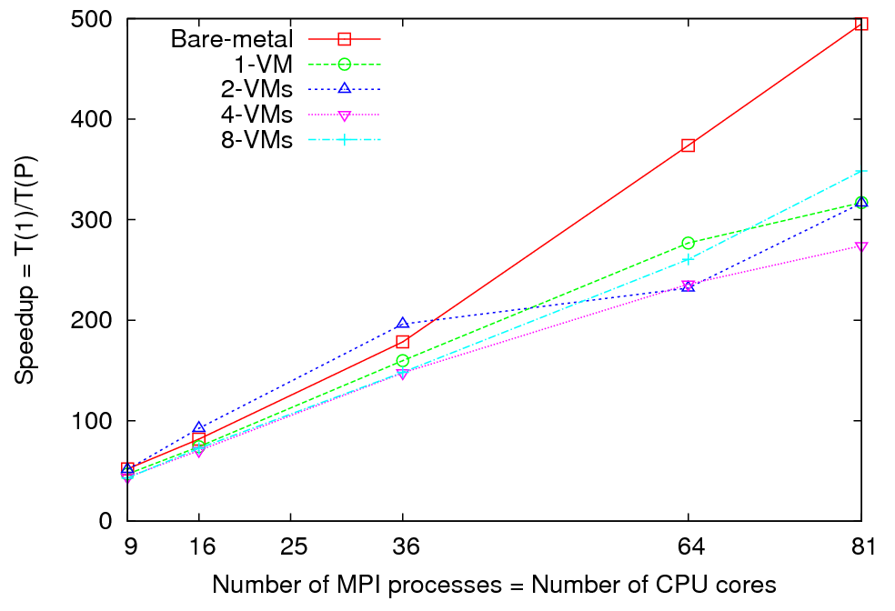
Matrix Multiplication - Speedup
Notes:
Performance and Overhead results are obtained using 8 nodes (64 cores) (Using a MPI grid of 8x8) Size of a matrix is shown in X axis. For speedup results I used a matrix of size 5184x5184 Number of MPI processes= Number of CPU cores is shown in X axis.

Slide 45
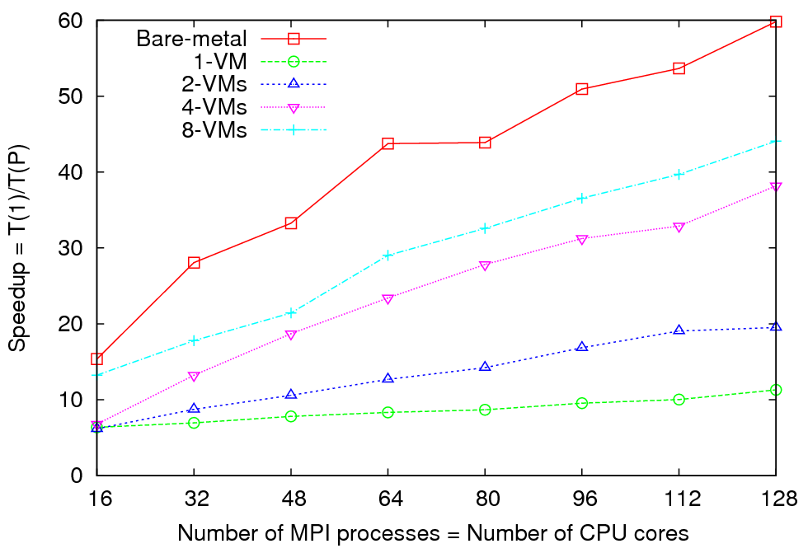
Kmeans Clustering - Speedup
Notes:
Performance and Overhead results are obtained using 16 nodes (128 cores) Each MPI process processes X/128 number of 3D data points. (0.5< X <40 ) millions. For speedup results, I used 860160 ( 0.8 million) 3D data points. Number of MPI processes= Number of CPU cores is shown in X axis.

Slide 46
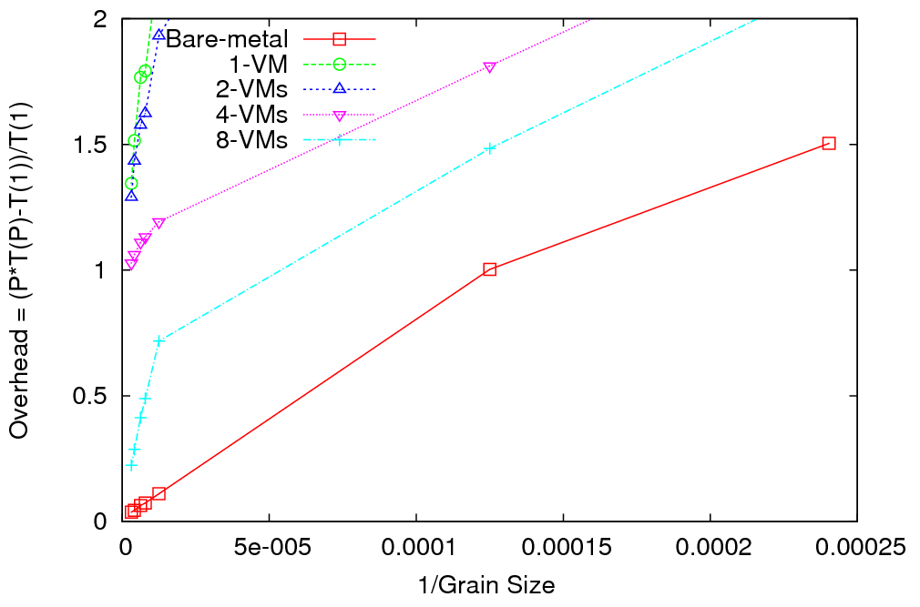
Kmeans Clustering - Overhead
Notes:
1 VM 8 cores per VM
8 VM’s 1 core per VM

Slide 47
Data Intensive Cloud Architecture
MPI/GPU Engines
Instruments
User Data
Specialized
Cloud
Cloud
Users
Files
Files
Files
Files
Dryad/Hadoop should manage decomposed data from database/file to Windows cloud (Azure) to Linux Cloud and specialized engines (MPI, GPU …)
Does Dryad replace Workflow? How does it link to MPI-based datamining?

Slide 48

Reduce Phase of Particle Physics “Find the Higgs” using Dryad
Combine Histograms produced by separate Root “Maps” (of event data to partial histograms) into a single Histogram delivered to Client

Slide 49
Data Analysis Examples
LHC Particle Physics analysis: File parallel over events
  Filter1: Process raw event data into “events with physics parameters”
  Filter2: Process physics into histograms
  Reduce2: Add together separate histogram counts
  Information retrieval similar parallelism over data files
Bioinformatics - Gene Families: Data parallel over sequences
  Filter1: Calculate similarities (distances) between sequences
  Filter2: Align Sequences (if needed)
  Filter3: Cluster to find families
  Filter 4/Reduce4: Apply Dimension Reduction to 3D
  Filter5: Visualize

Slide 50
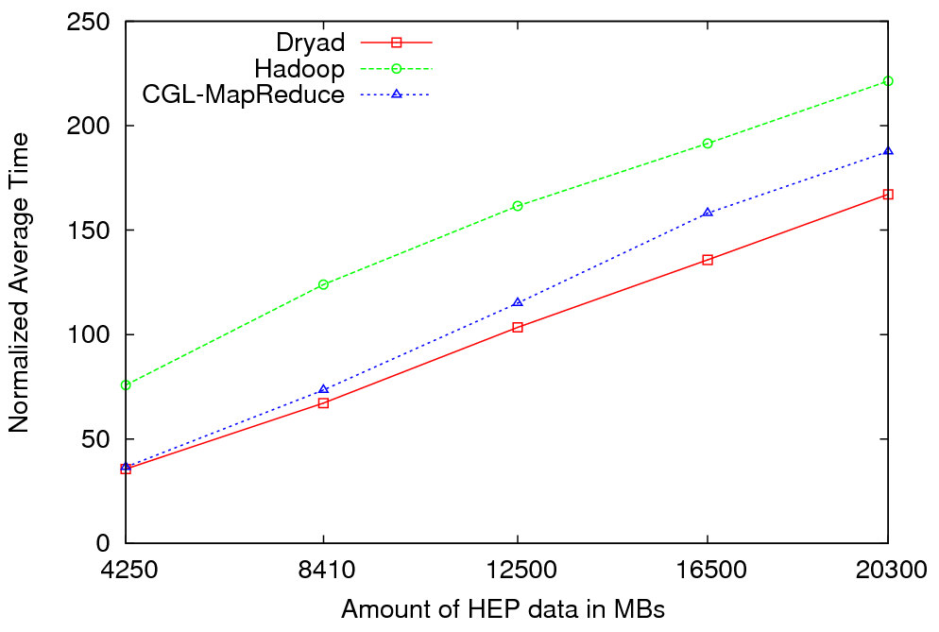

Particle Physics (LHC) Data Analysis
MapReduce for LHC data analysis
LHC data analysis, execution time vs. the volume of data (fixed compute resources)
Root running in distributed fashion allowing analysis to access distributed data – computing next to data
LINQ not optimal for expressing final merge

Slide 51
The many forms of MapReduce
MPI, Hadoop, Dryad,(Web services, workflow, (Enterprise) Service Buses all consist of execution units exchanging messages
MPI can do all parallel problems, but so can Hadoop, Dryad … (famous paper on MapReduce for datamining)
MPI’s “data-parallel” is actually “memory-parallel” as “owner computes” rule says “computer evolves points in its memory”
Dryad and Hadoop support “File/Repository-parallel” (attach computing to data on disk) which is natural for vast majority of experimental science
Dryad/Hadoop typically transmit all the data between steps (maps) by either queues or files (process lasts as long as map does)
MPI will only transmit needed state changes using rendezvous semantics with long running processes which is higher performance but less dynamic and less fault tolerant

Slide 52
Why Build Your Own Cloud?
Research and Development
  Let’s see how this works.
Infrastructure Centralization
  Total costs of ownership should be lower if you centralize.
Controlling risk
  Data and Algorithm Ownership
  Legal issues

Slide 53
MapReduce implemented
by Hadoop using files for communication or CGL-MapReduce using in memory queues as “Enterprise bus” (pub-sub)
H
Y
n
Y
map(key, value)
Example: Word Histogram
Start with a set of words
Each map task counts number of occurrences in each data partition
Reduce phase adds these counts
U
U
S
4n
S
reduce(key, list<value>)
M
4n
M
D
n
D
Dryad supports general dataflow – currently communicate via files; will use queues
X
n
X
U
N
U
N

