Slide 1
Massive Open Online Course MOOC
Judy Qiu
Indiana University Bloomington

Slide 2
What is a MOOC?
Massive
Open
Large number of students
Anyone can register
REGISTER
Its FREE!
Online
Course
Access anywhere,
anytime, any device
Video Lectures, Assignments,
Communication

Slide 3
Why use a MOOC?
Requires only an internet connection
No physical boundaries
Mostly free
Access to the latest knowledge

Slide 4
Why Create a MOOC?
Share knowledge
Improve the real world courses at universities
Universities are pushing for online education

Slide 5
MOOC Platforms

Slide 6
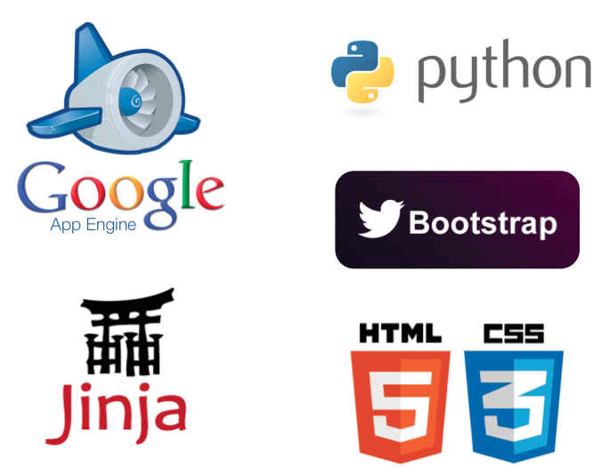
Google Course Builder
Open Source | Personalizable |Cloud Application

Slide 7
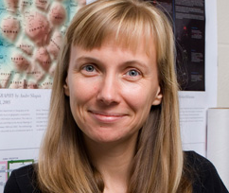
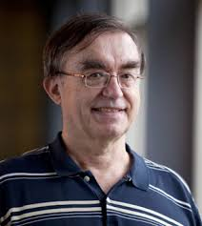
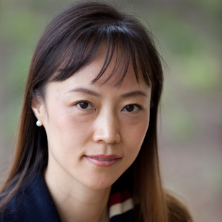
Indiana University MOOCs
Katy Börner
Geoffrey Fox
Judy Qiu

Slide 8
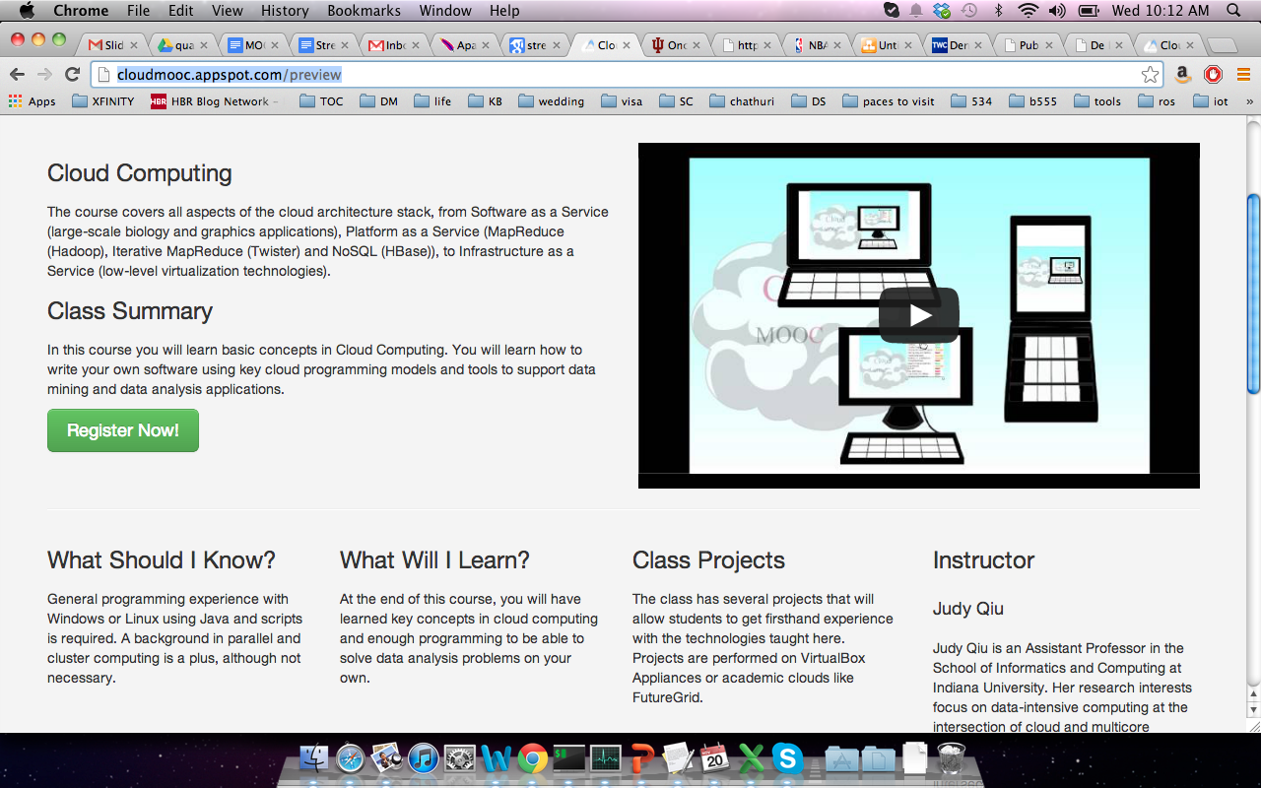
Cloud Computing MOOC

Slide 9
Big Data Applications & Analysis MOOC

Slide 10
Information Visualization MOOC

Slide 11
Challenges
Homework & Assessments
Communication
Motivate students to finish

Slide 12
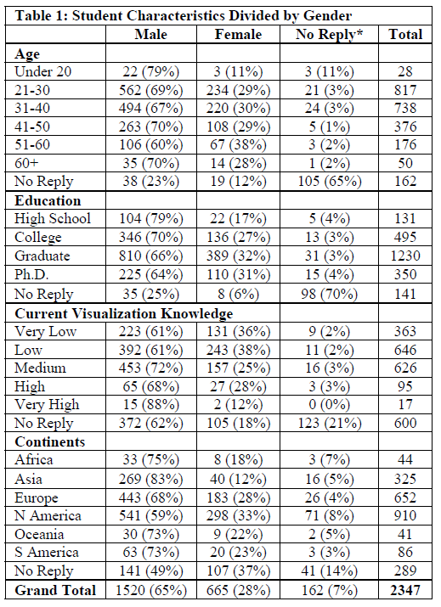
(Courtesy of Katy Börner)

Slide 13
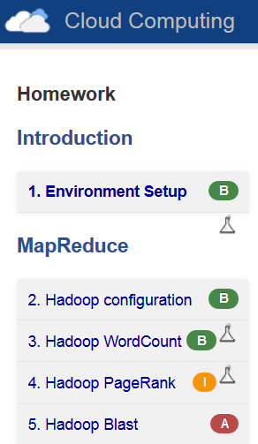
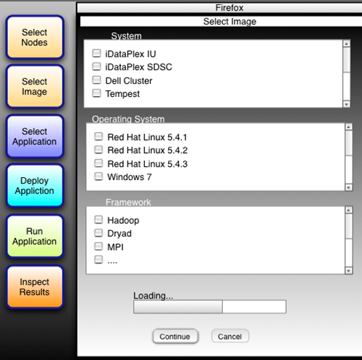
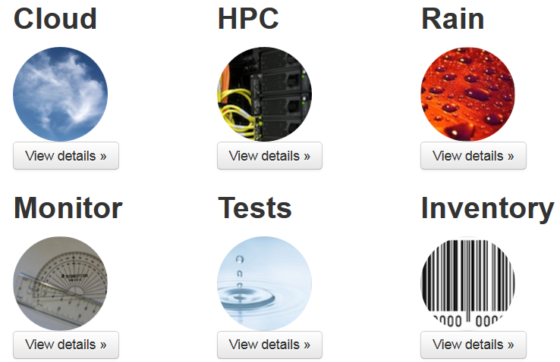
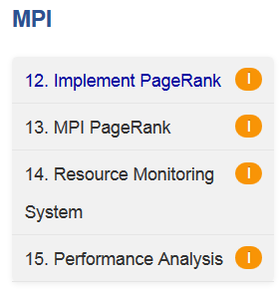
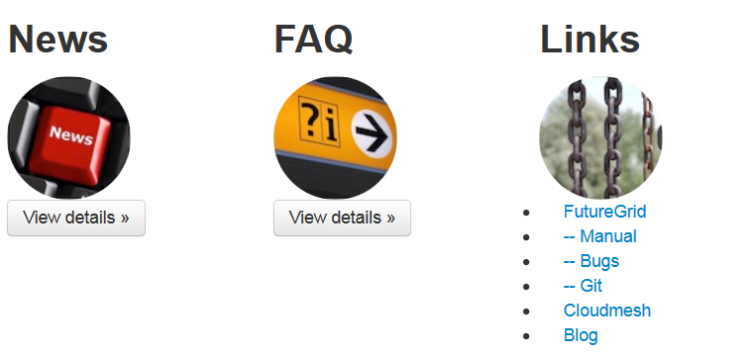
Virtual Computer Lab

