Slide 1
Clouds, Grids, Clusters and FutureGrid
IUPUI Computer Science
February 11 2011
Geoffrey Fox
gcf@indiana.edu
http://www.infomall.org http://www.futuregrid.org
Director, Digital Science Center, Pervasive Technology Institute
Associate Dean for Research and Graduate Studies, School of Informatics and Computing
Indiana University Bloomington

Slide 2
Abstract
We analyze the different tradeoffs and goals of Grid, Cloud and parallel (cluster/supercomputer) computing.
They tradeoff performance, fault tolerance, ease of use (elasticity), cost, interoperability.
Different application classes (characteristics) fit different architectures and we describe a hybrid model with Grids for data, traditional supercomputers for large scale simulations and clouds for broad based "capacity computing" including many data intensive problems.
We discuss the impressive features of cloud computing platforms and compare MapReduce and MPI where we take most of our examples from the life science area.
We conclude with a description of FutureGrid -- a TeraGrid system for prototyping new middleware and applications.

Slide 3
Important Trends
Data Deluge in all fields of science
Multicore implies parallel computing important again
  Performance from extra cores – not extra clock speed
  GPU enhanced systems can give big power boost
Clouds – new commercially supported data center model replacing compute grids (and your general purpose computer center)
Light weight clients: Sensors, Smartphones and tablets accessing and supported by backend services in cloud
Commercial efforts moving much faster than academia in both innovation and deployment

Slide 4
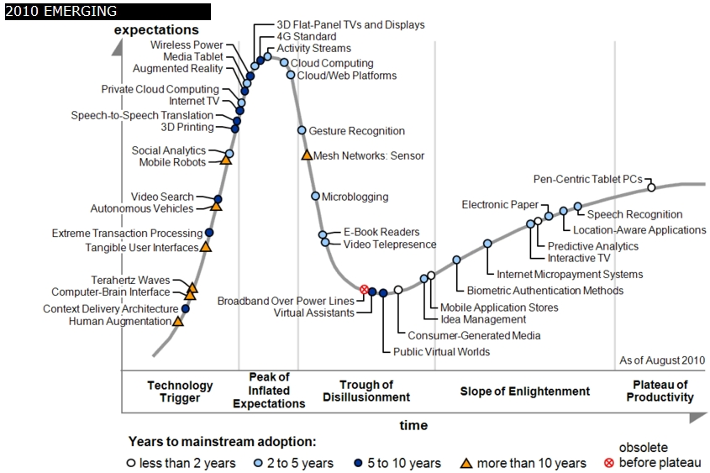
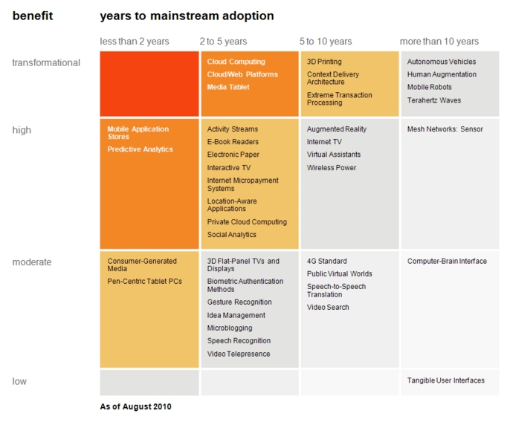

Transformational
High
Moderate
Low
Gartner 2009 Hype Curve
Clouds, Web2.0
Service Oriented Architectures
Cloud Computing
Cloud Web Platforms
Media Tablet

Slide 5



Data Centers Clouds &
Economies of Scale I
Range in size from “edge” facilities to megascale.
Economies of scale
  Approximate costs for a small size center (1K servers) and a larger, 50K server center.
2 Google warehouses of computers on the banks of the Columbia River, in The Dalles, Oregon
Such centers use 20MW-200MW
(Future) each with 150 watts per CPU
Save money from large size, positioning with cheap power and access with Internet
Technology | Cost in small-sized Data Center | Cost in Large Data Center | Ratio
Network | $95 per Mbps/ month | $13 per Mbps/ month | 7.1
Storage | $2.20 per GB/ month | $0.40 per GB/ month | 5.7
Administration | ~140 servers/ Administrator | >1000 Servers/ Administrator | 7.1
Each data center is
11.5 times
the size of a football field

Slide 6


Data Centers, Clouds
& Economies of Scale II
Builds giant data centers with 100,000’s of computers;
~ 200-1000 to a shipping container with Internet access
“Microsoft will cram between 150 and 220 shipping containers filled with data center gear into a new 500,000 square foot Chicago facility. This move marks the most significant, public use of the shipping container systems popularized by the likes of Sun Microsystems and Rackable Systems to date.”

Slide 7
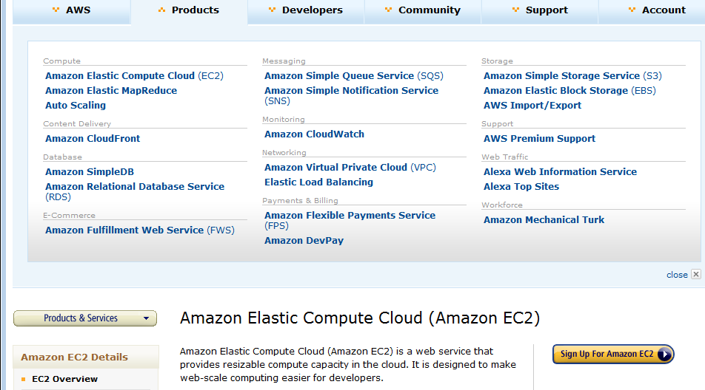
Amazon offers a lot!

Slide 8
















X as a Service
SaaS: Software as a Service imply software capabilities
(programs) have a service (messaging) interface
  Applying systematically reduces system complexity to being linear in number of components
  Access via messaging rather than by installing in /usr/bin
IaaS: Infrastructure as a Service or HaaS: Hardware as a Service – get your computer time with a credit card and with a Web interface
PaaS: Platform as a Service is IaaS plus core software capabilities on which you build SaaS
Cyberinfrastructure is “Research as a Service”
Other Services
Clients

Slide 9








Sensors as a Service
Cell phones are important sensor
Sensors as a Service
Sensor Processing as a Service (MapReduce)

Slide 10
C4 = Continuous Collaborative
Computational Cloud
C4 Education Vision
C4 Education will exploit advanced means of communication, for example, “Tabatars” conference tables , with real-time language translation, contextual awareness of speakers, in terms of the area of knowledge and level of expertise of participants to ensure correct semantic translation, and to ensure that people with disabilities can participate.
C4 EMERGING VISION
While the internet has changed the way we communicate and get entertainment, we need to empower the next generation of engineers and scientists with technology that enables interdisciplinary collaboration for lifelong learning.
Today, the cloud is a set of services that people intently have to access (from laptops, desktops, etc). In 2020 the C4 will be part of our lives, as a larger, pervasive, continuous experience. The measure of success will be how “invisible” it becomes.
C4 Society Vision
While we are no prophets and we can’t anticipate what exactly will work, we expect to have high bandwidth and ubiquitous connectivity for everyone everywhere, even in rural areas (using power-efficient micro data centers the size of shoe boxes)
Notes:
C4 Continuous Collaborative Computational Cloud

Slide 11
Higher Education 2020
Computational Thinking
Modeling
& Simulation
C⁴
Continuous
Collaborative
Computational
Cloud
Stewards of
C⁴ Intelligent Society
C⁴
I
N
T
E
C⁴ Intelligent Economy
C(DE)SE
L
L
C⁴ Intelligent People
Internet &
Cyberinfrastructure
I
G
E
Motivating
Issues
job / education mismatch
Higher Ed rigidity
Interdisciplinary work
Engineering v Science, Little v. Big science
N
C
E
NSF
Educate “Net Generation”
Re-educate pre “Net Generation”
in Science and Engineering
Exploiting and developing C⁴
C⁴ Stewards
C⁴ Curricula, programs
C⁴ Experiences (delivery mechanism)
C⁴ REUs, Internships, Fellowships

Slide 12
Philosophy of
Clouds and Grids
Clouds are (by definition) commercially supported approach to large scale computing
  So we should expect Clouds to replace Compute Grids
  Current Grid technology involves “non-commercial” software solutions which are hard to evolve/sustain
  Maybe Clouds ~4% IT expenditure 2008 growing to 14% in 2012 (IDC Estimate)
Public Clouds are broadly accessible resources like Amazon and Microsoft Azure – powerful but not easy to customize and perhaps data trust/privacy issues
Private Clouds run similar software and mechanisms but on “your own computers” (not clear if still elastic)
  Platform features such as Queues, Tables, Databases currently limited
Services still are correct architecture with either REST (Web 2.0) or Web Services
Clusters are still critical concept for MPI or Cloud software

Slide 13
Cloud Computing:
Infrastructure and Runtimes
Cloud infrastructure: outsourcing of servers, computing, data, file space, utility computing, etc.
  Handled through Web services that control virtual machine lifecycles.
Cloud runtimes or Platform: tools (for using clouds) to do data-parallel (and other) computations.
  Apache Hadoop, Google MapReduce, Microsoft Dryad, Bigtable, Chubby and others
  MapReduce designed for information retrieval but is excellent for a wide range of science data analysis applications
  Can also do much traditional parallel computing for data-mining if extended to support iterative operations
  MapReduce not usually on Virtual Machines

Slide 14
Authentication and Authorization: Provide single sign in to both FutureGrid and Commercial Clouds linked by workflow
Workflow: Support workflows that link job components between FutureGrid and Commercial Clouds. Trident from Microsoft Research is initial candidate
Data Transport: Transport data between job components on FutureGrid and Commercial Clouds respecting custom storage patterns
Program Library: Store Images and other Program material (basic FutureGrid facility)
Blob: Basic storage concept similar to Azure Blob or Amazon S3
DPFS Data Parallel File System: Support of file systems like Google (MapReduce), HDFS (Hadoop) or Cosmos (dryad) with compute-data affinity optimized for data processing
Table: Support of Table Data structures modeled on Apache Hbase/CouchDB or Amazon SimpleDB/Azure Table. There is “Big” and “Little” tables – generally NOSQL
SQL: Relational Database
Queues: Publish Subscribe based queuing system
Worker Role: This concept is implicitly used in both Amazon and TeraGrid but was first introduced as a high level construct by Azure
MapReduce: Support MapReduce Programming model including Hadoop on Linux, Dryad on Windows HPCS and Twister on Windows and Linux
Software as a Service: This concept is shared between Clouds and Grids and can be supported without special attention
Web Role: This is used in Azure to describe important link to user and can be supported in FutureGrid with a Portal framework
Components of a Scientific Computing Platform

Slide 15
MapReduce
Data Partitions
Map(Key, Value)
A hash function maps the results of the map tasks to reduce tasks
Reduce(Key, List<Value>)
Reduce Outputs
Implementations (Hadoop – Java; Dryad – Windows) support:
  Splitting of data
  Passing the output of map functions to reduce functions
  Sorting the inputs to the reduce function based on the intermediate keys
  Quality of service

Slide 16






MapReduce “File/Data Repository” Parallelism
Map = (data parallel) computation reading and writing data
Reduce = Collective/Consolidation phase e.g. forming multiple global sums as in histogram
Instruments
Iterative MapReduce
Map Map Map Map
Reduce Reduce Reduce
Communication
Reduce
Portals
/Users
Disks
Map₁
Map₂
Map₃

Slide 17

All-Pairs Using DryadLINQ
125 million distances
4 hours & 46 minutes
Calculate Pairwise Distances (Smith Waterman Gotoh)
Calculate pairwise distances for a collection of genes (used for clustering, MDS)
Fine grained tasks in MPI
Coarse grained tasks in DryadLINQ
Performed on 768 cores (Tempest Cluster)
Moretti, C., Bui, H., Hollingsworth, K., Rich, B., Flynn, P., & Thain, D. (2009). All-Pairs: An Abstraction for Data Intensive Computing on Campus Grids. IEEE Transactions on Parallel and Distributed Systems , 21, 21-36.

Slide 18
Hadoop VM Performance Degradation
Perf. Degradation = (T_{vm} – T_{baremetal})/T_{baremetal}
15.3% Degradation at largest data set size

Slide 19
Cap3 Performance with
Different EC2 Instance Types
Notes:
Instance Type CPU Cores Memory Local Disk Space Cost per hour
Small 1 1.7 GB 250 GB 0.12$
Medium 2 3.5 GB 500 GB 0.24$
Large 4 7 GB 1000 GB 0.48$
Extra Large 8 15 GB 2000 GB 0.96$

Slide 20
Cap3 Cost
Notes:
This is just the cost for the compute instances. In addition to this, there will be minor charges for the data storage for EMR & AzureMR. Also there will be additional minor charges for the queue service and table service for AzureMR.
Cost presented here are amortized for the actual time (time/3600 * num_instances * instance_price_per_hour), assuming the remaining time of the instance hour have been put to useful work.
Note: EMR & Hadoop-EC2 requires one extra node to act as the master node (included in the cost calculation)

Slide 21
SWG Cost
Notes:
This is just the cost for the compute instances. In addition to this, there will be minor charges for the data storage for EMR & AzureMR. Also there will be additional minor charges for the queue service and table service for AzureMR.
Cost presented here are amortized for the actual time (time/3600 * num_instances * instance_price_per_hour), assuming the remaining time of the instance hour have been put to useful work.
Note: EMR & Hadoop-EC2 requires one extra node to act as the master node (included in the cost calculation)

Slide 22
Smith Waterman:
Daily Effect

Slide 23
Grids MPI and Clouds
Grids are useful for managing distributed systems
  Pioneered service model for Science
  Developed importance of Workflow
  Performance issues – communication latency – intrinsic to distributed systems
  Can never run large differential equation based simulations or datamining
Clouds can execute any job class that was good for Grids plus
  More attractive due to platform plus elastic on-demand model
  MapReduce easier to use than MPI for appropriate parallel jobs
  Currently have performance limitations due to poor affinity (locality) for compute-compute (MPI) and Compute-data
  These limitations are not “inevitable” and should gradually improve as in July 13 2010 Amazon Cluster announcement
  Will probably never be best for most sophisticated parallel differential equation based simulations
Classic Supercomputers (MPI Engines) run communication demanding differential equation based simulations
  MapReduce and Clouds replaces MPI for other problems
  Much more data processed today by MapReduce than MPI (Industry Informational Retrieval ~50 Petabytes per day)

Slide 24
Fault Tolerance and MapReduce
MPI does “maps” followed by “communication” including “reduce” but does this iteratively
There must (for most communication patterns of interest) be a strict synchronization at end of each communication phase
  Thus if a process fails then everything grinds to a halt
In MapReduce, all Map processes and all reduce processes are independent and stateless and read and write to disks
  As 1 or 2 (reduce+map) iterations, no difficult synchronization issues
Thus failures can easily be recovered by rerunning process without other jobs hanging around waiting
Re-examine MPI fault tolerance in light of MapReduce
  Twister will interpolate between MPI and MapReduce

Slide 25

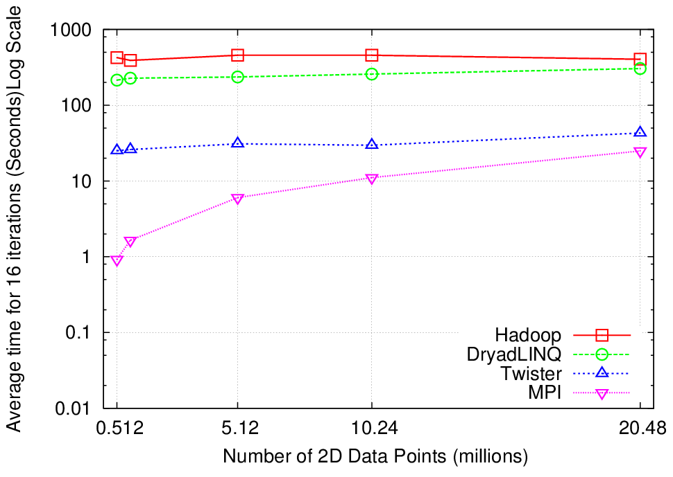
K-Means Clustering
Compute the distance to each data point from each cluster center and assign points to cluster centers
map
map
Time for 20 iterations
reduce
Compute new cluster
centers
User program
Compute new cluster centers
Iteratively refining operation
Typical MapReduce runtimes incur extremely high overheads
  New maps/reducers/vertices in every iteration
  File system based communication
Long running tasks and faster communication in Twister enables it to perform close to MPI

Slide 26


Twister
Pub/Sub Broker Network
Map Worker
M
Worker Nodes
R
Reduce Worker
Streaming based communication
Intermediate results are directly transferred from the map tasks to the reduce tasks – eliminates local files
Cacheable map/reduce tasks
  Static data remains in memory
Combine phase to combine reductions
User Program is the composer of MapReduce computations
Extends the MapReduce model to iterative computations
D
D
MR
Driver
User
Program
M
M
M
M
D
MRDeamon
R
R
R
R
Data Read/Write
Communication
Data Split
File System
Iterate
Static
data
Configure()
User Program
Map(Key, Value)
δ flow
Reduce (Key, List<Value>)
Combine (Key, List<Value>)
Different synchronization and intercommunication mechanisms used by the parallel runtimes
Close()

Slide 27
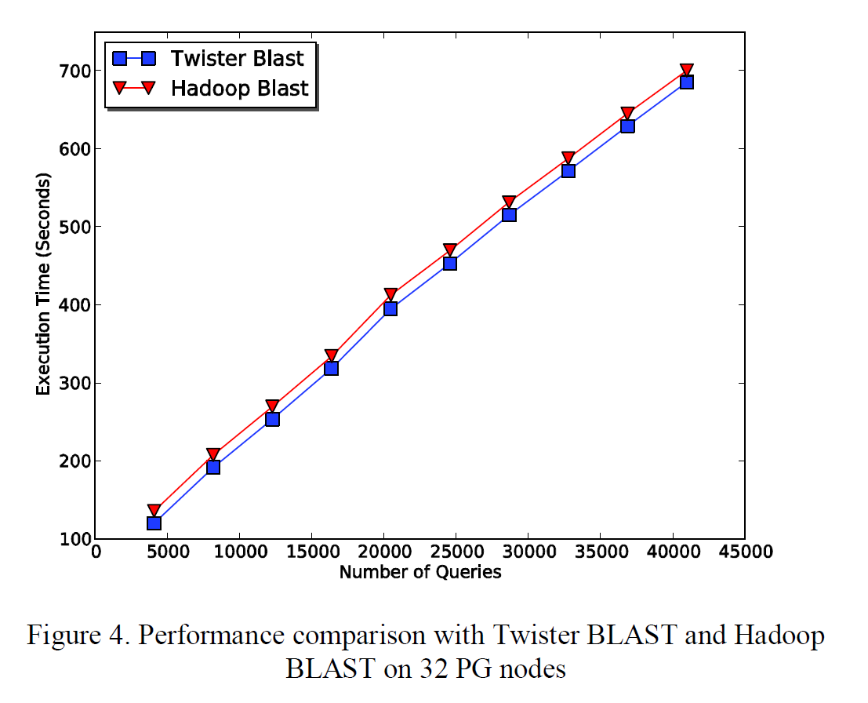
Twister-BLAST vs.
Hadoop-BLAST Performance

Slide 28
Overhead OpenMPI v Twister negative overhead due to cache

Slide 29

Performance of Pagerank using
ClueWeb Data (Time for 20 iterations)
using 32 nodes (256 CPU cores) of Crevasse

Slide 30
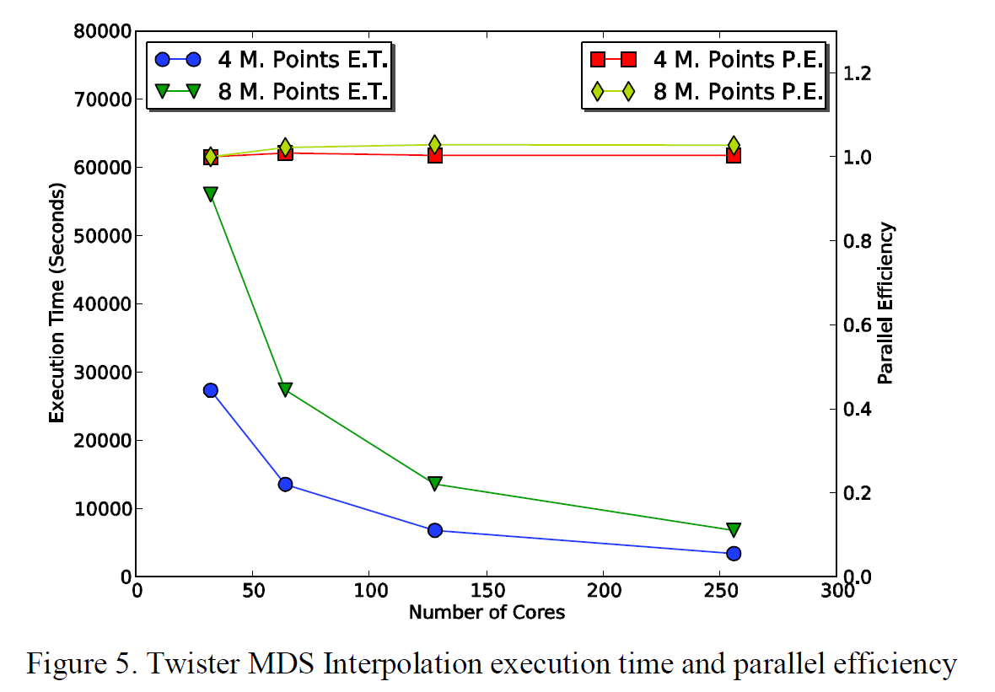
Twister MDS Interpolation Performance Test

Slide 31
US Cyberinfrastructure Context
There are a rich set of facilities
  Production TeraGrid facilities with distributed and shared memory
  Experimental “Track 2D” Awards
    FutureGrid: Distributed Systems experiments cf. Grid5000
    Keeneland: Powerful GPU Cluster
    Gordon: Large (distributed) Shared memory system with SSD aimed at data analysis/visualization
  Open Science Grid aimed at High Throughput computing and strong campus bridging

Slide 32
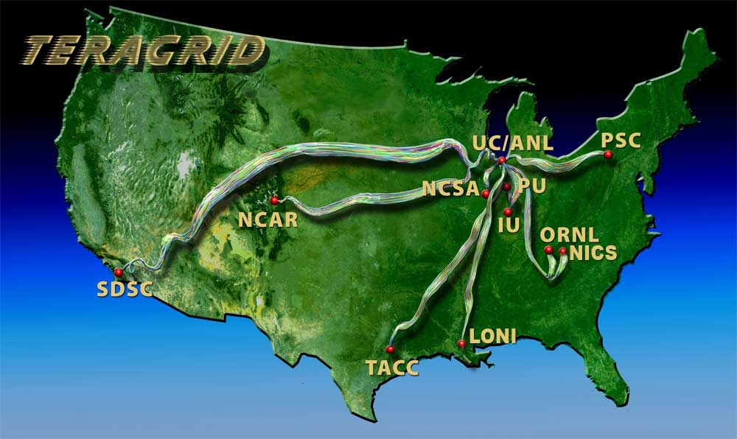
TeraGrid
~2 Petaflops; over 20 PetaBytes of storage (disk and tape), over 100 scientific data collections
UW
Grid Infrastructure Group (UChicago)
UC/ANL
PSC
NCAR
PU
NCSA
Caltech
IU
UNC/RENCI
ORNL
USC/ISI
NICS
SDSC
LONI
TACC
Resource Provider (RP)
Software Integration Partner
Network Hub

Slide 33
FutureGrid key Concepts I
FutureGrid is an international testbed modeled on Grid5000
Supporting international Computer Science and Computational Science research in cloud, grid and parallel computing (HPC)
  Industry and Academia
The FutureGrid testbed provides to its users:
  A flexible development and testing platform for middleware and application users looking at interoperability, functionality, performance or evaluation
  Each use of FutureGrid is an experiment that is reproducible
  A rich education and teaching platform for advanced cyberinfrastructure (computer science) classes

Slide 34
FutureGrid key Concepts I
FutureGrid has a complementary focus to both the Open Science Grid and the other parts of TeraGrid.
  FutureGrid is user-customizable, accessed interactively and supports Grid, Cloud and HPC software with and without virtualization.
  FutureGrid is an experimental platform where computer science applications can explore many facets of distributed systems
  and where domain sciences can explore various deployment scenarios and tuning parameters and in the future possibly migrate to the large-scale national Cyberinfrastructure.
  FutureGrid supports Interoperability Testbeds – OGF really needed!
Note a lot of current use Education, Computer Science Systems and Biology/Bioinformatics

Slide 35

FutureGrid key Concepts III
Rather than loading images onto VM’s, FutureGrid supports Cloud, Grid and Parallel computing environments by dynamically provisioning software as needed onto “bare-metal” using Moab/xCAT
  Image library for MPI, OpenMP, Hadoop, Dryad, gLite, Unicore, Globus, Xen, ScaleMP (distributed Shared Memory), Nimbus, Eucalyptus, OpenNebula, KVM, Windows …..
Growth comes from users depositing novel images in library
FutureGrid has ~4000 (will grow to ~5000) distributed cores with a dedicated network and a Spirent XGEM network fault and delay generator
Image1
Image2
…
ImageN
Choose
Load
Run

Slide 36
Dynamic Provisioning Results
Number of nodes
Time elapsed between requesting a job and the jobs reported start time on the provisioned node. The numbers here are an average of 2 sets of experiments.

Slide 37
FutureGrid Partners
Indiana University (Architecture, core software, Support)
Purdue University (HTC Hardware)
San Diego Supercomputer Center at University of California San Diego (INCA, Monitoring)
University of Chicago/Argonne National Labs (Nimbus)
University of Florida (ViNE, Education and Outreach)
University of Southern California Information Sciences (Pegasus to manage experiments)
University of Tennessee Knoxville (Benchmarking)
University of Texas at Austin/Texas Advanced Computing Center (Portal)
University of Virginia (OGF, Advisory Board and allocation)
Center for Information Services and GWT-TUD from Technische Universtität Dresden. (VAMPIR)
Red institutions have FutureGrid hardware

Slide 38
Compute Hardware
System type | # CPUs | # Cores | TFLOPS | Total RAM (GB) | Secondary Storage (TB) | Site | Status
IBM iDataPlex | 256 | 1024 | 11 | 3072 | 339* | IU | Operational
Dell PowerEdge | 192 | 768 | 8 | 1152 | 30 | TACC | Operational
IBM iDataPlex | 168 | 672 | 7 | 2016 | 120 | UC | Operational
IBM iDataPlex | 168 | 672 | 7 | 2688 | 96 | SDSC | Operational
Cray XT5m | 168 | 672 | 6 | 1344 | 339* | IU | Operational
IBM iDataPlex | 64 | 256 | 2 | 768 | On Order | UF | Operational
Large disk/memory system TBD | 128 | 512 | 5 | 7680 | 768 on nodes | IU | New System TBD
High Throughput Cluster | 192 | 384 | 4 | 192 |  | PU | Not yet integrated
Total | 1336 | 4960 | 50 | 18912 | 1353

Slide 39
Storage Hardware
System Type | Capacity (TB) | File System | Site | Status
DDN 9550 (Data Capacitor) | 339 | Lustre | IU | Existing System
DDN 6620 | 120 | GPFS | UC | New System
SunFire x4170 | 96 | ZFS | SDSC | New System
Dell MD3000 | 30 | NFS | TACC | New System
Will add substantially more disk on node and at IU and UF as shared storage

Slide 40

FutureGrid: a Grid/Cloud/HPC Testbed
NID: Network Impairment Device
Private
Public
FG Network

Slide 41
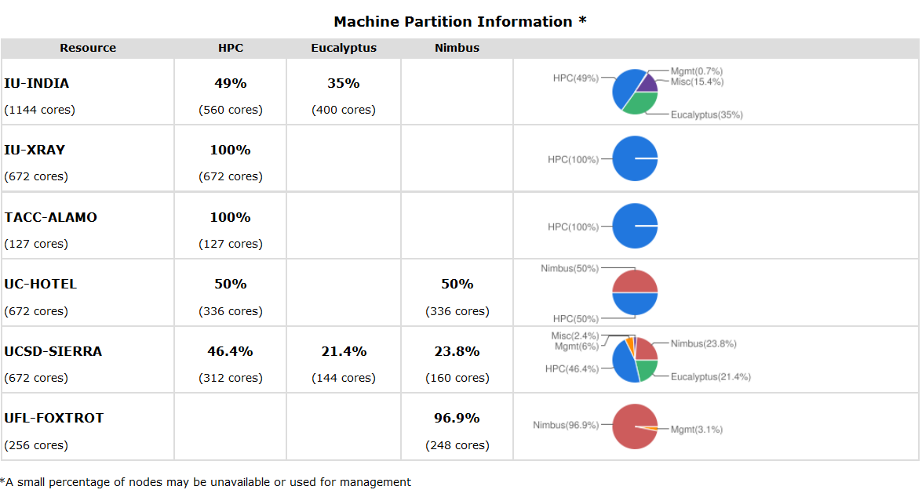
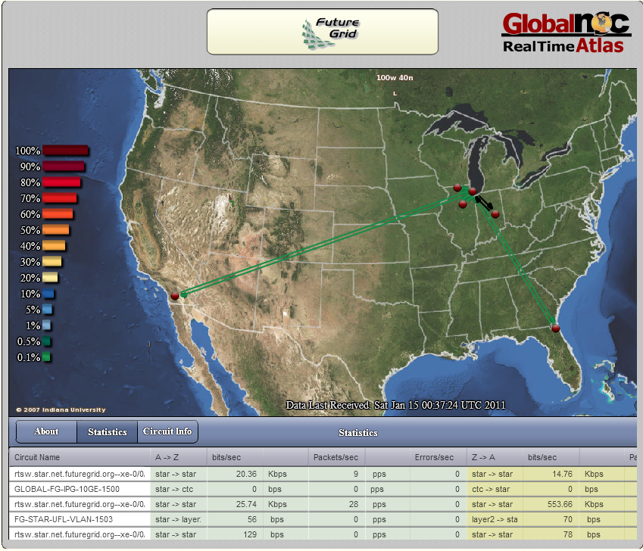
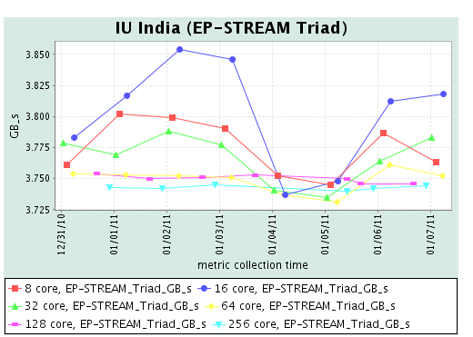
FG Status Screenshot
Partition Table
Globalnoc
Inca

Slide 42
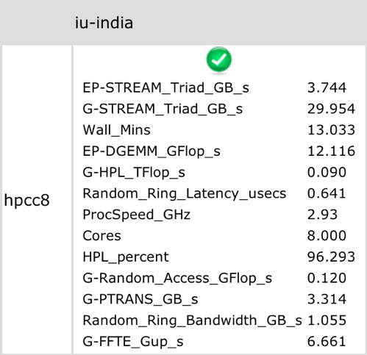
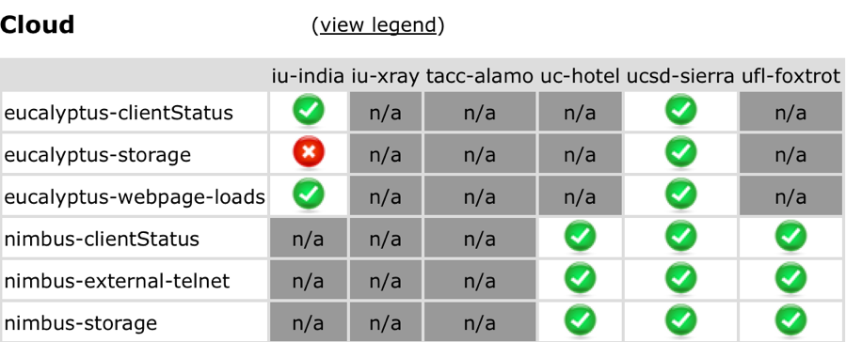
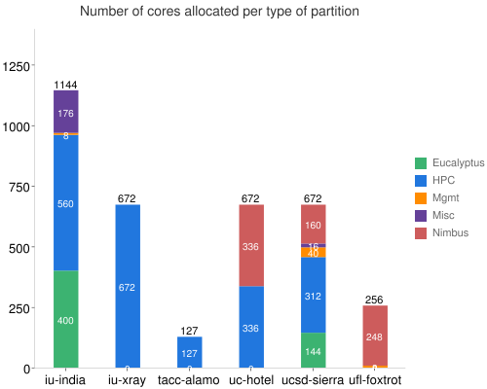
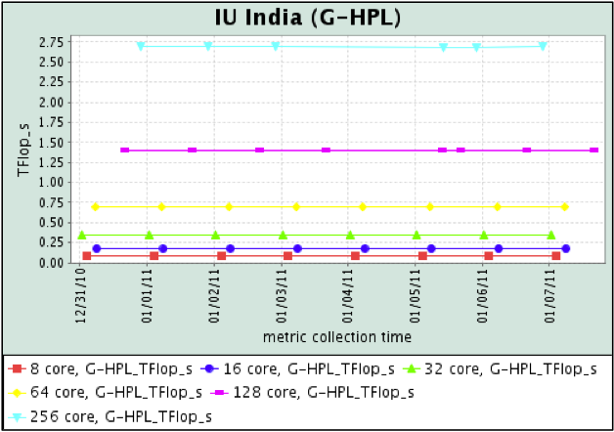
Inca http//inca.futuregrid.org
Status of basic cloud tests
Statistics displayed from HPCC performance measurement
Information on machine partitioning
History of HPCC performance

Slide 43
5 Use Types for FutureGrid
Training Education and Outreach
  Semester and short events; promising for MSI
Interoperability test-beds
  Grids and Clouds; OGF really needed this
Domain Science applications
  Life science highlighted
Computer science
  Largest current category
Computer Systems Evaluation
  TeraGrid (TIS, TAS, XSEDE), OSG, EGI

Slide 44
Some Current FutureGrid projects I
Project | Institution | Details
Educational Projects
VSCSE Big Data | IU PTI, Michigan, NCSA and 10 sites | Over 200 students in week Long Virtual School of Computational Science and Engineering on Data Intensive Applications & Technologies
LSU Distributed Scientific Computing Class | LSU | 13 students use Eucalyptus and SAGA enhanced version of MapReduce
Topics on Systems: Cloud Computing CS Class | IU SOIC | 27 students in class using virtual machines, Twister, Hadoop and Dryad
Interoperability Projects
OGF Standards | Virginia, LSU, Poznan | Interoperability experiments between OGF standard Endpoints
Sky Computing | University of Rennes 1 | Over 1000 cores in 6 clusters across Grid’5000 & FutureGrid using ViNe and Nimbus to support Hadoop and BLAST demonstrated at OGF 29 June 2010

Slide 45
Some Current FutureGrid projects II
Domain Science Application Projects
Combustion | Cummins | Performance Analysis of codes aimed at engine efficiency and pollution
Cloud Technologies for Bioinformatics Applications | IU PTI | Performance analysis of pleasingly parallel/MapReduce applications on Linux, Windows, Hadoop, Dryad, Amazon, Azure with and without virtual machines
Computer Science Projects
Cumulus | Univ. of Chicago | Open Source Storage Cloud for Science based on Nimbus
Differentiated Leases for IaaS | University of Colorado | Deployment of always-on preemptible VMs to allow support of Condor based on demand volunteer computing
Application Energy Modeling | UCSD/SDSC | Fine-grained DC power measurements on HPC resources and power benchmark system
Evaluation and TeraGrid/OSG Support Projects
Use of VM’s in OSG | OSG, Chicago, Indiana | Develop virtual machines to run the services required for the operation of the OSG and deployment of VM based applications in OSG environments.
TeraGrid QA Test & Debugging | SDSC | Support TeraGrid software Quality Assurance working group
TeraGrid TAS/TIS | Buffalo/Texas | Support of XD Auditing and Insertion functions

Slide 46

Typical FutureGrid Performance Study
Linux, Linux on VM, Windows, Azure, Amazon Bioinformatics

Slide 47

OGF’10 Demo from Rennes
SDSC
Rennes
Grid’5000 firewall
UF
Lille
UC
Sophia
ViNe provided the necessary inter-cloud connectivity to deploy CloudBLAST across 6 Nimbus sites, with a mix of public and private subnets.

Slide 48
User Support
Being upgraded now as we get into major use “An important lesson from early use is that our projects require less compute resources but more user support than traditional machines. “
Regular support: formed FET or “FutureGrid Expert Team” – initially 14 PhD students and researchers from Indiana University
  User gets Portal account at https://portal.futuregrid.org/login
  User requests project at https://portal.futuregrid.org/node/add/fg-projects
  Each user assigned a member of FET when project approved
  Users given machine accounts when project approved
  FET member and user interact to get going on FutureGrid
Advanced User Support: limited special support available on request

Slide 49
Education & Outreach on FutureGrid
Build up tutorials on supported software
Support development of curricula requiring privileges and systems destruction capabilities that are hard to grant on conventional TeraGrid
Offer suite of appliances (customized VM based images) supporting online laboratories
Supporting ~200 students in Virtual Summer School on “Big Data” July 26-30 with set of certified images – first offering of FutureGrid 101 Class; TeraGrid ‘10 “Cloud technologies, data-intensive science and the TG”; CloudCom conference tutorials Nov 30-Dec 3 2010
Experimental class use fall semester at Indiana, Florida and LSU; follow up core distributed system class Spring at IU
Planning ADMI Summer School on Clouds and REU program

Slide 50


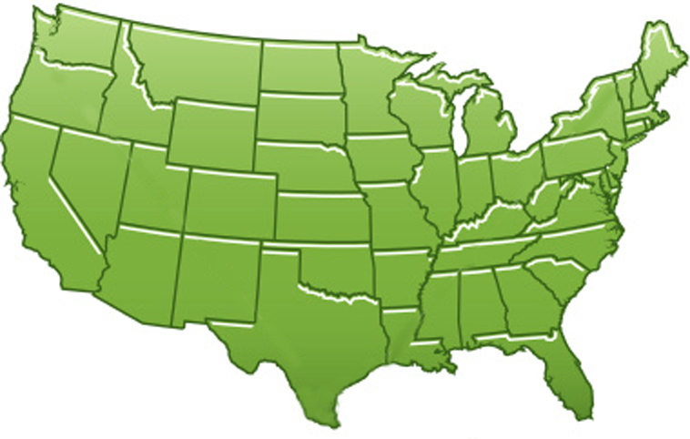















300+ Students learning about Twister & Hadoop
MapReduce technologies, supported by FutureGrid.
July 26-30, 2010 NCSA Summer School Workshop
http://salsahpc.indiana.edu/tutorial
Washington
University
University of
Minnesota
Michigan
State
Johns
Hopkins
Univ.Illinois
at Chicago
Iowa
Penn
State
IBM Almaden
Research Center
Notre
Dame
University of
California at
Los Angeles
Indiana
University
San Diego
Supercomputer
Center
University of
Texas at El Paso
University of
Arkansas
University
of Florida

Slide 51
FutureGrid Tutorials
Tutorial topic 3: Educational Virtual Appliances
Tutorial GA1: Introduction to the Grid Appliance
Tutorial GA2: Creating Grid Appliance Clusters
Tutorial GA3: Building an educational appliance from Ubuntu 10.04
Tutorial GA4: Deploying Grid Appliances using Nimbus
Tutorial GA5: Deploying Grid Appliances using Eucalyptus
Tutorial GA7: Customizing and registering Grid Appliance images using Eucalyptus
Tutorial MP1: MPI Virtual Clusters with the Grid Appliances and MPICH2
Tutorial topic 4: High Performance Computing
Tutorial VA1: Performance Analysis with Vampir
Tutorial VT1: Instrumentation and tracing with VampirTrace
Tutorial topic 1: Cloud Provisioning Platforms
Tutorial NM1: Using Nimbus on FutureGrid
Tutorial NM2: Nimbus One-click Cluster Guide
Tutorial GA6: Using the Grid Appliances to run FutureGrid Cloud Clients
Tutorial EU1: Using Eucalyptus on FutureGrid
Tutorial topic 2: Cloud Run-time Platforms
Tutorial HA1: Introduction to Hadoop using the Grid Appliance
Tutorial HA2: Running Hadoop on FG using Eucalyptus (.ppt)
Tutorial HA2: Running Hadoop on Eualyptus

Slide 52
Software Components
Important as Software is Infrastructure …
Portals including “Support” “use FutureGrid” “Outreach”
Monitoring – INCA, Power (GreenIT)
Experiment Manager: specify/workflow
Image Generation and Repository
Intercloud Networking ViNE
Virtual Clusters built with virtual networks
Performance library
Rain or Runtime Adaptable InsertioN Service for images
Security Authentication, Authorization,
Note Software integrated across institutions and between middleware and systems Management (Google docs, Jira, Mediawiki)
Note many software groups are also FG users

Slide 53
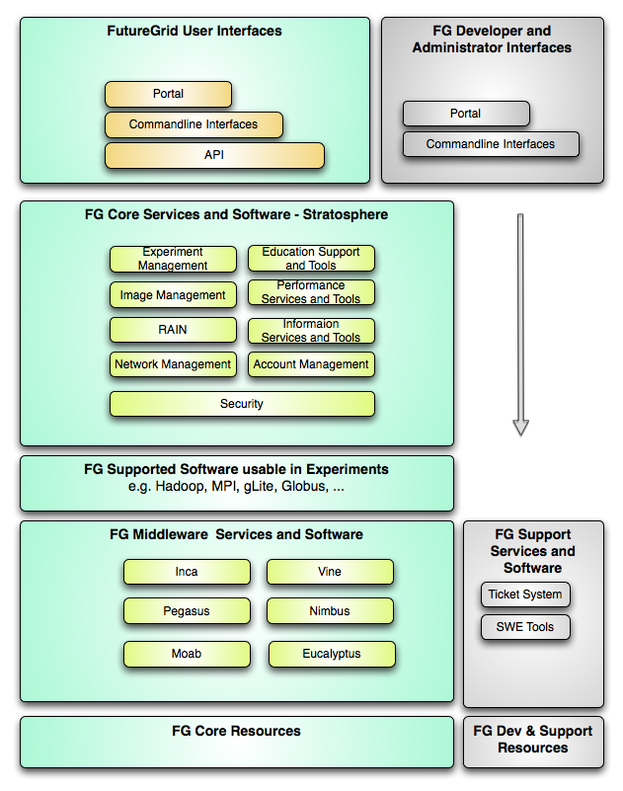
FutureGrid
Layered Software Stack
User Supported Software usable in Experiments e.g. OpenNebula, Kepler, Other MPI, Bigtable
Note on Authentication and Authorization
We have different environments and requirements from TeraGrid
Non trivial to integrate/align security model with TeraGrid

Slide 54
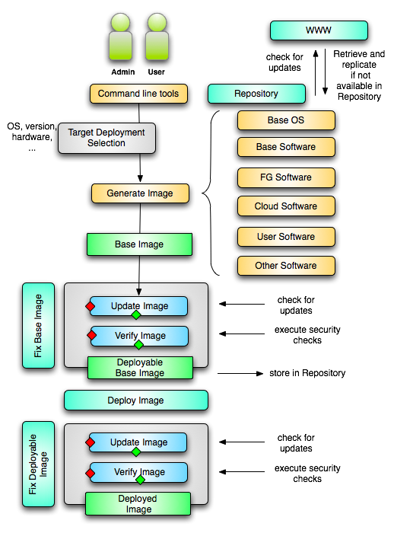
Image Creation
Creating deployable image
  User chooses one base mages
  User decides who can access the image; what additional software is on the image
  Image gets generated; updated; and verified
Image gets deployed
Deployed image gets continuously
  Updated; and verified
Note: Due to security requirement an image must be customized with authorization mechanism
  limit the number of images through the strategy of "cloning" them from a number of base images.
  users can build communities that encourage reuse of "their" images
  features of images are exposed through metadata to the community
  Administrators will use the same process to create the images that are vetted by them
  Customize images in CMS

Slide 55
From Dynamic Provisioning to “RAIN”
In FG dynamic provisioning goes beyond the services offered by common scheduling tools that provide such features.
  Dynamic provisioning in FutureGrid means more than just providing an image
  adapts the image at runtime and provides besides IaaS, PaaS, also SaaS
  We call this “raining” an environment
Rain = Runtime Adaptable INsertion Configurator
  Users want to ``rain'' an HPC, a Cloud environment, or a virtual network onto our resources with little effort.
  Command line tools supporting this task.
  Integrated into Portal
Example ``rain'' a Hadoop environment defined by an user on a cluster.
  fg-hadoop -n 8 -app myHadoopApp.jar …
  Users and administrators do not have to set up the Hadoop environment as it is being done for them

Slide 56
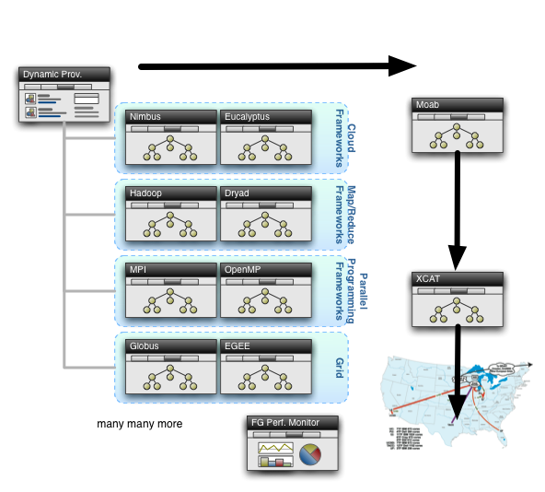
Rain in FutureGrid

Slide 57
FG RAIN Command
fg-rain –h hostfile –iaas nimbus –image img
fg-rain –h hostfile –paas hadoop …
fg-rain –h hostfile –paas dryad …
fg-rain –h hostfile –gaas gLite …
fg-rain –h hostfile –image img
Authorization is required to use fg-rain without virtualization.

Slide 58
FutureGrid Viral Growth Model
Users apply for a project
Users improve/develop some software in project
This project leads to new images which are placed in FutureGrid repository
Project report and other web pages document use of new images
Images are used by other users
And so on ad infinitum ………

