Slide 1
Indiana University QuakeSim Activities
Marlon Pierce, Geoffrey Fox, Xiaoming Gao, Jun Ji, Chao Sun

Slide 2
Updates to QuakeSim Services and User Interfaces

Slide 3
Summary of User Interface Revisions
Disloc, Simplex, and GeoFEST have been revised interact with the revised QuakeTables database using KML feeds.
One KML description for each fault collection
Fault selection map user interface significantly revised to handle multiple KML files.
Disloc, Simplex, RDAHMM, and GeoFEST all revised to work as Google gadgets as well as portlets.
Same code base. Difference is just a build option.
Gadgets integrated with Google OpenID, so you don’t need a portal login.
We have also developed a gadget container in related work.
All of this work is Open Source, in our SourceForge SVN, and buildable through Apache Maven.

Slide 4
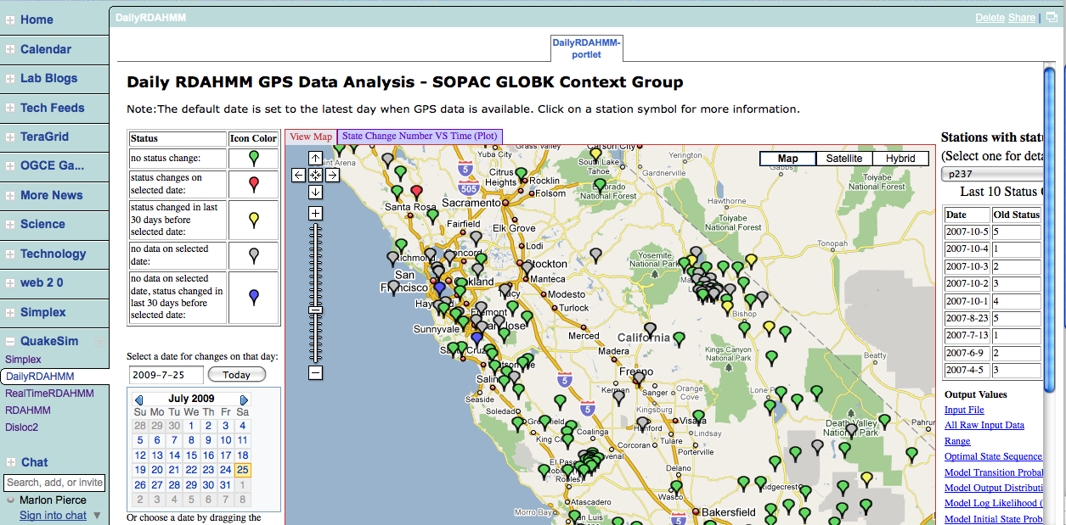
Simplex running in our OGCE Gadget Container
RDAHMM running in iGoogle.

Slide 5
Daily RDAHMM Updates

Slide 6
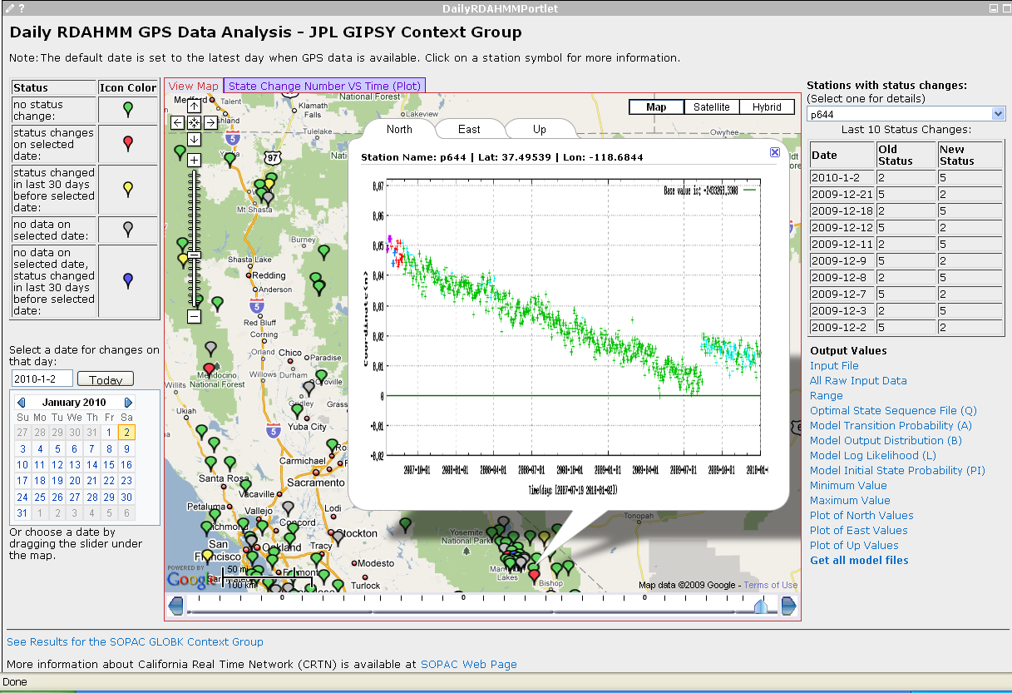
Support for the JPL data set
Same daily RDAHMM processing to the GPS data received from the JPL GIPSY Context Group

Slide 7
Daily RDAHMM service
Modified evaluation process using all GPS data since 1994-01-01 as input
Old evaluation process:
06-09.
input
RDAHMM evaluation
07-09.
Q
94-09.
Q
Model files
94-06.
Q
(model)
New evaluation process:
06-09.
input
94-09.
input
RDAHMM evaluation
94-09.
Q
94-06.
input
(model)
Model files
Effect: always enough input for evaluation

Slide 8
Daily RDAHMM video Web service
invoke
Daily RDAHMM service
Daily RDAHMM video service
add to
Request queue
return video URL
create
Video maker thread
access
Get next request
Make recent video
output
Recent video
Historical video
All-time video
input
input
output
Make all-time video
Update historical video
output

Slide 9
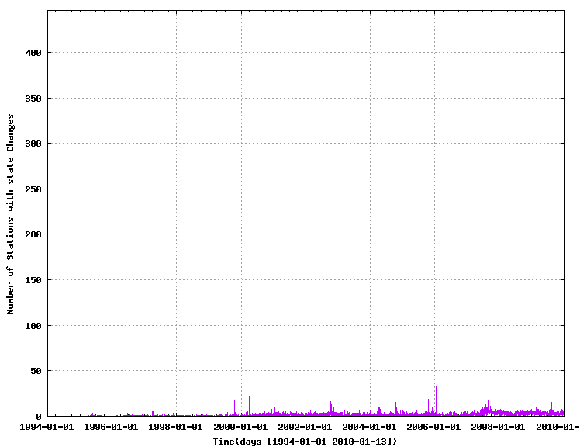
Daily RDAHMM Portlet
State change number vs. time plot for a bounded area

Slide 10
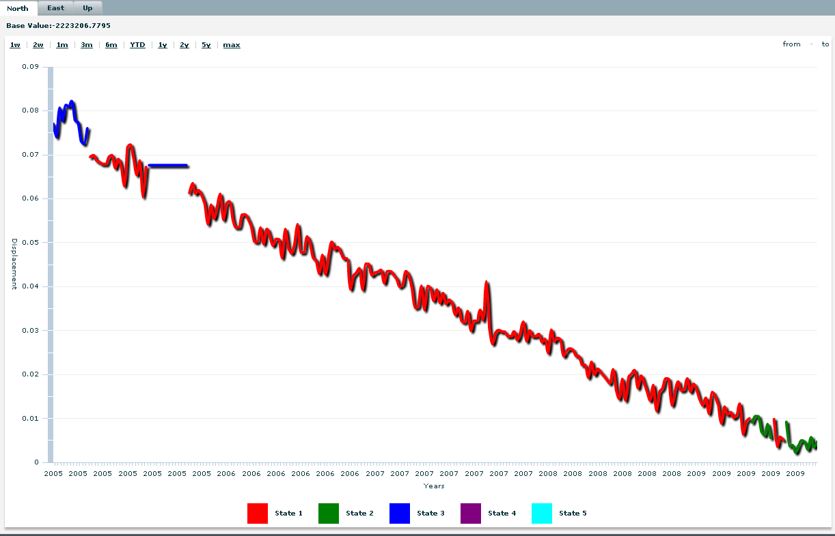
Daily RDAHMM Portlet
GPS data plot for different time scales. Developed interactive plotting tools to replace the static images.

Slide 11
Cloud Computing Research

Slide 12
Cloud Computing Overview
Computing as a Service (CaaS):
Using Data Parallel Tools such as Apache Hadoop and MS Dryad.
RDAHMM GPS Processing
Platform as a Service (PaaS):
QuakeSim Virtual Appliances running on IaaS
Future Effort
Infrastructure as a Service (IaaS):
Amazon Cloud Services (EC2, S3, EBS), MS Azure
IU Virtual Block Store Project

Slide 13
Infrastructure as a Service
For this particular project, we identified an open equivalent to Amazon’s Virtual Block Store.
Provides the Virtual Data equivalent to Virtual Machines.
Major Related Efforts: IU leads the $15M Future Grid project (NSF Track 2d award).
Future Grid is not a Cloud but a test-bed for evaluating Cloud and other technologies.
Closed early user testing is going on now, more open early user testing in the next 6 months (approx).
We note in addition major production Clouds from DOE, NASA, and other agencies are coming.

Slide 14
VBS Web Services Architecture
Volume Server
(LVM)
Virtual Machine Manager (Xen Dom 0)
VBD
VM instance (
Xen Dom U)
iSCSI
Volume Delegate
VMM Delegate
Create Volume,
Export Volume,
Create Snapshot, etc.
Import Volume,
Attach Device,
Detach Device, etc.
VBS Web Service
LVM: Logical Volume Manager
iSCSI: internet SCSI protocol
VBD: Virtual Block Device
VBS Client

Slide 15
VBS Integration with Nimbus
Volume Server
Xen Dom 0
VBD
Xen Dom U
iSCSI
Volume Delegate
Xen Delegate
Create Volume,
Export Volume,
Create Snapshot,Etc.
Import Volume,
Attach Device,
Detach Device,Etc.
Nimbus Workspace Service
VBS Web Service
Query for Xen Dom0 Host and DomUId with <Nimbus Instance Id>
VBS_Nimbus Web Service
Attch-volume <volId>
<Nimbus Instance Id> <device>
VBS Client

Slide 16
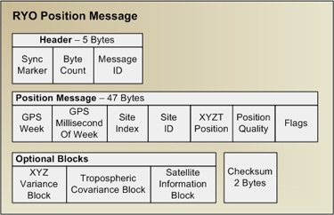
Processing Real-Time GPS Streams
ascii2gml
ryo2ascii
RYO Ports
ascii2pos
7010
NB Server
Raw Data
Scripps
RTD Server
ryo2nb
Single Station
7011
7012
GPS Networks
Displacement Filter
RDAHMM Filter
Station Health Filter
/SOPAC/GPS/CRTN01/RYO
Raw Data
ryo2nb
ryo2ascii
/SOPAC/GPS/CRTN01/ASCII
ascii2pos
Single Station
RDAHMM Filter
/SOPAC/GPS/CRTN01/POS
/SOPAC/GPS/CRTN01/DSME
16
A Complete Sensor Message Processing Path, including a data analysis application.
Notes:
16

Slide 17
Computing as a Service: Hadoop and GPS Processing
We identified the Real-Time RDAHMM GPS processing pipeline as a good candidate for evaluating Hadoop, Dryad, and other systems.
Our current system is a custom-built distributed pipeline based on publish/subscribe semantics.
But it matches well with the goals of both Hadoop and Dryad, which do the same thing.
This evaluation is on-going.
We also have a significant effort in researching these and other technologies for parallel computing that is outside the scope of the QuakeSim project.
See for example http://grids.ucs.indiana.edu/ptliupages/publications/cloud_handbook_final-with-diagrams.pdf
Recent efforts have focused on bioinformatics, but the research is general.

Slide 18
IU Participants
Xiaoming Gao, Ph. D student
RDAHMM/GPS infrastructure and user interfaces
Virtual Block Storage system.
Jun Ji, Master’s student, intern
Disloc, Simplex, and GeoFEST revisions
Google gadget development
OpenID for gadgets
Chao Sun, Master’s student, independent study
Hadoop investigation of RDAHMM GPS

Slide 19
More Information
QuakeSim Web Site:
www.quakesim.org
Portal URL:
http://gw11.quarry.iu.teragrid.org/gridsphere
Portal SourceForge Page:
https://sourceforge.net/projects/crisisgrid
Code SVN:
http://crisisgrid.svn.sourceforge.net/viewvc/crisisgrid/

