Slide 1
The Convergence of Cloud, Big Data and Mobile: What could happen in 5 years? Cloud Analytics Panel (IWCA Workshop)
Judy Qiu
Indiana University

Slide 2
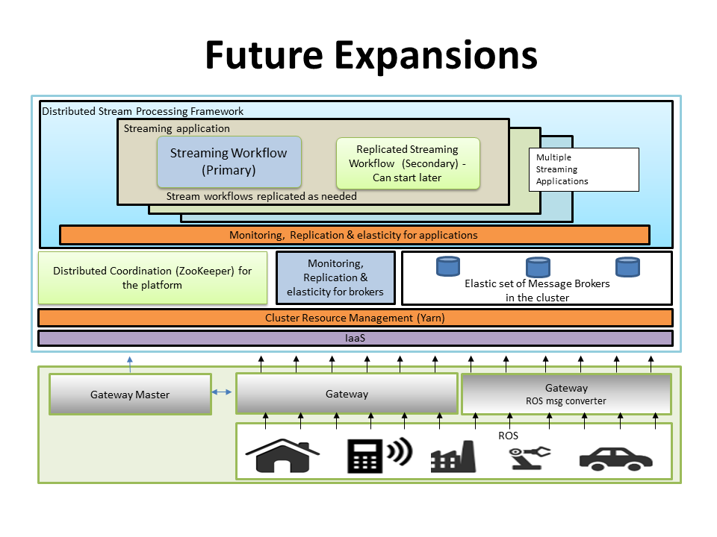
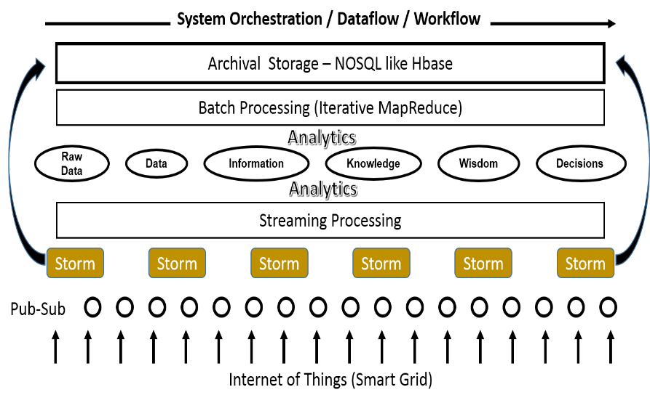
Outlines
Motivations
50 billion devices by 2020.
Academia and Industry need advanced analytics on the data they have already collected.
The role of Analytics in Cloud, Big Data and Mobile
A distributed runtime environment needs to integrate with community infrastructure which supports interoperable, sustainable and high performance data analytics.
One solution is to converge Apache Big Data stack from industry with High Performance Cyberinfrastructure into well-defined and implemented common building blocks, providing sufficient richness in capabilities and productivity. HPC-ABDS has about 300 packages and aims to provide them in a library form so that they can be reused by higher-level applications and tuned for a specific domain problem, such as Machine Learning.
Data, Information, Knowledge and Wisdom
Comparison of current Data Analytics stack from Cloud and HPC infrastructure

