Slide 1
FutureGrid Image Repository:
A Generic Catalog and Storage System for Heterogeneous Virtual Machine Images
Javier Diaz, Gregor von Laszewski, Fugang Wang, Andrew Younge, Geoffrey Fox

Slide 2
Index
Motivation
Requirements, Design, Implementation
Methodology
Results
Conclusions
Outgoing Work

Slide 3
Motivation
FutureGrid is an experimental cloud and grid testbed
  We support HPC, Grid, and Cloud frameworks and services
    Much interest by the community is in the offered frameworks and services are based on virtualization technologies or make use of them
    Apply: https://www.portal.futuregrid.org
Image management becomes a key issue
Generic catalog and repository of images that will be able to interact with other FG subsystems and potentially with other infrastructures
Create and maintain platforms within custom FG images that can be retrieved, deployed and provisioned on demand

Slide 4
FutureGrid Offerings (currently)
IaaS
  Nimbus
  OpenStack
  Eucalyptus
PaaS
  Hadoop
  SAGA
  …
HPC
  MPI
  OpenMP
  ScaleMP
  Vampir
Grid
  Genesis II
  Unicore
  (Globus)
  …
RAIN (ACL)
  Repository
  Initialization
  Provisioning
  (Management)

Slide 5
Index
Motivation
Requirements, Design, Implementation
Methodology
Results
Conclusions
Outgoing Work

Slide 6
Requirements
Four group of users considered
  A single user. Users create images that are part of experiments they conduct on FG
  A group of users that work together in the same project and share the images
  System administrators. They maintain the image repository ensuring backups and preserving space. They also may use it for the distribution of the HPC image that is accessible by default.
  FG services and subsystems
Requirements include:
  A simple, intuitive and user friendly environment
  A unified, extensible and integrated system design to manage various types of images for different systems
  Built in fault tolerance with proper accounting and information tools
  The ability to be integrated with the FG security.

Slide 7
Design
Integrated service that enables storing and organizing images from multiple cloud efforts in the same repository
Images are augmented with metadata to describe their properties like the software stack installed or the OS
Access to the images can be restricted to single users, groups of users or system administrators
Maintains data related with the usage to assist performance monitoring and accounting

Slide 8
Design (II)
Quota management to avoid space restrictions
Pedigree to recreate image on demand
Repository’s interfaces: API's, a command line, an interactive shell, and a REST service
Other cloud frameworks could integrate with this image repository by accessing it through an standard API

Slide 9
Design (III)

Slide 10
Implementation
Client-Server architecture
Support up to four different storage:
  MySQL where the image files are stored directly in the POSIX file system
  MongoDB where both data and files are stored in the NoSQL database
  OpenStack Object Store (Swift)
  Cumulus (Nimbus project)
Increase interoperability and provide templates to help community to create their own storage plugins
Notes:
For the last two the data can be stored in either MySQL or in MongoDB.

Slide 11
User Management and Authentication
Users have to authenticate to get access
Access based on roles and project/group memberships
FG account management services can provide needed metadata on project memberships and roles
Authentication based on LDAP

Slide 12
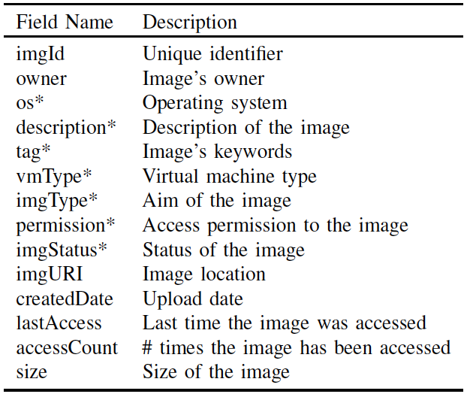
Image Metadata
Fields with Asterisks (*) can be modified by users

Slide 13
Image Management
Users upload the image and specify the metadata
Modifications to the metadata can be accomplished by the owner of an image
Repository can be queried by using a simplified SQL-style syntax
Support accounting services
  Number of times that an image has been requested
  Last time that an image was accessed
  Number of images registered by each user
  Disk space used by each user
Triggers that react upon certain conditions associated with the metadata

Slide 14
Index
Motivation
Requirements, Design, Implementation
Methodology
Results
Conclusions
Outgoing Work

Slide 15
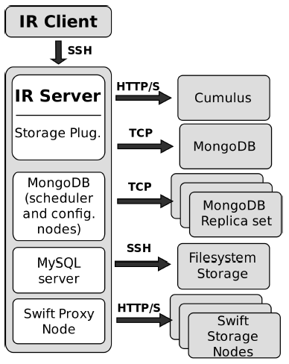
Experiment Methodology
Evaluate all these storage back-ends for the image repository
Seven configurations:
  Cumulus+MongoDB (Cumu+Mo)
  Cumulus+MySQL (Cumu+My)
  Filesystem+MySQL (Fs+My)
  MongoDB with Replication (Mo+Mo)
  MongoDB with No Replication (MoNR+MoNR)
  Swift+MongoDB (Swi+Mo)
  Swift+MySQL (Swi+My)
Five different image sizes: 50MB, 300MB, 500MB, 1GB and 2GB
Test read and write performance using a single client
Test 16 clients retrieving images concurrently

Slide 16
Index
Motivation
Requirements, Design, Implementation
Methodology
Results
Conclusions
Outgoing Work

Slide 17
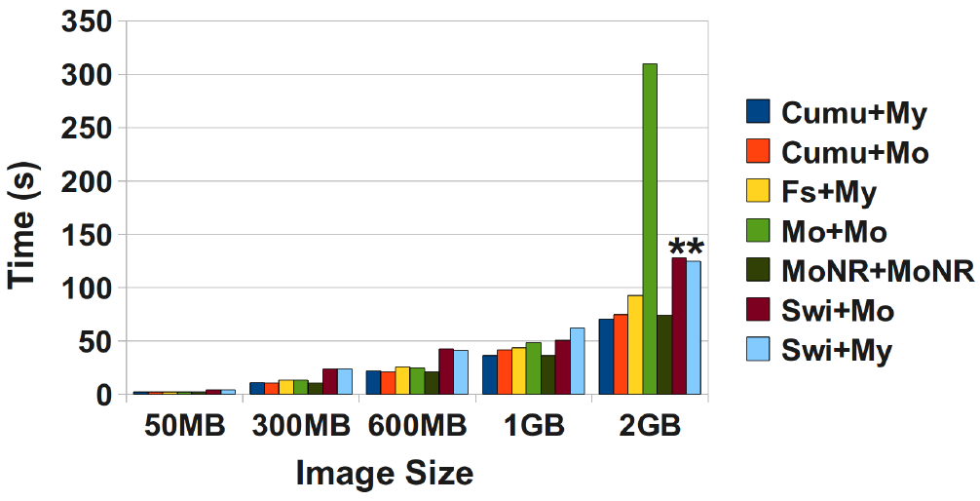
Upload Images
* done using the command line tool instead of the Python API

Slide 18
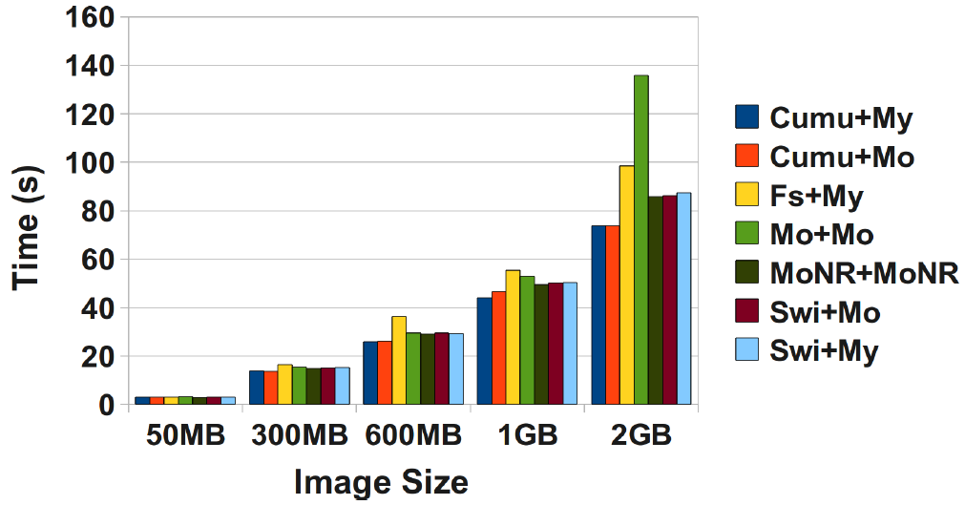
Retrieve Images

Slide 19
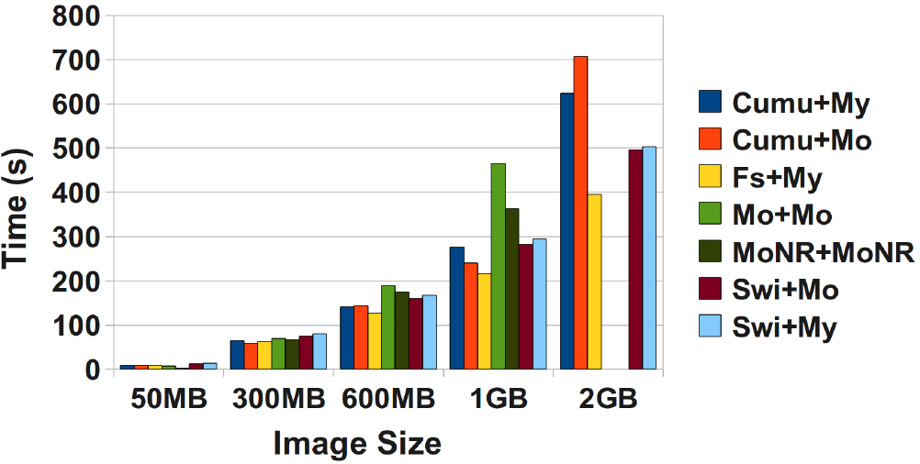
Retrieve Images using 16 client concurrently

Slide 20
Index
Motivation
Requirements, Design, Implementation
Methodology
Results
Conclusions
Outgoing Work

Slide 21
Conclusions
We have introduced the FutureGrid Image Repository and presented a functional prototype that implements most of the designed features
Key aspect of this image repository is the ability to provide a unique and common interface to manage any kind of image
Flexible design to be integrated with FG and other frameworks

Slide 22
Conclusions (Storage Backend)
MongoDB performance problems and high memory usage
Swift too many errors
Cumulus missing fault tolerance/scalability
Candidates to be our default storage system:
  Cumulus because is still quite fast and reliable
  Swift because has a good architecture to provide fault tolerance and scalability

Slide 23
Index
Motivation
Requirements, Design, Implementation
Methodology
Results
Conclusions
Outgoing Work

Slide 24
Ongoing Work
Development of Rest API
Integration with the rest of the image management components
Compatibility with the Open Virtualization Format (OVF) to describe the images.

Slide 25
Thank for your attention!
Contact info:
Gregor Laszewski: laszewski@gmail.com
Javier Diaz: javier.diazmontes@gmail.com
Fugang Wang: kevinwangfg@gmail.com
https://portal.futuregrid.org

