Slide 1
DryadLINQ for Scientific Analyses
MSR Internship – Final Presentation
Jaliya Ekanayake
jekanaya@cs.indiana.edu
School of Informatics and Computing Indiana University Bloomington

Slide 2
Acknowledgements to
ARTS Team
Nelson Araujo (my mentor)
Christophe Poulain
Roger Barga
Tim Chou
Dryad Team at Silicon Valley
School of Informatics and Computing, Indiana University
Prof. Geoffrey Fox (my advisor)
Thilina Gunarathne
Scott Beason
Xiaohong Qiu

Slide 3
Goals
Evaluate the usability of DryadLINQ for scientific analyses
Develop a series of scientific applications using DryadLINQ
Compare them with similar MapReduce implementations (E.g. Hadoop)
Run above DryadLINQ applications on Cloud

Slide 4
Applications & Different Interconnection Patterns
Map Only | MapReduce | Iterations | Tightly synchronized (MPI)
CAP3 Analysis Document conversion (PDF -> HTML) Brute force searches in cryptography Parametric sweeps | High Energy Physics (HEP) Histogramming operation Distributed search Distributed sorting Information retrieval | Expectation maximization algorithms Clustering Matrix multiplication | Many MPI applications utilizing wide variety of communication constructs
CAP3 – Gene Assembly | HEP Data Analysis CloudBurst Tera-Sort Calculation of Pairwise Distances for ALU Sequences | Kmeans Clustering | Kmeans Clustering Calculation of Pairwise Distances for ALU Sequences
Input
iterations
Input
Input
map
map
map
Pij
reduce
Output
reduce

Slide 5
Parallel Runtimes – DryadLINQ vs. Hadoop
Feature | Dryad/DryadLINQ | Hadoop
Programming Model & Language Support | DAG based execution flows. Programmable via C# DryadLINQ Provides LINQ programming API for Dryad | MapReduce Implemented using Java Other languages are supported via Hadoop Streaming
Data Handling | Shared directories/ Local disks | HDFS
Intermediate Data Communication | Files/TCP pipes/ Shared memory FIFO | HDFS/ Point-to-point via HTTP
Scheduling | Data locality/ Network topology based run time graph optimizations | Data locality/ Rack aware
Failure Handling | Re-execution of vertices | Persistence via HDFS Re-execution of map and reduce tasks
Monitoring | Monitoring support for execution graphs | Monitoring support of HDFS, and MapReduce computations

Slide 6
Cluster Configurations
Feature | GCB-K18 @ MSR | iDataplex @ IU | Tempest @ IU
CPU | Intel Xeon CPU L5420 2.50GHz | Intel Xeon CPU L5420 2.50GHz | Intel Xeon CPU E7450 2.40GHz
# CPU /# Cores | 2 / 8 | 2 / 8 | 4 / 24
Memory | 16 GB | 32GB | 48GB
# Disks | 2 | 1 | 2
Network | Giga bit Ethernet | Giga bit Ethernet | Giga bit Ethernet / 20 Gbps Infiniband
Operating System | Windows Server Enterprise - 64 bit | Red Hat Enterprise Linux Server -64 bit | Windows Server Enterprise - 64 bit
# Nodes Used | 32 | 32 | 32
Total CPU Cores Used | 256 | 256 | 768
DryadLINQ
Hadoop / MPI
DryadLINQ / MPI

Slide 7
CAP3 - DNA Sequence Assembly Program [1]
EST (Expressed Sequence Tag) corresponds to messenger RNAs (mRNAs) transcribed from the genes residing on chromosomes. Each individual EST sequence represents a fragment of mRNA, and the EST assembly aims to re-construct full-length mRNA sequences for each expressed gene.
Input files (FASTA)
GCB-K18-N01
\DryadData\cap3\cap3data
10
0,344,CGB-K18-N01
1,344,CGB-K18-N01
…
9,344,CGB-K18-N01
Cap3data.pf
V
V
Cap3data.00000000
\\GCB-K18-N01\DryadData\cap3\cluster34442.fsa
\\GCB-K18-N01\DryadData\cap3\cluster34443.fsa
...
\\GCB-K18-N01\DryadData\cap3\cluster34467.fsa
Output files
Input files
(FASTA)
IQueryable<LineRecord> inputFiles=PartitionedTable.Get <LineRecord>(uri);
IQueryable<OutputInfo> = inputFiles.Select(x=>ExecuteCAP3(x.line));
[1] X. Huang, A. Madan, “CAP3: A DNA Sequence Assembly Program,” Genome Research, vol. 9, no. 9, pp. 868-877, 1999.

Slide 8
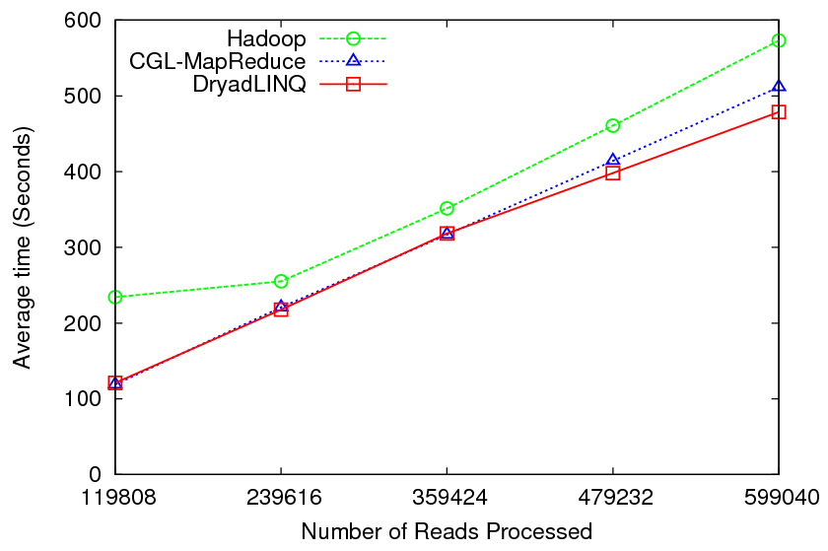
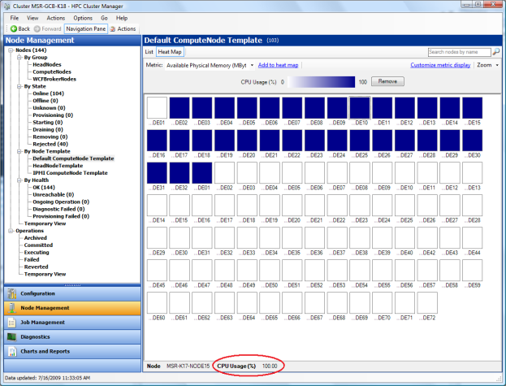
CAP3 - Performance

Slide 9
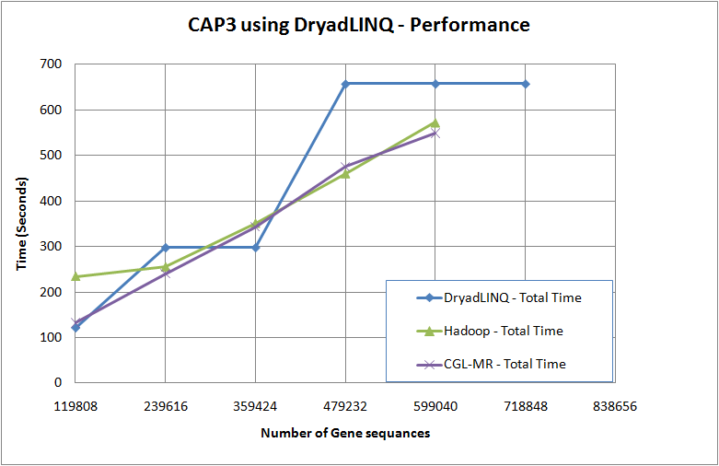
It was not so straight forward though…
Two issues (not) related to DryadLINQ
Scheduling at PLINQ
Performance of Threads
Skew in input data
Fluctuating
12.5-100% utilization of CPU cores
Sustained
100% utilization of CPU cores

Slide 10
Scheduling of Tasks
DryadLINQ Job
Partitions
/vertices
DryadLINQ schedules
Partitions to nodes
Hadoop Schedules map/reduce tasks
directly to CPU cores
1
PLINQ sub tasks
PLINQ explores
Further parallelism
2
Threads
Threads map PLINQ
Tasks to CPU cores
3
CPU cores
Problem
1
4 CPU cores
4 CPU cores
Partitions
1
2
3
Time
Partitions
1
2
3
Time
Better utilization when tasks are homogenous
Under utilization when tasks are non-homogenous

Slide 11
Scheduling of Tasks contd..
Problem
2
PLINQ Scheduler and coarse grained tasks
E.g. A data partition contains 16 records, 8 CPU cores in a node
We expect the scheduling of tasks to be as follows
X-ray tool shows this ->
8 CPU cores
100% 50% 50%
utilization of CPU cores
Heuristics at PLINQ (version 3.5) scheduler does not seem to work well for coarse grained tasks
Workaround
Use “Apply” instead of “Select”
Apply allows iterating over the complete partition (“Select” allows accessing a single element only)
Use multi-threaded program inside “Apply” (Ugly solution)
Bypass PLINQ
Problem
3
Discussed Later

Slide 12
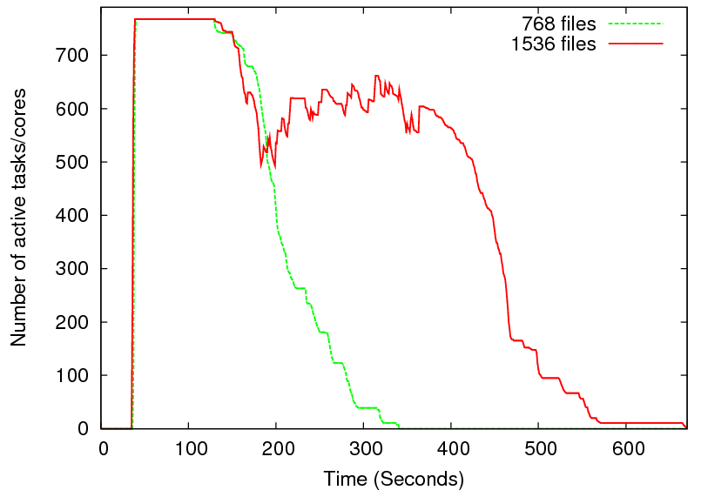
Heterogeneity in Data
2 partitions
per node
1 partition
per node
Two CAP3 tests on Tempest cluster
Long running tasks takes roughly 40% of time
Scheduling of the next partition getting delayed due to the long running tasks
Low utilization

Slide 13
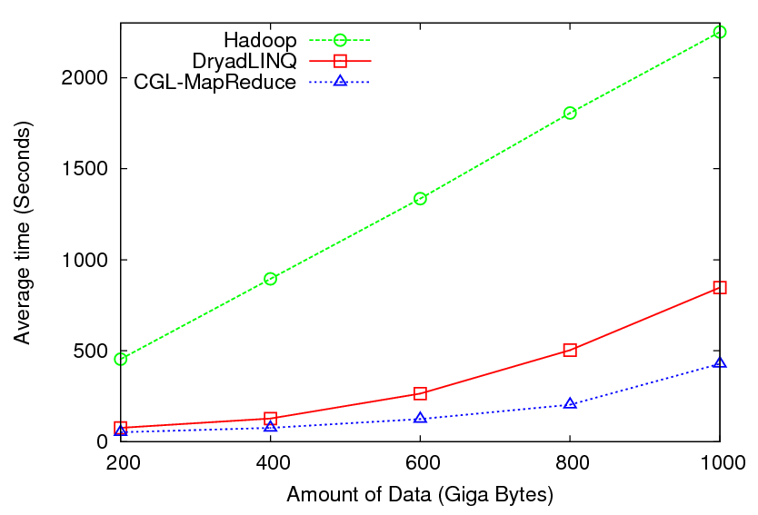
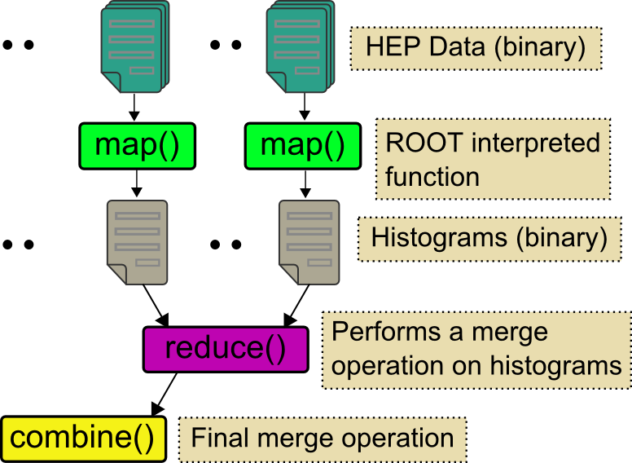
High Energy Physics Data Analysis
Histogramming of events from a large (up to 1TB) data set
Data analysis requires ROOT framework (ROOT Interpreted Scripts)
Performance depends on disk access speeds
Hadoop implementation uses a shared parallel file system (Lustre)
ROOT scripts cannot access data from HDFS
On demand data movement has significant overhead
Dryad stores data in local disks
Better performance

Slide 14
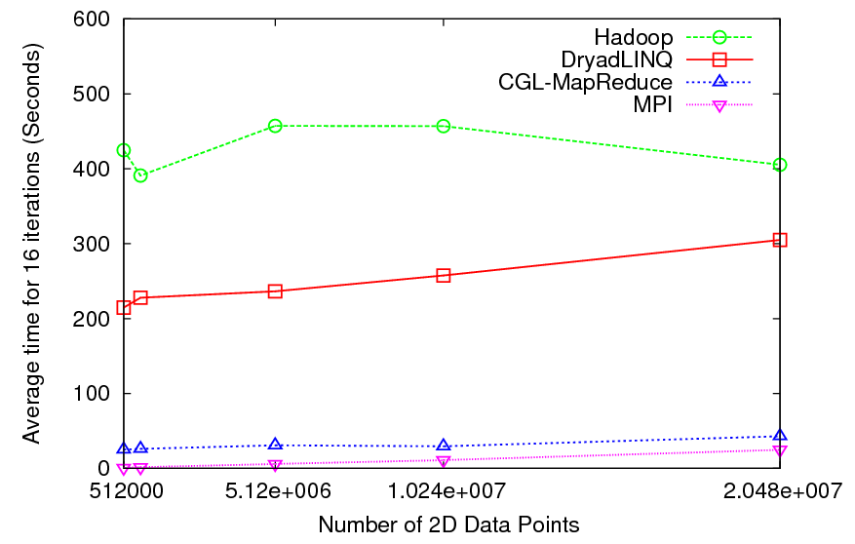
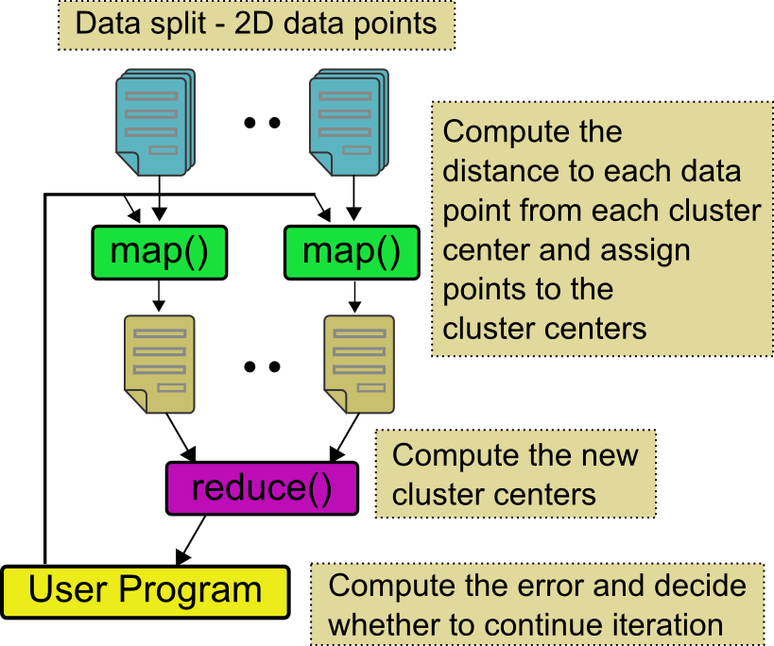
Kmeans Clustering
Time for 20 iterations
Iteratively refining operation
New maps/reducers/vertices in every iteration
File system based communication
Loop unrolling in DryadLINQ provide better performance
The overheads are extremely large compared to MPI
Large
Overheads

Slide 15
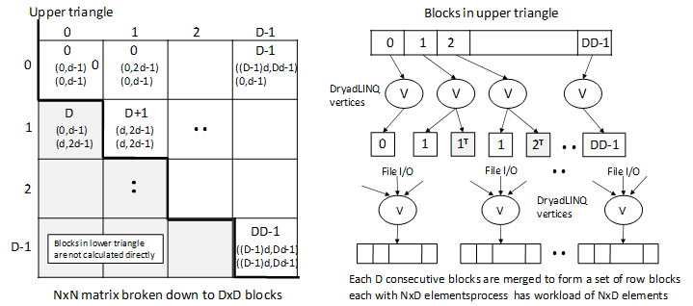
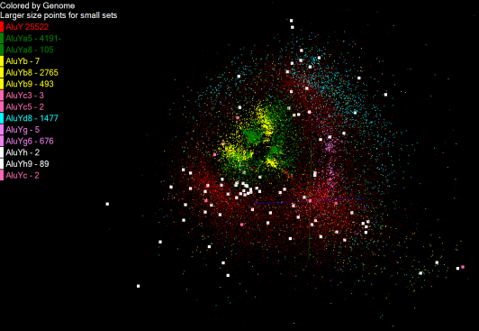
Pairwise Distances – ALU Sequencing
125 million distances
4 hours & 46 minutes
Calculate pairwise distances for a collection of genes (used for clustering, MDS)
O(N^2) effect
Fine grained tasks in MPI
Coarse grained tasks in DryadLINQ
Performance close to MPI
Performed on 768 cores (Tempest Cluster)
Processes work better than threads when used inside vertices
70% utilization vs. 100%
Problem
3
Notes:
1~180 lines without threading in DryadLINQ, with threading, it is about 400 lines
MPI ~500 lines
The Alu clustering problem [27] is one of the most challenging problems for sequencing clustering because Alus represent the largest repeat families in human genome. There are about 1 million copies of Alu sequences in human genome, in which most insertions can be found in other primates and only a small fraction (~ 7000) are human-specific. This indicates that the classification of Alu repeats can be deduced solely from the 1 million human Alu elements. Notable, Alu clustering can be viewed as a classical case study for the capacity of computational infrastructures because it is not only of great intrinsic biological interests, but also a problem of a scale that will remain as the upper limit of many other clustering problem in bioinformatics for the next few years, e.g. the automated protein family classification for a few millions of proteins predicted from large metagenomics projects. In our work here we examine Alu samples of 35339 and 50,000 sequences.

Slide 16
Questions?
Notes:
Transition to Atilla

Slide 17
DryadLINQ on Cloud
HPC release of DryadLINQ requires Windows Server 2008
Amazon does not provide this VM yet
Used GoGrid cloud provider
Before Running Applications
Create VM image with necessary software
E.g. NET framework
Deploy a collection of images (one by one – a feature of GoGrid)
Configure IP addresses (requires login to individual nodes)
Configure an HPC cluster
Install DryadLINQ
Copying data from “cloud storage”
We configured a 32 node virtual cluster in GoGrid

Slide 18
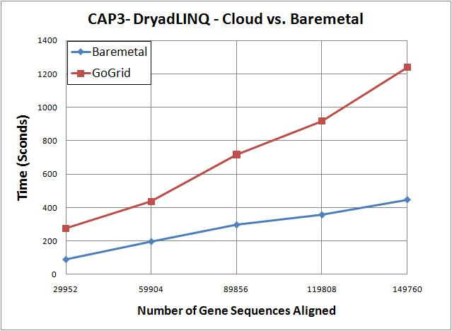
DryadLINQ on Cloud contd..
CAP3 works on cloud
Used 32 CPU cores
100% utilization of virtual CPU cores
3 times more time in cloud than the bare-metal runs
CloudBurst and Kmeans did not run on cloud
VMs were crashing/freezing even at data partitioning
Communication and data accessing simply freeze VMs
VMs become unreachable
We expect some communication overhead, but the above observations are more GoGrid related than to Cloud

Slide 19
Conclusions
Six applications with various computation, communication, and data access requirements
All DryadLINQ applications work, and in many cases perform better than Hadoop
We can definitely use DryadLINQ for scientific analyses
We did not implement (find)
Applications that can only be implemented using DryadLINQ but not with typical MapReduce
Current release of DryadLINQ has some performance limitations
DryadLINQ hides many aspects of parallel computing from user
Coding is much simpler in DryadLINQ than Hadoop (provided that the performance issues are fixed)
More simplicity comes with less control and sometimes it is hard to fine-tune
We showed that it is possible to run DryadLINQ on Cloud

Slide 20
Thank You!

