Slide 1
Big Data HPC Convergence and a bunch of other things
JSU/CSET’s BIG DATA | SPRING 2016
Thought Leaders Colloquium
Geoffrey Fox
February 4, 2016
gcf@indiana.edu
http://www.dsc.soic.indiana.edu/, http://spidal.org/ http://hpc-abds.org/kaleidoscope/
Department of Intelligent Systems Engineering
School of Informatics and Computing, Digital Science Center
Indiana University Bloomington

Slide 2
Abstract
Two major trends in computing systems are the growth in high performance computing (HPC) with an international exascale initiative, and the big data phenomenon with an accompanying cloud infrastructure of well publicized dramatic and increasing size and sophistication. We survey these trends focusing on Big Data due to its pervasive importance. Then we look at linking these trends together, where one needs to consider multiple aspects: hardware, software, applications/algorithms and even broader issues like business model and education. We study in detail a convergence (of big data and HPC/big simulations) approach for software and applications/algorithms and show what hardware architectures it suggests. We start by dividing applications into data plus model components and classifying each component (whether from Big Data or Big Simulations) in the same way. These leads to 64 properties divided into 4 views, which are Problem Architecture (Macro pattern); Execution Features (Micro patterns); Data Source and Style; and finally the Processing (runtime) View. We discuss convergence software built around HPC-ABDS (High Performance Computing enhanced Apache Big Data Stack) http://hpc-abds.org/kaleidoscope/ and show how one can merge Big Data and HPC (Big Simulation) concepts into a single stack. We give examples of data analytics running on HPC systems including details on persuading Java to run fast. Some details can be found at http://dsc.soic.indiana.edu/publications/HPCBigDataConvergence.pdf

Slide 3
Education

Slide 4

Background of the School of Informatics and Computing SOIC
The School of Informatics was established in 2000 as first of
its kind in the United States.
Computer Science was established in 1971 and became part
of the school in 2005.
Library and Information Science
was established in 1951 and
became part of the school
in 2013.
Now named the School of
Informatics and Computing.
Data Science added January 2014
  Masters now
Engineering to be added Fall 2016

Slide 5
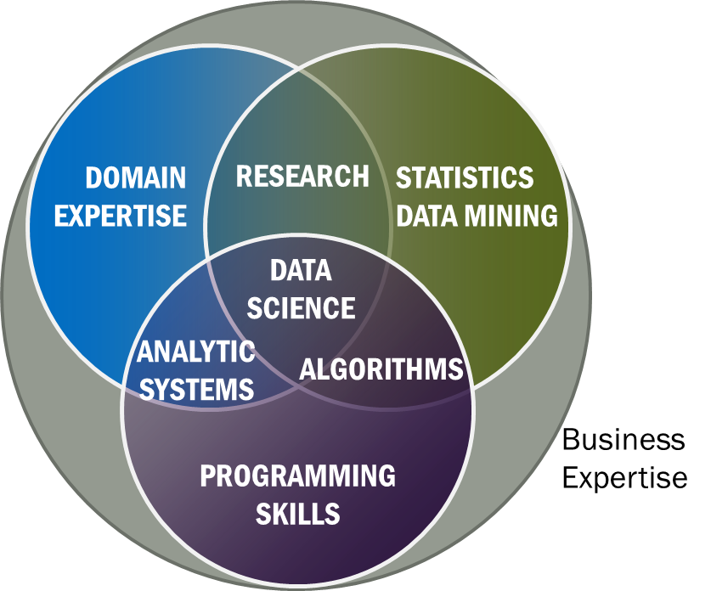
Data Science Definition from NIST Public Working Group
Data Science is the extraction of actionable knowledge directly from data through a process of discovery, hypothesis, and analytical hypothesis analysis.
Misses library science part like curation
A Data Scientist is a practitioner who has sufficient knowledge of the overlapping regimes of expertise in business needs, domain knowledge, analytical skills and programming expertise to manage the end-to-end scientific method process through each stage in the big data lifecycle.
See Big Data Definitions in http://bigdatawg.nist.gov/V1_output_docs.php
Notes:
Big Data refers to digital data volume, velocity and/or variety whose management requires scalability across coupled horizontal resources
Data Science is the extraction of actionable knowledge directly from data through a process of discovery, hypothesis, and analytical hypothesis analysis.
A Data Scientist is a practitioner who has sufficient knowledge of the overlapping regimes of expertise in business needs, domain knowledge, analytical skills and programming expertise to manage the end-to-end scientific method process through each stage in the big data lifecycle.

Slide 6
Data Science Summary
We have strong curriculum
  Online 4 course certificate
  Online Residential Hybrid masters started Spring 2015
  Adding PhD
Fall 2015 Data Science total enrollment 178
  34 Online Certificate
  82 Online Masters
  62 Residential Masters
Spring 2016
  total applicants:175
  Residential 74(58) These are admits (accepts)
  Online 60(51)
  Certificate 5(5)
Note high acceptance rate
This is “program” not a department

Slide 7
Computational Science
Computational science has important similarities to data science but with a simulation rather than data analysis flavor.
Although a great deal of effort went into with meetings and several academic curricula/programs, it didn’t take off
  In my experience not a lot of students were interested and
  The academic job opportunities were not great
Data science has more jobs; maybe it will do better?
Can we usefully link these concepts?
PS both use parallel computing!
In days gone by, I did research in particle physics phenomenology which in retrospect was an early form of data science using models extensively

Slide 8
Some Online Data Science Classes by Fox
BDAA: Big Data Applications & Analytics
  Used to be called X-Informatics
  ~40 hours of video mainly discussing applications (The X in X-Informatics or X-Analytics) in context of big data and clouds https://bigdatacourse.appspot.com/course
BDOSSP: Big Data Open Source Software and Projects http://bigdataopensourceprojects.soic.indiana.edu/
  ~27 Hours of video discussing HPC-ABDS and use on FutureSystems for Big Data software
Both divided into sections (coherent topics), units (~lectures) and lessons (5-20 minutes) in which student is meant to stay awake

Slide 9
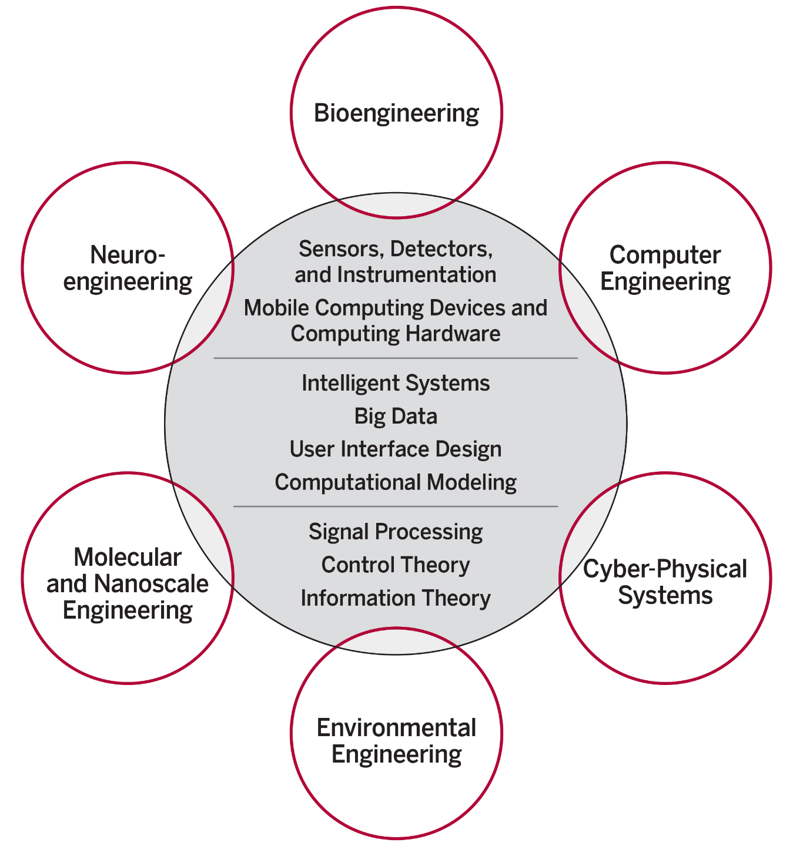
Intelligent Systems Engineering ISE Structure
The focus is on engineering of systems of small scale, often mobile devices that draw upon modern information technology techniques including intelligent systems, big data and user interface design. The foundation of these devices include sensor and detector technologies, signal processing, and information and control theory.
End to end Engineering in 6 areas
(Starting Fall 2016
IU Bloomington is the only university among AAU’s 62 member institutions that does not have any type of engineering program.

Slide 10
Introduction
What is Big Data
What is Big Simulation

Slide 11
Big Simulations
Complete model of the Kv1.2 channel. The atomic model comprises 1,560 amino acids, 645 lipid molecules, 80,850 water molecules and ~300K+ and Cl- ion pairs. In total, there are more than 350,000 atoms in the system
Computational Fluid Dynamics
Flow in an aircraft engine

Slide 12
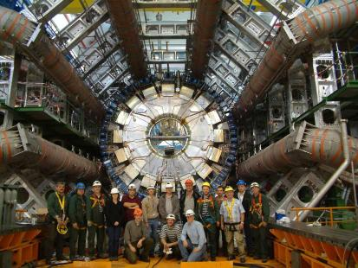
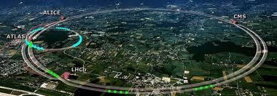
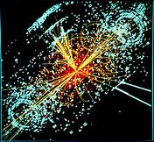
http://grids.ucs.indiana.edu/ptliupages/publications/Where%20does%20all%20the%20data%20come%20from%20v7.pdf
This analysis raw data → reconstructed data → AOD and TAGS → Physics is performed on the multi-tier LHC Computing Grid. Note that every event can be analyzed independently so that many events can be processed in parallel with some concentration operations such as those to gather entries in a histogram. This implies that both Grid and Cloud solutions work with this type of data with currently Grids being the only implementation today.
ATLAS Expt
Note LHC lies in a tunnel 27 kilometres (17 mi) in circumference
Higgs Event
The LHC produces some 15 petabytes of data per year of all varieties and with the exact value depending on duty factor of accelerator (which is reduced simply to cut electricity cost but also due to malfunction of one or more of the many complex systems) and experiments. The raw data produced by experiments is processed on the LHC Computing Grid, which has some 350,000 Cores arranged in a three level structure. Tier-0 is CERN itself, Tier 1 are national facilities and Tier 2 are regional systems. For example one LHC experiment (CMS) has 7 Tier-1 and 50 Tier-2 facilities.

Slide 13
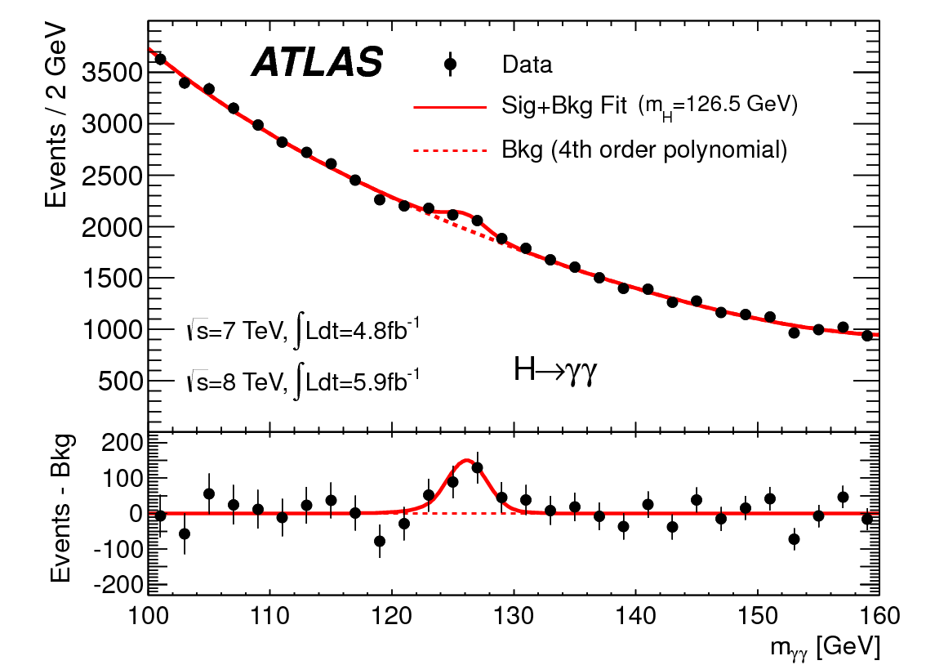
http://www.quantumdiaries.org/2012/09/07/why-particle-detectors-need-a-trigger/atlasmgg/
Model

Slide 14
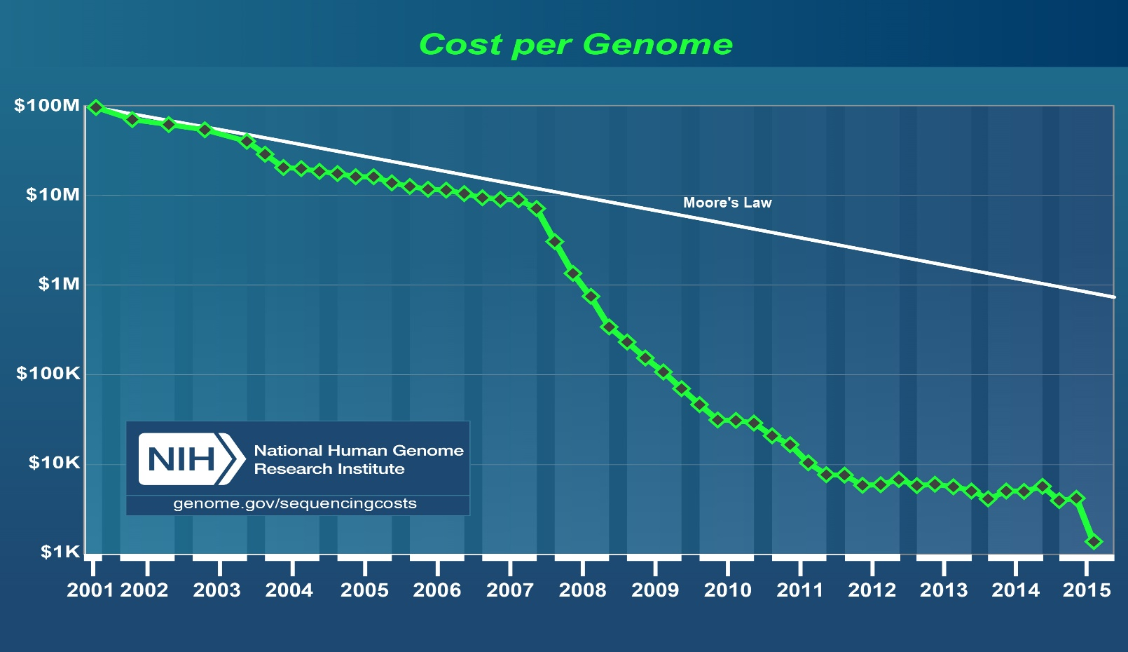
http://www.genome.gov/images/content/cost_per_genome_oct2015.jpg
http://www.kpcb.com/internet-trends

Slide 15
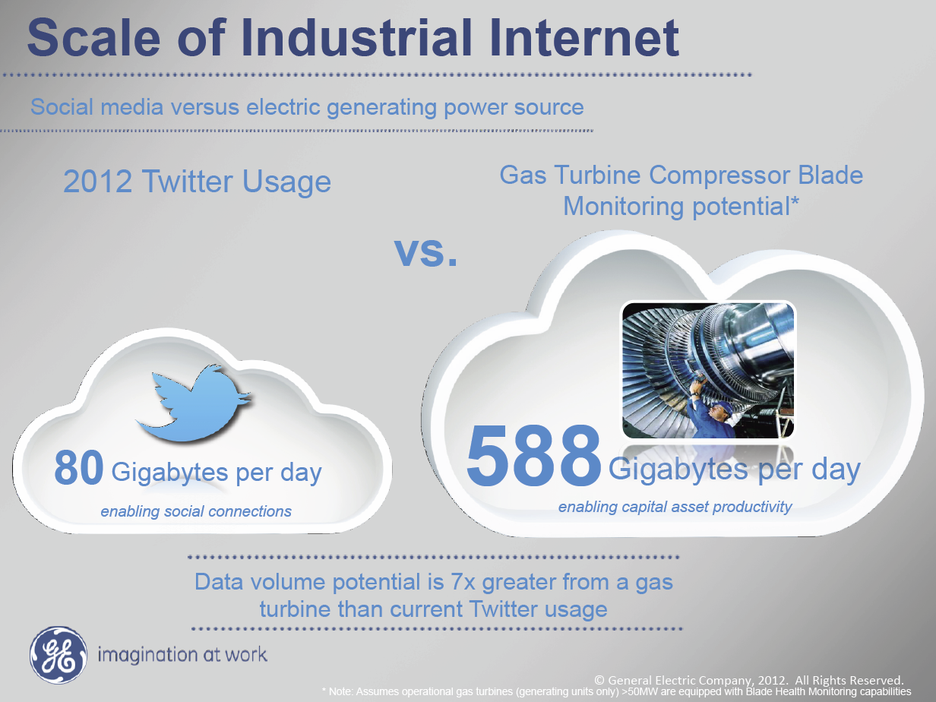
Ruh VP Software GE http://fisheritcenter.haas.berkeley.edu/Big_Data/index.html

Slide 16
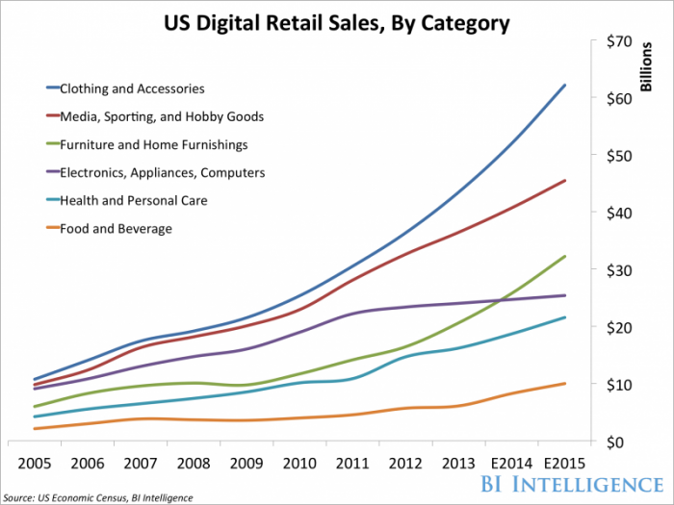
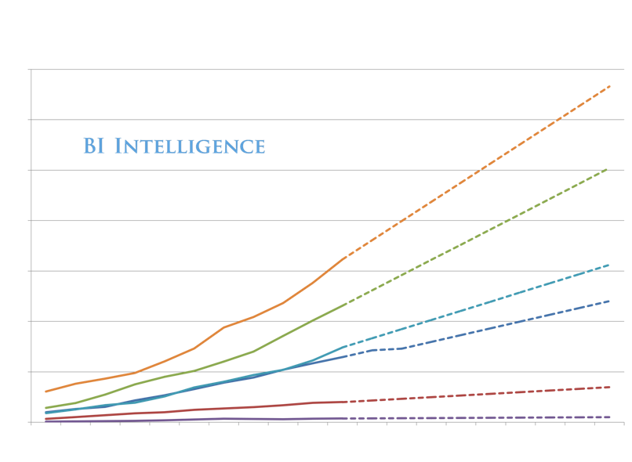
Online!
We Are Here

Slide 17
Introduction
Infrastructure

Slide 18
Note that translates NOW into smaller devices
In PAST translated into faster devices of same form factor
http://www.kpcb.com/internet-trends

Slide 19
http://www.kpcb.com/internet-trends

Slide 20
http://www.kpcb.com/internet-trends

Slide 21
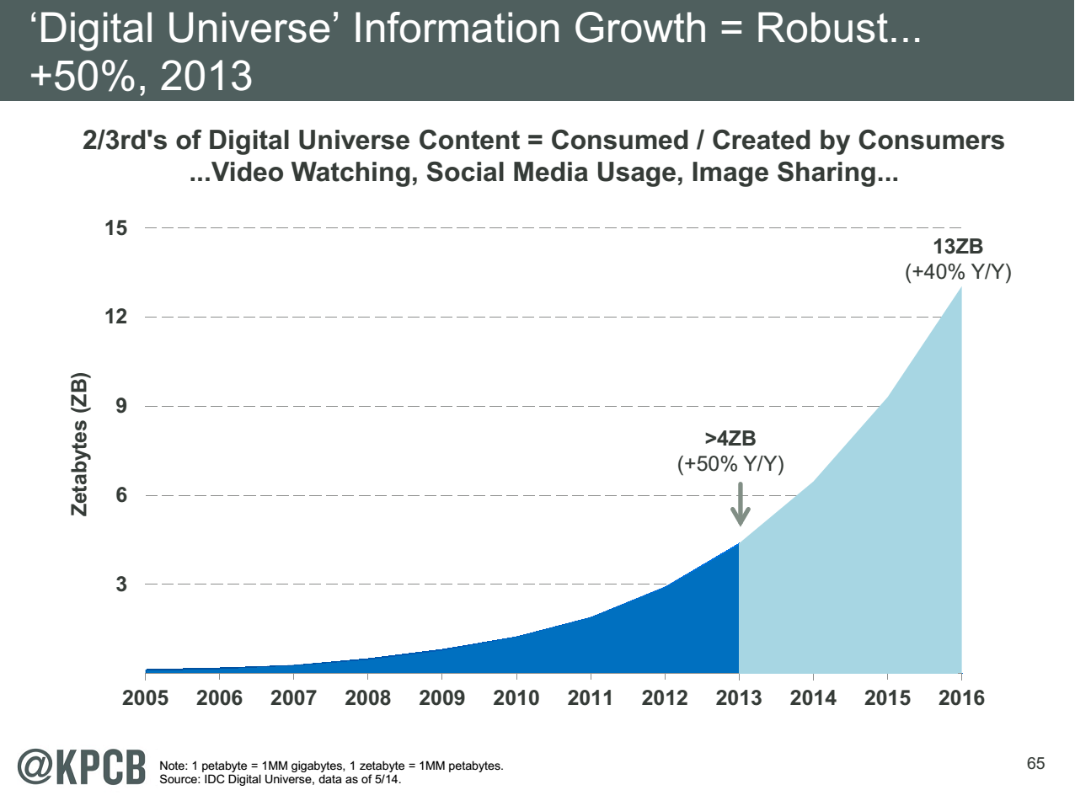
My Research focus is Science Big Data but largest science ~100 petabytes = 0.000025 total
Science should take notice of commodity
Converse not clearly true?
Note 7 ZB (7. 10²¹) is about a
terabyte (10¹²) for each person in world
http://www.kpcb.com/internet-trends

Slide 22
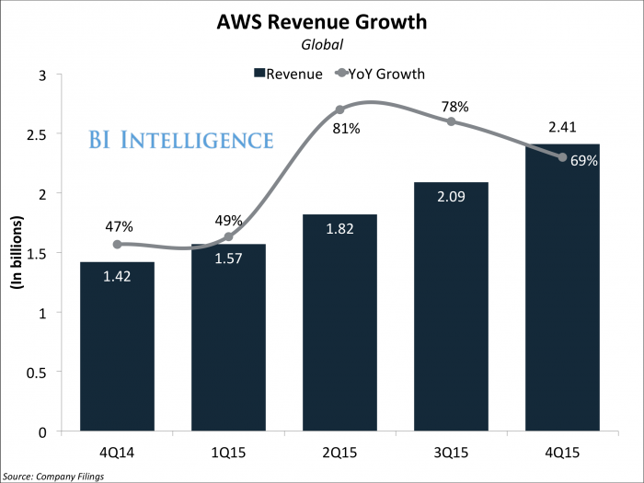
Amazon Web Services
Apple use is 10% AWS; will spend $1B in AWS in 2016 but building its own cloud; Netflix another major user
AWS 30%, Microsoft 12%, IBM 7%, and Google had 6% of global public cloud market

Slide 23
Top 500 Supercomputers
Exponential increase tailing off but such glitches seen before and “corrected”
Fastest machine ~ 100x #500 and 0.1 Sum

Slide 24
Clouds v Supercomputers
Clouds and Supercomputers are both collections of computers networked together in a data center
Top Supercomputers Intel MIC chip, NVIDIA+AMD, IBM Blue Gene
  #3 Sequoia Blue Gene Q at LLNL 16.32 Petaflop/s on the Linpack benchmark using 98,304 CPU compute chips with 1.6 million processor cores and 1.6 Petabyte of memory in 96 racks covering an area of about 3,000 square feet
  7.9 Megawatts power
Largest (cloud) computing data centers up to 100,000 servers at ~200 watts per CPU chip
Each of 3 major cloud vendors has ~2 million servers
Total clouds 100 times performance of largest supercomputer
  Clouds have different networking, I/O and CPU trade-offs than supercomputers
  Cloud workloads data oriented and less closely coupled than supercomputers but still principles of parallel computing same on both

Slide 25
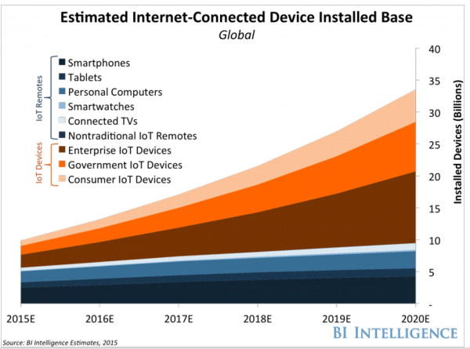

Slide 26
IoT
100B
Devices
~2025
http://www.kpcb.com/internet-trends

Slide 27
Introduction
Jobs

Slide 28
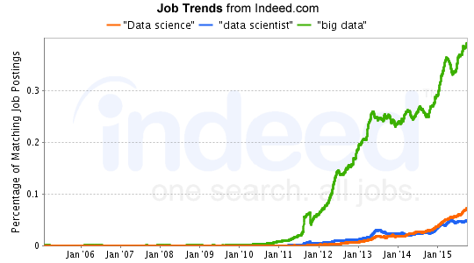
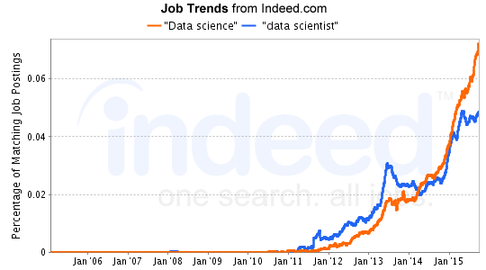
Job Trends
Charts Jan 6 2016
Big Data much larger than data science
19 May 2015 Jobs
3475 for “data science“
2277 for “data scientist“
19488 for “big data”
7 Dec 2015 Jobs
5014 for “data science“
2830 for “data scientist“
22388 for “big data”
http://www.indeed.com/jobtrends?q=%22Data+science%22%2C+%22data+scientist%22%2C+%22big+data%22%2C&l=

Slide 29
The 25 Hottest Skills of 2015 on LinkedIn -- Global
#1: Cloud Computing
#2 Data Science
http://www.slideshare.net/linkedin/the-25-skills-that-could-get-you-hired-in-2016

Slide 31
Introduction
HPC-ABDS

Slide 32
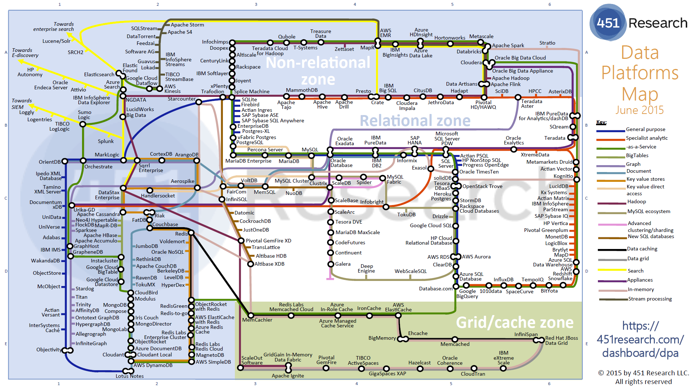
Data Platforms

Slide 33
Big Data and (Exascale) Simulation Convergence II

Slide 34
Functionality of 21 HPC-ABDS Layers
Message Protocols:
Distributed Coordination:
Security & Privacy:
Monitoring:
IaaS Management from HPC to hypervisors:
DevOps:
Interoperability:
File systems:
Cluster Resource Management:
Data Transport:
A) File management
B) NoSQL
C) SQL
In-memory databases&caches / Object-relational mapping / Extraction Tools
Inter process communication Collectives, point-to-point, publish-subscribe, MPI:
A) Basic Programming model and runtime, SPMD, MapReduce:
B) Streaming:
A) High level Programming:
B) Frameworks
Application and Analytics:
Workflow-Orchestration:
Here are 21 functionalities. (including 11, 14, 15 subparts)
4 Cross cutting at top
17 in order of layered diagram starting at bottom

Slide 36
Java Grande
Revisited on 3 data analytics codes
Clustering
Multidimensional Scaling
Latent Dirichlet Allocation all sophisticated algorithms

Slide 37
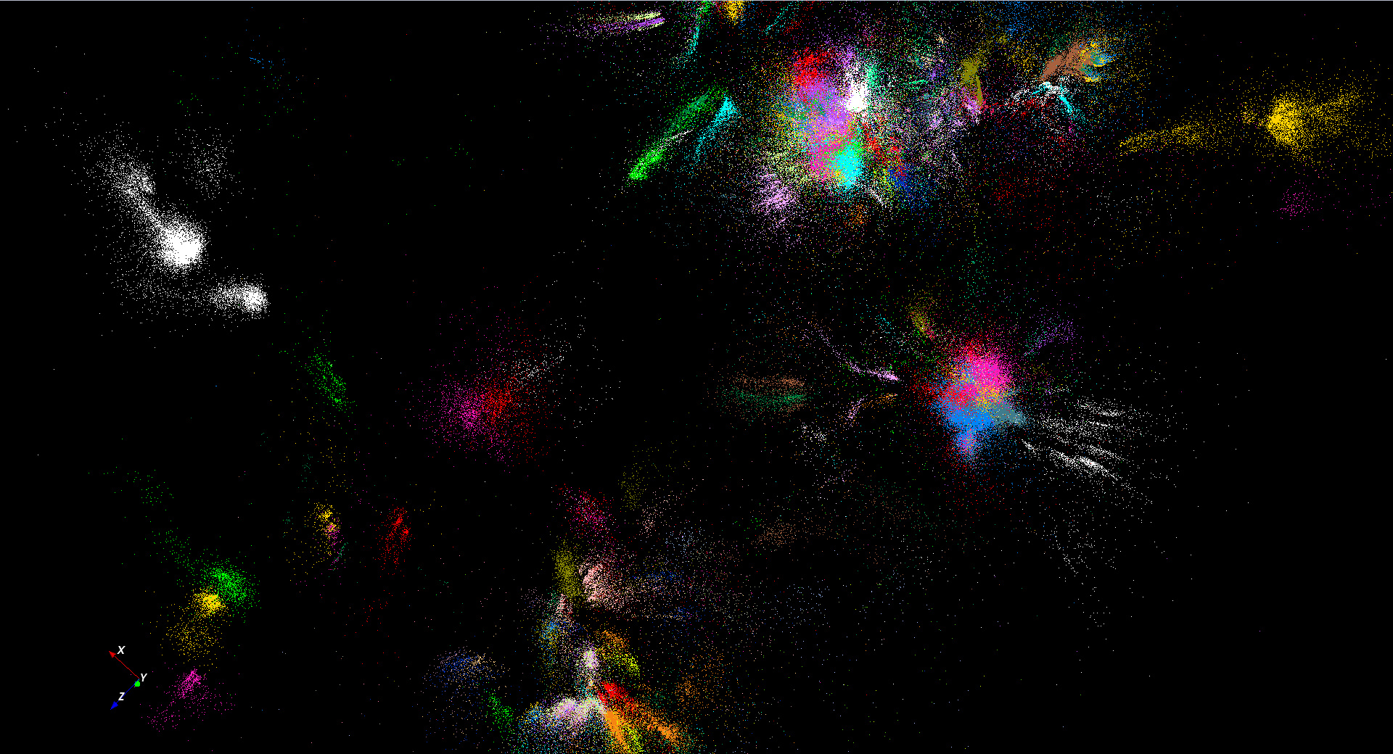
446K sequences
~100 clusters

Slide 38

Protein Universe Browser for COG Sequences with a few illustrative biologically identified clusters

Slide 39
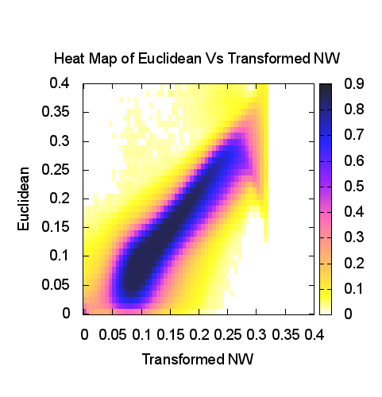
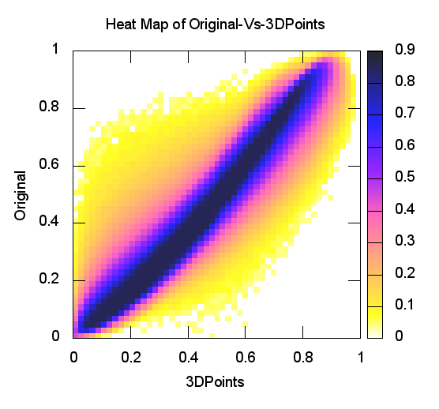
Heatmap of Original distances vs 3D Euclidean Distances
Stock market: Annual Change 2004
Proteomics (Needleman-Wunsch)
y=x is perfection

Slide 40
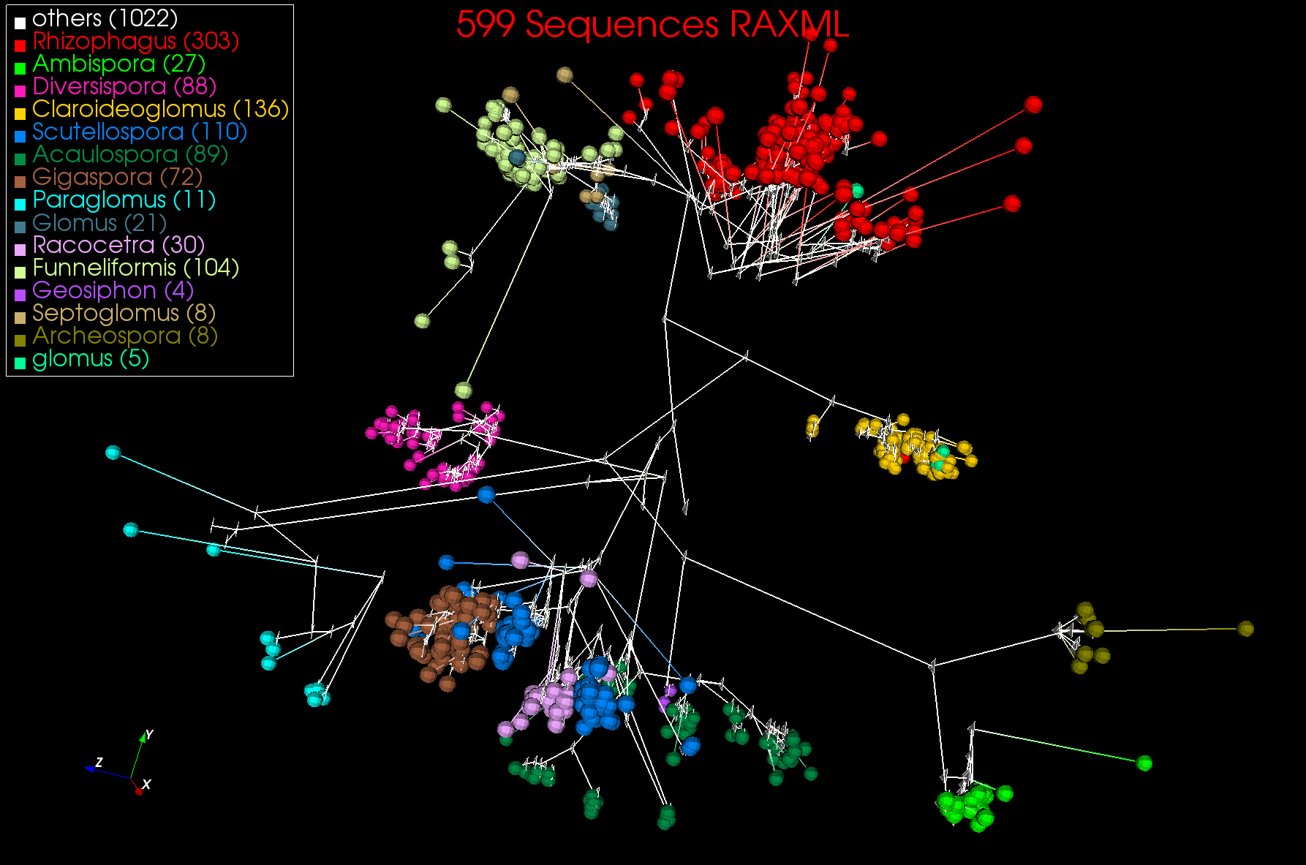
3D Phylogenetic Tree from WDA SMACOF

Slide 41
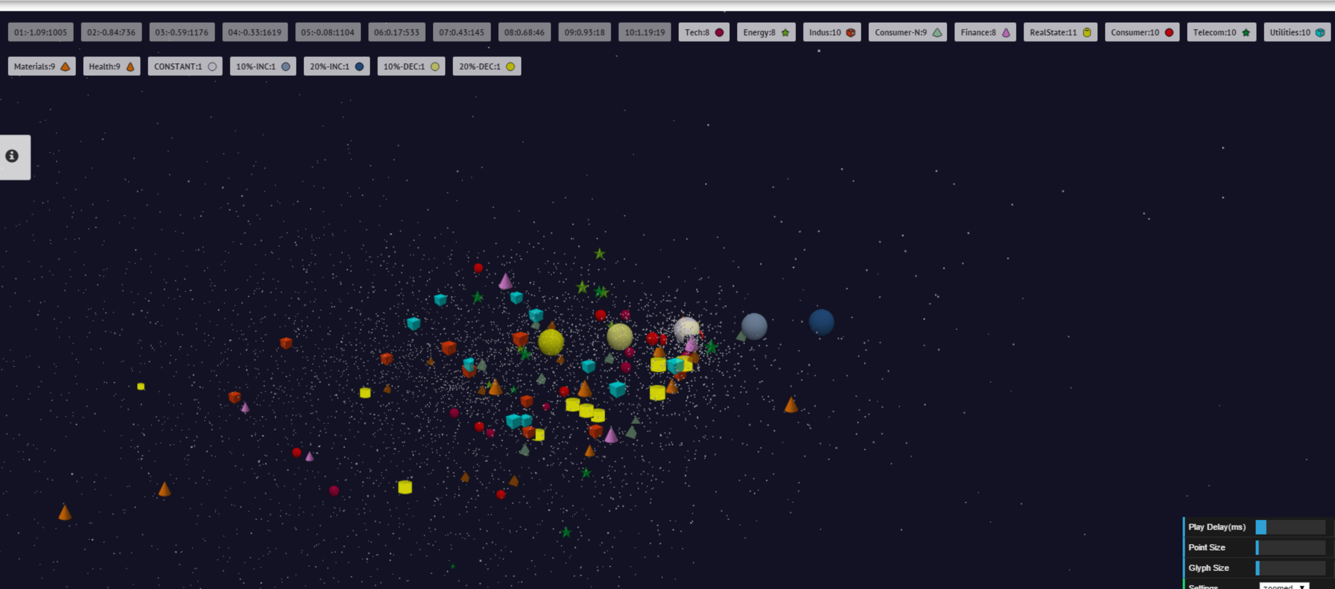
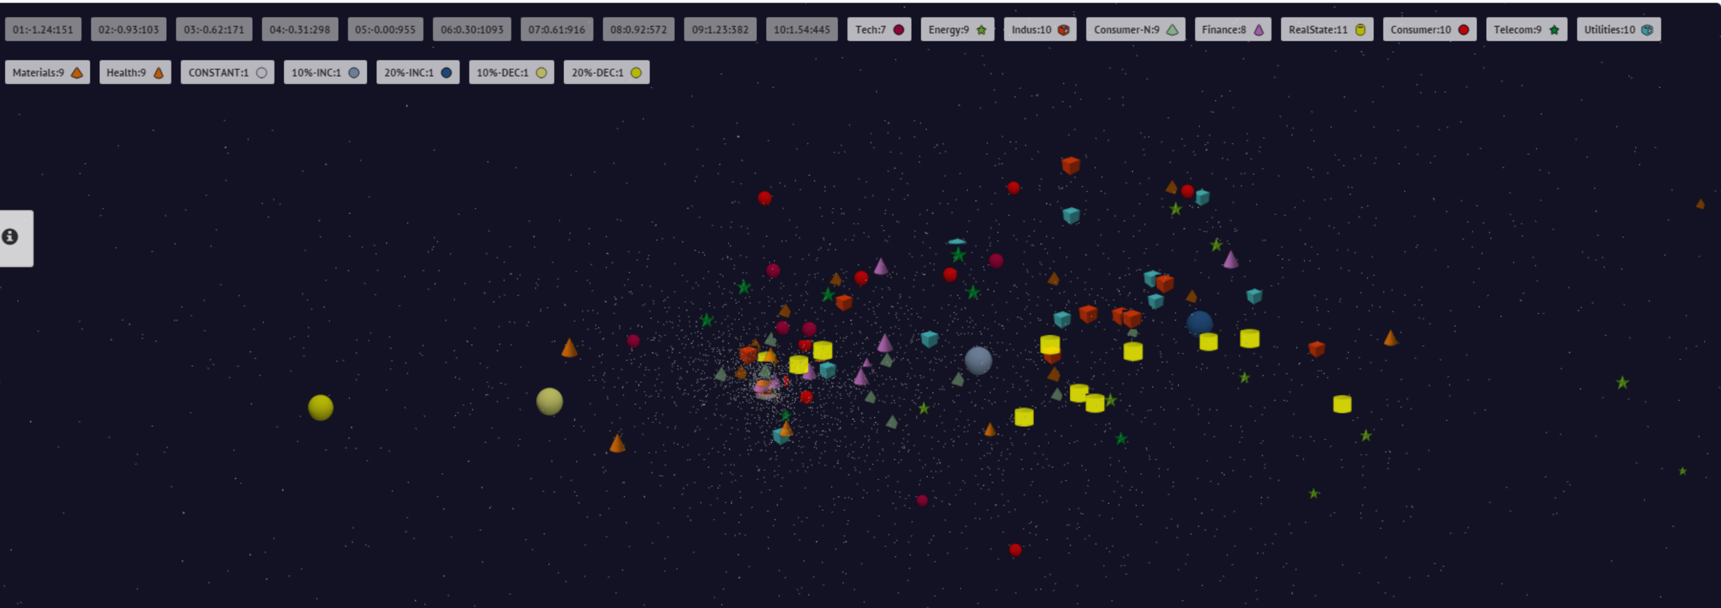
10 year US Stock daily price time series mapped to 3D (work in progress)
3400 stocks
Sector Groupings
End 2008 Positions
July 21 2007 Positions

Slide 42
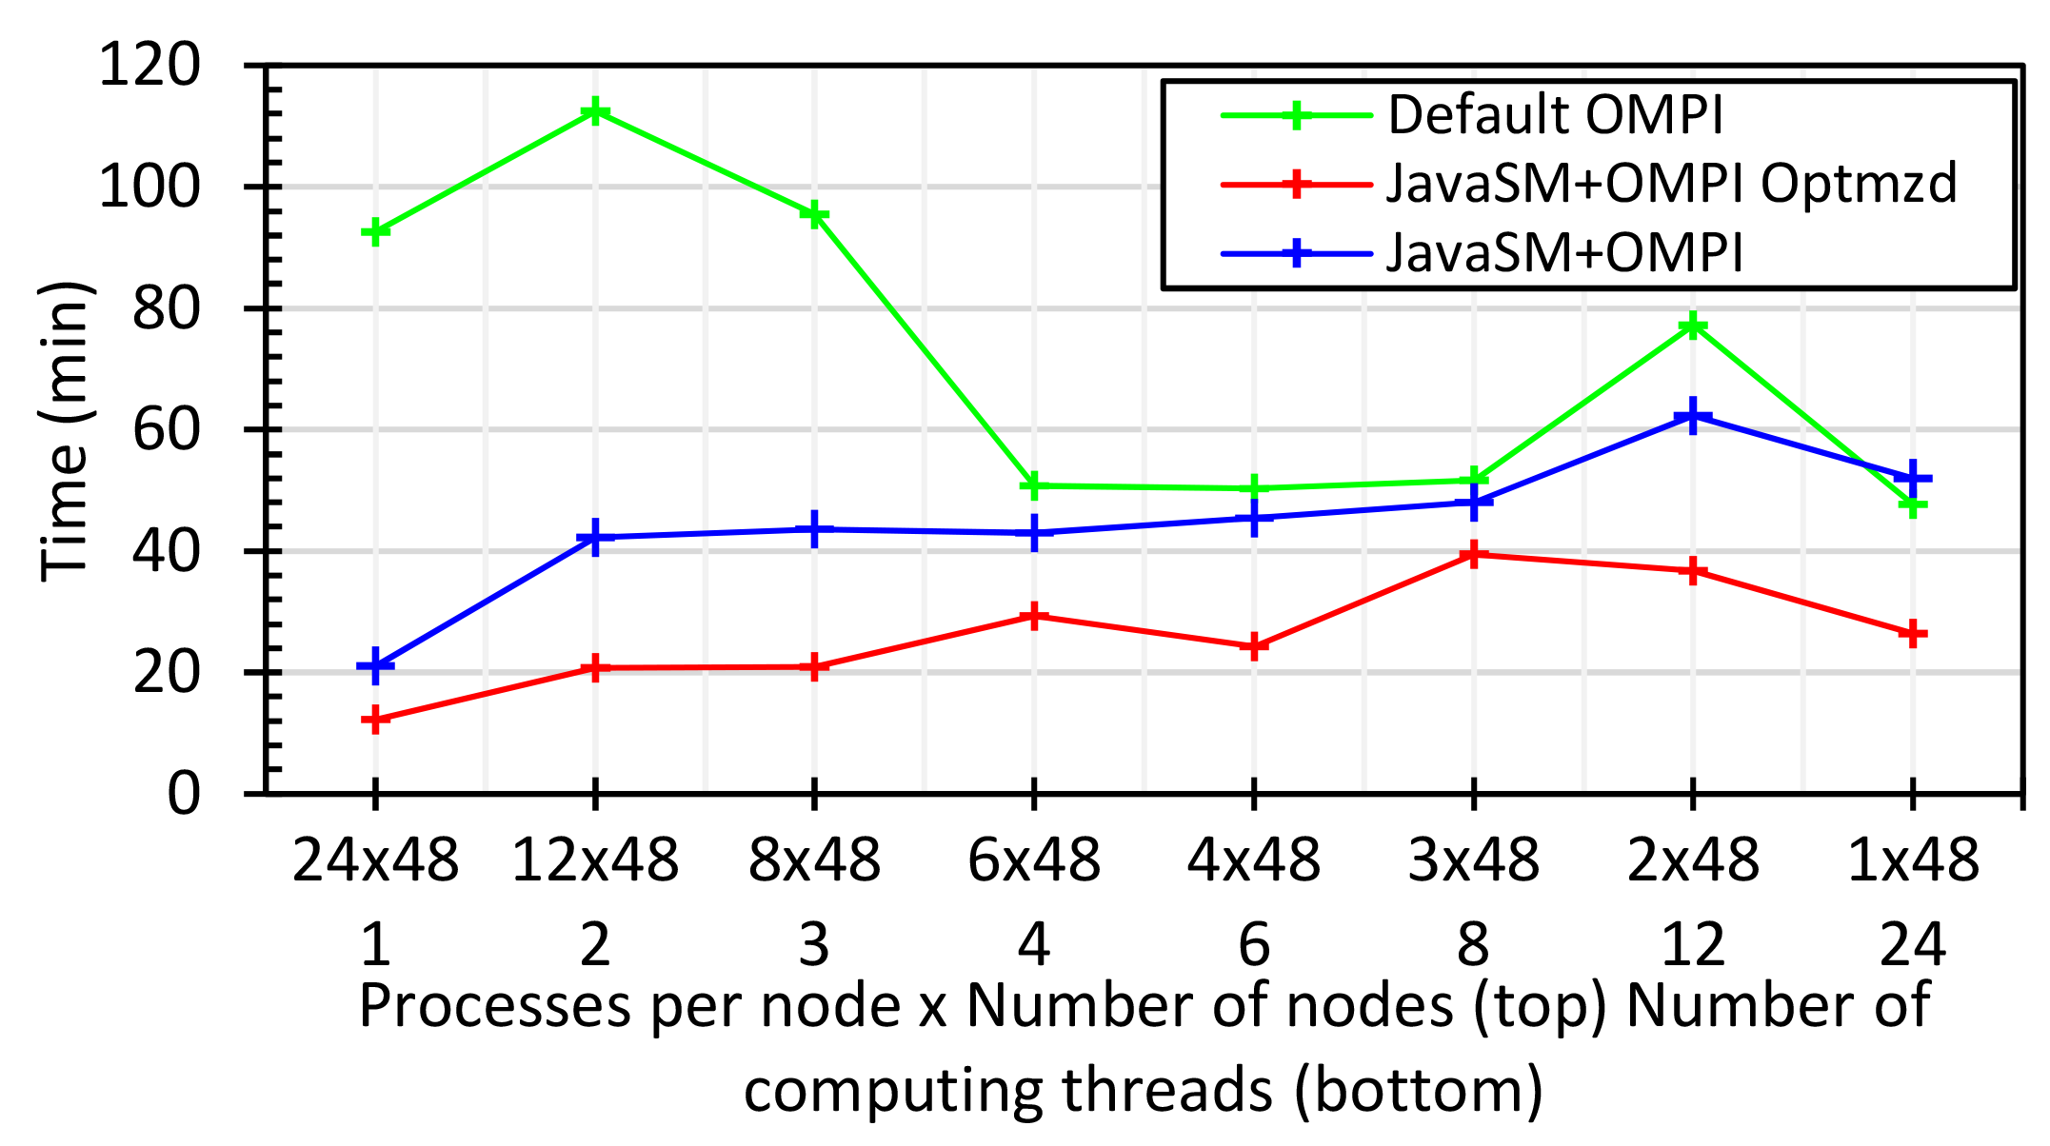
Java MPI performs better than Threads I
128 24 core Haswell nodes
Default MPI much worse than threads
Optimized MPI using shared memory node-based messaging is much better than threads

Slide 43
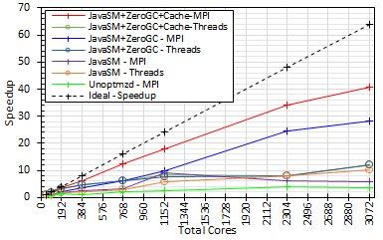
Java MPI performs better than Threads II
128 24 core Haswell nodes
200K Dataset Speedup

Slide 44
NIST Big Data Initiative
Led by Chaitin Baru, Bob Marcus, Wo Chang
And
Big Data Application Analysis

Slide 45
NBD-PWG (NIST Big Data Public Working Group) Subgroups & Co-Chairs
There were 5 Subgroups
  Note mainly industry
Requirements and Use Cases Sub Group
  Geoffrey Fox, Indiana U.; Joe Paiva, VA; Tsegereda Beyene, Cisco
Definitions and Taxonomies SG
  Nancy Grady, SAIC; Natasha Balac, SDSC; Eugene Luster, R2AD
Reference Architecture Sub Group
  Orit Levin, Microsoft; James Ketner, AT&T; Don Krapohl, Augmented Intelligence
Security and Privacy Sub Group
  Arnab Roy, CSA/Fujitsu Nancy Landreville, U. MD Akhil Manchanda, GE
Technology Roadmap Sub Group
  Carl Buffington, Vistronix; Dan McClary, Oracle; David Boyd, Data Tactics
See http://bigdatawg.nist.gov/usecases.php
and http://bigdatawg.nist.gov/V1_output_docs.php

Slide 46

Use Case Template
26 fields completed for 51 apps
Government Operation: 4
Commercial: 8
Defense: 3
Healthcare and Life Sciences: 10
Deep Learning and Social Media: 6
The Ecosystem for Research: 4
Astronomy and Physics: 5
Earth, Environmental and Polar Science: 10
Energy: 1
Now an online form

Slide 47
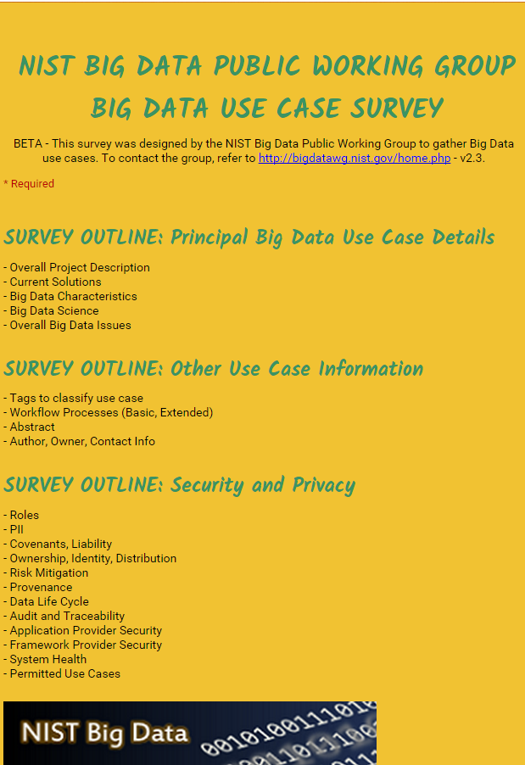
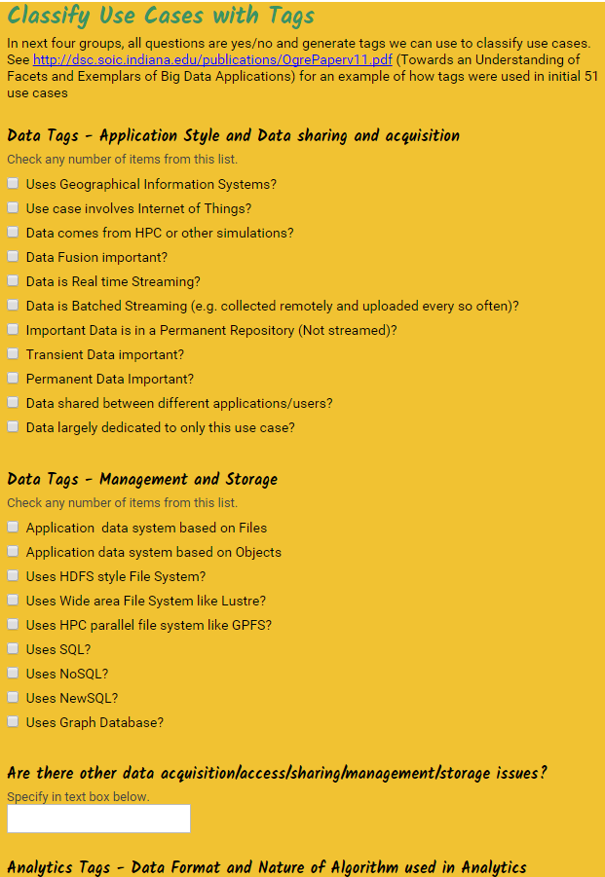
http://hpc-abds.org/kaleidoscope/survey/
Online Use Case Form

Slide 48
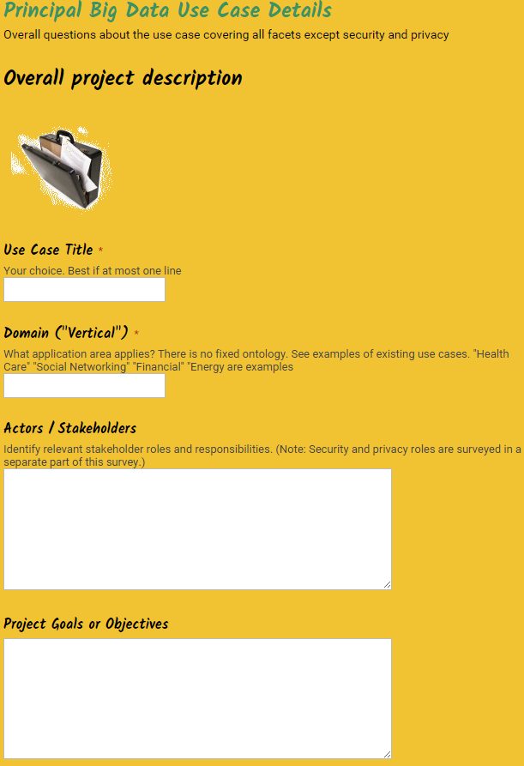
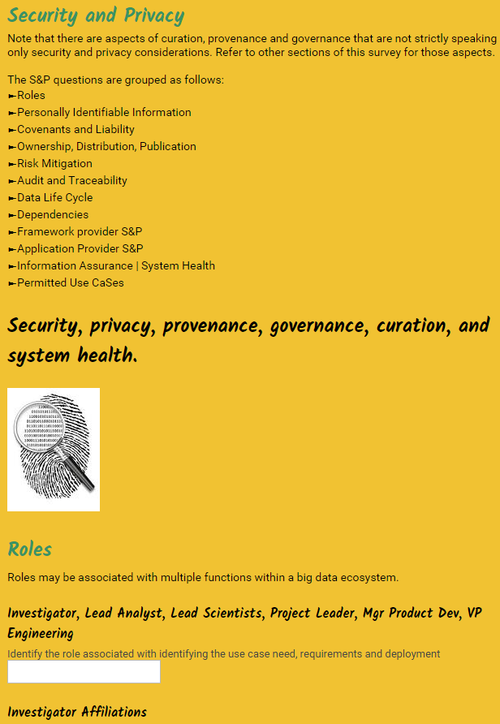
http://hpc-abds.org/kaleidoscope/survey/

Slide 49
51 Detailed Use Cases: Contributed July-September 2013
Covers goals, data features such as 3 V’s, software, hardware
26 Features for each use case
Biased to science
http://bigdatawg.nist.gov/usecases.php
https://bigdatacoursespring2014.appspot.com/course (Section 5)
Government Operation(4): National Archives and Records Administration, Census Bureau
Commercial(8): Finance in Cloud, Cloud Backup, Mendeley (Citations), Netflix, Web Search, Digital Materials, Cargo shipping (as in UPS)
Defense(3): Sensors, Image surveillance, Situation Assessment
Healthcare and Life Sciences(10): Medical records, Graph and Probabilistic analysis, Pathology, Bioimaging, Genomics, Epidemiology, People Activity models, Biodiversity
Deep Learning and Social Media(6): Driving Car, Geolocate images/cameras, Twitter, Crowd Sourcing, Network Science, NIST benchmark datasets
The Ecosystem for Research(4): Metadata, Collaboration, Language Translation, Light source experiments
Astronomy and Physics(5): Sky Surveys including comparison to simulation, Large Hadron Collider at CERN, Belle Accelerator II in Japan
Earth, Environmental and Polar Science(10): Radar Scattering in Atmosphere, Earthquake, Ocean, Earth Observation, Ice sheet Radar scattering, Earth radar mapping, Climate simulation datasets, Atmospheric turbulence identification, Subsurface Biogeochemistry (microbes to watersheds), AmeriFlux and FLUXNET gas sensors
Energy(1): Smart grid

Slide 50
Features and Examples

Slide 51
51 Use Cases: What is Parallelism Over?
People: either the users (but see below) or subjects of application and often both
Decision makers like researchers or doctors (users of application)
Items such as Images, EMR, Sequences below; observations or contents of online store
  Images or “Electronic Information nuggets”
  EMR: Electronic Medical Records (often similar to people parallelism)
  Protein or Gene Sequences;
  Material properties, Manufactured Object specifications, etc., in custom dataset
  Modelled entities like vehicles and people
Sensors – Internet of Things
Events such as detected anomalies in telescope or credit card data or atmosphere
(Complex) Nodes in RDF Graph
Simple nodes as in a learning network
Tweets, Blogs, Documents, Web Pages, etc.
  And characters/words in them
Files or data to be backed up, moved or assigned metadata
Particles/cells/mesh points as in parallel simulations

Slide 52
Features of 51 Use Cases I
PP (26) “All” Pleasingly Parallel or Map Only
MR (18) Classic MapReduce MR (add MRStat below for full count)
MRStat (7) Simple version of MR where key computations are simple reduction as found in statistical averages such as histograms and averages
MRIter (23) Iterative MapReduce or MPI (Spark, Twister)
Graph (9) Complex graph data structure needed in analysis
Fusion (11) Integrate diverse data to aid discovery/decision making; could involve sophisticated algorithms or could just be a portal
Streaming (41) Some data comes in incrementally and is processed this way
Classify (30) Classification: divide data into categories
S/Q (12) Index, Search and Query

Slide 53
Features of 51 Use Cases II
CF (4) Collaborative Filtering for recommender engines
LML (36) Local Machine Learning (Independent for each parallel entity) – application could have GML as well
GML (23) Global Machine Learning: Deep Learning, Clustering, LDA, PLSI, MDS,
  Large Scale Optimizations as in Variational Bayes, MCMC, Lifted Belief Propagation, Stochastic Gradient Descent, L-BFGS, Levenberg-Marquardt . Can call EGO or Exascale Global Optimization with scalable parallel algorithm
Workflow (51) Universal
GIS (16) Geotagged data and often displayed in ESRI, Microsoft Virtual Earth, Google Earth, GeoServer etc.
HPC (5) Classic large-scale simulation of cosmos, materials, etc. generating (visualization) data
Agent (2) Simulations of models of data-defined macroscopic entities represented as agents

Slide 54
Local and Global Machine Learning
Many applications use LML or Local machine Learning where machine learning (often from R) is run separately on every data item such as on every image
But others are GML Global Machine Learning where machine learning is a single algorithm run over all data items (over all nodes in computer)
  maximum likelihood or χ² with a sum over the N data items – documents, sequences, items to be sold, images etc. and often links (point-pairs).
  Graph analytics is typically GML
Covering clustering/community detection, mixture models, topic determination, Multidimensional scaling, (Deep) Learning Networks
PageRank is “just” parallel linear algebra
Note many Mahout algorithms are sequential – partly as MapReduce limited; partly because parallelism unclear
  MLLib (Spark based) better
SVM and Hidden Markov Models do not use large scale parallelization in practice?

Slide 55
13 Image-based Use Cases
13-15 Military Sensor Data Analysis/ Intelligence PP, LML, GIS, MR
7:Pathology Imaging/ Digital Pathology: PP, LML, MR for search becoming terabyte 3D images, Global Classification
18&35: Computational Bioimaging (Light Sources): PP, LML Also materials
26: Large-scale Deep Learning: GML Stanford ran 10 million images and 11 billion parameters on a 64 GPU HPC; vision (drive car), speech, and Natural Language Processing
27: Organizing large-scale, unstructured collections of photos: GML Fit position and camera direction to assemble 3D photo ensemble
36: Catalina Real-Time Transient Synoptic Sky Survey (CRTS): PP, LML followed by classification of events (GML)
43: Radar Data Analysis for CReSIS Remote Sensing of Ice Sheets: PP, LML to identify glacier beds; GML for full ice-sheet
44: UAVSAR Data Processing, Data Product Delivery, and Data Services: PP to find slippage from radar images
45, 46: Analysis of Simulation visualizations: PP LML ?GML find paths, classify orbits, classify patterns that signal earthquakes, instabilities, climate, turbulence

Slide 56
Internet of Things and Streaming Apps
It is projected that there will be 24 (Mobile Industry Group) to 50 (Cisco) billion devices on the Internet by 2020.
The cloud natural controller of and resource provider for the Internet of Things.
Smart phones/watches, Wearable devices (Smart People), “Intelligent River” “Smart Homes and Grid” and “Ubiquitous Cities”, Robotics.
Majority of use cases are streaming – experimental science gathers data in a stream – sometimes batched as in a field trip. Below is sample
10: Cargo Shipping Tracking as in UPS, Fedex PP GIS LML
13: Large Scale Geospatial Analysis and Visualization PP GIS LML
28: Truthy: Information diffusion research from Twitter Data PP MR for Search, GML for community determination
39: Particle Physics: Analysis of LHC Large Hadron Collider Data: Discovery of Higgs particle PP for event Processing, Global statistics
50: DOE-BER AmeriFlux and FLUXNET Networks PP GIS LML
51: Consumption forecasting in Smart Grids PP GIS LML

Slide 57
Big Data and Big Simulations Patterns – the Convergence Diamonds

Slide 58
Big Data - Big Simulation (Exascale) Convergence
Lets distinguish Data and Model (e.g. machine learning analytics) in Big data problems
Then almost always Data is large but Model varies
  E.g. LDA with many topics or deep learning has large model
  Clustering or Dimension reduction can be quite small
Simulations can also be considered as Data and Model
  Model is solving particle dynamics or partial differential equations
  Data could be small when just boundary conditions or
  Data large with data assimilation (weather forecasting) or when data visualizations produced by simulation
Data often static between iterations (unless streaming), model varies between iterations

Slide 59
Classifying Big Data and Big Simulation Applications
“Benchmarks” “kernels” “algorithm” “mini-apps” can serve multiple purposes
Motivate hardware and software features
  e.g. collaborative filtering algorithm parallelizes well with MapReduce and suggests using Hadoop on a cloud
  e.g. deep learning on images dominated by matrix operations; needs CUDA&MPI and suggests HPC cluster
Benchmark sets designed cover key features of systems in terms of features and sizes of “important” applications
Take 51 uses cases → derive specific features; each use case has multiple features
Generalize and systematize with features termed “facets”
50 Facets (Big Data) or 64 Facets (Big Simulation and Data) divided into 4 sets or views where each view has “similar” facets
  Allow one to study coverage of benchmark sets
Discuss Data and Model together as built around problems which combine them but we can get insight by separating and this allows better understanding of Big Data - Big Simulation “convergence”

Slide 60
7 Computational Giants of
NRC Massive Data Analysis Report
http://www.nap.edu/catalog.php?record_id=18374 Big Data Models?
G1: Basic Statistics e.g. MRStat
G2: Generalized N-Body Problems
G3: Graph-Theoretic Computations
G4: Linear Algebraic Computations
G5: Optimizations e.g. Linear Programming
G6: Integration e.g. LDA and other GML
G7: Alignment Problems e.g. BLAST

Slide 61
HPC (Simulation) Benchmark Classics
Linpack or HPL: Parallel LU factorization
for solution of linear equations
NPB version 1: Mainly classic HPC solver kernels
  MG: Multigrid
  CG: Conjugate Gradient
  FT: Fast Fourier Transform
  IS: Integer sort
  EP: Embarrassingly Parallel
  BT: Block Tridiagonal
  SP: Scalar Pentadiagonal
  LU: Lower-Upper symmetric Gauss Seidel
Simulation Models

Slide 62
13 Berkeley Dwarfs
Dense Linear Algebra
Sparse Linear Algebra
Spectral Methods
N-Body Methods
Structured Grids
Unstructured Grids
MapReduce
Combinational Logic
Graph Traversal
Dynamic Programming
Backtrack and
Branch-and-Bound
Graphical Models
Finite State Machines
Largely Models for Data or Simulation
First 6 of these correspond to Colella’s original. (Classic simulations)
Monte Carlo dropped.
N-body methods are a subset of Particle in Colella.
Note a little inconsistent in that MapReduce is a programming model and spectral method is a numerical method.
Need multiple facets!

Slide 64
Both
Analytics
(Model for Data)
Simulations
(Nearly all Data)
(All Model)
(Mix of Data and Model)
(Nearly all Data+Model)

Slide 65
Dwarfs and Ogres give
Convergence Diamonds
Macropatterns or Problem Architecture View: Unchanged
Execution View: Significant changes to separate Data and Model and add characteristics of Simulation models
Data Source and Style View: Same for Ogres and Diamonds – present but less important for Simulations compared to big data
Processing View is a mix of Big Data Processing View and Big Simulation Processing View and includes some facets like “uses linear algebra” needed in both: includes specifics of key simulation kernels – includes NAS Parallel Benchmarks and Berkeley Dwarfs

Slide 66
Facets of the Convergence Diamonds
Problem Architecture
Meta or Macro Aspects of Diamonds
Valid for Big Data or Big Simulations as describes Problem which is Model-Data combination

Slide 67
Problem Architecture View (Meta or MacroPatterns)
Pleasingly Parallel – as in BLAST, Protein docking, some (bio-)imagery including Local Analytics or Machine Learning – ML or filtering pleasingly parallel, as in bio-imagery, radar images (pleasingly parallel but sophisticated local analytics)
Classic MapReduce: Search, Index and Query and Classification algorithms like collaborative filtering (G1 for MRStat in Features, G7)
Map-Collective: Iterative maps + communication dominated by “collective” operations as in reduction, broadcast, gather, scatter. Common datamining pattern
Map-Point to Point: Iterative maps + communication dominated by many small point to point messages as in graph algorithms
Map-Streaming: Describes streaming, steering and assimilation problems
Shared Memory: Some problems are asynchronous and are easier to parallelize on shared rather than distributed memory – see some graph algorithms
SPMD: Single Program Multiple Data, common parallel programming feature
BSP or Bulk Synchronous Processing: well-defined compute-communication phases
Fusion: Knowledge discovery often involves fusion of multiple methods.
Dataflow: Important application features often occurring in composite Ogres
Use Agents: as in epidemiology (swarm approaches) This is Model only
Workflow: All applications often involve orchestration (workflow) of multiple components
11 of 12 are properties of Data+Model
Notes:
Big dwarfs are Ogres
Implement Ogres in ABDS+

Slide 68
Relation of Problem and Machine Architecture
Problem is Model plus Data
In my old papers (especially book Parallel Computing Works!), I discussed computing as multiple complex systems mapped into each other
Problem → Numerical formulation → Software → Hardware
Each of these 4 systems has an architecture that can be described in similar language
One gets an easy programming model if architecture of problem matches that of Software
One gets good performance if architecture of hardware matches that of software and problem
So “MapReduce” can be used as architecture of software (programming model) or “Numerical formulation of problem”

Slide 69
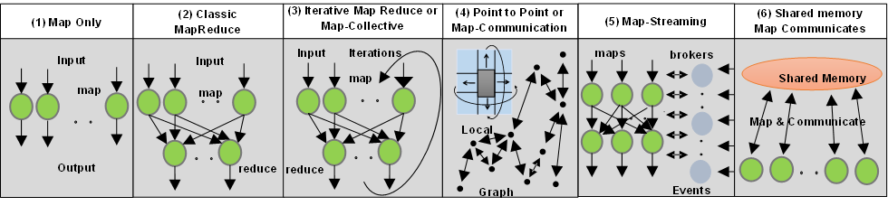
6 Forms of MapReduce cover “all” circumstances
Describes
- Problem (Model reflecting data)
- Machine
- Software
Architecture

Slide 70
Data Analysis Problem Architectures
1) Pleasingly Parallel PP or “map-only” in MapReduce
  BLAST Analysis; Local Machine Learning
2A) Classic MapReduce MR, Map followed by reduction
  High Energy Physics (HEP) Histograms; Web search; Recommender Engines
2B) Simple version of classic MapReduce MRStat
  Final reduction is just simple statistics
3) Iterative MapReduce MRIter
  Expectation maximization Clustering Linear Algebra, PageRank
4A) Map Point to Point Communication
  Classic MPI; PDE Solvers and Particle Dynamics; Graph processing Graph
4B) GPU (Accelerator) enhanced 4A) – especially for deep learning
5) Map + Streaming + some sort of Communication
  Images from Synchrotron sources; Telescopes; Internet of Things IoT
  Apache Storm is (Map + Dataflow) +Streaming
  Data assimilation is (Map + Point to Point Communication) + Streaming
  6) Shared memory allowing parallel threads which are tricky to program but lower latency
  Difficult to parallelize asynchronous parallel Graph Algorithms

Slide 71
Diamond Facets
Execution Features View
Many similar Features for Big Data and Simulations

Slide 72
View for Micropatterns or Execution Features
Performance Metrics; property found by benchmarking Diamond
Flops per byte; memory or I/O
Execution Environment; Core libraries needed: matrix-matrix/vector algebra, conjugate gradient, reduction, broadcast; Cloud, HPC etc.
Volume: property of a Diamond instance: a) Data Volume and b) Model Size
Velocity: qualitative property of Diamond with value associated with instance. Only Data
Variety: important property especially of composite Diamonds; Data and Model separately
Veracity: important property of applications but not kernels;
Model Communication Structure; Interconnect requirements; Is communication BSP, Asynchronous, Pub-Sub, Collective, Point to Point?
Is Data and/or Model (graph) static or dynamic?
Much Data and/or Models consist of a set of interconnected entities; is this regular as a set of pixels or is it a complicated irregular graph?
Are Models Iterative or not?
Data Abstraction: key-value, pixel, graph(G3), vector, bags of words or items; Model can have same or different abstractions e.g. mesh points, finite element, Convolutional Network
Are data points in metric or non-metric spaces? Data and Model separately?
Is Model algorithm O(N²) or O(N) (up to logs) for N points per iteration (G2)

Slide 73
Comparison of Data Analytics with Simulation I
Simulations produce big data as visualization of results – they are data source
  Or consume often smallish data to define a simulation problem
  HPC simulation in weather data assimilation is data + model
Pleasingly parallel often important in both
Both are often SPMD and BSP
  Non-iterative MapReduce is major big data paradigm
  not a common simulation paradigm except where “Reduce” summarizes pleasingly parallel execution as in Some Monte Carlos
Big Data often has large collective communication
  Classic simulation has a lot of smallish point-to-point messages
Simulations characterized often by difference or differential operators
Simulation dominantly sparse (nearest neighbor) data structures
  Some important data analytics involves full matrix algorithm but
  “Bag of words (users, rankings, images..)” algorithms are sparse, as is PageRank

Slide 74


“Force Diagrams” for macromolecules and Facebook

Slide 75
Comparison of Data Analytics with Simulation II
There are similarities between some graph problems and particle simulations with a strange cutoff force.
  Both Map-Communication
Note many big data problems are “long range force” (as in gravitational simulations) as all points are linked.
  Easiest to parallelize. Often full matrix algorithms
  e.g. in DNA sequence studies, distance δ(i, j) defined by BLAST, Smith-Waterman, etc., between all sequences i, j.
  Opportunity for “fast multipole” ideas in big data. See NRC report
In image-based deep learning, neural network weights are block sparse (corresponding to links to pixel blocks) but can be formulated as full matrix operations on GPUs and MPI in blocks.
In HPC benchmarking, Linpack being challenged by a new sparse conjugate gradient benchmark HPCG, while I am diligently using non- sparse conjugate gradient solvers in clustering and Multi-dimensional scaling.

Slide 76
Convergence Diamond Facets
Big Data and Big Simulation Processing View
All Model Properties but differences between Big Data and Big Simulation

Slide 77
Diamond Facets in Processing (runtime) View I used in Big Data and Big Simulation
Pr-1M Micro-benchmarks ogres that exercise simple features of hardware such as communication, disk I/O, CPU, memory performance
Pr-2M Local Analytics executed on a single core or perhaps node
Pr-3M Global Analytics requiring iterative programming models (G5,G6) across multiple nodes of a parallel system
Pr-12M Uses Linear Algebra common in Big Data and simulations
  Subclasses like Full Matrix
  Conjugate Gradient, Krylov, Arnoldi iterative subspace methods
  Structured and unstructured sparse matrix methods
Pr-13M Graph Algorithms (G3) Clear important class of algorithms -- as opposed to vector, grid, bag of words etc. – often hard especially in parallel
Pr-14M Visualization is key application capability for big data and simulations
Pr-15M Core Libraries Functions of general value such as Sorting, Math functions, Hashing
Notes:
Big dwarfs are Ogres
Implement Ogres in ABDS+

Slide 78
Diamond Facets in Processing (runtime) View II used in Big Data
Pr-4M Basic Statistics (G1): MRStat in NIST problem features
Pr-5M Recommender Engine: core to many e-commerce, media businesses; collaborative filtering key technology
Pr-6M Search/Query/Index: Classic database which is well studied (Baru, Rabl tutorial)
Pr-7M Data Classification: assigning items to categories based on many methods
  MapReduce good in Alignment, Basic statistics, S/Q/I, Recommender, Classification
Pr-8M Learning of growing importance due to Deep Learning success in speech recognition etc..
Pr-9M Optimization Methodology: overlapping categories including
  Machine Learning, Nonlinear Optimization (G6), Maximum Likelihood or χ² least squares minimizations, Expectation Maximization (often Steepest descent), Combinatorial Optimization, Linear/Quadratic Programming (G5), Dynamic Programming
Pr-10M Streaming Data or online Algorithms. Related to DDDAS (Dynamic Data-Driven Application Systems)
Pr-11M Data Alignment (G7) as in BLAST compares samples with repository
Notes:
Big dwarfs are Ogres
Implement Ogres in ABDS+

Slide 79
Diamond Facets in Processing (runtime) View III used in Big Simulation
Pr-16M Iterative PDE Solvers: Jacobi, Gauss Seidel etc.
Pr-17M Multiscale Method? Multigrid and other variable resolution approaches
Pr-18M Spectral Methods as in Fast Fourier Transform
Pr-19M N-body Methods as in Fast multipole, Barnes-Hut
Pr-20M Both Particles and Fields as in Particle in Cell method
Pr-21M Evolution of Discrete Systems as in simulation of Electrical Grids, Chips, Biological Systems, Epidemiology. Needs Ordinary Differential Equation solvers
Pr-22M Nature of Mesh if used: Structured, Unstructured, Adaptive
Covers NAS Parallel Benchmarks and Berkeley Dwarfs
Notes:
Big dwarfs are Ogres
Implement Ogres in ABDS+

Slide 80
Facets of the Ogres
Data Source and Style Aspects add streaming from Processing view here
Present but often less important for Simulations (that use and produce data)

Slide 81
Data Source and Style Diamond View I
SQL NewSQL or NoSQL: NoSQL includes Document,
Column, Key-value, Graph, Triple store; NewSQL is SQL redone to exploit NoSQL performance
Other Enterprise data systems: 10 examples from NIST integrate SQL/NoSQL
Set of Files or Objects: as managed in iRODS and extremely common in scientific research
File systems, Object, Blob and Data-parallel (HDFS) raw storage: Separated from computing or colocated? HDFS v Lustre v. Openstack Swift v. GPFS
Archive/Batched/Streaming: Streaming is incremental update of datasets with new algorithms to achieve real-time response (G7); Before data gets to compute system, there is often an initial data gathering phase which is characterized by a block size and timing. Block size varies from month (Remote Sensing, Seismic) to day (genomic) to seconds or lower (Real time control, streaming)
  Streaming divided into categories overleaf
Notes:
Big dwarfs are Ogres
Implement Ogres in ABDS+

Slide 82
Data Source and Style Diamond View II
  Streaming divided into 5 categories depending on event size and synchronization and integration
  Set of independent events where precise time sequencing unimportant.
  Time series of connected small events where time ordering important.
  Set of independent large events where each event needs parallel processing with time sequencing not critical
  Set of connected large events where each event needs parallel processing with time sequencing critical.
  Stream of connected small or large events to be integrated in a complex way.
Shared/Dedicated/Transient/Permanent: qualitative property of data; Other characteristics are needed for permanent auxiliary/comparison datasets and these could be interdisciplinary, implying nontrivial data movement/replication
Metadata/Provenance: Clear qualitative property but not for kernels as important aspect of data collection process
Internet of Things: 24 to 50 Billion devices on Internet by 2020
HPC simulations: generate major (visualization) output that often needs to be mined
Using GIS: Geographical Information Systems provide attractive access to geospatial data
Notes:
Big dwarfs are Ogres
Implement Ogres in ABDS+

Slide 83
2. Perform real time analytics on data source streams and notify users when specified events occur
Specify filter
Filter Identifying Events
Fetch streamed Data
Post Selected Events
Streaming Data
Posted Data
Identified Events
Streaming Data
Streaming Data
Archive
Repository
Storm, Kafka, Hbase, Zookeeper

Slide 84



5. Perform interactive analytics on data in analytics-optimized database
Mahout, R
Hadoop, Spark, Giraph, Pig …
Data Storage: HDFS, Hbase
Data, Streaming, Batch …..

Slide 85
5A. Perform interactive analytics on observational scientific data
Science Analysis Code, Mahout, R
Grid or Many Task Software, Hadoop, Spark, Giraph, Pig …
Data Storage: HDFS, Hbase, File Collection
Direct Transfer
Transport batch of data to primary analysis data system
Streaming Twitter data for Social Networking
Local Accumulate and initial computing
NIST examples include LHC, Remote Sensing, Astronomy and Bioinformatics
Record Scientific Data in “field”

Slide 86
Benchmarks and Ogres

Slide 87
Benchmarks/Mini-apps spanning Facets
Look at NSF SPIDAL Project, NIST 51 use cases, Baru-Rabl review
Catalog facets of benchmarks and choose entries to cover “all facets”
Micro Benchmarks: SPEC, EnhancedDFSIO (HDFS), Terasort, Wordcount, Grep, MPI, Basic Pub-Sub ….
SQL and NoSQL Data systems, Search, Recommenders: TPC (-C to x–HS for Hadoop), BigBench, Yahoo Cloud Serving, Berkeley Big Data, HiBench, BigDataBench, Cloudsuite, Linkbench
  includes MapReduce cases Search, Bayes, Random Forests, Collaborative Filtering
Spatial Query: select from image or earth data
Alignment: Biology as in BLAST
Streaming: Online classifiers, Cluster tweets, Robotics, Industrial Internet of Things, Astronomy; BGBenchmark.
Pleasingly parallel (Local Analytics): as in initial steps of LHC, Pathology, Bioimaging (differ in type of data analysis)
Global Analytics: Outlier, Clustering, LDA, SVM, Deep Learning, MDS, PageRank, Levenberg-Marquardt, Graph 500 entries
Workflow and Composite (analytics on xSQL) linking above

Slide 88
Big Data Exascale convergence

Slide 89
Big Data and (Exascale) Simulation Convergence I
Our approach to Convergence is built around two ideas that avoid addressing the hardware directly as with modern DevOps technology it isn’t hard to retarget applications between different hardware systems.
Rather we approach Convergence through applications and software. This talk has described the Convergence Diamonds Convergence that unify Big Simulation and Big Data applications and so allow one to more easily identify good approaches to implement Big Data and Exascale applications in a uniform fashion.
The software approach builds on the HPC-ABDS High Performance Computing enhanced Apache Big Data Software Stack concept (http://dsc.soic.indiana.edu/publications/HPC-ABDSDescribed_final.pdf, http://hpc-abds.org/kaleidoscope/ )
This arranges key HPC and ABDS software together in 21 layers showing where HPC and ABDS overlap. It for example, introduces a communication layer to allow ABDS runtime like Hadoop Storm Spark and Flink to use the richest high performance capabilities shared with MPI Generally it proposes how to use HPC and ABDS software together.
  Layered Architecture offers some protection to rapid ABDS technology change (for ABDS independent of HPC)

Slide 90
Dual Convergence Architecture
Running same HPC-ABDS across all platforms but data management has different balance in I/O, Network and Compute from “model” machine
Data Management Model for Big Data
and Big Simulation

Slide 91
Things to do for Big Data and (Exascale) Simulation Convergence II
Converge Applications: Separate data and model to classify Applications and Benchmarks across Big Data and Big Simulations to give Convergence Diamonds with many facets
  Indicated how to extend Big Data Ogres to Big Simulations by looking separately at model and data in Ogres
  Diamonds will have five views or collections of facets: Problem Architecture; Execution; Data Source and Style; Big Data Processing; Big Simulation Processing
  Facets cover data, model or their combination – the problem or application
  Note Simulation Processing View has similarities to old parallel computing benchmarks

Slide 92
Things to do for Big Data and (Exascale) Simulation Convergence III
Convergence Benchmarks: we will use benchmarks that cover the facets of the convergence diamonds i.e. cover big data and simulations;
  As we separate data and model, compute intensive simulation benchmarks (e.g. solve partial differential equation) will be linked with data analytics (the model in big data)
  IU focus SPIDAL (Scalable Parallel Interoperable Data Analytics Library) with high performance clustering, dimension reduction, graphs, image processing as well as MLlib will be linked to core PDE solvers to explore the communication layer of parallel middleware
  Maybe integrating data and simulation is an interesting idea in benchmark sets
Convergence Programming Model
  Note parameter servers used in machine learning will be mimicked by collective operators invoked on distributed parameter (model) storage
  E.g. Harp as Hadoop HPC Plug-in
  There should be interest in using Big Data software systems to support exascale simulations
  Streaming solutions from IoT to analysis of astronomy and LHC data will drive high performance versions of Apache streaming systems

Slide 93
Things to do for Big Data and (Exascale) Simulation Convergence IV
Converge Language: Make Java run as fast as C++ (Java Grande) for computing and communication – see following slide
  Surprising that so much Big Data work in industry but basic high performance Java methodology and tools missing
  Needs some work as no agreed OpenMP for Java parallel threads
  OpenMPI supports Java but needs enhancements to get best performance on needed collectives (For C++ and Java)
  Convergence Language Grande should support Python, Java (Scala), C/C++ (Fortran)

