Slide 1
Big Data HPC Convergence and a bunch of other things
JSU/CSET’s BIG DATA | SPRING 2016
Thought Leaders Colloquium
Geoffrey Fox
February 4, 2016
gcf@indiana.edu
http://www.dsc.soic.indiana.edu/, http://spidal.org/ http://hpc-abds.org/kaleidoscope/
Department of Intelligent Systems Engineering
School of Informatics and Computing, Digital Science Center
Indiana University Bloomington

Slide 2
Education

Slide 3

Background of the School of Informatics and Computing SOIC
The School of Informatics was established in 2000 as first of
its kind in the United States.
  Informatics Undergraduate # around 3 times Computer Science
Computer Science was established in 1971 and became part
of the school in 2005.
Library and Information Science
was established in 1951 and
became part of the school in 2013.
Now named the School of
Informatics and Computing.
Data Science added January 2014
  Masters now
Engineering to be added Fall 2016

Slide 4
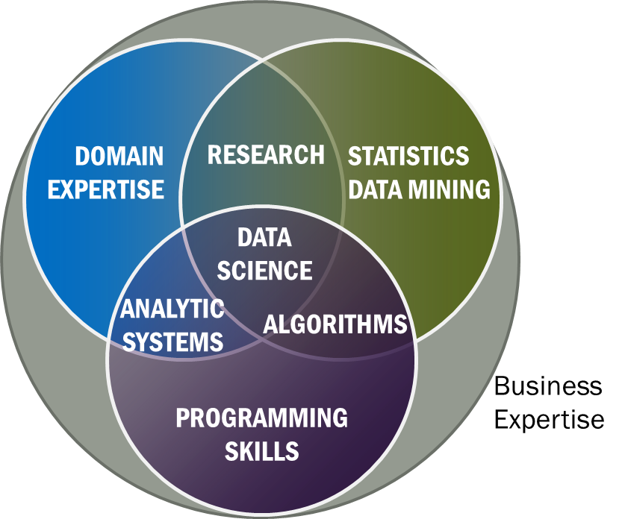
Data Science Definition from NIST Public Working Group
Data Science is the extraction of actionable knowledge directly from data through a process of discovery, hypothesis, and analytical hypothesis analysis.
Misses library science part like curation
A Data Scientist is a practitioner who has sufficient knowledge of the overlapping regimes of expertise in business needs, domain knowledge, analytical skills and programming expertise to manage the end-to-end scientific method process through each stage in the big data lifecycle.
See Big Data Definitions in http://bigdatawg.nist.gov/V1_output_docs.php
Notes:
Big Data refers to digital data volume, velocity and/or variety whose management requires scalability across coupled horizontal resources
Data Science is the extraction of actionable knowledge directly from data through a process of discovery, hypothesis, and analytical hypothesis analysis.
A Data Scientist is a practitioner who has sufficient knowledge of the overlapping regimes of expertise in business needs, domain knowledge, analytical skills and programming expertise to manage the end-to-end scientific method process through each stage in the big data lifecycle.

Slide 5
Data Science Summary
We have strong curriculum
  Online 4 course certificate
  Online Residential Hybrid masters started Spring 2015
  Adding PhD
Fall 2015 Data Science total enrollment 178
  34 Online Certificate
  82 Online Masters
  62 Residential Masters
Spring 2016
  total applicants:175
  Residential 74(58) These are admits (accepts)
  Online 60(51)
  Certificate 5(5)
Note high acceptance rate
This is “program” not a department

Slide 6
Computational Science
Computational science has important similarities to data science but with a simulation rather than data analysis flavor.
Although a great deal of effort went into with meetings and several academic curricula/programs, it didn’t take off
  In my experience not a lot of students were interested and
  The academic job opportunities were not great
Data science has more jobs; maybe it will do better?
Can we usefully link these concepts?
PS both use parallel computing!
In days gone by, I did research in particle physics phenomenology which in retrospect was an early form of data science using models extensively

Slide 7
Some Online Data Science Classes by Fox
BDAA: Big Data Applications & Analytics
  Used to be called X-Informatics
  ~40 hours of video mainly discussing applications (The X in X-Informatics or X-Analytics) in context of big data and clouds https://bigdatacourse.appspot.com/course
BDOSSP: Big Data Open Source Software and Projects http://bigdataopensourceprojects.soic.indiana.edu/
  ~27 Hours of video discussing HPC-ABDS and use on FutureSystems for Big Data software
Both divided into sections (coherent topics), units (~lectures) and lessons (5-20 minutes) in which student is meant to stay awake

Slide 8
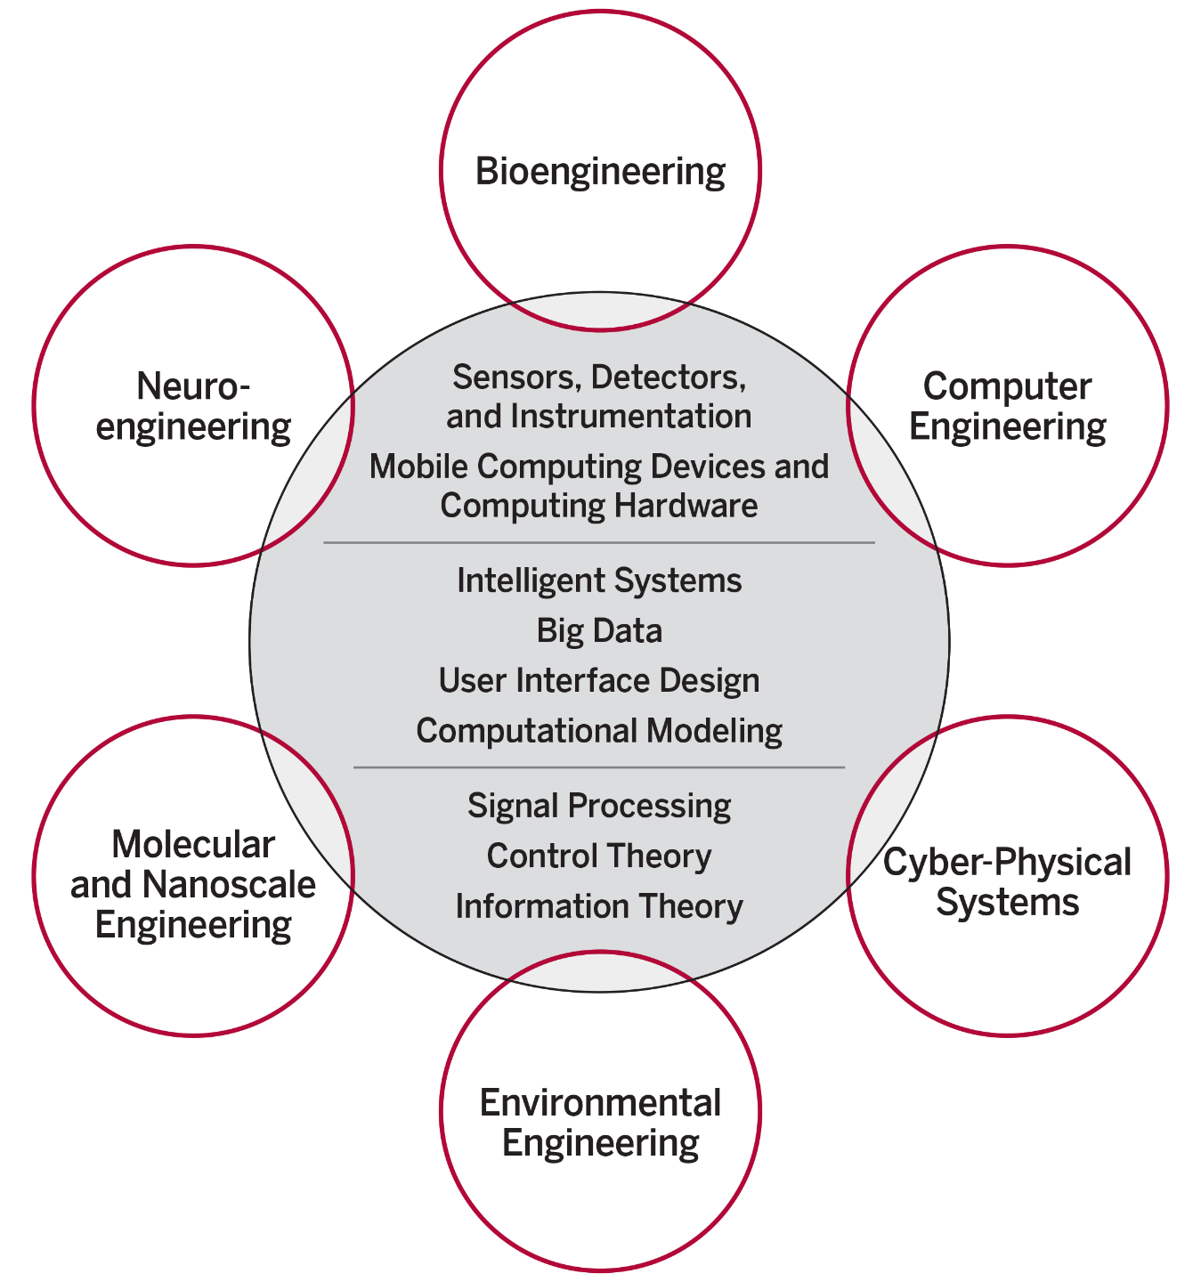
Intelligent Systems Engineering ISE Structure
The focus is on engineering of systems of small scale, often mobile devices that draw upon modern information technology techniques including intelligent systems, big data and user interface design. The foundation of these devices include sensor and detector technologies, signal processing, and information and control theory.
End to end Engineering in 6 areas
Starting Fall 2016
IU Bloomington is the only university among AAU’s 62 member institutions that does not have any type of engineering program.

Slide 9
Introduction
What is Big Data
What is Big Simulation

Slide 10
Big Simulations
Complete model of the Kv1.2 channel. The atomic model comprises 1,560 amino acids, 645 lipid molecules, 80,850 water molecules and ~300K+ and Cl- ion pairs. In total, there are more than 350,000 atoms in the system
Computational Fluid Dynamics
Flow in an aircraft engine

Slide 11
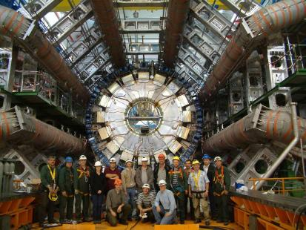
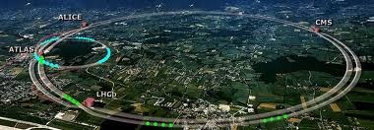
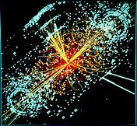
http://grids.ucs.indiana.edu/ptliupages/publications/Where%20does%20all%20the%20data%20come%20from%20v7.pdf
This analysis raw data → reconstructed data → AOD and TAGS → Physics is performed on the multi-tier LHC Computing Grid. Note that every event can be analyzed independently so that many events can be processed in parallel with some concentration operations such as those to gather entries in a histogram. This implies that both Grid and Cloud solutions work with this type of data with currently Grids being the only implementation today.
ATLAS Expt
Note LHC lies in a tunnel 27 kilometres (17 mi) in circumference
Higgs Event
The LHC produces some 15 petabytes of data per year of all varieties and with the exact value depending on duty factor of accelerator (which is reduced simply to cut electricity cost but also due to malfunction of one or more of the many complex systems) and experiments. The raw data produced by experiments is processed on the LHC Computing Grid, which has some 350,000 Cores arranged in a three level structure. Tier-0 is CERN itself, Tier 1 are national facilities and Tier 2 are regional systems. For example one LHC experiment (CMS) has 7 Tier-1 and 50 Tier-2 facilities.

Slide 12
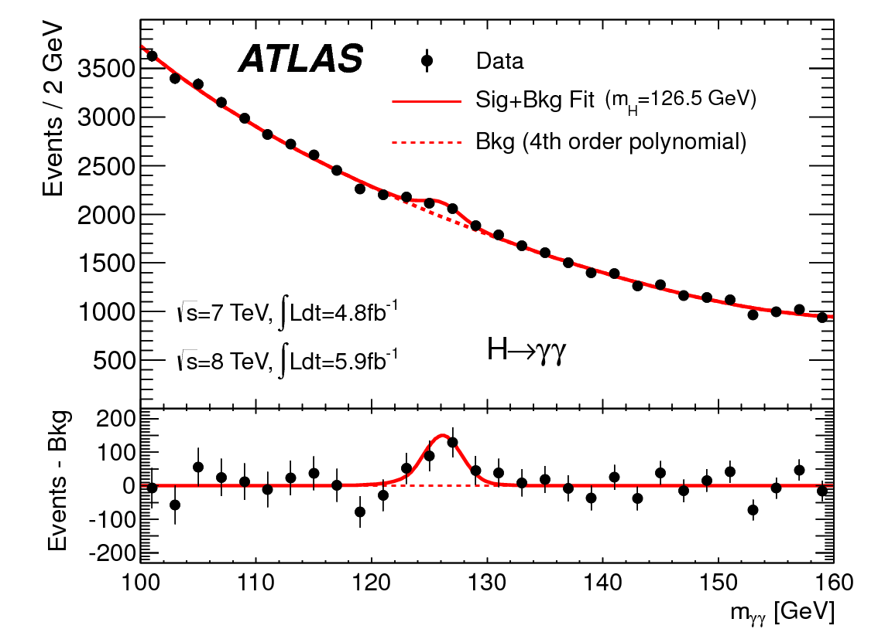
http://www.quantumdiaries.org/2012/09/07/why-particle-detectors-need-a-trigger/atlasmgg/
Model

Slide 13
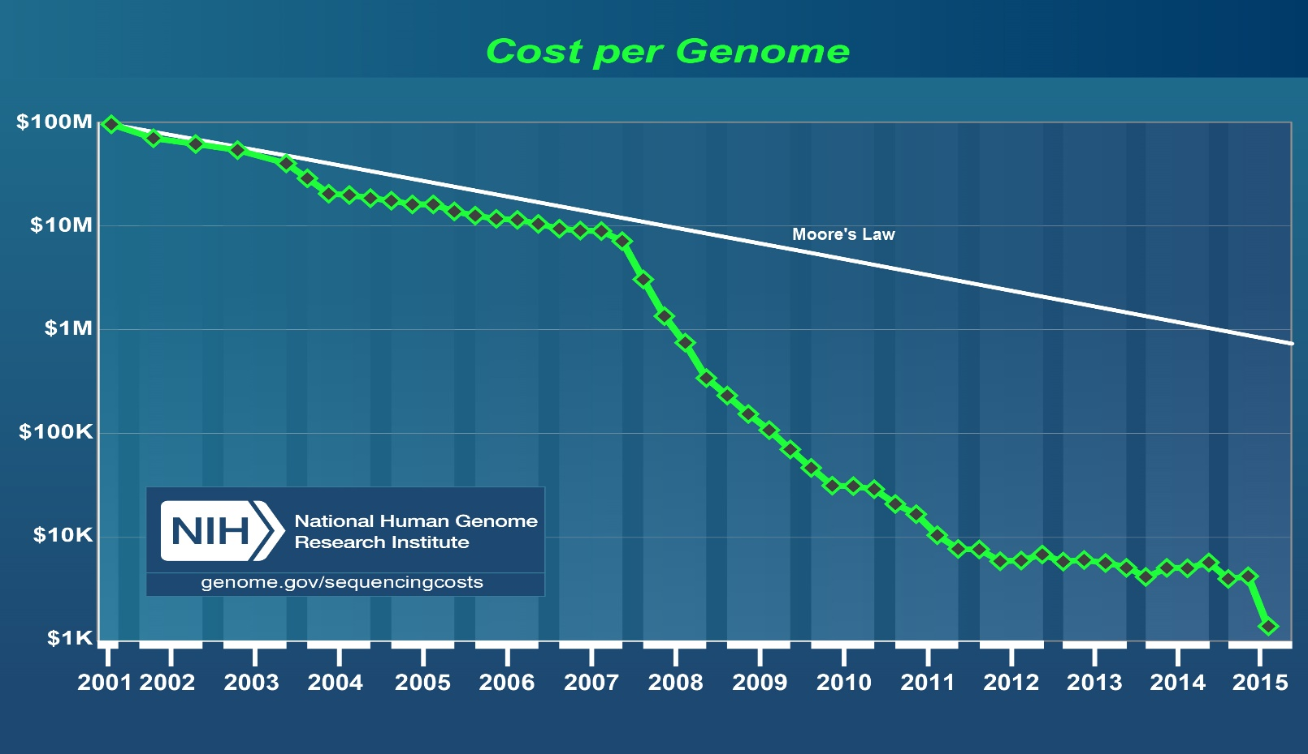
http://www.genome.gov/images/content/cost_per_genome_oct2015.jpg
http://www.kpcb.com/internet-trends

Slide 14
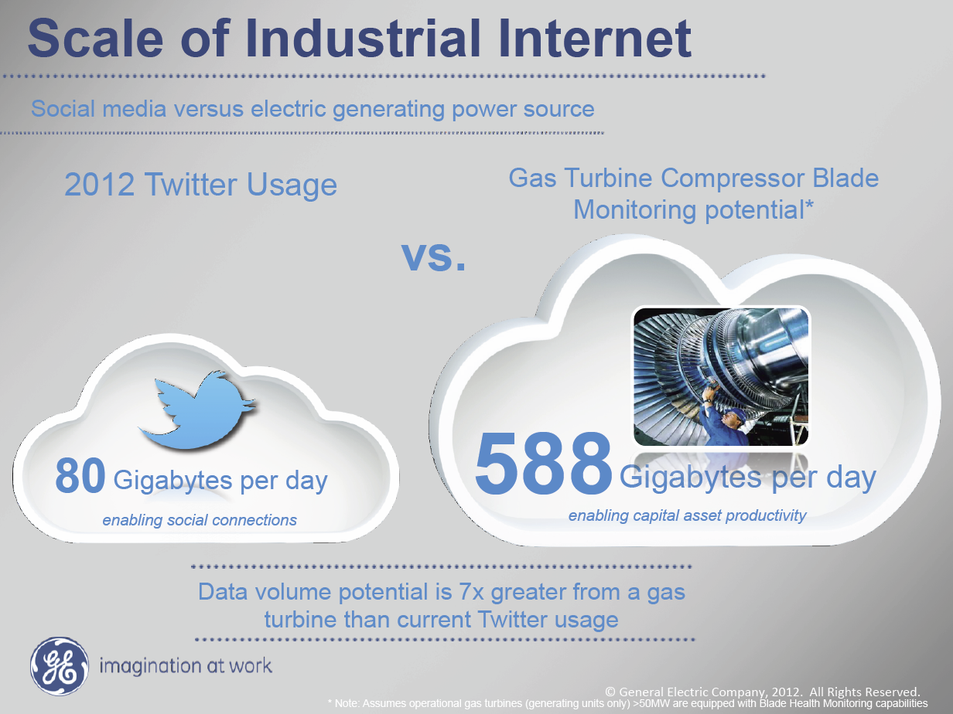
Ruh VP Software GE http://fisheritcenter.haas.berkeley.edu/Big_Data/index.html

Slide 15
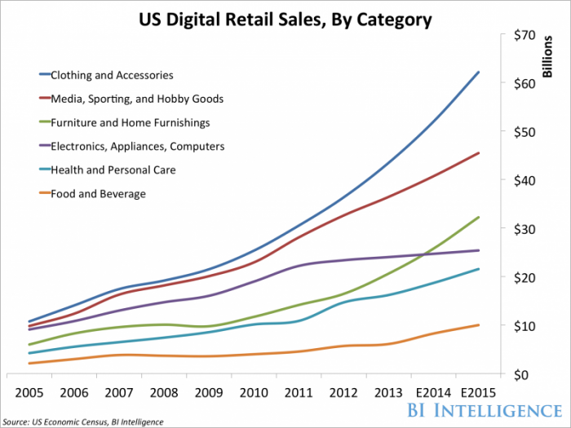
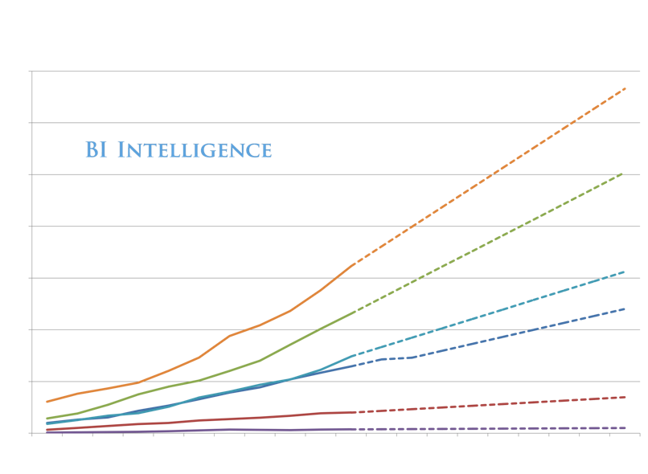
Online!
We Are Here

Slide 16
Introduction
Infrastructure

Slide 17
Note that translates NOW into smaller devices
In PAST translated into faster devices of same form factor
http://www.kpcb.com/internet-trends

Slide 18
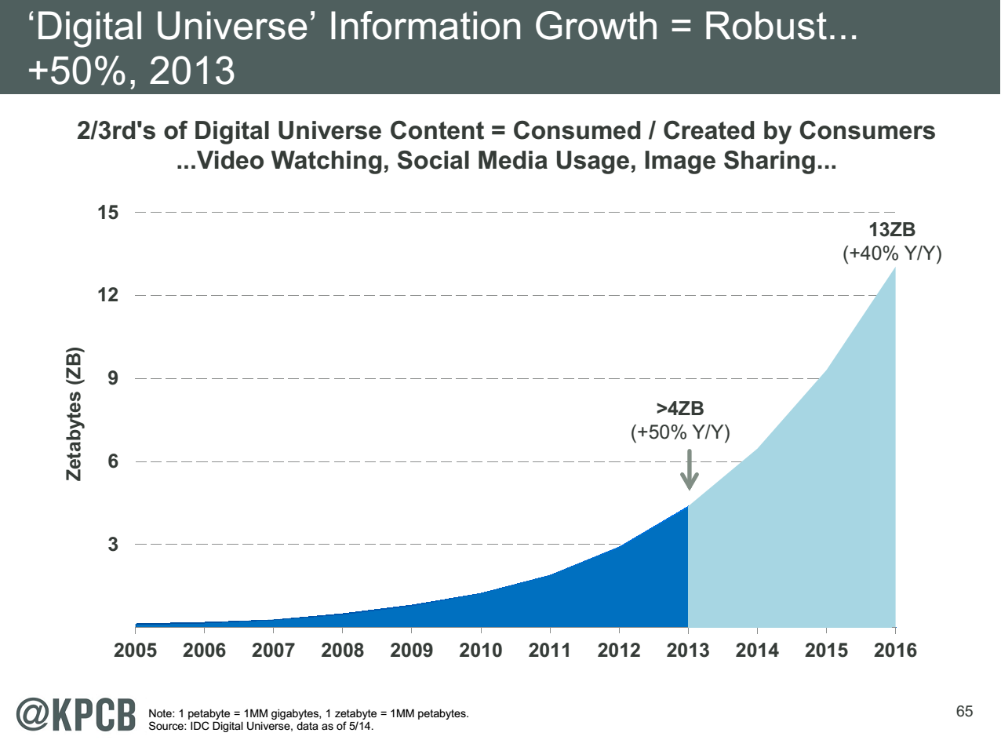
My Research focus is Science Big Data but largest science ~100 petabytes = 0.000025 total
Science should take notice of commodity
Converse not clearly true?
Note 7 ZB (7. 10²¹) is about a
terabyte (10¹²) for each person in world
http://www.kpcb.com/internet-trends

Slide 19
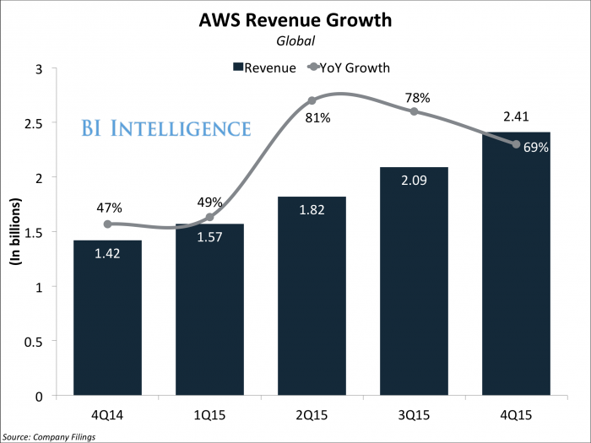
Amazon Web Services
Apple use is 10% AWS; will spend $1B in AWS in 2016 but building its own cloud; Netflix another major user
AWS 30%, Microsoft 12%, IBM 7%, and Google had 6% of global public cloud market

Slide 20
Top 500 Supercomputers
Exponential increase tailing off but such glitches seen before and “corrected”
Fastest machine ~ 100x #500 and 0.1 Sum

Slide 21
Clouds v Supercomputers
Clouds and Supercomputers are both collections of computers networked together in a data center
Top Supercomputers Intel MIC chip, NVIDIA+AMD, IBM Blue Gene
  #3 Sequoia Blue Gene Q at LLNL 16.32 Petaflop/s on the Linpack benchmark using 98,304 CPU compute chips with 1.6 million processor cores and 1.6 Petabyte of memory in 96 racks covering an area of about 3,000 square feet
  7.9 Megawatts power
Largest (cloud) computing data centers up to 100,000 servers at ~200 watts per CPU chip
Each of 3 major cloud vendors has ~2 million servers
Total clouds 100 times performance of largest supercomputer
  Clouds have different networking, I/O and CPU trade-offs than supercomputers
  Cloud workloads data oriented and less closely coupled than supercomputers but still principles of parallel computing same on both

Slide 22
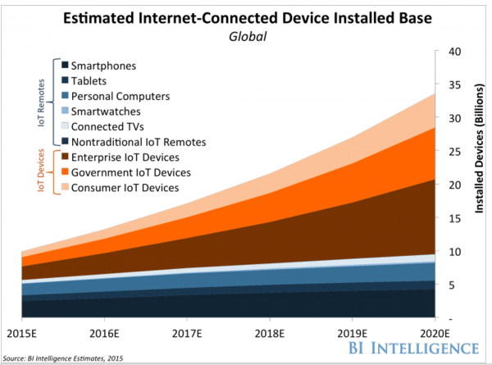

Slide 23
IoT
100B
Devices
~2030
http://www.kpcb.com/internet-trends

Slide 24
Introduction
Jobs

Slide 25
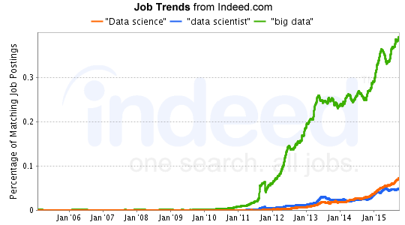
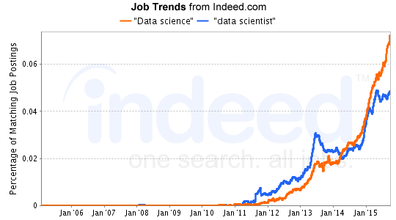
Job Trends
Charts Jan 6 2016
Big Data much larger than data science
19 May 2015 Jobs
3475 for “data science“
2277 for “data scientist“
19488 for “big data”
7 Dec 2015 Jobs
5014 for “data science“
2830 for “data scientist“
22388 for “big data”
http://www.indeed.com/jobtrends?q=%22Data+science%22%2C+%22data+scientist%22%2C+%22big+data%22%2C&l=

Slide 26
The 25 Hottest Skills of 2015 on LinkedIn -- Global
#1: Cloud Computing
#2 Data Science
http://www.slideshare.net/linkedin/the-25-skills-that-could-get-you-hired-in-2016

Slide 28
Introduction
HPC-ABDS

Slide 29
Big Data and (Exascale) Simulation Convergence II

Slide 30
Functionality of 21 HPC-ABDS Layers
Message Protocols:
Distributed Coordination:
Security & Privacy:
Monitoring:
IaaS Management from HPC to hypervisors:
DevOps:
Interoperability:
File systems:
Cluster Resource Management:
Data Transport:
A) File management
B) NoSQL
C) SQL
In-memory databases&caches / Object-relational mapping / Extraction Tools
Inter process communication Collectives, point-to-point, publish-subscribe, MPI:
A) Basic Programming model and runtime, SPMD, MapReduce:
B) Streaming:
A) High level Programming:
B) Frameworks
Application and Analytics:
Workflow-Orchestration:
Here are 21 functionalities. (including 11, 14, 15 subparts)
4 Cross cutting at top
17 in order of layered diagram starting at bottom

Slide 32
Java Grande
Revisited on 3 data analytics codes
Clustering
Multidimensional Scaling
Latent Dirichlet Allocation all sophisticated algorithms

Slide 33
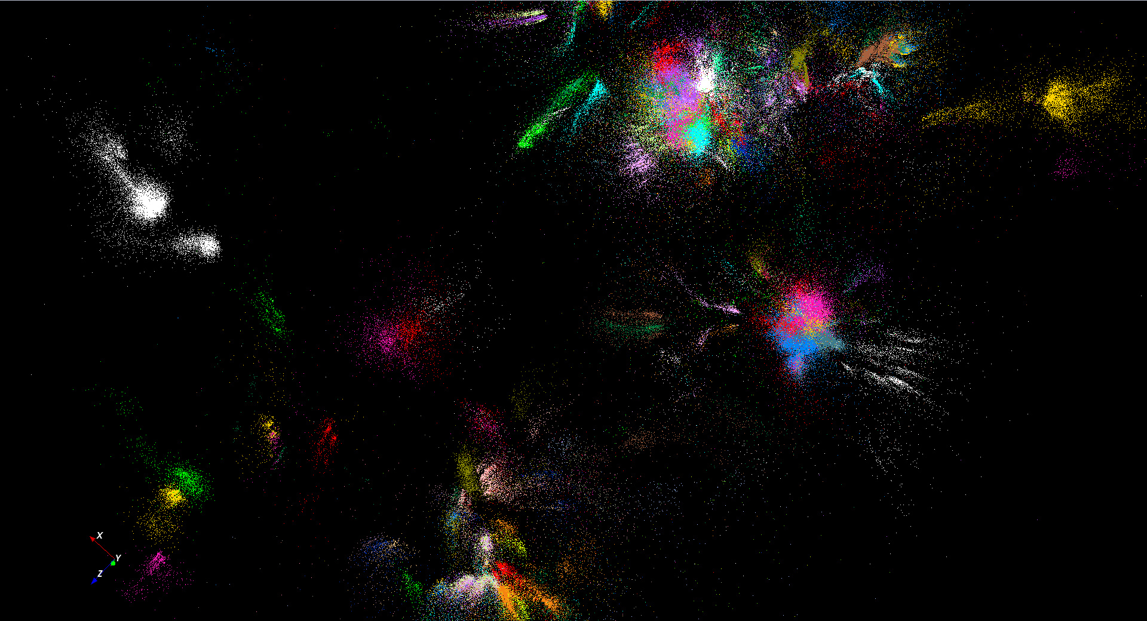
446K sequences
~100 clusters

Slide 34

Protein Universe Browser for COG Sequences with a few illustrative biologically identified clusters

Slide 35
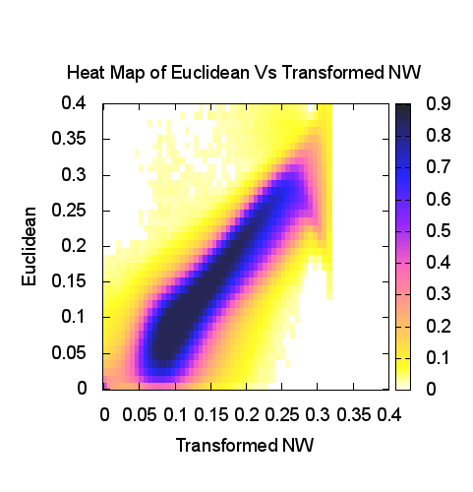
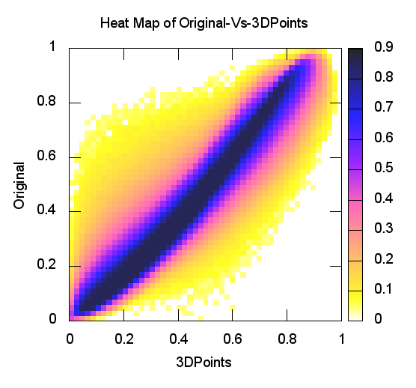
Heatmap of Original distances vs 3D Euclidean Distances
Stock market: Annual Change 2004
Proteomics (Needleman-Wunsch)
y=x is perfection

Slide 36
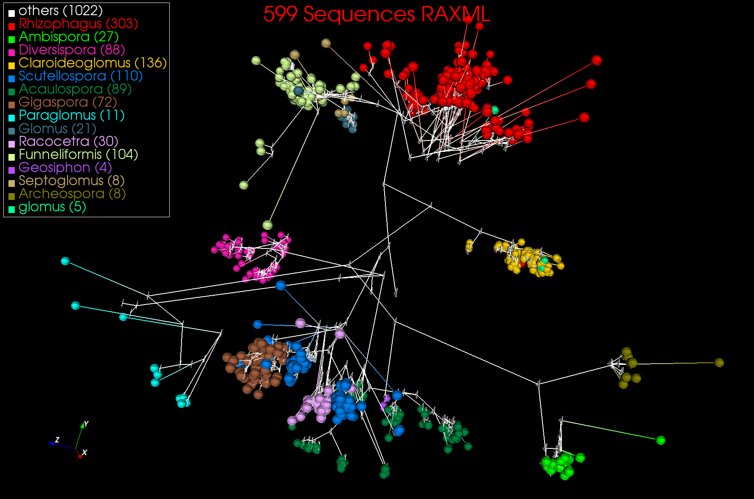
3D Phylogenetic Tree from WDA SMACOF

Slide 37
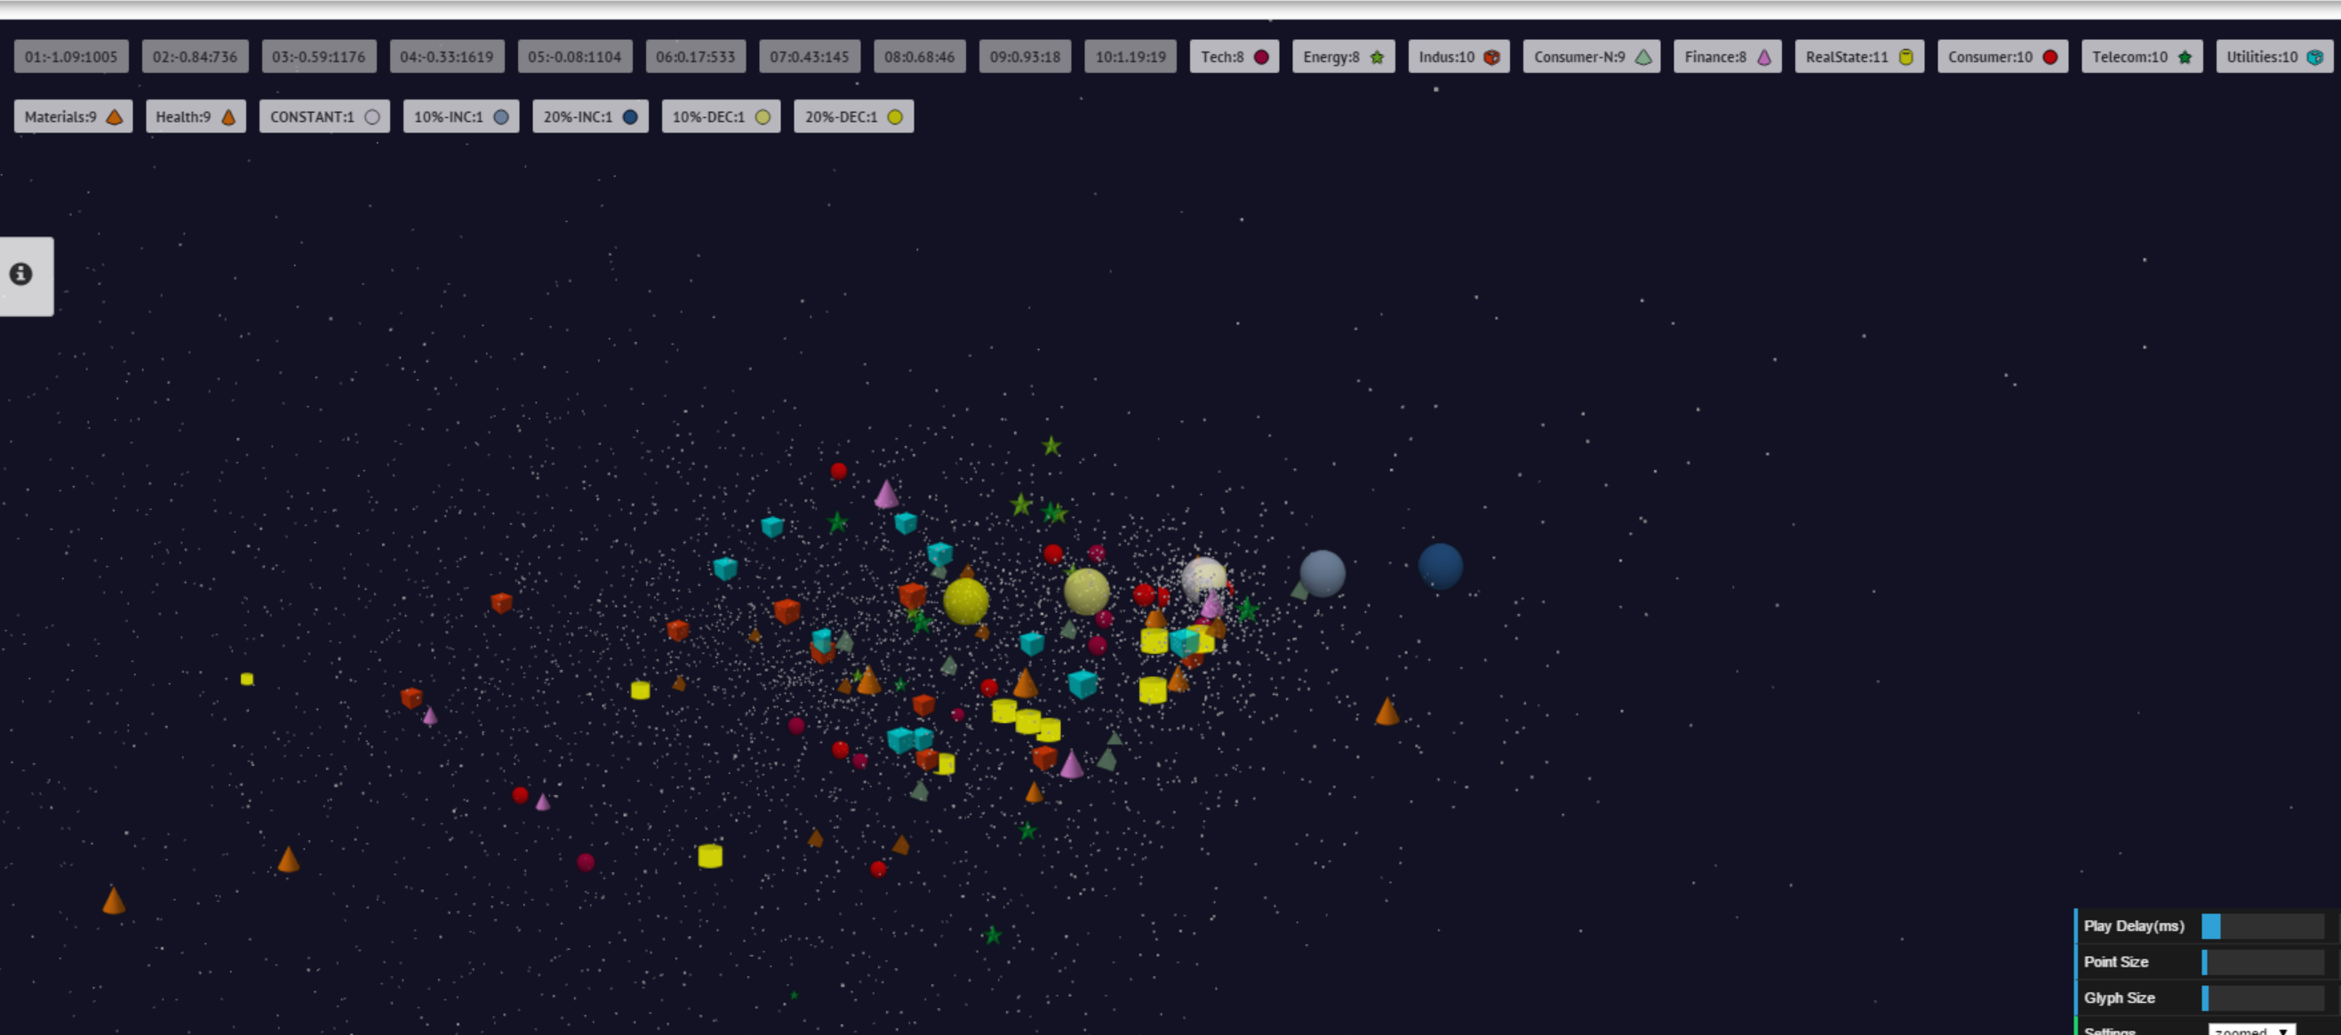
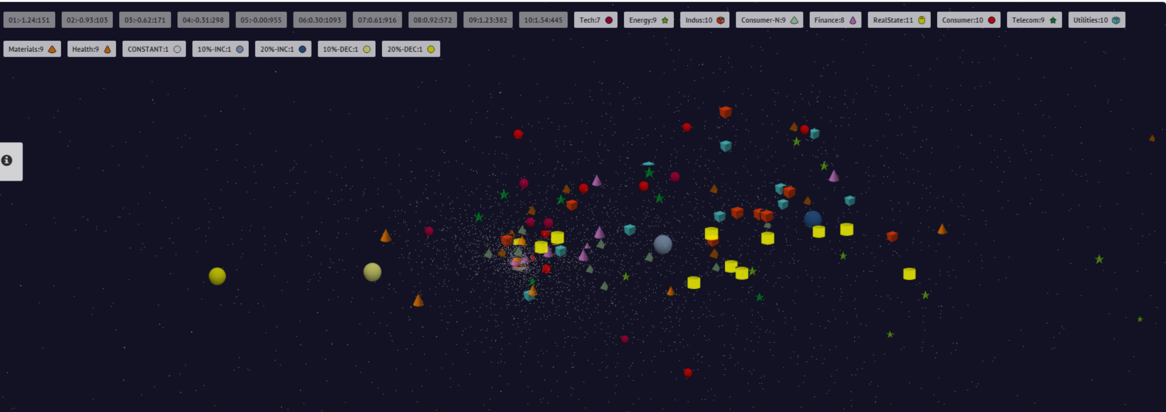
10 year US Stock daily price time series mapped to 3D (work in progress)
3400 stocks
Sector Groupings
End 2008 Positions
July 21 2007 Positions

Slide 38
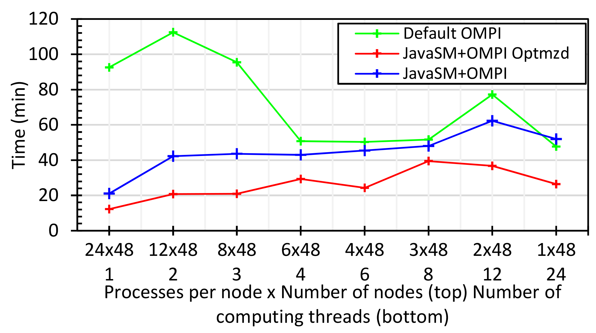
Java MPI performs better than Threads I
128 24 core Haswell nodes
Default MPI much worse than threads
Optimized MPI using shared memory node-based messaging is much better than threads

Slide 39
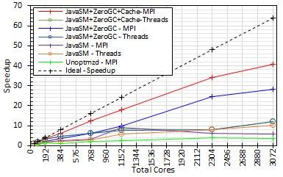
Java MPI performs better than Threads II
128 24 core Haswell nodes
200K Dataset Speedup

Slide 40
NIST Big Data Initiative
Led by Chaitin Baru, Bob Marcus, Wo Chang
And
Big Data Application Analysis

Slide 41
NBD-PWG (NIST Big Data Public Working Group) Subgroups & Co-Chairs
There were 5 Subgroups
  Note mainly industry
Requirements and Use Cases Sub Group
  Geoffrey Fox, Indiana U.; Joe Paiva, VA; Tsegereda Beyene, Cisco
Definitions and Taxonomies SG
  Nancy Grady, SAIC; Natasha Balac, SDSC; Eugene Luster, R2AD
Reference Architecture Sub Group
  Orit Levin, Microsoft; James Ketner, AT&T; Don Krapohl, Augmented Intelligence
Security and Privacy Sub Group
  Arnab Roy, CSA/Fujitsu Nancy Landreville, U. MD Akhil Manchanda, GE
Technology Roadmap Sub Group
  Carl Buffington, Vistronix; Dan McClary, Oracle; David Boyd, Data Tactics
See http://bigdatawg.nist.gov/usecases.php
and http://bigdatawg.nist.gov/V1_output_docs.php

Slide 42

Use Case Template
26 fields completed for 51 apps
Government Operation: 4
Commercial: 8
Defense: 3
Healthcare and Life Sciences: 10
Deep Learning and Social Media: 6
The Ecosystem for Research: 4
Astronomy and Physics: 5
Earth, Environmental and Polar Science: 10
Energy: 1
Now an online form

Slide 43
51 Detailed Use Cases: Contributed July-September 2013
Covers goals, data features such as 3 V’s, software, hardware
26 Features for each use case
Biased to science
http://bigdatawg.nist.gov/usecases.php
https://bigdatacoursespring2014.appspot.com/course (Section 5)
Government Operation(4): National Archives and Records Administration, Census Bureau
Commercial(8): Finance in Cloud, Cloud Backup, Mendeley (Citations), Netflix, Web Search, Digital Materials, Cargo shipping (as in UPS)
Defense(3): Sensors, Image surveillance, Situation Assessment
Healthcare and Life Sciences(10): Medical records, Graph and Probabilistic analysis, Pathology, Bioimaging, Genomics, Epidemiology, People Activity models, Biodiversity
Deep Learning and Social Media(6): Driving Car, Geolocate images/cameras, Twitter, Crowd Sourcing, Network Science, NIST benchmark datasets
The Ecosystem for Research(4): Metadata, Collaboration, Language Translation, Light source experiments
Astronomy and Physics(5): Sky Surveys including comparison to simulation, Large Hadron Collider at CERN, Belle Accelerator II in Japan
Earth, Environmental and Polar Science(10): Radar Scattering in Atmosphere, Earthquake, Ocean, Earth Observation, Ice sheet Radar scattering, Earth radar mapping, Climate simulation datasets, Atmospheric turbulence identification, Subsurface Biogeochemistry (microbes to watersheds), AmeriFlux and FLUXNET gas sensors
Energy(1): Smart grid

Slide 44
Features and Examples

Slide 45
51 Use Cases: What is Parallelism Over?
People: either the users (but see below) or subjects of application and often both
Decision makers like researchers or doctors (users of application)
Items such as Images, EMR, Sequences below; observations or contents of online store
  Images or “Electronic Information nuggets”
  EMR: Electronic Medical Records (often similar to people parallelism)
  Protein or Gene Sequences;
  Material properties, Manufactured Object specifications, etc., in custom dataset
  Modelled entities like vehicles and people
Sensors – Internet of Things
Events such as detected anomalies in telescope or credit card data or atmosphere
(Complex) Nodes in RDF Graph
Simple nodes as in a learning network
Tweets, Blogs, Documents, Web Pages, etc.
  And characters/words in them
Files or data to be backed up, moved or assigned metadata
Particles/cells/mesh points as in parallel simulations

Slide 46
Features of 51 Use Cases I
PP (26) “All” Pleasingly Parallel or Map Only
MR (18) Classic MapReduce MR (add MRStat below for full count)
MRStat (7) Simple version of MR where key computations are simple reduction as found in statistical averages such as histograms and averages
MRIter (23) Iterative MapReduce or MPI (Spark, Twister)
Graph (9) Complex graph data structure needed in analysis
Fusion (11) Integrate diverse data to aid discovery/decision making; could involve sophisticated algorithms or could just be a portal
Streaming (41) Some data comes in incrementally and is processed this way
Classify (30) Classification: divide data into categories
S/Q (12) Index, Search and Query

Slide 47
Features of 51 Use Cases II
CF (4) Collaborative Filtering for recommender engines
LML (36) Local Machine Learning (Independent for each parallel entity) – application could have GML as well
GML (23) Global Machine Learning: Deep Learning, Clustering, LDA, PLSI, MDS,
  Large Scale Optimizations as in Variational Bayes, MCMC, Lifted Belief Propagation, Stochastic Gradient Descent, L-BFGS, Levenberg-Marquardt . Can call EGO or Exascale Global Optimization with scalable parallel algorithm
Workflow (51) Universal
GIS (16) Geotagged data and often displayed in ESRI, Microsoft Virtual Earth, Google Earth, GeoServer etc.
HPC (5) Classic large-scale simulation of cosmos, materials, etc. generating (visualization) data
Agent (2) Simulations of models of data-defined macroscopic entities represented as agents

Slide 48
Big Data and Big Simulations Patterns – the Convergence Diamonds

Slide 49
Big Data - Big Simulation (Exascale) Convergence
Lets distinguish Data and Model (e.g. machine learning analytics) in Big data problems
Then almost always Data is large but Model varies
  E.g. LDA with many topics or deep learning has large model
  Clustering or Dimension reduction can be quite small
Simulations can also be considered as Data and Model
  Model is solving particle dynamics or partial differential equations
  Data could be small when just boundary conditions or
  Data large with data assimilation (weather forecasting) or when data visualizations produced by simulation
Data often static between iterations (unless streaming), model varies between iterations

Slide 50
Classifying Big Data and Big Simulation Applications
“Benchmarks” “kernels” “algorithm” “mini-apps” can serve multiple purposes
Motivate hardware and software features
  e.g. collaborative filtering algorithm parallelizes well with MapReduce and suggests using Hadoop on a cloud
  e.g. deep learning on images dominated by matrix operations; needs CUDA&MPI and suggests HPC cluster
Benchmark sets designed cover key features of systems in terms of features and sizes of “important” applications
Take 51 uses cases → derive specific features; each use case has multiple features
Generalize and systematize with features termed “facets”
50 Facets (Big Data) or 64 Facets (Big Simulation and Data) divided into 4 sets or views where each view has “similar” facets
  Allow one to study coverage of benchmark sets
Discuss Data and Model together as built around problems which combine them but we can get insight by separating and this allows better understanding of Big Data - Big Simulation “convergence”

Slide 51
7 Computational Giants of
NRC Massive Data Analysis Report
http://www.nap.edu/catalog.php?record_id=18374 Big Data Models?
G1: Basic Statistics e.g. MRStat
G2: Generalized N-Body Problems
G3: Graph-Theoretic Computations
G4: Linear Algebraic Computations
G5: Optimizations e.g. Linear Programming
G6: Integration e.g. LDA and other GML
G7: Alignment Problems e.g. BLAST

Slide 52
HPC (Simulation) Benchmark Classics
Linpack or HPL: Parallel LU factorization
for solution of linear equations
NPB version 1: Mainly classic HPC solver kernels
  MG: Multigrid
  CG: Conjugate Gradient
  FT: Fast Fourier Transform
  IS: Integer sort
  EP: Embarrassingly Parallel
  BT: Block Tridiagonal
  SP: Scalar Pentadiagonal
  LU: Lower-Upper symmetric Gauss Seidel
Simulation Models

Slide 53
13 Berkeley Dwarfs
Dense Linear Algebra
Sparse Linear Algebra
Spectral Methods
N-Body Methods
Structured Grids
Unstructured Grids
MapReduce
Combinational Logic
Graph Traversal
Dynamic Programming
Backtrack and
Branch-and-Bound
Graphical Models
Finite State Machines
Largely Models for Data or Simulation
First 6 of these correspond to Colella’s original. (Classic simulations)
Monte Carlo dropped.
N-body methods are a subset of Particle in Colella.
Note a little inconsistent in that MapReduce is a programming model and spectral method is a numerical method.
Need multiple facets!

Slide 54
Both
Analytics
(Model for Data)
Simulations
(Nearly all Data)
(All Model)
(Mix of Data and Model)
(Nearly all Data+Model)

Slide 55
Dwarfs and Ogres give
Convergence Diamonds
Macropatterns or Problem Architecture View: Unchanged
Execution View: Significant changes to separate Data and Model and add characteristics of Simulation models
Data Source and Style View: Same for Ogres and Diamonds – present but less important for Simulations compared to big data
Processing View is a mix of Big Data Processing View and Big Simulation Processing View and includes some facets like “uses linear algebra” needed in both: includes specifics of key simulation kernels – includes NAS Parallel Benchmarks and Berkeley Dwarfs

Slide 56
Facets of the Convergence Diamonds
Problem Architecture
Meta or Macro Aspects of Diamonds
Valid for Big Data or Big Simulations as describes Problem which is Model-Data combination

Slide 57
Problem Architecture View (Meta or MacroPatterns)
Pleasingly Parallel – as in BLAST, Protein docking, some (bio-)imagery including Local Analytics or Machine Learning – ML or filtering pleasingly parallel, as in bio-imagery, radar images (pleasingly parallel but sophisticated local analytics)
Classic MapReduce: Search, Index and Query and Classification algorithms like collaborative filtering (G1 for MRStat in Features, G7)
Map-Collective: Iterative maps + communication dominated by “collective” operations as in reduction, broadcast, gather, scatter. Common datamining pattern
Map-Point to Point: Iterative maps + communication dominated by many small point to point messages as in graph algorithms
Map-Streaming: Describes streaming, steering and assimilation problems
Shared Memory: Some problems are asynchronous and are easier to parallelize on shared rather than distributed memory – see some graph algorithms
SPMD: Single Program Multiple Data, common parallel programming feature
BSP or Bulk Synchronous Processing: well-defined compute-communication phases
Fusion: Knowledge discovery often involves fusion of multiple methods.
Dataflow: Important application features often occurring in composite Ogres
Use Agents: as in epidemiology (swarm approaches) This is Model only
Workflow: All applications often involve orchestration (workflow) of multiple components
11 of 12 are properties of Data+Model
Notes:
Big dwarfs are Ogres
Implement Ogres in ABDS+

Slide 58
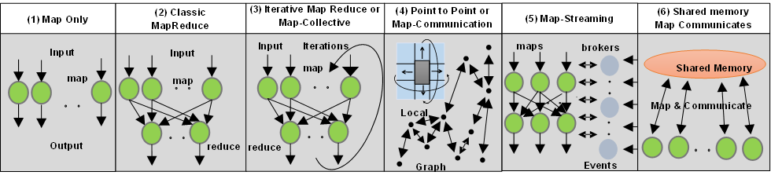
6 Forms of MapReduce cover “all” circumstances
Describes
- Problem (Model reflecting data)
- Machine
- Software
Architecture

Slide 59
Comparison of Data Analytics with Simulation I
Simulations produce big data as visualization of results – they are data source
  Or consume often smallish data to define a simulation problem
  HPC simulation in weather data assimilation is data + model
Pleasingly parallel often important in both
Both are often SPMD and BSP
  Non-iterative MapReduce is major big data paradigm
  not a common simulation paradigm except where “Reduce” summarizes pleasingly parallel execution as in Some Monte Carlos
Big Data often has large collective communication
  Classic simulation has a lot of smallish point-to-point messages
Simulations characterized often by difference or differential operators
Simulation dominantly sparse (nearest neighbor) data structures
  Some important data analytics involves full matrix algorithm but
  “Bag of words (users, rankings, images..)” algorithms are sparse, as is PageRank

Slide 60


“Force Diagrams” for macromolecules and Facebook

Slide 61
Comparison of Data Analytics with Simulation II
There are similarities between some graph problems and particle simulations with a strange cutoff force.
  Both Map-Communication
Note many big data problems are “long range force” (as in gravitational simulations) as all points are linked.
  Easiest to parallelize. Often full matrix algorithms
  e.g. in DNA sequence studies, distance δ(i, j) defined by BLAST, Smith-Waterman, etc., between all sequences i, j.
  Opportunity for “fast multipole” ideas in big data. See NRC report
In image-based deep learning, neural network weights are block sparse (corresponding to links to pixel blocks) but can be formulated as full matrix operations on GPUs and MPI in blocks.
In HPC benchmarking, Linpack being challenged by a new sparse conjugate gradient benchmark HPCG, while I am diligently using non- sparse conjugate gradient solvers in clustering and Multi-dimensional scaling.

Slide 62
Big Data Exascale convergence

Slide 63
Big Data and (Exascale) Simulation Convergence I
Our approach to Convergence is built around two ideas that avoid addressing the hardware directly as with modern DevOps technology it isn’t hard to retarget applications between different hardware systems.
Rather we approach Convergence through applications and software. This talk has described the Convergence Diamonds Convergence that unify Big Simulation and Big Data applications and so allow one to more easily identify good approaches to implement Big Data and Exascale applications in a uniform fashion.
The software approach builds on the HPC-ABDS High Performance Computing enhanced Apache Big Data Software Stack concept (http://dsc.soic.indiana.edu/publications/HPC-ABDSDescribed_final.pdf, http://hpc-abds.org/kaleidoscope/ )
This arranges key HPC and ABDS software together in 21 layers showing where HPC and ABDS overlap. It for example, introduces a communication layer to allow ABDS runtime like Hadoop Storm Spark and Flink to use the richest high performance capabilities shared with MPI Generally it proposes how to use HPC and ABDS software together.
  Layered Architecture offers some protection to rapid ABDS technology change (for ABDS independent of HPC)

Slide 64
Dual Convergence Architecture
Running same HPC-ABDS across all platforms but data management has different balance in I/O, Network and Compute from “model” machine
Data Management Model for Big Data
and Big Simulation

Slide 65
Things to do for Big Data and (Exascale) Simulation Convergence II
Converge Applications: Separate data and model to classify Applications and Benchmarks across Big Data and Big Simulations to give Convergence Diamonds with many facets
  Indicated how to extend Big Data Ogres to Big Simulations by looking separately at model and data in Ogres
  Diamonds will have five views or collections of facets: Problem Architecture; Execution; Data Source and Style; Big Data Processing; Big Simulation Processing
  Facets cover data, model or their combination – the problem or application
  Note Simulation Processing View has similarities to old parallel computing benchmarks

Slide 66
Things to do for Big Data and (Exascale) Simulation Convergence III
Convergence Benchmarks: we will use benchmarks that cover the facets of the convergence diamonds i.e. cover big data and simulations;
  As we separate data and model, compute intensive simulation benchmarks (e.g. solve partial differential equation) will be linked with data analytics (the model in big data)
  IU focus SPIDAL (Scalable Parallel Interoperable Data Analytics Library) with high performance clustering, dimension reduction, graphs, image processing as well as MLlib will be linked to core PDE solvers to explore the communication layer of parallel middleware
  Maybe integrating data and simulation is an interesting idea in benchmark sets
Convergence Programming Model
  Note parameter servers used in machine learning will be mimicked by collective operators invoked on distributed parameter (model) storage
  E.g. Harp as Hadoop HPC Plug-in
  There should be interest in using Big Data software systems to support exascale simulations
  Streaming solutions from IoT to analysis of astronomy and LHC data will drive high performance versions of Apache streaming systems

Slide 67
Things to do for Big Data and (Exascale) Simulation Convergence IV
Converge Language: Make Java run as fast as C++ (Java Grande) for computing and communication – see following slide
  Surprising that so much Big Data work in industry but basic high performance Java methodology and tools missing
  Needs some work as no agreed OpenMP for Java parallel threads
  OpenMPI supports Java but needs enhancements to get best performance on needed collectives (For C++ and Java)
  Convergence Language Grande should support Python, Java (Scala), C/C++ (Fortran)

