Slide 1
The Promise of Learning Everywhere and MLforHPC
Geoffrey Fox and Shantenu Jha contribution to Kobe BDEC meeting
HPC to enhance ML is important
Arguably more important is the question: Can ML enhance the effective performance of HPC simulations ?
We argue that ML can enhance HPC simulations by 10⁶ if not greater!
Enhancement not measured by Flops or usual performance measures
But science done using same amount of computing for given accuracy
Many challenges must be overcome
Right hardware, right software system (platform)
Application architecture and formulation.
For details see team papers
http://dsc.soic.indiana.edu/publications/Learning_Everywhere.pdf
http://dsc.soic.indiana.edu/publications/Learning_Everywhere_Summary.pdf

Slide 2
MLforHPC and HPCforML
We distinguish between different interfaces for ML/DL and HPC.
HPCforML: Using HPC to execute and enhance ML performance, or using HPC simulations to train ML algorithms (theory guided machine learning), which are then used to understand experimental data or simulations.
HPCrunsML: Using HPC to execute ML with high performance
SimulationTrainedML: Using HPC simulations to train ML algorithms, which are then used to understand experimental data or simulations.
MLforHPC: Using ML to enhance HPC applications and systems
MLautotuning: Using ML to configure (autotune) ML or HPC simulations.
MLafterHPC: ML analyzing results of HPC, e.g., trajectory analysis in biomolecular simulations
MLaroundHPC: Using ML to learn from simulations and produce learned surrogates for the simulations. The same ML wrapper can also learn configurations as well as results
MLControl: Using simulations (with HPC) in control of experiments and in objective driven computational campaigns, where simulation surrogates allow real-time predictions.

Slide 3
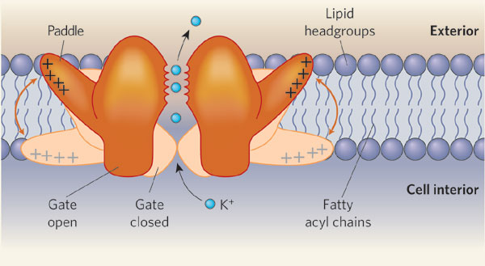
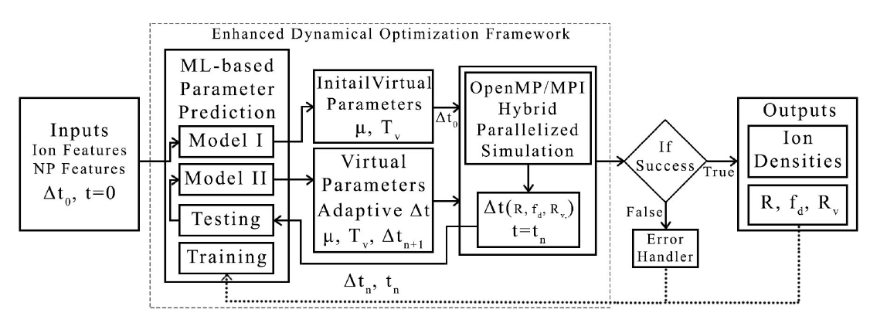
MLAutotuned HPC. Machine Learning for Parameter Auto-tuning in Molecular Dynamics Simulations: Efficient Dynamics of Ions near Polarizable Nanoparticles
Integration of machine learning (ML) methods for parameter prediction for MD simulations by demonstrating how they were realized in MD simulations of ions near polarizable NPs.
Note ML used at start and end of simulation blocks
JCS Kadupitiya, Geoffrey Fox, Vikram Jadhao
ML-Based Simulation Configuration
Inference I
Inference I
Inference II
Inference II
Testing
Testing
Training
Training

Slide 4
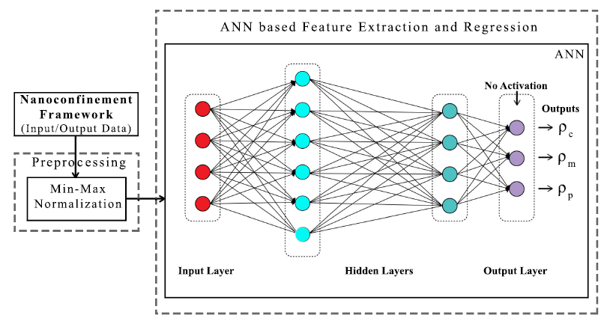
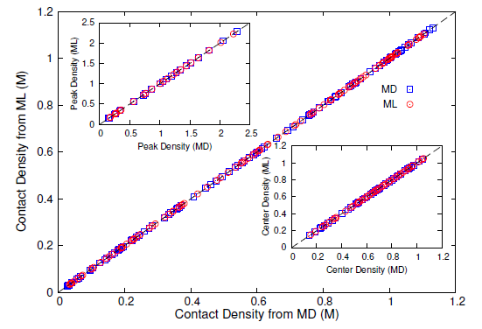
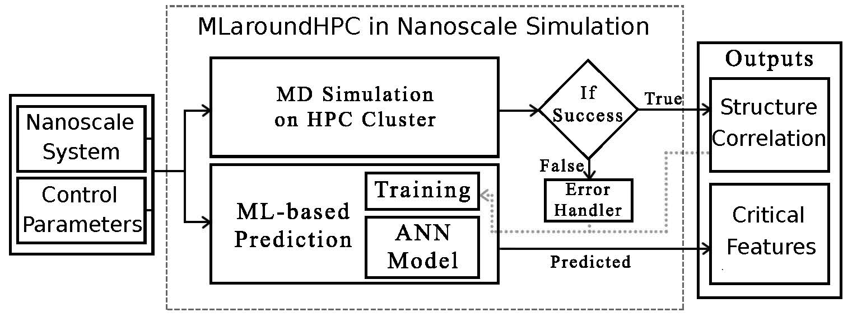
MLaroundHPC: Machine learning for performance enhancement with Surrogates of molecular dynamics simulations
We find that an artificial neural network based regression model successfully learns desired features associated with the output ionic density profiles (the contact, mid-point and peak densities) generating predictions for these quantities that are in excellent agreement with the results from explicit molecular dynamics simulations.
The integration of an ML layer enables real-time and anytime engagement with the simulation framework, thus enhancing the applicability for both research and educational use.
Deployed on nanoHUB for education
ML-Based Simulation Prediction ANN Model
Training
Inference
ML used during simulation

Slide 5
Speedup of MLaroundHPC
T_{seq} is sequential time
T_{train} time for a (parallel) simulation used in training ML
T_{learn} is time per point to run machine learning
T_{lookup} is time to run inference per instance
N_{train} number of training samples
N_{lookup} number of results looked up
Becomes T_{seq}/T_{train} if ML not used
Becomes T_{seq}/T_{lookup} (10⁵ faster in our case) if inference dominates (will overcome end of Moore’s law and win the race to zettascale)
This application deployed on nanoHub for high performance education use
N_{train} is 7K to 16K in our work

