Slide 1


Large-scale Data Visualization For
Data-intensive And High-dimensional Scientific Data Analysis
SC11 Doctoral Research Showcase
Nov 15, 2011
Student: Jong Youl Choi
Advisor: Geoffrey Fox
School of Informatics and Computing
Pervasive Technology Institute
Indiana University
SALSA project
http://salsahpc.indiana.edu

Slide 2
Large and High-dimensional Data
High-dimensional
K Latent Components
≈
Large-scale
Examples
  Cheminformatics: PubChem (60M, 166 dimension)
  Bioinformatics
  Document indexing

Slide 3
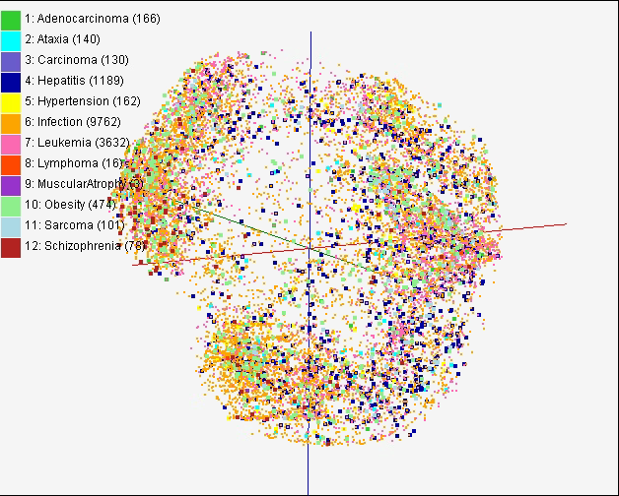
Dimension Reduction for Visualization
Purpose : simplication, clustering, browsing, ...
Research challenges
  Optimization : preserve the original data’s information
  High-performance : parallel and efficient implementation

Slide 4


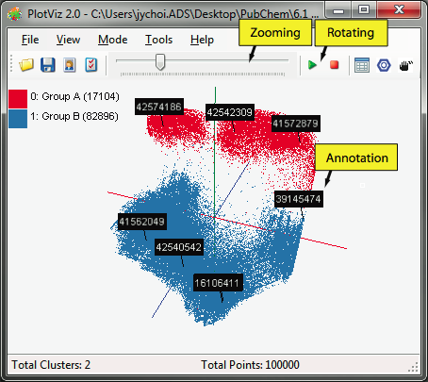
PlotViz, Large-Scale Visualization System
3-D Map File
Parallel Dimension Reduction Algorithms
PlotViz
Light-weight client
High-Performance Cluster
Meta data
DrugBank
CTD
SPARQL query
QSAR
PubChem
External Data Repository
Aggregated public databases

Slide 5
Parallel Dimension Reduction Algorithms
EM
DA
Interpolation
EM
DA
Inference
Generative Topographic Mapping (GTM)
Probabilistic Latent Semantic Analysis (PLSA)
Parallel HDF5
ScaLAPACK
MPI / MPI-IO
Cray / Linux / Windows Cluster
Parallel File System
Interconnect Network
. . .
Software Stack

Slide 6
Generative Topographic Mapping
K latent points
N data points
An algorithm for dimension reduction
  Find an optimal user-defined K latent variables in L-dim.
  Non-linear mappings
Find K centers for N data
  K-clustering problem, known as NP-hard
  Use Expectation-Maximization (EM) method

Slide 7
Advantages of GTM
Computational complexity is O(KN), where
  N is the number of data points
  K is the number of latent variables or clusters. K << N
Efficient, compared with MDS which is O(N²)
Produce more separable map (right) than PCA (left)
PCA
GTM

Slide 8

Deterministic Annealing Optimization
EM
  Local optimum problem
  Very sensitive to initial condition
  Large deviation
DA Method
  Numeric temperature (high → low)
  Principle of maximum entropy
DA Characteristics
  Less sensitive to a random initial condition
  Avoid local optimum
  Require more computational time than EM
  But, smaller deviation

Slide 9
Interpolation Extension
M
In-sample
Training
Trained data
Interpolated Mapping
N - M
Out-of-sample
Interpolation
Total N data
Training is the most time and memory consuming process
Two step procedure
  Training : training by M samples out of N data
  Interpolation : remaining (N-M) out-of-samples are approximated without training
Notes:
Unsupervised learning

Slide 10
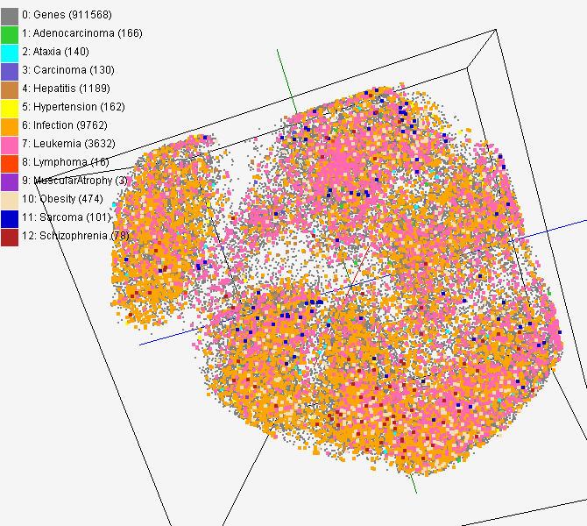
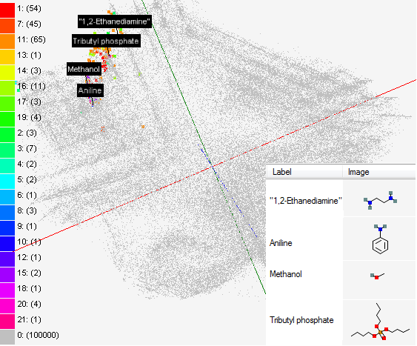
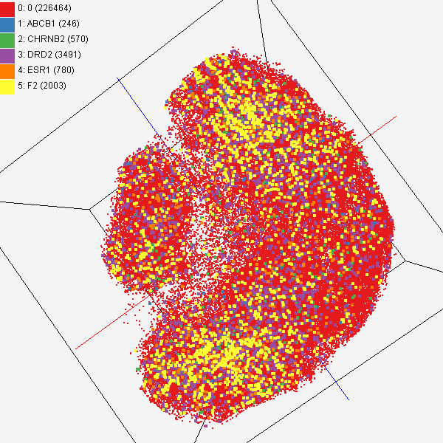
Data Mining Projects using GTM
Visualizing 215 solvents by GTM-Interpolation
215 solvents (colored and labeled) are embedded with 100,000 chemical compounds (colored in grey) in PubChem database
Chemical compounds reported in literatures
Visualized 234,000 chemical compounds which may be related with a set of 5 genes of interest (ABCB1, CHRNB2, DRD2, ESR1, and F2) based on the dataset collected from major journal literatures
PubChem data with CTD visualization
About 930,000 chemical compounds are visualized in a 3D space, annotated by the related genes in Comparative Toxicogenomics Database (CTD)

Slide 11
Demo

Slide 12
Summary
Dimension Reduction
  Generative Topographic Mapping
  Probabilistic Latent Semantic Analysis
Deterministic Annealing
  Overcome EM problem
  Avoid local optimum
  Robust and reliable
High-performance Computing
  Parallel numeric libraries
  Parallel IO

Slide 13
Thank you!!
Question?
Email me at jychoi@cs.indiana.edu

Slide 14
Deterministic Annealing (DA) Optimization
EM-GTM
(traditional method)
DA-GTM
(new algorithm)
Optimization
Maximize log-likelihood L
Minimize free energy F
Objective
Function
When T = 1, L = -F.
Pros & Cons
Very sensitive
Trapped in local optima
Faster
Large deviation
Less sensitive to an initial condition
Find global optimum
Require more computational time
Small deviation

Slide 15
Parallel GTM
Finding K clusters for N data points
  Relationship is a bipartite graph (bi-graph)
  Represented by K-by-N matrix (K << N)
Decomposition for P-by-Q compute grid
  Reduce memory requirement by 1/PQ
Example:
A 8-byte double precision matrix for N=100K and K=8K requires 6.4GB
A
A
B
C
1
B
1
2
C
2
K latent
points
N data
points

