Slide 1
Generative Topographic Mapping in Life Science
Ph.D. Thesis Proposal
Jong Youl Choi
School of Informatics and Computing
Pervasive Technology Institute
Indiana University
(jychoi@cs.indiana.edu)

Slide 2
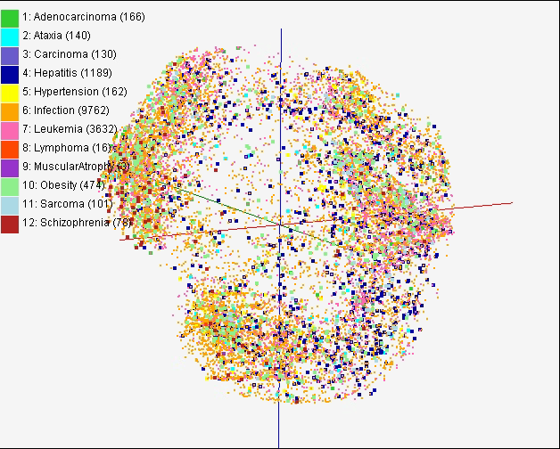
Visualization in Life Science (1)
2D or 3D visualization of high-dimensional data can provide an efficient way to find relationships between data elements
Display each element as a point and distances represent similarities (or dissimilarities)
Easy to recognize clusters or groups
  An example of chemical data (PubChem)
  Visualization to display disease-gene relationship, aiming at finding cause-effect relationships between disease and genes.
Notes:
Data analysis in life science is challenged by:
The large volume of data
The complexity of data. Typically it’s very high-dimensional

Slide 3
Visualization in Life Science (2)
Visualization can be used to verify the correctness of analysis
Feature selections in the child obesity data can be verified through visualization
Genetic Algorithm
Canonical Correlation Analysis
Visualization
  A workflow of feature selection
  In health data analysis for child obesity study, visualization has been used for verification purpose. Data was collected from electronic medical record system (RMRS, Indianapolis, IN) in Indiana University Medical Center
Notes:
Data visualization is an essential tool in many life science researches.

Slide 4
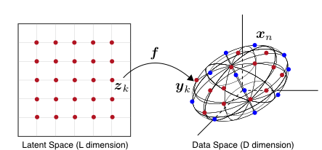
Generative Topographic Mapping
K latent points
N data points
Algorithm for dimension reduction
  Find an optimal user-defined L-dim. representation
  Use Gaussian distribution as distortion measurement
Find K centers for N data
  K-clustering problem, known as NP-hard
  Use Expectation-Maximization (EM) method
Notes:
For a long time, a lot of data visualization algorithm has been developed:
MDS
Isomap
GTM
NP-hard (Non-deterministic Polynomial)

Slide 5
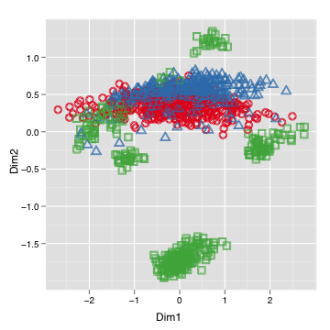
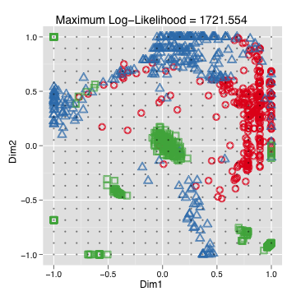
Advantages of GTM
Complexity is O(KN), where
  N is the number of data points
  K is the number of clusters. Usually K << N
Efficient, compared with MDS which is O(N²)
Produce more separable map (right) than PCA (left)

Slide 6
Problems
O(KN) is still demanding in most life science
  Parallelization with distributed memory model (CCGrid 2010)
  Interpolation (aka, out-of-sample extension) can be used (HPDC 2010)
GTM find only local optimal solution
  Applying Deterministic Annealing (DA) algorithm for global optimal solution (ICCS 2010)
Optimal choice of K is still unknown
  Developing hierarchical GTM can help
  DA-GTM support natively hierarchical structure

Slide 7
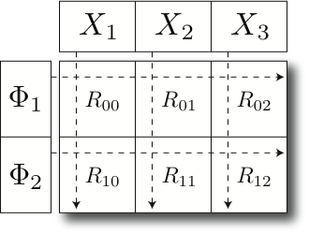
Parallel GTM
Finding K clusters for N data points
  Relationship is a bipartite graph (bi-graph)
  Represented by K-by-N matrix
Decomposition for P-by-Q compute grid
  Reduce memory requirement by 1/PQ
Example:
A 8-byte double precision matrix for N=1M and K=8K requires 64GB
A
A
B
C
1
B
1
2
C
2
K latent
points
N data
points
Notes:
If N=1M and K=8K, 8Gx8B = 64 GB

Slide 8
GTM Interpolation
Training in GTM is to find an optimal K positions, which is the most time consuming
Two step procedure
  GTM training only by n samples out of N data
  Remaining (N-n) out-of-samples are approximated without training
n
In-sample
Training
Trained data
N-n
Out-of-sample
Interpolated
GTM map
Interpolation
Total N data

Slide 9
Deterministic Annealing (DA)
An heuristic to find a global solution
  The principle of maximum entropy : choose the most unbiased and non-committal answers
  Similar with Simulated Annealing (SA) which is based on random walk model
  But, DA is deterministic as no randomness is involved
New paradigm
  Analogy in thermodynamics
  Find solutions as lowering temperature T
  New objective function, free energy F = D−TH
  Minimize free energy F as T → 1
Notes:
F : Helmholtz free energy
D : expected distortion
H : Shannon entropy

Slide 10
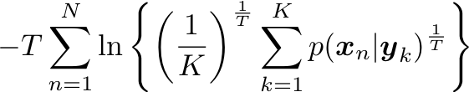
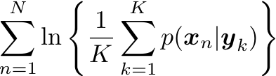
GTM with Deterministic Annealing
EM-GTM
DA-GTM
Optimization
Maximize log-likelihood L
Minimize free energy F
Objective
Function
When T = 1, L = -F
Pros & Cons
Very sensitive
Trapped in local optima
Faster
Large deviation
Less sensitive to an initial condition
Find global optimum
Require more computational time
Small deviation

Slide 11
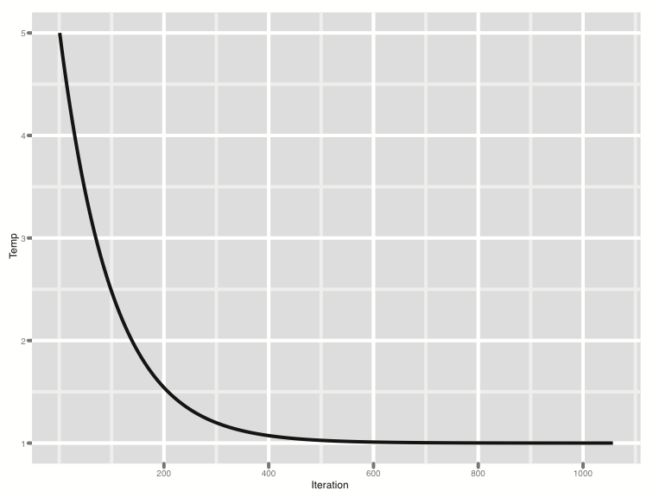
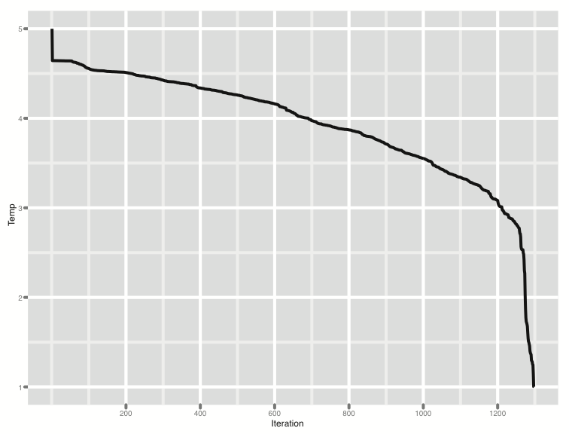
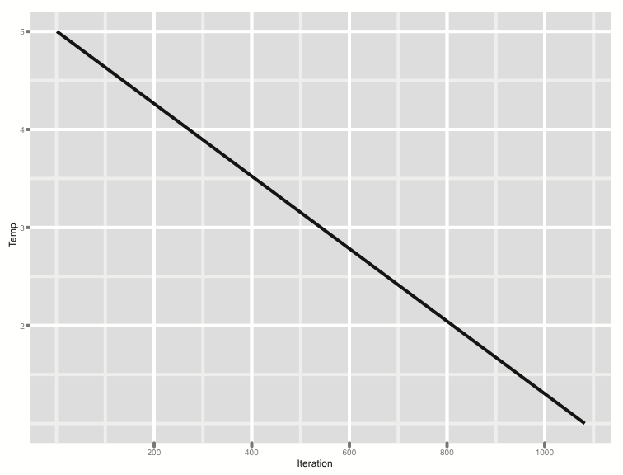
Adaptive Cooling Schedule
Typical cooling schedule
  Fixed
  Exponential
  Linear
Adaptive cooling schedule
  Dynamic
  Adjust on the fly
  Move to the next critical
  temperature as fast as possible
Temperature
Iteration
Iteration
Temperature
Iteration

Slide 12
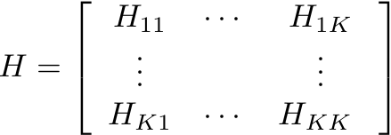


Phase transition
DA’s discrete behavior
  In some range of temperatures, solutions are settled
  At a specific temperature, start to explode, which is known as critical temperature T_{c}
Critical temperature T_{c}
  Free energy F is drastically changing at T_{c}
  Second derivative test : Hessian matrix loose its positive definiteness at T_{c}
  det ( H ) = 0 at T_{c} , where

Slide 13
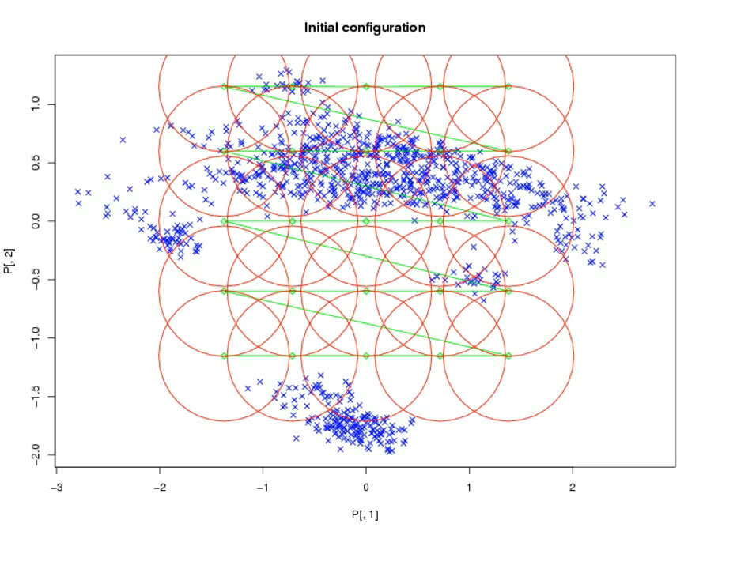
Demonstration
25 latent points
1K data points

Slide 14
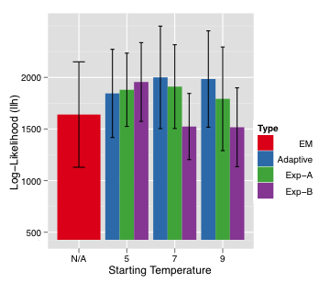
DA-GTM Result

Slide 15
Contributions
GTM optimization
  GTM with distributed memory model
  GTM interpolation as an out-of-sample extension
  Deterministic Annealing for global optimal solution
  Research on hierarchical DA-GTM
GTM/DA-GTM application
  PubChem data visualization
  Health data visualization

Slide 16
Selected Papers
J. Y. Choi, J. Qiu, M. Pierce, and G. Fox. Generative topographic mapping by deterministic annealing. To appear in the International Conference on Computational Science (ICCS) 2010, 2010.
J. Y. Choi, S.-H. Bae, X. Qiu, and G. Fox. High performance dimension reduction and visualization for large high-dimensional data analysis. To appear in the Proceedings of the 10th IEEE/ACM International Symposium on Cluster, Cloud and Grid Computing (CCGrid) 2010, 2010.
S.-H. Bae, J. Y. Choi, J. Qiu, and G. Fox. Dimension reduction and visualization of large high-dimensional data via interpolation. Submitted to HPDC 2010, 2010.
J. Y. Choi, J. Rosen, S. Maini, M. E. Pierce, and G. C. Fox. Collective collaborative tagging system. In proceedings of GCE08 workshop at SC08, 2008.
M. E. Pierce, G. C. Fox, J. Rosen, S. Maini, and J. Y. Choi. Social networking for scientists using tagging and shared bookmarks: a web 2.0 application. In 2008 International Symposium on Collaborative Technologies and Systems (CTS 2008), 2008.

Slide 17
Thank you
Question?
Email me at jychoi@cs.indiana.edu

Slide 18


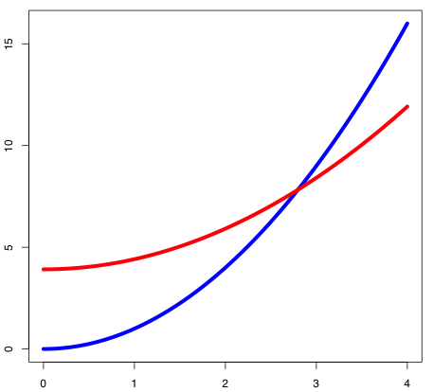
Comparison of DA Clustering
DA Clustering
DA-GTM
Distortion
Related Algorithm
K-means
Gaussian mixture
Distortion
DA Clustering
DA-GTM
Distance

