Slide 1
Judy Qiu
Harp-Daal: A High Performance Big Data Analytics Framework for HPC-Cloud
COLLABORATORS
SPIDAL: Intel, Arizona State University, Rutgers University, Stony Brook University, Universities of Kansas and Utah, Virginia Tech

Slide 2
50 Billion Devices by 2020
World Population will be 7.6 billion by 2020
HPC Cloud
(e.g. CPU, GPU, FPGA)
©Digital Transformation and Innovation

Slide 3
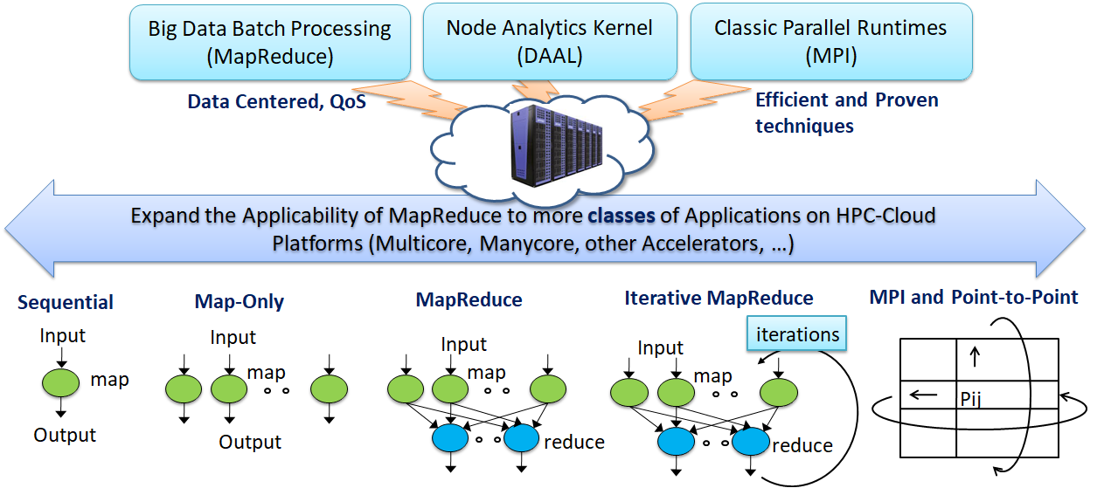
Figure. Cloud-HPC interoperable software for High Performance Big Data Analytics at Scale

Slide 4
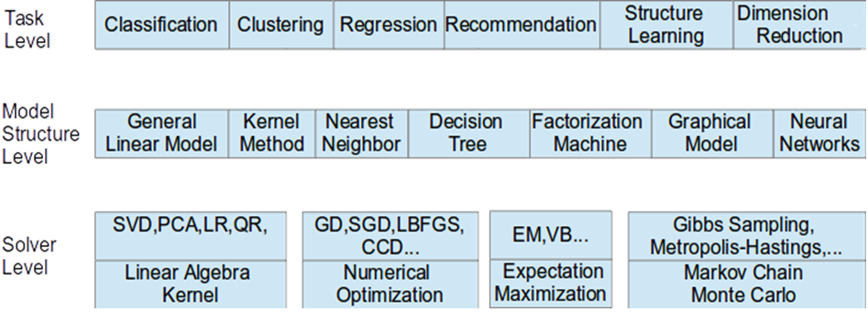
Taxonomy for Machine Learning Algorithms
Optimization and related issues
Task level only can't capture the traits of computation
Model is the key for iterative algorithms. The structure (e.g. vectors, matrix, tree, matrices) and size are critical for performance
Solver has specific computation and communication pattern

Slide 5
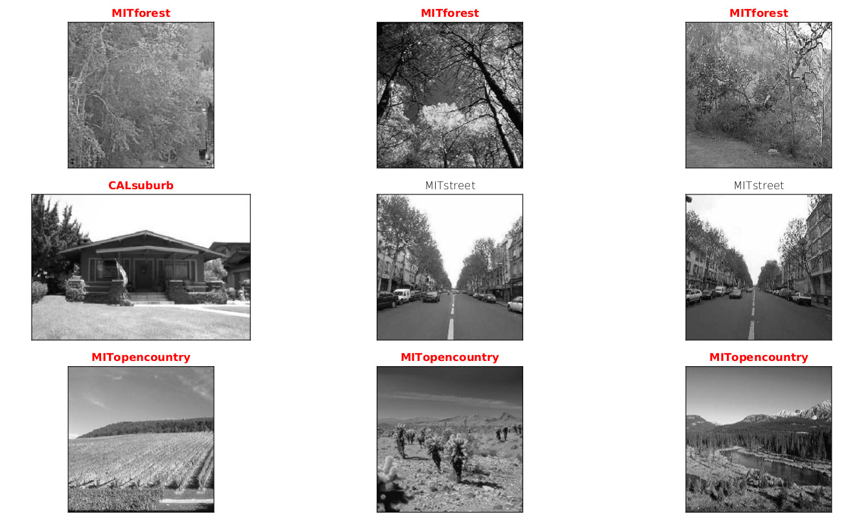
result: sample images of the result clusters, one row for each cluster
Result

Slide 6
Image results from Scikit-learn
Image results from Harp-Daal

Slide 7
Demo: Harp-Daal KMeans for image clustering

Slide 8
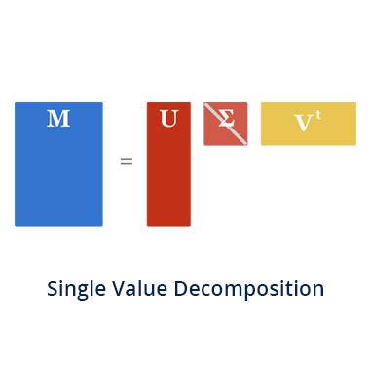
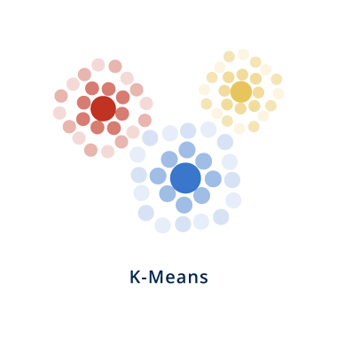
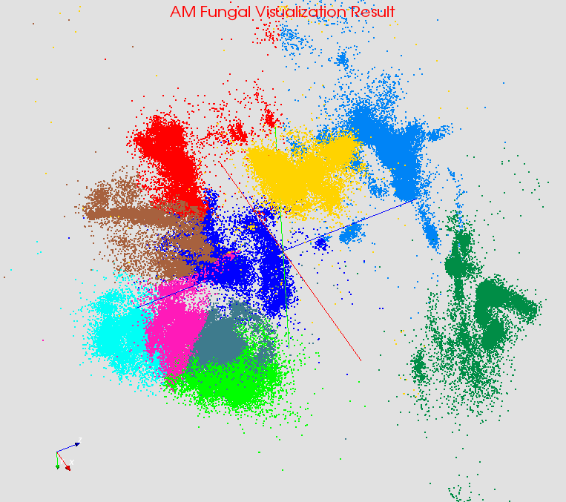
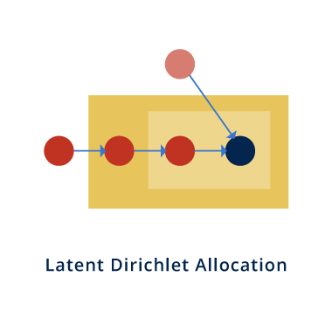
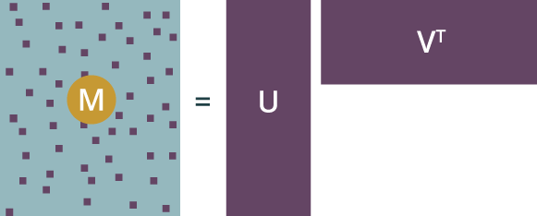
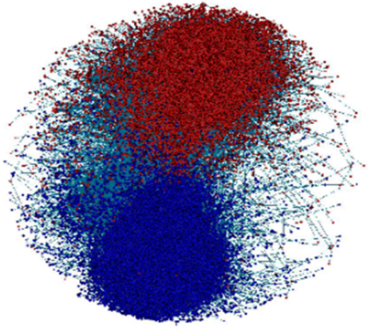
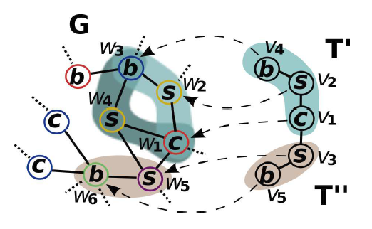
Explore Algorithms
PCA
Bioinformatics
Computer Vision
Alternating least squares (ALS)
Complex Networks
Text Mining
MatrixFactorization-SGD
SubGraph Counting

Slide 9
THANK YOU
PRESENTER CONTACT INFO
xqiu@indiana.edu
Intelligent Systems Engineering
School of Informatics, Computing and Engineering
Indiana University

