Slide 1



Twister4Azure: Parallel Data Analytics on Azure
Judy Qiu Thilina Gunarathne
SALSA HPC Group
http://salsahpc.indiana.edu
School of Informatics and Computing
Indiana University
CAREER Award

Slide 2
Outline
Iterative Mapreduce Programming Model
Interoperability
Reproducibility

Slide 3


















300+ Students learning about Twister & Hadoop
MapReduce technologies, supported by FutureGrid.
July 26-30, 2010 NCSA Summer School Workshop
http://salsahpc.indiana.edu/tutorial
Washington
University
University of
Minnesota
Michigan
State
Johns
Hopkins
Univ.Illinois
at Chicago
Iowa
Penn
State
IBM Almaden
Research Center
Notre
Dame
University of
California at
Los Angeles
Indiana
University
San Diego
Supercomputer
Center
University of
Texas at El Paso
University of
Arkansas
University
of Florida

Slide 4
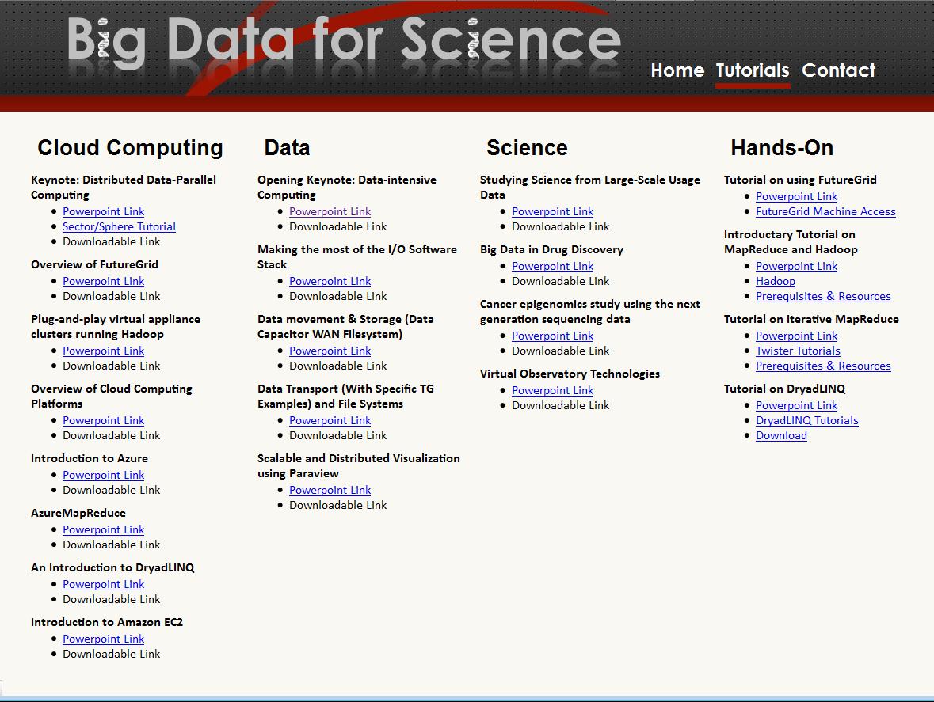

Slide 5
Intel’s Application Stack

Slide 6
(Iterative) MapReduce in Context
Support Scientific Simulations (Data Mining and Data Analysis)
Kernels, Genomics, Proteomics, Information Retrieval, Polar Science, Scientific Simulation Data Analysis and Management, Dissimilarity Computation, Clustering, Multidimensional Scaling, Generative Topological Mapping
Applications
Security, Provenance, Portal
Programming Model
Services and Workflow
High Level Language
Runtime
Cross Platform Iterative MapReduce (Collectives, Fault Tolerance, Scheduling)
Storage
Distributed File Systems
Object Store
Data Parallel File System
Linux HPC
Bare-system
Amazon Cloud
Windows Server HPC
Bare-system
Azure Cloud
Grid Appliance
Infrastructure
Virtualization
Virtualization
Hardware
CPU Nodes
GPU Nodes

Slide 7





Map Reduce
Programming Model
Moving Computation to Data
Scalable
Fault Tolerance
  Simple programming model
  Excellent fault tolerance
  Moving computations to data
  Works very well for data intensive pleasingly parallel applications
  Ideal for data intensive pleasingly parallel applications
Notes:
MapReduce provides a easy to use programming model together with very good fault tolerance and scalability for large scale applications. MapReduce model is proving to be Ideal for data intensive pleasingly parallel applications in commodity hardware and in clouds.

Slide 8
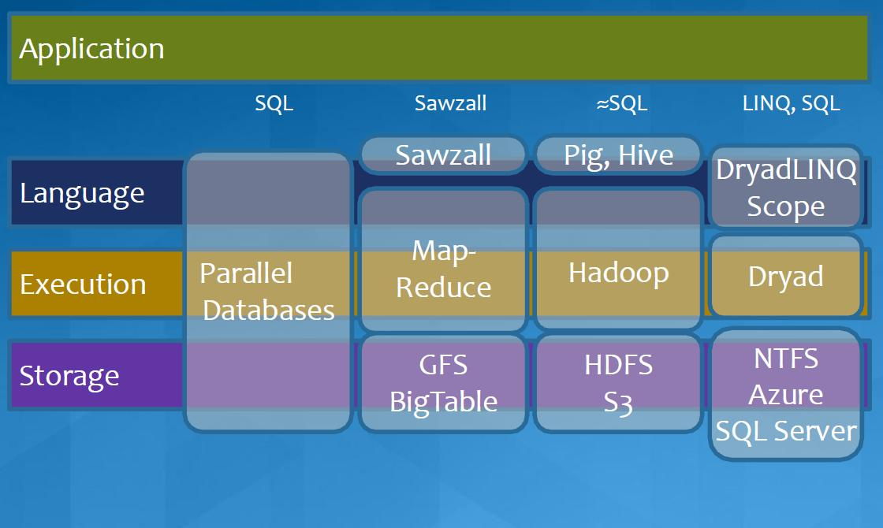
MapReduce in Heterogeneous Environment
MICROSOFT

Slide 9
Iterative MapReduce Frameworks
Twister^{[1]}
  Map->Reduce->Combine->Broadcast
  Long running map tasks (data in memory)
  Centralized driver based, statically scheduled.
Daytona^{[3]}
  Iterative MapReduce on Azure using cloud services
  Architecture similar to Twister
Haloop^{[4]}
  On disk caching, Map/reduce input caching, reduce output caching
  Spark^{[5]}
  Iterative Mapreduce Using Resilient Distributed Dataset to ensure the fault tolerance
Notes:
iMapReduce, Twister -> single wave..
Iterative MapReduce: Haloop, Twister @IU, Spark
Map-Reduce-Merge: enable processing heterogeneous data sets
MapReduce online: online aggregation, and continuous queries

Slide 10
Others
Mate-EC2^{[6]}
  Local reduction object
Network Levitated Merge^{[7]}
  RDMA/infiniband based shuffle & merge
Asynchronous Algorithms in MapReduce^{[8]}
  Local & global reduce
MapReduce online^{[9]}
  online aggregation, and continuous queries
  Push data from Map to Reduce
Orchestra^{[10]}
  Data transfer improvements for MR
iMapReduce^{[11]}
  Async iterations, One to one map & reduce mapping, automatically joins loop-variant and invariant data
CloudMapReduce^{[12]} & Google AppEngine MapReduce^{[13]}
  MapReduce frameworks utilizing cloud infrastructure services
Notes:
Orchestra : Broadcast and shuffle improvements…

Slide 11
Twister4Azure
Azure Cloud Services
Highly-available and scalable
Decentralized
Avoids Single Point of Failure
Utilize eventually-consistent , high-latency cloud services effectively
Minimal maintenance and management overhead
Dynamically scale up/down
Global queue based dynamic scheduling
MapReduce
Iterative MapReduce for Azure
Fault tolerance
Notes:
We built MRR4Azure decentralized MapReduce framework for Azure cloud utilizing the highly-available and scalable, Azure infrastructure services as the building blocks.
MRRoles4Azure hides the complexity of cloud services from the users and
is designed to co-exist with the eventual consistent nature of cloud services.
The decentralized architecture avoid the single point of failure and bottleneck, while global queue based dynamic scheduling achieves better load balancing.
We selected Azure platform, as at that time there weren’t any distributed data processing frameworks available for Azure. We performed the first public release of MRRoles4Azure in the 4th quarter of 2010 as the first pure MapReduce framework for Azure.

Slide 12
Applications of Twister4Azure
Implemented
  Multi Dimensional Scaling
  KMeans Clustering
  PageRank
  SmithWatermann-GOTOH sequence alignment
  WordCount
  Cap3 sequence assembly
  Blast sequence search
  GTM & MDS interpolation
Under Development
  Latent Dirichlet Allocation
  Descendent Query

Slide 13
Twister4Azure – Iterative MapReduce
Extends MapReduce programming model
Decentralized iterative MR architecture for clouds
  Utilize highly available and scalable Cloud services
Multi-level data caching
  Cache aware hybrid scheduling
Multiple MR applications per job
Collective communication primitives
  Outperforms Hadoop in local cluster by 2 to 4 times
Sustain features
  dynamic scheduling, load balancing, fault tolerance, monitoring, local testing/debugging
http://salsahpc.indiana.edu/twister4azure/
Notes:
Collective communications increasing the performance and giving users more easy options to perform their computations.

Slide 14
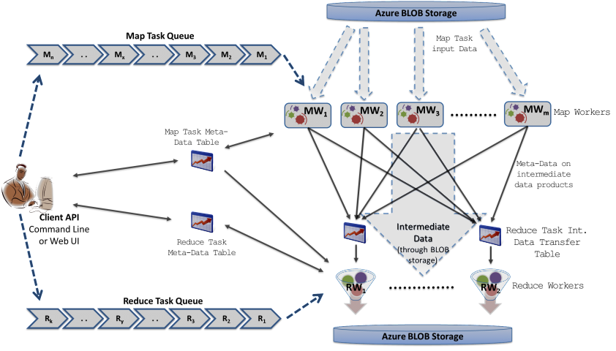
Twister4Azure Architecture
Azure Queues for scheduling, Tables to store meta-data and monitoring data, Blobs for input/output/intermediate data storage.
Notes:
Ability to dynamically scale up/down
Easy testing and deployment
Combiner step
Web based monitoring console

Slide 15
Data Intensive Iterative Applications
Compute
Communication
Reduce/ barrier
Smaller Loop-Variant Data
Broadcast
New Iteration
Larger Loop-Invariant Data
Growing class of applications
  Clustering, data mining, machine learning & dimension reduction applications
  Driven by data deluge & emerging computation fields
Notes:
Most of these applications consists of iterative computation and communication steps where single iterations can easily be specified as MapReduce computations.
Large input data sizes which are loop-invariant and can be reused across iterations.
Loop-variant results.. Orders of magnitude smaller…
While these can be performed using traditional MapReduce frameworks, Traditional is not efficient for these types of computations. MR leaves lot of room for improvements in terms of iterative applications.

Slide 16

Iterative MapReduce for Azure Cloud
http://salsahpc.indiana.edu/twister4azure
Extensions to support broadcast data
Hybrid intermediate data transfer
Merge step
Cache-aware Hybrid Task Scheduling
Collective Communication Primitives
Multi-level caching of static data
Portable Parallel Programming on Cloud and HPC: Scientific Applications of Twister4Azure, Thilina Gunarathne, BingJing Zang, Tak-Lon Wu and Judy Qiu, (UCC 2011) , Melbourne, Australia.

Slide 17

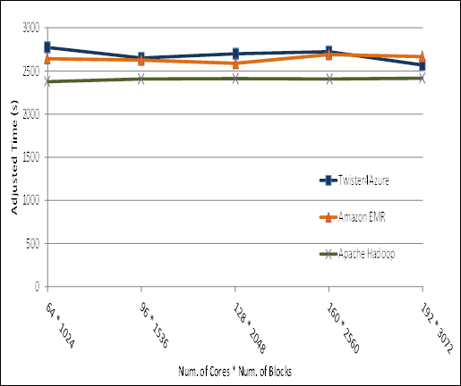
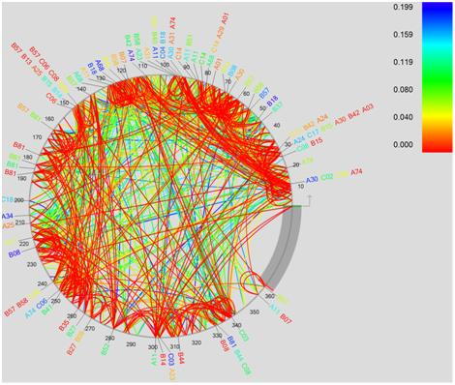
Performance of Pleasingly Parallel Applications on Azure
BLAST Sequence Search
Smith Watermann
Sequence Alignment
Cap3 Sequence Assembly
MapReduce in the Clouds for Science, Thilina Gunarathne, et al. CloudCom 2010, Indianapolis, IN.

Slide 18





Performance – Kmeans Clustering
Overhead between iterations
First iteration performs the initial data fetch
Task Execution Time Histogram
Number of Executing Map Task Histogram
Scales better than Hadoop on bare metal
Strong Scaling with 128M Data Points
Weak Scaling
Performance with/without
data caching
Speedup gained using data cache
Scaling speedup
Increasing number of iterations

Slide 19
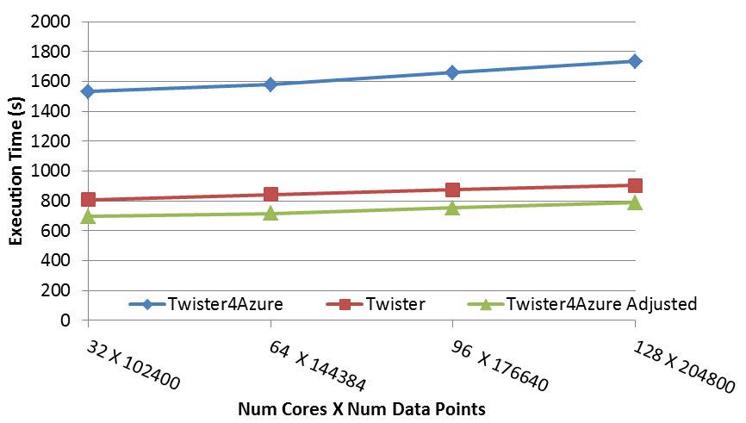
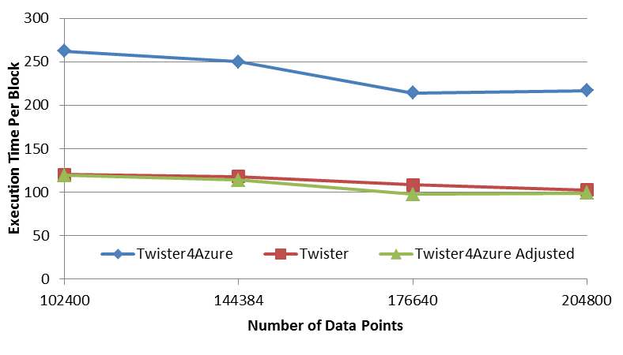
Performance – Multi Dimensional Scaling
BC: Calculate BX
X: Calculate invV (BX)
Calculate Stress
Map
Reduce
Merge
Map
Reduce
Merge
Map
Reduce
Merge
New Iteration
Performance adjusted for sequential performance difference
Weak Scaling
Data Size Scaling
Scalable Parallel Scientific Computing Using Twister4Azure. Thilina Gunarathne, BingJing Zang, Tak-Lon Wu and Judy Qiu. Submitted to Journal of Future Generation Computer Systems. (Invited as one of the best 6 papers of UCC 2011)

Slide 20
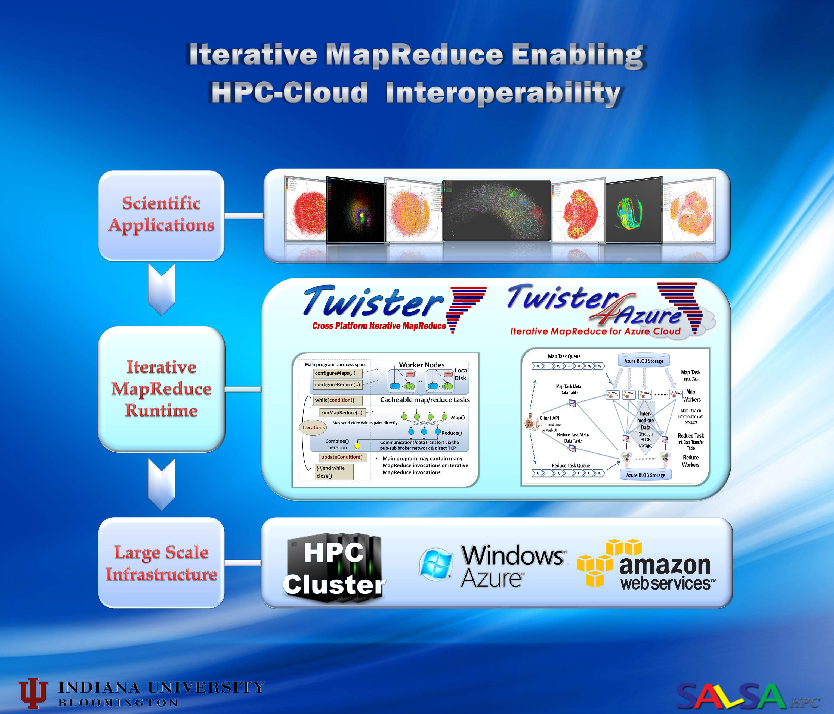

Slide 21
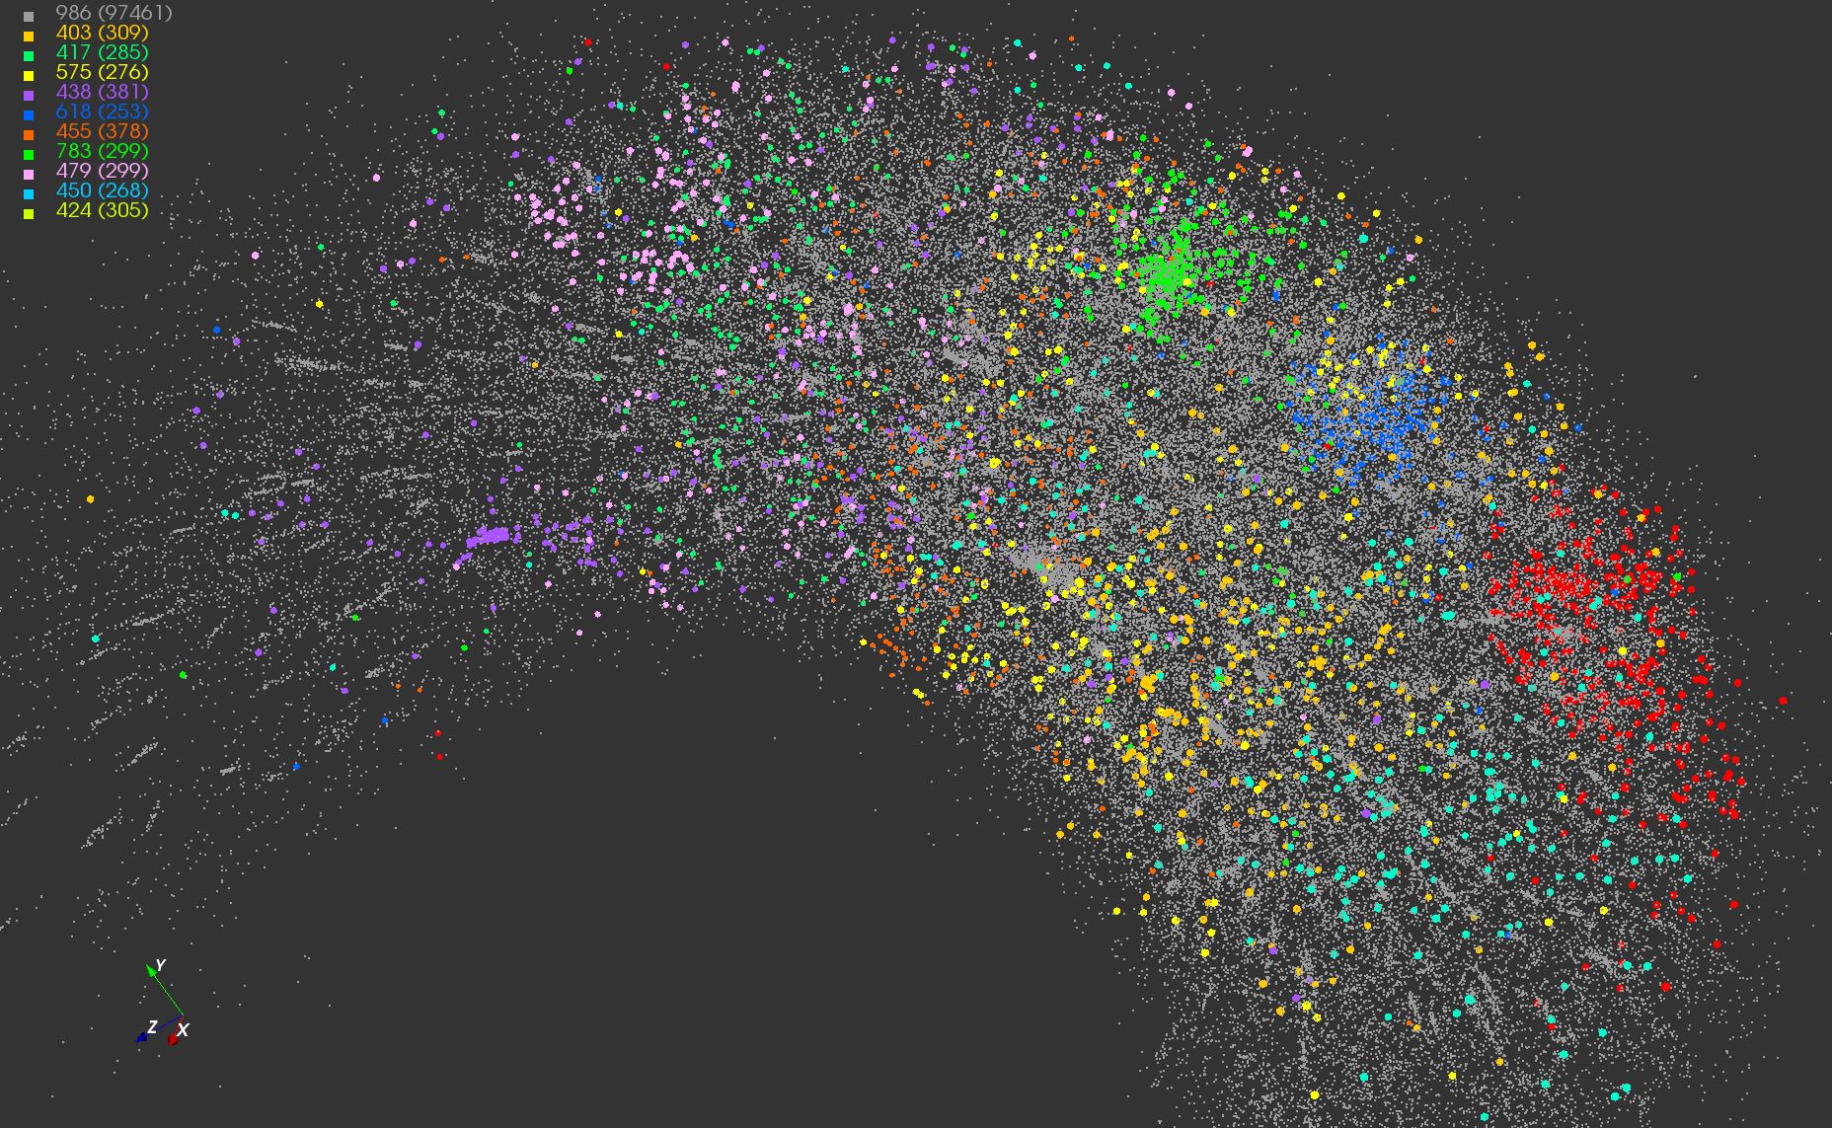
Twister-MDS Output
MDS projection of 100,000 protein sequences showing a few experimentally
identified clusters in preliminary work with Seattle Children’s Research Institute

Slide 22
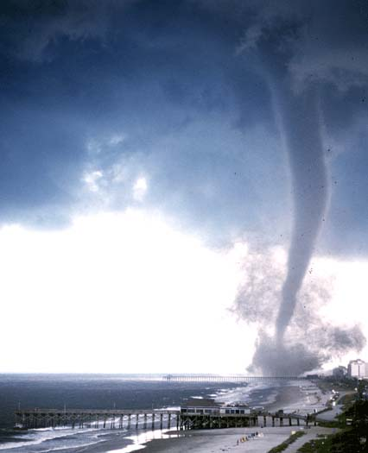

Twister v0.9
  New Infrastructure for Iterative MapReduce Programming
  Configuration Program to setup Twister environment automatically on a cluster
  Full mesh network of brokers for facilitating communication
  New messaging interface for reducing the message serialization overhead
  Memory Cache to share data between tasks and jobs

Slide 23
Twister4Azure Communications
Broadcast
Broadcasting
  Data could be large
  Chain & MST
Map Collectives
  Local merge
Reduce Collectives
  Collect but no merge
Combine
  Direct download or Gather
Map Tasks
Map Tasks
Map Tasks
Map Collective
Map Collective
Map Collective
Reduce Tasks
Reduce Tasks
Reduce Tasks
Reduce Collective
Reduce Collective
Reduce Collective
Gather

Slide 24
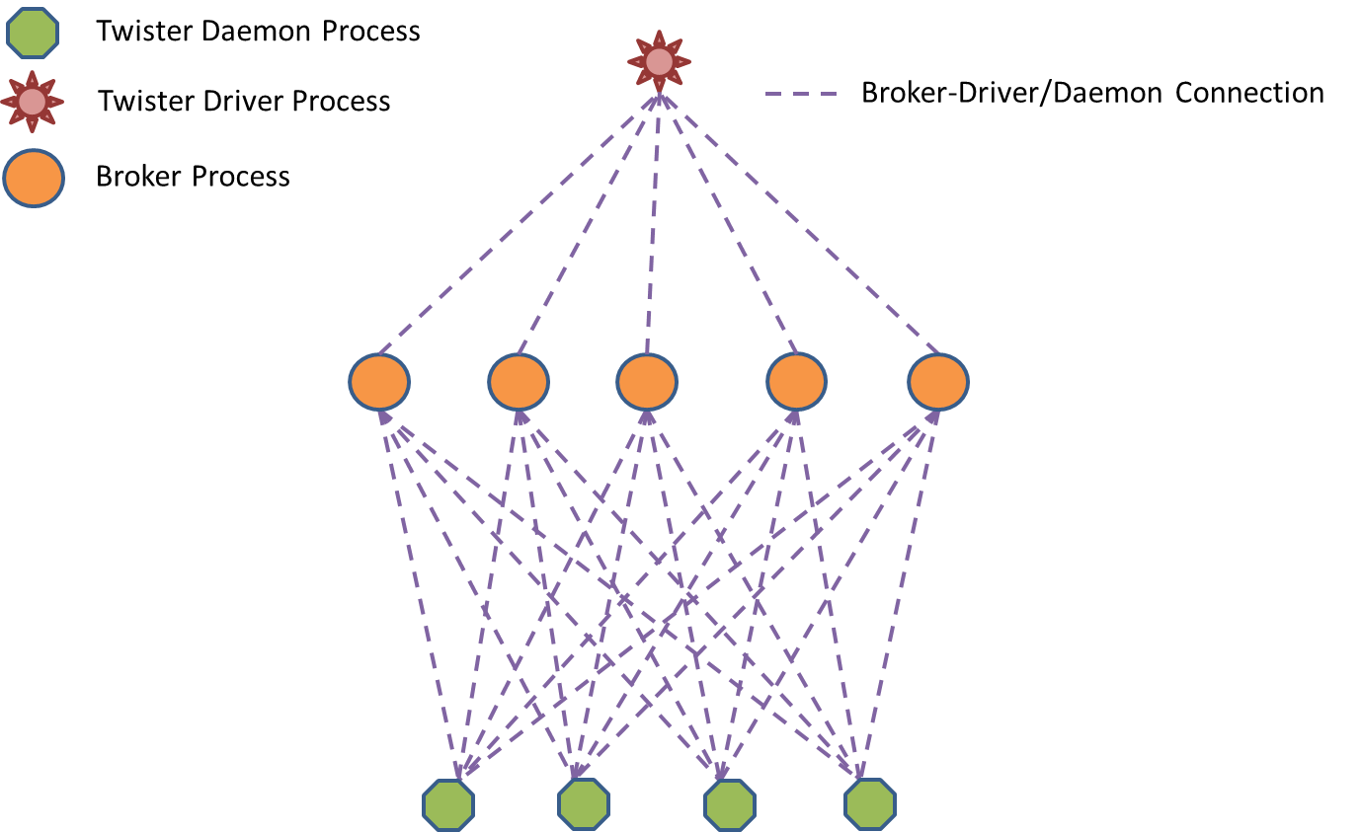
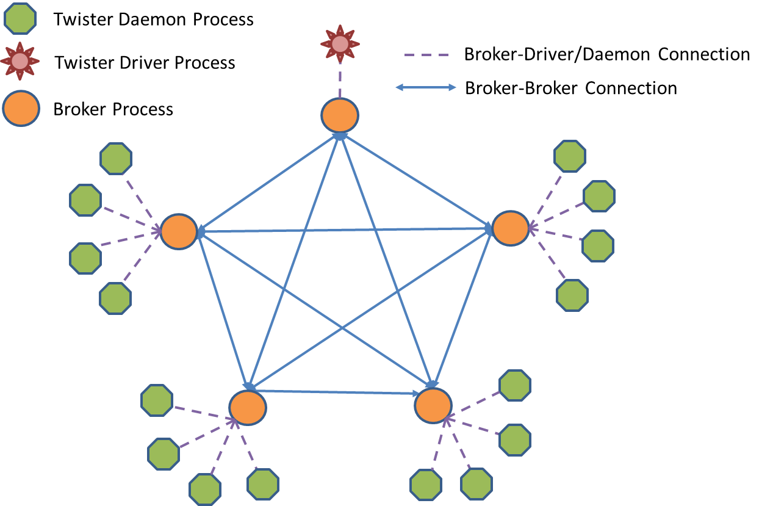
Improving Performance of Map Collectives
Full Mesh Broker Network
Scatter and Allgather

Slide 25
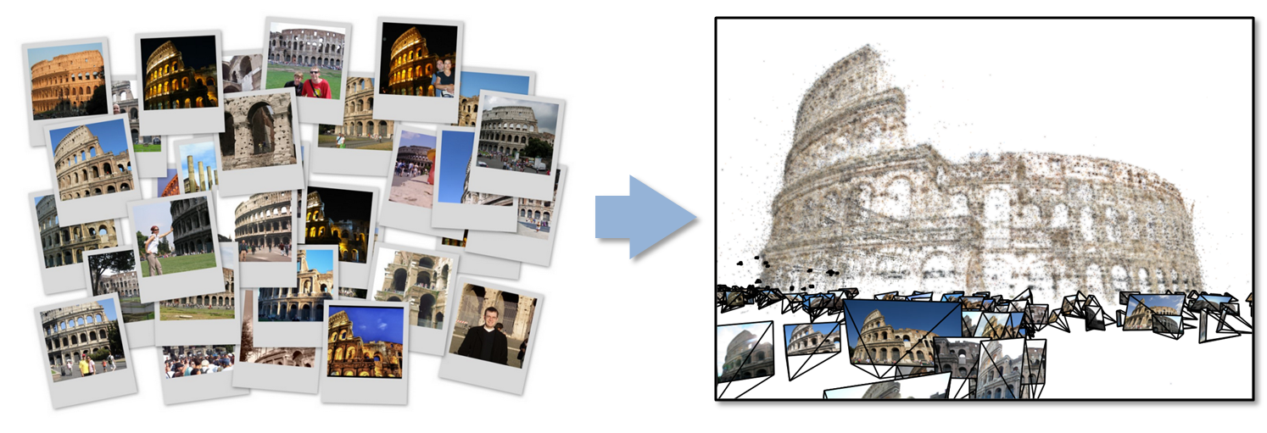
Data Intensive Kmeans Clustering
  ─ Image Classification: 1.5 TB; 1.5 TB; 500 features per image;10k clusters
  1000 Map tasks; 1GB data transfer per Map task

Slide 26
Polymorphic Scatter-Allgather in Twister

Slide 27
Twister Performance on Kmeans Clustering

Slide 28
Twister on InfiniBand
InfiniBand successes in HPC community
  More than 42% of Top500 clusters use InfiniBand
  Extremely high throughput and low latency
    Up to 40Gb/s between servers and 1μsec latency
  Reduce CPU overhead up to 90%
Cloud community can benefit from InfiniBand
  Accelerated Hadoop (sc11)
  HDFS benchmark tests
RDMA can make Twister faster
  Accelerate static data distribution
  Accelerate data shuffling between mappers and reducer
In collaboration with ORNL on a large InfiniBand cluster
Notes:
Even higher between switches

Slide 29
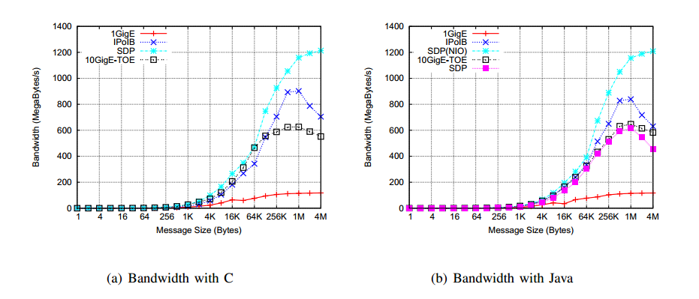
Bandwidth comparison of HDFS on various network technologies

Slide 30
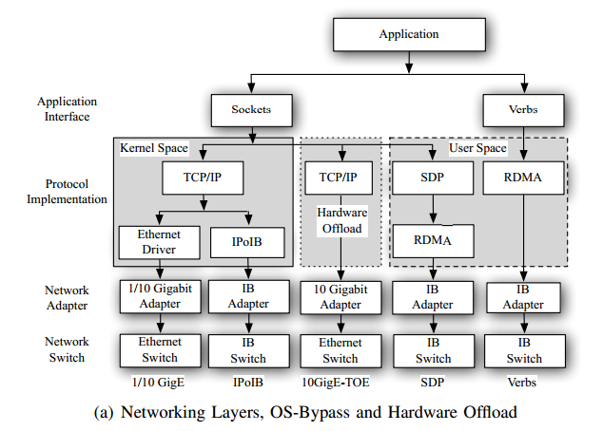
Using RDMA for Twister on InfiniBand

Slide 31
Twister Broadcast Comparison: Ethernet vs. InfiniBand

Slide 32

Building Virtual Clusters
Towards Reproducible eScience in the Cloud
Separation of concerns between two layers
Infrastructure Layer – interactions with the Cloud API
Software Layer – interactions with the running VM

Slide 33
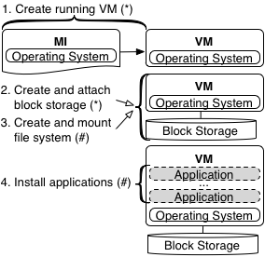
Separation Leads to Reuse
Infrastructure Layer = (*) Software Layer = (#)
By separating layers, one can reuse software layer artifacts in separate clouds

Slide 34
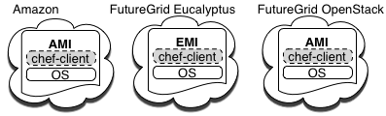

Design and Implementation
Equivalent machine images (MI) built in separate clouds
Common underpinning in separate clouds for software installations and configurations
Extend to Azure
Configuration management used for software automation

Slide 35
Cloud Image Proliferation

Slide 36
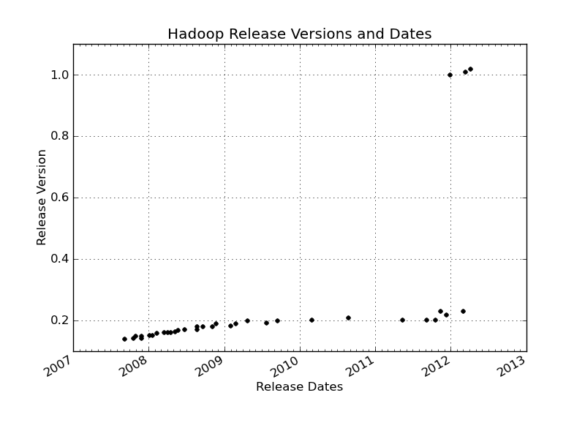
Changes of Hadoop Versions

Slide 37
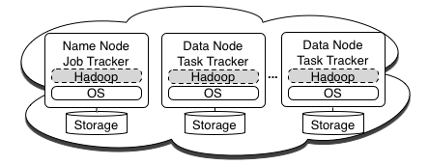
Implementation - Hadoop Cluster
Hadoop cluster commands
knife hadoop launch {name} {slave count}
knife hadoop terminate {name}

Slide 38
Running CloudBurst on Hadoop
Running CloudBurst on a 10 node Hadoop Cluster
knife hadoop launch cloudburst 9
echo ‘{"run list": "recipe[cloudburst]"}' > cloudburst.json
chef-client -j cloudburst.json
CloudBurst on a 10, 20, and 50 node Hadoop Cluster

Slide 39
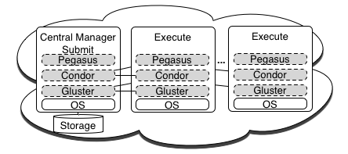
Implementation - Condor Pool
Condor Pool commands
knife cluster launch {name} {exec. host count}
knife cluster terminate {name}
knife cluster node add {name} {node count}

Slide 40
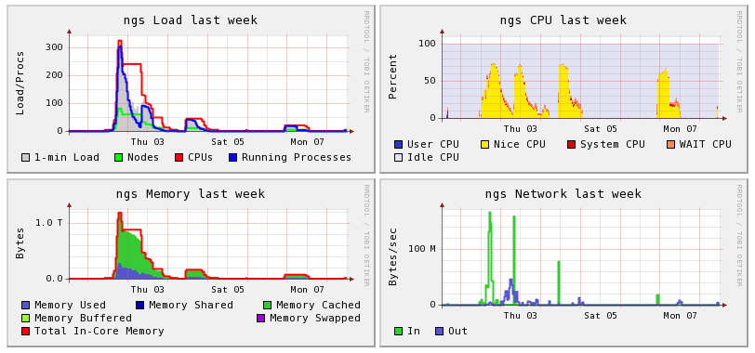
Implementation - Condor Pool
Ganglia screen shot of a Condor pool in Amazon EC2
80 node – (320 core) at this point in time

Slide 41



Ackowledgements
SALSA HPC Group
http://salsahpc.indiana.edu
School of Informatics and Computing
Indiana University

Slide 42

















Slide 43
References
M. Isard, M. Budiu, Y. Yu, A. Birrell, D. Fetterly, Dryad: Distributed data-parallel programs from sequential building blocks, in: ACM SIGOPS Operating Systems Review, ACM Press, 2007, pp. 59-72
J.Ekanayake, H.Li, B.Zhang, T.Gunarathne, S.Bae, J.Qiu, G.Fox, Twister: A Runtime for iterative MapReduce, in: Proceedings of the First International Workshop on MapReduce and its Applications of ACM HPDC 2010 conference June 20-25, 2010, ACM, Chicago, Illinois, 2010.
Daytona iterative map-reduce framework. http://research.microsoft.com/en-us/projects/daytona/.
Y. Bu, B. Howe, M. Balazinska, M.D. Ernst, HaLoop: Efficient Iterative Data Processing on Large Clusters, in: The 36th International Conference on Very Large Data Bases, VLDB Endowment, Singapore, 2010.
Matei Zaharia, Mosharaf Chowdhury, Michael J. Franklin, Scott Shenker, Ion Stoica, University of Berkeley. Spark: Cluster Computing with Working Sets. HotCloud’10 Proceedings of the 2nd USENIX conference on Hot topics in cloud computing. USENIX Association Berkeley, CA. 2010.
Yanfeng Zhang , Qinxin Gao , Lixin Gao , Cuirong Wang, iMapReduce: A Distributed Computing Framework for Iterative Computation, Proceedings of the 2011 IEEE International Symposium on Parallel and Distributed Processing Workshops and PhD Forum, p.1112-1121, May 16-20, 2011
Tekin Bicer, David Chiu, and Gagan Agrawal. 2011. MATE-EC2: a middleware for processing data with AWS. In Proceedings of the 2011 ACM international workshop on Many task computing on grids and supercomputers (MTAGS '11). ACM, New York, NY, USA, 59-68.
Yandong Wang, Xinyu Que, Weikuan Yu, Dror Goldenberg, and Dhiraj Sehgal. 2011. Hadoop acceleration through network levitated merge. In Proceedings of 2011 International Conference for High Performance Computing, Networking, Storage and Analysis (SC '11). ACM, New York, NY, USA, , Article 57 , 10 pages.
Karthik Kambatla, Naresh Rapolu, Suresh Jagannathan, and Ananth Grama. Asynchronous Algorithms in MapReduce. In IEEE International Conference on Cluster Computing (CLUSTER), 2010.
T. Condie, N. Conway, P. Alvaro, J. M. Hellerstein, K. Elmleegy, and R. Sears. Mapreduce online. In NSDI, 2010.
M. Chowdhury, M. Zaharia, J. Ma, M.I. Jordan and I. Stoica, Managing Data Transfers in Computer Clusters with Orchestra SIGCOMM 2011, August 2011
M. Zaharia, M. Chowdhury, M.J. Franklin, S. Shenker and I. Stoica. Spark: Cluster Computing with Working Sets, HotCloud 2010, June 2010.
Huan Liu and Dan Orban. Cloud MapReduce: a MapReduce Implementation on top of a Cloud Operating System. In 11th IEEE/ACM International Symposium on Cluster, Cloud and Grid Computing, pages 464–474, 2011
AppEngine MapReduce, July 25th 2011; http://code.google.com/p/appengine-mapreduce.
J. Dean, S. Ghemawat, MapReduce: simplified data processing on large clusters, Commun. ACM, 51 (2008) 107-113.

