Slide 1
Iterative MapReduce and
High Performance Datamining
May 8 2013
Seminar
Forschungszentrum Juelich GmbH
Geoffrey Fox
gcf@indiana.edu
http://www.infomall.org http://www.futuregrid.org
School of Informatics and Computing
Digital Science Center
Indiana University Bloomington

Slide 2
Abstract
I discuss the programming model appropriate for data analytics on both cloud and HPC environments.
I describe Iterative MapReduce as an approach that interpolates between MPI and classic MapReduce.
I note that the increasing volume of data demands the development of data analysis libraries that have robustness and high performance.
I illustrate this with clustering and information visualization (Multi-Dimensional Scaling).
I mention FutureGrid and a software defined Computing Testbed as a Service

Slide 3
Issues of Importance
Computing Model: Industry adopted clouds which are attractive for data analytics
Research Model: 4th Paradigm; From Theory to Data driven science?
Confusion in a new-old field: lack of consensus academically in several aspects of data intensive computing from storage to algorithms, to processing and education
Progress in Data Intensive Programming Models
Progress in Academic (open source) clouds
FutureGrid supports Experimentation
Progress in scalable robust Algorithms: new data need better algorithms?
(Economic Imperative: There are a lot of data and a lot of jobs)
(Progress in Data Science Education: opportunities at universities)

Slide 4
Big Data Ecosystem in One Sentence
Use Clouds (and HPC) running Data Analytics processing Big Data to solve problems in X-Informatics ( or e-X)
X = Astronomy, Biology, Biomedicine, Business, Chemistry, Crisis, Energy, Environment, Finance, Health, Intelligence, Lifestyle, Marketing, Medicine, Pathology, Policy, Radar, Security, Sensor, Social, Sustainability, Wealth and Wellness with more fields (physics) defined implicitly
Spans Industry and Science (research)
Education: Data Science see recent New York Times articles
http://datascience101.wordpress.com/2013/04/13/new-york-times-data-science-articles/

Slide 5
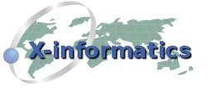

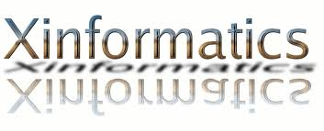

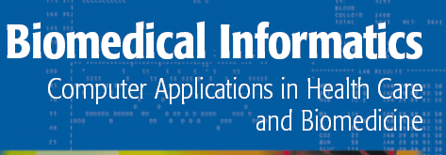


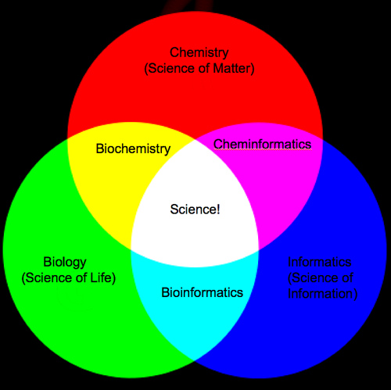

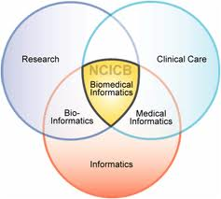
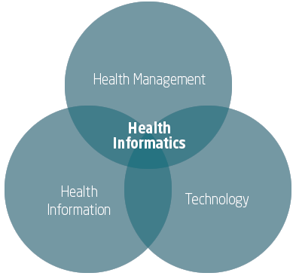
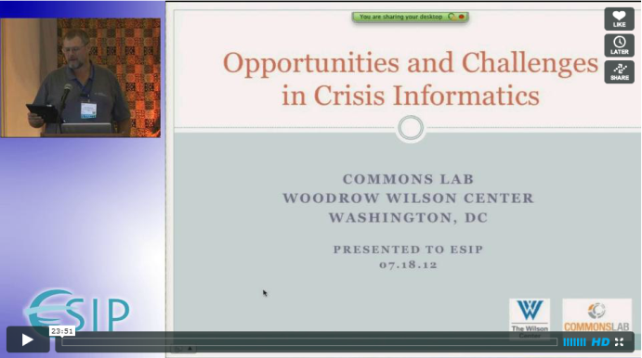

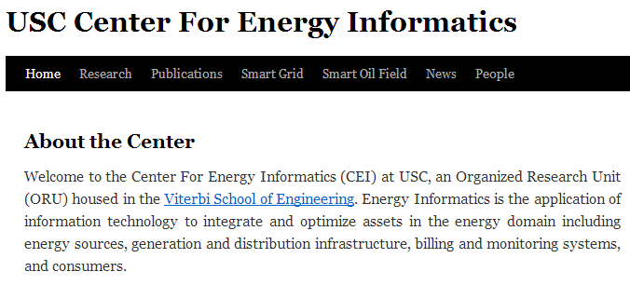
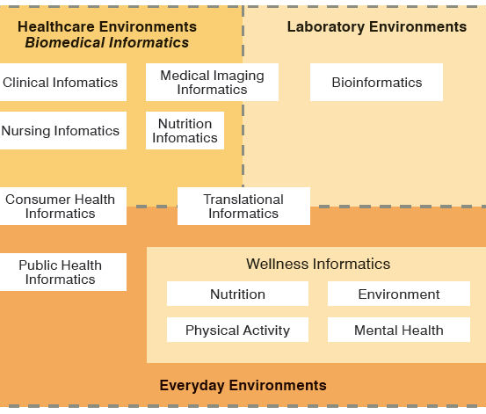
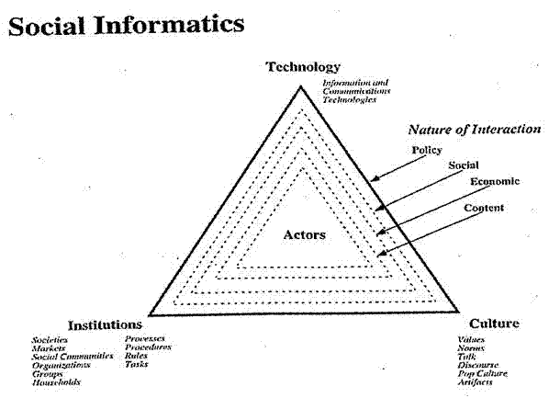
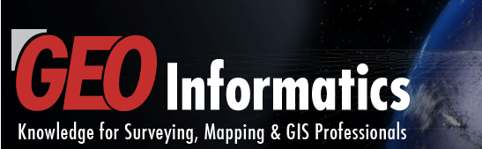
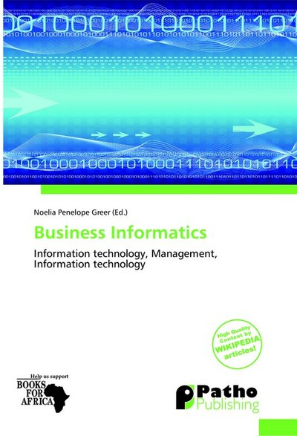
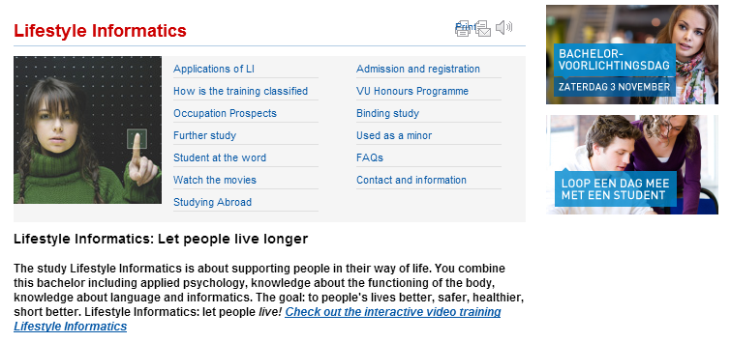
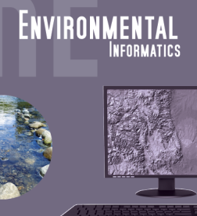

Social Informatics

Slide 6
Computing Model
Industry adopted clouds which are attractive for data analytics

Slide 7
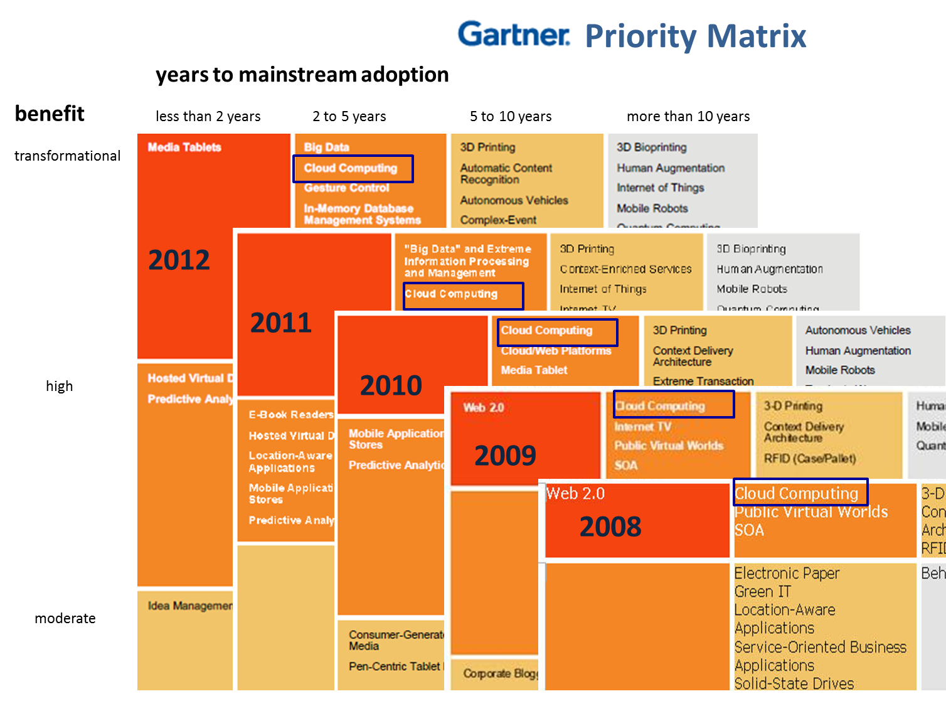
5 years Cloud Computing
2 years Big Data Transformational

Slide 8
Amazon making money
It took Amazon Web Services (AWS) eight years to hit $650 million in revenue, according to Citigroup in 2010.
Just three years later, Macquarie Capital analyst Ben Schachter estimates that AWS will top $3.8 billion in 2013 revenue, up from $2.1 billion in 2012 (estimated), valuing the AWS business at $19 billion.

Slide 9
Research Model
4th Paradigm; From Theory to Data driven science?

Slide 10
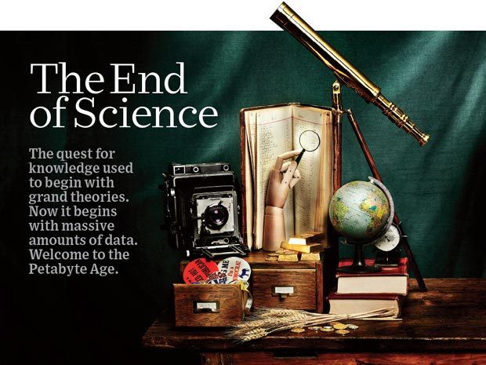
http://www.wired.com/wired/issue/16-07 September 2008

Slide 11
The 4 paradigms of Scientific Research
Theory
Experiment or Observation
  E.g. Newton observed apples falling to design his theory of mechanics
Simulation of theory or model
Data-driven (Big Data) or The Fourth Paradigm: Data-Intensive Scientific Discovery (aka Data Science)
  http://research.microsoft.com/en-us/collaboration/fourthparadigm/ A free book
  More data; less models

Slide 12

More data usually beats better algorithms
Here's how the competition works. Netflix has provided a large data set that tells you how nearly half a million people have rated about 18,000 movies. Based on these ratings, you are asked to predict the ratings of these users for movies in the set that they have not rated. The first team to beat the accuracy of Netflix's proprietary algorithm by a certain margin wins a prize of $1 million!
Different student teams in my class adopted different approaches to the problem, using both published algorithms and novel ideas. Of these, the results from two of the teams illustrate a broader point. Team A came up with a very sophisticated algorithm using the Netflix data. Team B used a very simple algorithm, but they added in additional data beyond the Netflix set: information about movie genres from the Internet Movie Database(IMDB). Guess which team did better?
Anand Rajaraman is Senior Vice President at Walmart Global eCommerce, where he heads up the newly created @WalmartLabs,
http://anand.typepad.com/datawocky/2008/03/more-data-usual.html
20120117berkeley1.pdf Jeff Hammerbacher

Slide 13
Confusion in the new-old data field
lack of consensus academically in several aspects from storage to algorithms, to processing and education

Slide 14
Data Communities Confused I?
Industry seems to know what it is doing although it’s secretive – Amazon’s last paper on their recommender system was 2003
  Industry runs the largest data analytics on clouds
  But industry algorithms are rather different from science
Academia confused on repository model: traditionally one stores data but one needs to support “running Data Analytics” and one is taught to bring computing to data as in Google/Hadoop file system
  Either store data in compute cloud OR enable high performance networking between distributed data repositories and “analytics engines”
Academia confused on data storage model: Files (traditional) v. Database (old industry) v. NOSQL (new cloud industry)
  Hbase MongoDB Riak Cassandra are typical NOSQL systems
Academia confused on curation of data: University Libraries, Projects, National repositories, Amazon/Google?

Slide 15
Data Communities Confused II?
Academia agrees on principles of Simulation Exascale Architecture: HPC Cluster with accelerator plus parallel wide area file system
  Industry doesn’t make extensive use of high end simulation
Academia confused on architecture for data analysis: Grid (as in LHC), Public Cloud, Private Cloud, re-use simulation architecture with database, object store, parallel file system, HDFS style data
Academia has not agreed on Programming/Execution model: “Data Grid Software”, MPI, MapReduce ..
Academia has not agreed on need for new algorithms: Use natural extension of old algorithms, R or Matlab. Simulation successes built on great algorithm libraries;
Academia has not agreed on what algorithms are important?
Academia could attract more students: with data-oriented curricula that prepare for industry or research careers

Slide 16
Clouds in Research

Slide 17
2 Aspects of Cloud Computing:
Infrastructure and Runtimes
Cloud infrastructure: outsourcing of servers, computing, data, file space, utility computing, etc..
Cloud runtimes or Platform: tools to do data-parallel (and other) computations. Valid on Clouds and traditional clusters
  Apache Hadoop, Google MapReduce, Microsoft Dryad, Bigtable, Chubby and others
  MapReduce designed for information retrieval but is excellent for a wide range of science data analysis applications
  Can also do much traditional parallel computing for data-mining if extended to support iterative operations
  Data Parallel File system as in HDFS and Bigtable

Slide 18
Clouds have highlighted SaaS PaaS IaaS
But equally valid for classic clusters
Software
(Application
Or Usage) SaaS
Education
Applications
CS Research Use e.g. test new compiler or storage model
Software Services are building blocks of applications
The middleware or computing environment including HPC, Grids …
Nimbus, Eucalyptus, OpenStack, OpenNebula
CloudStack plus Bare-metal
OpenFlow – likely to grow in importance
Cloud e.g. MapReduce
HPC e.g. PETSc, SAGA
Computer Science e.g. Compiler tools, Sensor nets, Monitors
Platform
PaaS
Infra
structure
IaaS
Software Defined Computing (virtual Clusters)
Hypervisor, Bare Metal
Operating System
Network
NaaS
Software Defined Networks
OpenFlow GENI

Slide 19
Science Computing Environments
Large Scale Supercomputers – Multicore nodes linked by high performance low latency network
  Increasingly with GPU enhancement
  Suitable for highly parallel simulations
High Throughput Systems such as European Grid Initiative EGI or Open Science Grid OSG typically aimed at pleasingly parallel jobs
  Can use “cycle stealing”
  Classic example is LHC data analysis
Grids federate resources as in EGI/OSG or enable convenient access to multiple backend systems including supercomputers
Use Services (SaaS)
  Portals make access convenient and
  Workflow integrates multiple processes into a single job

Slide 20
Clouds HPC and Grids
Synchronization/communication Performance
Grids > Clouds > Classic HPC Systems
Clouds naturally execute effectively Grid workloads but are less clear for closely coupled HPC applications
Classic HPC machines as MPI engines offer highest possible performance on closely coupled problems
The 4 forms of MapReduce/MPI
  Map Only – pleasingly parallel
  Classic MapReduce as in Hadoop; single Map followed by reduction with fault tolerant use of disk
  Iterative MapReduce use for data mining such as Expectation Maximization in clustering etc.; Cache data in memory between iterations and support the large collective communication (Reduce, Scatter, Gather, Multicast) use in data mining
  Classic MPI! Support small point to point messaging efficiently as used in partial differential equation solvers

Slide 21
Cloud Applications

Slide 22
What Applications work in Clouds
Pleasingly (moving to modestly) parallel applications of all sorts with roughly independent data or spawning independent simulations
  Long tail of science and integration of distributed sensors
Commercial and Science Data analytics that can use MapReduce (some of such apps) or its iterative variants (most other data analytics apps)
Which science applications are using clouds?
  Venus-C (Azure in Europe): 27 applications not using Scheduler, Workflow or MapReduce (except roll your own)
  50% of applications on FutureGrid are from Life Science
  Locally Lilly corporation is commercial cloud user (for drug discovery) but not IU Biology
But overall very little science use of clouds

Slide 23
Parallelism over Users and Usages
“Long tail of science” can be an important usage mode of clouds.
In some areas like particle physics and astronomy, i.e. “big science”, there are just a few major instruments generating now petascale data driving discovery in a coordinated fashion.
In other areas such as genomics and environmental science, there are many “individual” researchers with distributed collection and analysis of data whose total data and processing needs can match the size of big science.
Clouds can provide scaling convenient resources for this important aspect of science.
Can be map only use of MapReduce if different usages naturally linked e.g. exploring docking of multiple chemicals or alignment of multiple DNA sequences
  Collecting together or summarizing multiple “maps” is a simple Reduction

Slide 24
Internet of Things and the Cloud
It is projected that there will be 24 billion devices on the Internet by 2020. Most will be small sensors that send streams of information into the cloud where it will be processed and integrated with other streams and turned into knowledge that will help our lives in a multitude of small and big ways.
The cloud will become increasing important as a controller of and resource provider for the Internet of Things.
As well as today’s use for smart phone and gaming console support, “Intelligent River” “smart homes and grid” and “ubiquitous cities” build on this vision and we could expect a growth in cloud supported/controlled robotics.
Some of these “things” will be supporting science
Natural parallelism over “things”
“Things” are distributed and so form a Grid

Slide 25
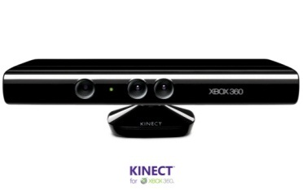








Sensors (Things) as a Service
Output Sensor
Sensors as a Service
Sensor Processing as a Service (could use
MapReduce)
A larger sensor ………
https://sites.google.com/site/opensourceiotcloud/ Open Source Sensor (IoT) Cloud

Slide 26
4 Forms of MapReduce
(a) Map Only
(b) Classic MapReduce
(c) Iterative MapReduce
(d) Loosely Synchronous
Input
Input
Iterations
Input
map
map
map
P_{ij}
reduce
reduce
Output
BLAST Analysis
Parametric sweep
Pleasingly Parallel
High Energy Physics (HEP) Histograms
Distributed search
Expectation maximization Clustering e.g. Kmeans
Linear Algebra, Page Rank
Classic MPI
PDE Solvers and particle dynamics
Domain of MapReduce and Iterative Extensions
Science Clouds
MPI
Exascale
MPI is Map followed by Point to Point Communication – as in style d)

Slide 27
Classic Parallel Computing
HPC: Typically SPMD (Single Program Multiple Data) “maps” typically processing particles or mesh points interspersed with multitude of low latency messages supported by specialized networks such as Infiniband and technologies like MPI
  Often run large capability jobs with 100K (going to 1.5M) cores on same job
  National DoE/NSF/NASA facilities run 100% utilization
  Fault fragile and cannot tolerate “outlier maps” taking longer than others
Clouds: MapReduce has asynchronous maps typically processing data points with results saved to disk. Final reduce phase integrates results from different maps
  Fault tolerant and does not require map synchronization
  Map only useful special case
HPC + Clouds: Iterative MapReduce caches results between “MapReduce” steps and supports SPMD parallel computing with large messages as seen in parallel kernels (linear algebra) in clustering and other data mining

Slide 28
Data Intensive Applications
Applications tend to be new and so can consider emerging technologies such as clouds
Do not have lots of small messages but rather large reduction (aka Collective) operations
  New optimizations e.g. for huge messages
EM (expectation maximization) tends to be good for clouds and Iterative MapReduce
  Quite complicated computations (so compute largish compared to communicate)
  Communication is Reduction operations (global sums or linear algebra in our case)
We looked at Clustering and Multidimensional Scaling using deterministic annealing which are both EM
  See also Latent Dirichlet Allocation and related Information Retrieval algorithms with similar EM structure

Slide 29
Data Intensive Programming Models

Slide 30
Map Collective Model (Judy Qiu)
Combine MPI and MapReduce ideas
Implement collectives optimally on Infiniband, Azure, Amazon ……
Iterate
Input
map
Initial Collective Step
Generalized Reduce
Final Collective Step

Slide 31
Twister for Data Intensive
Iterative Applications
Generalize to arbitrary Collective
Broadcast
Compute
Communication
Reduce/ barrier
New Iteration
Smaller Loop-Variant Data
Larger Loop-Invariant Data
(Iterative) MapReduce structure with Map-Collective is framework
Twister runs on Linux or Azure
Twister4Azure is built on top of Azure tables, queues, storage
Qiu, Gunarathne
Notes:
Most of these applications consists of iterative computation and communication steps where single iterations can easily be specified as MapReduce computations.
Large input data sizes which are loop-invariant and can be reused across iterations.
Loop-variant results.. Orders of magnitude smaller…
While these can be performed using traditional MapReduce frameworks, Traditional is not efficient for these types of computations. MR leaves lot of room for improvements in terms of iterative applications.

Slide 32
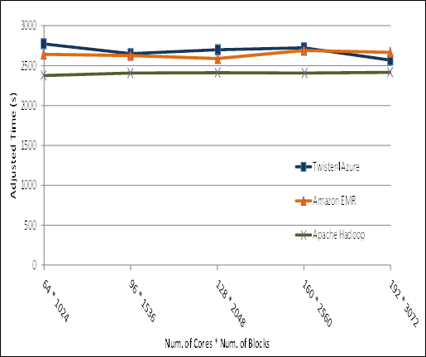

Pleasingly Parallel
Performance Comparisons
Smith Waterman
Sequence Alignment
BLAST Sequence Search
Cap3 Sequence Assembly

Slide 33
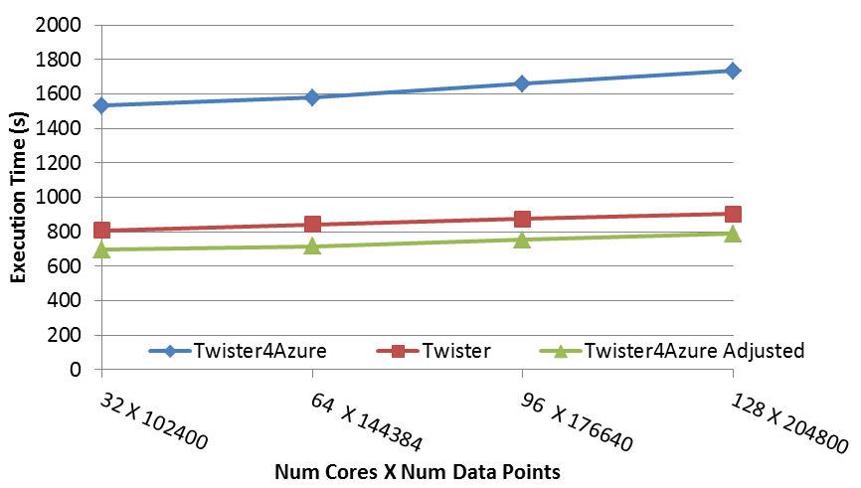
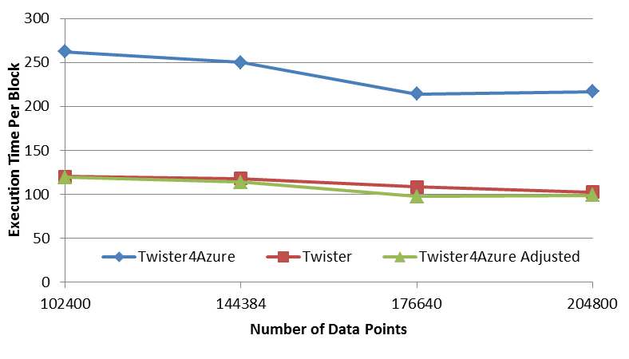
Multi Dimensional Scaling
BC: Calculate BX
X: Calculate invV (BX)
Calculate Stress
Map
Reduce
Merge
Map
Reduce
Merge
Map
Reduce
Merge
New Iteration
Performance adjusted for sequential performance difference
Weak Scaling
Data Size Scaling
Scalable Parallel Scientific Computing Using Twister4Azure. Thilina Gunarathne, BingJing Zang, Tak-Lon Wu and Judy Qiu. Submitted to Journal of Future Generation Computer Systems. (Invited as one of the best 6 papers of UCC 2011)
Notes:
The Java HPC Twister experiment was performed in a dedicated large-memory cluster of Intel(R) Xeon(R) CPU E5620 (2.4GHz) x 8 cores with 192GB memory per compute node and with Gigabit Ethernet on Linux. Java HPC Twister results do not include the initial data distribution time.
Azure large instances with 4 workers per instances is used. Memory mapped based caching and AllGather primitive are used.
Left: Weak scaling where workload per core is ~constant. Ideal is a straight horizontal line. X axis is
Right: Data size scaling with 128 Azure small instances/cores, 20 iterations.
The Twister4Azure adjusted (t_{a}) depicts the performance of Twister4Azure normalized according to the sequential MDS BC calculation and Stress calculation performance ratio between the Azure(t_{sa}) and Cluster(t_{sc}) environments used for Java HPC Twister. It is calculated using t_{a} x (t_{sc}/t_{sa}). This estimation however does not account for the overheads that remain constant irrespective of the computation time. Hence Twister4Azure seems to perform better, but in reality when the task execution times become smaller, twister4Azure overheads will become relatively larger and the performance would not be as good as shown in the adjusted curve.

Slide 34
Kmeans
Hadoop adjusted for Azure: Hadoop KMeans run time adjusted for the performance difference of iDataplex vs Azure

Slide 35
Kmeans Strong Scaling
(with Hadoop Adjusted)
128 Million data points. 500 Centroids (clusters). 20 Dimensions. 10 iterations
Parallel efficiency relative to the 32 core run time.
Note Hadoop slower by factor of 2

Slide 36
Kmeans Clustering
This shows that the communication and synchronization overheads between iterations are very small (less than one second, which is the lowest measured unit for this graph).
128 Million data points(19GB), 500 centroids (78KB), 20 dimensions
10 iterations, 256 cores, 256 map tasks per iteration

Slide 37
Kmeans Clustering
128 Million data points(19GB), 500 centroids (78KB), 20 dimensions
10 iterations, 256 cores, 256 map tasks per iteration

Slide 38
FutureGrid Technology

Slide 39
FutureGrid Testbed as a Service
FutureGrid is part of XSEDE set up as a testbed with cloud focus
Operational since Summer 2010 (i.e. now in third year of use)
The FutureGrid testbed provides to its users:
  Support of Computer Science and Computational Science research
  A flexible development and testing platform for middleware and application users looking at interoperability, functionality, performance or evaluation
  FutureGrid is user-customizable, accessed interactively and supports Grid, Cloud and HPC software with and without VM’s
  A rich education and teaching platform for classes
Offers OpenStack, Eucalyptus, Nimbus, OpenNebula, HPC (MPI) on same hardware moving to software defined systems; supports both classic HPC and Cloud storage

Slide 40
4 Use Types for FutureGrid TestbedaaS
292 approved projects (1734 users) April 6 2013
  USA(79%), Puerto Rico(3%- Students in class), India, China, lots of European countries (Italy at 2% as class)
  Industry, Government, Academia
Computer science and Middleware (55.6%)
  Core CS and Cyberinfrastructure; Interoperability (3.6%) for Grids and Clouds such as Open Grid Forum OGF Standards
New Domain Science applications (20.4%)
  Life science highlighted (10.5%), Non Life Science (9.9%)
Training Education and Outreach (14.9%)
  Semester and short events; focus on outreach to HBCU
Computer Systems Evaluation (9.1%)
  XSEDE (TIS, TAS), OSG, EGI; Campuses

Slide 41
Performance of Dynamic Provisioning
4 Phases a) Design and create image (security vet) b) Store in repository as template with components c) Register Image to VM Manager (cached ahead of time) d) Instantiate (Provision) image

Slide 42
FutureGrid is an onramp to other systems
FG supports Education & Training for all systems
User can do all work on FutureGrid OR
User can download Appliances on local machines (Virtual Box) OR
User soon can use CloudMesh to jump to chosen production system
CloudMesh is similar to OpenStack Horizon, but aimed at multiple federated systems.
  Built on RAIN and tools like libcloud, boto with protocol (EC2) or programmatic API (python)
  Uses general templated image that can be retargeted
  One-click template & image install on various IaaS & bare metal including Amazon, Azure, Eucalyptus, Openstack, OpenNebula, Nimbus, HPC
  Provisions the complete system needed by user and not just a single image; copes with resource limitations and deploys full range of software
  Integrates our VM metrics package (TAS collaboration) that links to XSEDE (VM's are different from traditional Linux in metrics supported and needed)

Slide 43
Direct GPU Virtualization
Allow VMs to directly access GPU hardware
Enables CUDA and OpenCL code – no need for custom APIs
Utilizes PCI-passthrough of device to guest VM
  Hardware directed I/O virt (VT-d or IOMMU)
  Provides direct isolation and security of device from host or other VMs
  Removes much of the Host <-> VM overhead
Similar to what Amazon EC2 uses (proprietary)

Slide 44
Performance 1
Notes:
See native performance for FLOPS metrics (great!) See a 4-5% overhead and slightly higher variance with PCI-Express bus speed benchmarks. Still not bad!

Slide 45
Performance 2
Notes:
Overall FFT and all Matrix multiplication is near native. As we can see with the PCIE benchmarks, there is some added overhead there, but only a few % of native.

Slide 46
Algorithms
Scalable Robust Algorithms: new data need better algorithms?

Slide 47
Algorithms for Data Analytics
In simulation area, it is observed that equal contributions to improved performance come from increased computer power and better algorithms
http://cra.org/ccc/docs/nitrdsymposium/pdfs/keyes.pdf
In data intensive area, we haven’t seen this effect so clearly
  Information retrieval revolutionized but
  Still using Blast in Bioinformatics (although Smith Waterman etc. better)
  Still using R library which has many non optimal algorithms
  Parallelism and use of GPU’s often ignored

Slide 48
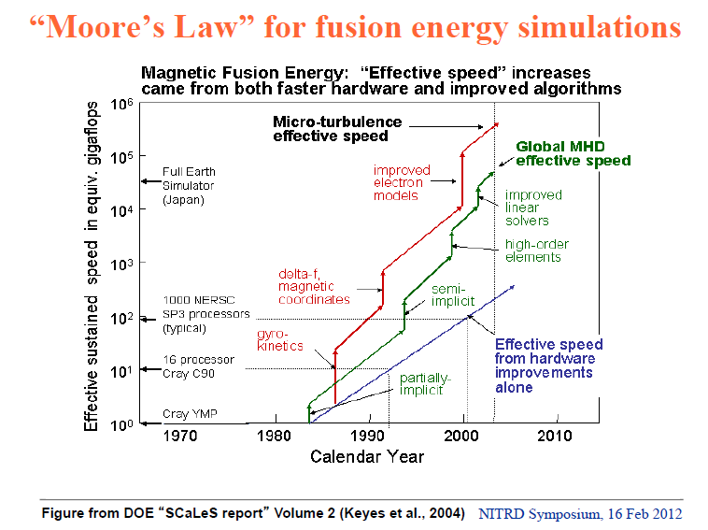

Slide 49
Data Analytics Futures?
PETSc and ScaLAPACK and similar libraries very important in supporting parallel simulations
Need equivalent Data Analytics libraries
Include datamining (Clustering, SVM, HMM, Bayesian Nets …), image processing, information retrieval including hidden factor analysis (LDA), global inference, dimension reduction
  Many libraries/toolkits (R, Matlab) and web sites (BLAST) but typically not aimed at scalable high performance algorithms
Should support clouds and HPC; MPI and MapReduce
  Iterative MapReduce an interesting runtime; Hadoop has many limitations
Need a coordinated Academic Business Government Collaboration to build robust algorithms that scale well
  Crosses Science, Business Network Science, Social Science
Propose to build community to define & implement
SPIDAL or Scalable Parallel Interoperable Data Analytics Library

Slide 50
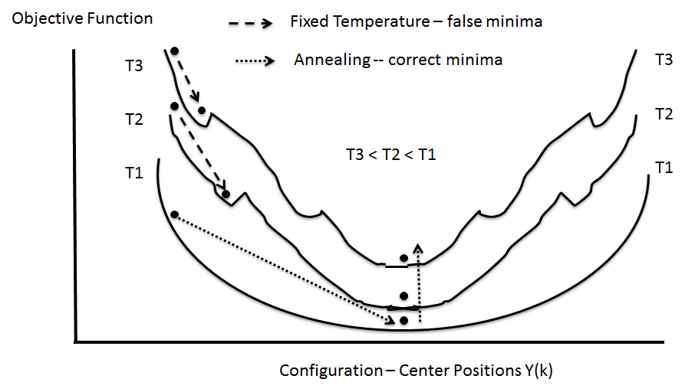
Deterministic Annealing
Deterministic Annealing works in many areas including clustering, latent factor analysis, dimension reduction for both metric and non metric spaces
  ~Always gets better answers than K-means and R?
  But can be parallelized and put on GPU

Slide 51
Remarks on Clustering and MDS
The standard data libraries (R, Matlab, Mahout) do not have best algorithms/software in either functionality or scalable parallelism
A lot of algorithms are built around “classic full matrix” kernels
Clustering, Gaussian Mixture Models, PLSI (probabilistic latent semantic indexing), LDA (Latent Dirichlet Allocation) similar
Multi-Dimensional Scaling (MDS) classic information visualization algorithm for high dimension spaces (map preserving distances)
Vector O(N) and Non Vector semimetric O(N²) space cases for N points; “all” apps are points in spaces – not all “Proper linear spaces”
Trying to release ~most powerful (in features/performance) available Clustering and MDS library although unfortunately in C#
Supported Features: Vector, Non-Vector, Deterministic annealing, Hierarchical, sharp (trimmed) or general cluster sizes, Fixed points and general weights for MDS, (generalized Elkans algorithm)

Slide 52
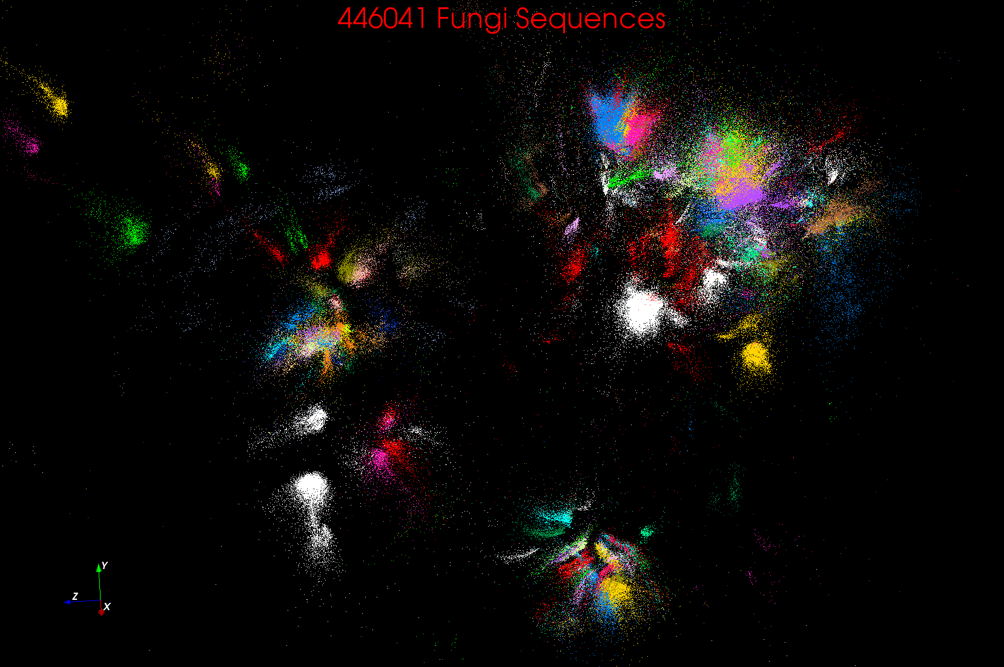
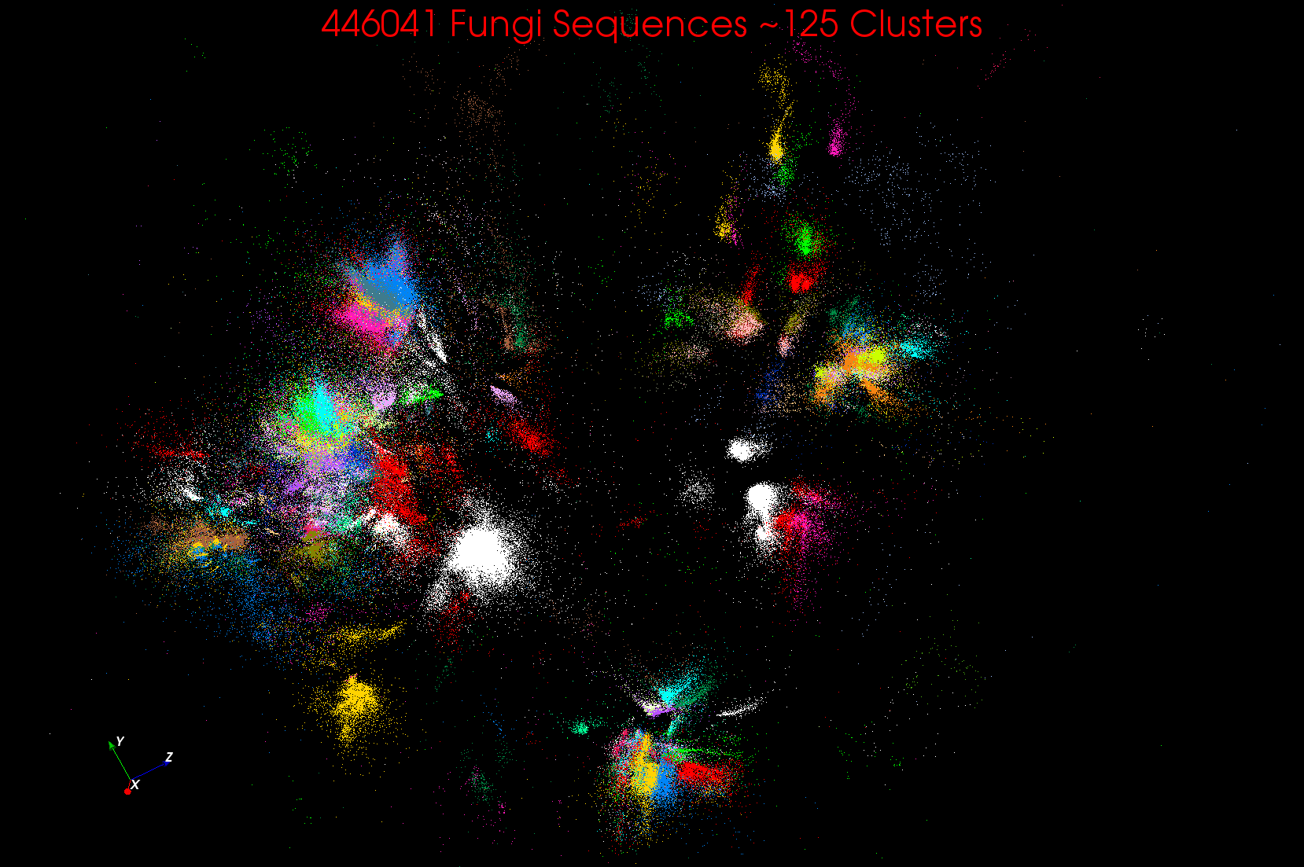
~125 Clusters from Fungi sequence set
Non metric space
Sequences Length ~500 Smith Waterman
A month on 768 cores

Slide 53
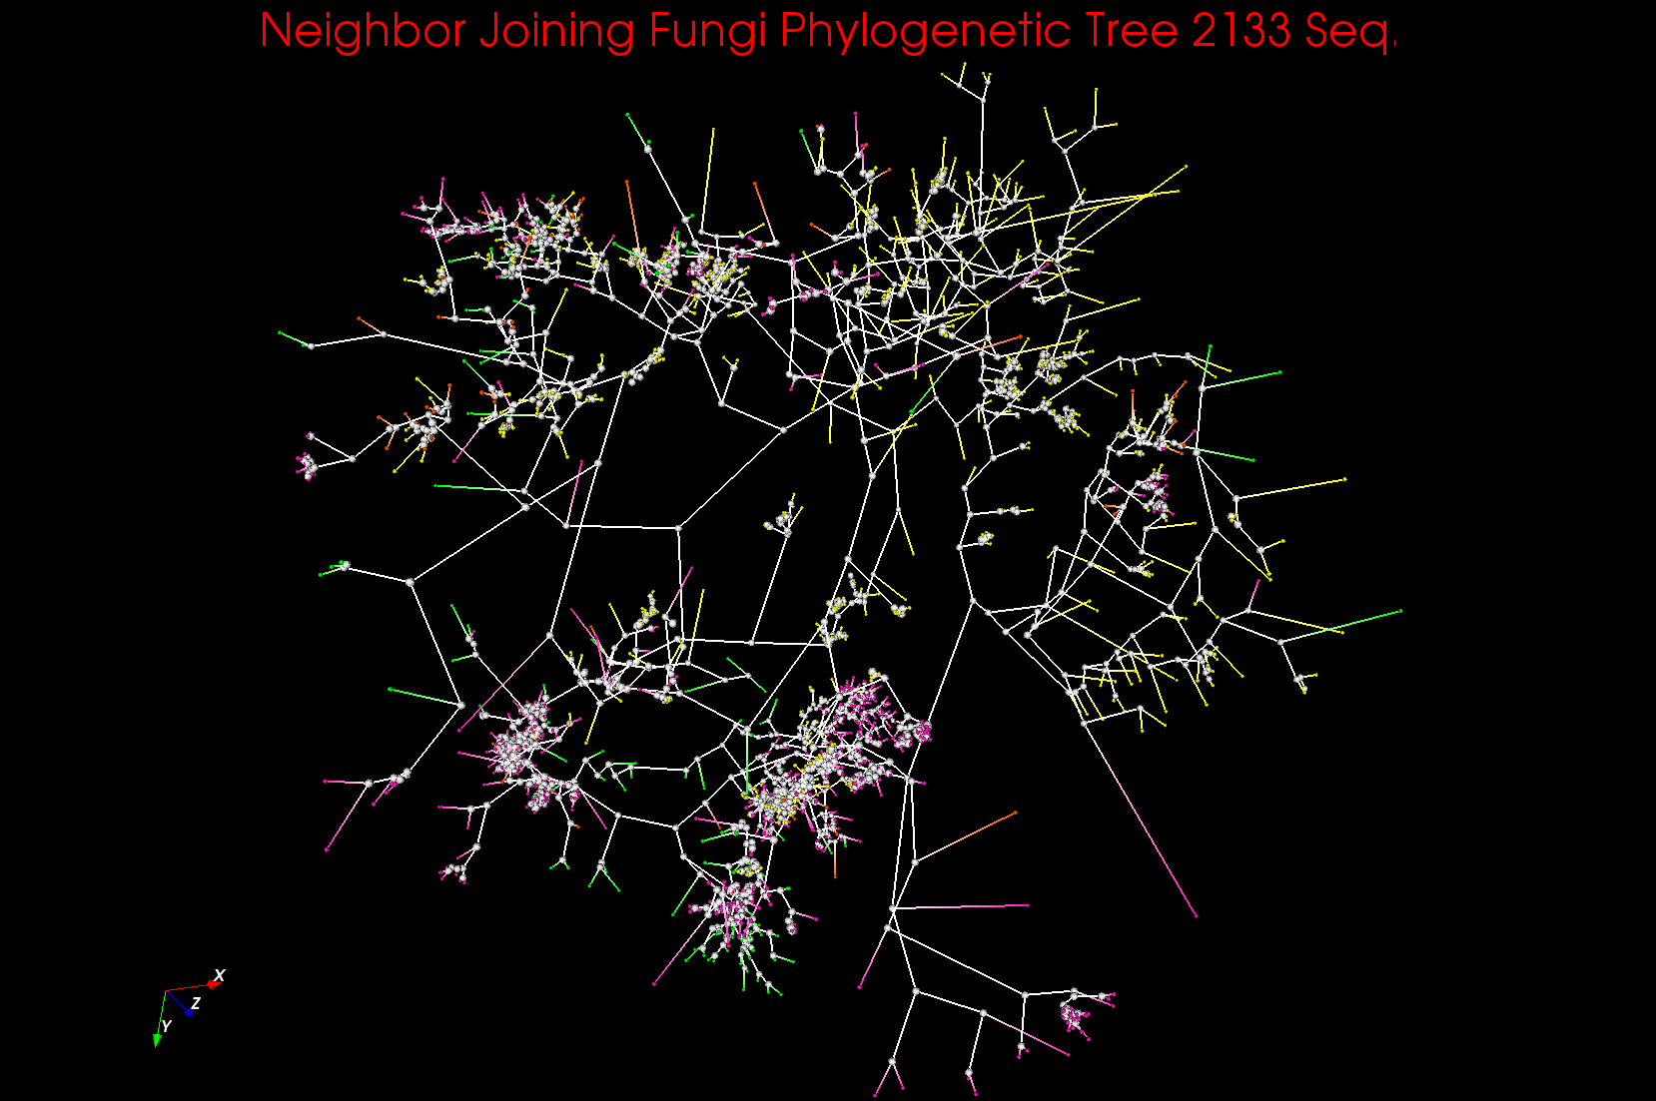
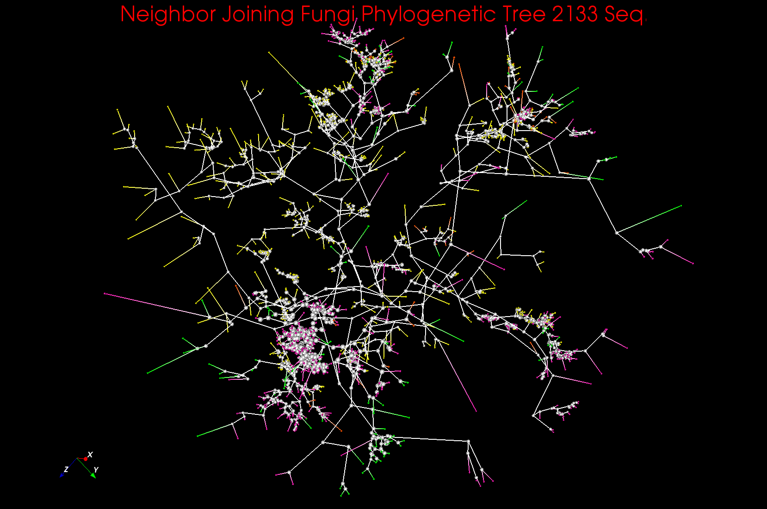
Phylogenetic Trees in 3D (usual 1D)
~125 centers (consensus vectors) found from Fungi data plus existing sequences from GenBank etc.

Slide 54
Clustering + MDS Applications
Cases where “real clusters” as in genomics
Cases as in pathology, proteomics, deep learning and recommender systems (Amazon, Netflix ….) where used for unsupervised classification of related items
Recent “deep learning” papers either use Neural networks with 40 million- 11 billion parameters (10-50 million YouTube images) or (Kmeans) Clustering with up to 1-10 million clusters
  Applications include automatic (Face) recognition; Autonomous driving; Pathology detection (Saltz)
  Generalize to χ² fit of all (Internet) data to a model
  Internet offers “infinite” image and text data
MDS (map all points to 3D for visualization) can be used to verify “correctness” of analysis and/or to browse data as in Geographical Information Systems
Ab-initio (hardest, compute dominated) and Update (streaming, interpolation)

Slide 55

Protein Universe Browser for COG Sequences with a few illustrative biologically identified clusters

Slide 56
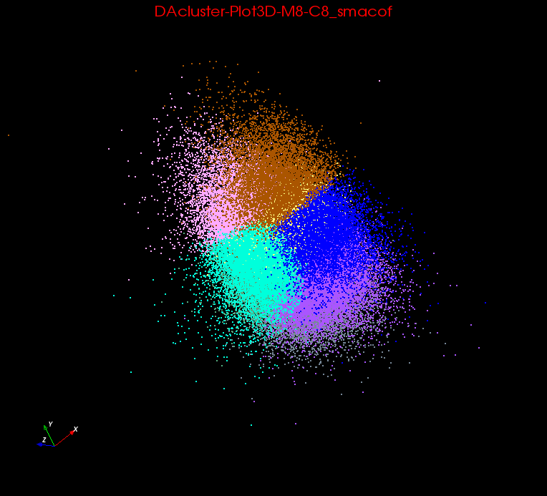
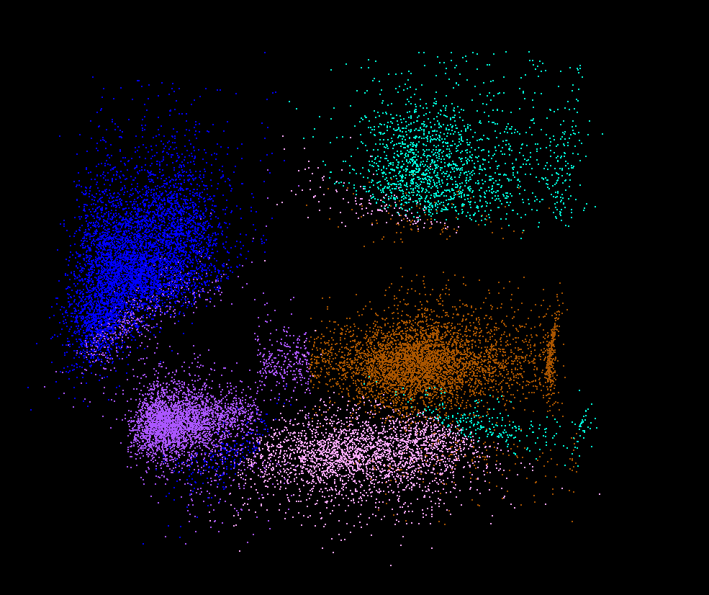
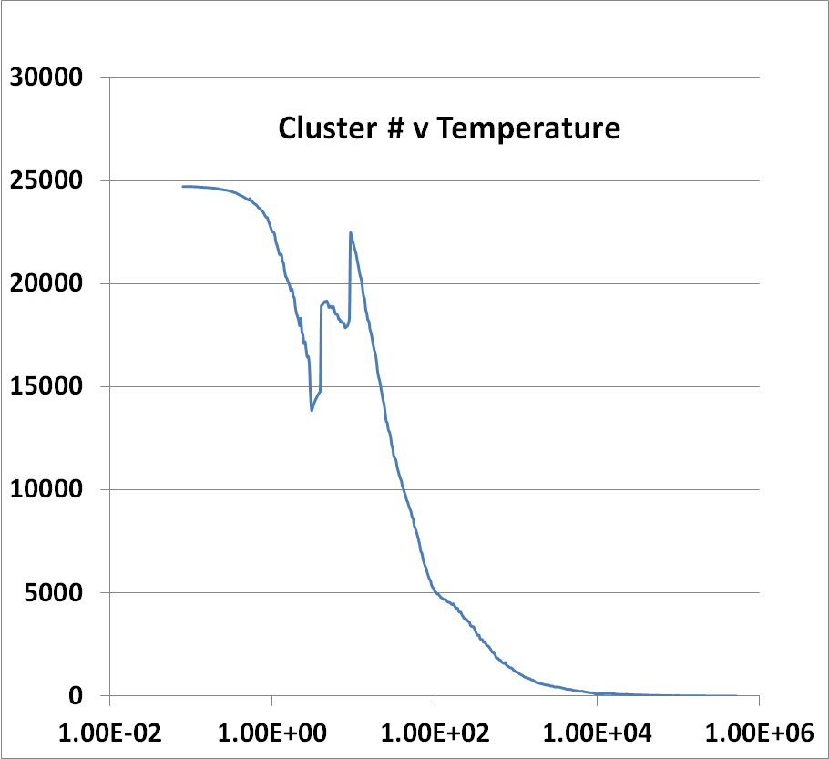
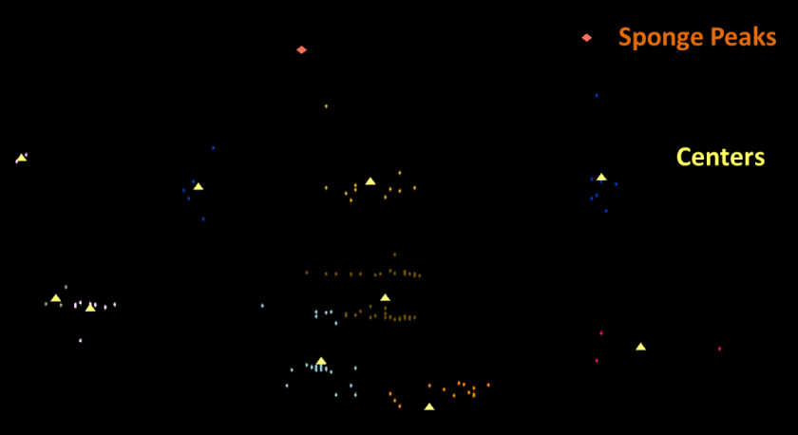
Lymphocytes 4D
Pathology 54D
Comparison of clustering and classification (top right)
LC-MS Mass Spectrometry Sharp Clusters as known error in measurement
LC-MS 2D
(sponge points not in cluster)

Slide 57
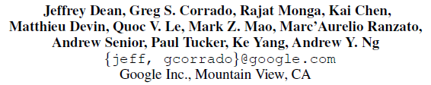

Large Scale Distributed Deep Networks
NIPS 2012
DistBelief (Google) rejected MapReduce but still didn’t work well
Coates and Ng (Stanford) et al. redid much larger problem on HPC cluster with Infiniband with 16 nodes and 64 GPU’s
Could use Iterative MapReduce (Twister) with GPU’s
40 million parameters
Scaling Breaks Down

Slide 58
Triangle Inequality and Kmeans
Dominant part of Kmeans algorithm is finding nearest center to each point
O(#Points * #Clusters * Vector Dimension)
Simple algorithms finds
min over centers c: d(x, c) = distance(point x, center c)
But most of d(x, c) calculations are wasted as much larger than minimum value
Elkan (2003) showed how to use triangle inequality to speed up using relations like
d(x, c) >= d(x,c-last) – d(c, c-last)
c-last position of center at last iteration
So compare d(x,c-last) – d(c, c-last) with d(x, c-best) where c-best is nearest cluster at last iteration
Complexity reduced by a factor = Vector Dimension and so this important in clustering high dimension spaces such as social imagery with 512 or more features per image
GPU performance unclear

Slide 59
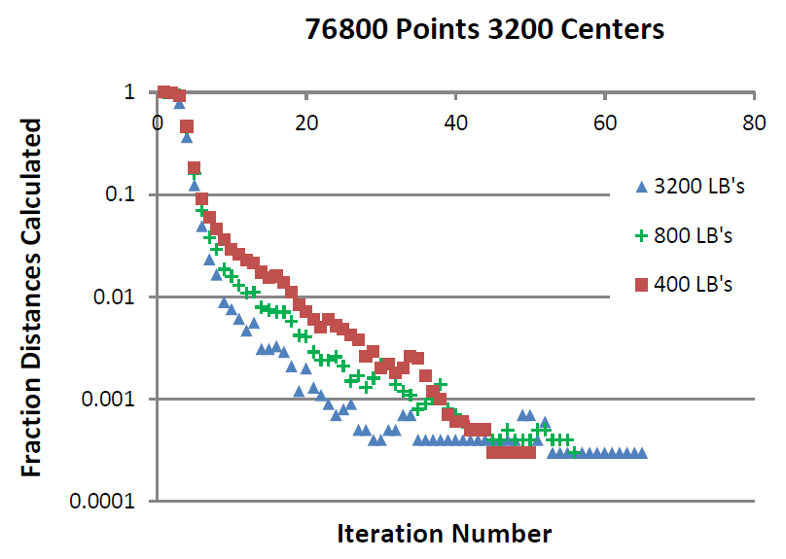
Fraction of Point-Center Distances
Calculated in Kmeans D=2048

Slide 60
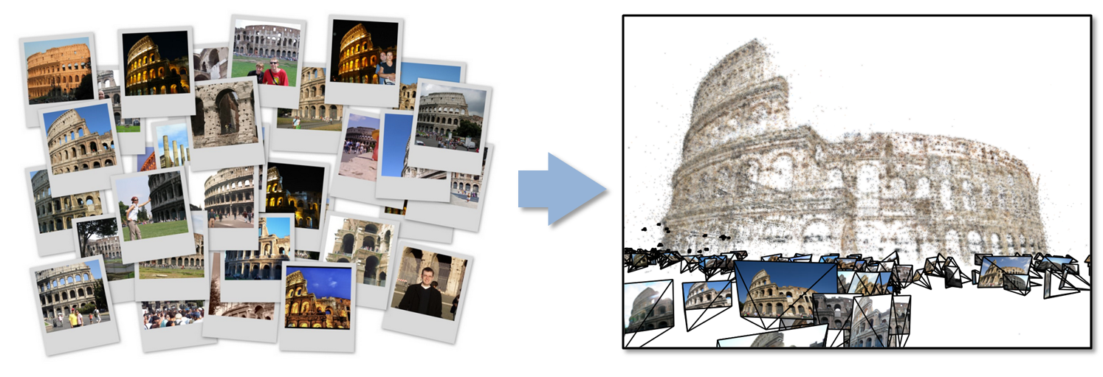
Data Intensive Kmeans Clustering
  ─ Image Classification: 7 million images;
  512 features per image; 1 million clusters
  10K Map tasks; 64G broadcasting data (1GB data transfer per Map task node);
  20 TB intermediate data in shuffling.

Slide 61
Clustering Social Images
Crandall and Qiu+Zhang (Indiana University)
K-means Clustering algorithm is used to cluster the images with similar features.
In image clustering application, each image is characterized as a data point with dimension in range 512 ~ 2048. Each value ranges from 0 to 255.
Currently, they are able to run K-means Clustering up to 1 million clusters and 7 million data points on 125 computer nodes.
  Needs ~10 times larger

Slide 62
Twister Bcast Collective
Optimize Collectives

Slide 63
Conclusions

Slide 64
Conclusions
Clouds and HPC are here to stay and one should plan on using both
Data Intensive programs are not like simulations as they have large “reductions” (“collectives”) and do not have many small messages
  Clouds suitable
Iterative MapReduce an interesting approach; need to optimize collectives for new applications (Data analytics) and resources (clouds, GPU’s …)
Need an initiative to build scalable high performance data analytics library on top of interoperable cloud-HPC platform
Many promising data analytics algorithms such as deterministic annealing not used as implementations not available in R/Matlab etc.
  More sophisticated software and runs longer but can be efficiently parallelized so runtime not a big issue

Slide 65
Conclusions II
Software defined computing systems linking NaaS, IaaS, PaaS, SaaS (Network, Infrastructure, Platform, Software) likely to be important
More employment opportunities in clouds than HPC and Grids and in data than simulation; so cloud and data related activities popular with students
Community activity to discuss data science education
  Agree on curricula; is such a degree attractive?
Role of MOOC’s as either
  Disseminating new curricula
  Managing course fragments that can be assembled into custom courses for particular interdisciplinary students

