Slide 1
Managing allocatable resources
Kate Keahey, Pierre Riteau, Jason Anderson, and Zhuo Zhen
Argonne National Laboratory, University of Chicago
keahey@anl.gov
Cloud 2019
July 11, 2019

Slide 2
Chameleon in a Nutshell
We like to change: testbed that adapts itself to your experimental needs
Deep reconfigurability (bare metal) and isolation (CHI) – but also ease of use (KVM)
CHI: power on/off, reboot, custom kernel, serial console access, etc.
We want to be all things to all people: balancing large-scale and diverse
Large-scale: ~large homogenous partition (~15,000 cores), 5 PB of storage distributed over 2 sites (now +1!) connected with 100G network…
…and diverse: ARMs, Atoms, FPGAs, GPUs, Corsa switches, etc.
Cloud on cloud: leveraging mainstream cloud technologies
Powered by OpenStack with bare metal reconfiguration (Ironic) + “special sauce”
Chameleon team contribution recognized as official OpenStack component
We live to serve: open, production testbed for Computer Science Research
Started in 10/2014, testbed available since 07/2015, renewed in 10/2017
Currently 3,000+ users, 500+ projects, 100+ institutions

Slide 3
Allocatable resources
Definition: object within a system that can be automatically allocated and managed for exclusive, metered usage, delimited by well- defined time events
Exclusive usage/isolation:
System versus performance isolation
Examples: GENI slice, containers, virtual machines, instances on commercial clouds, physical modes
Implementation costs: e.g., hypervisor overhead, or default state recovery
Time-bounded: e.g., advance reservation (including on-demand)
Metered: policy enforcement and incentive management (via monetary or non-monetary means)
Automated lease management: extends over both time and resource types; ensures scalability

Slide 4
Non-fungible Allocatable resource availability representation

Slide 5
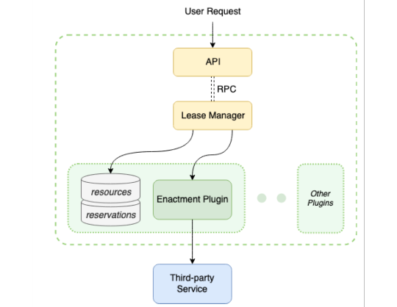
Architecture
Components
Service interfaces
Lease Manager (functionality generic to all leases)
Enactment Plugins (resource-specific functionality)
Third-party Services
Adaptation of non-allocatable resources
Examples: Nova, Neutron

Slide 6
Service interfaces
Inventory management (operators)
Objective: manage resource database
Create, update, delete manage resource database
Informational (show and list)
Lease management (resource clients)
Objectives: create and manage records in lease database
Leases versus reservations
Create and delete: range from a very partial description of a resource, (e.g., “two nodes on the same rack”, “node with at least 2GB of memory”) to very specific (“node X”) and can include multiple resources (e.g., nodes, IPs, VLANs)
Update (active or inactive) lease: change resources, numbers, or temporal constraints
Informational (show and list)

Slide 7
Lease Manager
Interface to lease database
Information persisted includes original constraints
Early or late assignment
Simplicity versus efficiency
Resolved at activation time at the latest
Selection targets ranging from user choice to operation optimization
Event-based assignment management
E.g., reassignment in case of resource failure

Slide 8
Resource Plugins
Allow lease manager to manage diverse resources
Inventory management: separate reservable resources from freely available resources
Lease management: allocating and deallocating resources to a lease
Lease management functions
on_start: resource allocation
on_end: resource deallocation
before_end: trigger an action at a configurable time before the end of a reservation (e.g., snapshot instances)
update_reservation: e.g., add nodes to a lease

Slide 9
implementation
Allocatable resources in Chameleon
Heterogeneous bare metal machines
Isolated network segments (VLANs)
Public IP addresses
OpenStack Blazar implementation with plugins for each
HTTP/JSON (Keystone for authentication), SQL Alchemy, early binding with optimizations
Bare-metal nodes: system and performance isolation, implemented as OpenStack Nova/Ironic plugin
VLANs: system isolation, implemented as OpenStack Neutron plugin
IP addresses: implemented as OpenStack Neutron plugin

Slide 10
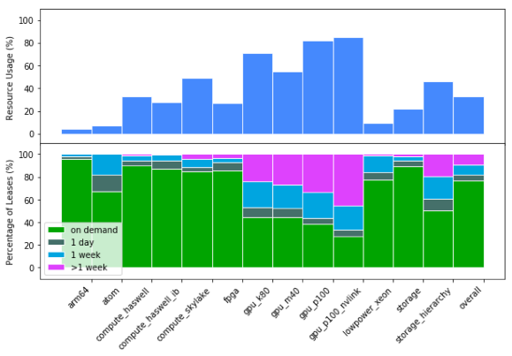
Allocatable resource usage on Chameleon

Slide 11
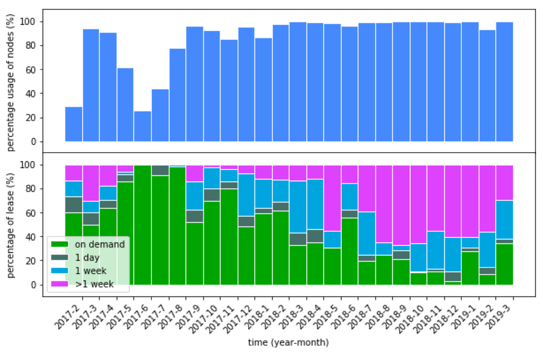
Allocatable resource usage over time

Slide 12
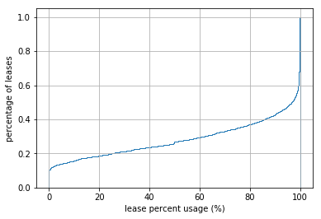
How responsibly are reservations used
Fully used: ~40%
80% used: ~60%
20% used: ~ 20%
Not used: ~15%
Management
Idle at beginning or end: ~5% each
~20% early release

Slide 13
Conclusions
Articulated resource management service
Implemented in OpenStack Blazar
Collaboration with OpenStack Blazar community
Can be used independently of OpenStack – anticipate future work with IoT devices
Effective tool in the management of scarce resources
Managing user incentives
Come and give it a shot! www.chameleoncloud.org

