Slide 1
Simple Kmeans Examples
September 25 2018
Geoffrey Fox
gcf@indiana.edu
http://www.infomall.org
School of Informatics, Computing and Engineering
Digital Science Center
Indiana University Bloomington

Slide 2
Simple T-Shirt Example
Cluster 85 T-shirt records in sample.csv into a number of categories set by number of clusters set in xmean.py file
2 clusters is default
We try 2 3 4 5 Clusters
Note Kmeans allows more clusters but plot only works up to 5

Slide 3
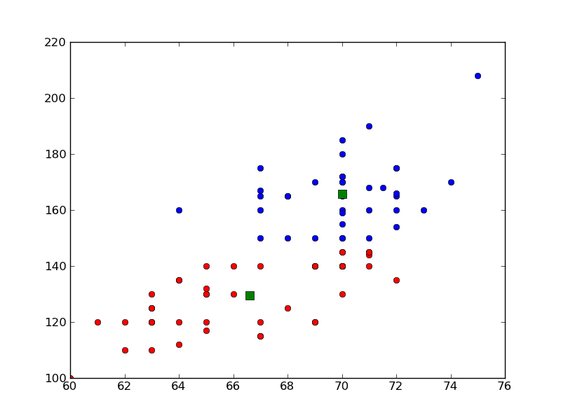
Weight (y) versus Height(x)
2 T-Shirt Sizes
Kmeans K=2 on data from a file

Slide 4
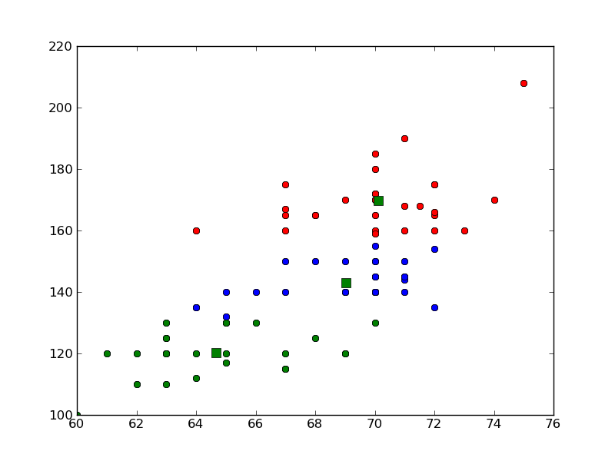
Weight (y) versus Height(x)
3 T-Shirt Sizes

Slide 5
Kmeans
Have a set N of Points – find a specified number K of clusters
Choose a “random” starting point e.g. randomly choose K points to be centers
Iterate until converged
Associate points with cluster whose center they are nearest
Calculate new center positions as centroid (average) of points associated with center
Note Python has a Kmeans code which we use
As source available we modify to illustrate parallel computing and change goodness criterion

Slide 6
Sequential version of Kmeans
Overall iteration over starting positions
Initialize Centroids
Iterate until converged
Find association of points and centers
Calculate distortion (Point-Center distance)
Find centroids as mean of point vectors
Delete zero size clusters
Check convergence
Return best solution based on Goodness criterion which for SciPy version is average distortion
Later tweak algorithm to put in MapReduce form

Slide 7
Analysis of 4 Artificial Clusters

Slide 8
Kmeans on 4 “Artificial” Clusters
Fixed Center positions at
(0,0) radius 0.375
(3,3) radius 0.55
(0,3) radius 0.6
(3,0) radius 0.25
These are “large clusters”
“Small Clusters” have radius multiplied by 0.25
“Very Large Clusters” radius multiplied by 1.5
Each clusters has 250 points generated in normal (Gaussian) distribution with standard deviation 1
We used Kmeans with 2, 4 and just for fun 6 or 8 clusters (i.e. more than “real number” of clusters

Slide 9
Comments
As random data and random starting points, get different answers each time
Can fix seeds for reproducible results
Generally get “correct” answers
Reduce number of iterations (20 default in Python) of independent runs to increase “interesting” results with non optimal solutions

Slide 10
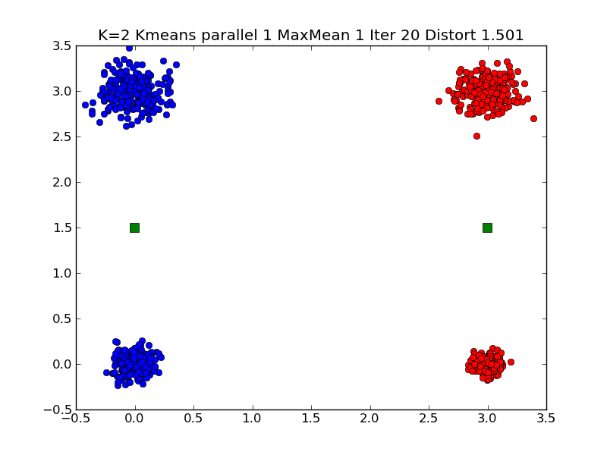
Typical K=2 Small Clustering Note distortion ~1.5

Slide 11
In Graph Title
K is number of clusters looked for K = 2…8
Parallelism is level of (pseudo) parallelism. Used for illustrating MapReduce
MaxMean = 1 Judge quality by mean distortion
Distortion is distance from point to its center
MaxMean = 2 Judge quality by max distortion
Iter is number of totally independent Kmeans iterations to run; return highest quality
Minimizing distortion measure controlled by MaxMean is quality measure

Slide 12
kmeans_gcf(data, Numclusters, NumIterations, Thresh, Parallelism, MaxMean)
data is points to be clustered
Numclusters (2 4 6 8 here) is number of clusters to find
NumIterations is number of independent iterations to perform returning solution with minimum “distortion” as described earlier
Thresh controls each iteration of Kmeans; stop when change in distortion < Thresh. Note this can still be a non optimal solution
Parallelism = 1 here. Later lecture runs a simple MapReduce parallel version with Parallelism = 2
MaxMean = 1 is usual Python Kmeans. MaxMean = 2 is alternative quality measure described earlier

Slide 13
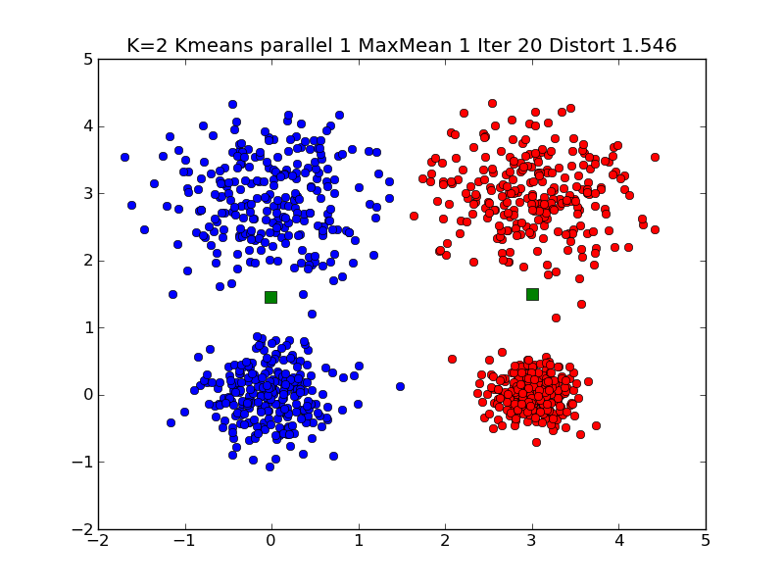
Typical K=2 Large Clustering

Slide 14
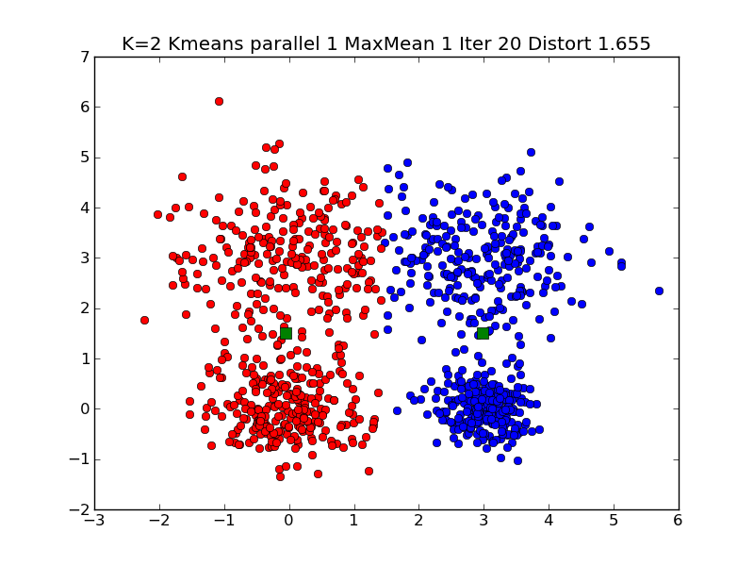
Typical K=2 Very Large Clustering

Slide 15
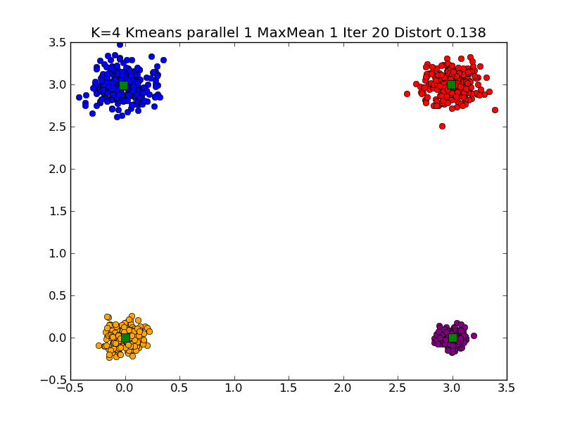
Typical K=4 Small Clustering

Slide 16
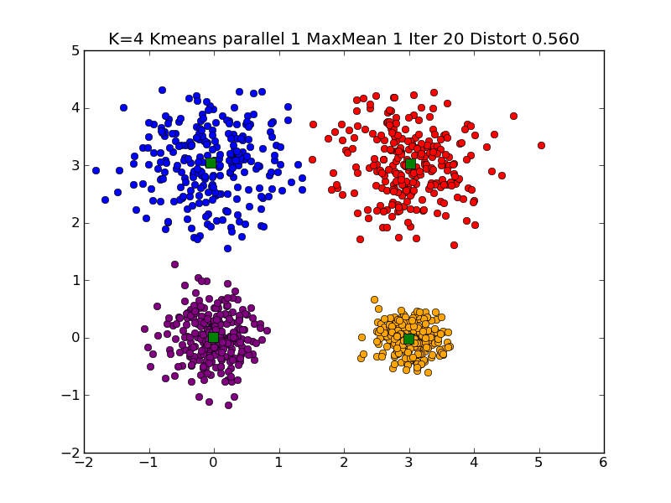
Typical K=4 Large Clustering

Slide 17
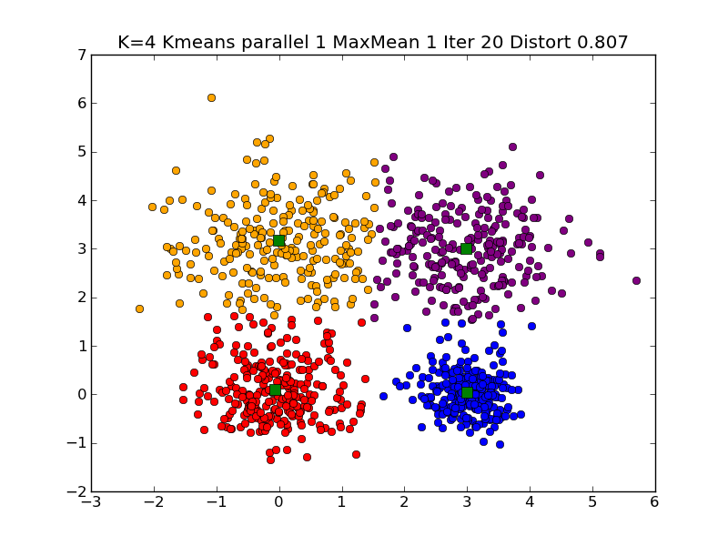
Typical K=4 Very Large Clustering

Slide 18
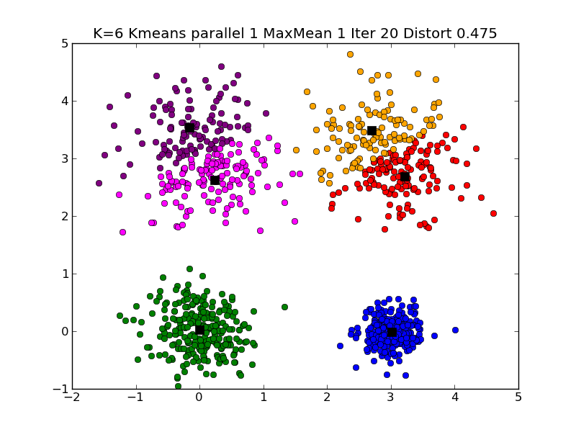
Typical K=6 Large Clustering

Slide 19
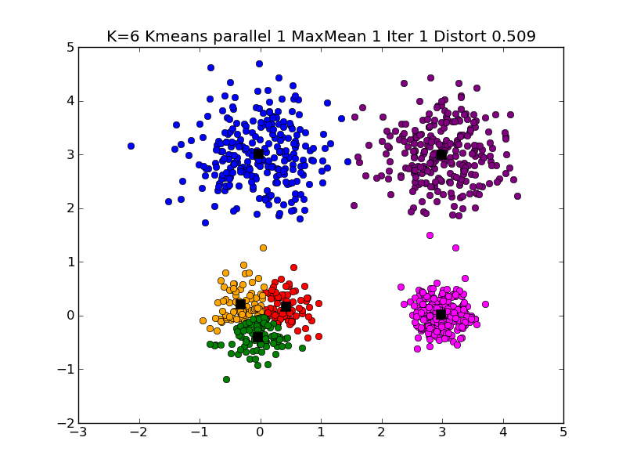
Different K=6 Large Clustering

Slide 20
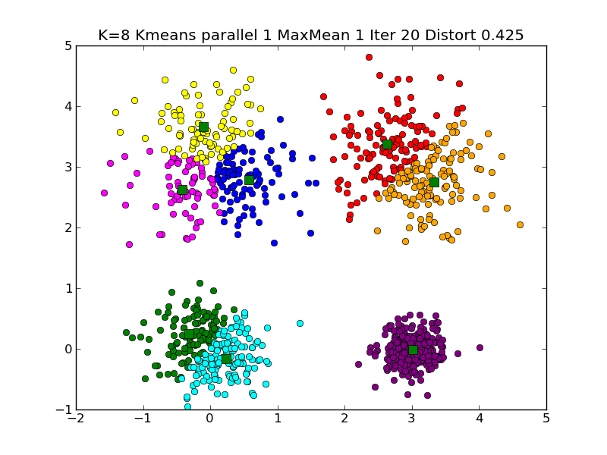
Typical K=8 Large Clustering

Slide 21
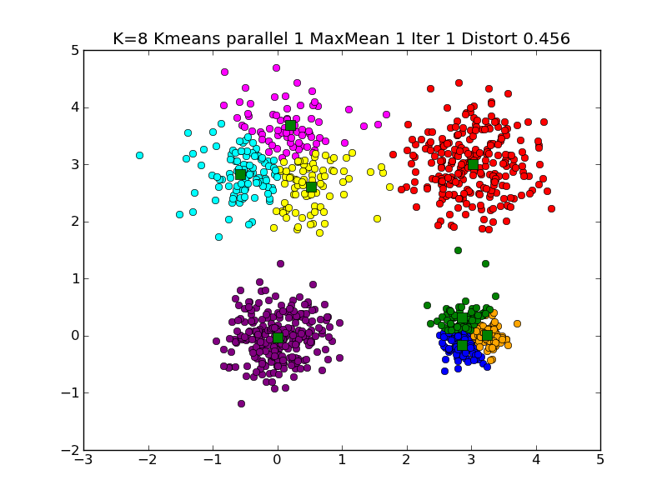
Another K=8 Large Clustering

Slide 22
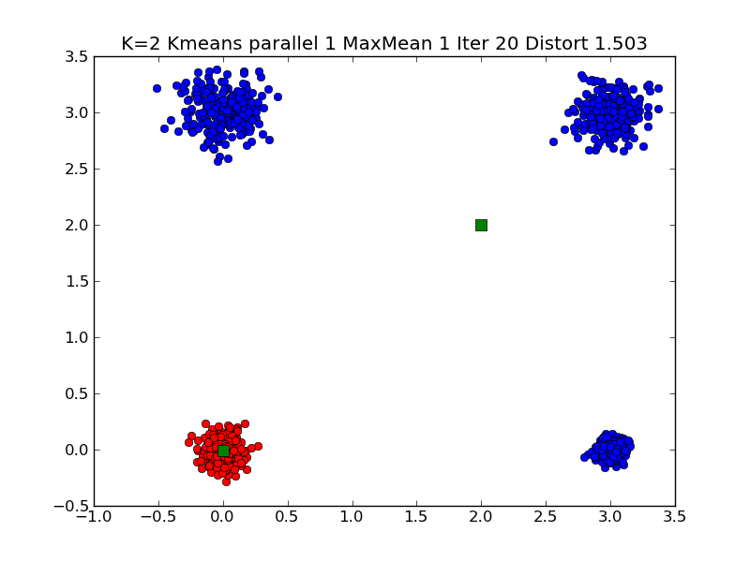
A different solution of K=2 Small Clustering

Slide 23
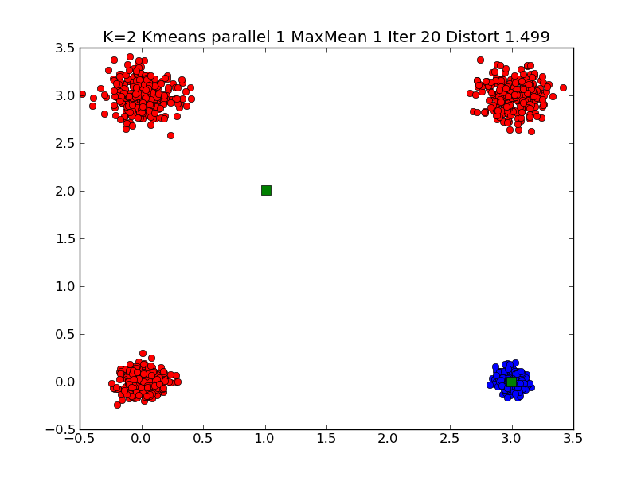
Note Symmetry related solutions
A second look at a different solution of K=2 Small Clustering

Slide 24
Typical K=2 Small Clustering

Slide 25
Note 4 Small Cluster Case is Ambiguous
There are two solutions for K =2 which have similar measures of goodness
2 Clusters each of 2 real clusters
1 Cluster is 1 real cluster, the other is three real clusters
Current measure of goodness is “Average distance between point and its cluster”. This roughly 1.5 for both solutions
Details of starting point determines which solution you find
Also sensitive to “random clusters” i.e. solutions are so near that they can change with choice of Gaussianly distributed points
Typical function with two widely separated minima
Goodness of Fit
Cluster positions (4 parameters for K=2)

Slide 26
Ambiguous Solutions
The Python code runs Kmeans 20 times and chooses best solution out of this 20.
The 4 small cluster case has such similar goodness values for two cases that results vary from run to run
The 2 real cluster case has goodness ~ 3 (distance between generated centers)/2 = 1.5
In other solution a typical case is centers at (0,0) and (2,2) with goodness = (2√5 + √2 + 0)/4 = 1.47
Exact for very small size clusters
Changing goodness to Maximum not mean distance of points to centers will lead to unique solution with each cluster having two real clusters
Max values is 1.5 which is much less than √5 = 2.24

Slide 27
Note the Hill between Solutions
There are 2 symmetry related solutions with 2 real clusters per Kmeans solution
There are 4 symmetry related solutions with 3+1 real clusters per Kmeans solution
These 6 solutions are separated by hills and are local minima
They are stable on small perturbations
Need big change to get from one to another
Very common feature seen in change of leadership in both democratic and non democratic societies
Perhaps in play in battle IoS v Android v Blackberry v Windows 8 in smart phones
Blackberry messed up enough to let Android/IoS take over
To change state, it is insufficient to be better
You need to be so much better that can jump hill

Slide 28
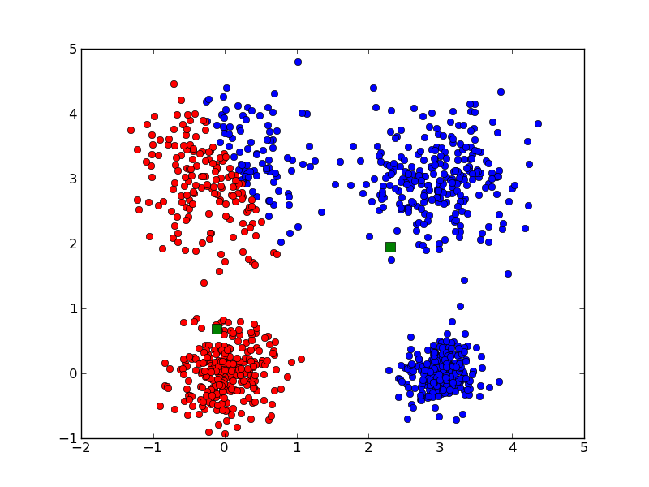
Messy K=2 large Clustering

Slide 29
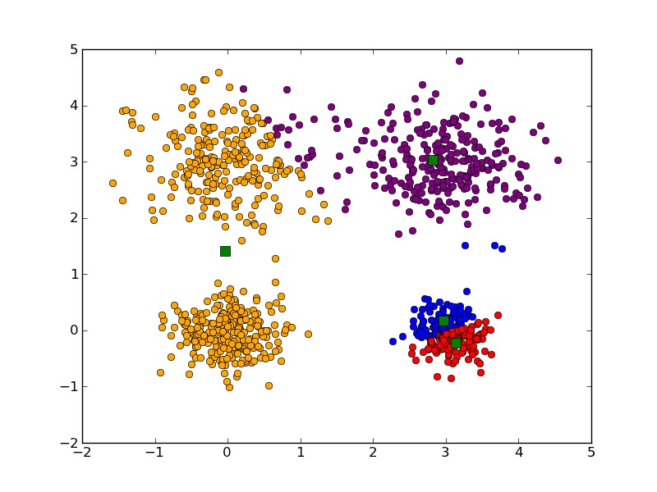
Messy K=4 large Clustering

Slide 30
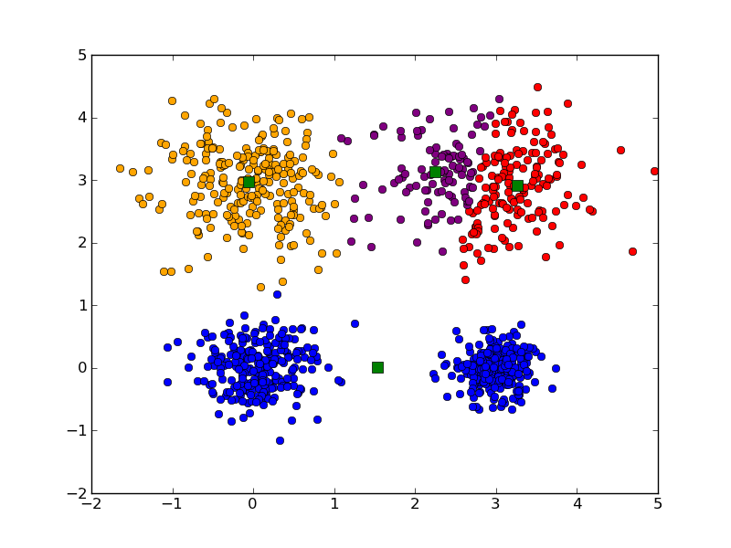
Messy K=4 large Clustering

Slide 31
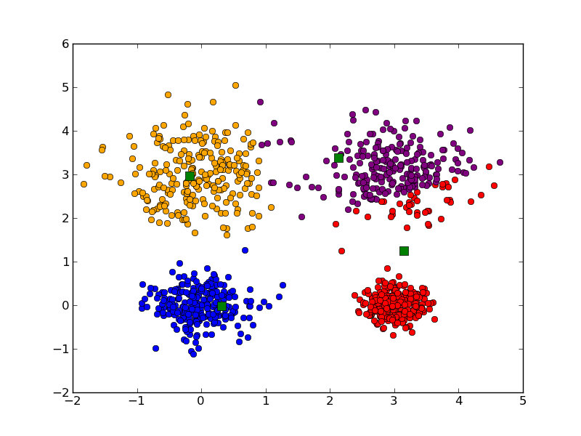
Messy K=4 large Clustering

Slide 32
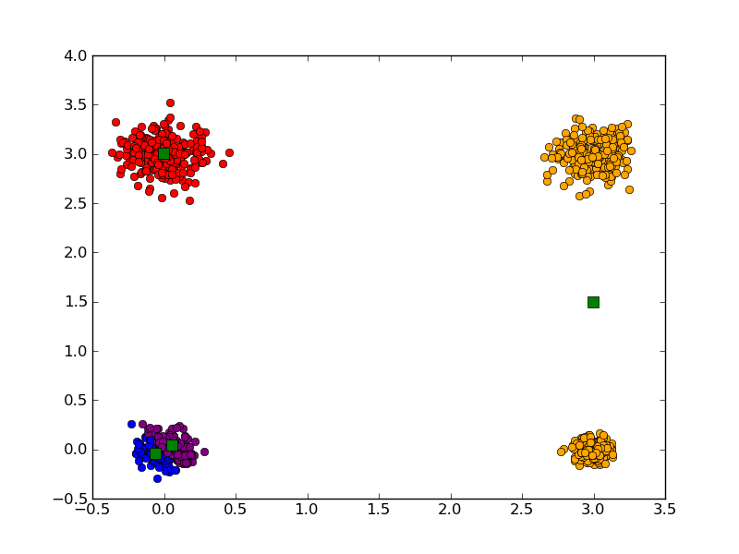
Messy K=4 Small Clustering

Slide 33
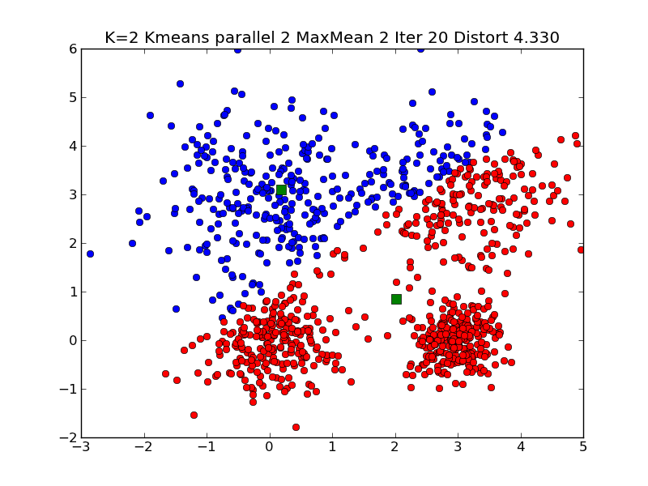
Messy K=2 Very large Clustering

Slide 34
Different K=6 Large Clustering

Slide 35
Another K=8 Large Clustering

