Slide 1
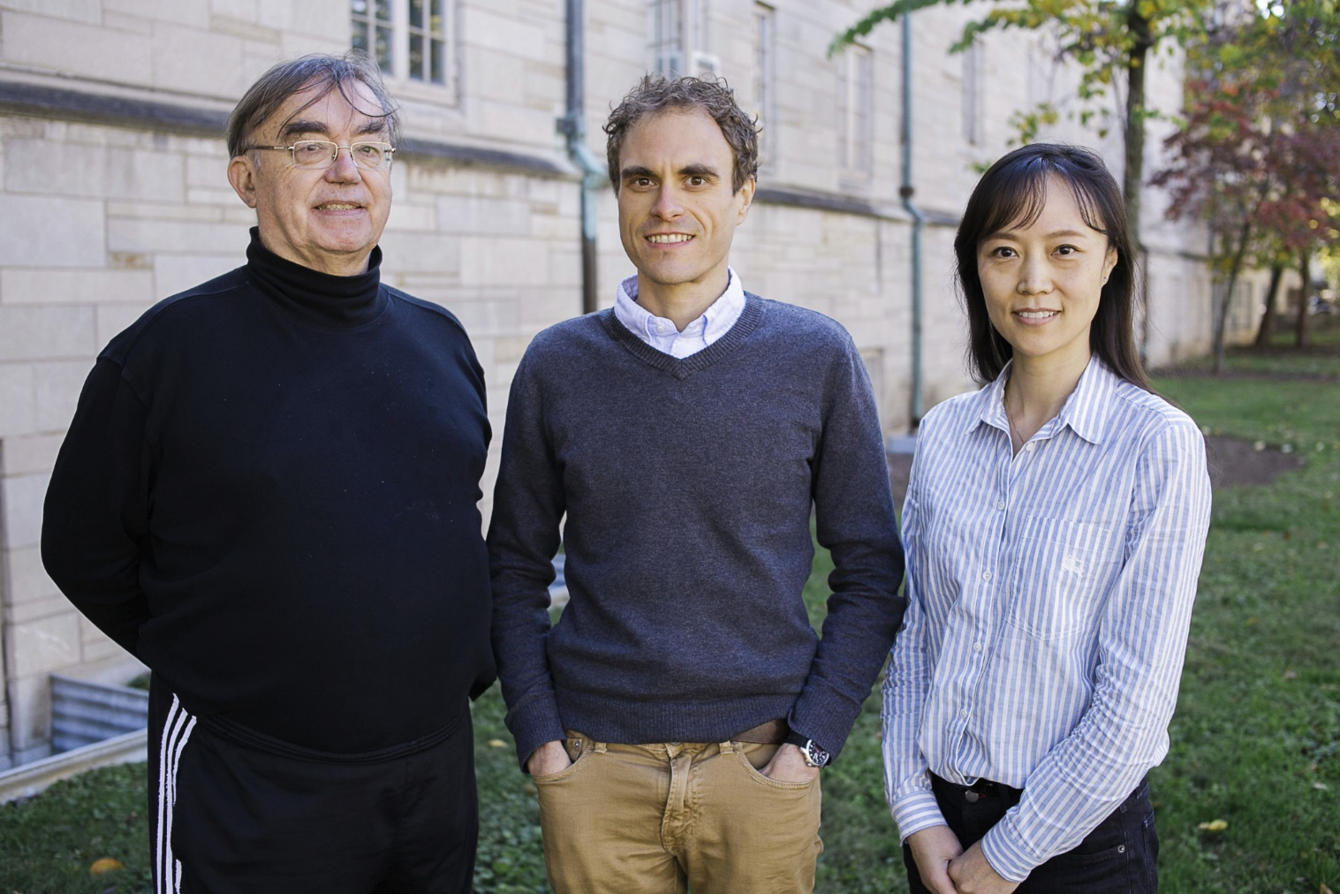
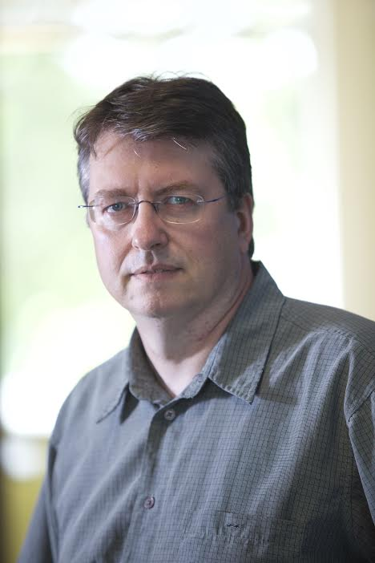
Data Science at
Digital Science Center
Indiana University Faculty
Geoffrey Fox, David Crandall, Judy Qiu, Gregor von Laszewski

Slide 2
Work on Applications Algorithms Systems Software
Biology/Bioinformatics
Computational Finance
Network Science and Epidemiology
Analysis of Biomolecular Simulations
Analysis of Remote Sensing Data
Computer Vision
Pathology Images
Real time robot data
Parallel Algorithms and Software
  Deep Learning
  Clustering
  Dimension Reduction
  Image Analysis
  Graph

Slide 3
Digital Science Center Research Areas
Digital Science Center Facilities
RaPyDLI Deep Learning Environment
SPIDAL Scalable Data Analytics Library
MIDAS Big Data Software
Big Data Ogres Classification and Benchmarks
CloudIOT Internet of Things Environment
Cloudmesh Cloud and Bare metal Automation
XSEDE TAS Monitoring citations and system metrics
Data Science Education with MOOC’s

Slide 4
DSC Computing Systems
Just installed 128 node Haswell based system (Juliet)
  128 GB memory per node
  Substantial conventional disk per node (8TB) plus PCI based SSD
  Infiniband with SR-IOV
  24 and 36 core nodes (3456 total cores)
Working with SDSC on NSF XSEDE Comet System (Haswell 47,776 cores)
Older machines
  India (128 nodes, 1024 cores), Bravo (16 nodes, 128 cores), Delta(16 nodes, 192 cores), Echo(16 nodes, 192 cores), Tempest (32 nodes, 768 cores) with large memory, large disk and GPU
Optimized for Cloud research and Large scale Data analytics exploring storage models, algorithms
Build technology to support high performance virtual clusters

Slide 5
Cloudmesh Software Defined System Toolkit
Cloudmesh Open source http://cloudmesh.github.io/ supporting
  The ability to federate a number of resources from academia and industry. This includes existing FutureSystems infrastructure, Amazon Web Services, Azure, HP Cloud, Karlsruhe using several IaaS frameworks
  IPython-based workflow as an interoperable onramp
Supports reproducible computing environments
Uses internally Libcloud and Cobbler
Celery Task/Query manager (AMQP - RabbitMQ)
MongoDB
Gregor von Laszewski
Fugang Wang
Notes:
Due to its integrated services Cloudmesh provides the ability to be an onramp for other clouds.
It provides information services to various system level sensors to give access to sensor and utilization data. Internally, it can be used to optimize the system usage.
The provisioning experience from FutureGrid has taught us that we need to provide
the creation of new clouds (rain)
the repartitioning of resources between services (cloud shifting)
and the integration of external cloud resources in case of over provisioning (cloud bursting)
As we deal with many IaaS frameworks, we need an abstraction layer on top of the IaaS framework.
Experiment management is conducted with workflows controlled in shells, Python/iPython, as well as systems such as OpenStack's Heat.
Accounting is supported through additional services such as user management and charge rate management.
Not all features are yet implemented. Figure shows the main functionality that we target at this time to implement.

Slide 6
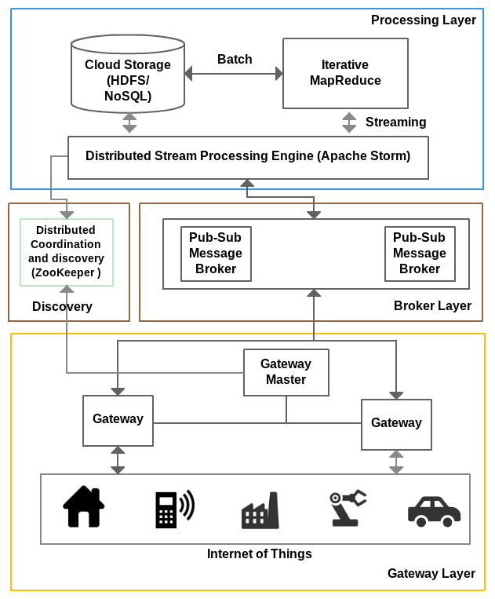
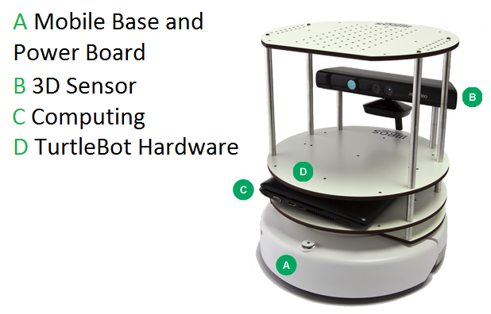
IOTCloud
Device → Pub-Sub→Storm → Datastore → Data Analysis
Apache Storm provides scalable distributed system for processing data streams coming from devices in real time.
For example Storm layer can decide to store the data in cloud storage for further analysis or to send control data back to the devices
Evaluating Pub-Sub Systems ActiveMQ, RabbitMQ, Kafka, Kestrel
Turtlebot and Kinect

Slide 7
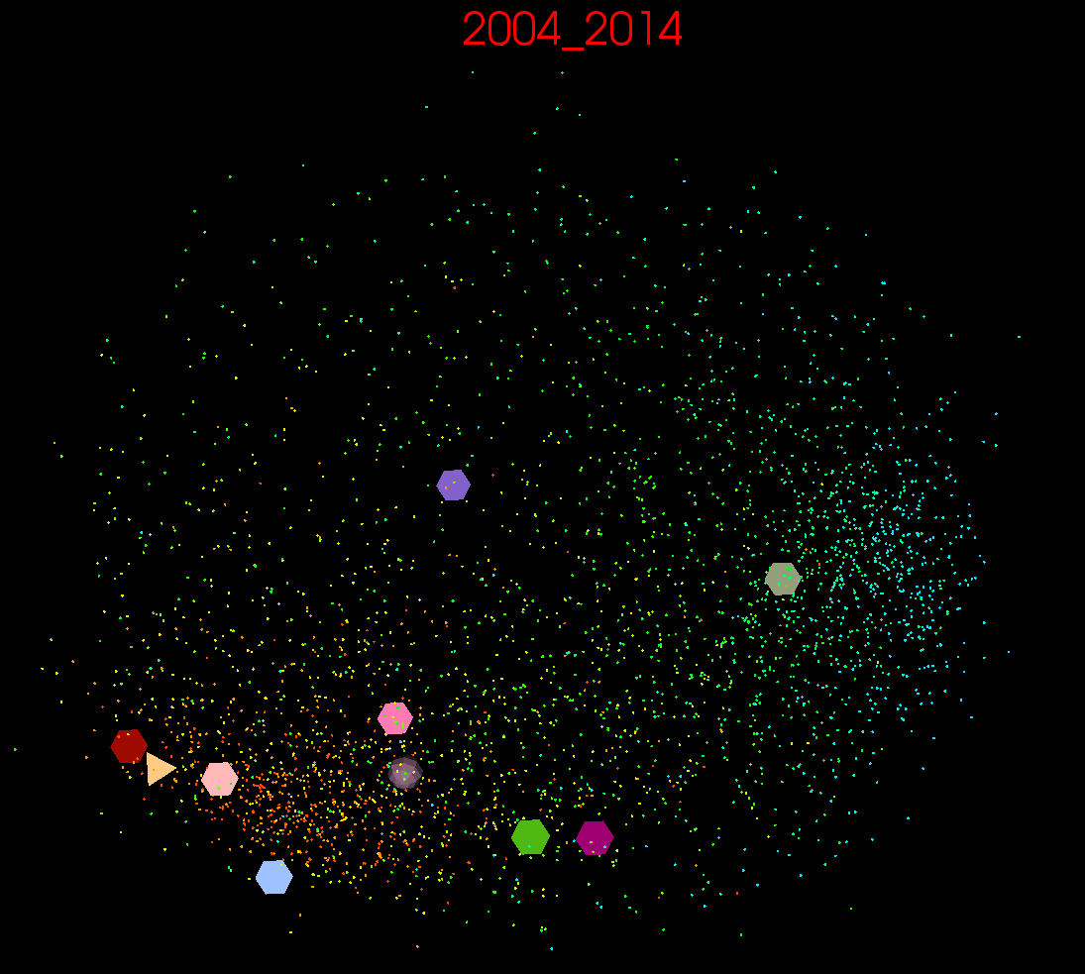
10 year US Stock daily price time series mapped to 3D (work in progress)
3400 stocks
10 large ones shown
down
up

Slide 8

Protein Universe Browser for COG Sequences with a few illustrative biologically identified clusters

Slide 9
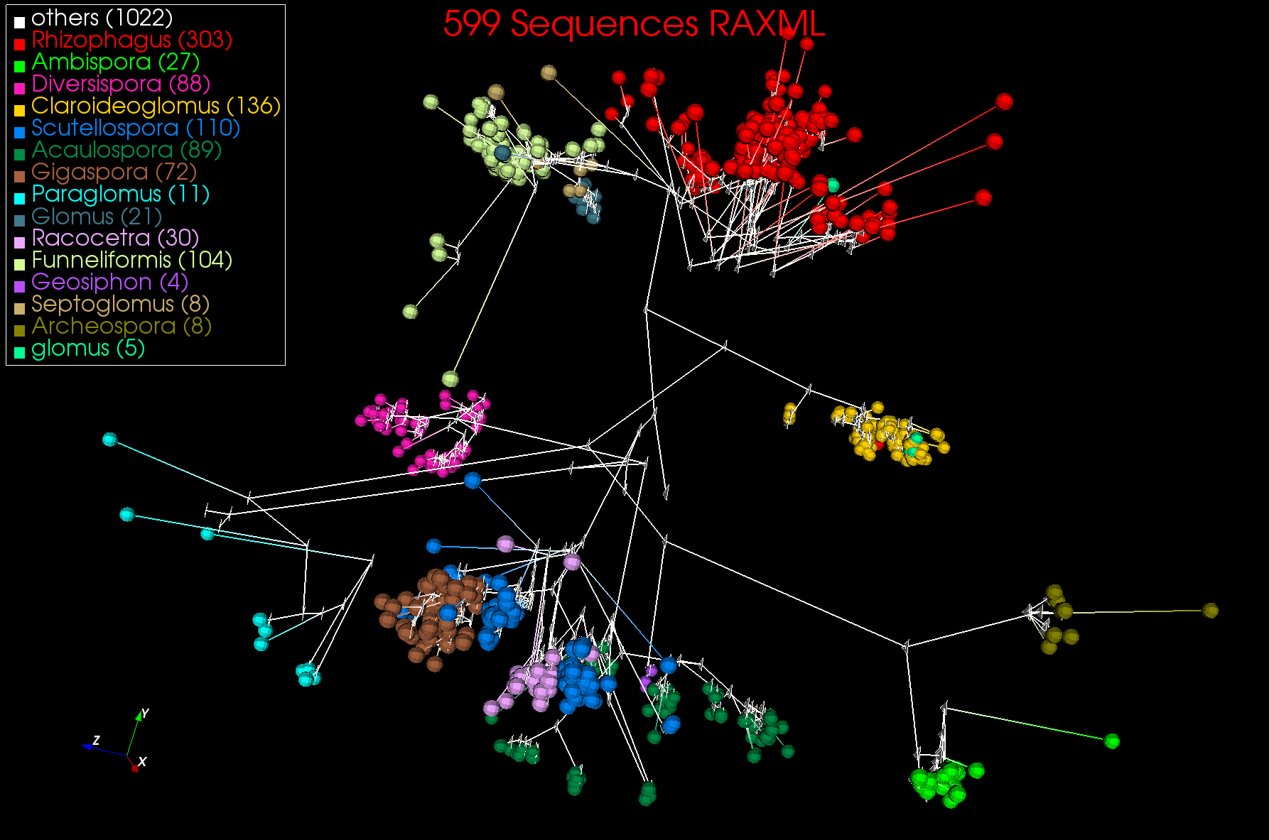
3D Phylogenetic Tree from WDA SMACOF

