Slide 1

Distinguishing Parallel and Distributed Computing Performance
CCDSC 2016 http://www.netlib.org/utk/people/JackDongarra/CCDSC-2016/
La maison des contes Lyon France
Geoffrey Fox, Saliya Ekanayake, Supun Kamburugamuve October 4, 2016
gcf@indiana.edu
http://www.dsc.soic.indiana.edu/, http://spidal.org/ http://hpc-abds.org/kaleidoscope/
Department of Intelligent Systems Engineering
School of Informatics and Computing, Digital Science Center
Indiana University Bloomington

Slide 2
Abstract
We are pursuing the concept of HPC-ABDS -- High Performance Computing Enhanced Apache Big Data Stack -- where we try to blend the usability and functionality of the community big data stack with the performance of HPC.
Here we examine major Apache Programming environments including Spark, Flink, Hadoop, Storm, Heron and Beam.
We suggest that parallel and distributed computing often implement similar concepts (such as reduction, communication or dataflow) but that these need to be implemented differently to respect the different performance, fault-tolerance, synchronization, and execution flexibility requirements of parallel and distributed programs.
We present early results on the HPC-ABDS strategy of implementing best-practice runtimes for both these computing paradigms in major Apache environments.

Slide 3
Data and Model in Big Data and Simulations I
Need to discuss Data and Model as problems have both intermingled, but we can get insight by separating which allows better understanding of Big Data - Big Simulation “convergence” (or differences!)
The Model is a user construction and it has a “concept”, parameters and gives results determined by the computation. We use term “model” in a general fashion to cover all of these.
Big Data problems can be broken up into Data and Model
  For clustering, the model parameters are cluster centers while the data is set of points to be clustered
  For queries, the model is structure of database and results of this query while the data is whole database queried and SQL query
  For deep learning with ImageNet, the model is chosen network with model parameters as the network link weights. The data is set of images used for training or classification

Slide 4
Data and Model in Big Data and Simulations II
Simulations can also be considered as Data plus Model
  Model can be formulation with particle dynamics or partial differential equations defined by parameters such as particle positions and discretized velocity, pressure, density values
  Data could be small when just boundary conditions
  Data large with data assimilation (weather forecasting) or when data visualizations are produced by simulation
Big Data implies Data is large but Model varies in size
  e.g. LDA with many topics or deep learning has a large model
  Clustering or Dimension reduction can be quite small in model size
Data often static between iterations (unless streaming); Model parameters vary between iterations

Slide 5

Java MPI performance is good if you work hard
128 24 core Haswell nodes on SPIDAL 200K DA-MDS Code
Communication dominated by MPI Collective performance
Speedup compared to 1 process per node on 48 nodes
Best MPI; inter and intra node
MPI; inter/intra node; Java not optimized
Best FJ Threads intra node; MPI inter node

Slide 6
Java versus C Performance
C and Java Comparable with Java doing better on larger problem sizes
LRT-BSP affinity CE; one million point dataset 1k,10k,50k,100k, and 500k centers on 16 24 core Haswell nodes over varying threads and processes.

Slide 7
HPC-ABDS
High Performance Computing Enhanced Big Data Apache Stack
DataFlow and In-place Runtime

Slide 8
Big Data and Parallel/Distributed Computing
In one beginning, MapReduce enables easy parallel database like operations and Hadoop provided wonderful open source implementation
Andrew Ng introduced “summation form” and showed much Machine Learning could be implemented in MapReduce (Mahout in Apache)
Then noted that iteration ran badly in Hadoop as used disks for communication; Hadoop choice gives great fault tolerance
This led to a slew of MapReduce improvements using either BSP SPMD (Twister, Giraph) or
Dataflow: Apache Storm, Spark, Flink, Heron …. and Dryad
Recently Google open sources Google Cloud Dataflow as Apache Beam using Spark and Flink as runtime or proprietary Google Dataflow
  Support Batch and Streaming

Slide 9
HPC-ABDS Parallel Computing
Both simulations and data analytics use similar parallel computing ideas
Both do decomposition of both model and data
Both tend use SPMD and often use BSP Bulk Synchronous Processing
One has computing (called maps in big data terminology) and communication/reduction (more generally collective) phases
Big data thinks of problems as multiple linked queries even when queries are small and uses dataflow model
Simulation uses dataflow for multiple linked applications but small steps such as iterations are done in place
Reduction in HPC (MPIReduce) done as optimized tree or pipelined communication between same processes that did computing
Reduction in Hadoop or Flink done as separate map and reduce processes using dataflow
  This leads to 2 forms (In-Place and Flow) of runtime discussed later
Interesting Fault Tolerance issues highlighted by Hadoop-MPI comparisons – not discussed here!

Slide 10
Apache Flink and Spark Dataflow Centric Computation
Both express a computation as a data-flow graph
Graph Nodes → User defined operators
Graph Edges → Data
Data source nodes and Data sink nodes (i.e. File read, File write, Message Queue read)
Automatic placement of partitioned data in the parallel tasks

Slide 11
Dataflow Operators
The operators in API define the computation as well how nodes are connected
  For example lets take map and reduce operators and our initial data set is A
  Map function produces a distributed dataset B by applying the user defined operator on each partition of A. If A had N partitions, B can contain N elements.
  The Reduce function is applied on B, producing a data set with a single partition.
A
Map
B
Reduce
C
B = A.map() {
User defined code to execute on a partition of A
};
C = B.reduce() {
User defined code to reduce two elements in B
}
Logical graph
a_1
Map 1
b_1
Reduce
C
a_n
Map
n
b_n
Execution graph

Slide 12
Dataflow operators
Map: Parallel execution
Filter: Filter out data
Project: Select part of the data unit
Group: Group data according to some criteria like keys
Reduce: Reduce the data into a small data set.
Aggregate: Works on the whole data set to compute a value, SUM, MIN
Join: Join two data sets based on Keys.
Cross: Join two data sets as in the cross product
Union: Union of two data sets

Slide 13

Apache Flink
The data is represented as a DataSet
User creates the dataflow graph and submits to cluster
Flink optimizes this graph and creates an execution graph
This graph is executed by the cluster
Support Streaming natively
Check-pointing based fault tolerance

Slide 14


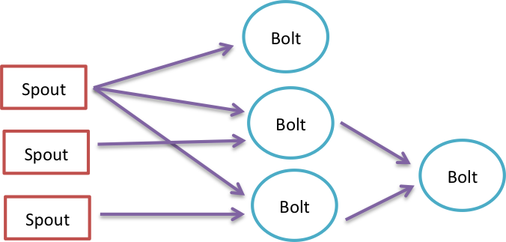
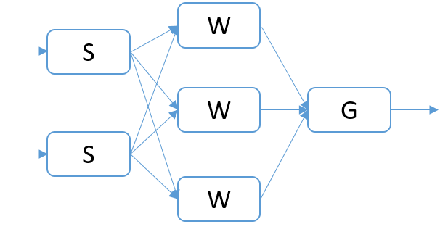
Twitter Heron
Pure data streaming
Data flow graph is called a topology
User Graph
Topology

Slide 15

Apache Spark
Dataflow is executed by a driver program
The graph is created on the fly by the driver program
The data is represented as Resilient Distributed Data Sets (RDD)
The data is on the worker nodes and operators applied on this data
These operators produce other RDDs and so on
Using lineage graph of RDDs for fault tolerence

Slide 16
Data abstractions
(Spark RDD & Flink DataSet)
In memory representation of the partitions of a distributed data set
Has a high level language type (Integer, Double, custom Class)
Immutable
Lazy loading
Partitions are loaded in the tasks
Parallelism is controlled by the no of partitions (parallel tasks on a data set <= no of partitions)
Partition 0
Partition i
Partition n
RDD/DataSet
Input Format to Read Data as partitions
HDFS/Lustre/Local File system

Slide 17
Flink K-Means
Point data set is partitioned and loaded to multiple map tasks
  Custom input format for loading the data as block of points
Full centroid data set is loaded at each map task
Iterate over the centroids
  Calculate the local point average at each map task
  Reduce (sum) the centroid averages to get a global centroids
  Broadcast the new centroids back to the map tasks
Data Set <Points>
Map (nearest centroid calculation)
Reduce (update centroids)
Data Set <Initial Centroids>
Data Set <Updated Centroids>
Broadcast

Slide 18

Breaking Programs into Parts
Fine Grain Parallel Computing Data/model parameter decomposition
Coarse Grain Dataflow
HPC or ABDS

Slide 19
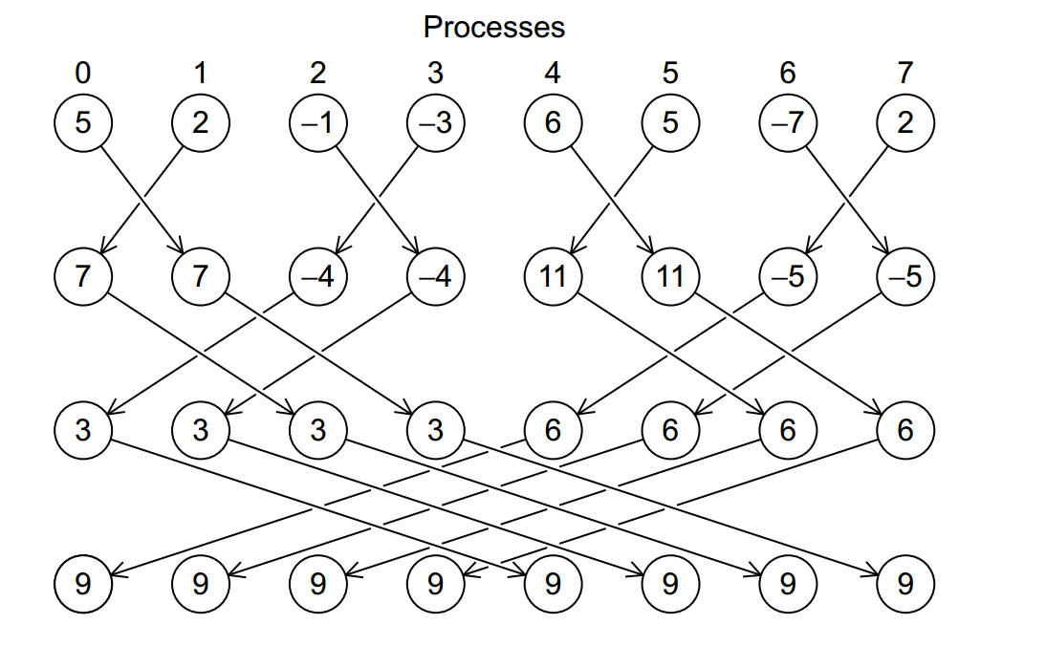
Illustration of In-Place AllReduce in MPI

Slide 20
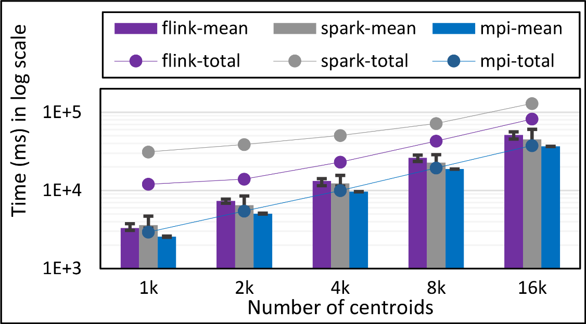
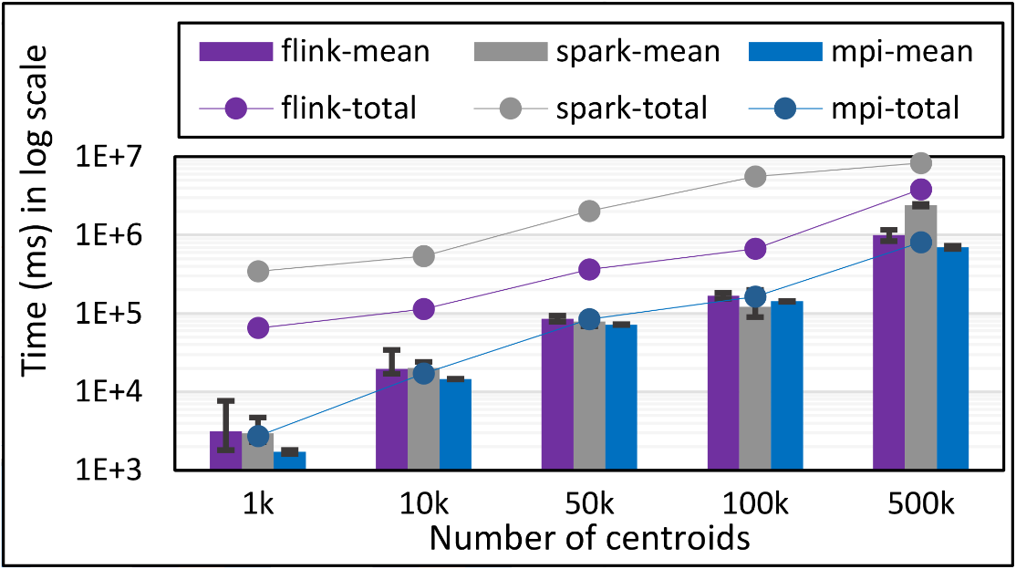
K-Means Clustering in Spark, Flink, MPI
Data Set <Points>
Map (nearest centroid calculation)
Reduce (update centroids)
Data Set <Initial Centroids>
Data Set <Updated Centroids>
Broadcast
K-Means total and compute times for 1 million 2D points and 1k,10,50k,100k, and 500k centroids for Spark, Flink, and MPI Java LRT-BSP CE. Run on 16 nodes as 24x1.
K-Means total and compute times for 1 million 2D points and 1k,10,50k,100k, and 500k centroids for Spark, Flink, and MPI Java LRT-BSP CE. Run on 16 nodes as 24x1.
K-Means total and compute times for 100k 2D points and1k,2k,4k,8k, and 16k centroids for Spark, Flink, and MPI Java LRT-BSP CE. Run on 1 node as 24x1.
Notes:
Note the differences in communication architectures
Note times are in log scale
Bars indicate compute only times, which is similar across these frameworks
Overhead is dominated by communications in Flink and Spark

Slide 21
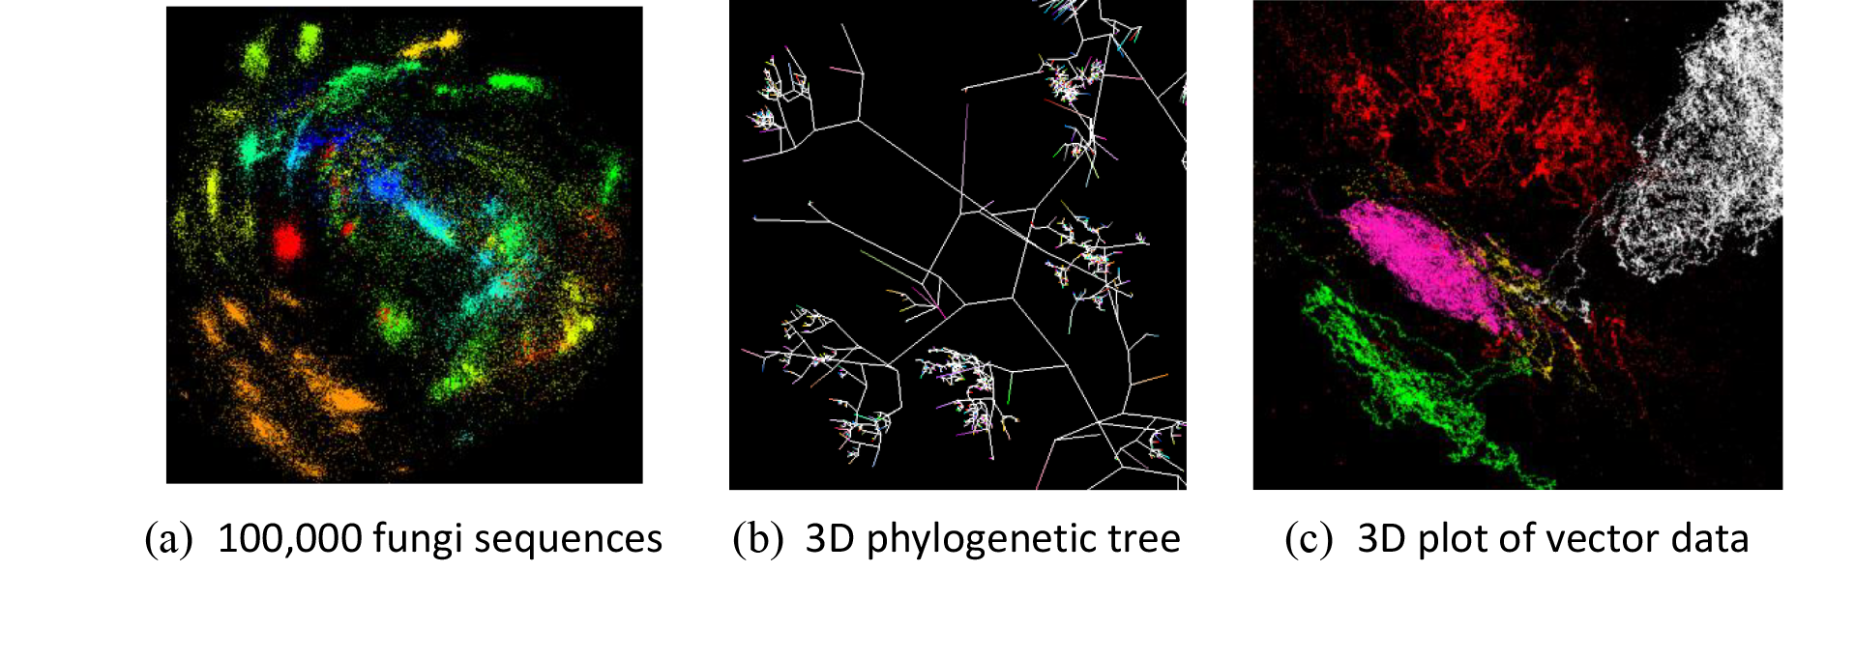
Flink Multi Dimensional Scaling (MDS)
Projects NxN distance matrix to NxD matrix where N is the number of points and D is the target dimension.
The input is two NxN matrices (Distance and Weight) and one NxD initial point file.
The NxN matrices are partitioned row wise
3 NxD matrices are used in the computations which are not partitioned.
For each operation on NxN matrices, one or more of NxD matrices are required.
All three iterations have dynamic stopping criteria. So loop unrolling is not possible.
Our algorithm uses deterministic annealing and has three nested loops called Temperature, Stress and CG in that order.

Slide 22
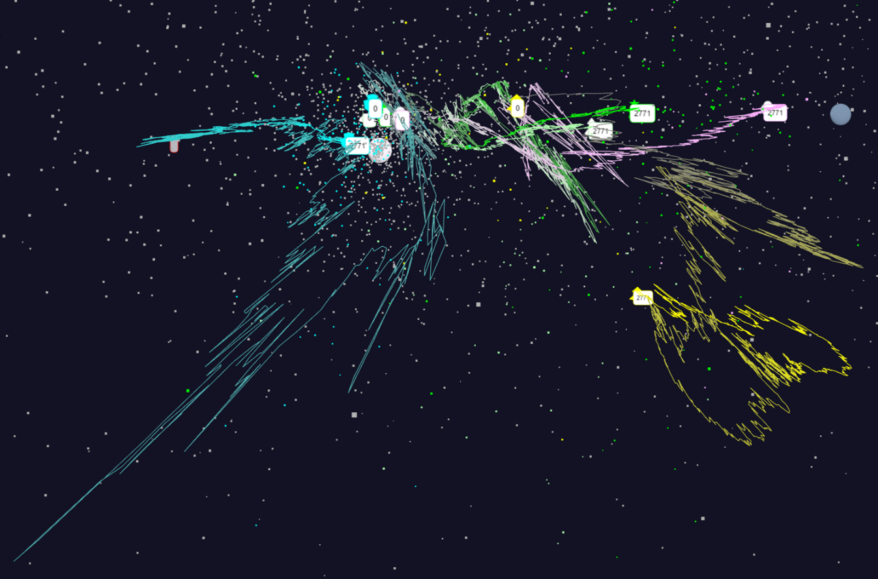
Flink MDS Notes
Flink doesn’t support nested loops, so only the CG iteration is implemented as a native iteration in Flink.
Each temperature and stress loop combination is executed as a separate Job.
The data-flow graph is complex and long
For each distributed operation on partitioned NxN matrix we need to broadcast Nx3 matrix (can be very in-efficient).
  In MPI we keep the Nx3 matrices in all the tasks.
We need to combine the partitions of the two NxN matrices once they are loaded. Natural choice was Joining. But it turned out Joining was very in-efficient and we had to load partitions of one matrix manually in a Map operator.

Slide 23
Flink vs MPI DA-MDS Performance
Total time of MPI Java and Flink MDS implementations for 96 and 192 parallel tasks with no of points ranging from 1000 to 32000. The graph also show the computation time. The total time includes computation time, communication overhead, data loading and framework overhead. In case of MPI there is no framework overhead. This test has 5 Temperature Loops, 2 Stress Loops and 16 CG Loops.
Total time of MPI Java and Flink MDS implementations for 96 and 192 parallel tasks with no of points ranging from 1000 to 32000. The graph also show the computation time. The total time includes computation time, communication overhead, data loading and framework overhead. In case of MPI there is no framework overhead. This test has 1 Temperature Loop, 1 Stress Loop and 32 CG Loops.

Slide 24

Flink MDS Dataflow Graph

Slide 25
HPC-ABDS Parallel Computing
MPI designed for fine grain case and typical of parallel computing used in large scale simulations
  Only change in model parameters are transmitted
  In-place implementation
  Synchronization important as parallel computing
Dataflow typical of distributed or Grid computing workflow paradigms
  Data sometimes and model parameters certainly transmitted
  If used in workflow, large amount of computing and no synchronization constraints
  Caching in iterative MapReduce avoids data communication and in fact systems like TensorFlow, Spark or Flink are called dataflow but often implement “model-parameter” flow
Inefficient to use same runtime mechanism independent of characteristics
  Use In-Place implementations for parallel computing with high overhead and Flow for flexible low overhead cases
HPC-ABDS plan is to keep current user interfaces (say to Spark Flink Hadoop Storm Heron) and transparently use HPC to improve performance

Slide 26
Harp (Hadoop Plugin) brings HPC to ABDS
Basic Harp: Iterative HPC communication; scientific data abstractions
Careful support of distributed data AND distributed model
Avoids parameter server approach but distributes model over worker nodes and supports collective communication to bring global model to each node
Applied first to Latent Dirichlet Allocation LDA with large model and data
MapReduce Model
MapCollective Model
MapReduce Applications
MapCollective Applications
M
M
M
M
M
M
M
M
MapReduce V2
Harp
Shuffle
Collective Communication
R
R
YARN

Slide 27
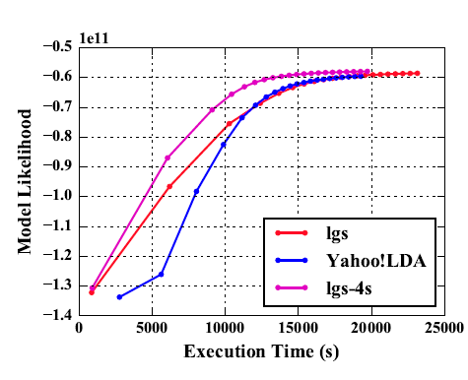
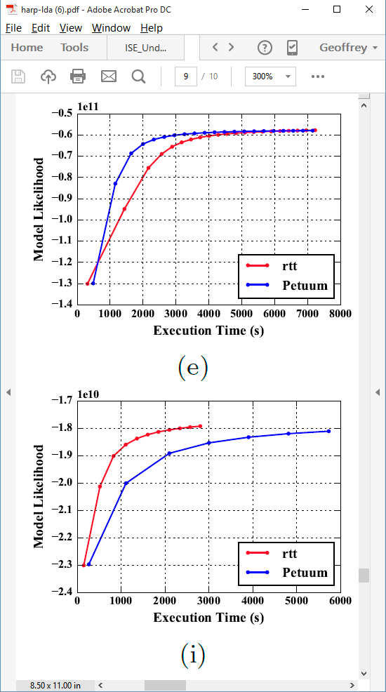
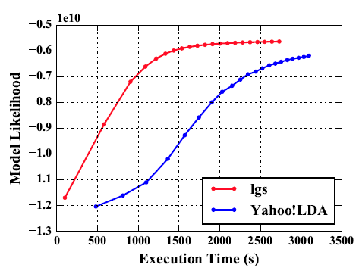
Latent Dirichlet Allocation on 100 Haswell nodes: red is Harp (lgs and rtt)
Clueweb
Clueweb
enwiki
Bi-gram

Slide 28
Streaming Applications and Technology

Slide 29
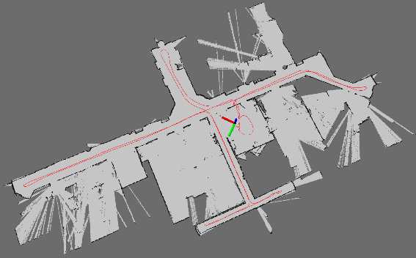
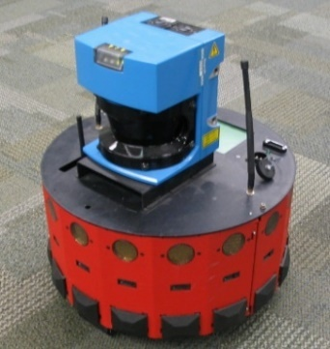
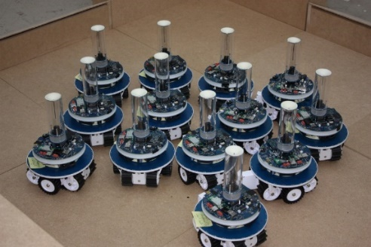
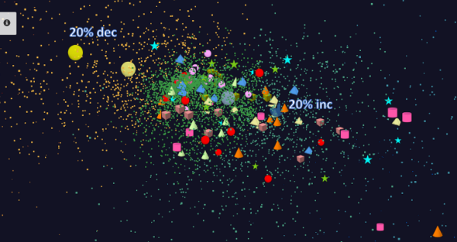
Adding HPC to Storm & Heron for Streaming
Robotics Applications
Time series data visualization in real time
Simultaneous Localization and Mapping
N-Body Collision
Avoidance
Map Built from
Robot data
Robot with a Laser Range Finder
Robots need to avoid collisions when they move
Map High dimensional data to 3D visualizer
Apply to Stock market data tracking 6000 stocks

Slide 30
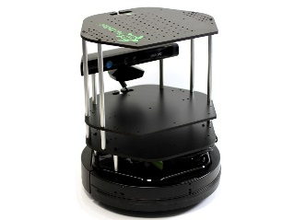
Data Pipeline
Sending to
pub-sub
Sending to
Persisting
storage
Multiple
streaming
workflows
Streaming
workflow
A stream application with some tasks running in parallel
Gateway
Message Brokers
RabbitMQ, Kafka
Streaming Workflows
Apache Heron and Storm
End to end delays without any processing is less than 10ms
Storm does not support “real parallel processing” within bolts – add optimized inter-bolt communication
Hosted on HPC and OpenStack cloud

Slide 31
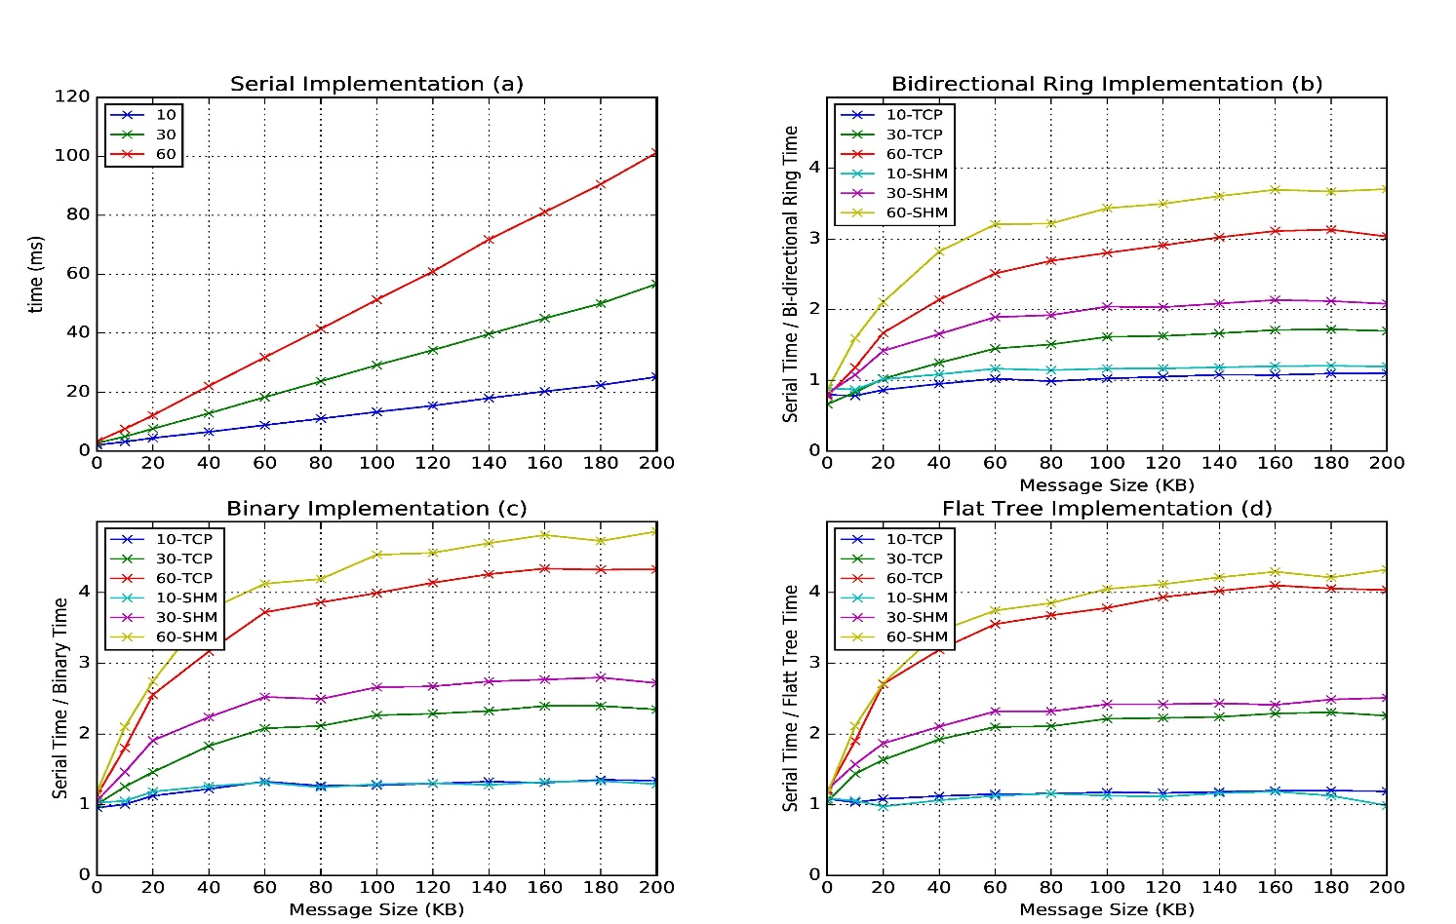
Improvement of Storm (Heron) using HPC communication algorithms
Latency of binary tree, flat tree and bi-directional ring implementations compared to serial implementation. Different lines show varying # of parallel tasks with either TCP communications and shared memory communications(SHM).
Original Time
Speedup Ring
Speedup Binary
Speedup Tree

Slide 32
Next Steps in HPC-ABDS
Currently we are circumventing the dataflow and adding HPC runtime to Apache systems (Storm, Hadoop, Heron)
We can aim exploit better Apache capabilities and additionally
  Allow more careful data specification such as separating "model parameters" (variable) from "data“ (fixed)
  Allowing richer (less automatic) dataflow and data placement operations. In particular allow equivalent of HPF DECOMPOSITION directive to align decompositions
  Implement HPC dataflow runtime "in-place" to implement "classic parallel computing" and higher performance dataflow
This is all as modifications to Apache source
We should be certain to be less ambitious than HPF and not spend 5 years making an inadequate compiler
Resultant system will support parallel computing and orchestration (workflow), batch and streaming.

Slide 33
Application Requirements
It would be good to understand which applications fit
  MapReduce
  Current Spark/Flink/Heron but not MapReduce
  HPC-ABDS but not current Spark/Flink/Heron
a) could be Database (Hive etc.), Data-lake and
b) is certainly Streaming
c) is Global Machine Learning (large scale and iterative like Deep learning, clustering, hidden factors, topic models) and graph problems

Slide 34
Some Performance Vignettes
Java K-Means 10K performance on 16 24 core nodes
FJ standard Fork Join OpenMP pattern
BSP threads running replicated code as in MPI process model
No thread pinning and FJ
No thread pinning and FJ
Threads pinned to cores and FJ
Threads pinned to cores and FJ
No thread pinning and BSP
No thread pinning and BSP
Threads pinned to cores and BSP
Threads pinned to cores and BSP

Slide 35
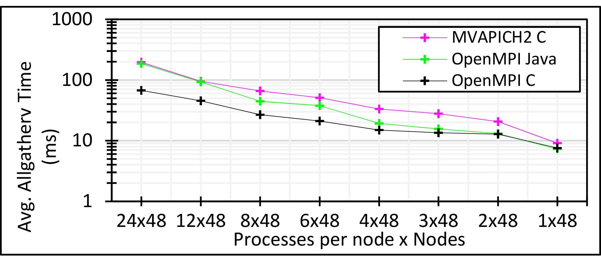
Communication Optimization
Collective communications are important in many machine learning algorithms
  Allgather, allreduce, broadcast
Look at allgather performance for 3 million double values distributed uniformly over 48 nodes
  Compare performance with different number of processes per node

Slide 36
Java and C K-Means LRT-FJ and LRT-BSP with different affinity patterns over varying threads and processes.
Java K-Means 1 mil points with 50k, and 500k centers performance on 16 nodes for LRT-FJ and LRT-BSP over varying threads and processes. The affinity pattern is CE.
Java (left) and C(right) K-Means 1 mil points and 1k centers performance on 16 nodes for LRT-FJ and LRT-BSP with varying affinity patterns over varying threads and processes.
Java MPI + HJ
C MPI + OpenMP

Slide 37
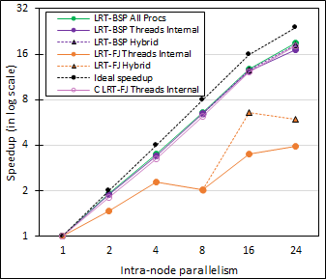
Performance Dependence on Number of Cores inside node (16 nodes total)
Long-Running Theads LRT Java
  All Processes
  All Threads internal to node
  Hybrid – Use one process per chip
Fork Join Java
  All Threads
  Hybrid – Use one process per chip
Fork Join C
  All Threads
All MPI internode

Slide 38
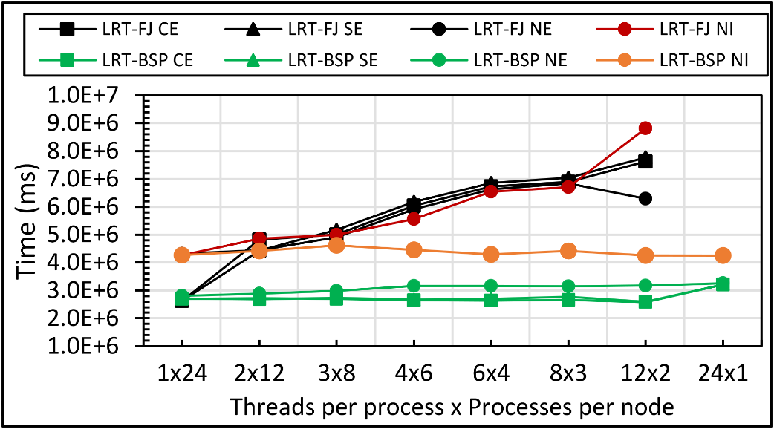
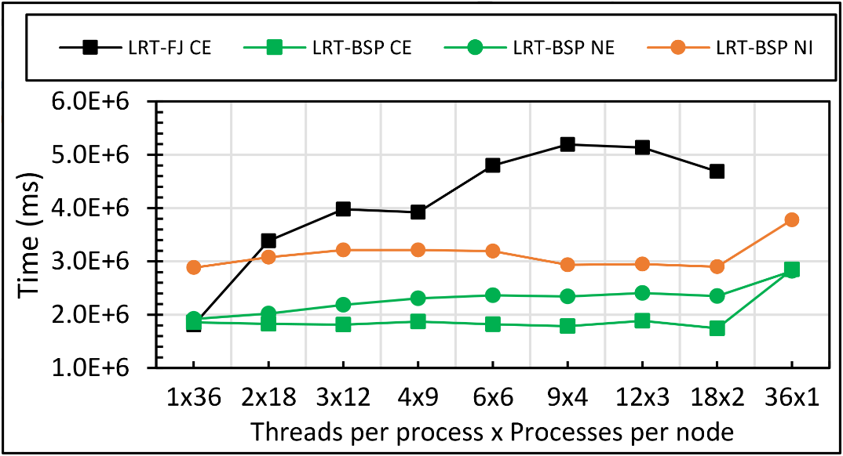
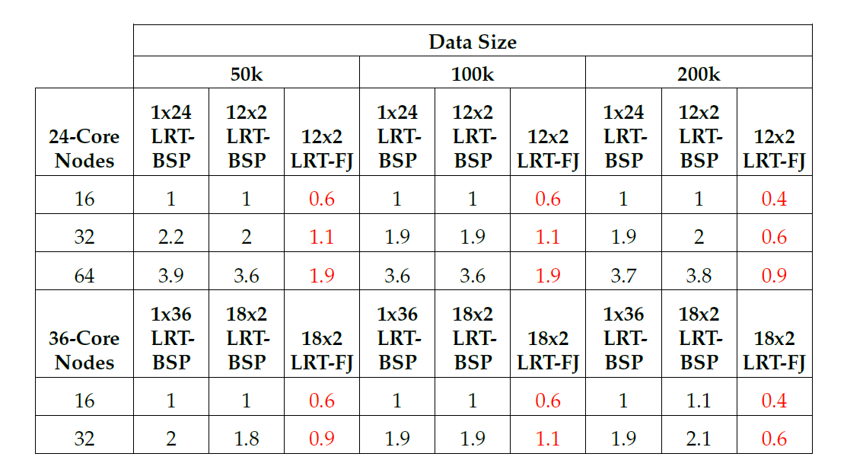
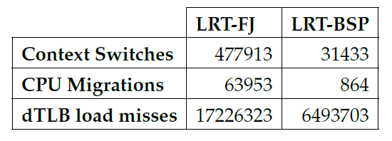
DA-MDS
Java DA-MDS 200k on 16 of 24-core nodes
Java DA-MDS 200k on 16 of 36-core nodes
15x
74x
2.6x
Linux perf statistics for DA-MDS run of 18x2 on 32 nodes. Affinity pattern is CE.
Java DA-MDS speedup comparison for LRT-FJ and LRT-BSP

Slide 39
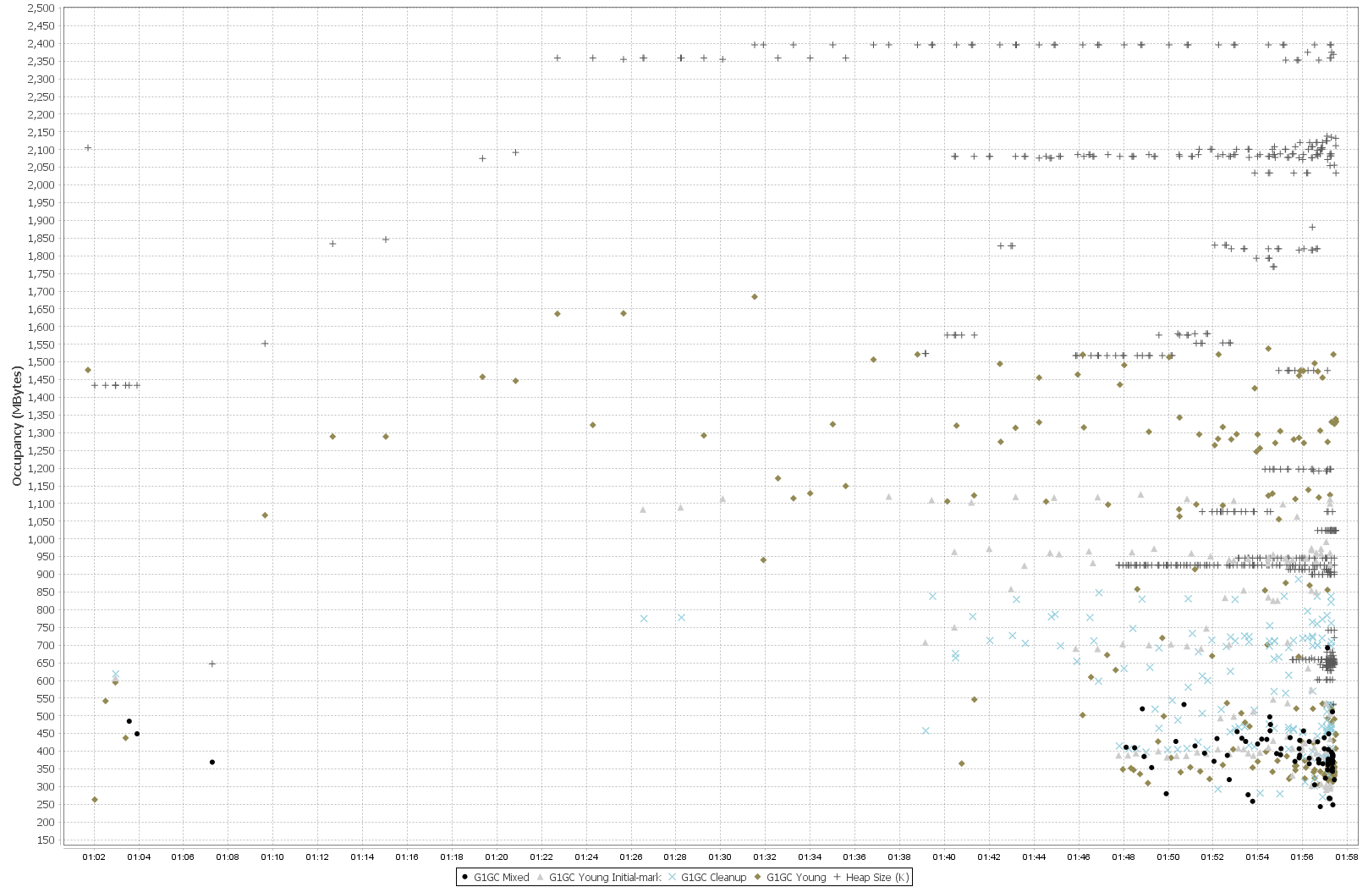
Heap Size
Each point is a Garbage Collection Activity
Time

Slide 40
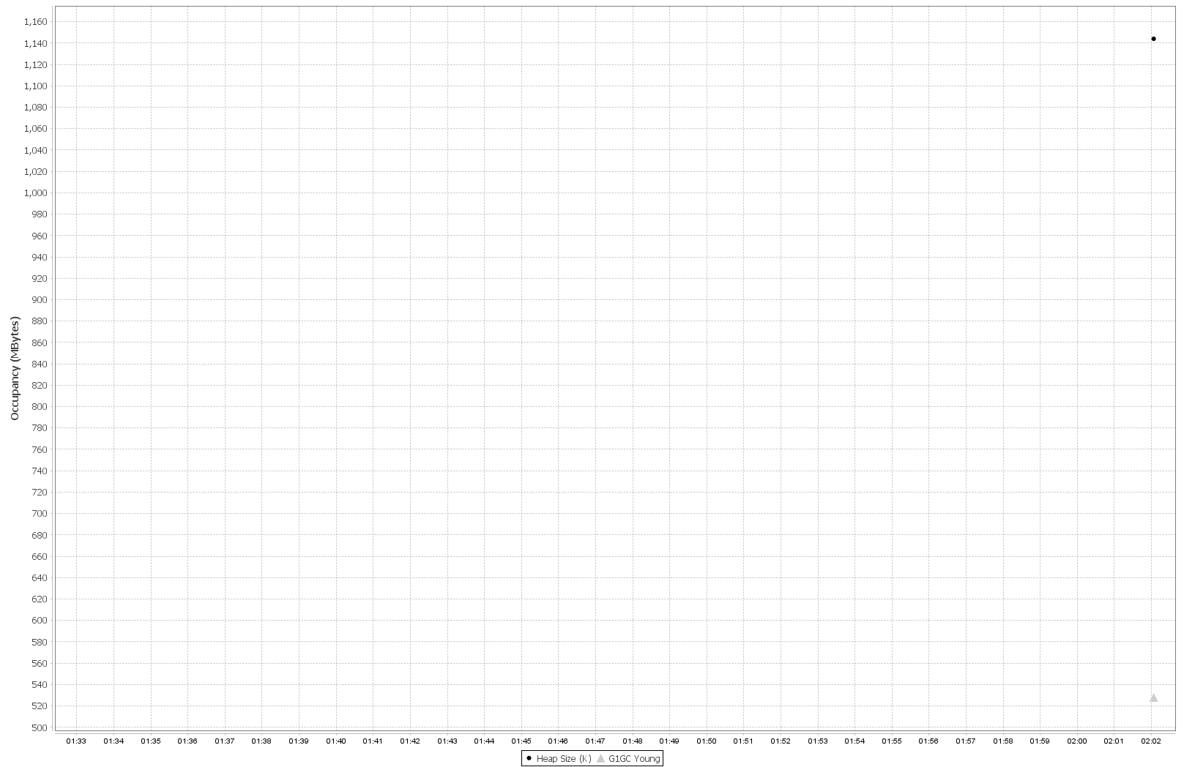
Heap Size
After Java Optimization
Time

