Slide 1
Issues at the intersection of AI, Streaming, HPC, Data-centers and the Edge
NITRD Middleware and Grid Interagency Coordination Team (MAGIC) Geoffrey Fox 1 April 2020
Digital Science Center, Indiana University gcf@indiana.edu, http://www.dsc.soic.indiana.edu/

Slide 2
Some Simple Observations
Consider Science Research Benchmarks in MLPerf
Enhance collaboration between Industry and Research; HPC and MLPerf MLSys communities
Support common environments from Edge to Cloud and HPC systems
Huge switch to Deep Learning for Big Data
Many new algorithms to be developed
Deep Learning for (Geospatial) Time Series (staple of the edge) incredibly promising: obvious relevance to Covid-19 studies
Examples
Inference at the edge
Fusion instabilities
Ride-hailing
Racing Cars
Images
Earthquakes
Solving ODE’s
Particle Physics Events
Timely versus real-time (throughput versus latency); both important

Slide 3
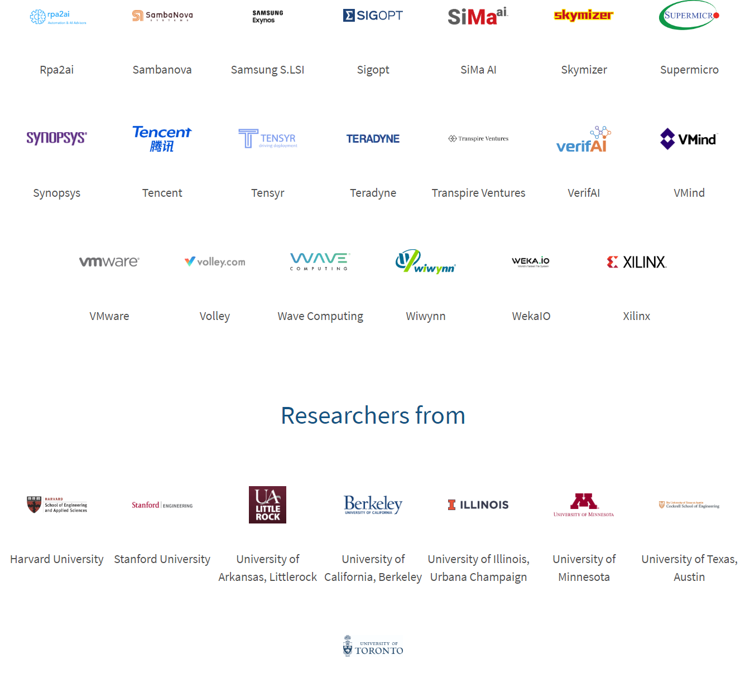
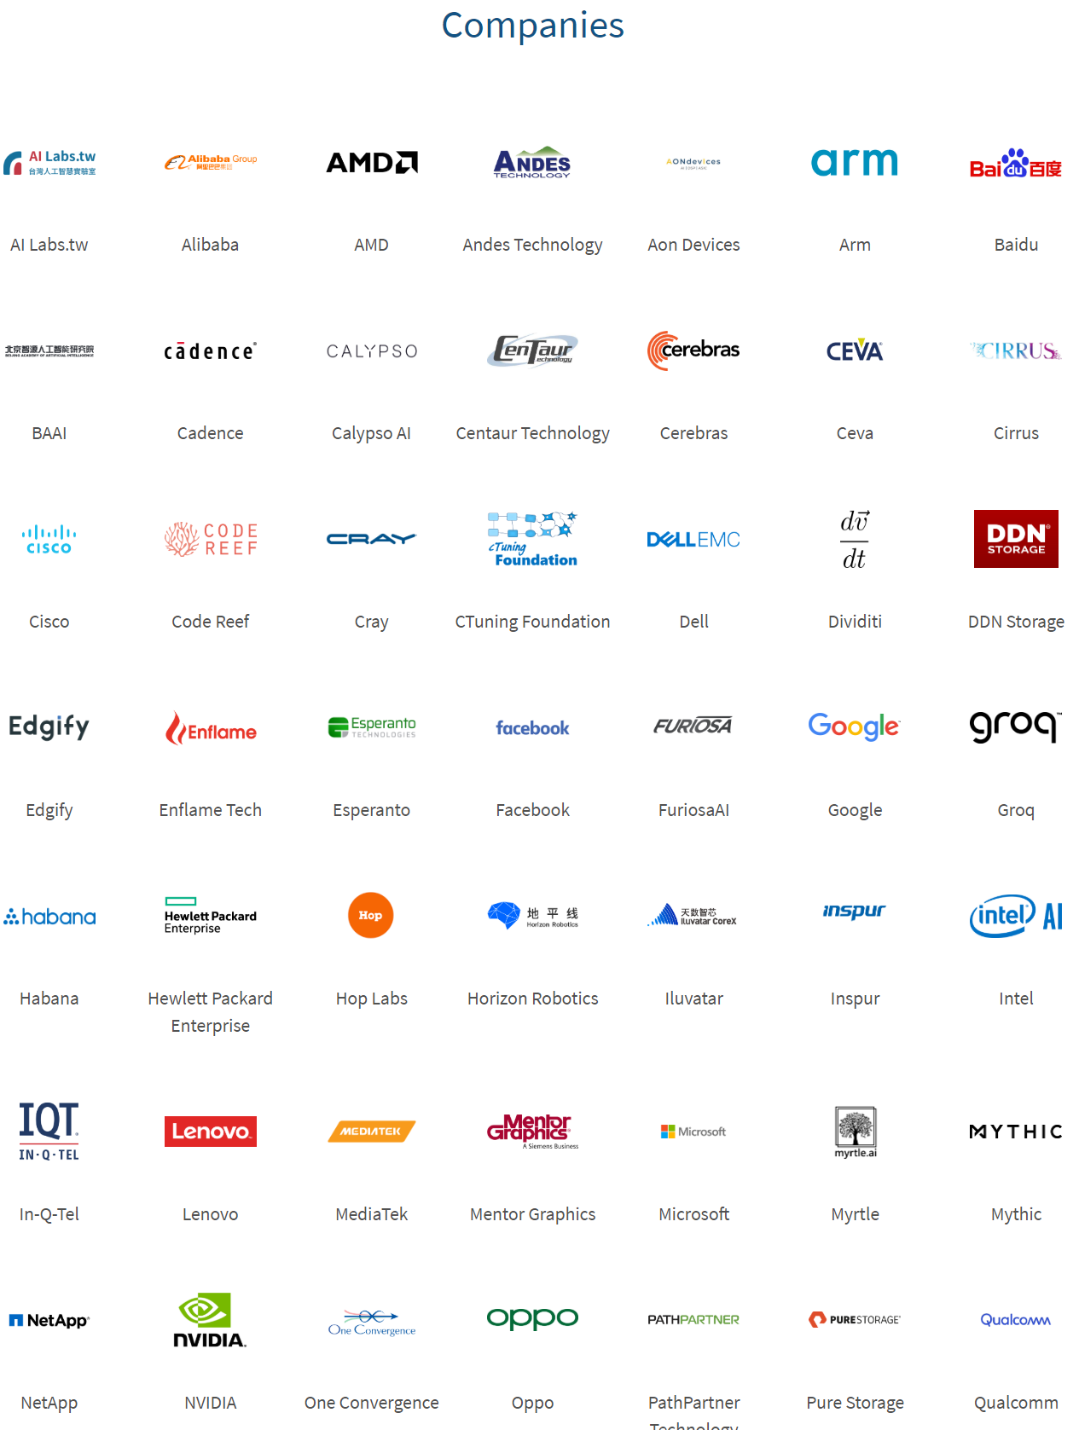
MLPerf Consortium Deep Learning Benchmarks
Some Relevant Working Groups
Training
Inference (Batch and Streaming)
TinyML (embedded)
Deep Learning for Time Series
Power
Datasets
HPC (DoE Labs)
Research
Science Data (Proposed by Fox, Hey)
MLPerf's mission is to build fair and useful benchmarks for measuring training and inference performance of ML hardware, software, and services.
Benchmark what user sees
Accelerate progress in ML via fair and useful measurement
Serve both the commercial and research communities
Enable fair comparison of competing systems yet encourage innovation to improve the state-of-the-art of ML
Enforce replicability to ensure reliable results
Keep benchmarking effort affordable so all can participate
69 Companies; 8 universities

Slide 4
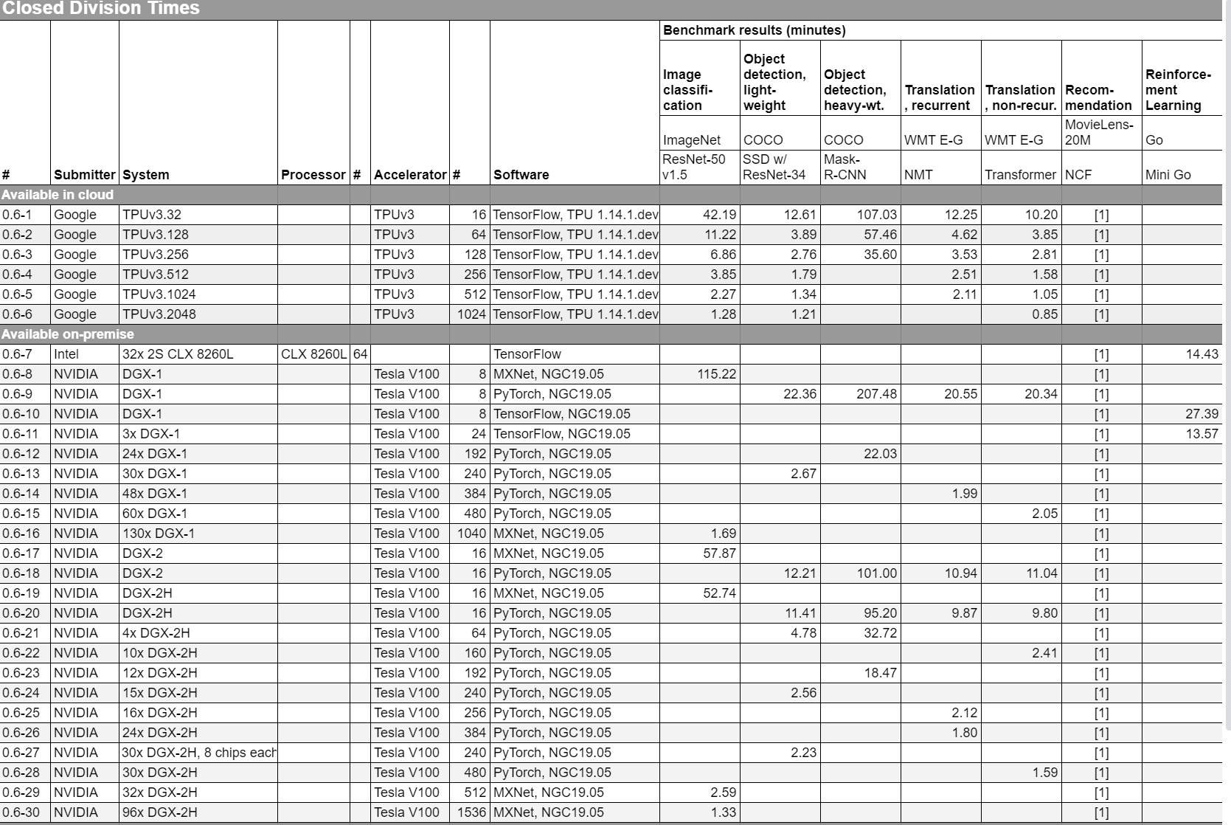
Training v0.6
Typical Benchmarks
2048 TPUs or
1536 V100’s with Infiniband quite powerful

Slide 5
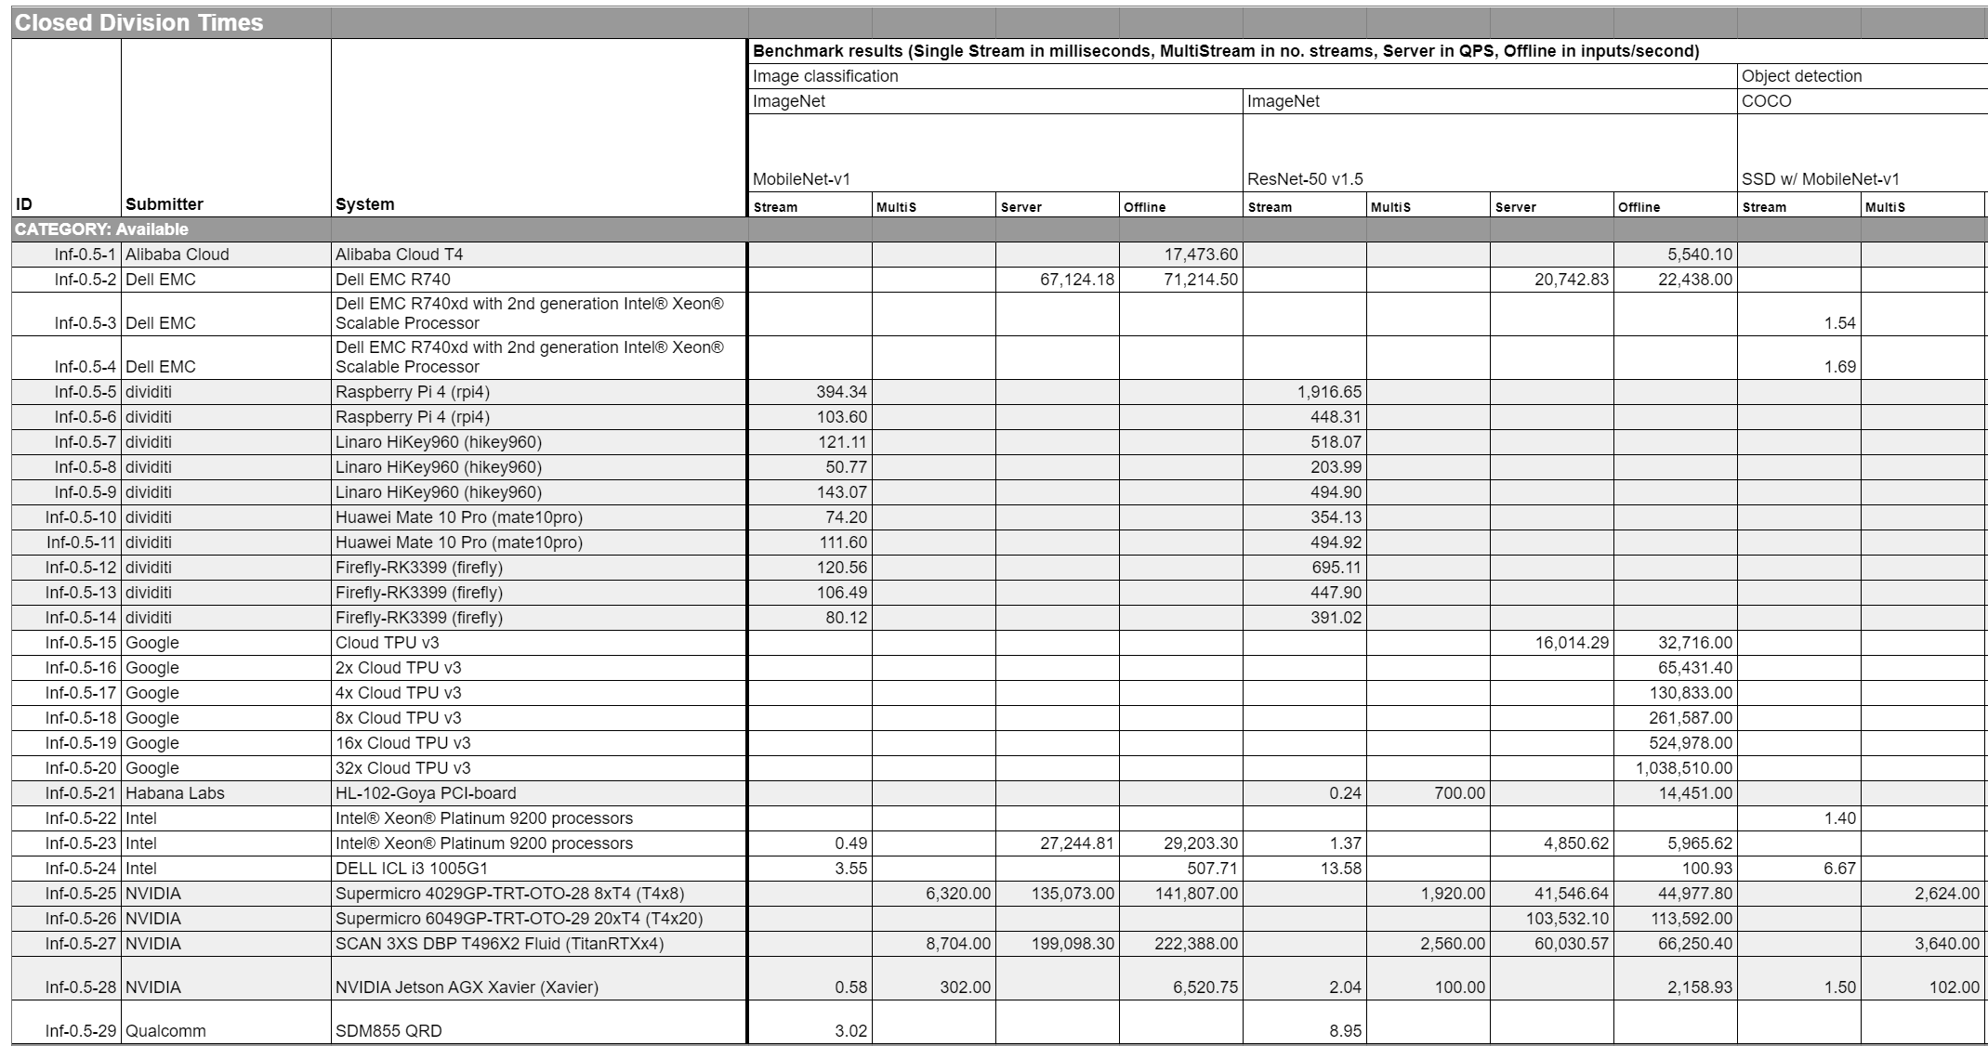
Inference v0.5
Benchmarks and rules
Dividiti is MLPerf member in Cambridge UK

Slide 6
Science Data and MLPerf I
Suggest that MLPerf should address Science Research Data
There is no existing scientific data benchmarking activity with a similar flavor to MLPerf -- namely addressing important realistic problems aiming at modern data analytics including deep learning on modern high-performance analysis systems.
Further, the challenges of science data benchmarking both benefit from the approach of MLPerf and will be synergistic with existing working groups.
Science like industry involves edge and data-center issues, inference, and training, There are some similarities in the datasets and analytics as both industry and science involve image data but also differences;
Science data associated with simulations and particle physics experiments are quite different from most industry exemplars.
Science datasets are often large and growing in size, while the multitude of active areas gives diverse challenges. The best practice science algorithms are shifting to deep learning approaches as in industry today.
Benchmarks will help more science fields take advantage of modern ML and increase link between Industry and Research
Setting up first working group meeting: Tell me if you are interested

Slide 7
Science Data and MLPerf II
We foresee that scientific machine learning benchmarks for MLPerf will include a number of datasets, from each of the scientific domains, along with a representative problem from those domains. Some example benchmarks where we already have contacted scientists are:
Classifying cloud types from satellite imagery (environmental sciences)
Photometric redshift estimation based on observational data (astronomy), and
Removing noise from microscopic datasets (life and material sciences)
Real-time monitoring and archival analysis of data from light sources at DIAMOND (UK) and DoE Laboratories (US) (Biological and Material sciences)
Simulations covering near term recurrent neural networks and long term studies with fully connected and convolutional networks. This would initially be taken from biomolecular and material science areas but these examples will lead to work across many fields
Time series of geographically distributed disease occurrences with simulated and observed data
Monitoring of plasma instabilities in fusion Tokamaks with observation and simulation
When fully contributed, the benchmark suite will cover the following domains: material sciences, environmental sciences, life sciences, fusion, particle physics, astronomy, earthquake and earth sciences, with more than one representative problem from each of these domains

Slide 8
Linkage of Deep Learning (AI) and High Performance Computing
On general principles, Big data stresses capabilities of compute/data platforms and needs best possible performance and naturally uses HPC
HPC are not just Supercomputers and the use of HPC for deep learning is pervasive in both industry and academia/government
Cloud/Supercomputer/HPC Cluster: GPU and TPU
Edge: FPGA Edge GPU, Edge TPU, Custom …
Large number of new architectures focussed on AI, CPU also useful!
As well as HPC for AI (GPU’s for deep learning), dramatic progress on AI for HPC enhancing simulations with 100’s of papers in last 3 years
PyTorch and TensorFlow (maybe MXNET) dominate; should collaborate on enhancing these and building systems around them
Hyper-parameter search needs to be deployed broadly; places like IU do not have resources to support extensive hyper-parameter search but more common in Industry and DoE
Need to advance tools for time series: LSTM, GRU, ConvLSTM, CNN+LSTM, Reformer, Transformer
Industry logistics, ride-hailing, speech, image streams but science can be different
Need to advance deep learning for clustering, dimension reduction and other classic machine learning problems

Slide 9
HPCforML: Integration Challenges
This well-known paper points out that parallel high-performance machine learning is perhaps most fun but just a part of system. We need to integrate in the other data and orchestration components.
This integration is not very good or easy partly because data management systems like Spark are JVM-based which doesn’t cleanly link to C++, Python world of high-performance ML
My project Twister2 at IU addresses this problem
Not much addressed at MLSys
ML Code
NIPS 2015 http://papers.nips.cc/paper/5656-hidden-technical-debt-in-machine-learning-systems.pdf

Slide 10
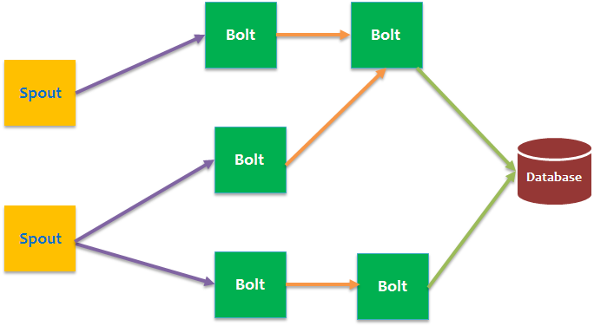
Classic Streaming Software Solution
Cloud/Data-center
Device
Fog
Pub-Sub Buffer
Analysis Streams
Fog interface similar to Cloud
Required response latency and functionality decides where work done
Apache Storm model supported by Apache Beam (Google Cloud Dataflow)
Streaming software surrounded by well known Big Data Engineering Systems such as Spark, Flink, Hadoop, MongoDB and use Serverless (Function as a Service) architecture
Java Python C++ integration not so easy with good performance

Slide 11
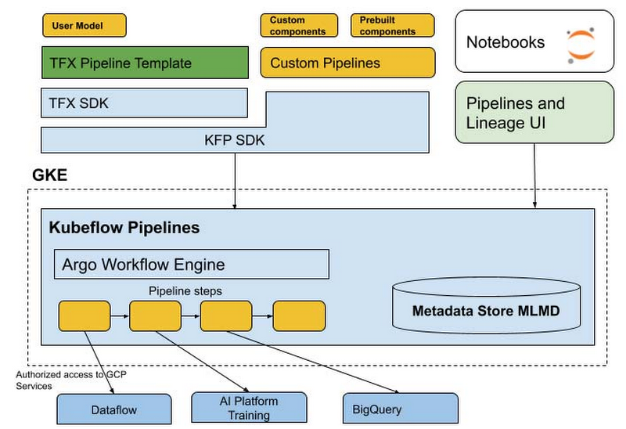
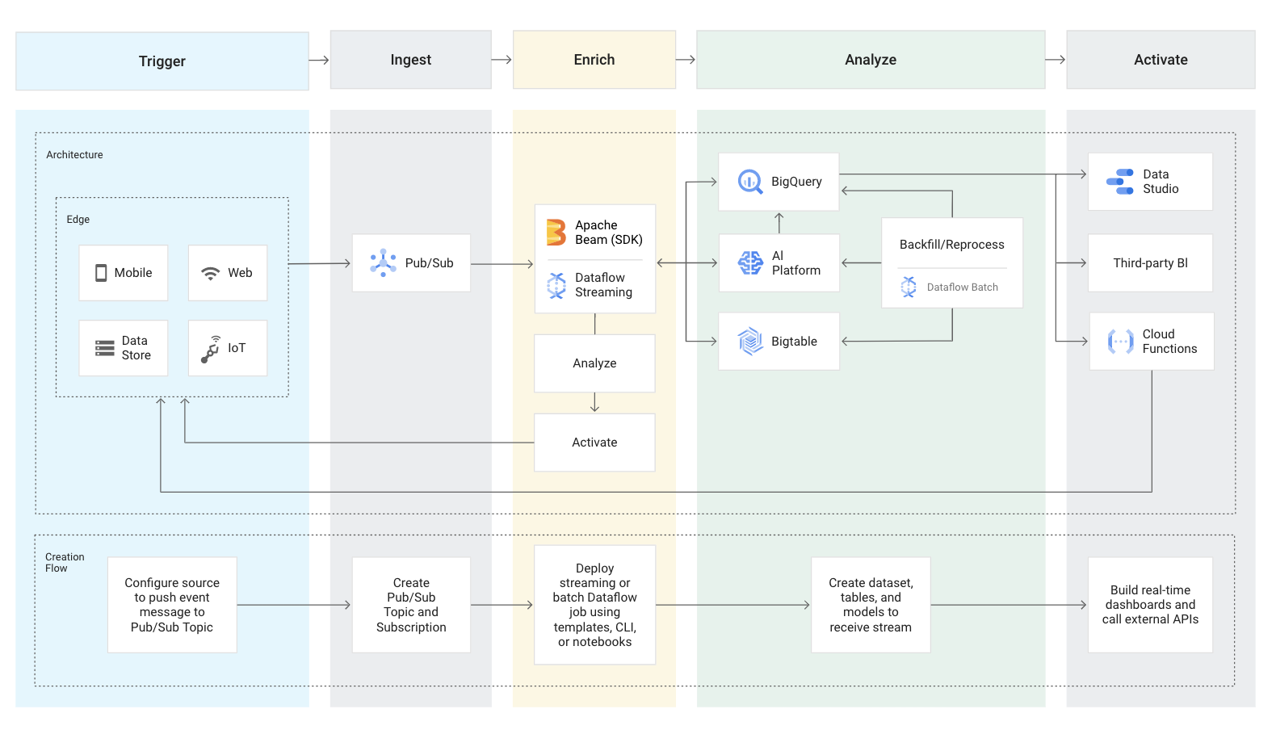
Apache Beam, Kubeflow, Argo: Typical Industry Edge to Cloud Workflow
Recent Industry solution aimed at AI workflows constructed as a graph of containers
March 11, 2020 https://cloud.google.com/blog/products/ai-machine-learning/introducing-cloud-ai-platform-pipelines
Full edge to cloud workflow
Google Cloud AI Platform Pipelines on Kubernetes General DAG connected containers

Slide 12
MLSys Edge Deep Learning Papers on the Edge
Top conference at interface of Systems and AI; >50% Industry
Federated Optimization in Heterogeneous Networks; Distributed AI Loss functions
SkyNet: a Hardware-Efficient Method for Object Detection and Tracking on Embedded Systems: Image analysis on edge
MNN: A Universal and Efficient Inference Engine: Edge inference with CPU used in production by Alibaba (Strassen’s algorithm)
Predictive Precompute with Recurrent Neural Networks: DNN to predict user actions and suggest precomputing used in production by Facebook
Ordering Chaos: Memory-Aware Scheduling of Irregularly Wired Neural Networks for Edge Devices: optimize scheduling
PoET-BiN: Power Efficient Tiny Binary Neurons: Deep Learning on FPGA’s and 4 other papers on edge quantization (low precision)
Rest of papers (total 34 in main track) on server side and all focus on direct System-Deep Learning Integration

Slide 13
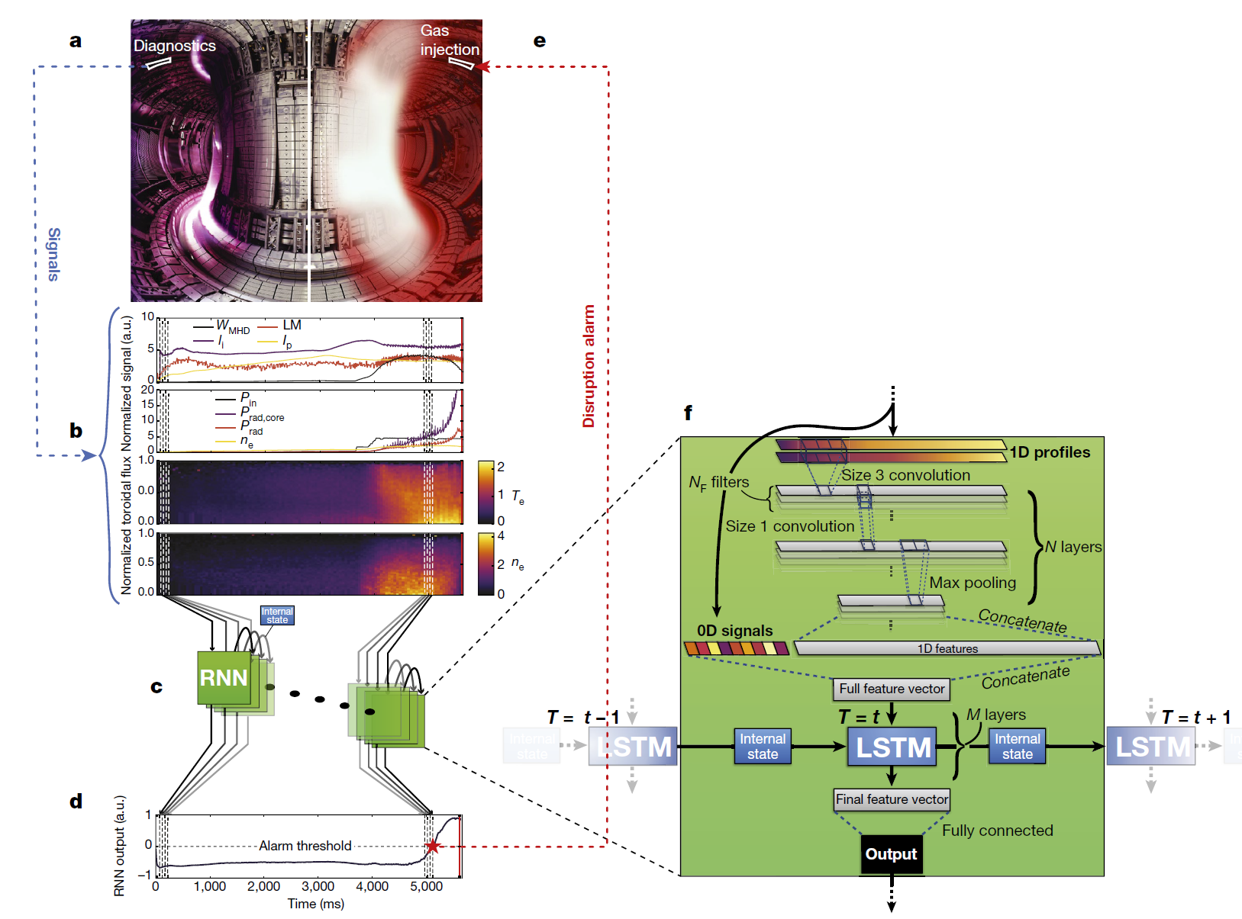
Deep Learning Prediction of Fusion Tokomak Instabilities
An example of Spatial Deep Learning
Streaming data at one per ms rate fed into CNN’s followed by LSTM’s
Creates “Disruption Alarm”
Predicting disruptive instabilities in controlled fusion plasmas through deep learning
Kates-Harbeck, Julian; Svyatkovskiy, Alexey; Tang, William
Nature

Slide 14
http://arxiv.org/abs/1905.11395 X Geng, X Wu, L Zhang, Q Yang, Y Liu, J Ye, (Didi, HK, USC)
“Multi-Modal Graph Interaction for Multi-Graph Convolution Network in Urban Spatiotemporal Forecasting” built on 3 different graphs (roads, function, geometry) plus RNN
Apply to Ride-Hailing
Few minutes - hours-days-weeks
Multi-graph Convolutional Neural Network

Slide 15
Indianapolis 500 Real-Time Anomaly Detection and Ranking Prediction
Data Sources
Sensor data for IndyCar races.
Statistics of previous years: https://www.indycar.com/Stats
Selection of Features
Ranking prediction mainly depends on three measurable factors:
Past performance: Time series data.
Current position: The current Lap and Lap Distance.
Remaining fuel: The time difference from the last Pit Stop.
Data Preprocessing
Streaming data is adjusted to appropriate representation of time-series vector by interpolation methods.
Judy Qiu Indiana University
and Jiayu Li in her research group
Indy Car Race Analysis
Real-time video, track data, car sensor data

Slide 16
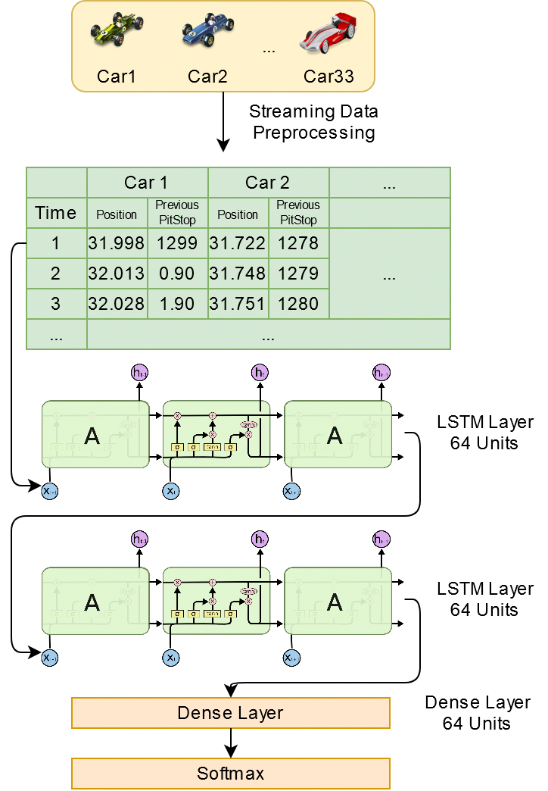
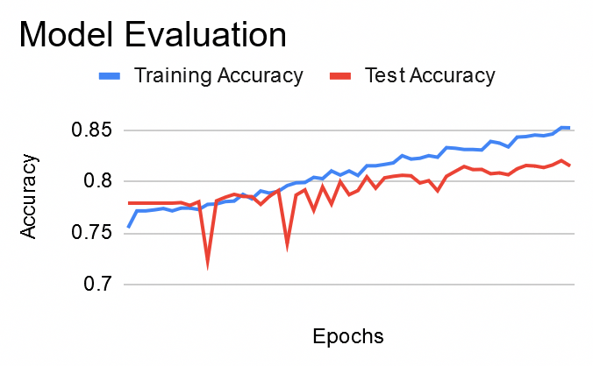
Indy500 Rank Prediction using LSTM on Streaming Data
Features Used
Position: The current position of the car.
Previous Pitstop: How long has passed since the last pit stop.
Dimensions of the Data Sets
A total of 66 features: 33 cars * 2 features each.
Each sample lasts approximately 10,000 seconds
Model Output
Probability distribution of the leading car.
Ranking Prediction

Slide 17
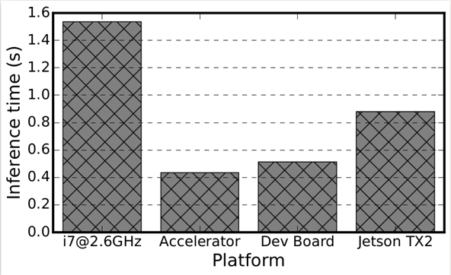
Denoising Images from Light Sources (Argonne, IU)
Paper from SC20 Workshop
Scientific Image Restoration Anywhere
Vibhatha Abeykoon, Zhengchun Liu, Rajkumar Kettimuthu, Geoffrey Fox and Ian Foster
Edge TPU’s
1024 by 1024 Image

Slide 18
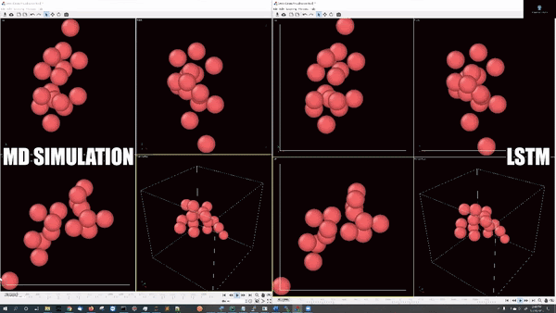
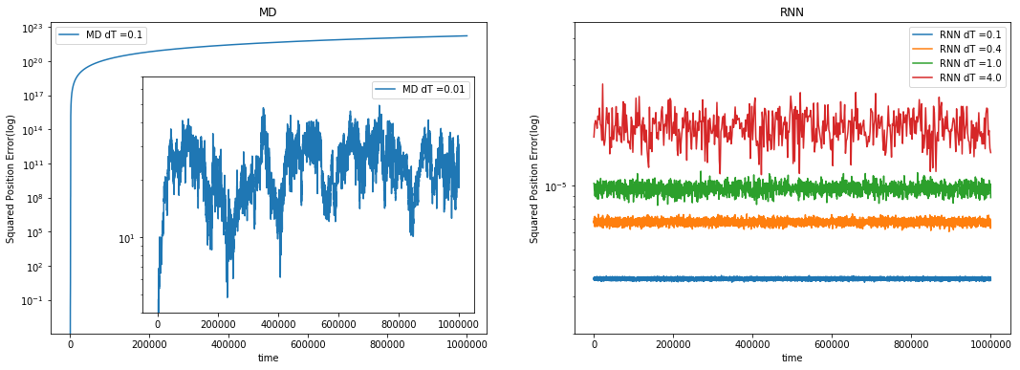
Learn Newton’s laws with Recurrent Neural Networks
(work with JCS Kadupitiya, Vikram Jadhao)
Deep Learning is revolutionizing (spatial) Time series Analysis
Good example is integrating sets of differential equations
Train the network on traditional 5 time step series from (Verlet) difference equations
Verlet needs time step .001 for reliable integration but
Learnt LSTM network is reliable for time steps which
are 4000 times longer and also learn potential.
Speedup is 30000 on 16 particles interacting with Lennard-Jones potentials
2 layer-64 units per layer LSTM network: 65,072 trainable parameters
5000 training simulations
10²³
RNN Error² up to step size dT=4 and total time 10⁶
10⁻⁵
10¹
Verlet error² dT = 0.01, 0.1

Slide 19
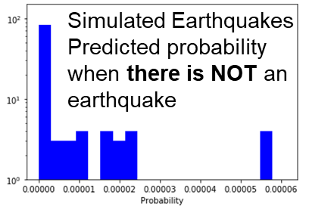
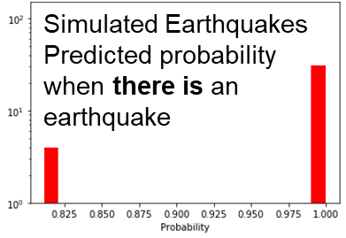
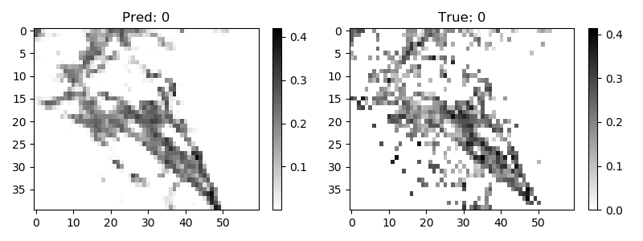
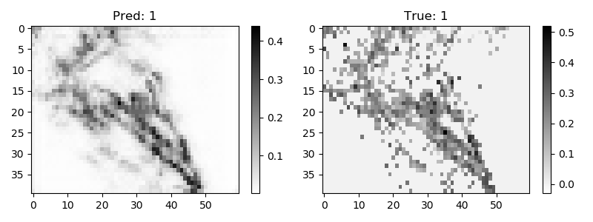
Hidden Theories and Hidden Instances
The LSTM description of particle dynamics suggests that the DNN has learnt “Newton’s laws” and then you look at different instances in the inference
To the right is model learning simulated earthquakes
Below are two predictions compared to observation for annual earthquake activity in Southern California (each pixel is about 11 km square)
Uses Convolutional LSTM with 5 time steps and data is log of aggregated energy released (can’t use energy as too large a dynamic range)
DNN learns theories

Slide 20
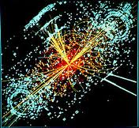
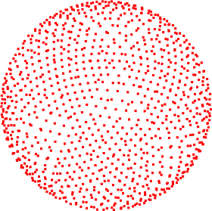
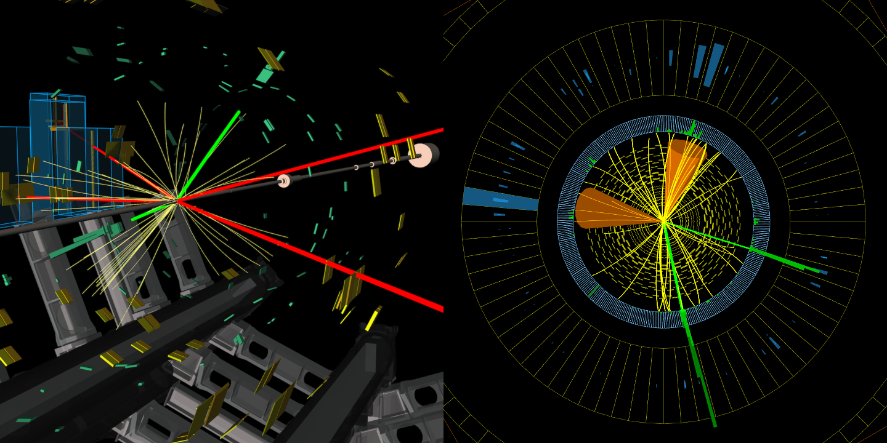
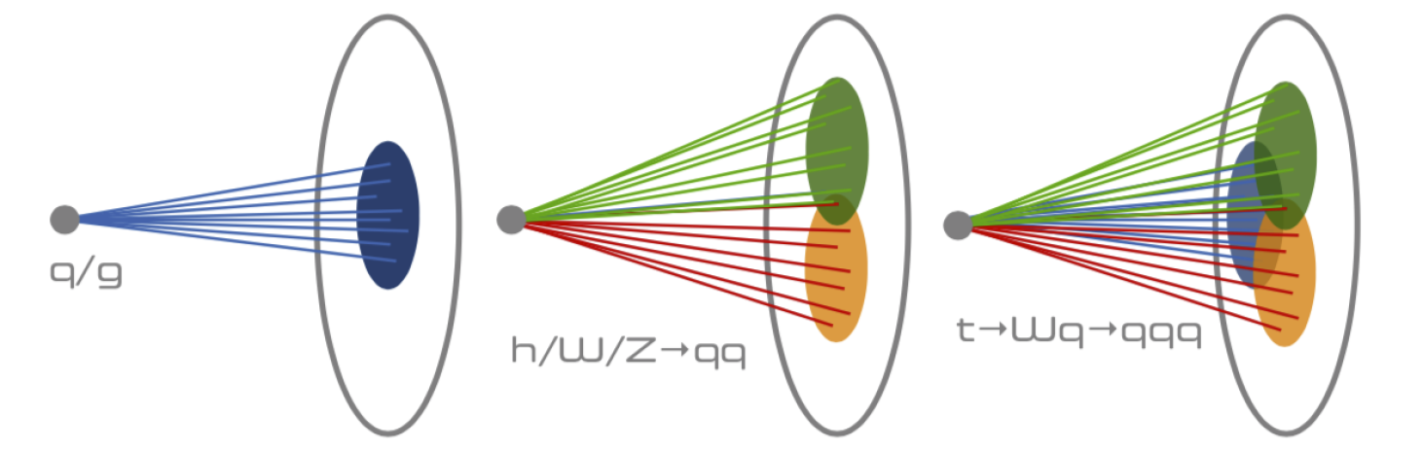
Deep Learning in Particle Physics Data Analysis
Train on LHC and simulation events with input as angular distribution of momentum in a 4π steradian detector i.e. you have total energy transmitted in each direction on sphere surrounding interaction point
Different physics gives different patterns of particles
Energy flowing in each direction
LHC Events

Slide 21
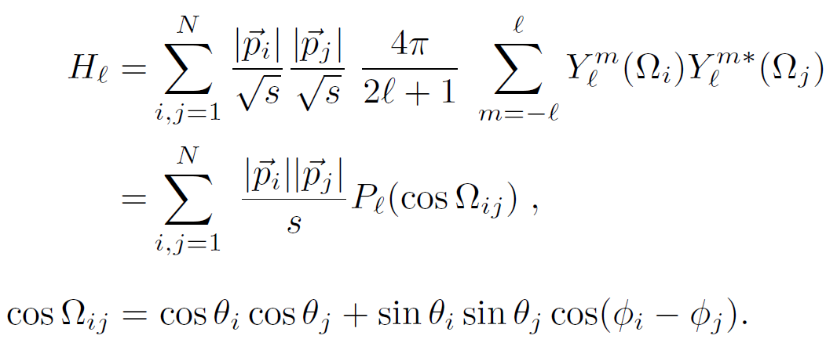
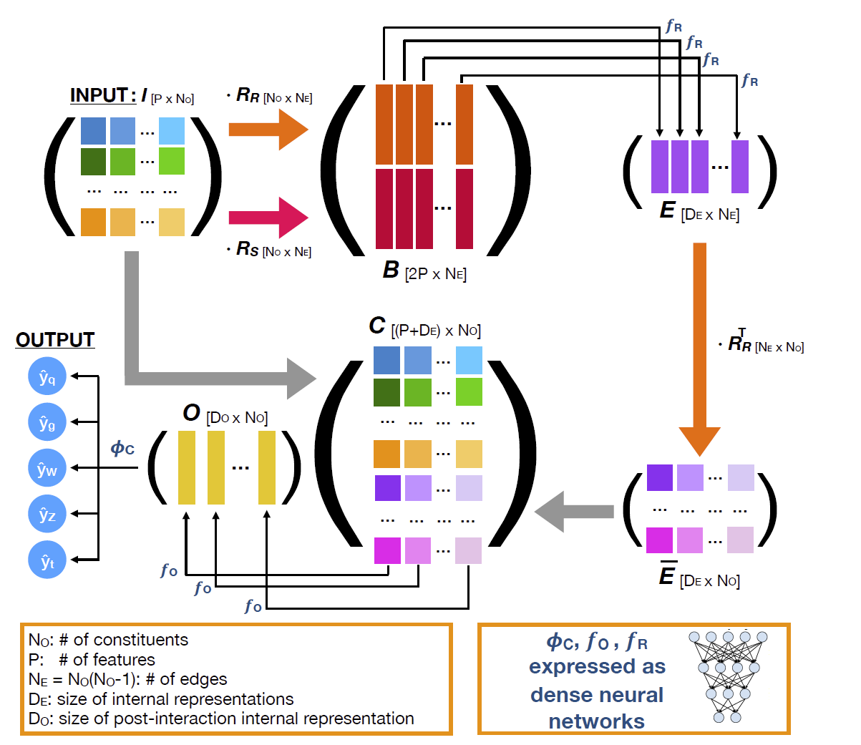
Deep Learning in Particle Physics Data Analysis
(Caltech) Observables for the analysis of event shapes in e+ e− annihilation and other processes, GC Fox, S Wolfram, Physical Review Letters 1978, 1648 citations (50 in 2019) introduced quantities to characterize shapes of collections of particles. They were invariant exactly to rotations and approximately to unknown details of decays of hidden particles (quarks, gluons, Higgs, W/Z bosons) as involved sums over momenta preserved in decays
Need tiny computing!
(Caltech, Fermilab, CERN) arXiv:1908.05318 from CMS introduces JEDI-NET with 3 DNN’s for this
This just one of many classic ideas replaced by deep learning.
Fox Wolfram Moments
JEDI-NET

Slide 22
Conclusions: Reiterate Simple Observations
Consider Science Research Benchmarks in MLPerf
Enhance collaboration between Industry and Research; HPC and MLPerf/MLSys communities
Support common environments from Edge to Cloud and HPC systems
Huge switch to Deep Learning for Big Data
Many new algorithms to be developed
Deep Learning for (Geospatial) Time Series (staple of the edge) incredibly promising: obvious relevance to Covid-19 studies
Examples
Inference at the edge
Fusion instabilities
Ride-hailing
Indy car racing
Images
Earthquakes
Solving ODE’s
Particle Physics Events
Timely versus real-time (throughput versus latency); both important

