Slide 1
2020-2025 Scientific Computing Environments ( Distributed Computing in an Exascale era)
August 7 2013
Geoffrey Fox
gcf@indiana.edu
http://www.infomall.org http://www.futuregrid.org
School of Informatics and Computing
Community Grids Laboratory
Indiana University Bloomington

Slide 2
2020-2025 Scientific Computing Environments ( Distributed Computing in an Exascale era)
The components of national research computing in exascale era with mix of high end machines, clouds (whatever commercial companies offer broadly or publicly), university centers, high throughput systems and with growing amounts of distributed and "repositorized" data serving High End and Long Tail researchers.
The nature of an environment like XSEDE in the Exascale era; i.e. the nature of a distributed system of facilities including one or more exascale machines. Should it be relatively tightly coupled like XSEDE or more loosely coupled like DoE leadership systems (or both!)

Slide 3
Considerations
Both of these major topics can be considered with attention to
A) What services do 2025 science projects need from cyberinfrastructure; examples are -- Collaboration; On-demand computing; Digital observatory; High-speed scratch and persistent storage; Data preservation; Identity, profile, group management, reproducibility of results, versioning, and documentation of results
B) What are requirements in 2025 -- are there changes in distributed system requirements outside details of exascale machines with their novel architecture e.g.
Will big data lead to new requirements
Will feeding/supporting exascale machine lead to new requirements
Will supporting long tail of science lead to new requirements
Can we do more to make people use central services rather than building their own

Slide 4
Speakers
Miron Livny, Wisconsin
Shantenu Jha, Rutgers
Dennis Gannon, Microsoft
Ioan Raicu, IIT
Jim Pepin, Clemson

Slide 5
Network v Data v Compute Growth
Moore’s Law Unnormalized
Slope of #1 Top 500 > Total Data > Moore > IP Traffic

Slide 6
Trends Network, Data, Computing
Data likely to get larger and produced all over the world i.e. stay distributed
Network rise underlies MOOC’s and Cloud computing
Not obvious that data/network increase any larger than computing
Cisco network traffic < Moore’s Law
IDC total data > (little bit) Moore’s Law
Some areas of data like genomics and social images have seen huge (one time?) increases

Slide 7
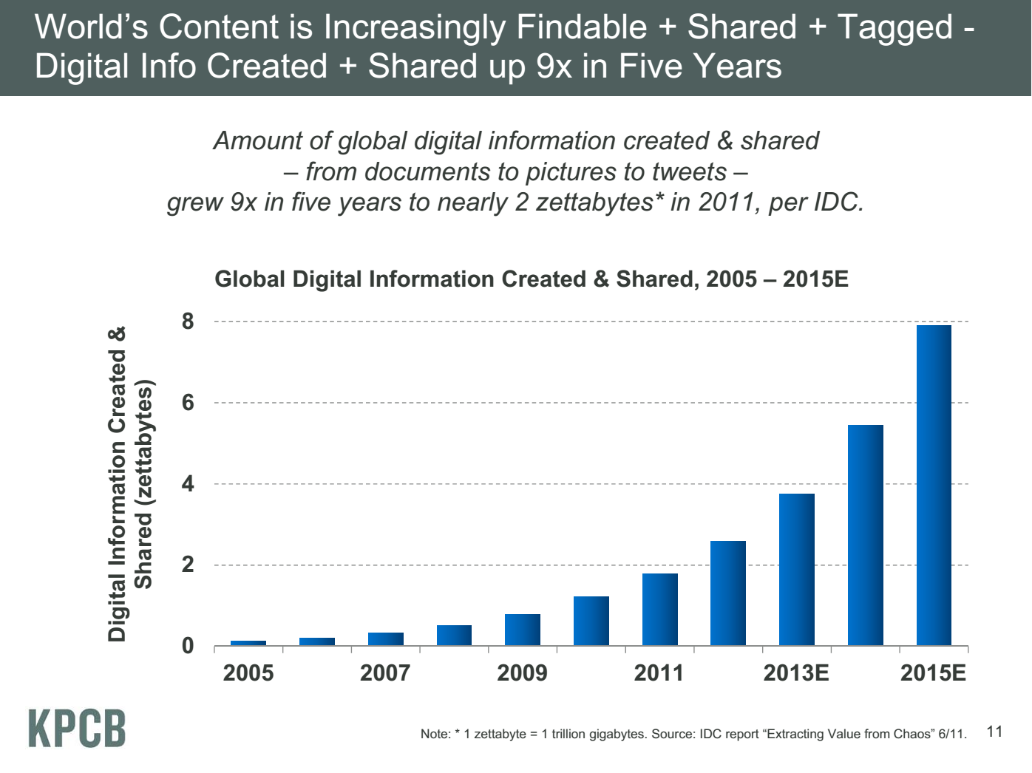
Zettabyte = 1000 Exabytes
Exabyte = 1000 Petabytes
Petabyte = 1000 Terabyte
Terabyte = 1000 Gigabytes
Gigabyte = 1000 Megabytes
Meeker/Wu May 29 2013 Internet Trends D11 Conference

Slide 8
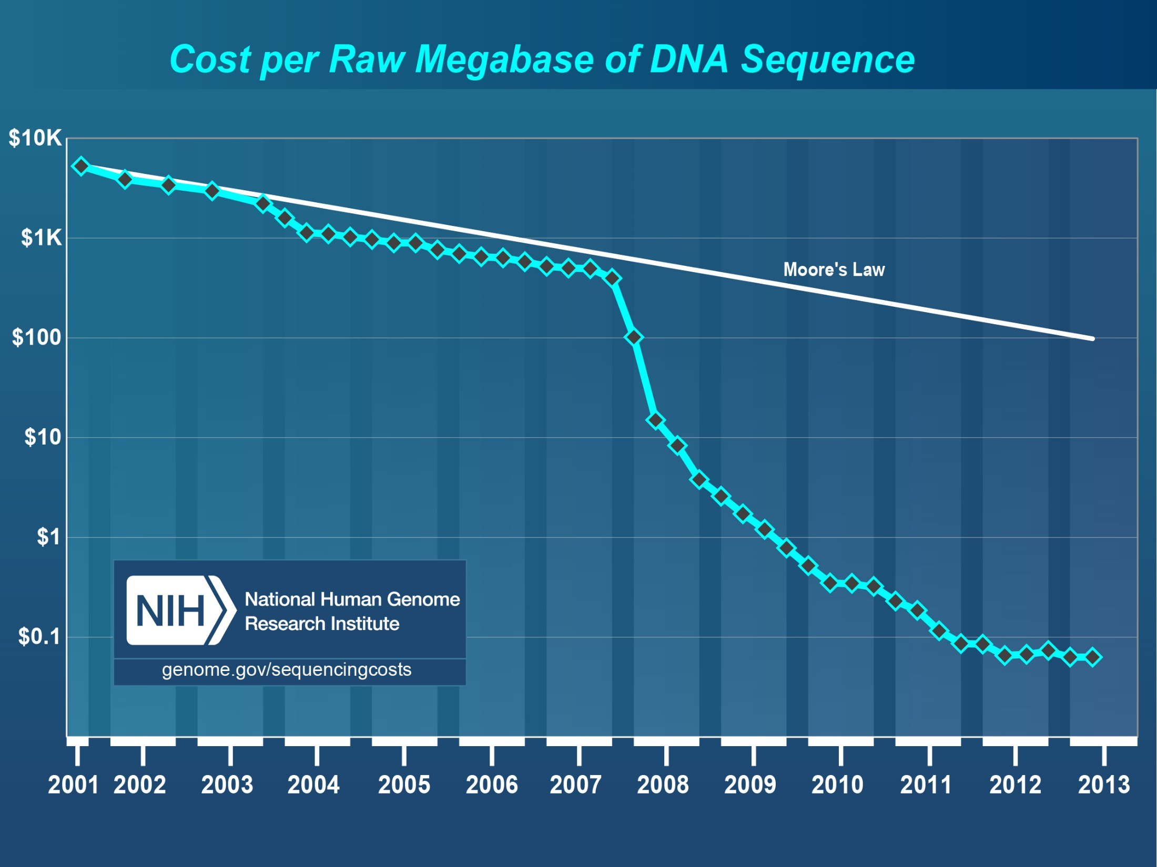
Faster than Moore’s Law
Slower?
http://www.genome.gov/sequencingcosts/

Slide 9
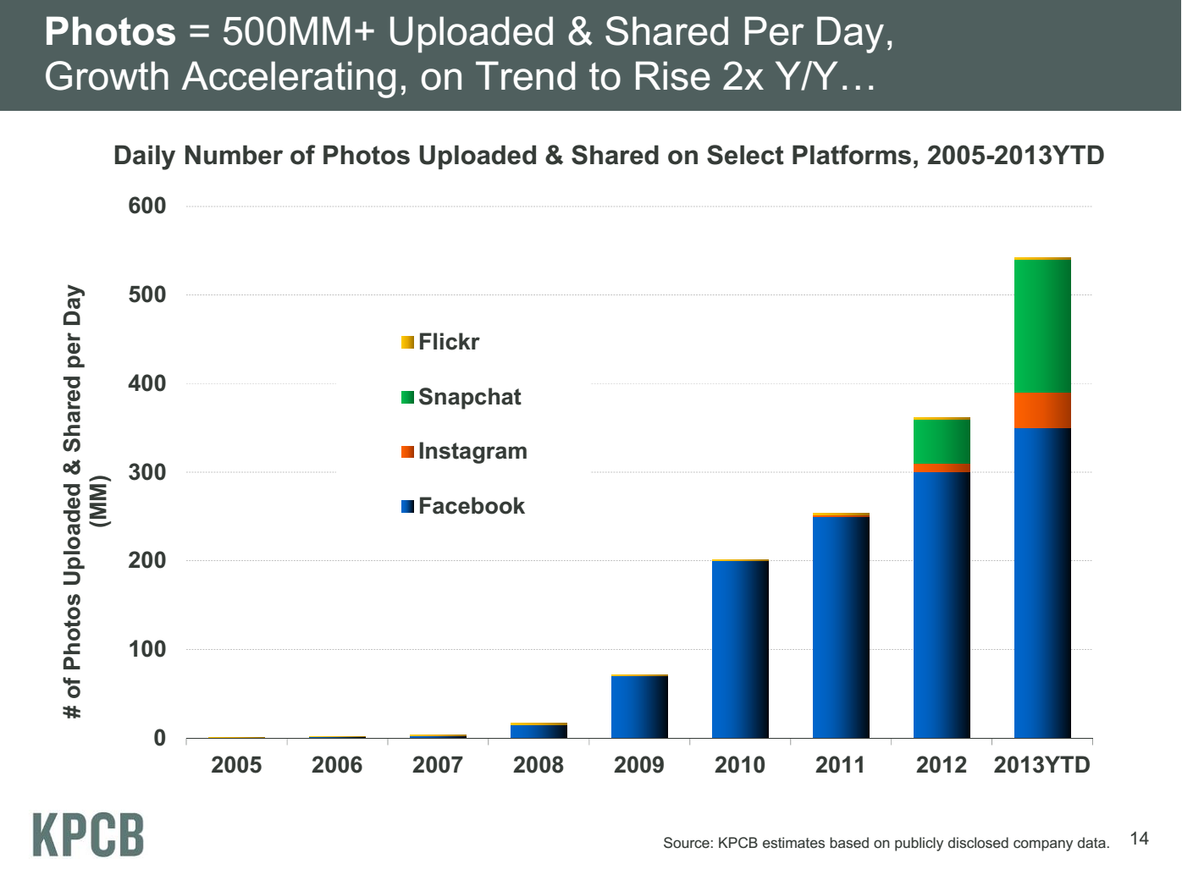
Factor of 2 per year faster than Computing
2013 JUST to date (May 2013)
Meeker/Wu May 29 2013 Internet Trends D11 Conference

Slide 10
Image based Computations
Deep Learning with COTS HPC, Adam Coates, Brody Huval, Tao Wang, David J. Wu, Andrew Y. Ng and Bryan Catanzaro ICML 2013 (Stanford AI group) http://www.stanford.edu/~acoates/papers/ CoatesHuvalWangWuNgCatanzaro_icml2013.pdf
64 GPU’s on 16 nodes; MPI Speed up of 32; GPU parallelism “perfect”
Train 11 BILLION parameters in 3 days on just 10 million 200 by 200 images from YouTube (note 500 million per day on FaceBook etc.)
MPI Parallelism over pixels; GPU uses optimized Matrix-Matrix multiplication with Parallelism over Neuron banks and Images
Earlier paper NIPS2012 using MapReduce variant with Google (Dean) had MUCH poorer performance on 16000 Intel style cores
Next: Neural networks for driving: 100 million ~1000 by 1000 images

Slide 11
Is Big Data Changing Requirements?
Will Compute/Data/Network ratios change?
Not obvious but needs more study
I expect “Data Science” to grow and increased use of large scale data analytics as in deep learning and image clustering (100 million images, 10 million clusters)
Richer set of data areas and new users like AI/Image processing
Compute requirements unclear for data analytics
Status of bringing data to computing still unclear
NIST BigData effort defining use cases and associated reference architecture
So changes due to Big Data just because we haven’t got it right now
However applications like LHC analysis and Long Tail Science will keep high throughput computing structure

