Slide 1
AVATS Audio-Video and Textual Synchronization
CTS Demo Live URL: http://tinyurl.com/qq27jx
Siddharth Maini
Joshua Rosen
Marlon E. Pierce
Geoffrey C. Fox

Slide 2
Agenda
Introduction
Related Work
Describe AVATS
Evaluation
Testing
Survey
Post-conference Analysis
Future Work
Conclusion

Slide 3
Introduction
Web 2.0 Trend in Web Application Development
Popular Asynchronous Collaborations
Facebook, LinkedIn, MySpace
Our focus has been on synchronous collaboration
Research Question
Is it possible to build a robust, collaborative “mash-up” out of reusable client parts and standard services?
AVATS
synchronous collaborative tool
Goal to stream live video content and enable live discussion
Notes:
Web 2.0 -
driving trend in development of web applications these days.
Rich User Interface based on AJAX, Flash etc.
Built on open architecture and service infrastructure
Mostly focus on Asynchronous collaboration
Allows developers to build Web 2.0 websites/applications out of reusable pieces, known as mash-ups
Revolutionized the use of internet by enabling collaboration and building social networks that can scale into millions of users
Concept of Web 2.0 makes it very attractive for research/academic community
Focus on Asynchronous Collaboration
well-known difficulties of building a reliable, synchronous, and real-time collaboration system
Human usage pattern – makes it difficult to have all the participants online simultaneously
Evident in international collaborative efforts – time difference

Slide 4
AVATS Main Interface

Slide 5
Features/Capabilities
Stream live and archived videos alike
Live discussion capability
And enable online viewers to ask direct questions to the presenters
Ability to import author blogs as RSS Feeds
Greater flexibility in video sources – any external flash video url
Current focus on educational/conference purposes
Developed, tested, and deployed in production environment in a short time period

Slide 6
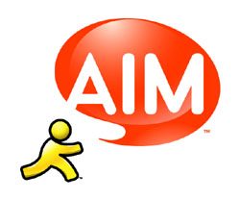
Related Work
Early Efforts in Synchronous Collaboration
Asynchronous Collaborative Efforts
Most popular Asynchronous collaboration concepts
Facebook, LinkedIn, MySpace
Synchronous Collaborative Efforts
Full-function Collaboration
Facebook Online Chat
Notes:
Collaboration on the Web – not new synch/asynch.
Tango, Access Grid, GlobalMMCS –
Typically sophisticated end-to-end solutions to difficult problems in collaboration
Result of huge amount of research effort
Example: buffering content, time ordering of events, multicast networking, application software-level stream control
Asynchronous Collaborative Efforts:
May not be fully asynchronous – include chat – focus on asynchronous content management
Open source Learning management systems (drupal, joomla)
May not be fully asynchronous – may include chats
Focus on asynchronous content management
Synchronous Collaborative Efforts
Instant Messaging (AIM, ICQ, Facebook Live Chat)
Live video systems (ORLive, CNN’s Live with Facebook, Ustream

Slide 7
Related Work (contd.)
In contrast, we implemented a much lighter-weight solution
AVATS was developed in a time-period of three months from start - end
AVATS built as a web application client-interface
No worry about the underlying networking infrastructure

Slide 8
Initial Requirements
To Support the 4th IEEE eScience Conference
Broadcast 5 simultaneous live streams
Play archived videos for later use
Import and display presenter’s blog
Live discussion feature
Communicate with each other and presenter as well
URL: http://escience2008.iu.edu
Later provided support for NSF CI Sustainability Conference, March, 2009
URL: http://cisoftwaresustainability.iu-pti.org/
Notes:
Show both conferences and talk about multi-room capabilities. Show numbers of people who used it live and since.

Slide 9
AVATS Application Architecture

Slide 10
Main Application
Video Component
Blog Component
Chat Component

Slide 11
Video Component
Chat Component
Zoom In View

Slide 12
Main Application
Grabs meeting ID from URL
http://..../ctsdemo.html#ID=14
Gets presentation information for that meeting ID using a HTTPService call
Eg title, name of speaker, time, blog rss url etc.
Sends data to other components – video, blog, and chat

Slide 13
Video Component
Gets live/archived stream URL from main application depending upon the status
Plays the video stream using the live/archived stream URLS

Slide 14
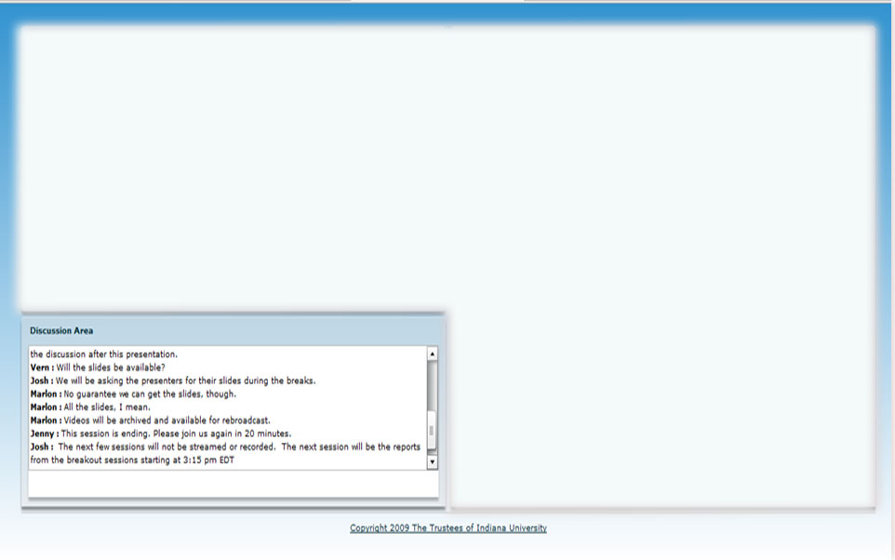
Chat Component
Uses ActiveMQ Messaging Server for distributing chat messages
On load, gets the chat log from the DB server using an HTTP Service call

Slide 15
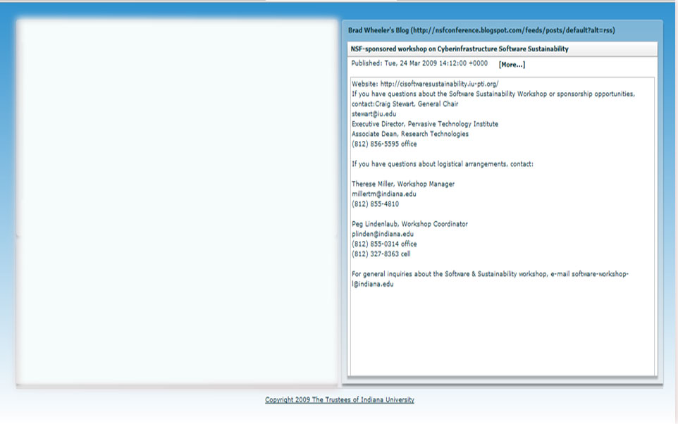
Basically an RSS Reader built in Flex
Blog Component
Obtains blog URL RSS Feed from main application
Imports, parse, and display RSS feed in an accordion component

Slide 16
AVATS Main Interface

Slide 17
AVATS Calendar Interface

Slide 18
AVATS Administrator Interface

Slide 19
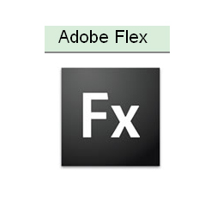
Technologies Used
Front End User Interface
Backend

Slide 20
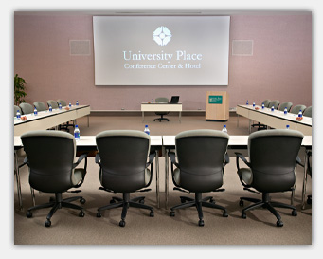
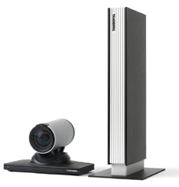
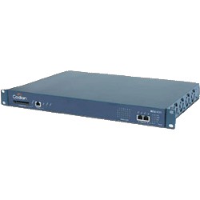
Video Streaming/Recording Process
Conference Room
Flash Stream URL
H.239 Dual Stream
Flash Streaming/Encoding Server
Codian IPVCR
Records &
Converts to flash video files
Tandberg Edge 95 end point

Slide 21
Evaluation
Testing
Survey Results
Post Conference Site Analysis

Slide 22
Testing
AVATS was tested on a weekly basis
Bugs/Additional features were added as per user input
Put a limit on the number of concurrent users
Some bugs
Echo problem in IE
Denial of service in Chat
Large text (cut and paste) would freeze the system
Resolution: Text input limit was placed

Slide 23
eScience 2008 Survey Results

Slide 24
eScience 2008 Survey Results

Slide 25
eScience 2008 Survey Results

Slide 26
Map Overlay – eScience 2008 Conference

Slide 27
Site Usage – eScience 2008 Conference

Slide 28
Map Overlay - NSF CI 2009 Conference

Slide 29
Future Work
AVATS can be deployed to be used over multiple conferences
Used for Classroom purposes or distant education
AVATS functionality - can be expanded to enable conference administrators to add/change conference details.
Deployed as Desktop software using Adobe AIR platform
Import any XML/RSS data and integration scalability
May be developed into a mobile app???

Slide 30
Summary
Ability to stream live video content with discussion capability and import author’s blog as RSS
Distributed under IU RTC

Slide 31
Conclusion
It was possible to make a mash-up of different components in a short time
Scalable

Slide 32
Any Questions/Comments?
CTS 2009 Demo Live URL
http://tinyurl.com/qq27jx
S
Contact:
Sidd Maini (smaini@indiana.edu)
Josh Rosen (jjrosen@indiana.edu)
http://pti.iu.edu/cgl

