Slide 1
MapReduce in the Clouds for Science
Thilina Gunarathne, Tak-Lon Wu, Judy Qiu, Geoffrey Fox
{tgunarat, taklwu, xqiu,gcf}@indiana.edu
CloudCom 2010
Nov 30 – Dec 3, 2010

Slide 2
Introduction
Cloud computing combined with cloud infrastructure services
A very viable alternative for scientists
MapReduce
Excellent fault tolerance features
Scalability
Ease of use.
Several options for using MapReduce in cloud environments
MapReduce as a service
Setting up MapReduce cluster on cloud instances
Specialized cloud MapReduce runtimes
Take advantage of cloud infrastructure services.
Notes:
The utility computing model introduced by cloud computing combined with the rich set of cloud infrastructure services offers a very viable alternative to traditional servers and computing clusters. MapReduce distributed data processing architecture has become the weapon of choice for data-intensive analyses in the clouds and in commodity clusters due to its excellent fault tolerance features, scalability and the ease of use. Currently, there are several options for using MapReduce in cloud environments, such as using MapReduce as a service, setting up one’s own MapReduce cluster on cloud instances, or using specialized cloud MapReduce runtimes that take advantage of cloud infrastructure services. In this paper, we introduce AzureMapReduce, a novel MapReduce runtime built using the Microsoft Azure cloud infrastructure services. AzureMapReduce architecture successfully leverages the high latency, eventually consistent, yet highly scalable Azure infrastructure services to provide an efficient, on demand alternative to traditional MapReduce clusters. Further we evaluate the use and performance of MapReduce frameworks, including AzureMapReduce, in cloud environments for scientific applications using sequence assembly and sequence alignment as use cases.

Slide 3
Introduction
Analyze the performance and viability of performing 2 types of bioinformatics computations using MapReduce in cloud environments
Sequence alignment
Sequence assembly
AzureMapReduce
Leverages the high latency, eventually consistent, yet highly scalable Azure infrastructure services to provide an decentralized, on demand MapReduce framework
Sustained performance of clouds

Slide 4
Platforms
Apache Hadoop
On BareMetal
On EC2
Amazon Web Services
Elastic MapReduce
Microsoft Azure
AzureMapReduce

Slide 5
Challenges for MapReduce in the clouds
Data storage
Reliability
Master node
Metadata storage
Performance consistency
Communication consistency and scalability
Sustained performance
Choosing suitable instance types
Logging
Notes:
Data storage: Clouds typically provide a variety of storage options, such as off-instance cloud storage (e.g.: Amazon S3), mountable off-instance block storage (e.g.: Amazon EBS) as well as virtualized instance storage (persistent for the lifetime of the instance), which can be used to set up a file system similar to HDFS [13]. The choice of the storage best-suited to the particular MapReduce deployment plays a crucial role as the performance of data intensive applications rely a lot on the storage location and on the storage bandwidth.
Metadata storage: MapReduce frameworks need to maintain metadata information to manage the jobs as well as the infrastructure. This metadata needs to be stored reliability ensuring good scalability and the accessibility to avoid single point of failures and performance bottlenecks to the MapReduce computation.
Communication consistency and scalability: Cloud infrastructures are known to exhibit inter-node I/O performance fluctuations (due to shared network, unknown topology), which affect the intermediate data transfer performance of MapReduce applications.
Performance consistency (sustained performance): Clouds are implemented as shared infrastructures operating using virtual machines. It’s possible for the performance to fluctuate based the load of the underlying infrastructure services as well as based on the load from other users on the shared physical node which hosts the virtual machine (see Section VII).
Reliability (Node failures): Node failures are to be expected whenever large numbers of nodes are utilized for computations. But they become more prevalent when virtual instances are running on top of non-dedicated hardware. While MapReduce frameworks can recover jobs from worker node failures, master node (nodes which store meta-data, which handle job scheduling queue, etc) failures can become disastrous.
Choosing a suitable instance type: Clouds offer users several types of instance options, with different configurations and price points (See Sections B and D). It’s important to select the best matching instance type, both in terms of performance as well as monetary wise, for a particular MapReduce job.
Logging: Cloud instance storage is preserved only for the lifetime of the instance. Hence, information logged to the instance storage would be lost after the instance termination. This can be crucial if one needs to process the logs afterwards, for an example to identify a software-caused instance failure. On the other hand, performing excessive logging to a bandwidth limited off-instance storage location can become a performance bottleneck for the MapReduce computation.

Slide 6
AzureMapReduce
A solution to the void of parallel programming frameworks on Microsoft Azure
Built on using Azure cloud services
Distributed, highly scalable & highly available services, backed by industrial strength data centers and technologies
Minimal management / maintenance overhead
Reduced footprint
Decentralized control
Ability to dynamically scale up/down

Slide 7
AzureMapReduce Features
Familiar programming model
Fault Tolerance
Co-exist with eventual consistency of cloud services
Easy testing and deployment
Combiner step
Web based monitoring console

Slide 8
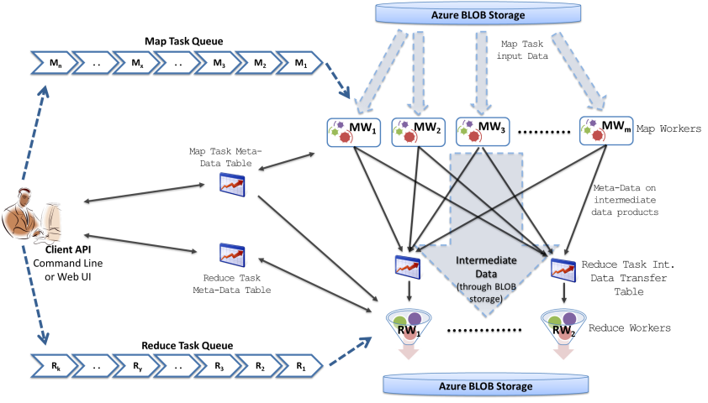
AzureMapReduce Architecture

Slide 9
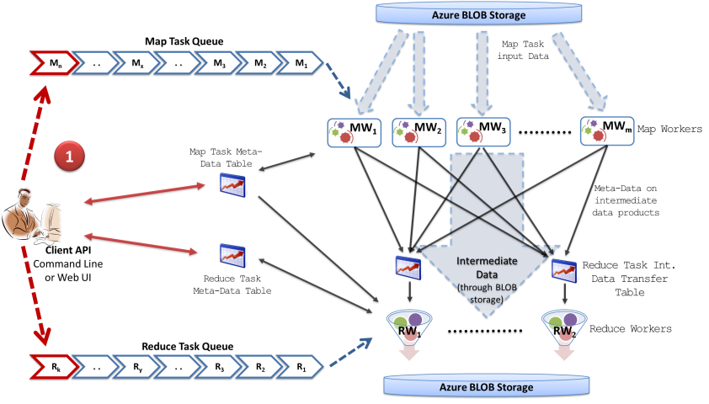
AzureMapReduce Architecture
Notes:
Client driver loads the map & reduce tasks to queues in parallel using TPL..
Create the task monitoring table.
Standalone client or a web client.
Can wait for completion.
Explain the advantages of using Azure queues.
Explain the advantages of using Azure table.. Scalability. Ease of use.. No maintenance overhead. No need to install DB. Easily visualize using a webrole.

Slide 10
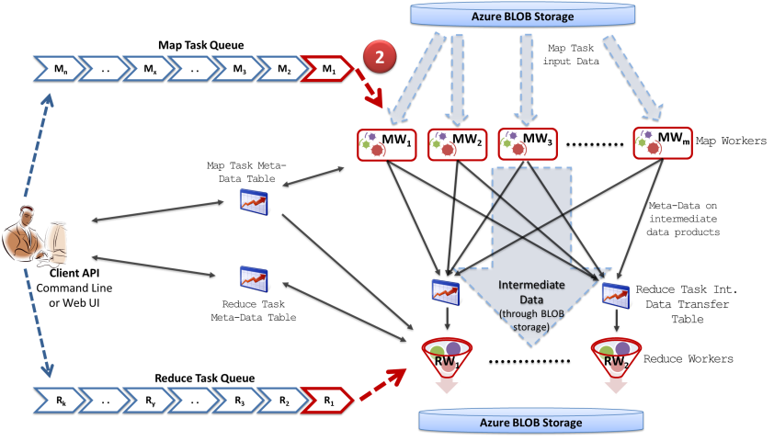
AzureMapReduce Architecture
Notes:
Map & Reduce workers pick up map tasks from the queue

Slide 11
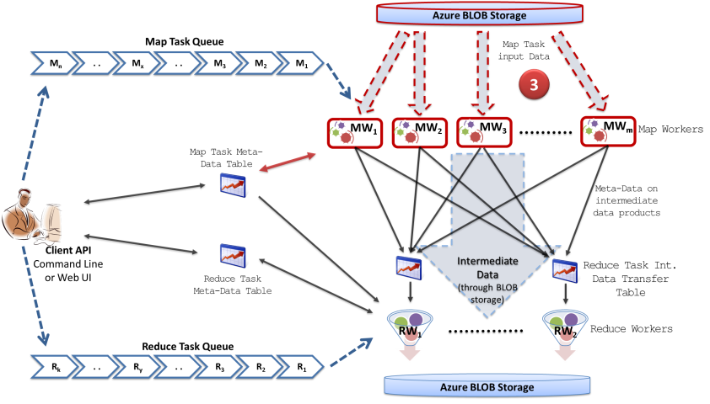
AzureMapReduce Architecture
Notes:
Map workers download data from Blob storage and start processing- – update the status in the task monitoring table.
Advantages of blob storage.

Slide 12
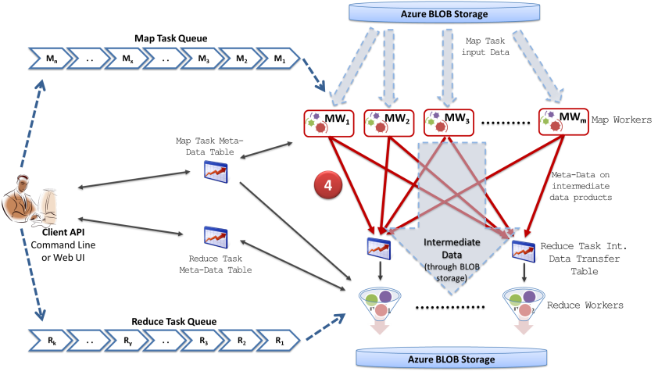
AzureMapReduce Architecture
Notes:
Finished Map tasks upload result data sets to Azure Storage and then add entries for the respective reduce task tables. – update the status. Get the next task from the queue and start processing it.

Slide 13
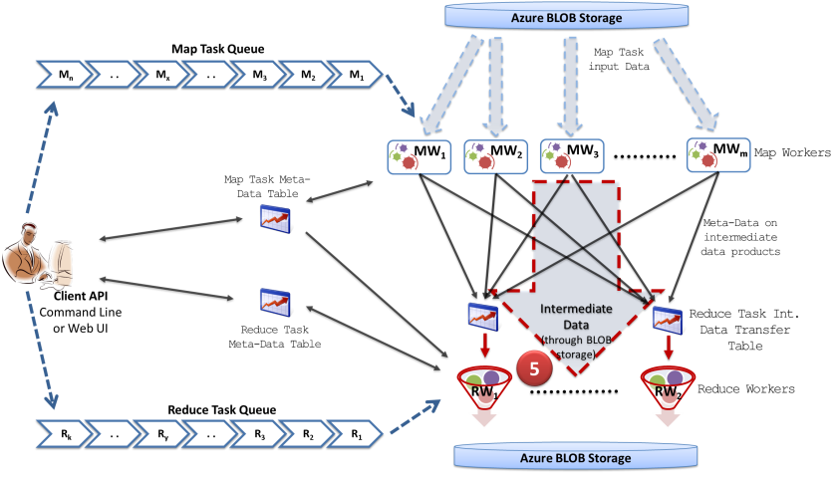
AzureMapReduce Architecture
Notes:
Reduce tasks notice the intermediate data product meta-data in reduce task tables and start downloading them -> update the reduce task tables
This happens when the map tasks are actually processing the next set of map tasks..

Slide 14
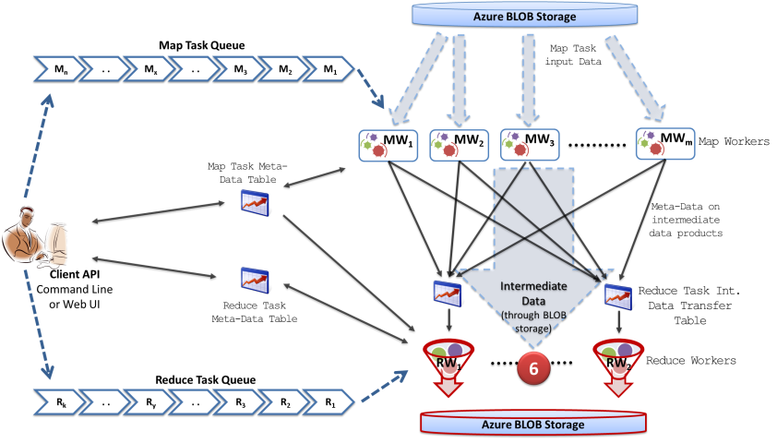
AzureMapReduce Architecture
Notes:
Reduce tasks start reducing, when all the map tasks are finished and when the respective reduce tasks are finish downloading the intermediate data products.

Slide 15
AzureMapReduce Architecture
Starting the Sort & Reduce phases,
When all the map tasks are finished &
When a reduce task is finished downloading all the intermediate data products
No guarantee when all the intermediate data will appear in Task tables
Map Tasks store the number of reduce data products it generated for each reduce task
Notes:
Global barrier…

Slide 16
Performance
Parallel efficiency
AzureMapReduce
Azure small instances – Single Core
Hadoop Bare Metal -IBM iDataplex cluster
EMR & Hadoop on EC2
Cap3 – HighCPU Extra Large (8 Cores, 20 CU)
SWG – Extra Large (4 Cores, 8 CU)
Notes:
Idataplex - Two quad-core CPUs (Intel Xeon CPU E5410 2.33GHz) 16 GB memory, Gigabit Ethernet network interface

Slide 17
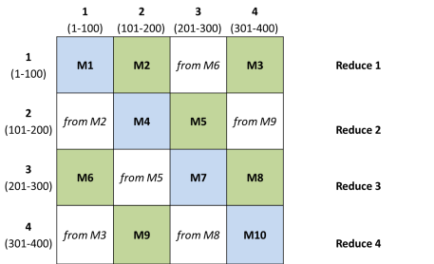
Sequence Alignment
Smith-Waterman-GOTOH to calculate all-pairs dissimilarity
OutFile1
OutFile2
OutFile3
OutFile4

Slide 18
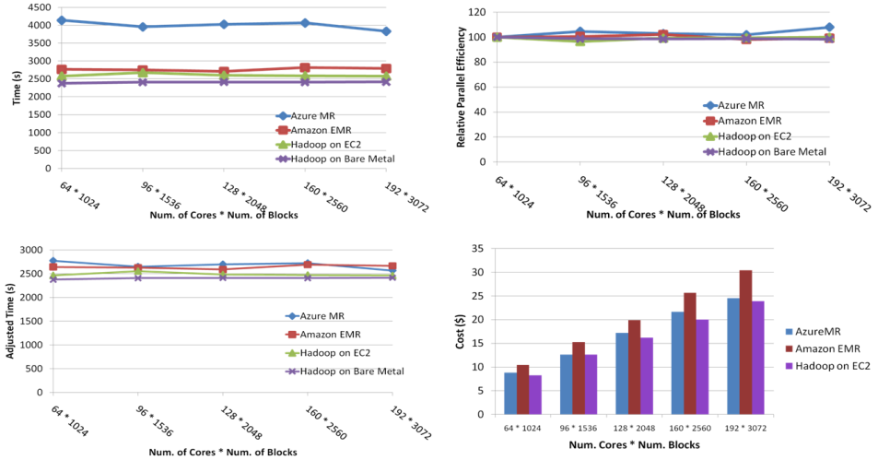
Sequence Alignment Performance

Slide 19
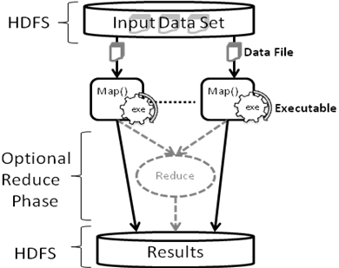
Seqeunce Assembly
Assemble sequences using Cap3
Pleasingly parallel
Map Only

Slide 20
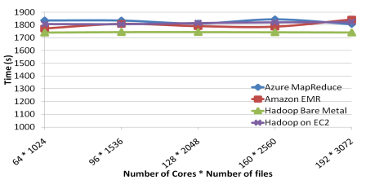
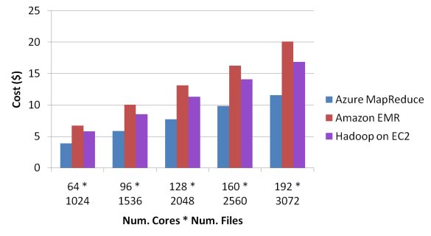
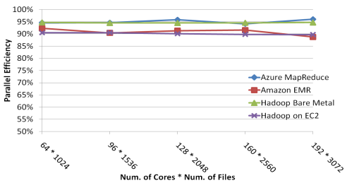
Sequence Assembly Performance

Slide 21
Sustained performance of clouds
Notes:
SWG - In these tests, 32 cores were used to align 4000 sequences.
Standard deviations of 1.56% for EMR and 2.25% for AzureMapReduce.

Slide 22
Thanks
http://salsahpc.indiana.edu/azuremapreduce/

