Slide 1
Health Informatics, Big Data, Clouds, Data Analytics
February 28 2013
March 7 2013
Geoffrey Fox
gcf@indiana.edu
http://www.infomall.org/
Associate Dean for Research and Graduate Studies, School of Informatics and Computing
Indiana University Bloomington
2013

Slide 2
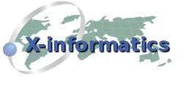
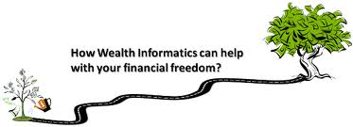
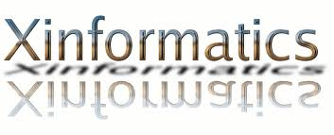

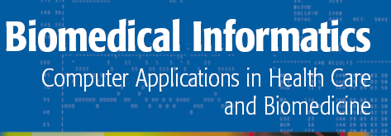


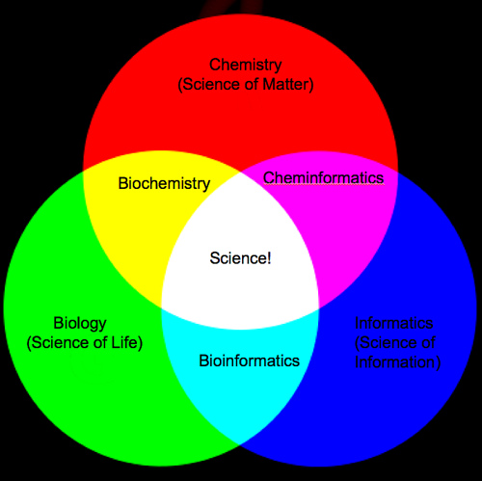
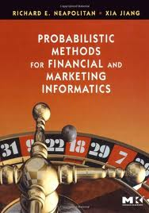
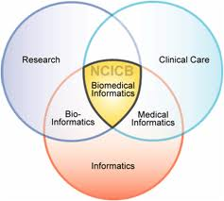
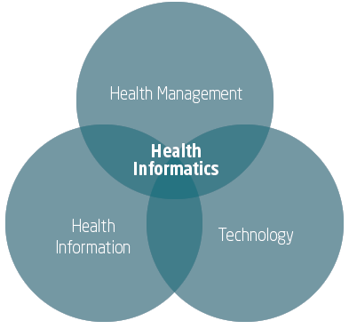
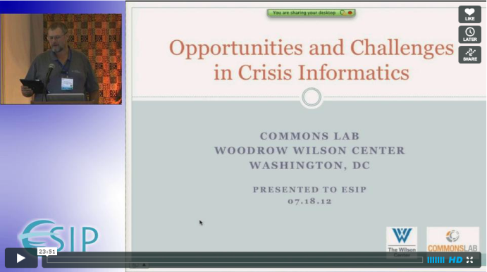
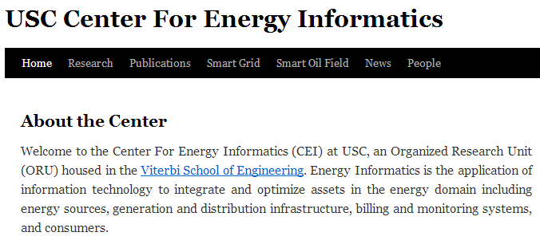
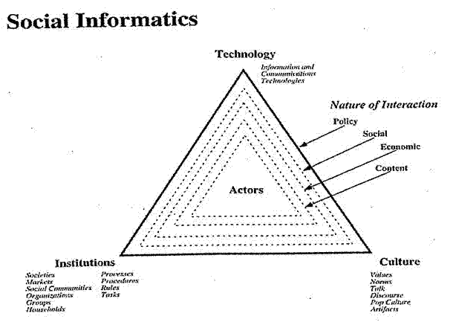

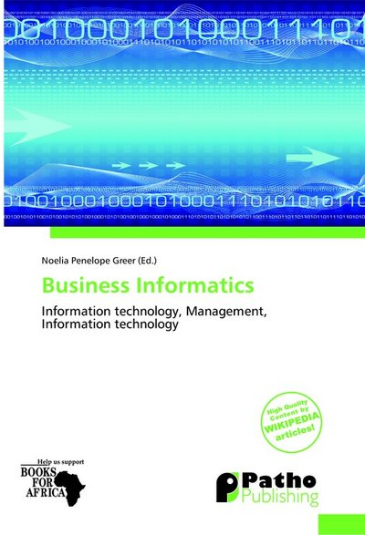
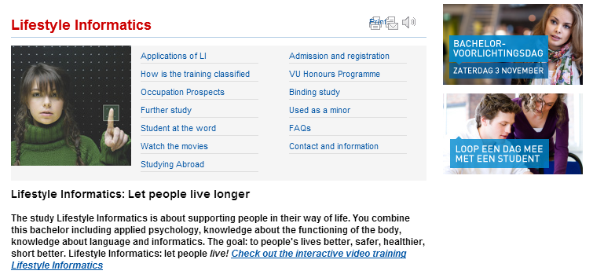
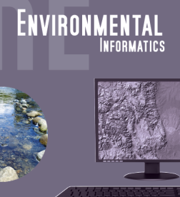


Slide 3
Big Data Ecosystem in One Sentence
Use Clouds running Data Analytics processing Big Data to solve problems in X-Informatics
X = Health, Medical, Bio, Biomedical, Chem, Pathology, Lifestyle

Slide 4

Some Data sizes
  ~40 10⁹ Web pages at ~300 kilobytes each = 10 Petabytes
  Youtube 48 hours video uploaded per minute;
    in 2 months in 2010, uploaded more than total NBC ABC CBS
    ~2.5 petabytes per year uploaded?
  LHC 15 petabytes per year
  Radiology 69 petabytes per year
  Square Kilometer Array Telescope will be 100 terabits/second
  Earth Observation becoming ~4 petabytes per year
  Earthquake Science – few terabytes total today
  PolarGrid – 100’s terabytes/year
  Exascale simulation data dumps – terabytes/second

Slide 5
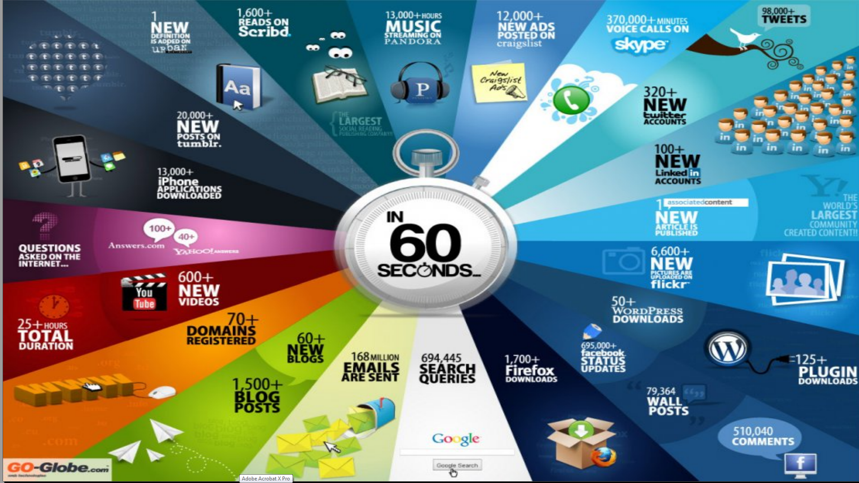
http://cs.metrostate.edu/~sbd/ Oracle

Slide 6
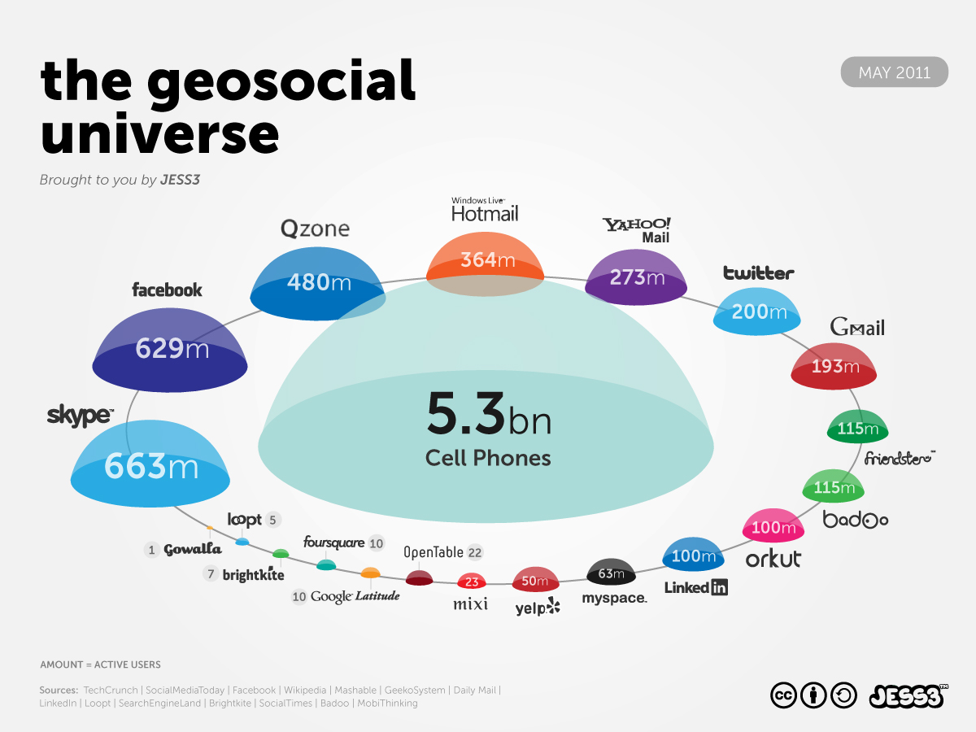
http://jess3.com/geosocial-universe-2/

Slide 7
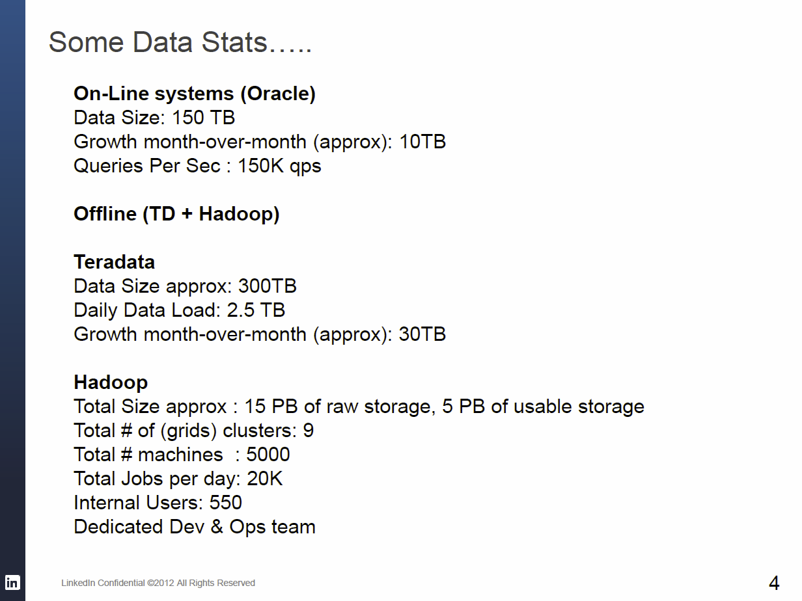
LinkedIn Data Sizes
Henke Senior Vice President of Operations LinkedIn http://fisheritcenter.haas.berkeley.edu/Big_Data/index.html Nov 2012

Slide 8
Cyberinfrastructure e-moreorlessanything
X = moreorlessanything
e-X is roughly X-Informatics

Slide 9
What is Cyberinfrastructure
Cyberinfrastructure is (from NSF) infrastructure that supports distributed research and learning (e-Science, e-Research, e-Education)
  Links data, people, computers
Exploits Internet technology (Web2.0 and Clouds) adding (via Grid technology) management, security, supercomputers etc.
It has two aspects: parallel – low latency (microseconds) between nodes and distributed – highish latency (milliseconds) between nodes
Parallel needed to get high performance on individual large simulations, data analysis etc.; must decompose problem
Distributed aspect integrates already distinct components – especially natural for data (as in biology databases etc.)
9
Notes:
9

Slide 10
e-moreorlessanything
‘e-Science is about global collaboration in key areas of science, and the next generation of infrastructure that will enable it.’ from inventor of term John Taylor Director General of Research Councils UK, Office of Science and Technology
e-Science is about developing tools and technologies that allow scientists to do ‘faster, better or different’ research
Similarly e-Business captures the emerging view of corporations as dynamic virtual organizations linking employees, customers and stakeholders across the world.
This generalizes to e-moreorlessanything including e-DigitalLibrary, e-SocialScience, e-LifeStyle and e-Education
A deluge of data of unprecedented and inevitable size must be managed and understood.
People (virtual organizations), computers, data (including sensors and instruments) must be linked via hardware and software networks
10
Notes:
10

Slide 11
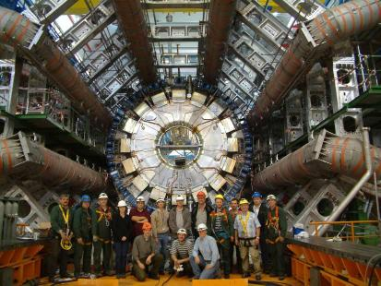
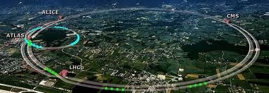
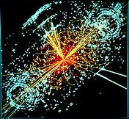
http://grids.ucs.indiana.edu/ptliupages/publications/Where%20does%20all%20the%20data%20come%20from%20v7.pd
This analysis raw data → reconstructed data → AOD and TAGS → Physics is performed on the multi-tier LHC Computing Grid. Note that every event can be analyzed independently so that many events can be processed in parallel with some concentration operations such as those to gather entries in a histogram. This implies that both Grid and Cloud solutions work with this type of data with currently Grids being the only implementation today.
ATLAS Expt
Note LHC lies in a tunnel 27 kilometres (17 mi) in circumference
Higgs Event
The LHC produces some 15 petabytes of data per year of all varieties and with the exact value depending on duty factor of accelerator (which is reduced simply to cut electricity cost but also due to malfunction of one or more of the many complex systems) and experiments. The raw data produced by experiments is processed on the LHC Computing Grid, which has some 200,000 Cores arranged in a three level structure. Tier-0 is CERN itself, Tier 1 are national facilities and Tier 2 are regional systems. For example one LHC experiment (CMS) has 7 Tier-1 and 50 Tier-2 facilities.

Slide 12
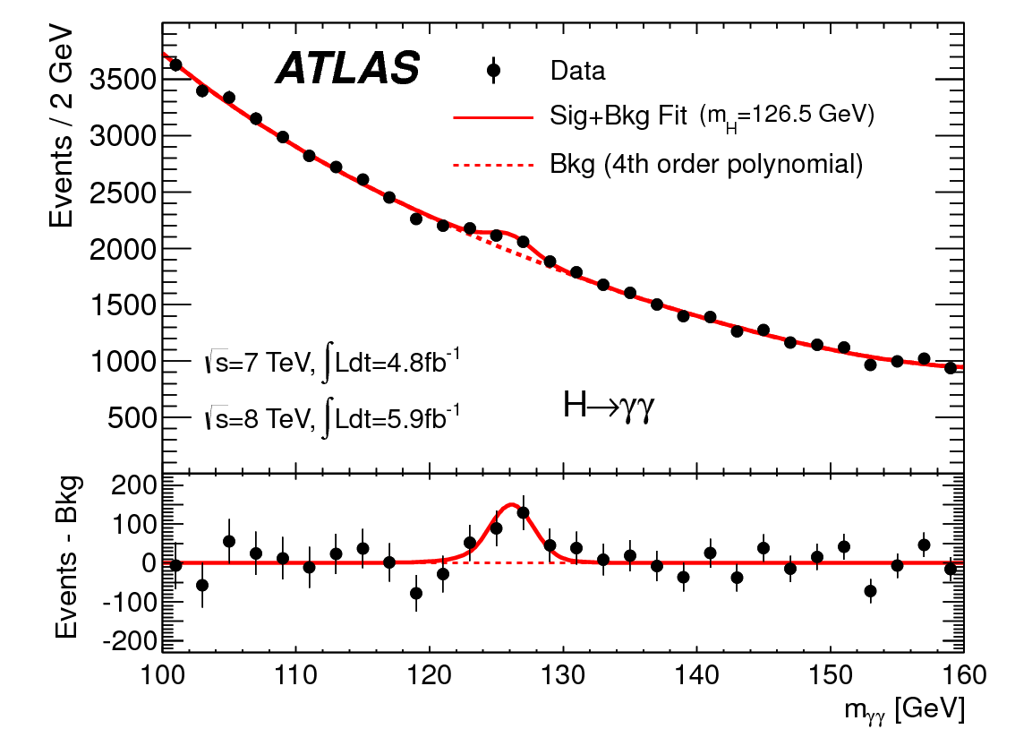
http://www.quantumdiaries.org/2012/09/07/why-particle-detectors-need-a-trigger/atlasmgg/
Model

Slide 13
USArray
Seismic
Sensors

Slide 14
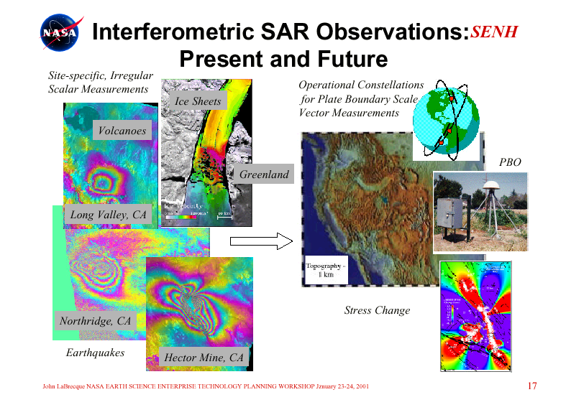
a
Site-specific Irregular
Scalar Measurements
a
Constellations for Plate Boundary-Scale Vector Measurements
Ice Sheets
a
Volcanoes
PBO
Greenland
Long Valley, CA
Topography
1 km
Stress Change
Northridge, CA
Earthquakes
Hector Mine, CA

Slide 15
Big Data Process

Slide 16
Some Terms
Data: the raw bits and bytes produced by instruments, web , e-mail, social media
Information: The cleaned up data without deep processing applied to it
Knowledge/wisdom/decisions comes from sophisticated analysis of Information
Data Analytics is the process of converting data to Information and Knowledge and then decisions or policy
Data Science describes the whole process
X-Informatics is use of Data Science to produce wisdom in field X

Slide 17
DIKW Process
Data becomes
Information becomes
Knowledge becomes
Wisdom or Decisions
  Community acceptance of results or approach important here
  Volume of bits&bytes decreases as we proceed down DIKW pipeline

Slide 18
Data Deluge is also Information/Knowledge/Wisdom/Decision Deluge?

Slide 19
Example of Google Maps/Navigation
Data comes from traditional maps (US Geological Survey), Satellites (overlays) and street cams
Information is presented by basic Google Maps web page
Knowledge is a particular optimized route
Decisions (wisdom) comes from deciding to drive a particular route

Slide 20
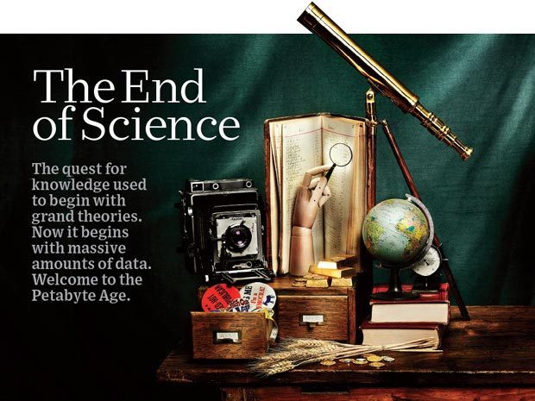
http://www.wired.com/wired/issue/16-07

Slide 21
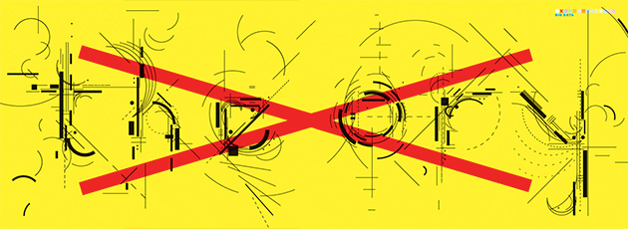
The End of Theory: The Data Deluge Makes the Scientific Method Obsolete
"All models are wrong, but some are useful.“ So proclaimed statistician George Box 30 years ago, and he was right. But what choice did we have? Only models, from cosmological equations to theories of human behavior, seemed to be able to consistently, if imperfectly, explain the world around us. Until now. Today companies like Google, which have grown up in an era of massively abundant data, don't have to settle for wrong models. Indeed, they don't have to settle for models at all.
Peter Norvig, Google's research director, offered an update to George Box's maxim: "All models are wrong, and increasingly you can succeed without them."
http://www.wired.com/wired/issue/16-07

Slide 22
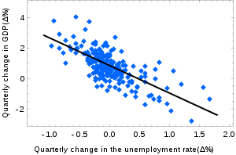
Models and Theory
Newton’s laws such Mass . Acceleration = Force is a theory as is Einstein’s special relativity and gravitational (general relativity) theory
Physicists just discovered a new particle – the Higgs or God particle whose existence was predicted by the “Grand Unified Theory”
Its search was handicapped as theory did not predict mass and a model is needed to calculate this (I used to build such models)
A model is a hopefully theoretically motivated “phenomenological” approach that allows predictions. Models often have parameters that are fit to existing data to predict new data (see FFF paper)
http://en.wikipedia.org/wiki/Simple_linear_regression: Okun's law in macroeconomics is an example of the simple linear regression. Here the dependent variable (GDP growth) is presumed to be in a linear relationship with the changes in the unemployment rate.

Slide 23
The 4 paradigms of Scientific Research
Theory
Experiment or Observation
  E.g. Newton observed apples falling to design his theory of mechanics
Simulation of theory or model
Data-driven (Big Data) or The Fourth Paradigm: Data-Intensive Scientific Discovery (aka Data Science)
  http://research.microsoft.com/en-us/collaboration/fourthparadigm/
  A free book
  More data; less models

Slide 24
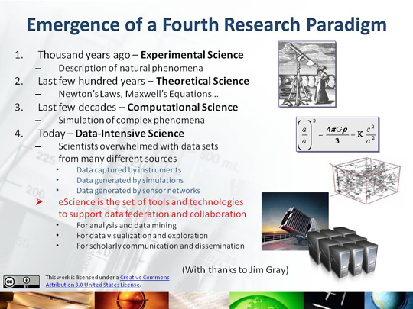

Slide 25
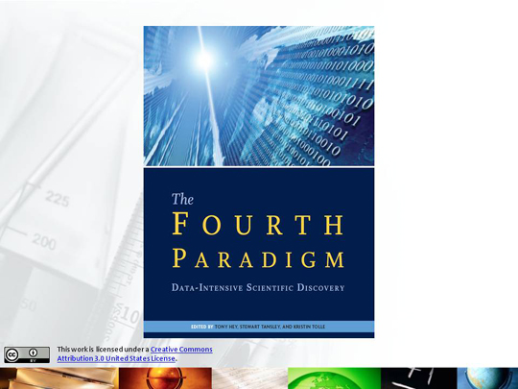

Slide 26
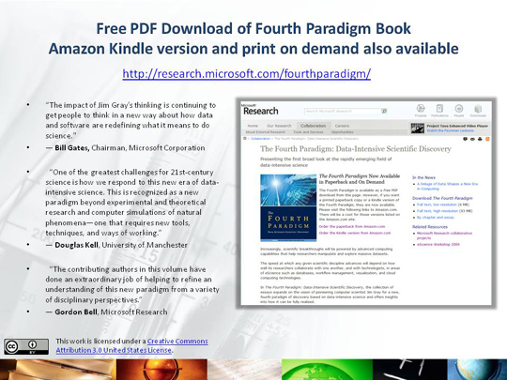

Slide 27

More data usually beats better algorithms
Here's how the competition works. Netflix has provided a large data set that tells you how nearly half a million people have rated about 18,000 movies. Based on these ratings, you are asked to predict the ratings of these users for movies in the set that they have not rated. The first team to beat the accuracy of Netflix's proprietary algorithm by a certain margin wins a prize of $1 million!
Different student teams in my class adopted different approaches to the problem, using both published algorithms and novel ideas. Of these, the results from two of the teams illustrate a broader point. Team A came up with a very sophisticated algorithm using the Netflix data. Team B used a very simple algorithm, but they added in additional data beyond the Netflix set: information about movie genres from the Internet Movie Database(IMDB). Guess which team did better?
Anand Rajaraman is Senior Vice President at Walmart Global eCommerce, where he heads up the newly created @WalmartLabs,
http://anand.typepad.com/datawocky/2008/03/more-data-usual.html
20120117berkeley1.pdf Jeff Hammerbacher

Slide 28
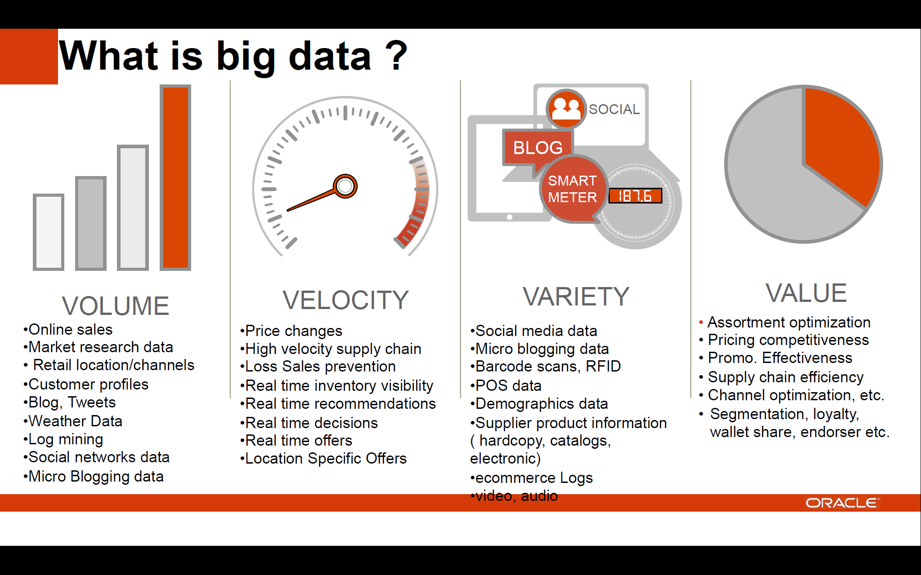
http://cs.metrostate.edu/~sbd/ Oracle

Slide 29
Semantic Web/Grid v. Big Data
Original vision of Semantic Web was that one would annotate (curate) web pages by extra “meta-data” (data about data) to tell web browser (machine, person) the “real meaning” of page
The success of Google Search is “Big Data” approach; one mines the text on page to find “real meaning”
Obviously combination is powerful but the pure “Big Data” method is more powerful than expected 15 years ago

Slide 30
Big Data and Health

Slide 31
Types of Biomedical Big Data Problems
Pervasive Health Sensors including data entered into or from smart phones (events)
Radiology (images)
Genomics/Proteomics
Electronic medical records sizewise dominated by omics and images?
  Updated by events
Classic data access and sophisticated datamining

Slide 32
Ninety-six percent of radiology practices in the USA are filmless and Table below illustrates the annual volume of data across the types of diagnostic imaging; this does not include cardiology which would take the total to over 10⁹ GB (an Exabyte).
http://grids.ucs.indiana.edu/ptliupages/publications/Where%20does%20all%20the%20data%20come%20from%20v7.pd
Modality | Part B non HMO | All Medicare | All Population | Per 1000 persons | Ave study size (GB) | Total annual data generated in GB
CT | 22 million | 29 million | 87 million | 287 | 0.25 | 21,750,000
MR | 7 million | 9 million | 26 million | 86 | 0.2 | 5,200,000
Ultrasound | 40 million | 53 million | 159 million | 522 | 0.1 | 15,900,000
Interventional | 10 million | 13 million | 40 million | 131 | 0.2 | 8,000,000
Nuclear Medicine | 10 million | 14 million | 41 million | 135 | 0.1 | 4,100,000
PET | 1 million | 1 million | 2 million | 8 | 0.1 | 200,000
Xray, total incl. mammography | 84 million | 111 million | 332 million | 1,091 | 0.04 | 13,280,000
All Diagnostic Radiology | 174 million | 229 million | 687 million | 2,259 | 0.1 | 68,700,000 68.7 PETAbytes

Slide 33
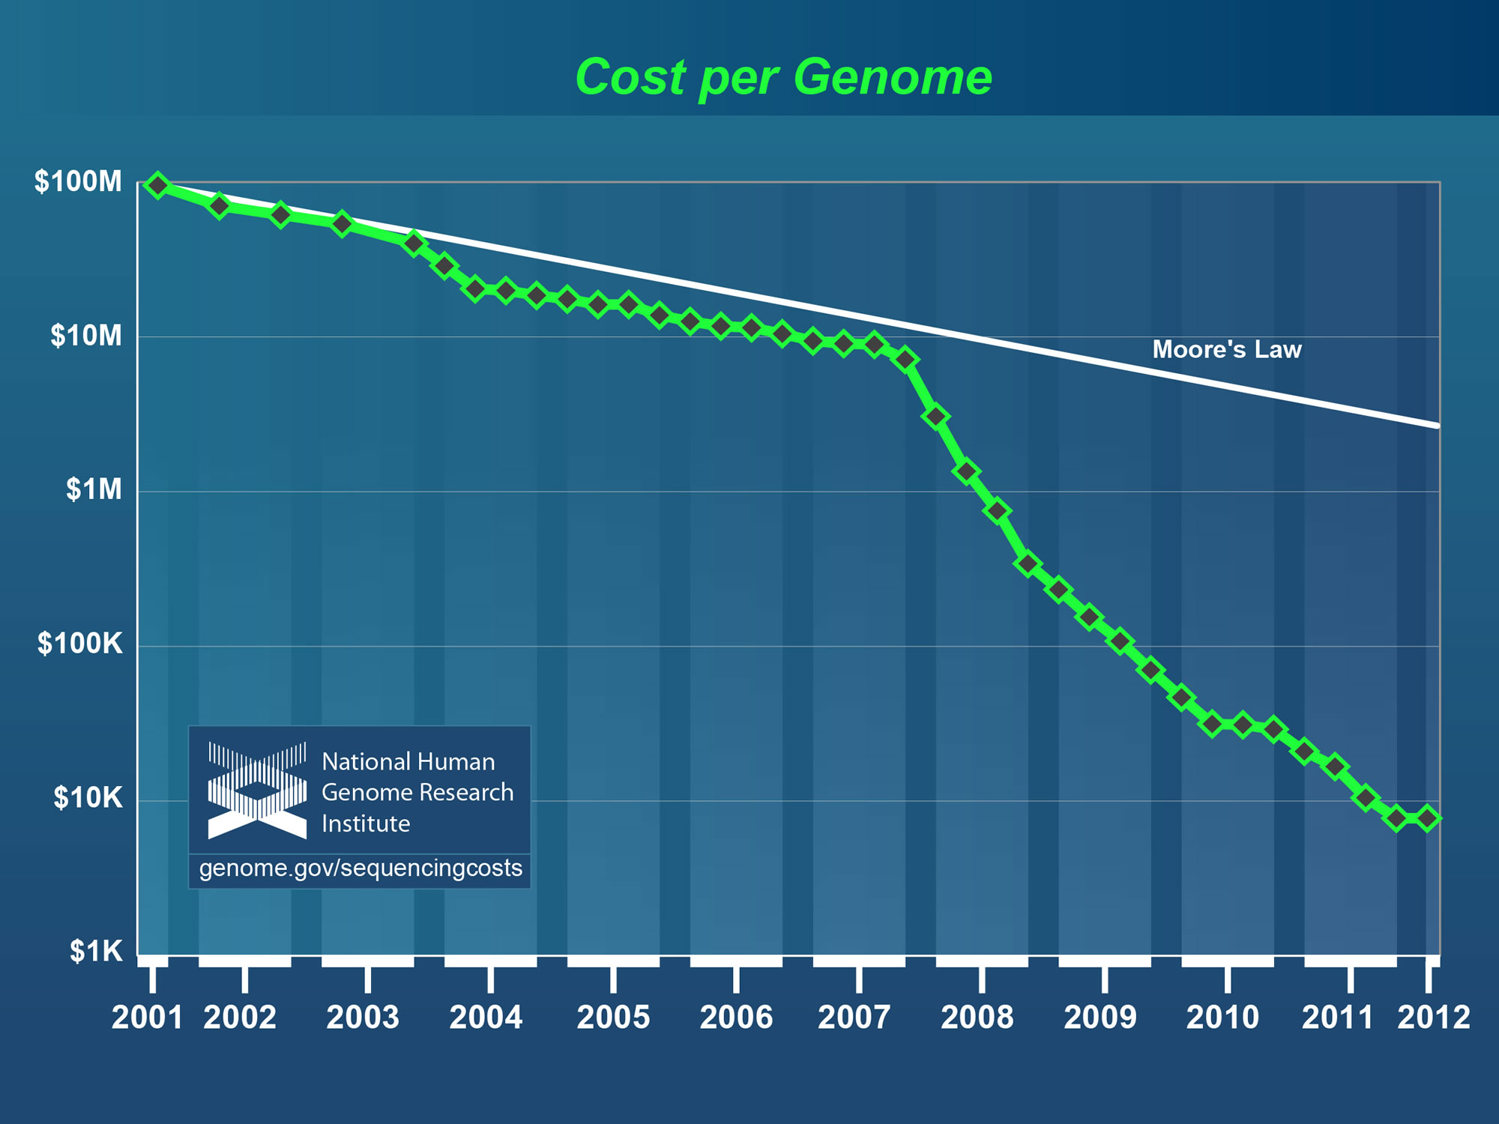
Why need cost effective
Computing!
Full Personal Genomics: 3 petabytes per day
http://www.genome.gov/sequencingcosts/

Slide 34
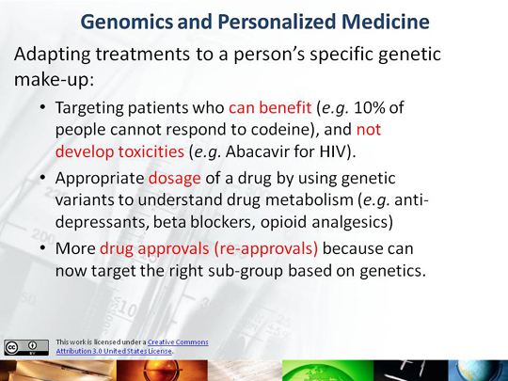

Slide 35
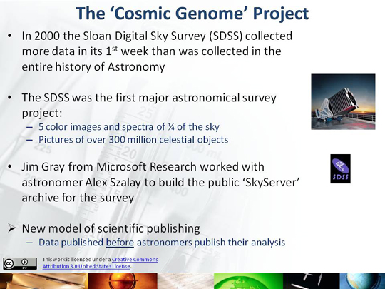

Slide 36
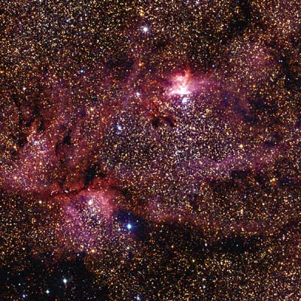
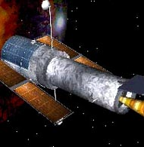
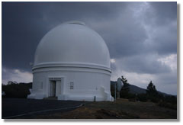
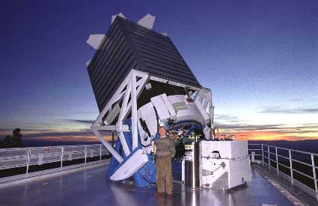
Tracking the Heavens
“The Universe is now being explored systematically, in a panchromatic way, over a range of spatial and temporal scales that lead to a more complete, and less biased understanding of its constituents, their evolution, their origins, and the physical processes governing them.”
Towards a National Virtual Observatory
Hubble Telescope
Palomar Telescope
Sloan Telescope

Slide 37
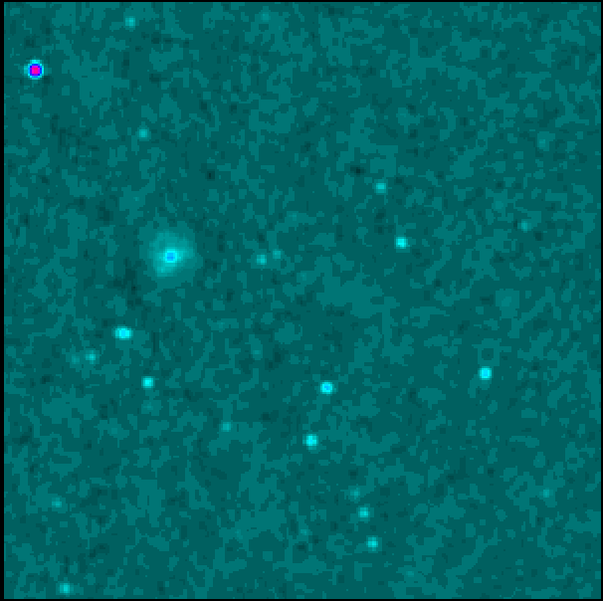
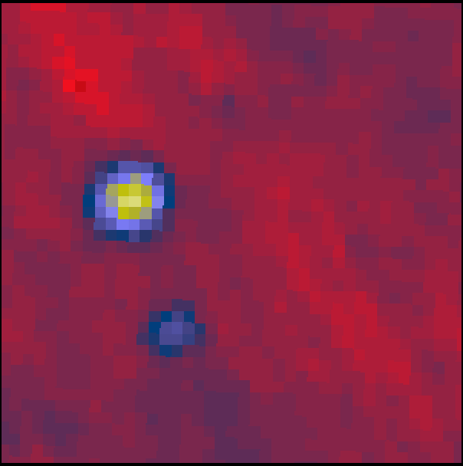
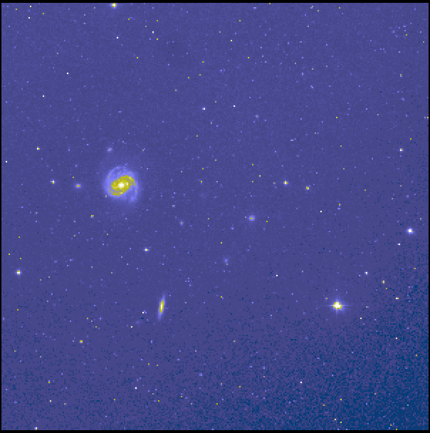
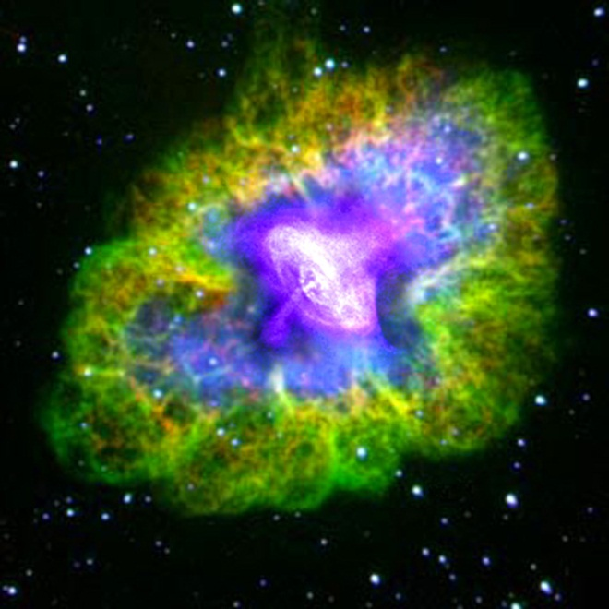
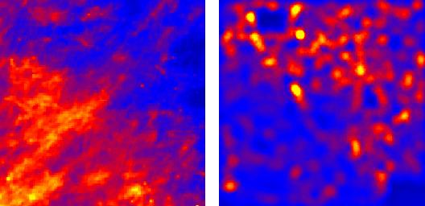
Virtual Observatory Astronomy Grid
Integrate Experiments
Radio
Far-Infrared
Visible
Dust Map
Visible + X-ray
Galaxy Density Map

Slide 38
Big Data Ecosystem in One Sentence
Use Clouds running Data Analytics processing Big Data to solve problems in X-Informatics
X = Health, Medical, Bio, Biomedical, Chem, Pathology, Lifestyle

Slide 40
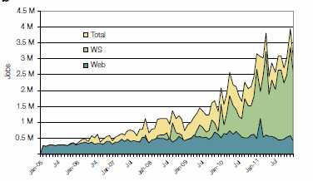
2005-20011 Job request at European Bioinformatics Institute EBI for Web hits and automated services WS
http://www.ebi.ac.uk/Information/Brochures/

Slide 41
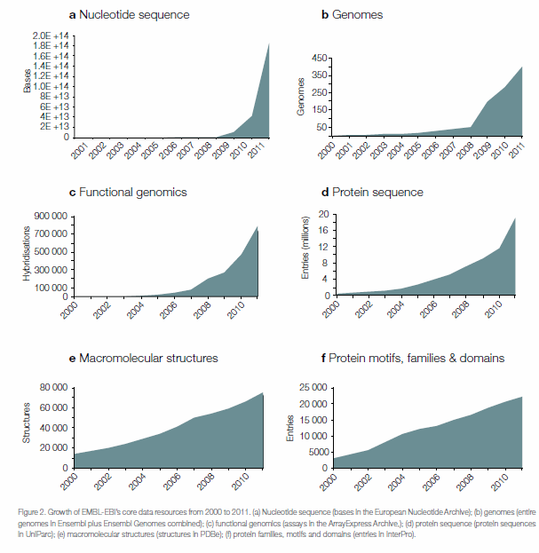
2005-20011 Data stored at European Bioinformatics Institute EBI
http://www.ebi.ac.uk/Information/Brochures/

Slide 42
Big Data opportunities in health
Section 2: Big Data in Health
The promise of Big Data to transform health and social services comes from new capabilities to increases “Data Convergence” opportunities.
Correlational Data
Geo-environmental, weather patterns, etc.
Clinical Data
EMRs, diagnostic images
Claims & Cost Data
Claims, revenue cycle
Big Data
Opportunities
Pharma & Life Science Data
Clinical trials, genomics
Patient & Consumer Data
Purchasing patterns,
social media
https://partner.microsoft.com/download/global/40193764
Table of Contents

Slide 43

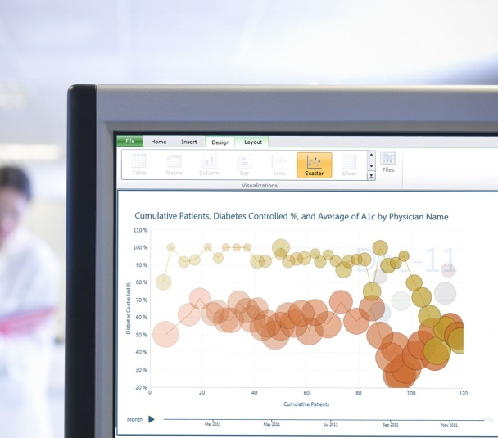

New possibilities with Big Data
Section 2: Big Data in Health
Live data feed
Based on a “snapshot” of large and different datasets right now, what can I predict will happen going forward?
For example, how do I optimize my resources to see and plan for the emerging outbreak of infectious diseases?
Social analytics
What are the top health topics and issues on the minds of consumers now?
What can I predict based on social media topics?
Advanced analytics
How might I determine the best care pathways for treating a population of patients with the same medical condition?
What actions might I take to decrease the likelihood of a medical condition?
https://partner.microsoft.com/download/global/40193764
Table of Contents

Slide 44
Use the power of data
Data often sits in silos in primary, secondary and tertiary health institutions. This silo mentality mirrors the way that health professionals guard their own competence and areas of expertise. In the new era of eHealth, this has to end.
Multidisciplinary teams of different actors, not all of whom are healthcare professionals, are part of future picture of health. Currently there is a sharp divide between ‘official’ medical data and the wealth of other health information generated by users that is not used for care. We need to find a way of making this data more trustworthy.
The key question is what people do with this information and how they can use it. New rules are needed to define how to integrate official data and user data to create a more holistic picture of patient situation for health care as well provide early feedback for preventive care. Certification of applications is one way forward but it should be based on a set of principles for how health related data should be treated rather than regulation.
Health institutions must publish the data on their performance and health outcomes. This information should be regularly collected, comparable and publicly available. This will support a drive to the top as high performing organisations and individuals can be identified and used as an example to inspire change. In health, performance is not just how efficiently the system operates but also the patient experience of the care. Publication of such data in other sectors has led to strong public demand for better performance and a greater focus on accountability and results.
http://ec.europa.eu/information_society/activities/health/docs/policy/taskforce/redesigning_health-eu-for2020-ehtf-report2012.pdf

Slide 50

Jobs v. Countries
http://www.microsoft.com/en-us/news/features/2012/mar12/03-05CloudComputingJobs.aspx

Slide 51

McKinsey Institute on Big Data Jobs
There will be a shortage of talent necessary for organizations to take advantage of big data. By 2018, the United States alone could face a shortage of 140,000 to 190,000 people with deep analytical skills as well as 1.5 million managers and analysts with the know-how to use the analysis of big data to make effective decisions.
This course aimed at 1.5 million jobs. Computer Science covers the 140,000 to 190,000
http://www.mckinsey.com/mgi/publications/big_data/index.asp.

Slide 52
What is Cloud Computing
Introduction

Slide 53
Physically Clouds are Clear
A bunch of computers (100K to 1000K) in an efficient data center with an excellent Internet connection (PUE 1.15)
They were produced to meet need of public-facing Web 2.0 e-Commerce/Social Networking sites
They can be considered as “optimal giant data center” plus internet connection
Note enterprises use private clouds that are giant data centers but not optimized for Internet access

Slide 54
Virtualization made several things more convenient
Virtualization = abstraction; run a job – you know not where
Virtualization = use hypervisor to support “images”
  Allows you to define complete job as an “image” – OS + application
  Do not require your applications runs on installed OS
Efficient packing of multiple applications into one server as they don’t interfere (much) with each other if in different virtual machines;
They interfere if put as two jobs in same machine as for example must have same OS and same OS services
Also security model (important medical informatics) between VM’s more robust than between processes

Slide 55
Next Step is Renting out Idle Clouds
Amazon noted it could rent out its idle machines
Use virtualization for maximum efficiency and security
If cloud bigger enough, one gets elasticity – namely you can rent as much as you want except perhaps at peak times
This assumes machine hardware quite cheap and can keep some in reserve
  10% of 100,000 servers is 10,000 servers
I don’t know if Amazon switches off spare computers and powers up on “mothers day”
  Illustrates difficulties in studying field – proprietary secrets
Amazon Cloud revenue $650M 2010 to $3.8B 2013
(good for a project to use idle cycles)

Slide 56
Service Model
This generalizes the Web where every site gobbles up commands from client and returns something – which could be quite complicated
Generalization is “Service Oriented Architecture”
  Everything has an interface that accepts information – in general from another service but perhaps from a client
  Everything spits out information to where instructed to send
Closely coupled Java/Python Methods …
Coarse Grain Service Model
Module
B
Module A
Service
B
Service A
Messages
Method Calls
.001 to 1 millisecond
0.1 to 1000 millisecond latency
Everything is a message of some sort ……

Slide 57
Different aaS (as aService)’s
IaaS: Infrastructure is “renting” service for hardware
PaaS: Convenient service interface to Systems capabilities
SaaS: Convenient service interface to applications
NaaS: Summarizes modern “Software Defined Networks”

Slide 58
Support
Computing
aaS
Custom Images
Courses
Consulting
Portals
Archival Storage
Software
(Application) SaaS
CS Research Use
Class Use
Research Applications
Commercial Use
Platform
PaaS
Cloud e.g. MapReduce
HPC e.g. PETSc, SAGA
Computer Science
Data Algorithms
Infra
structure
IaaS
Software Defined Computing (virtual Clusters)
Hypervisor, Bare Metal
Operating System
Network
NaaS
Software Defined Networks
OpenFlow GENI

Slide 59
















X as a Service
SaaS: Software as a Service imply software capabilities
(programs) have a service (messaging) interface
  Applying systematically reduces system complexity to being linear in number of components
  Access via messaging rather than by installing in /usr/bin
IaaS: Infrastructure as a Service or HaaS: Hardware as a Service – get your computer time with a credit card and with a Web interface
PaaS: Platform as a Service is IaaS plus core software capabilities on which you build SaaS
Cyberinfrastructure is “Research as a Service”
Other Services
Clients

Slide 60
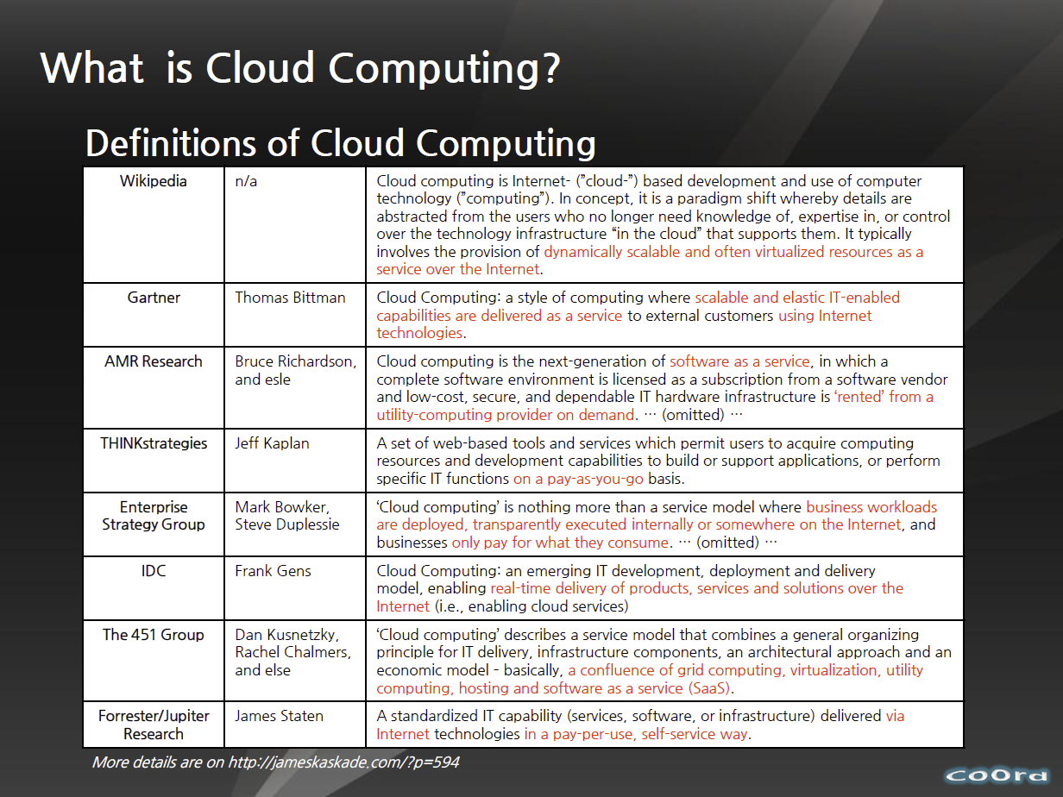
http://www.slideshare.net/woorung/trend-and-future-of-cloud-computing

Slide 61
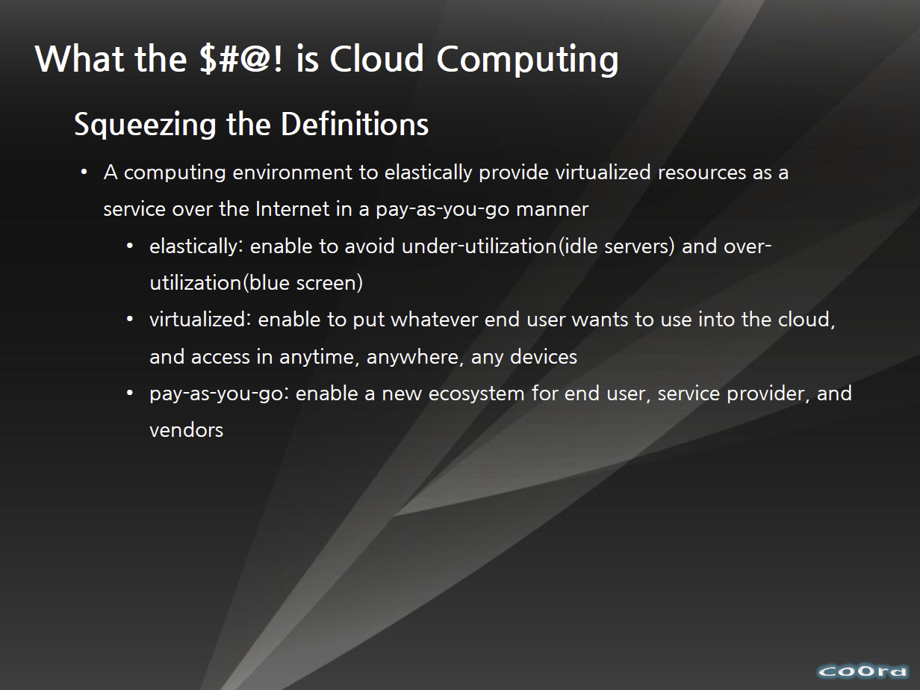
http://www.slideshare.net/woorung/trend-and-future-of-cloud-computing

Slide 62

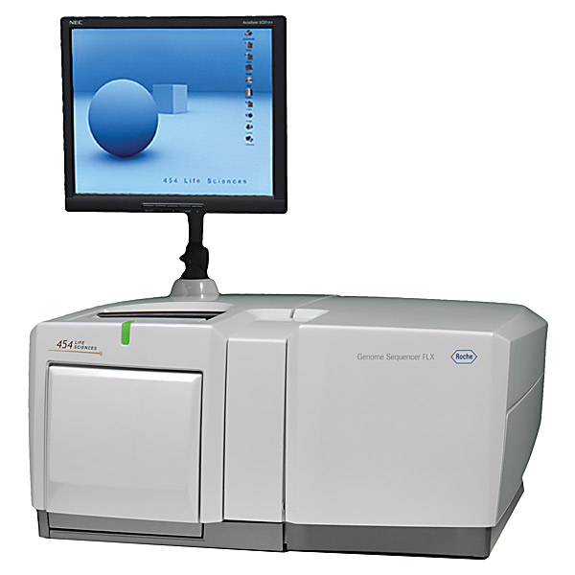
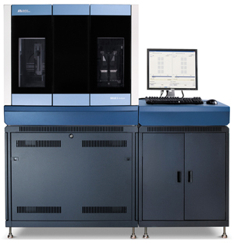
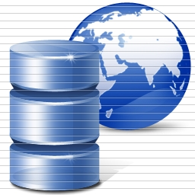
DNA Sequencing Pipeline
All Cloud Services. 3 Petabytes per day Personal Genomics
Illumina/Solexa Roche/454 Life Sciences Applied Biosystems/SOLiD
Internet
~300 million base pairs per day leading to
~3000 sequences per day per instrument
? 500 instruments at ~0.5M$ each
Read Alignment
Pairwise
clustering
Form block
Pairings
Sequence
alignment
Dissimilarity
Matrix
N(N-1)/2 values
Visualization
Plotviz
FASTA File
N Sequences
Blocking
MPI
MDS
MapReduce

Slide 63
Internet of Things

Slide 64
Internet of Things and the Cloud
It is projected that there will be 24 billion devices on the Internet by 2020. Most will be small sensors that send streams of information into the cloud where it will be processed and integrated with other streams and turned into knowledge that will help our lives in a multitude of small and big ways.
The cloud will become increasing important as a controller of and resource provider for the Internet of Things.
As well as today’s use for smart phone and gaming console support, “Intelligent River” “smart homes and grid” and “ubiquitous cities” build on this vision and we could expect a growth in cloud supported/controlled robotics.
Some of these “things” will be supporting science
Natural parallelism over “things”
“Things” are distributed and so form a Grid

Slide 65
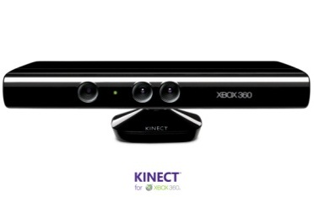








Sensors (Things) as a Service
Output Sensor
Sensors as a Service
Sensor Processing as a Service (could use
MapReduce)
A larger sensor ………
https://sites.google.com/site/opensourceiotcloud/ Open Source Sensor (IoT) Cloud

Slide 66

Ruh VP Software GE http://fisheritcenter.haas.berkeley.edu/Big_Data/index.html

Slide 67
Cloud Computing and Health

Slide 68
27 Venus-C Azure Applications
Chemistry (3)
• Lead Optimization in Drug Discovery
• Molecular Docking
Civil Protection (1)
• Fire Risk estimation and fire propagation
Biodiversity &
Biology (2)
• Biodiversity maps in marine species
• Gait simulation
Civil Eng. and Arch. (4)
• Structural Analysis
• Building information Management
• Energy Efficiency in Buildings
• Soil structure simulation
Physics (1)
• Simulation of Galaxies configuration
Earth Sciences (1)
• Seismic propagation
Mol, Cell. & Gen. Bio. (7)
• Genomic sequence analysis
• RNA prediction and analysis
• System Biology
• Loci Mapping
• Micro-arrays quality.
ICT (2)
• Logistics and vehicle routing
• Social networks analysis
Medicine (3)
• Intensive Care Units decision support.
• IM Radiotherapy planning.
• Brain Imaging
Mathematics (1)
• Computational Algebra
Mech, Naval & Aero. Eng. (2)
• Vessels monitoring
• Bevel gear manufacturing simulation

Slide 69

Anjul Bhambhri, VP of Big Data, IBM http://fisheritcenter.haas.berkeley.edu/Big_Data/index.html

Slide 70

http://cs.metrostate.edu/~sbd/ Oracle

Slide 71
Healthcare & Cloud Computing
Patient’s information would be stored in a cloud
Accessed and managed over the Internet
Since we are on a paperless route, this is a great idea to store information
Authorized users
Information on one cloud is connected to bigger clouds
  Ex. Big Bend RHIO connected to the NHIN
http://healthinformatics.wikispaces.com/file/view/cloud_computing.ppt

Slide 72
Considerations With Cloud Computing in Healthcare
Since information is stored over the Internet, precautions must be taken
Cloud system must conform to the HIPAA act
  Personal Health Information
  Secure transmission of PHI over the Internet
  Need to maintain a secure, safe, and authorized environment for the prevention of information leakage

Slide 73
Advantages of Cloud Computing
Low costs
  Outsourcing information reduces amount spent on new technology
  Easier to maintain
More secure
  Companies are hired to watch over the information
Interoperability
  Access information from anywhere
  Can be accessed using different devices

Slide 74

Advantages of Cloud Computing
Increases the adoption of EMRs
Beneficial for small companies
Easy to share information among different organizations and doctors

Slide 75
Cloud Computing Disadvantages
Security is the main disadvantage of cloud computing
Consumers are worried about Insurance companies getting a hold of there information and discriminating based upon current medical conditions they may have or medical conditions that they could develop later in life.
They are also worried about government agencies getting a hold of there information and exploiting it to third party vendors, or there place of work.

Slide 76
Disadvantages Cont.
The cloud companies do not always handle all of the security themselves and sometimes pass it off to third party vendors
Consumers need to make sure to thoroughly check out these companies to see who else they are involved with and check out there reputation to see if you trust them to not share your information with any other outside sources. If the third party vendor looks trustworthy then you are probably safe to send your medical records over the cloud safely.

Slide 77
MapReduce

Slide 78






MapReduce “File/Data Repository” Parallelism
Map = (data parallel) computation reading and writing data
Reduce = Collective/Consolidation phase e.g. forming multiple global sums as in histogram
Instruments
MPI and Iterative MapReduce
Map Map Map Map
Reduce Reduce Reduce
Communication
Reduce
Portals
/Users
Disks
Map₁
Map₂
Map₃

Slide 79
MapReduce
A parallel Runtime coming from Information Retrieval
Data Partitions
Map(Key, Value)
A hash function maps the results of the map tasks to r reduce tasks
Reduce(Key, List<Value>)
Reduce Outputs
Implementations support:
  Splitting of data
  Passing the output of map functions to reduce functions
  Sorting the inputs to the reduce function based on the intermediate keys
  Quality of services

Slide 80
4 Forms of MapReduce
(a) Map Only
(b) Classic MapReduce
(c) Iterative MapReduce
(d) Loosely Synchronous
Input
Input
Iterations
Input
map
map
map
P_{ij}
reduce
reduce
Output
BLAST Analysis
Parametric sweep
Pleasingly Parallel
High Energy Physics (HEP) Histograms
Distributed search
Expectation maximization Clustering e.g. Kmeans
Linear Algebra, Page Rank
Classic MPI
PDE Solvers and particle dynamics
Domain of MapReduce and Iterative Extensions
Science Clouds
MPI
Exascale
MPI is Map followed by Point to Point Communication – as in style d)

Slide 81






Sam’s Problem http://www.slideshare.net/esaliya/mapreduce-in-simple-terms
Sam thought of “drinking” the apple
He used a to cut the and a to make juice.

Slide 82






Creative Sam
Implemented a parallel version of his innovation
Fruits
Each input to a map is a list of <key, value> pairs
A list of <key, value> pairs mapped into another list of <key, value> pairs which gets grouped by the key and reduced into a list of values
(<a, > , <o, > , <p, > , …)
Each output of slice is a list of <key, value> pairs
(<a’, > , <o’, > , <p’, > )
Grouped by key
The idea of Map Reduce in Data Intensive Computing
Each input to a reduce is a <key, value-list> (possibly a list of these, depending on the grouping/hashing mechanism)
e.g. <ao, ( …)>
Reduced into a list of values

Slide 83
Genomic Proteomics and Information Visualization

Slide 84
COG: Clusters of Orthologous Groups
COG database was developed by NCBI.
Proteins classified into groups with common function encoded in complete genomes.
Prokaryotes (COG): 66 genomes, 200K proteins, 5K clusters.
Eukaryotes (KOG): 7 genomes, 113K proteins, 5K clusters.
Valuable scientific resource: 5K citations.
Last updated: 2006.

Slide 85
Protein Sequence Universe
PSU Goal: Enhance annotation resources with analytic and visualization (browser) tools.
One component of PSU is to project sequence data into 3D using multidimensional scaling (MDS).
MDS interpolation allows expanding the universe without time consuming all vs all O(N²)
  3D map allows much faster interpolation
Use set of pairwise dissimilarities – don’t do MSA – so don’t have vectors in some space

Slide 86
High Performance Dimension Reduction and Visualization
Need is pervasive
  Large and high dimensional data are everywhere: biology, physics, Internet, …
  Visualization can help data analysis
Visualization of large datasets with high performance
  Map high-dimensional data into low dimensions (2D or 3D).
  Need Parallel programming for processing large data sets
  Developing high performance dimension reduction algorithms:
    MDS(Multi-dimensional Scaling)
    GTM(Generative Topographic Mapping)
    DA-MDS(Deterministic Annealing MDS)
    DA-GTM(Deterministic Annealing GTM)
  Interactive visualization tool PlotViz
Notes:
With David Wild

Slide 87
Multi-Dimensional Scaling (MDS)
Sammon‘s objective function
is dissimilarity measure between sequences i and j
d is Euclidean distance (here in 3D for visualization) between projections x_{i} and x_{j}
Denominator chosen to get larger contribution in objective function from smaller dissimilarities
f is monotone transformation of dissimilarity measure chosen “artistically”

Slide 88

Typical Metagenomics MDS

Slide 89

Metagenomics
http://salsahpc.indiana.edu/millionseq/mina/16SrRNA_index.html

Slide 90
MDS Details
f chosen heuristically to increase the ratio of standard deviation to mean for and to increase the range of dissimilarity measures.
O(n²) complexity to map n sequences into 3D.
MDS can be solved using EM (SMACOF – fastest but limited) or directly by Newton's method (it’s just χ² )
Used robust implementation of nonlinear χ² minimization with Levenberg-Marquardt
3D projections visualized in PlotViz

Slide 91
MDS Details
Input Data: 100K sequences from well-characterized prokaryotic COGs.
Proximity measure: sequence alignment % scores
Scores calculated using Needleman-Wunsch
Scores “sqrt 4D” transformed and fed into MDS
  Analytic form for transformation to 4D
  δ_{ij}^{n} decreases dimension n > 1; increases n < 1
“sqrt 4D” reduced dimension of distance data from 244 for δ_{ij} to14 for f(δ_{ij})
Hence more uniform coverage of Euclidean space

Slide 92

3D View of 100K COG Sequences

Slide 93
Cluster Annotation
COG | Annotation | Uniref100
COG1131 | ABC-type multidrug transport system, ATPase component | 14406
COG1136 | ABC-type antimicrobial peptide transport system, ATPase component | 7306
COG1126 | ABC-type polar amino acid transport system, ATPase component | 4061
COG3839 | ABC-type sugar transport systems, ATPase component | 4121
COG0444 | ABC-type dipeptide/oligopeptide/nickel transport system ATPase comp | 3520
COG4608 | ABC-type oligopeptide transport system, ATPase component | 3074
COG3842 | ABC-type spermidine/putrescine transport systems, ATPase comp | 3665
COG0333 | Ribosomal protein L32 | 1148
COG0454 | Histone acetyltransferase HPA2 and Related acetyltransferases | 14085
COG0477 | Permeases of the major facilitator superfamily | 48590
COG1028 | Dehydrogenases with different specificities | 37461

Slide 94

Selected Clusters

Slide 95
Metagenomics with 3 Clustering Methods
DA-PWC 188 Clusters; CD-Hit 6000; UCLUST 8418
DA-PWC doesn’t need seeding like other methods – All clusters found by splitting
# Clusters

Slide 96
Advantages of GTM
Computational complexity is O(KN), where
  N is the number of data points
  K is the number of latent variables or clusters. K << N
Efficient, compared with MDS which is O(N²)
Produce more separable map (right) than PCA (left)
PCA
GTM
Oil flow data
1000 points
12 Dimensions
3 Clusters

Slide 97



Data Mining Projects using GTM
Visualizing 215 solvents by GTM-Interpolation
215 solvents (colored and labeled) are embedded with 100,000 chemical compounds (colored in grey) in PubChem database
Chemical compounds reported in literatures
Visualized 234,000 chemical compounds which may be related with a set of 5 genes of interest (ABCB1, CHRNB2, DRD2, ESR1, and F2) based on the dataset collected from major journal literatures
PubChem data with CTD visualization
About 930,000 chemical compounds are visualized in a 3D space, annotated by the related genes in Comparative Toxicogenomics Database (CTD)

Slide 98

DA-PLSA with DA-GTM
Corpus
(Set of documents)
DA-PLSA
Corpus
in K-dimension
DA-GTM
Embedded Corpus in 3D

Slide 99


Slide 100



Lymphocytes 4D
Pathology 54D
Dimension Reduction/MDS helps address
You can get answers (from clustering) but do and how do you believe them!
LC-MS 2D

Slide 101


Phylogenetic tree using MDS
200 Sequences
(126 centers of clusters found from 446K)
Tree found from mapping sequences to 10D using Neighbor Joining
Whole collection mapped to 3D
2133 Sequences
Extended from set of 200
Trees by Neighbor Joining in 3D map
Silver Spheres Internal Nodes

