Slide 1
Services, Security, and Privacy in Cloud Computing
HPCC 2010 Crown Conference Center Melbourne
September 3 2010
Geoffrey Fox
gcf@indiana.edu
http://www.infomall.org http://www.futuregrid.org
Director, Digital Science Center, Pervasive Technology Institute
Associate Dean for Research and Graduate Studies, School of Informatics and Computing
Indiana University Bloomington

Slide 2
Research and Clouds
Clouds are suitable for “Loosely coupled” data parallel applications
Quantify “loosely coupled” and define appropriate programming model
MapReduce and Twister are candidates for “appropriate cloud programming model”
How important is compute-data affinity and concepts like Data Parallel File Systems
Are “academic” private clouds interesting as they (currently) only have a few of Platform features of commercial clouds and are not usually big enough to be elastic?
What are Security/Privacy issues?

Slide 3
Services
Clouds and Services are a marriage made in heaven
Cloud Platforms can for example automatically scale service to meet increased demand

Slide 4
Security, Privacy
Virtualization and sharing of a large data center creates risks from mixing of
Computing
Data
Networks
3 approaches
Run sensitive applications on a private cloud
Use a hybrid public/private cloud
Establish a Secure partition of a Public Cloud

Slide 5
Hybrid Clouds
“small” Private Cloud
Public Cloud
Some issues:
Can algorithm isolate “sensitive” computation to a small private cloud
Is private—public bandwidth sufficient?
Is whole system elastic?

Slide 6
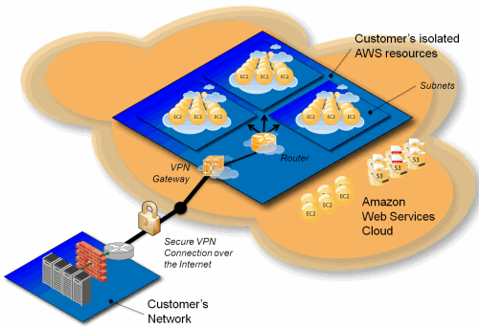
Amazon Virtual Private Cloud
Can Amazon implement elastic VPC’s that really separate storage, computing and networkking
Do you trust barriers Amazon implemented in public cloud

