Slide 1
Data Science and the Cloud; Centerpieces of the Future Economy
June 14 2013
Indiana University Mini University
Geoffrey Fox
gcf@indiana.edu
http://www.infomall.org http://www.futuregrid.org
School of Informatics and Computing
Digital Science Center
Indiana University Bloomington

Slide 2
Abstract
There is an endlessly growing amount of data as we record every transaction between people and the environment (whether shopping or on a social networking site) while smart phones, smart homes, ubiquitous cities, smart power grids, and intelligent vehicles deploy sensors recording even more.
Science with satellites and accelerators is giving data on transactions of particles and photons at the microscopic scale.
This data are and will be stored in immense clouds with co-located storage and computing that perform "analytics" that transform data into information and then to wisdom and decisions; data mining finds the proverbial knowledge diamonds in the data rough.
This disruptive transformation is driving the economy and creating millions of jobs in the emerging area of "data science".
We discuss this revolution and its implications for universities and society

Slide 3

Some Trends
  The Data Deluge is clear trend from Commercial (Amazon, e-commerce) , Community (Facebook, Search) and Scientific applications
  Smaller (INTEL/ARM/AMD) chips drive
    Multicore (i.e. more computing) on shared servers
    Smaller Light weight clients from smartphones, tablets to sensors (i.e. more clients)
  Clouds with cheaper, greener, easier to use IT for applications
  New jobs associated with new curricula
    Clouds as a distributed system (changing a classic CS course)
    Data Science (new area)

Slide 4
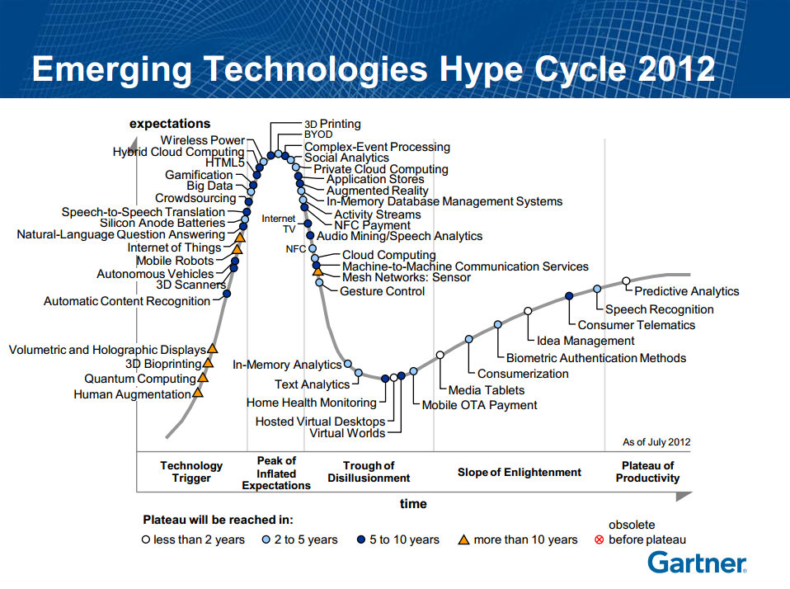
48 technologies are listed in this year’s hype cycle which is the highest in last ten years. Year 2008 was the lowest (27)
Gartner Says: We are at an interesting moment — a time when the scenarios we’ve been talking about for a long time are almost becoming reality.

Slide 5
Issues of Importance
Economic Imperative: There are a lot of data and a lot of jobs
Computing Model: Industry adopted clouds which are attractive for data analytics
Research Model: 4th Paradigm; From Theory to Data driven science?
Research/Business opportunities in advancing computing technologies and algorithms
Research/Business opportunities in X-Informatics: applying 4th paradigm (more here!)
Development in Data Science Education: opportunities at universities

Slide 6
Data Deluge

Slide 7
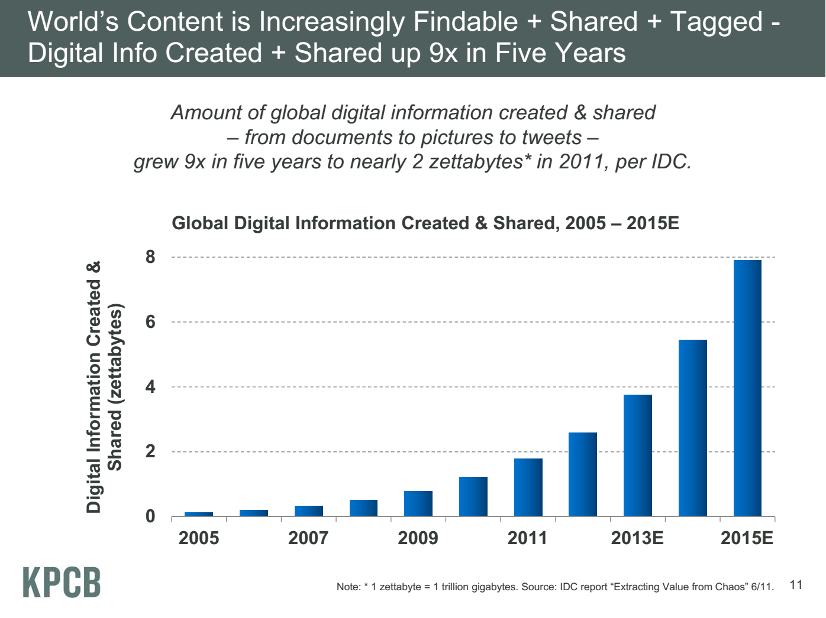
Zettabyte ~10¹⁰ Typical Local Storage (100 Gigabytes)
Zettabyte = 1000 Exabytes
Exabyte = 1000 Petabytes
Petabyte = 1000 Terabyte
Terabyte = 1000 Gigabytes
Gigabyte = 1000 Megabytes
Meeker/Wu May 29 2013 Internet Trends D11 Conference

Slide 8
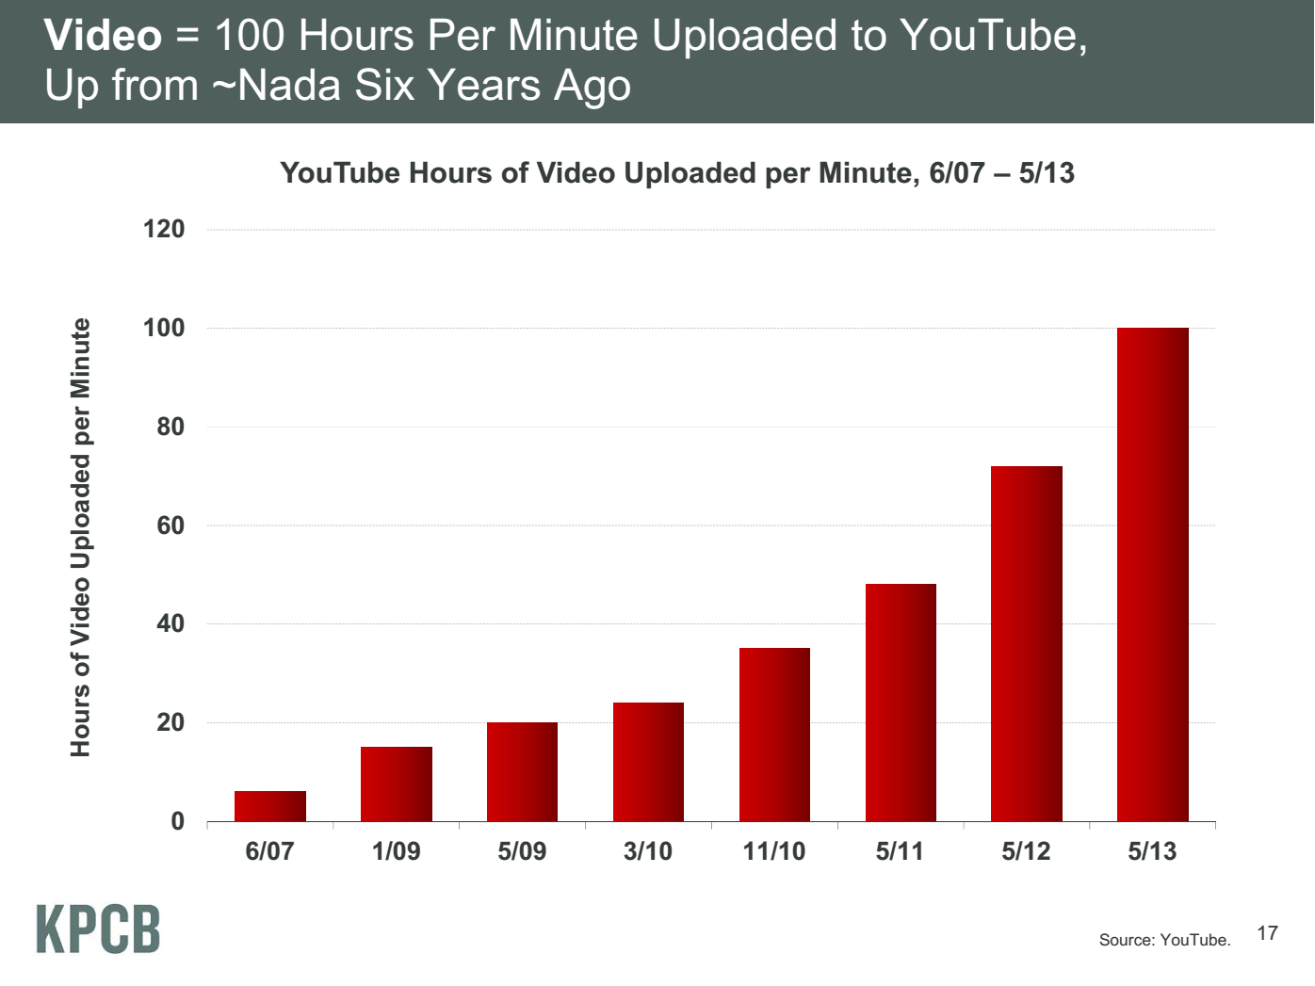
20 hours
Meeker/Wu May 29 2013 Internet Trends D11 Conference

Slide 9
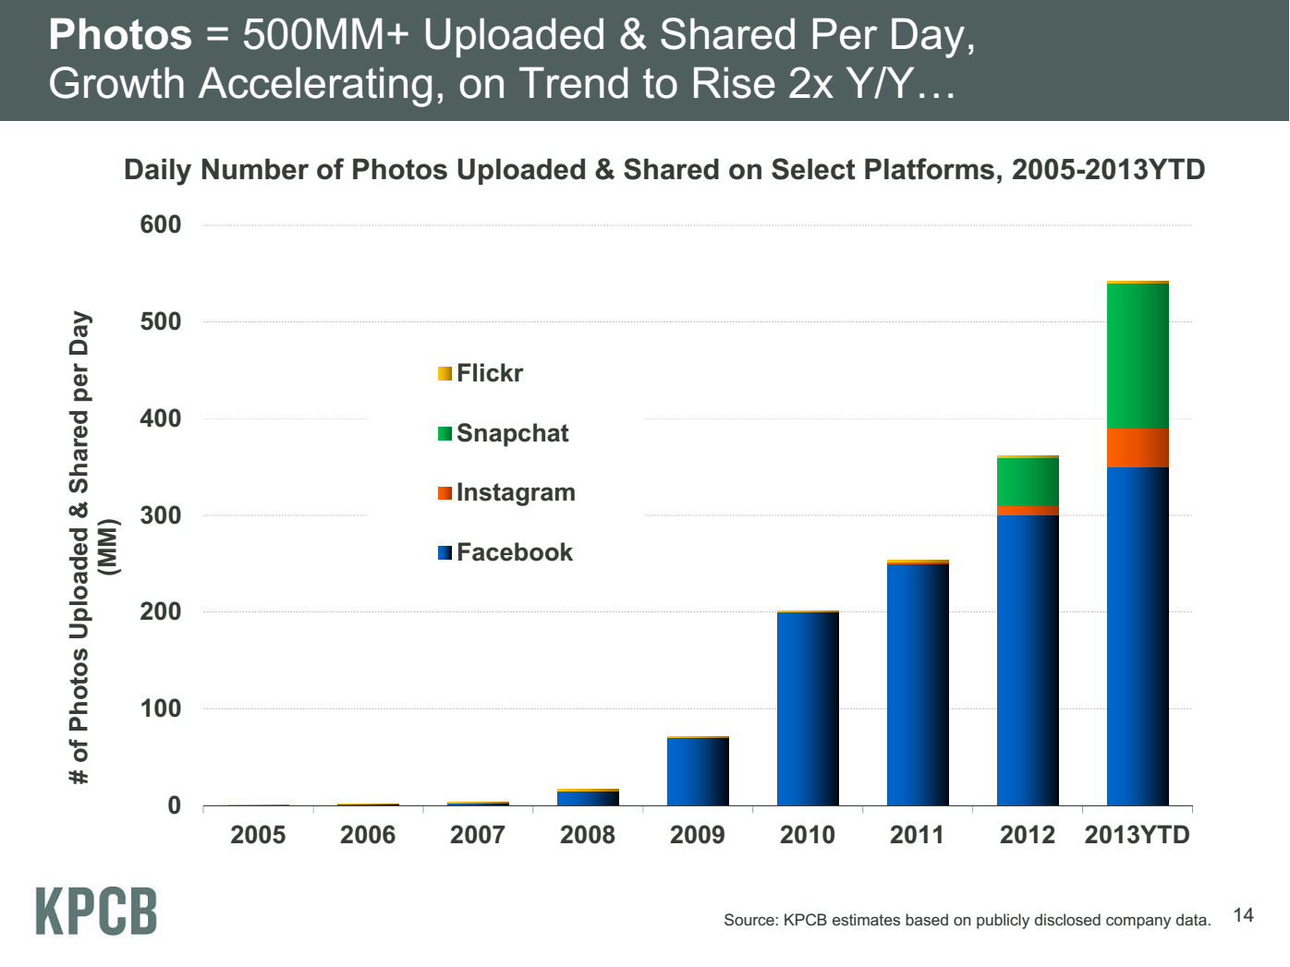
Meeker/Wu May 29 2013 Internet Trends D11 Conference

Slide 10
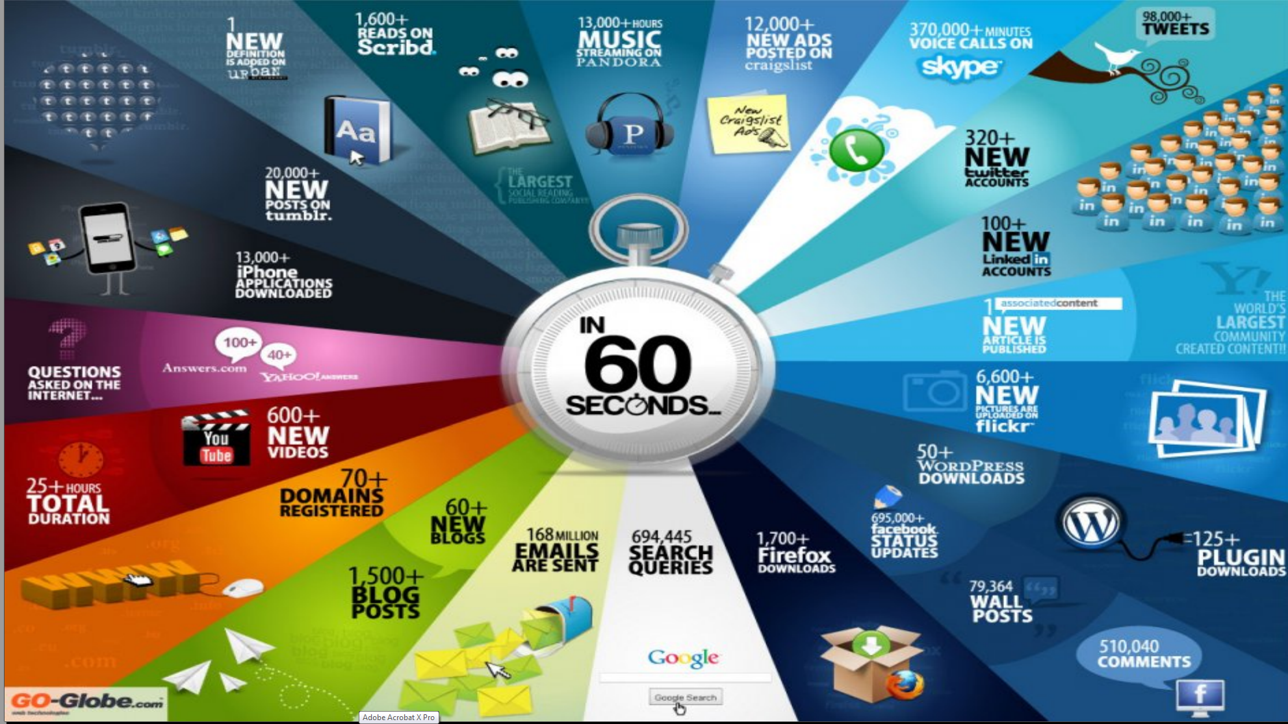
http://cs.metrostate.edu/~sbd/ Oracle

Slide 11
“Taming the Big Data Tidal Wave” 2012
(Bill Franks, Chief Analytics Officer Teradata)
Web Data (“the original big data”)
  Analyze customer web browsing of e-commerce site to see topics looked at etc.
Auto Insurance (telematics monitoring driving)
  Equip cars with sensors
Text data in multiple industries
  Sentiment analysis, identify common issues (as in eBay lamp example), Natural Language processing
Time and location (GPS) data
  Track trucks (delivery), vehicles(track), people(tell them nearby goodies)
Retail and manufacturing: RFID
  Asset and inventory management,
Utility industry: Smart Grid
  Sensors allow dynamic optimization of power
Gaming industry: Casino Chip tracking (RFID)
  Track individual players, detect fraud, identify patterns
Industrial engines and equipment: sensor data
  See GE engine
Video games: telemetry
  This is like monitoring web browsing but rather monitor actions in a game
Telecommunication and other industries: Social Network data
  Connections make this big data.
  Use connections to find new customers with similar interests

Slide 12
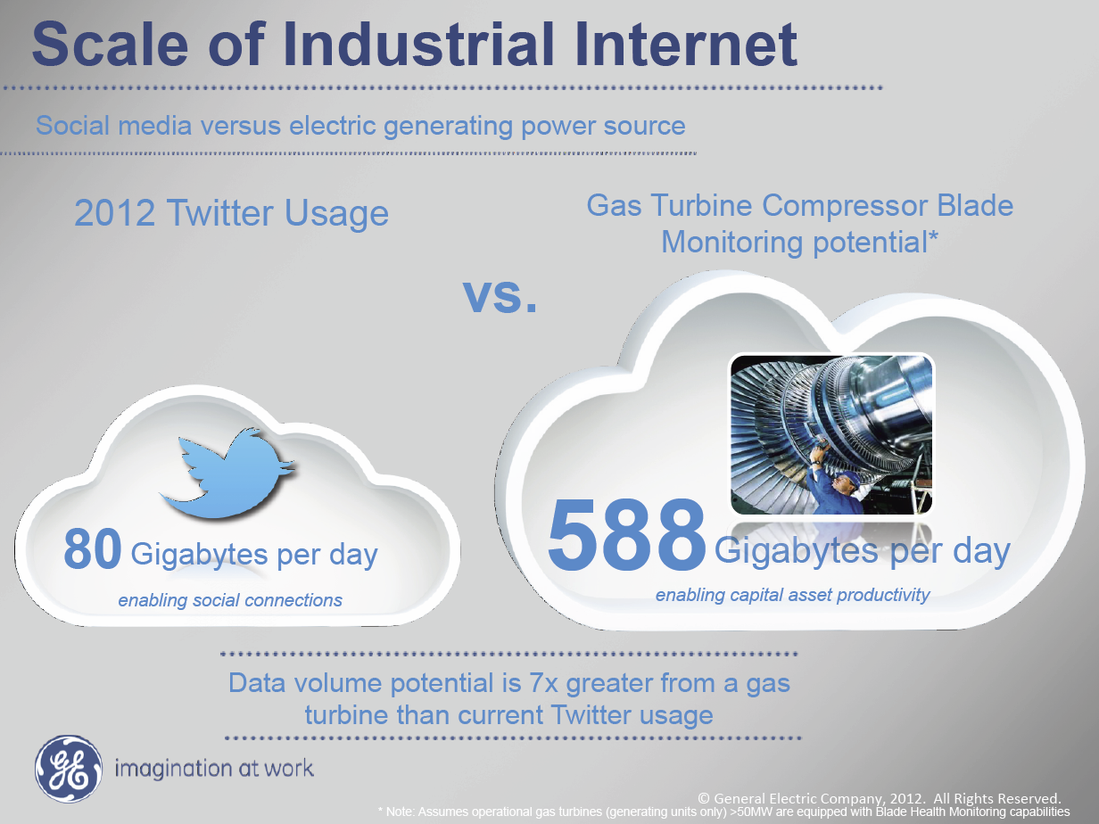
Ruh VP Software GE http://fisheritcenter.haas.berkeley.edu/Big_Data/index.html

Slide 13
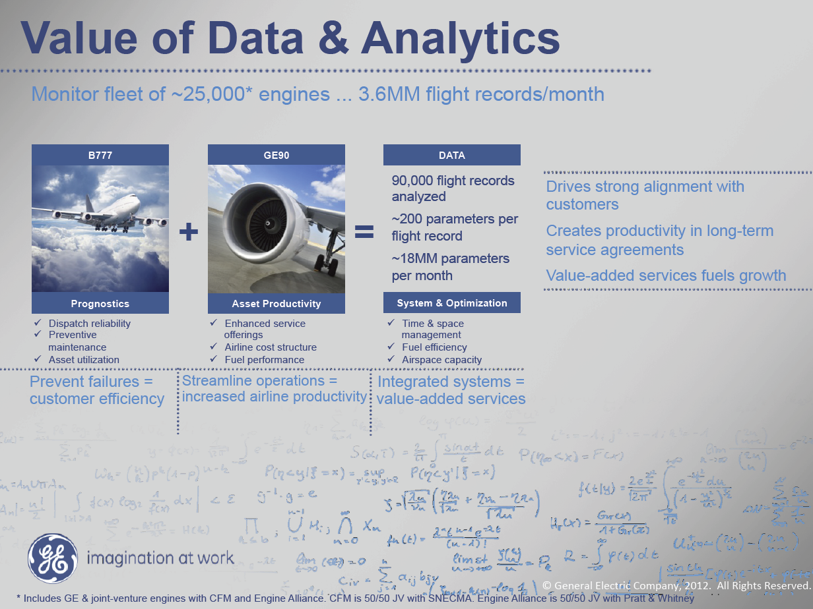
MM = Million
Ruh VP Software GE http://fisheritcenter.haas.berkeley.edu/Big_Data/index.html

Slide 14
Some Science/Technical Data sizes
LHC Particle Physics 15 petabytes per year
Radiology 69 petabytes per year
Square Kilometer Array Telescope will be 0.5 zettabytes per year raw data in ~2022
Earth Observation becoming ~4 petabytes per year
Earthquake Science – few terabytes total today
PolarGrid Radar studies of glaciers– 100’s terabytes/year
Exascale simulation data dumps – ~0.1 zettabyte per year

Slide 15
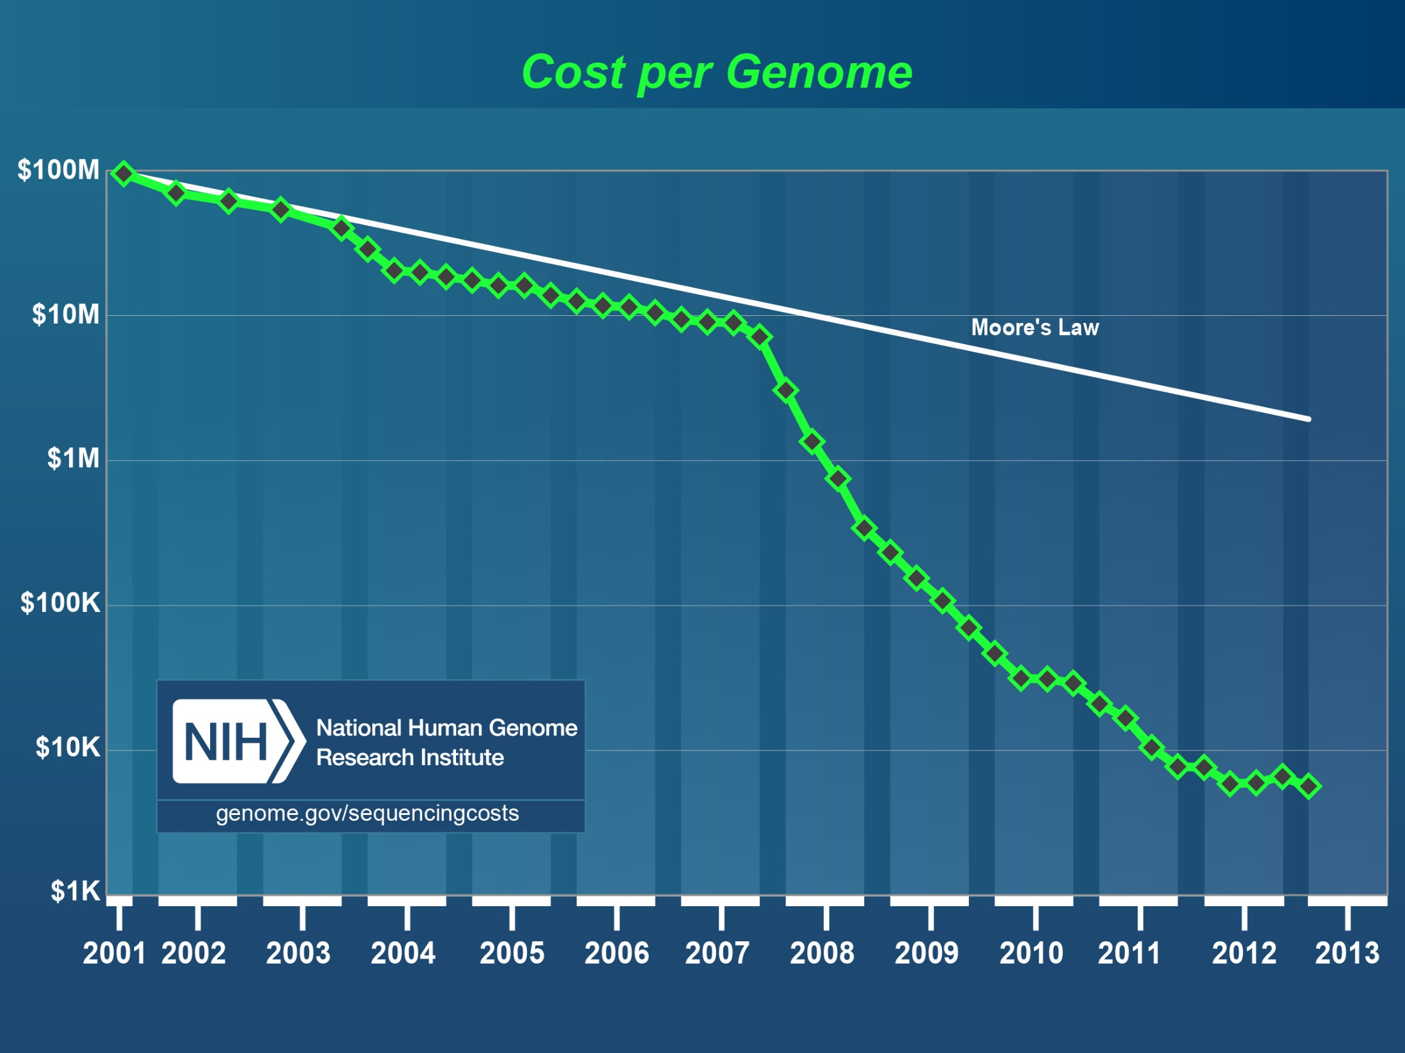
Need cost effective
Computing!
Sequence every newborn by 2019 100 petabytes/year
http://www.genome.gov/sequencingcosts/

Slide 16
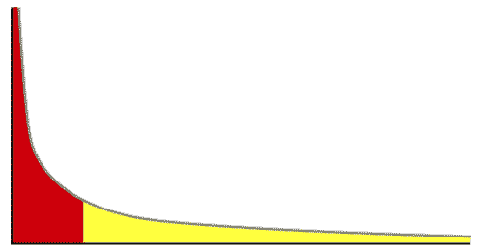
The Long Tail of Science
High energy physics, astronomy
genomics
The long tail: economics, social science, ….
Collectively “long tail” science is generating a lot of data
  Estimated at over 1PB per year and it is growing fast.
80-20 rule: 20% users generate 80% data but not necessarily 80% knowledge
From Dennis Gannon Talk

Slide 17
Data Intensive Activities
Particle Physics LHC (bag of events of particles)
Information Retrieval or web search (bag of words)
e-commerce (bag of items with properties or users with rankings)
Social Networking (bag of people with links & properties)
Health Informatics (bag of health records, gene sequences)
Sensors – web cams, self driving cars etc. (bag of pixels)
Using
Statistics (Histograms, Chisq)
Deep Learning (Machine Learning)
Image Analysis (including internet uploaded images)
Recommender Engines (Bag of Ratings or properties)
Patterns or Anomaly detection in graphs (linked data)
On Clouds using MapReduce etc.
Bag=Space

Slide 18
Big Data Ecosystem in One Sentence
Use Clouds running Data Analytics Collaboratively processing Big Data to solve problems in X-Informatics educated in data science
X = Astronomy, Biology, Biomedicine, Business, Chemistry, Climate, Crisis, Earth Science, Energy, Environment, Finance, Health, Intelligence, Lifestyle, Marketing, Medicine, Pathology, Policy, Radar, Security, Sensor, Social, Sustainability, Wealth and Wellness with more fields (physics) defined implicitly
Spans Industry and Science (research)

Slide 19
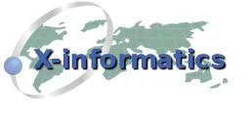





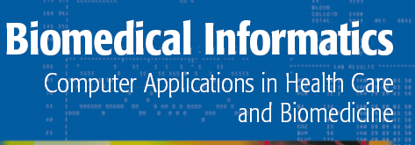


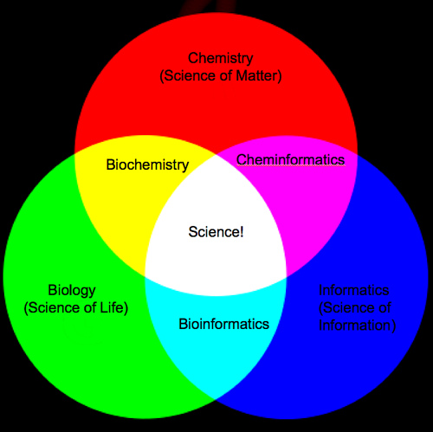
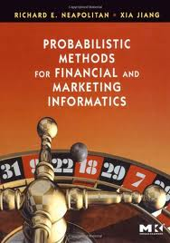
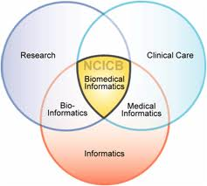
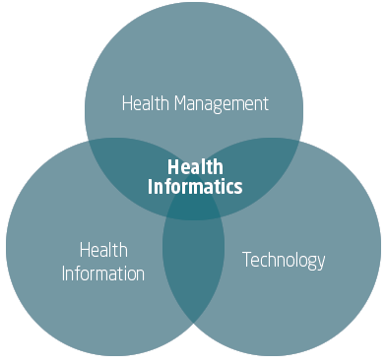
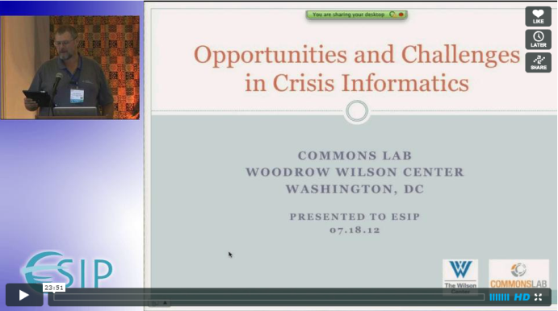

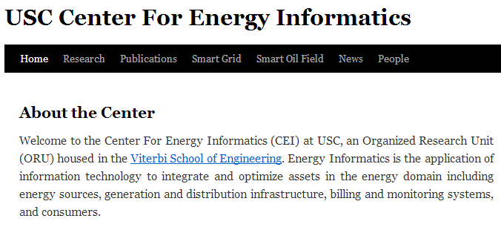
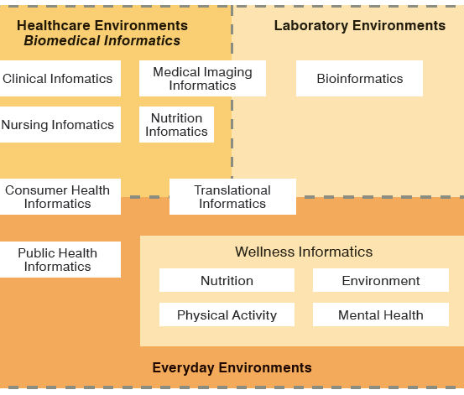
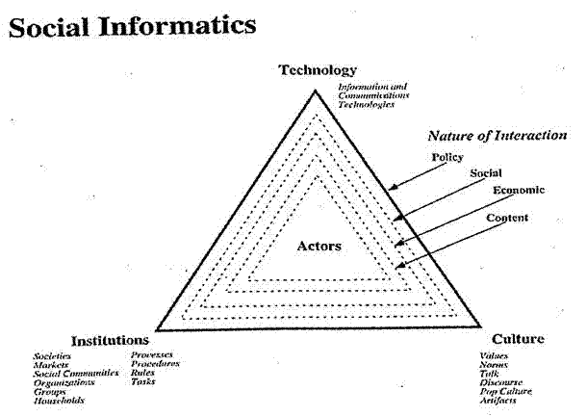

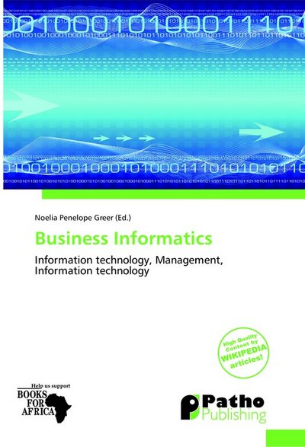
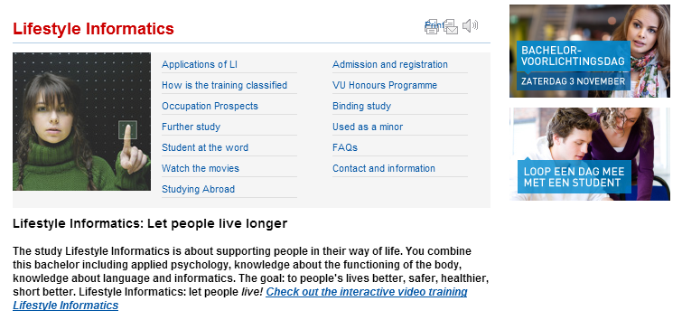


Social Informatics

Slide 20
Jobs

Slide 21

Jobs v. Countries
http://www.microsoft.com/en-us/news/features/2012/mar12/03-05CloudComputingJobs.aspx

Slide 22

McKinsey Institute on Big Data Jobs
There will be a shortage of talent necessary for organizations to take advantage of big data. By 2018, the United States alone could face a shortage of 140,000 to 190,000 people with deep analytical skills as well as 1.5 million managers and analysts with the know-how to use the analysis of big data to make effective decisions.
Informatics aimed at 1.5 million jobs. Computer Science covers the 140,000 to 190,000
http://www.mckinsey.com/mgi/publications/big_data/index.asp.

Slide 23
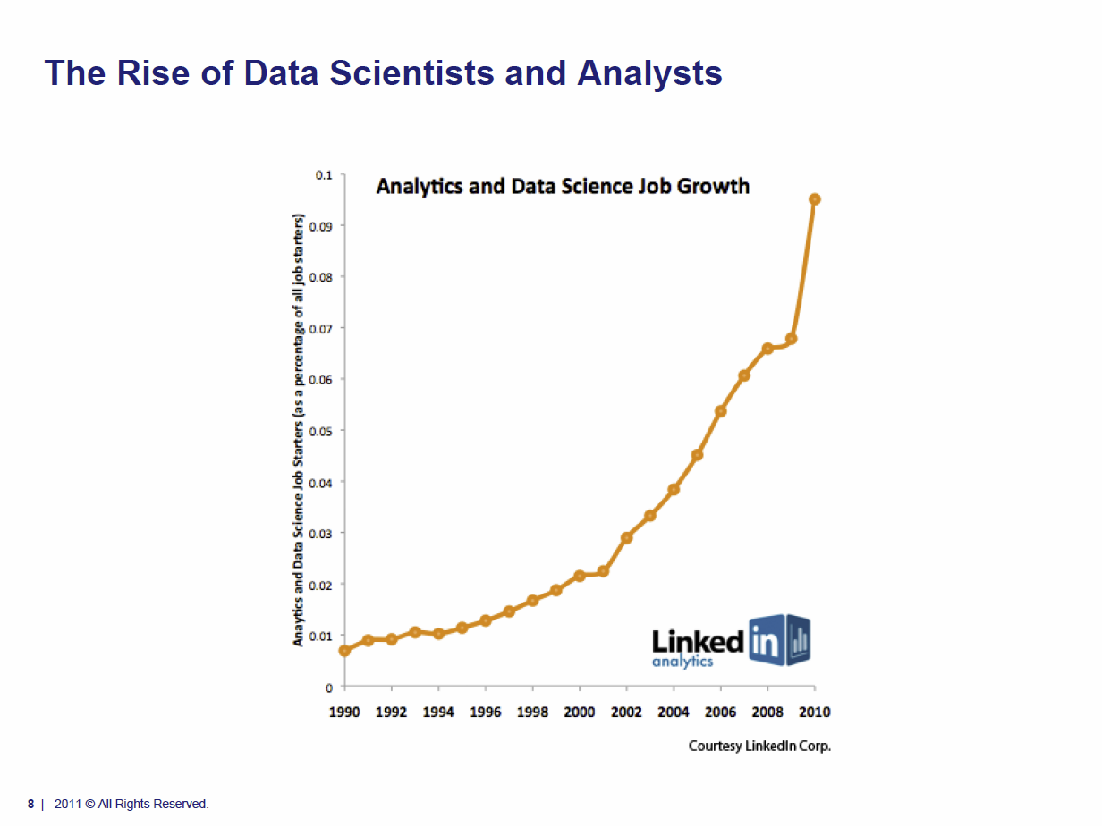
Tom Davenport Harvard Business School http://fisheritcenter.haas.berkeley.edu/Big_Data/index.html Nov 2012

Slide 24
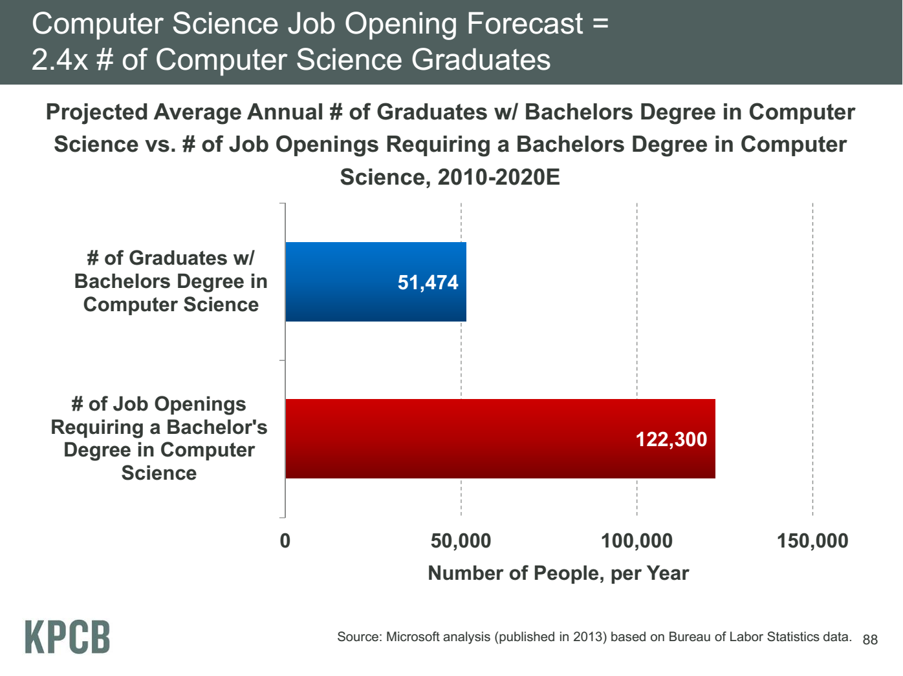
Meeker/Wu May 29 2013 Internet Trends D11 Conference

Slide 25
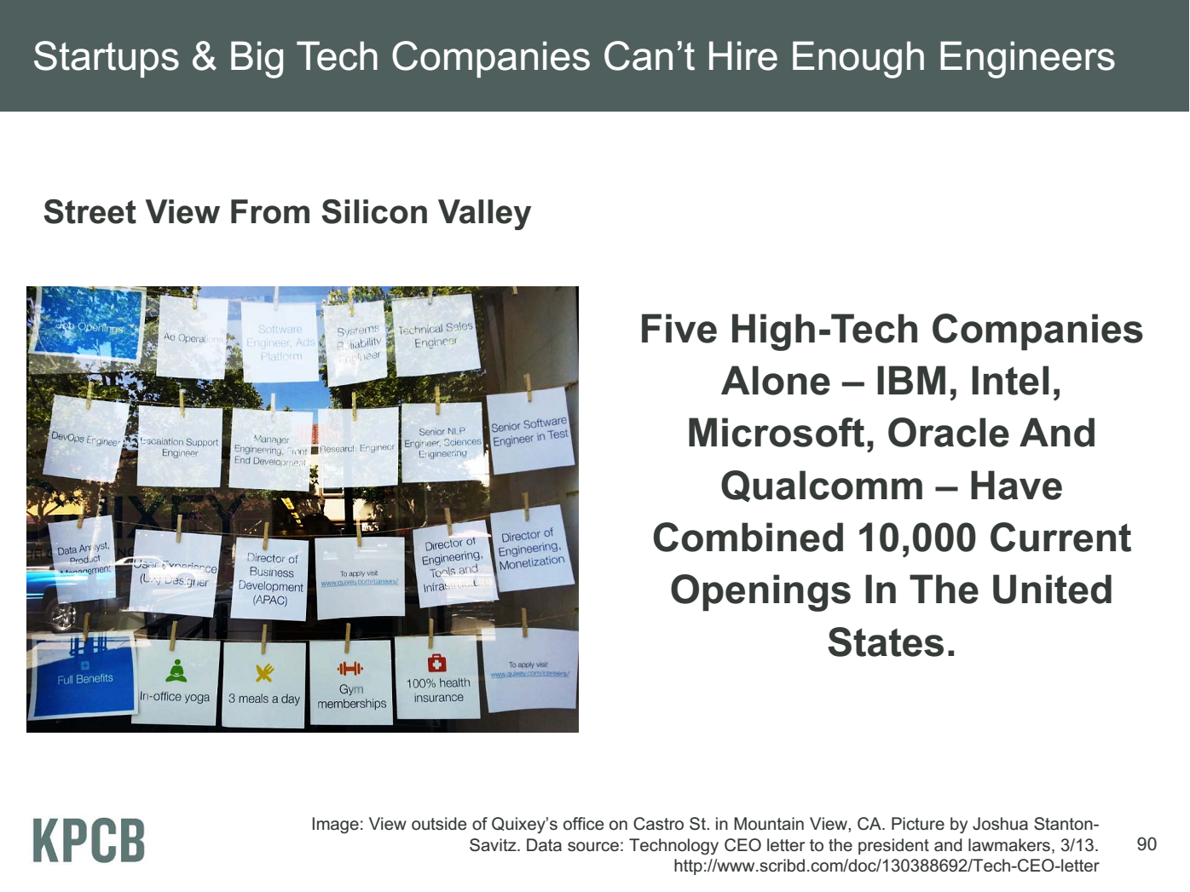
Meeker/Wu May 29 2013 Internet Trends D11 Conference

Slide 26
Industry Trends

Slide 27
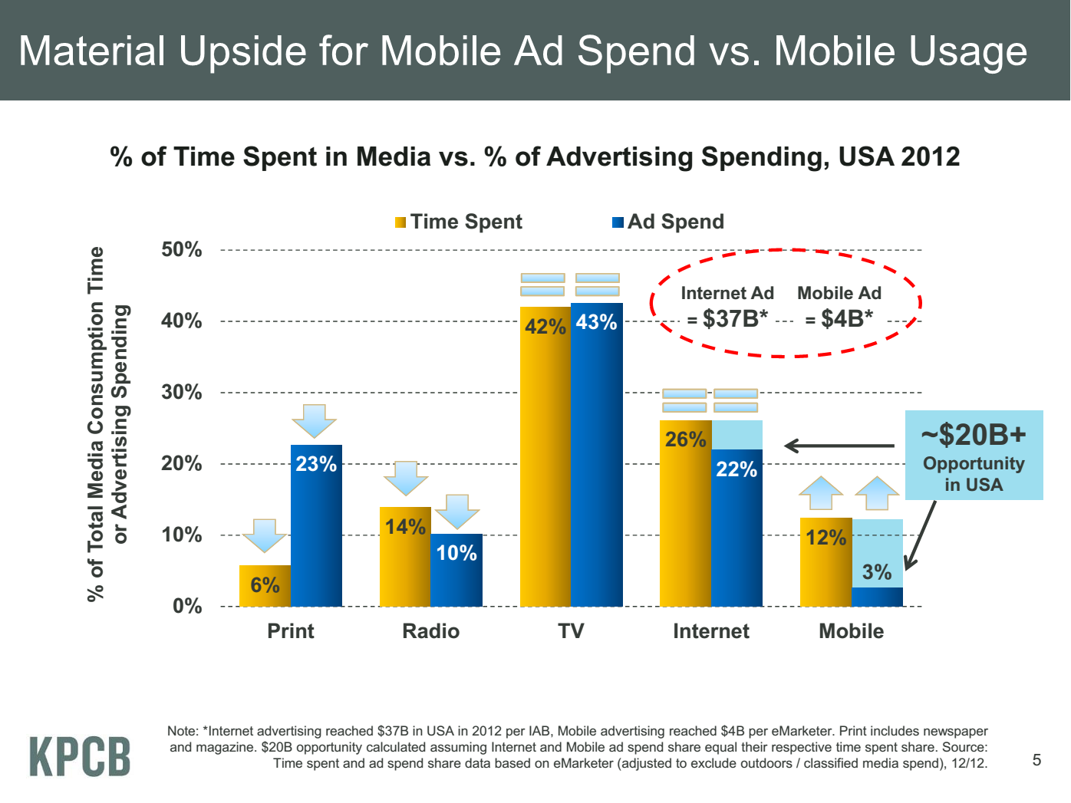
Meeker/Wu May 29 2013 Internet Trends D11 Conference

Slide 28
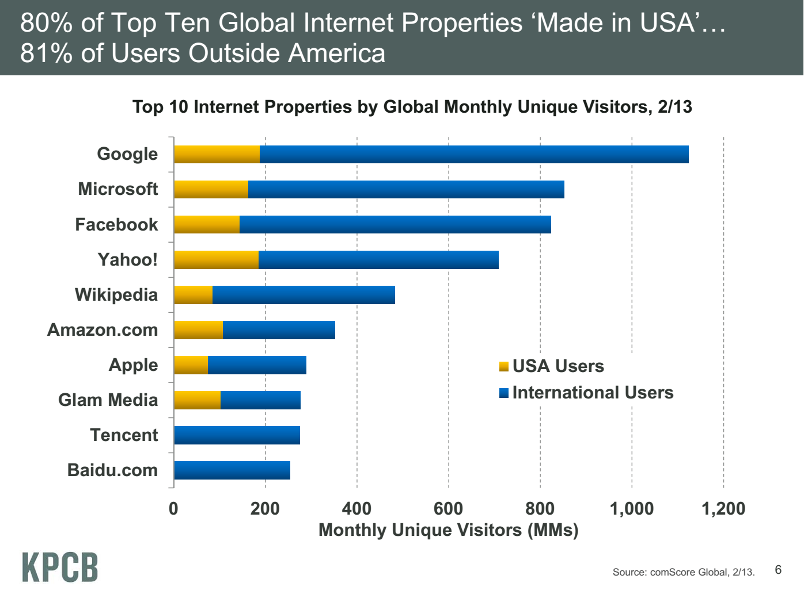
Meeker/Wu May 29 2013 Internet Trends D11 Conference

Slide 29
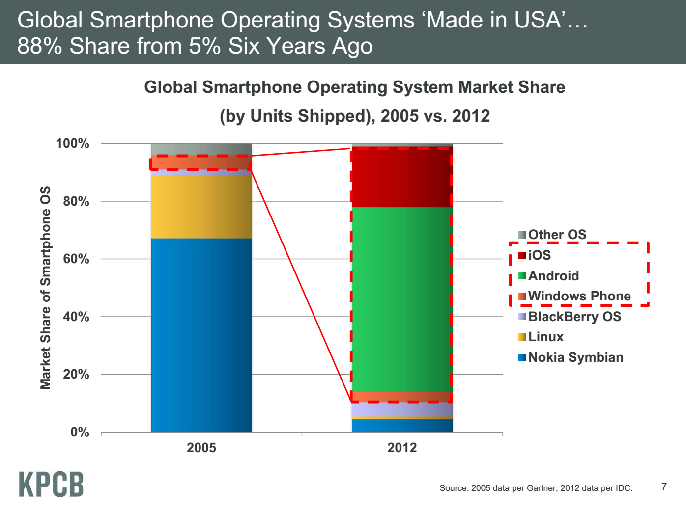
Meeker/Wu May 29 2013 Internet Trends D11 Conference

Slide 30
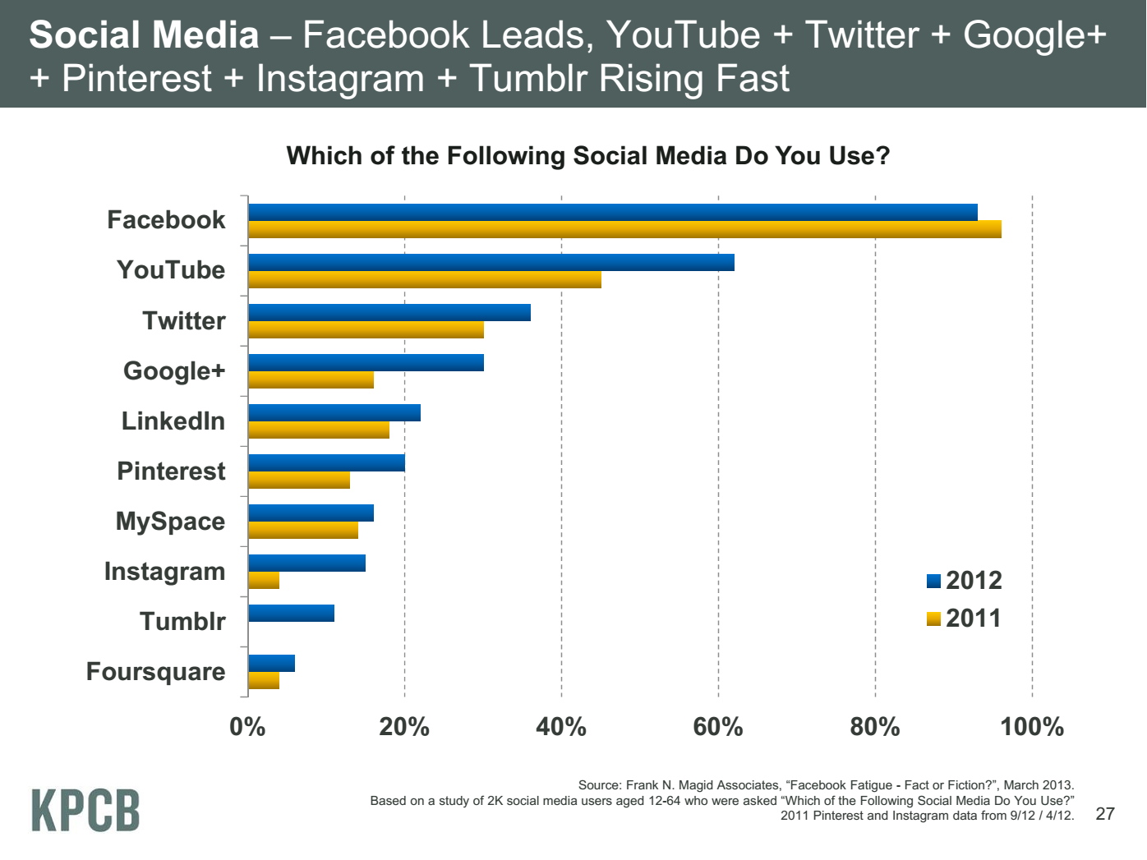
Meeker/Wu May 29 2013 Internet Trends D11 Conference

Slide 31
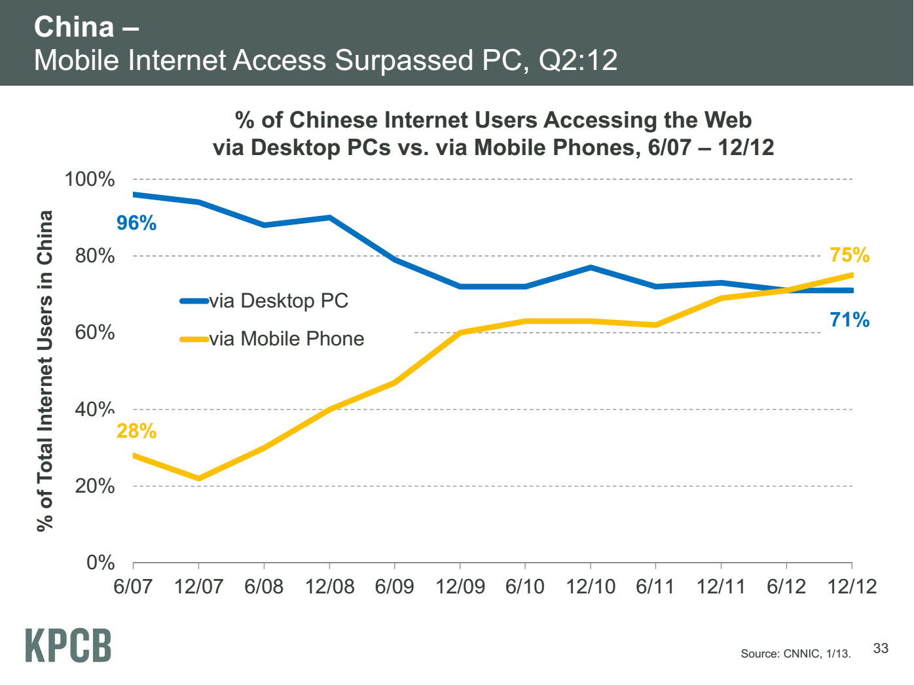
Meeker/Wu May 29 2013 Internet Trends D11 Conference

Slide 32
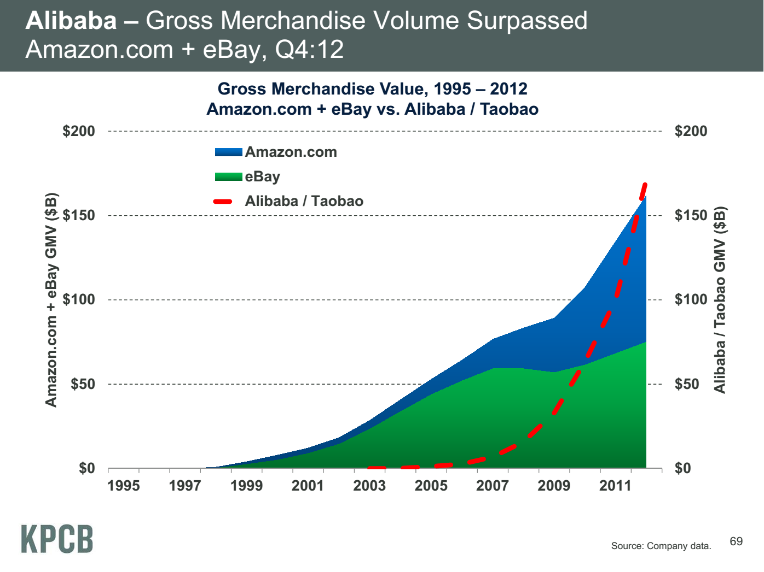
Meeker/Wu May 29 2013 Internet Trends D11 Conference

Slide 33
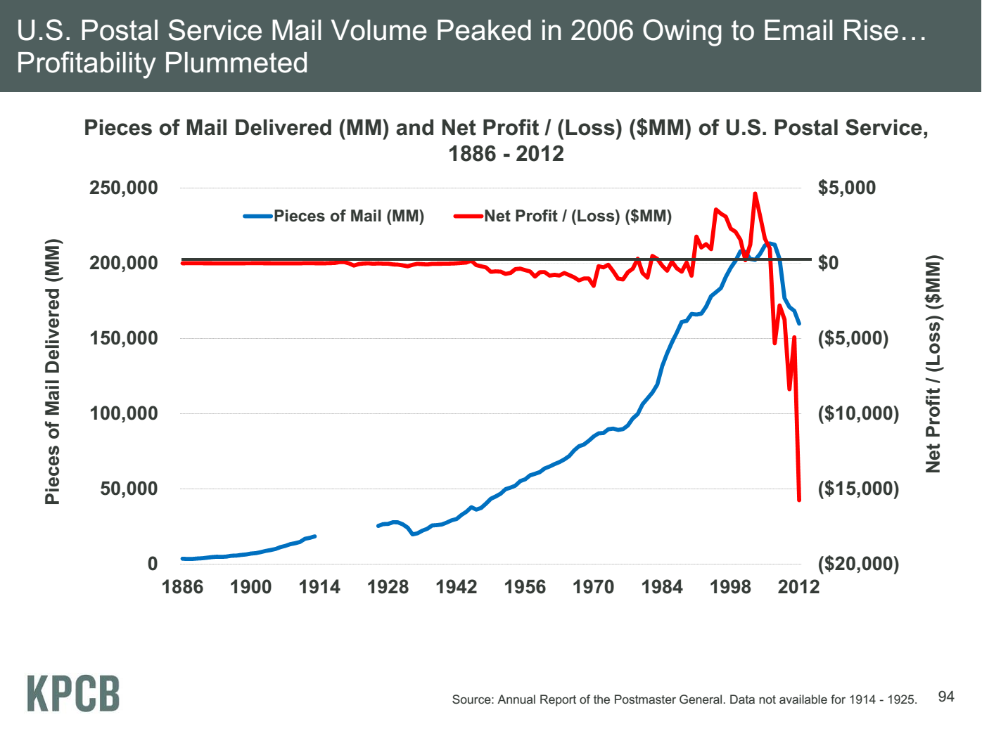
Meeker/Wu May 29 2013 Internet Trends D11 Conference

Slide 34
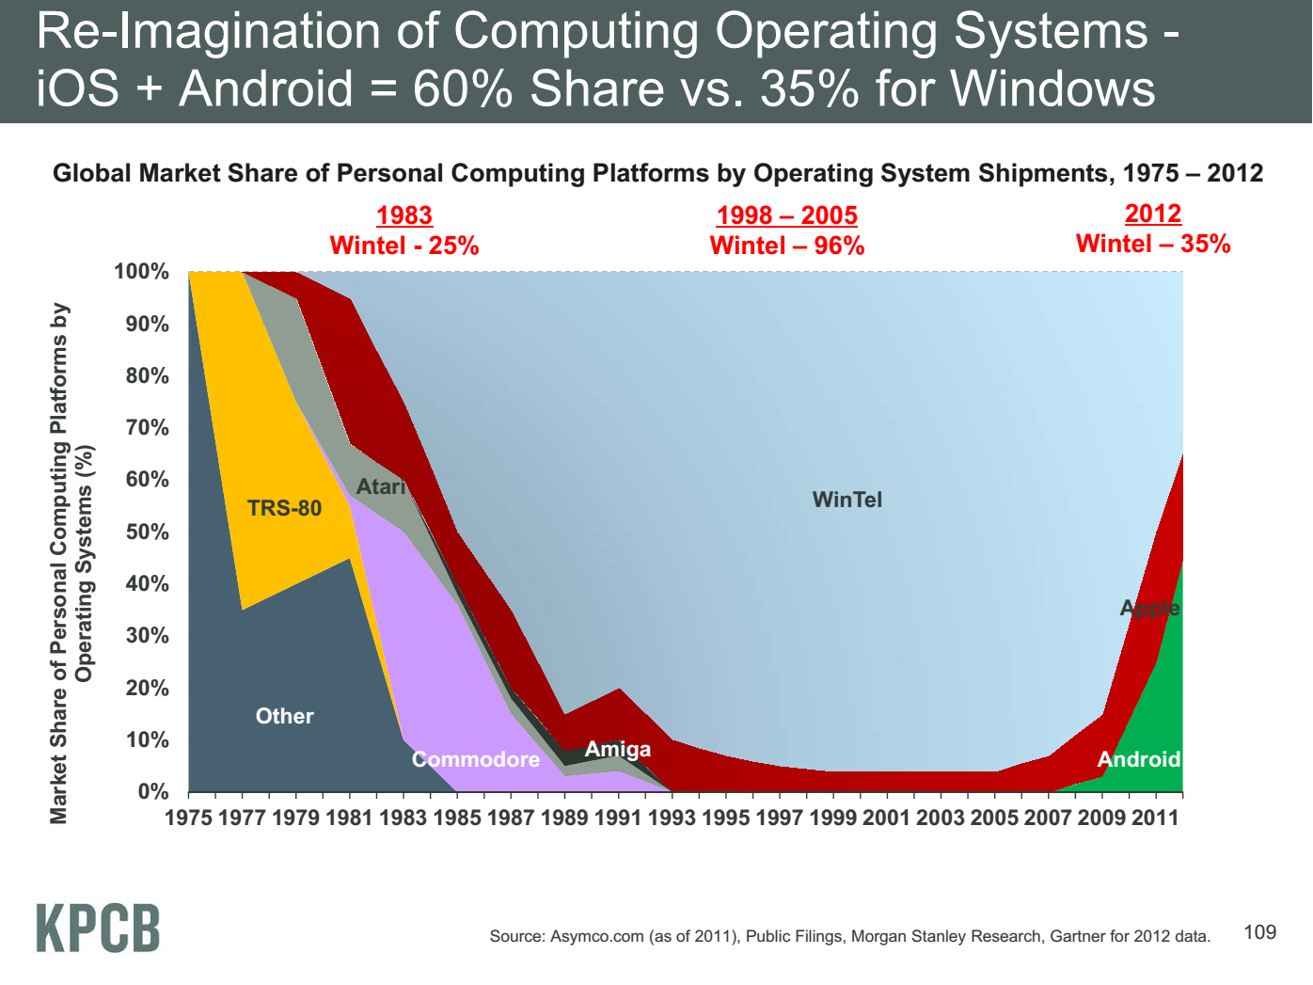
Meeker/Wu May 29 2013 Internet Trends D11 Conference

Slide 35
Computing Model
Industry adopted clouds which are attractive for data analytics

Slide 36
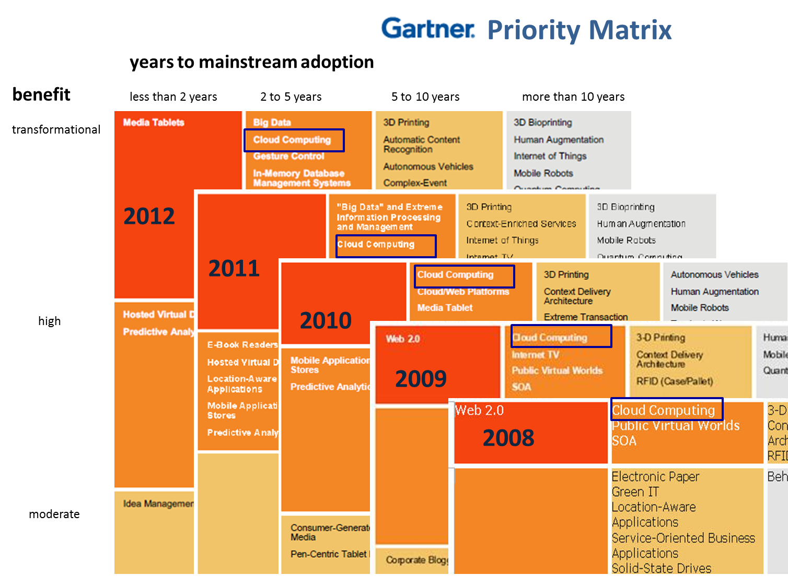
5 years Cloud Computing
2 years Big Data Transformational

Slide 37
Amazon Cloud AWS making money
It took Amazon Web Services (AWS) eight years to hit $650 million in revenue, according to Citigroup in 2010.
Just three years later, Macquarie Capital analyst Ben Schachter estimates that AWS will top $3.8 billion in 2013 revenue, up from $2.1 billion in 2012 (estimated), valuing the AWS business at $19 billion.
First public cloud computing supplier building on many cloud systems used to run Amazon, Google, Bing, eBay ….

Slide 38
Physically Clouds are Clear
A bunch of computers in an efficient data center with an excellent Internet connection
They were produced to meet need of public-facing Web 2.0 e-Commerce/Social Networking sites
They can be considered as “optimal giant data center” plus internet connection
Note enterprises use private clouds that are giant data centers but not optimized for Internet access

Slide 39
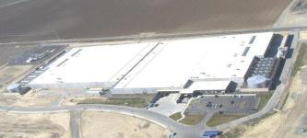

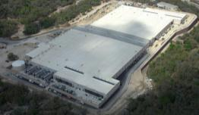
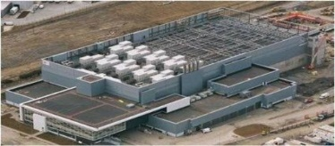
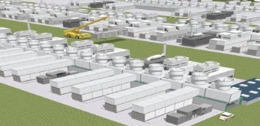
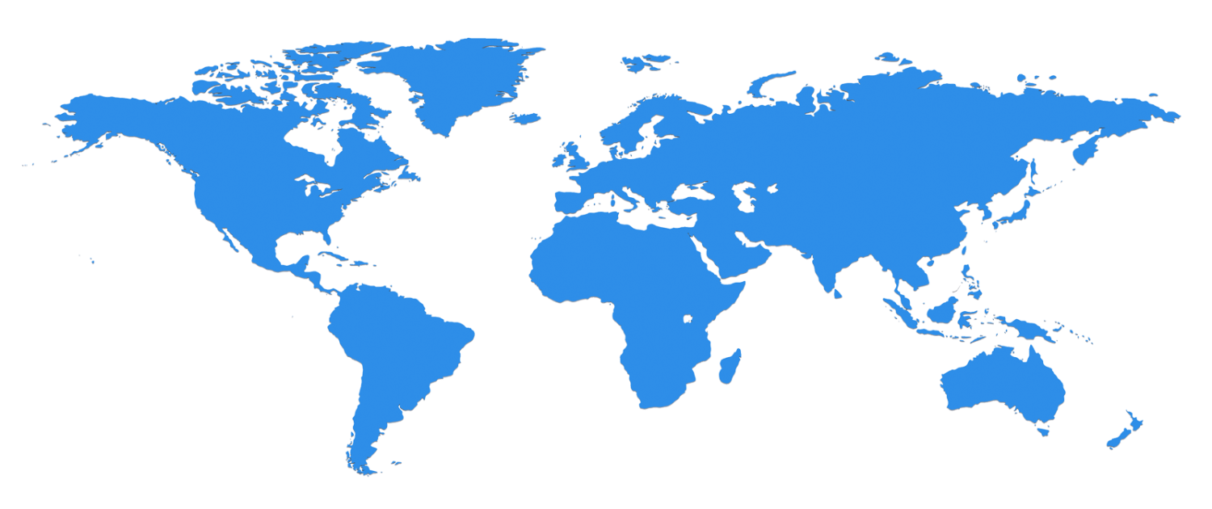


The Microsoft Cloud is Built on Data Centers
~100 Globally Distributed Data Centers
Range in size from “edge” facilities to megascale (100K to 1M servers)
Quincy, WA
Chicago, IL
San Antonio, TX
Dublin, Ireland
Generation 4 DCs
Build giant data centers with 100,000’s of computers;
~ 200-1000 to a shipping container with Internet access
Gannon Talk

Slide 40



Data Centers Clouds &
Economies of Scale
Range in size from “edge” facilities to megascale.
Economies of scale
  Approximate costs for a small size center (1K servers) and a larger, 50K server center.
2 Google warehouses of computers on the banks of the Columbia River, in The Dalles, Oregon
Such centers use 20MW-200MW
(Future) each with 150 watts per CPU
Save money from large size, positioning with cheap power and access with Internet
Technology | Cost in small-sized Data Center | Cost in Large Data Center | Ratio
Network | $95 per Mbps/ month | $13 per Mbps/ month | 7.1
Storage | $2.20 per GB/ month | $0.40 per GB/ month | 5.7
Administration | ~140 servers/ Administrator | >1000 Servers/ Administrator | 7.1
Each data center is
11.5 times
the size of a football field

Slide 41
Virtualization made several things more convenient
Virtualization = abstraction; run a job – you know not where
Virtualization = use hypervisor to support “images”
  Allows you to define complete job as an “image” – OS + application
Efficient packing of multiple applications into one server as they don’t interfere (much) with each other if in different virtual machines;
They interfere if put as two jobs in same machine as for example must have same OS and same OS services
Also security model between VM’s more robust than between processes

Slide 42
Microsoft Server Consolidation
http://research.microsoft.com/pubs/78813/AJ18_EN.pdf
Typical data center CPU has 9.75% utilization
Take 5000 SQL servers and rehost on virtual machines with 6:1 consolidation
60% saving

Slide 43
The Google gmail example
http://www.google.com/green/pdfs/google-green-computing.pdf
Clouds win by efficient resource use and efficient data centers
Business Type | Number of users | # servers | IT Power per user | PUE (Power Usage effectiveness) | Total Power per user | Annual Energy per user
Small | 50 | 2 | 8W | 2.5 | 20W | 175 kWh
Medium | 500 | 2 | 1.8W | 1.8 | 3.2W | 28.4 kWh
Large | 10000 | 12 | 0.54W | 1.6 | 0.9W | 7.6 kWh
Gmail (Cloud) | ∞ | ∞ | < 0.22W | 1.16 | < 0.25W | < 2.2 kWh

Slide 44
Clouds Offer From different points of view
Features from NIST:
  On-demand service (elastic);
  Broad network access;
  Resource pooling;
  Flexible resource allocation;
  Measured service
Economies of scale in performance and electrical power (Green IT)
Powerful new software models
  Platform as a Service is not an alternative to Infrastructure as a Service – it is instead an incredible valued added
  Amazon is as much PaaS as Azure
They are cheaper than classic clusters unless latter 100% utilized

Slide 45
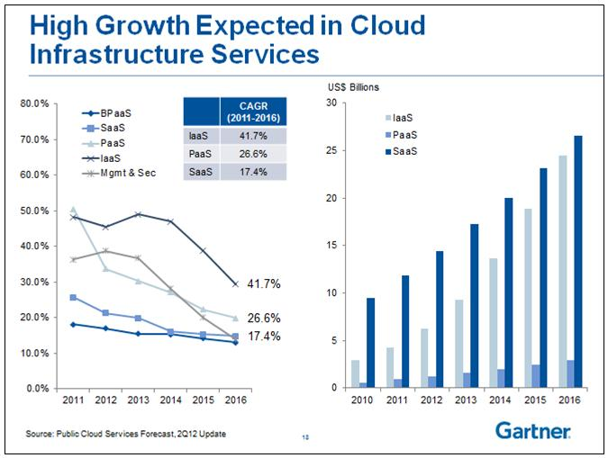
IaaS Hardware e.g. Server
PaaS Systems Services e.g. MapReduce, Database
SaaS Applications e.g. Recommender System, Clustering
BPaaS Particular Application Set
BPM = Business Process management

Slide 46
Research Model
4th Paradigm; From Theory to Data driven science?

Slide 47
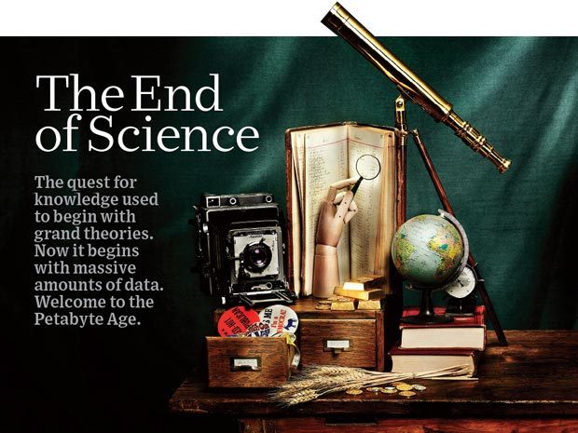
http://www.wired.com/wired/issue/16-07 September 2008

Slide 48
The 4 paradigms of Scientific Research
Theory
Experiment or Observation
  E.g. Newton observed apples falling to design his theory of mechanics
Simulation of theory or model Supercomputers
Data-driven (Big Data) or The Fourth Paradigm: Data-Intensive Scientific Discovery (aka Data Science)
  http://research.microsoft.com/en-us/collaboration/fourthparadigm/ A free book
  More data; less models

Slide 49
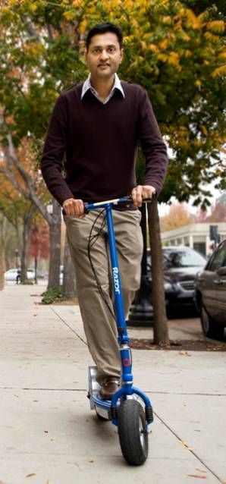
More data usually beats better algorithms
Here's how the competition works. Netflix has provided a large data set that tells you how nearly half a million people have rated about 18,000 movies. Based on these ratings, you are asked to predict the ratings of these users for movies in the set that they have not rated. The first team to beat the accuracy of Netflix's proprietary algorithm by a certain margin wins a prize of $1 million!
Different student teams in my class adopted different approaches to the problem, using both published algorithms and novel ideas. Of these, the results from two of the teams illustrate a broader point. Team A came up with a very sophisticated algorithm using the Netflix data. Team B used a very simple algorithm, but they added in additional data beyond the Netflix set: information about movie genres from the Internet Movie Database(IMDB). Guess which team did better?
Anand Rajaraman is Senior Vice President at Walmart Global eCommerce, where he heads up the newly created @WalmartLabs,
http://anand.typepad.com/datawocky/2008/03/more-data-usual.html
20120117berkeley1.pdf Jeff Hammerbacher

Slide 50
Data Science Process

Slide 51
DIKW Process
Data becomes
Information becomes
Knowledge becomes
Wisdom or Decisions
  Community acceptance of results or approach important here
  Volume of bits&bytes decreases as we proceed down DIKW pipeline

Slide 52
Data Deluge is also Information/Knowledge/Wisdom/Decision Deluge?

Slide 53
Example of Google Maps/Navigation
Data comes from traditional maps (US Geological Survey), Satellites (overlays) and street cams
Information is presented by basic Google Maps web page
Knowledge is a particular optimized route
Decisions (Wisdom) comes from deciding to drive a particular route

Slide 54
Physics-Informatics
Looking for Higgs Particle with Large Hadron Collider LHC

Slide 55
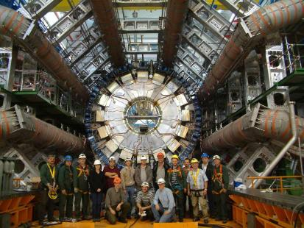
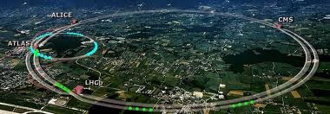
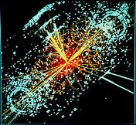
http://grids.ucs.indiana.edu/ptliupages/publications/Where%20does%20all%20the%20data%20come%20from%20v7.pd
This analysis raw data → reconstructed data → AOD and TAGS → Physics is performed on the multi-tier LHC Computing Grid. Note that every event can be analyzed independently so that many events can be processed in parallel with some concentration operations such as those to gather entries in a histogram. This implies that both Grid and Cloud solutions work with this type of data with currently Grids being the only implementation today.
ATLAS Expt
Note LHC lies in a tunnel 27 kilometres (17 mi) in circumference
Higgs Event
The LHC produces some 15 petabytes of data per year of all varieties and with the exact value depending on duty factor of accelerator (which is reduced simply to cut electricity cost but also due to malfunction of one or more of the many complex systems) and experiments. The raw data produced by experiments is processed on the LHC Computing Grid, which has some 200,000 Cores arranged in a three level structure. Tier-0 is CERN itself, Tier 1 are national facilities and Tier 2 are regional systems. For example one LHC experiment (CMS) has 7 Tier-1 and 50 Tier-2 facilities.

Slide 56
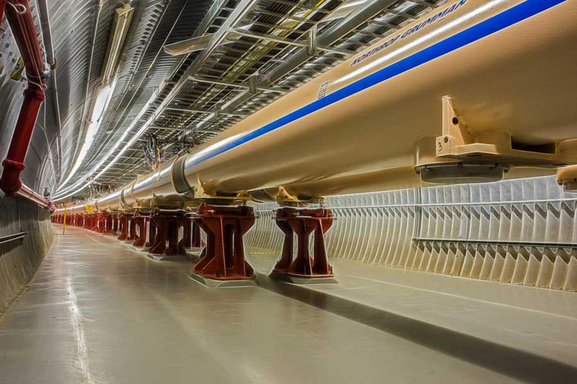
The inside of the RHIC (Relativistic Heavy Ion Collider) tunnel, a 2.4-mile high-tech particle racetrack at Brookhaven National Laboratory.
http://www.interactions.org/cms/?pid=1032811

Slide 57
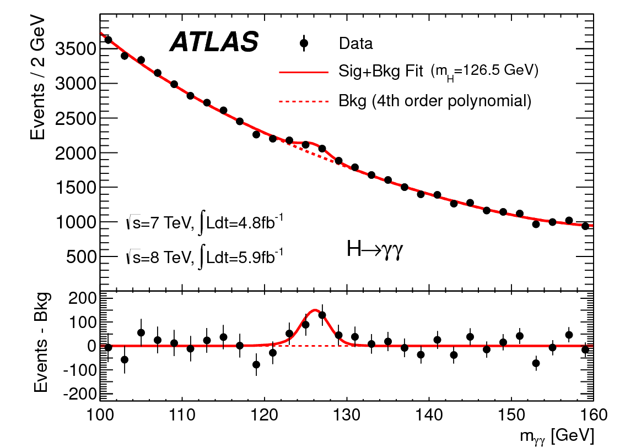
http://www.quantumdiaries.org/2012/09/07/why-particle-detectors-need-a-trigger/atlasmgg/
Model

Slide 58
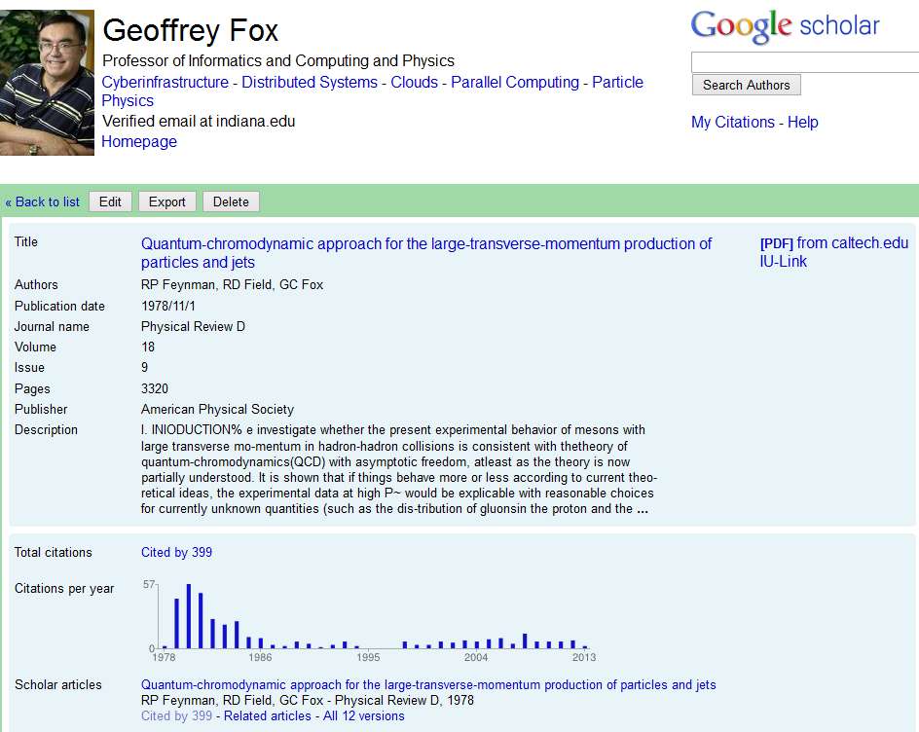
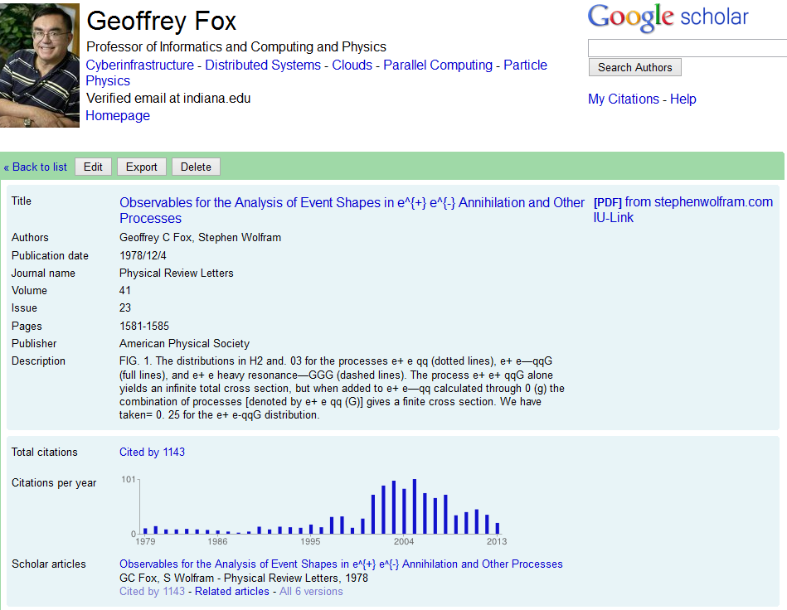
Personal Note
As a naïve undergraduate in 1964, I was told by Professor who later left university to enter church that bumps like
were particles. I was amazed and found this more intriguing than anything else I had heard about so I decided to do PhD in particle physics.
I later decided computing moving faster than physics, so I went into Informatics
Also I was alarmed by size and time scale of physics activities
Note ATLAS is 45 metres long, 25 metres in diameter, and weighs about 7,000 tons. The experiment is a collaboration involving roughly 3,000 physicists at 175 institutions in 38 countries
US version of LHC, Superconducting Super Collider (SSC) discussed in 1983 was cancelled in 1993 after $2B spent

Slide 59
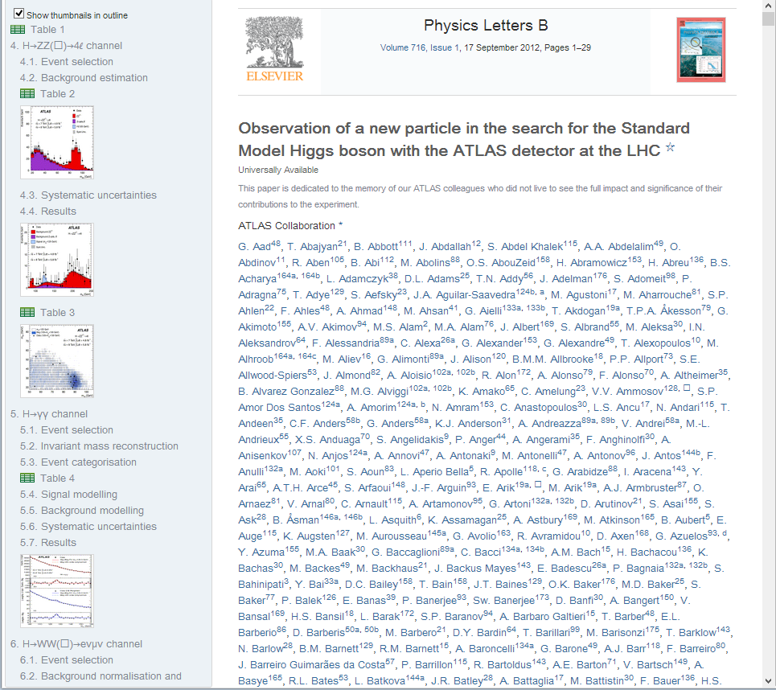
http://www.sciencedirect.com/science/article/pii/S037026931200857X

Slide 60
Recommender Systems

Slide 61
Overview of Many Informatics Areas
In many cases, one needs personalized matching of items to people or perhaps collections of items to collections of people
People to products: Online and Offline Commerce
People to People: Social Networking
People to Jobs or Employers: Job Sites
People+Queries to the Web: Information Retrieval (search as in Bing/Google)

Slide 62
Recommender Systems in more detail
A large number of online and offline commerce activities plus basic Internet site personalization relies on “recommender systems”
Given real-time action by user, immediately suggest new actions (as in Amazon buy recommendations on web)
Based on past actions of users (and others) suggest movies to look at, restaurants to eat at, events to go to, books and music to buy
Based on mix of explicit user choice and grouping of internet sites, present customized Google News page
Given sales statistics, decide on discounts at “real” supermarkets and placement of related (by analysis of buying habits) products
Identify possible colleagues at Social Networking sites like LinkedIn
Identify matches between employers and employees at sites like CareerBuilder and Monster

Slide 63
Everything is an Optimization Problem?
Fit Model to Data
  Higgs + Background
Match User to Jobs or Books or Other Users?
Classification is optimizing assignment of members of an ontology (list of categories) to data
Typically minimize some function (or maximize negative of function)
  Interesting feature of these problems is ingenious choice of function
  Note Physics minimizes (free) energy
Often involves thinking of people and/or items as points in a space (not always a traditional vector space)
  Space called “bag” in “bag of words” model for information retrieval

Slide 64
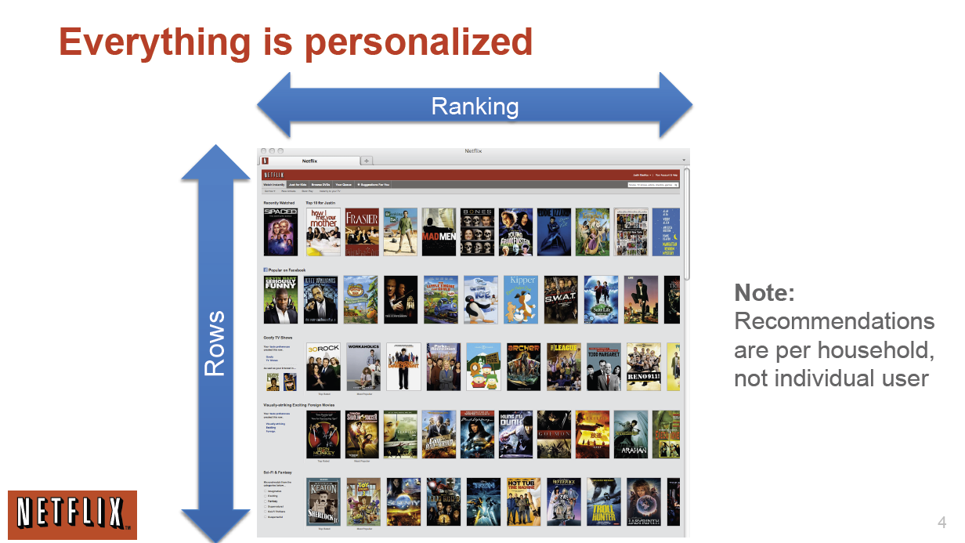
http://www.slideshare.net/xamat/building-largescale-realworld-recommender-systems-recsys2012-tutorial
Netflix on Personalization

Slide 65

http://www.slideshare.net/xamat/building-largescale-realworld-recommender-systems-recsys2012-tutorial
Netflix on Recommendations

Slide 66

http://www.slideshare.net/xamat/building-largescale-realworld-recommender-systems-recsys2012-tutorial
April 2013: The last two quarters have each brought more than 2 million new streaming subscriber signups. That gives Netflix a current total of nearly 29.2 million subscribers

Slide 67

http://www.ifi.uzh.ch/ce/teaching/spring2012/16-Recommender-Systems_Slides.pdf

Slide 68

http://www.slideshare.net/xamat/building-largescale-realworld-recommender-systems-recsys2012-tutorial
Netflix on Data Science
Note Netflix and others run tests all the time on subsets of customers

Slide 69
Distances in Funny Spaces I
In user-based collaborative filtering, we can think of users in a space of dimension N where there are N items and M users.
  Let i run over items and u over users
Then each user is represented as a vector U_{i}(u) in “item-space” where ratings are vector components. We are looking for users u u’ that are near each other in this space as measured by some distance between U_{i}(u) and U_{i}(u’)
If u and u’ rate all items then these are “real” vectors but almost always they each only rates a small fraction of items and the number in common is even smaller
The “Pearson coefficient” is just one distance measure that can be used
  Only sum over i rated by u and u’
Last.fm uses this for songs as does Amazon, Netflix

Slide 70
Distances in Funny Spaces II
In item-based collaborative filtering, we can think of items in a space of dimension M where there are N items and M users.
  Let i run over items and u over users
Then each item is represented as a vector R_{u}(i) in “user-space” where ratings are vector components. We are looking for items i i’ that are near each other in this space as measured by some distance between R_{u}(i) and R_{u}(i’)
If i and i’ rated by all users then these are “real” vectors but almost always they are each only rated by a small fraction of users and the number in common is even smaller
The “Cosine measure” is just one distance measure that can be used
  Only sum over users u rating both i and i’

Slide 71
Distances in Funny Spaces III
In content based recommender systems, we can think of items in a space of dimension M where there are N items and M properties.
  Let i run over items and p over properties
Then each item is represented as a vector P_{p}(i) in “property-space” where values of properties are vector components. We are looking for items i i’ that are near each other in this space as measured by some distance between P_{p}(i) and R_{p}(i’)
Properties could be “reading age” or “character highlighted” or “author” for books
Properties can be genre or artist for songs and video
Properties can characterize pixel structure for images used in face recognition, driving etc.
Pandora uses this for songs (Music Genome) as does Amazon, Netflix

Slide 72
Do we need “real” spaces?
Much of (eCommerce/LifeStyle) Informatics involves “points”
  Events in LHC analysis
  Users (people) or items (books, jobs, music, other people)
These points can be thought of being in a “space” or “bag”
  Set of all books
  Set of all physics reactions
  Set of all Internet users
However as in recommender systems where a given user only rates some items, we don’t know “full position”
However we can nearly always define a useful distance d(a,b) between points
Always d(a,b) >= 0
Usually d(a,b) = d(b,a)
Rarely d(a,b) + d(b,c) >= d(a,c) Triangle Inequality

Slide 73
Using Distances
The simplest way to use distances is “nearest neighbor algorithms” – given one point, find a set of points near it – cut off by number of identified nearby points and/or distance to initial point
  Here point is either user or item
Another approach is divide space into regions (topics, latent factors) consisting of nearby points
  This is clustering
  Also other algorithms like Gaussian mixture models or Latent Semantic Analysis or Latent Dirichlet Allocation which use a more sophisticated model

Slide 74
Web Search
Information Retrieval

Slide 75
“Web Data Analytics”
Get the digital data (from web or from scanning)
  Need to crawl web (? Solved “engineering” problem)
Preprocess data to get searchable things (words positions)
Form Inverted Index mapping words to documents
Typically use TF-IDF (term frequency, Inverse Document frequency) to quantify importance of word match
Rank relevance of documents: PageRank
Lots of technology for advertising, “reverse engineering” “preventing reverse engineering”
Clustering of documents into topics (as in Google News)

Slide 76

Size of face proportional to PageRank

Slide 77
Modern Recommendation Systems (from Yahoo)
Goal (Function to Optimize – Long Term dollars)
  Serve the right item to a user in a given context to optimize long-term business objectives
A scientific discipline that involves
  Large scale Machine Learning & Statistics
    Offline Models (capture global & stable characteristics)
    Online Models (incorporates dynamic components)
    Explore/Exploit (active and adaptive experimentation)
  Multi-Objective Optimization
    Click-rates (CTR), Engagement, advertising revenue, diversity, etc
  Inferring user interest
    Constructing User Profiles
  Natural Language Processing to understand content
    Topics, “aboutness”, entities, follow-up of something, breaking news,…
http://pages.cs.wisc.edu/~beechung/icml11-tutorial/

Slide 78

Recommend search queries
Recommend packages:
Image
Title, summary
Links to other pages
Pick 4 out of a pool of K
K = 20 ~ 40
Dynamic
Routes traffic other pages
Recommend applications
Recommend news article
http://pages.cs.wisc.edu/~beechung/icml11-tutorial/

Slide 79
Some examples from content optimization
Simple version
  I have a content module on my page, content inventory is obtained from a third party source which is further refined through editorial oversight. Can I algorithmically recommend content on this module? I want to improve overall click-rate (CTR) on this module
More advanced
  I got X% lift in CTR. But I have additional information on other downstream utilities (e.g. advertising revenue). Can I increase downstream utility without losing too many clicks?
Highly advanced
  There are multiple modules running on my webpage. How do I perform a simultaneous optimization?
http://pages.cs.wisc.edu/~beechung/icml11-tutorial/

Slide 80
Cloud Applications in Research

Slide 81
Science Computing Environments
Large Scale Supercomputers – Multicore nodes linked by high performance low latency network
  Increasingly with GPU enhancement
  Suitable for highly parallel simulations
High Throughput Systems such as European Grid Initiative EGI or Open Science Grid OSG typically aimed at pleasingly parallel jobs
  Can use “cycle stealing”
  Classic example is LHC data analysis
Grids federate resources as in EGI/OSG or enable convenient access to multiple backend systems including supercomputers
Use Services (SaaS)
  Portals make access convenient and
  Workflow integrates multiple processes into a single job

Slide 82
Clouds HPC and Grids
Synchronization/communication Performance
Grids > Clouds > Classic HPC Systems
Clouds naturally execute effectively Grid workloads but are less clear for closely coupled HPC applications
Classic HPC machines as MPI engines offer highest possible performance on closely coupled problems
The 4 forms of MapReduce/MPI
  Map Only – pleasingly parallel
  Classic MapReduce as in Hadoop; single Map followed by reduction with fault tolerant use of disk
  Iterative MapReduce use for data mining such as Expectation Maximization in clustering etc.; Cache data in memory between iterations and support the large collective communication (Reduce, Scatter, Gather, Multicast) use in data mining
  Classic MPI! Support small point to point messaging efficiently as used in partial differential equation solvers

Slide 83
What Applications work in Clouds
Pleasingly (moving to modestly) parallel applications of all sorts with roughly independent data or spawning independent simulations
  Long tail of science and integration of distributed sensors
Commercial and Science Data analytics that can use MapReduce (some of such apps) or its iterative variants (most other data analytics apps)
Which science applications are using clouds?
  Venus-C (Azure in Europe): 27 applications not using Scheduler, Workflow or MapReduce (except roll your own)
  50% of applications on FutureGrid are from Life Science
  Locally Lilly corporation is commercial cloud user (for drug discovery) but not IU Biology
But overall very little science use of clouds yet

Slide 84
Parallelism over Users and Usages
“Long tail of science” can be an important usage mode of clouds.
In some areas like particle physics and astronomy, i.e. “big science”, there are just a few major instruments generating now petascale data driving discovery in a coordinated fashion.
In other areas such as genomics and environmental science, there are many “individual” researchers with distributed collection and analysis of data whose total data and processing needs can match the size of big science.
Clouds can provide scaling convenient resources for this important aspect of science.
Can be map only use of MapReduce if different usages naturally linked e.g. exploring docking of multiple chemicals or alignment of multiple DNA sequences
  Collecting together or summarizing multiple “maps” is a simple Reduction

Slide 85
Internet of Things and the Cloud
It is projected that there will be 24 billion devices on the Internet by 2020. Most will be small sensors that send streams of information into the cloud where it will be processed and integrated with other streams and turned into knowledge that will help our lives in a multitude of small and big ways.
The cloud will become increasing important as a controller of and resource provider for the Internet of Things.
As well as today’s use for smart phone and gaming console support, “Intelligent River” “smart homes and grid” and “ubiquitous cities” build on this vision and we could expect a growth in cloud supported/controlled robotics.
Some of these “things” will be supporting science
Natural parallelism over “things”
“Things” are distributed and so form a Grid

Slide 86









Sensors (Things) as a Service
Output Sensor
Sensors as a Service
Sensor Processing as a Service (could use
MapReduce)
A larger sensor ………
https://sites.google.com/site/opensourceiotcloud/ Open Source Sensor (IoT) Cloud

Slide 87

Meeker/Wu May 29 2013 Internet Trends D11 Conference

Slide 88

Meeker/Wu May 29 2013 Internet Trends D11 Conference

Slide 89

Meeker/Wu May 29 2013 Internet Trends D11 Conference

Slide 90
Classic Parallel Computing
HPC: Typically SPMD (Single Program Multiple Data) “maps” typically processing particles or mesh points interspersed with multitude of low latency messages supported by specialized networks such as Infiniband and technologies like MPI
  Often run large capability jobs with 100K (going to 1.5M) cores on same job
  National DoE/NSF/NASA facilities run 100% utilization
  Fault fragile and cannot tolerate “outlier maps” taking longer than others
Clouds: MapReduce has asynchronous maps typically processing data points with results saved to disk. Final reduce phase integrates results from different maps
  Fault tolerant and does not require map synchronization
  Map only useful special case
HPC + Clouds: Iterative MapReduce caches results between “MapReduce” steps and supports SPMD parallel computing with large messages as seen in parallel kernels (linear algebra) in clustering and other data mining

Slide 91






MapReduce “File/Data Repository” Parallelism
Map = (data parallel) computation reading and writing data
Reduce = Collective/Consolidation phase e.g. forming multiple global sums as in histogram
Instruments
Iterative MapReduce
Map Map Map Map
Reduce Reduce Reduce
Communication
Reduce
Portals
/Users
Disks
Map₁
Map₂
Map₃

Slide 92






Sam’s Problem http://www.slideshare.net/esaliya/mapreduce-in-simple-terms
Sam thought of “drinking” the apple
He used a to cut the and a to make juice.

Slide 93






Creative Sam
Implemented a parallel version of his innovation
Fruits
Each input to a map is a list of <key, value> pairs
A list of <key, value> pairs mapped into another list of <key, value> pairs which gets grouped by the key and reduced into a list of values
(<a, > , <o, > , <p, > , …)
Each output of slice is a list of <key, value> pairs
(<a’, > , <o’, > , <p’, > )
Grouped by key
The idea of Map Reduce in Data Intensive Computing
Each input to a reduce is a <key, value-list> (possibly a list of these, depending on the grouping/hashing mechanism)
e.g. <ao, ( …)>
Reduced into a list of values

Slide 94
Data Science Education
Opportunities at universities
see recent New York Times articles
http://datascience101.wordpress.com/2013/04/13/new-york-times-data-science-articles/

Slide 95
Data Science Education
Broad Range of Topics from Policy to curation to applications and algorithms, programming models, data systems, statistics, and broad range of CS subjects such as Clouds, Programming, HCI,
Plenty of Jobs and broader range of possibilities than computational science but similar cosmic issues
  What type of degree (Certificate, minor, track, “real” degree)
  What implementation (department, interdisciplinary group supporting education and research program)

Slide 96
At Indiana University
Have a proposal to set up certificates and Masters degree in data science
Joint between 3 units in School of Informatics and Computing: Computer Science, Informatics, Information & Library Science, and Statistics department in COAS College
Looking at version with Kelley with Business data analytics flavor
Attractive to offer online as few universities have this and so a potentially large audience outside IU

Slide 97

Meeker/Wu May 29 2013 Internet Trends D11 Conference

Slide 98

Meeker/Wu May 29 2013 Internet Trends D11 Conference

Slide 99
Massive Open Online Courses (MOOC)
MOOC’s are very “hot” these days with Udacity and Coursera as start-ups; perhaps over 100,000 participants
Relevant to Data Science as this is a new field with few courses at most universities
Typical model is collection of short prerecorded segments (talking head over PowerPoint) of length 3-15 minutes
  This is Boredom limit http://blog.coursera.org/post/49750392396/on-the-topic-of-boredom
These “lesson objects” can be viewed as “songs”
Google Course Builder (python open source) builds customizable MOOC’s as “playlists” of “songs”
Tells you to capture all material as “lesson objects”
We are aiming to build a repository of many “songs”; used in many ways – tutorials, classes …

Slide 100

http://x-informatics.appspot.com/course
Complete end of June
Currently 7 ~ one hour lectures

Slide 101

Seven ~10 minutes lesson objects in this lecture
IU wants us to close caption if use in real course

Slide 102
Customizable MOOC’s I
We could teach one class to 100,000 students or 2,000 classes to 50 students
The 2,000 class choice has 2 useful features
  One can use the usual (electronic) mentoring/grading technology
  One can customize each of 2,000 classes for a particular audience given their level and interests
  One can even allow student to customize – that’s what one does in making play lists in iTunes
Both models can be supported by a repository of lesson objects (10-15 minute video segments) in the cloud
The teacher can choose from existing lesson objects and add their own to produce a new customized course with new lessons contributed back to repository

Slide 103

Cloud MOOC
Repository
http://iucloudsummerschool.appspot.com/preview
Unit ~1 hour with ~6 lessons,
Total 115 lesson objects

Slide 104
Customizable MOOC’s II
The 3-15 minute Video over PowerPoint of MOOC lesson object’s is easy to re-use
Qiu (IU)and Hayden (ECSU Elizabeth City State University – (a small HBCU Historically Black University) will customize a module
  Starting with Qiu’s cloud computing course at IU
  Adding material on use of Cloud Computing in Remote Sensing (area covered by ECSU course)
This is a model for adding cloud curricula material to wide set of universities where faculty not able to teach
Defining how to support computing labs associated with MOOC’s with clouds or VM’s on clients
  Appliances scale as download to student’s client

Slide 105

Can of course build many different interfaces
Songs stored on YouTube
Songs prepared with Adobe Presenter on Laptop

Slide 106
Two limits where MOOC’s are Compelling
High volume courses (CS/Ph/Chem/Bio101…) where scalability of MOOC’s make them attractive to reach a lot of students
Niche areas where there is some student interest but either no faculty expertise or not enough students to justify traditional courses
  Offer to many institutions simultaneously

Slide 107


Hermit’s Cave Virtual University
I proposed in 1999 misjudging pace of online education: One can place faculty in their favorite location (e.g. remote cave) and universities provide structure to give “credentials” while faculty teach
  Maybe some populate repository; others actually deliver courses
Note Google Course Builder has no need for local resources except for faculty client (laptop) – entire course stored in the cloud
So we can radically change university system with a major cross institution virtual education and
as well research component
Enabled by cloud plus high
performance reliable networking
Lets set up community to define
and build the virtual university
MOOC repository and other
needed activities

Slide 108

Mentoring / Grading
We should aim at simplicity; attractive at moment is a mix of multi-topic forum plus more interactive Hangouts or equivalent (5-12 people)
https://www.youtube.com/watch?v=M3jcSCA9_hM

Slide 109

Meeker/Wu May 29 2013 Internet
Trends D11 Conference

Slide 110
Many Synergies Clouds and Universities
Use clouds in faculty, graduate student and undergraduate research
  Clouds for Scientific data analysis
  Core cloud technologies (MapReduce, Virtualization)
Teach clouds as it involves areas of Information Technology with lots of job opportunities
Use clouds to support distributed learning and research environment
  A cloud backend for course materials and collaboration as in MOOC repository
Green environmentally friendly computing infrastructure

Slide 111
Conclusions

Slide 112
Conclusions
Clouds are here to stay and one should plan on exploiting them
Data Intensive studies in business and research continue to grow in importance
  Data Analytics: Everything is an optimization problem in a funny space
Growing employment opportunities in clouds and data related activities and so popular with students
  Enabling many of the most important companies from Facebook/Google to General Electric
Need community discussion of data science education
  Agree on curricula; is such a degree attractive?
MOOC’s interesting for
  Disseminating new curricula
  Managing course fragments that can be assembled into custom courses for particular interdisciplinary students

Slide 113
Big Data Ecosystem in One Sentence
Use Clouds running Data Analytics Collaboratively processing Big Data to solve problems in X-Informatics educated in data science
X = Astronomy, Biology, Biomedicine, Business, Chemistry, Climate, Crisis, Earth Science, Energy, Environment, Finance, Health, Intelligence, Lifestyle, Marketing, Medicine, Pathology, Policy, Radar, Security, Sensor, Social, Sustainability, Wealth and Wellness with more fields (physics) defined implicitly
Spans Industry and Science (research)

