Slide 1

An Improved Probabilistic Graphical Model for the Detection of Internal Layers from Polar Radar Imagery
Jerome E. Mitchell
2013 NASA Earth and Space Science Fellow
Ph.D Thesis Proposal
Advisor: Geoffrey C. Fox
Committee: David J. Paden, Judy Qiu, Minje Kim, and John D. Paden*

Slide 2
Introduction
The Problem
Understanding Layers in the radar images:
the ice thickness and accumulation rate maps
help studies relating to the ice sheets, their volume, and how they contribute to climate change
An automated approach (to include the detection of a varying number of layers)
  Improve internal layer accuracy by incorporating prior information from data collection strategies

Slide 3
Depth Sounder
Accumulation
ice surface
internal layers (millennial +)
ice surface
Internal layers (annual/decadal)
bedrock
Ku-Band Altimeter
Snow Radar
Ice surface
ice surface
internal layers (annual)
internal layers (annual)

Slide 4
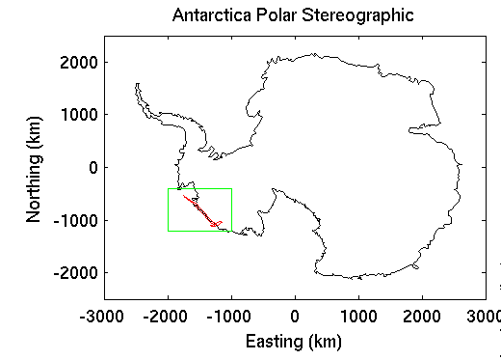
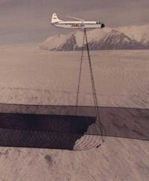
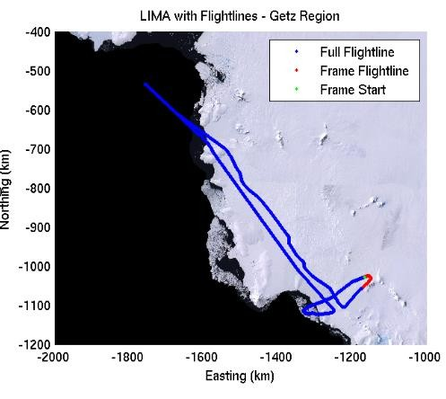
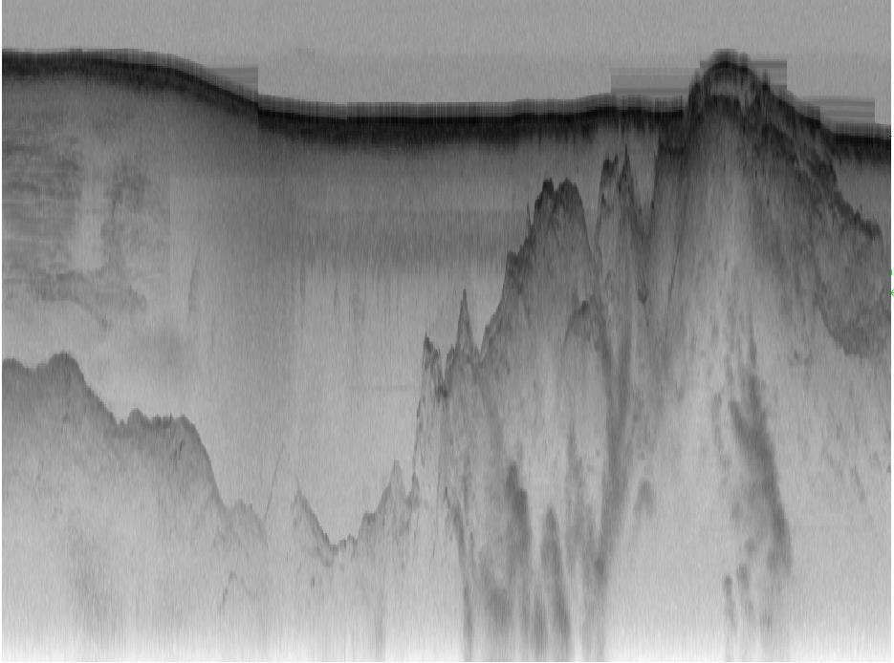
Distance along flight line
Distance below aircraft

Slide 5
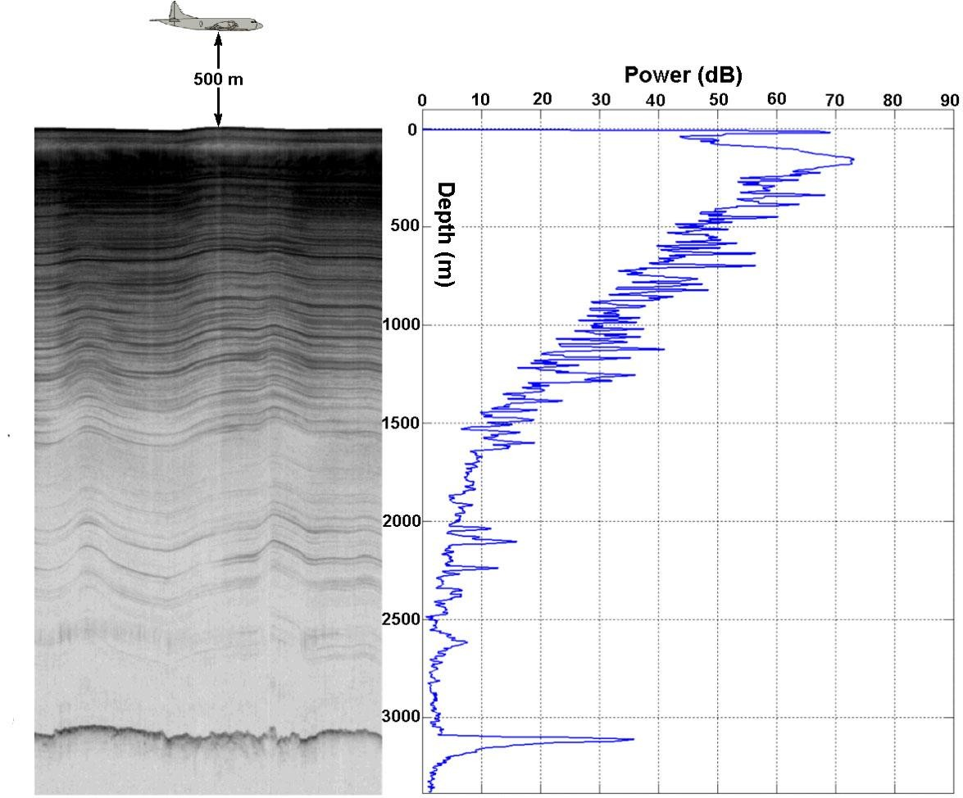
Column
Pixel
100

Slide 6
Challenges in Processing RADAR Imagery
Bedrock/Surface Layers
  Two Layers (but, false positives)
  Low magnitude, faint, or non-existent bedrock reflections
  Strong surface reflections can be repeated in an image causing surface multiples
Internal Layers
  Multiple Layers (a couple dozen)
  Fuse into existing Layers
  Disappear and Reappear

Slide 7
Internal Layer Approaches…
Cross-correlation and a Peak following routine
Internal Layer Tracing and Age Depth Accumulation Relationships for the Northern Greenland Ice Sheet
M. Fahnestock, W. Abdalati, S. Luo, and S. Gogineni
Ramp based function
Tracing the Depth of the Holocene Ice in North Greenland from Radio-Echo Sounding Data
N. Karlsson, D. Dahl-Jensen, S. Gogineni, and J. Paden
Radon Transform
Automated MultiLayer Picking Algorithm for Ice Sheet Radar Echograms Applied to Ground-Based Near Surface Data
V. de Paul Onana, L. Koenig, J. Ruth, M. Studinger, and J. Harbeck

Slide 8
Internal Layer Approaches…
Several Semi-Automated Methods
Radiostratigraphy and Age Structure of the Greenland Ice Sheet
J. MacGregor, M. Fahnestock, G. Catania, J. Paden, S. Gogineni, S. Young, S. Rybarski, A. Mabrey, B. Wagman, and M. Morlighem
ARESP 6 Phases
Automated Processing to Derive Dip Angles of Englacial Radar Reflectors in Ice Sheets
  L. Sime, R. Hindmarsh, and H. Corr
Active Contours (‘Snakes’) [Layer Position: Dynamic Time Warping ]
Detection of layer slopes and mapping of discrete reflectors in radio echograms
C. Panton

Slide 9
Active Contours
Active contour models, computer generated curves, which move within images to detect object boundaries
Used in Image Segmentation
Examples
Level Sets, Intelligent Scissors, Snakes

Slide 10
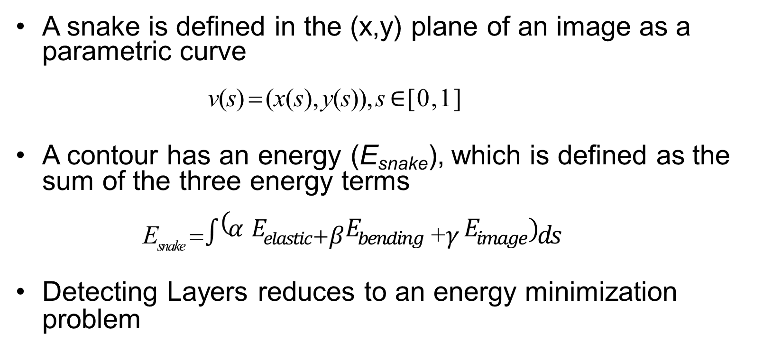
Snakes
A snake is defined in the (x,y) plane of an image as a parametric curve
v(s) = (x(s), y(s)), s $∈$[0,1]
A contour has an energy (E_{snake}), which is defined as the sum of the three energy terms
^{E}snake ⁼$\int{(α }E_{elastic}$⁺$β$ $E_{bending}$ ⁺$γ$ $E_{image})ds$
Detecting Layers reduces to an energy minimization problem

Slide 11
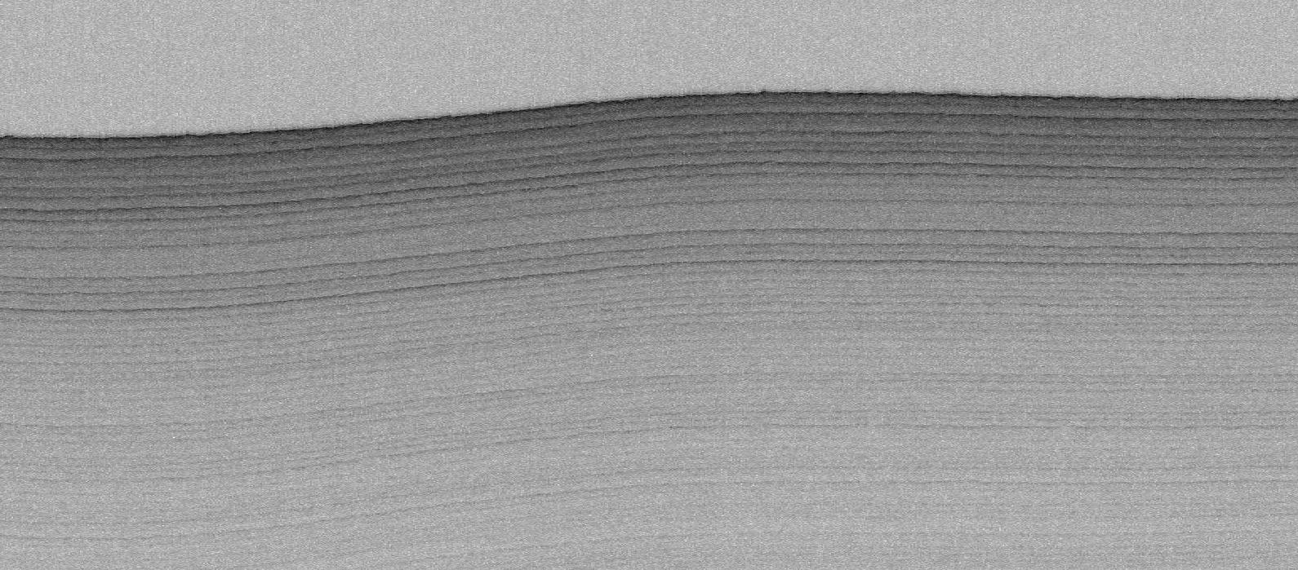
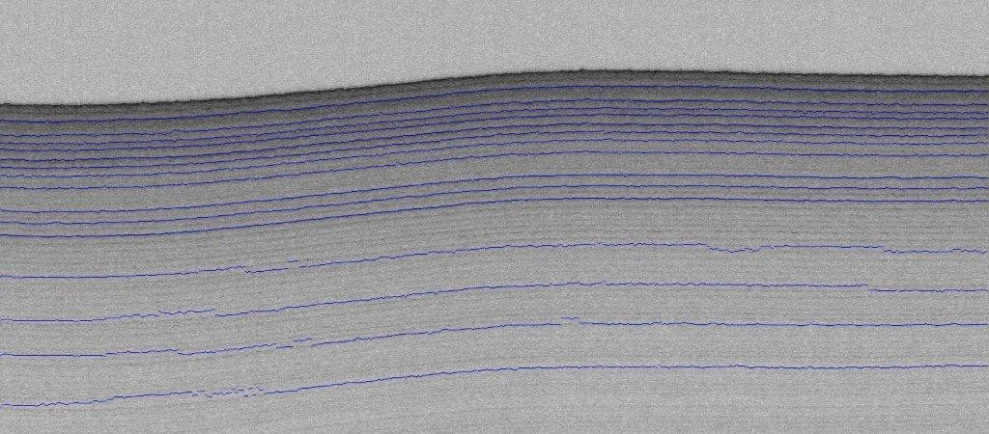
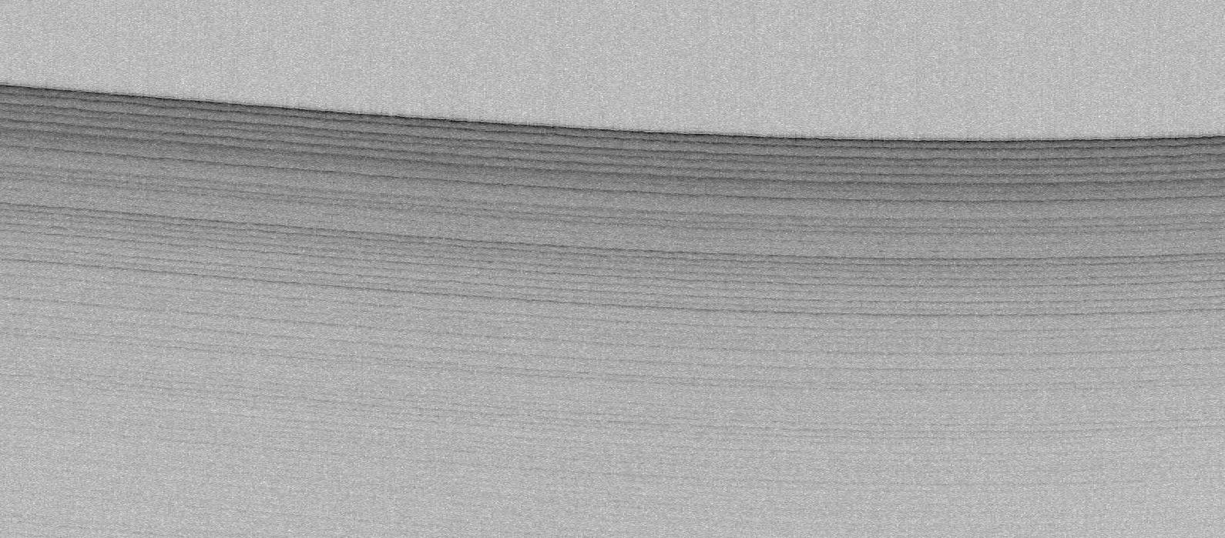
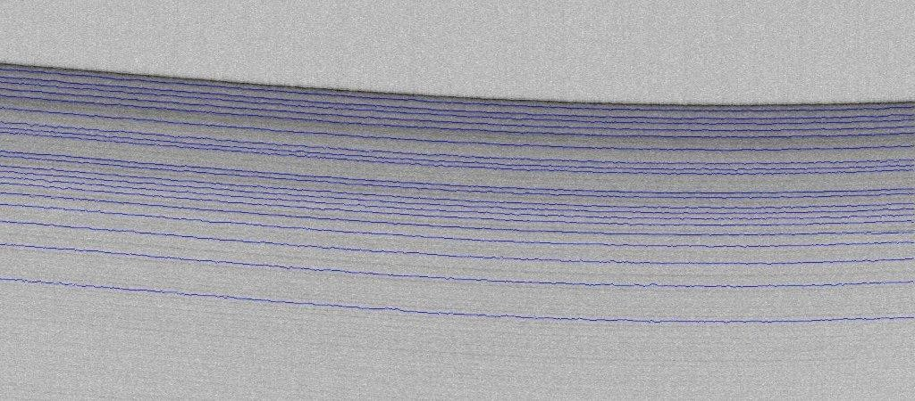
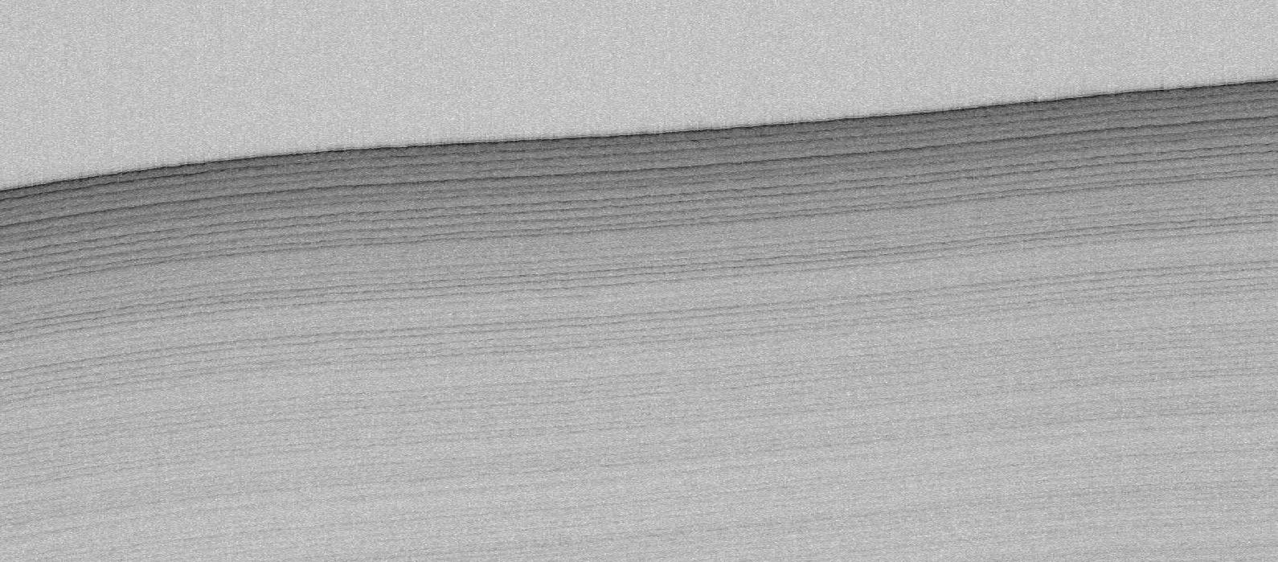
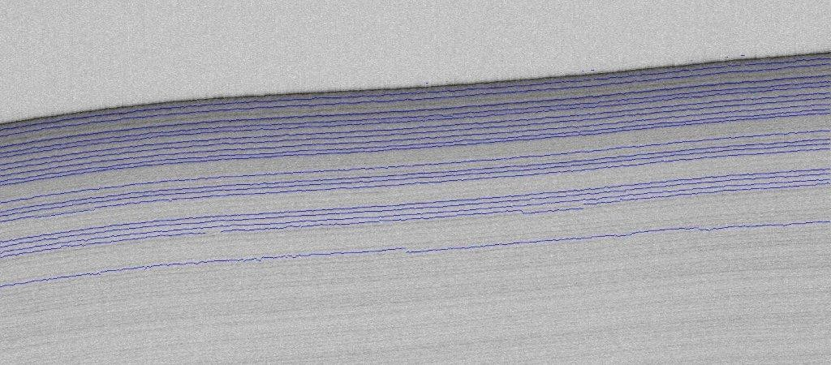
Near Surface Internal Layers
Mitchell, Crandall, Fox, and Paden, “A Semi-Automated Approach to Estimating Near Surface Internal Layers from Snow Radar Imagery”, International Geoscience and Remote Sensing (IGARSS), 2013.

Slide 12
Probabilistic Graphical Models
A graph comprises nodes (or vertices) and links (or edges),
where each node represents a random variable and the link probabilistic relationship between these variables
Models
  Bayesian Network
  Markov Random Field encode contextual constraints visual information
Inference is the process of computing posterior probabilities of one or more nodes

Slide 13
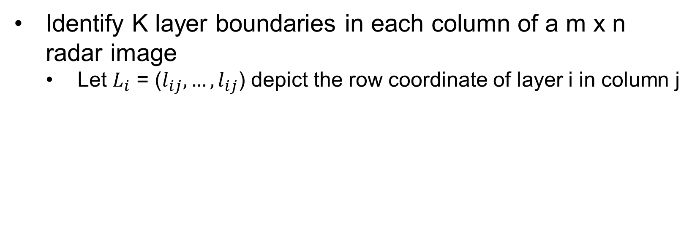
The Model
Identify K layer boundaries in each column of a m x n radar image
  Let $L_{i}$ = ($l_{ij}, …,l_{ij}$) depict the row coordinate of layer i in column j
Goal: Find a labeling for entire image, 𝐿 = (𝐿₁, … , 𝐿_{𝑘})

Slide 14



Probabilistic Formulation
The problem of layer detection is posed as a probabilistic graphical model based on the following assumptions:
$P\left(L \right|I) ∝P\left(I \right| L)$ P(L)
Prior term models how well labeling agrees with typical ice layer properties
Likelihood term models how well labeling agrees with image

Slide 15
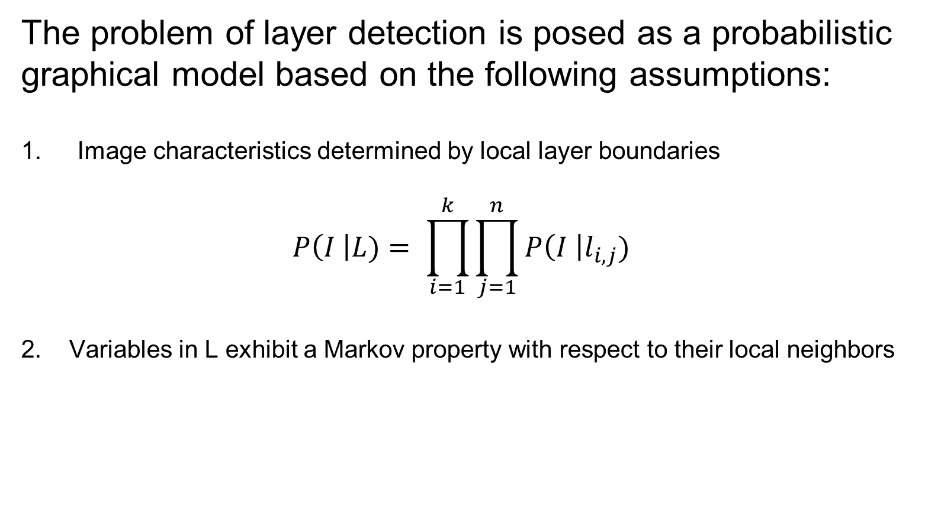
Probabilistic Formulation
The problem of layer detection is posed as a probabilistic graphical model based on the following assumptions:
Image characteristics determined by local layer boundaries
$$P\left(I \right|L)= \prod_{i=1}^{k}{\prod_{j=1}^{n}{P\left(I \right|l_{i,j})}}$$
2. Variables in L exhibit a Markov property with respect to their local neighbors

Slide 16


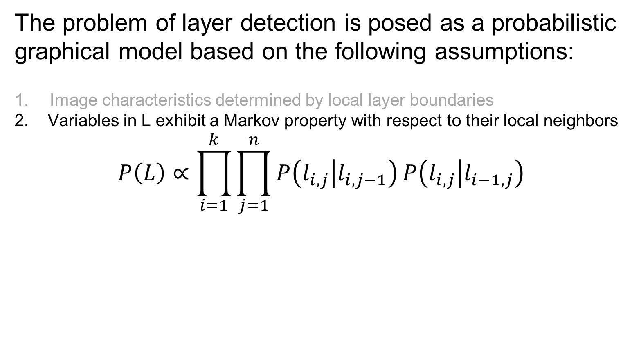
Probabilistic Formulation
The problem of layer detection is posed as a probabilistic graphical model based on the following assumptions:
Image characteristics determined by local layer boundaries
2. Variables in L exhibit a Markov property with respect to their local neighbors
$$P\left(L\right)∝\prod_{i=1}^{k}{\prod_{j=1}^{n}{P\left(l_{i,j} | l_{i,j−1}\right)}}P\left(l_{i,j} | l_{i−1,j}\right)$$
Zero-mean Gaussian penalizes discontinuities in layer boundaries across columns
Repulsive term prevents
boundary crossing

Slide 17
Crandall et al, “Layer-finding in Radar Echograms using Probabilistic Graphical Models”, International Conference on Pattern Recognition (ICPR), 2012
Developed an automated layer detection method, which used an statistical graphical model for integrating local and global features.
  Technique developed from simplistic model and solved for layer
boundaries incrementally, producing a single answer

Slide 18
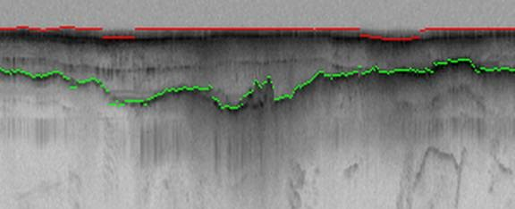
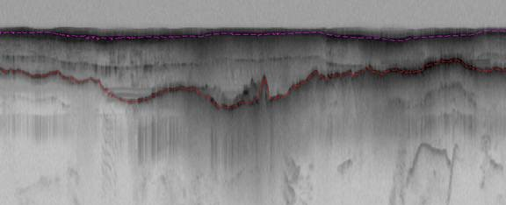
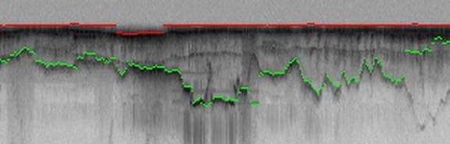
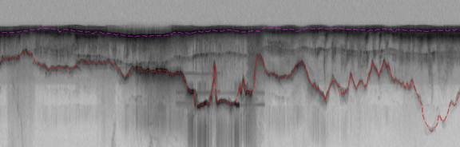
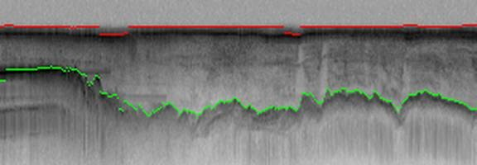
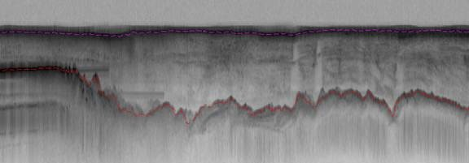
Surface and Bedrock (Hidden Markov Model)
Approach Ground-Truth
Crandall, Fox, Paden, “Layer-finding in Radar Echograms using Probabilistic Graphical Models”, International Conference on Pattern Recognition (ICPR), 2012.

Slide 19
Estimating Bedrock and Surface Boundaries with Confidence Intervals in Ice Sheet Radar Imagery using MCMC
Improved the model by solving for layer boundaries simultaneously and providing confidence intervals, which can aid in glaciologists in determining correct layer boundaries
  using Gibbs sampling for performing inference instead of the dynamic programming
  Gibbs sampler produces explicit confidence intervals, thus giving bands of uncertainty in the layer boundary locations

Slide 20
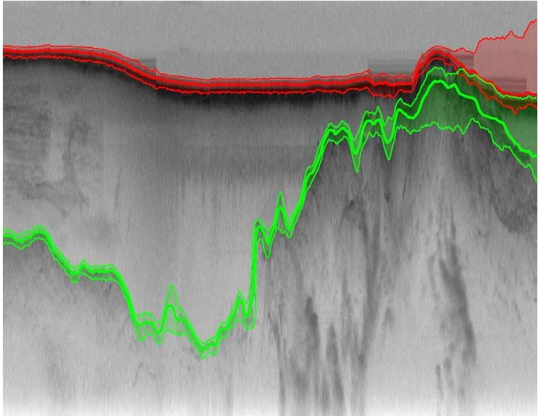
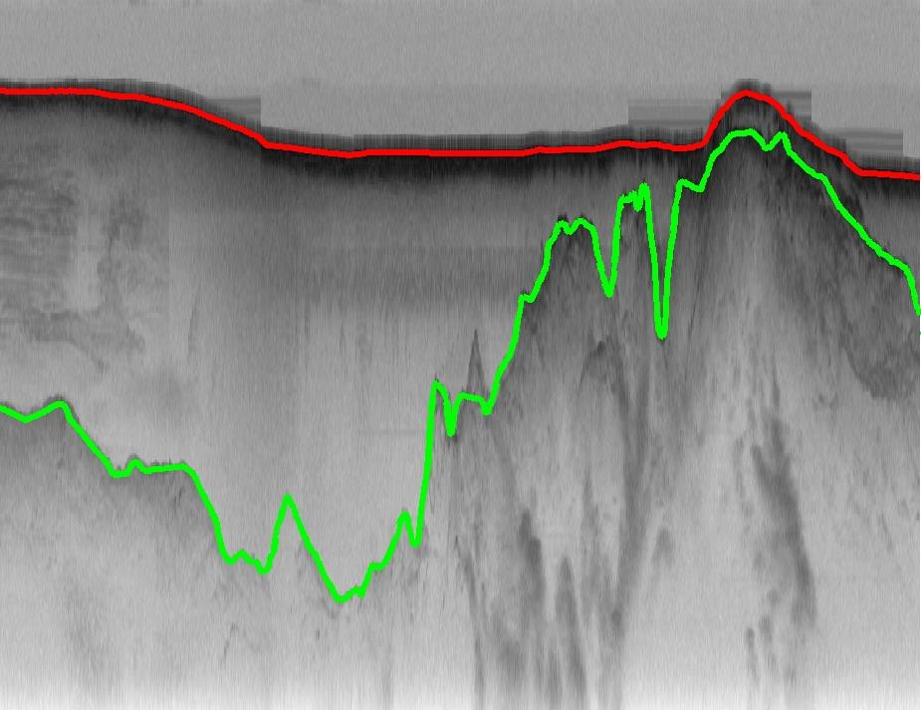
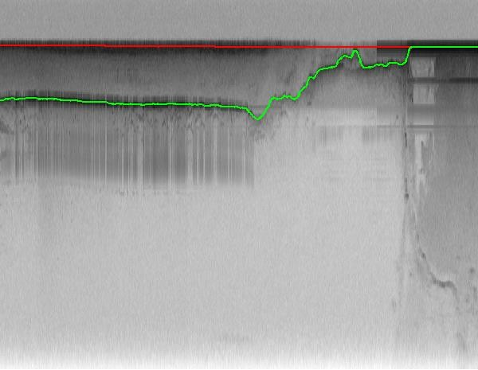
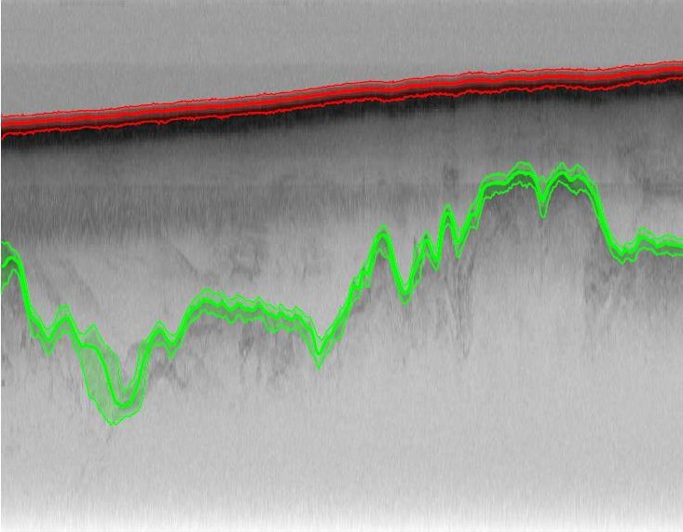
Surface and Bedrock
Approach Ground-Truth
Lee, Mitchell, Crandall, and Fox “Estimating Bedrock and Surface Boundaries with Confidence Intervals in Ice Sheet Radar Imagery using MCMC”, International Conference on Image Processing (ICIP), 2014.

Slide 21
An Automatic Approach to Detecting Internal Layer Boundaries using RJMCMC
Reversible Jumps Markov Chain Monte Carlo (RJMCMC) based Sampling procedure
  Birth
    a layer is added to the configuration
  Update
  a layer is adjusted
  Death
  a layer is deleted from configuration
Uniform spacing of layers as an initialization. The RJMCMC sampler is coupled with simulated annealing in order to ensure convergence of the Markov Chain by a temperature parameter.
The temperature gradually decreases as the number of iterations increase – layers were detected between 500 and 1000 iterations

Slide 22
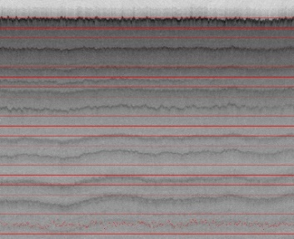
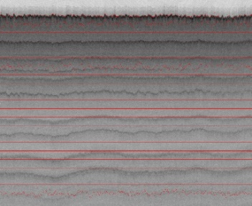
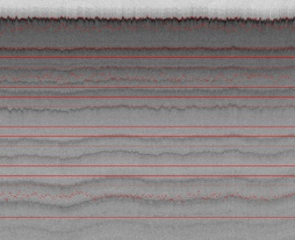
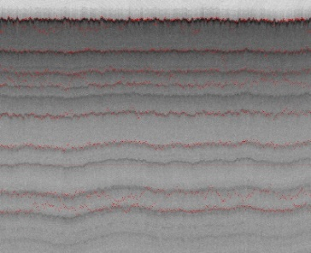
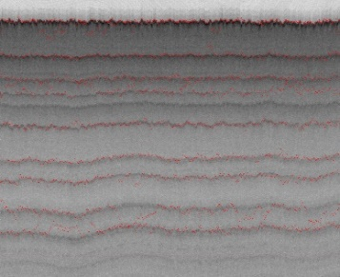
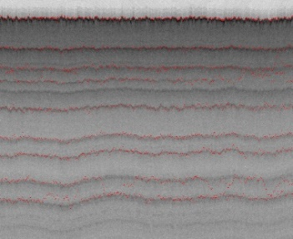
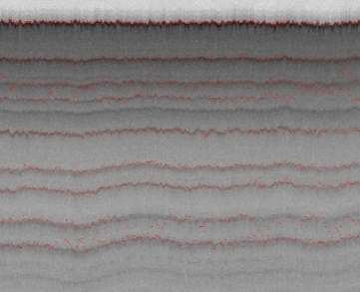
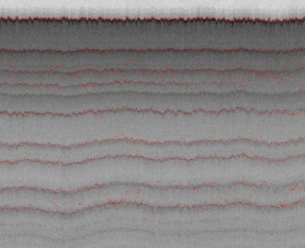
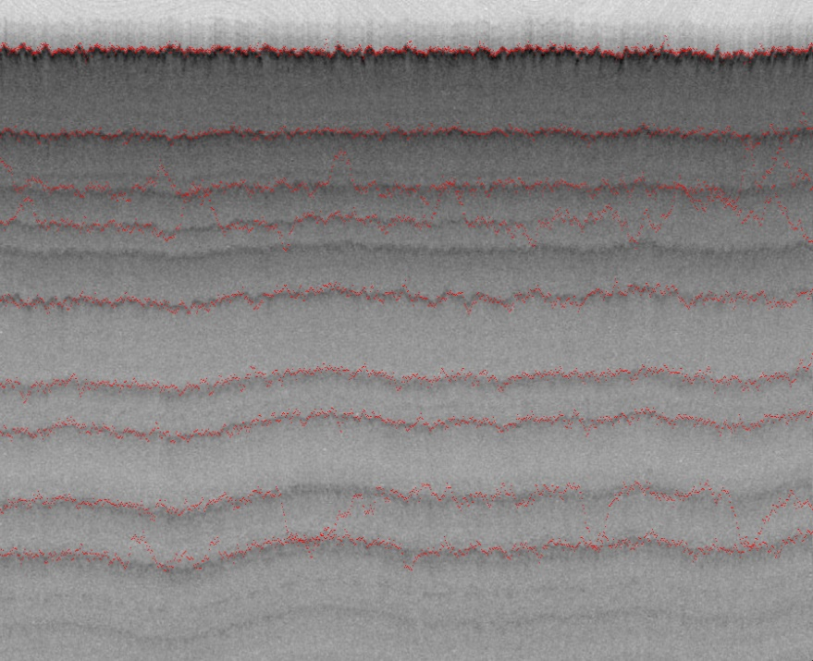
Iteration 1: Update
Iteration 6: Death
Iteration 14: Birth
Iteration 160: Birth
Iteration 251: Death
Iteration 351: Update
Iteration 378: Update
Iteration 491: Birth
Mitchell, Lee, Crandall, and Fox “An Automatic Approach to Detecting Internal Layer Boundaries using RJMCMC”, TBA.

Slide 23
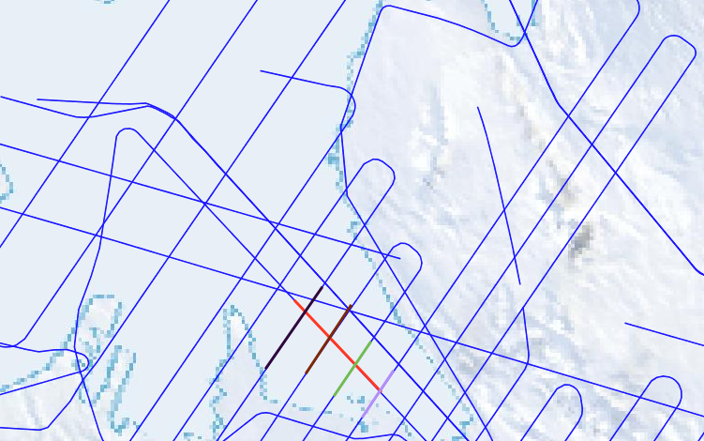
Preliminary Proposed Work: Extended ‘Cross-Sectional’ Prior
Sample Radar Survey: 5 line segments (black, brown, green, purple, and red) represent radar images. The red segment intersects with the 4 overlapping images

Slide 24
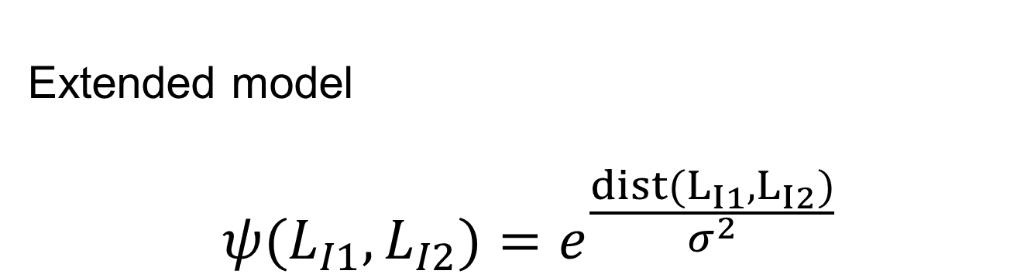
Preliminary Proposed Work: Extended ‘Cross-Sectional’ Prior
Extended model
$$ψ(L_{I1}, L_{I2})=e^{\frac{dist(L_{I1}, L_{I2})}{σ^{2}}}$$
This term would model the similarly of labels at cross-sectional intersections

Slide 25
Timeline
Date | Activity
September 2017 | Specify specific layer datasets with corresponding radar surveys
November 2017 | Determine intersections for highly dense radar surveys
December 2017 | Encode cross-sectional prior in Bayesian framework
January – March 2018 | Write and Defend Thesis

Slide 26
Conclusion
Identifying snow layers from can aid in forecasting global change
From a semi-automated approach to an the detection of an unknown number of layers
The potential to improve layer accuracy by incorporating additional information (i.e cross-sectional radar surveys) into the model

Slide 27
Questions?

