Slide 1
Multicore and Cloud Technologies for Data Intensive Applications
Ballantine Hall 006 , Indiana University Bloomington
October 23, 2009
Judy Qiu
xqiu@indiana.edu www.infomall.org/salsa
Pervasive Technology Institute
Indiana University
Notes:
SALSA is
Service Aggregated Linked Sequential Activities

Slide 2
Abstract
The SALSA project is developing and applying parallel and distributed Cyberinfrastructure to support large scale data analysis.
  Semiconductor companies provides Multicore, Manycore, Cell, and GPGPU etc.
  New programming model and system software to bridge an application and architecture/hardward
  The exponentially growing volumes of data requires robust high performance tools.
We show how clusters of Multicore systems give high parallel performance while Cloud technologies (Hadoop from Yahoo and Dryad from Microsoft) allow the integration of the large data repositories with data analysis engines from BLAST to Information retrieval.
We describe implementations of clustering and Multi Dimensional Scaling (Dimension Reduction) which are rendered quite robust with deterministic annealing -- the analytic smoothing of objective functions with the Gibbs distribution.
We present detailed performance results.

Slide 3
Convergence is Happening
Multicore
Clouds
Data Intensive Applications

Slide 4
Collaborators in SALSA Project
Microsoft Research
Technology Collaboration
Azure (Clouds)
Dennis Gannon
Roger Barga
Dryad (Cloud Runtime)
Christophe Poulain
CCR (Threading)
George Chrysanthakopoulos
DSS (Services)
Henrik Frystyk Nielsen
Indiana University
SALSA Technology Team
Geoffrey Fox
Judy Qiu
Scott Beason
Jaliya Ekanayake
Thilina Gunarathne
Thilina Gunarathne
Jong Youl Choi
Yang Ruan
Seung-Hee Bae
Hui Li
Saliya Ekanayake
Applications
Bioinformatics, CGB
Haixu Tang, Mina Rho,
Peter Cherbas, Qunfeng Dong
IU Medical School
Gilbert Liu
Demographics (Polis Center)
Neil Devadasan
Cheminformatics
David Wild, Qian Zhu
Physics
CMS group at Caltech (Julian Bunn)
Community Grids Lab
and UITS RT – PTI

Slide 5
Data Intensive (Science) Applications
Applications
Biology: Expressed Sequence Tag (EST) sequence assembly (CAP3)
Biology: Pairwise Alu sequence alignment (SW)
Health: Correlating childhood obesity with environmental factors
Cheminformatics: Mapping PubChem data into low dimensions to aid drug discovery
Data mining Algorithm
Clustering (Pairwise , Vector)
MDS, GTM, PCA, CCA
Visualization
PlotViz
Cloud Technologies
(MapReduce, Dryad, Hadoop)
Classic HPC or Multicore
(MPI, Threading)
FutureGrid/VM
(A high performance grid test bed that supports new approaches to parallel, Grids and Cloud computing for science applications)
Bare metal
(Computer, network, storage)
Notes:
We suggest that the data deluge will demand more robust algorithms in many areas and these algorithms will be highly I/O and compute intensive
Clustering N= 200,000 sequences using deterministic annealing will require around 750 cores and this need scales like N²
NSF Track 1 – Blue Waters in 2011 – could be saturated by 5,000,000 point clustering
Bio-Computing a Major Focus of SC09
FutureGrid is a high performance grid test bed that supports new approaches to parallel, Grids and Cloud

Slide 6
FutureGrid Architecture

Slide 7
Cluster Configurations
Feature | GCB-K18 @ MSR | iDataplex @ IU | Tempest @ IU
CPU | Intel Xeon CPU L5420 2.50GHz | Intel Xeon CPU L5420 2.50GHz | Intel Xeon CPU E7450 2.40GHz
# CPU /# Cores per node | 2 / 8 | 2 / 8 | 4 / 24
Memory | 16 GB | 32GB | 48GB
# Disks | 2 | 1 | 2
Network | Giga bit Ethernet | Giga bit Ethernet | Giga bit Ethernet / 20 Gbps Infiniband
Operating System | Windows Server Enterprise - 64 bit | Red Hat Enterprise Linux Server -64 bit | Windows Server Enterprise - 64 bit
# Nodes Used | 32 | 32 | 32
Total CPU Cores Used | 256 | 256 | 768
DryadLINQ
Hadoop/ Dryad / MPI
DryadLINQ / MPI

Slide 8
Cloud Computing: Infrastructure and Runtimes
Cloud infrastructure: outsourcing of servers, computing, data, file space, etc.
  Handled through Web services that control virtual machine lifecycles.
Cloud runtimes: tools (for using clouds) to do data-parallel computations.
  Apache Hadoop, Google MapReduce, Microsoft Dryad, and others
  Designed for information retrieval but are excellent for a wide range of science data analysis applications
  Can also do much traditional parallel computing for data-mining if extended to support iterative operations
  Not usually on Virtual Machines
Notes:
Clouds for HPC == clouds based on VMs plus Cloud Technologies
Cloud Technologies -- Dryad and Hadoop -- are very suitable for data intensive computing
Will get more so as extend MapReduce++ to iterative processes

Slide 9
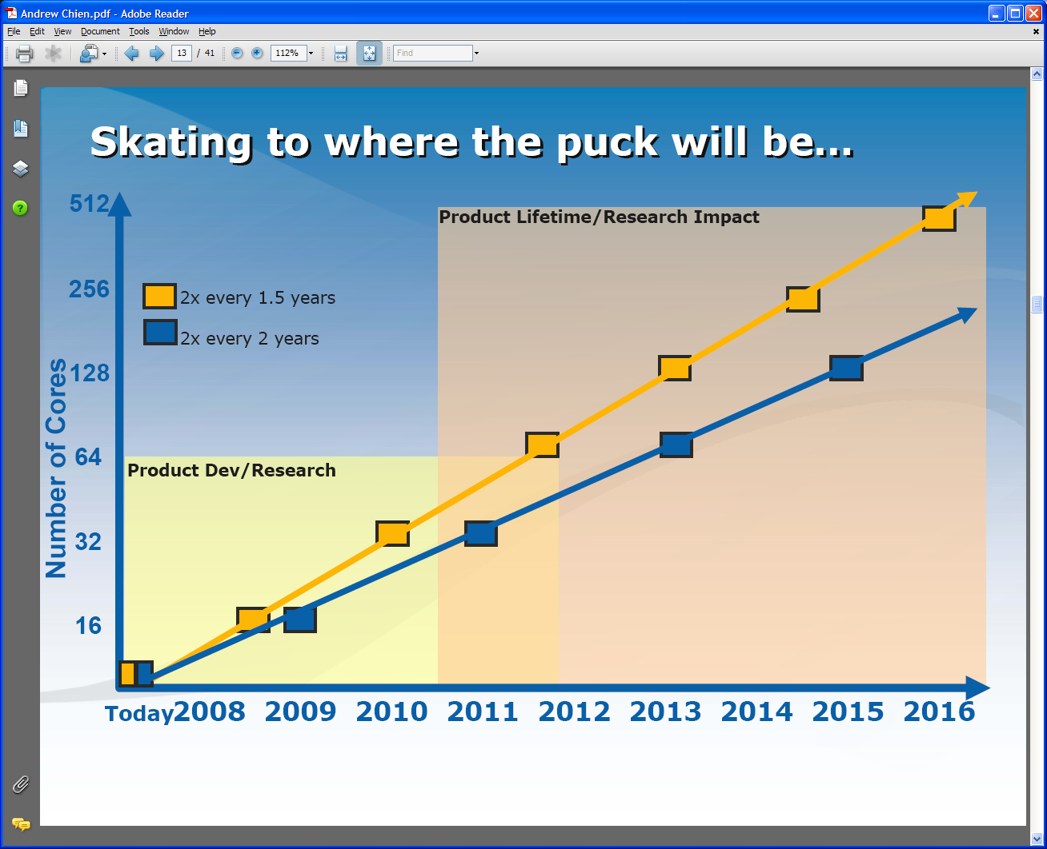
Intel’s Projection

Slide 10
Intel’s Application Stack

Slide 11
Use any Collection of Computers
We can have various hardware
  Multicore – Shared memory, low latency
  High quality Cluster – Distributed Memory, Low latency
  Standard distributed system – Distributed Memory, High latency
We can program the coordination of these units by
  Threads on cores
  MPI on cores and/or between nodes
  MapReduce/Hadoop/Dryad../AVS for dataflow
  Workflow or Mashups linking services
  These can all be considered as some sort of execution unit exchanging information (messages) with some other unit
And there are higher level programming models such as OpenMP, PGAS, HPCS Languages – Ignore!

Slide 12
Parallel Dataming Algorithms on Multicore
Developing a suite of parallel data-mining capabilities
  Clustering with deterministic annealing (DA)
  Mixture Models (Expectation Maximization) with DA
  Metric Space Mapping for visualization and analysis
  Matrix algebra as needed
Notes:
Results
Microsoft CCR supports MPI, dynamic threading
Detailed performance measurements with Speedups of 7.5 or above on 8-core systems for “large problems” using deterministic annealed (avoid local minima) algorithms for clustering, Gaussian Mixtures, GTM (dimensional reduction) etc.

Slide 13
Runtime System Used
We implement micro-parallelism using Microsoft CCR
(Concurrency and Coordination Runtime) as it supports both MPI rendezvous and dynamic (spawned) threading style of parallelism http://msdn.microsoft.com/robotics/
CCR Supports exchange of messages between threads using named ports and has primitives like:
  FromHandler: Spawn threads without reading ports
  Receive: Each handler reads one item from a single port
  MultipleItemReceive: Each handler reads a prescribed number of items of a given type from a given port. Note items in a port can be general structures but all must have same type.
  MultiplePortReceive: Each handler reads a one item of a given type from multiple ports.
CCR has fewer primitives than MPI but can implement MPI collectives efficiently
Use DSS (Decentralized System Services) built in terms of CCR for service model
DSS has ~35 µs and CCR a few µs overhead (latency, details later)

Slide 14
General Formula DAC GM GTM DAGTM DAGM
N data points E(x) in D dimensions space and minimize F by EM
  Deterministic Annealing Clustering (DAC)
F is Free Energy
EM is well known expectation maximization method
p(x) with Σ p(x) =1
T is annealing temperature varied down from ∞ with final value of 1
Determine cluster center Y(k) by EM method
K (number of clusters) starts at 1 and is incremented by algorithm

Slide 15
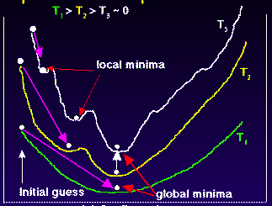
Deterministic
Annealing
F({Y}, T)
Solve Linear Equations for each temperature
Nonlinearity removed by approximating with solution at previous higher temperature
Configuration {Y}
Minimum evolving as temperature decreases
Movement at fixed temperature going to local minima if not initialized “correctly”

Slide 16
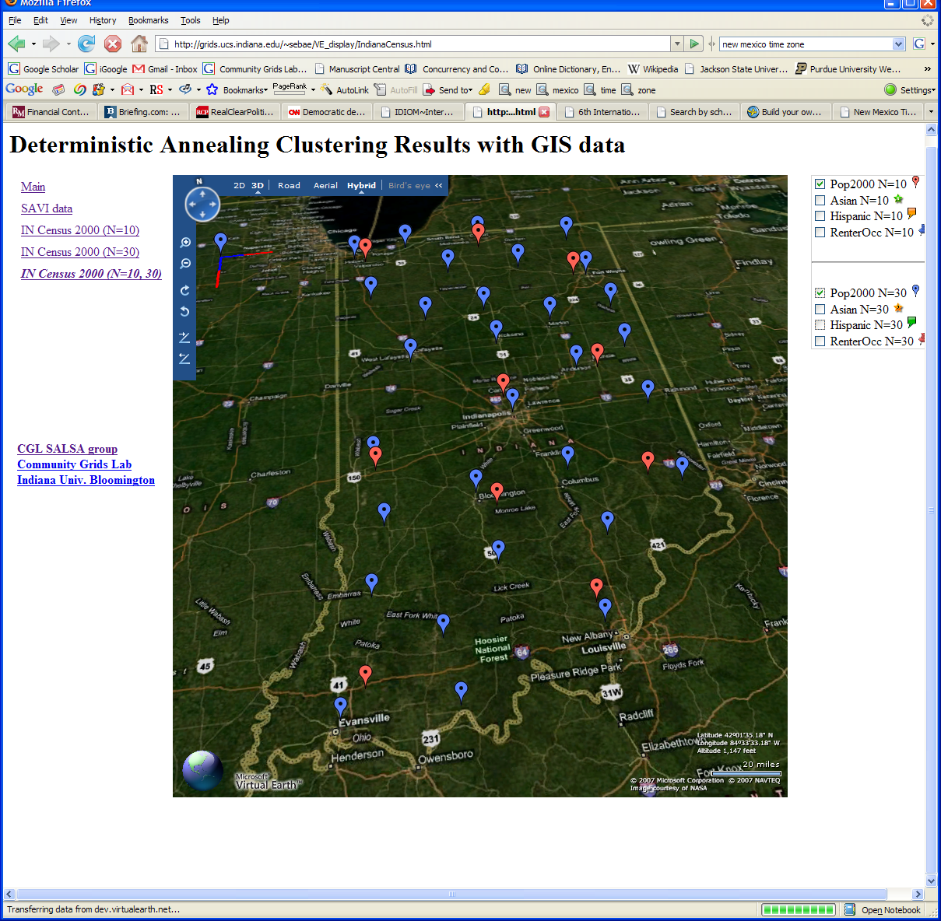
Deterministic Annealing Clustering of Indiana Census Data
Decrease temperature (distance scale) to discover more clusters

Slide 17
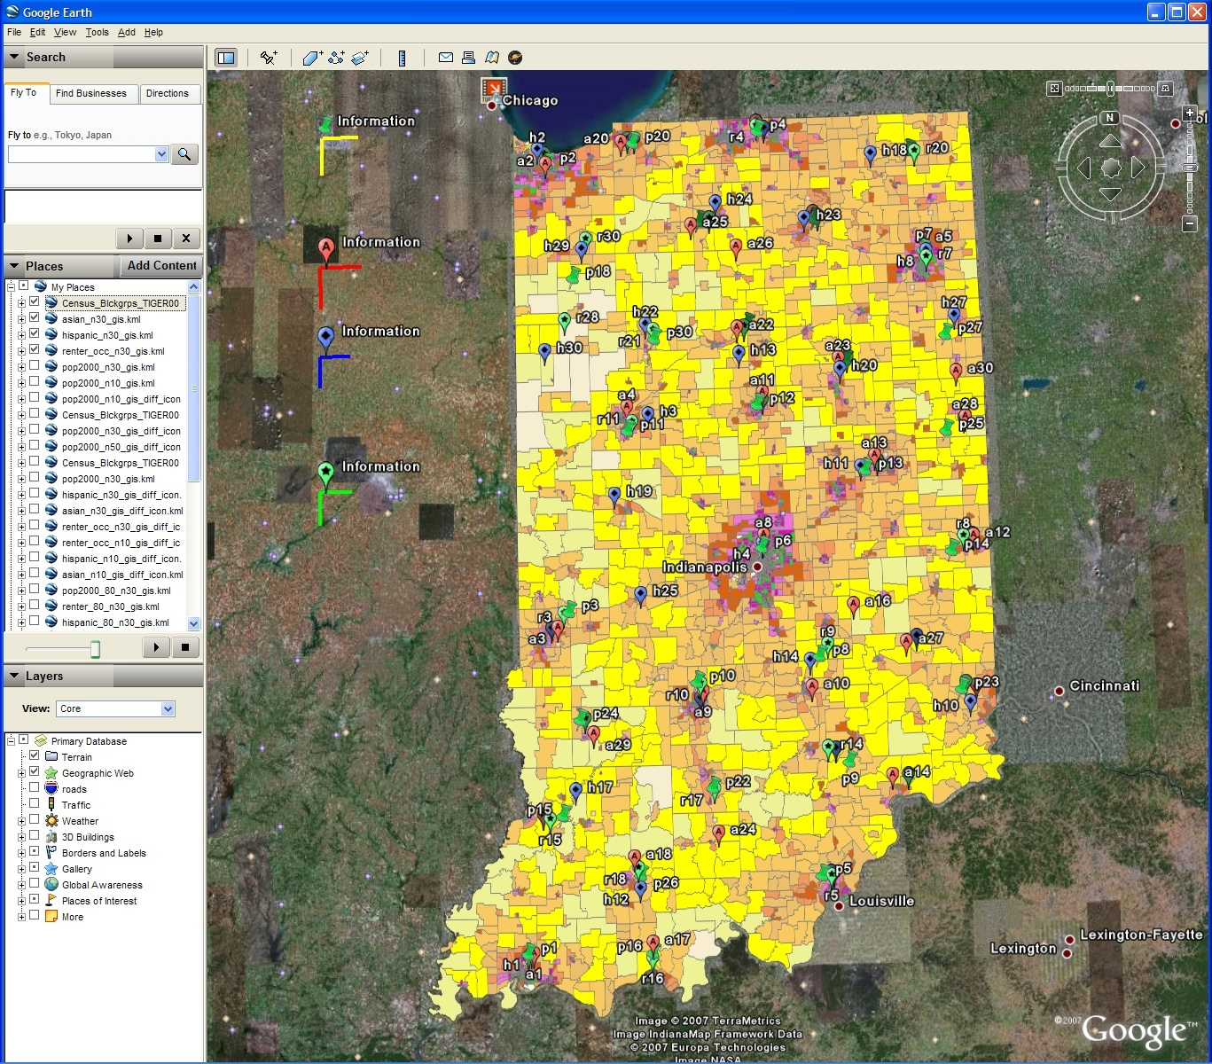
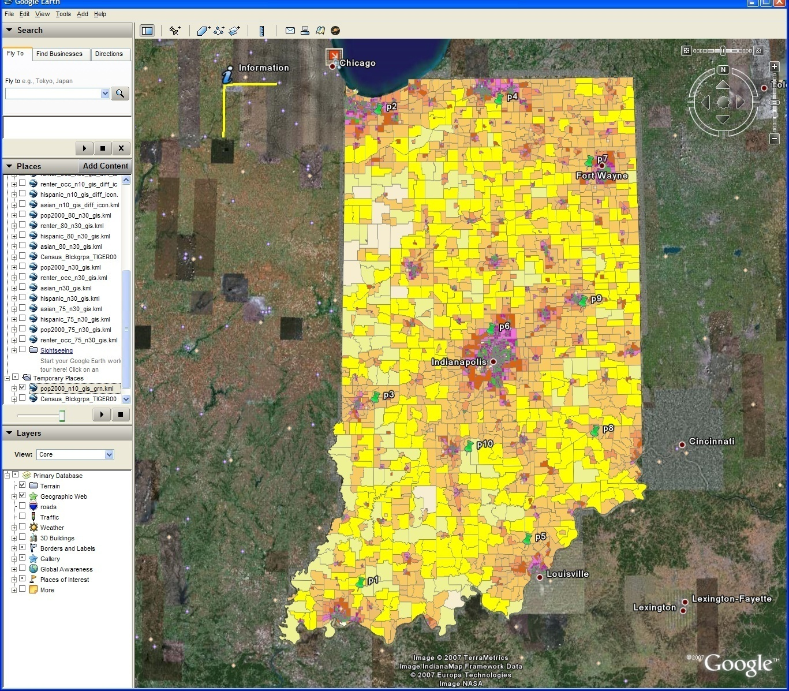
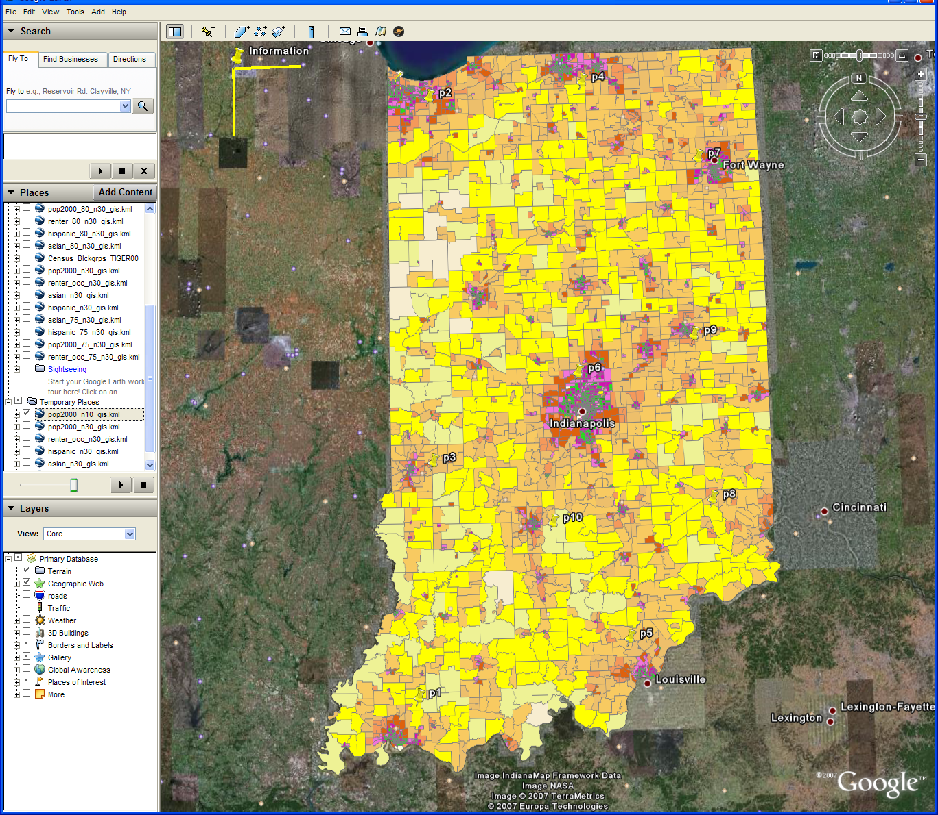
Changing resolution of GIS CluStering
Total
Asian
Hispanic
Renters
30 Clusters
GIS Clustering
30 Clusters
10 Clusters

Slide 18
MPI Exchange Latency in µs (20-30 µs computation between messaging)
Machine | OS | Runtime | Grains | Parallelism | MPI Latency
Intel8c:gf12 (8 core 2.33 Ghz) (in 2 chips) | Redhat | MPJE(Java) | Process | 8 | 181
 |  | MPICH2 (C) | Process | 8 | 40.0
 |  | MPICH2:Fast | Process | 8 | 39.3
 |  | Nemesis | Process | 8 | 4.21
Intel8c:gf20 (8 core 2.33 Ghz) | Fedora | MPJE | Process | 8 | 157
 |  | mpiJava | Process | 8 | 111
 |  | MPICH2 | Process | 8 | 64.2
Intel8b (8 core 2.66 Ghz) | Vista | MPJE | Process | 8 | 170
 | Fedora | MPJE | Process | 8 | 142
 | Fedora | mpiJava | Process | 8 | 100
 | Vista | CCR (C#) | Thread | 8 | 20.2
AMD4 (4 core 2.19 Ghz) | XP | MPJE | Process | 4 | 185
 | Redhat | MPJE | Process | 4 | 152
 |  | mpiJava | Process | 4 | 99.4
 |  | MPICH2 | Process | 4 | 39.3
 | XP | CCR | Thread | 4 | 16.3
Intel(4 core) | XP | CCR | Thread | 4 | 25.8
Messaging CCR versus MPI C# v. C v. Java
SALSA
Notes:
18

Slide 19
Notes on Performance
Speed up = T(1)/T(P) = ε (efficiency ) P
  with P processors
Overhead f = (PT(P)/T(1)-1) = (1/ε -1)
is linear in overheads and usually best way to record results if overhead small
For communication f ∝ ratio of data communicated to calculation complexity = n^{-0.5} for matrix multiplication where n (grain size) matrix elements per node
Overheads decrease in size as problem sizes n increase (edge over area rule)
Scaled Speed up: keep grain size n fixed as P increases
Conventional Speed up: keep Problem size fixed n ∝ 1/P

Slide 20
CCR Overhead for a computation of 23.76 µs between messaging
Intel8b: 8 Core |  | Number of Parallel Computations
(μs) |  | 1 | 2 | 3 | 4 | 7 | 8
Spawned | Pipeline | 1.58 | 2.44 | 3 | 2.94 | 4.5 | 5.06
 | Shift |  | 2.42 | 3.2 | 3.38 | 5.26 | 5.14
 | Two Shifts |  | 4.94 | 5.9 | 6.84 | 14.32 | 19.44
 | Pipeline | 2.48 | 3.96 | 4.52 | 5.78 | 6.82 | 7.18
 | Shift |  | 4.46 | 6.42 | 5.86 | 10.86 | 11.74
 | Exchange As Two Shifts |  | 7.4 | 11.64 | 14.16 | 31.86 | 35.62
 | Exchange |  | 6.94 | 11.22 | 13.3 | 18.78 | 20.16
Rendezvous
MPI

Slide 21
Time Microseconds
Stages (millions)
Overhead (latency) of AMD4 PC with 4 execution threads on MPI style Rendezvous Messaging for Shift and Exchange implemented either as two shifts or as custom CCR pattern

Slide 22
Time Microseconds
Stages (millions)
Overhead (latency) of Intel8b PC with 8 execution threads on MPI style Rendezvous Messaging for Shift and Exchange implemented either as two shifts or as custom CCR pattern

Slide 23
Parallel Pairwise Clustering PWDA
Speedup Tests on eight 16-core Systems (6 Clusters, 10,000 records)
Threading with Short Lived CCR Threads
Parallel Overhead
128-way
64-way
48-way
16-way
32-way
4-way
8-way
2-way
8x1x1
2x8x3
4x4x3
8x1x8
2x8x8
4x2x6
1x2x1
1x8x8
1x1x2
2x1x1
1x2x2
1x4x1
2x1x2
2x2x1
4x1x1
1x4x2
1x8x1
2x2x2
2x4x1
4x1x2
4x2x1
1x8x2
2x4x2
2x8x1
4x2x2
4x4x1
8x1x2
8x2x1
2x8x2
4x4x2
8x2x2
1x8x6
2x4x6
2x4x8
4x2x8
1x16x1
1x16x4
2x8x4
8x2x4
4x4x8
16x1x1
1x16x8
8x2x8
1x16x2
16x1x2
1x16x3
16x1x4
16x1x8
Parallel Patterns (# Thread /process) x (# MPI process /node) x (# node)
June 3 2009

Slide 24
June 11 2009
Parallel Pairwise Clustering PWDA
Speedup Tests on eight 16-core Systems (6 Clusters, 10,000 records)
Threading with Short Lived CCR Threads
Parallel Overhead
Parallel Patterns (# Thread /process) x (# MPI process /node) x (# node)

Slide 25
PWDA Parallel Pairwise data clustering
by Deterministic Annealing run on 24 core computer
Parallel
Overhead
Intra-node
MPI
Inter-node
MPI
Threading
Parallel Pattern (Thread X Process X Node)
June 11 2009

Slide 26
Data Intensive Architecture
Instruments
User Data
Files
Files
Files
Visualization
User Portal
Knowledge
Discovery
Users
Files
Files
Files
Initial
Processing
Higher Level
Processing
Such as R
PCA, Clustering
Correlations …
Maybe MPI
Prepare for
Viz
MDS
Notes:
From 1980-2000?, we largely looked at HPC for simulation; now we have data deluge
1) Data starts on some disk/sensor/instrument
It needs to be decomposed/partitioned; often partitioning natural from source of data
2) One runs a filter of some sort extracting data of interest and (re)formatting it
Pleasingly parallel with often “millions” of jobs
Communication latencies can be many milliseconds and can involve disks
3) Using same (or map to a new) decomposition, one runs a possibly parallel application that could require iterative steps between communicating processes or could be pleasing parallel
Communication latencies may be at most some microseconds and involves shared memory or high speed networks
Workflow links 1) 2) 3) with multiple instances of 2) 3)
Pipeline or more complex graphs
Filters are “Maps” or “Reductions” in MapReduce language

Slide 27






MapReduce “File/Data Repository” Parallelism
Instruments
Map = (data parallel) computation reading and writing data
Reduce = Collective/Consolidation phase e.g. forming multiple global sums as in histogram
Communication via Messages/Files
Portals
/Users
Disks
Map₁
Map₂
Map₃
Reduce
Computers/Disks

Slide 28
Alu Sequencing Workflow
Data is a collection of N sequences – 100’s of characters long
  These cannot be thought of as vectors because there are missing characters
  “Multiple Sequence Alignment” (creating vectors of characters) doesn’t seem to work if N larger than O(100)
First calculate N² dissimilarities (distances) between sequences (all pairs)
Find families by clustering (much better methods than Kmeans). As no vectors, use vector free O(N²) methods
Map to 3D for visualization using Multidimensional Scaling MDS – also O(N²)
N = 50,000 runs in 10 hours (all above) on 768 cores
Our collaborators just gave us 170,000 sequences and want to look at 1.5 million – will develop new algorithms!

Slide 29
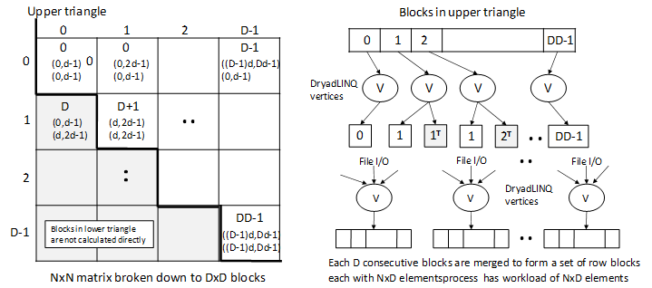
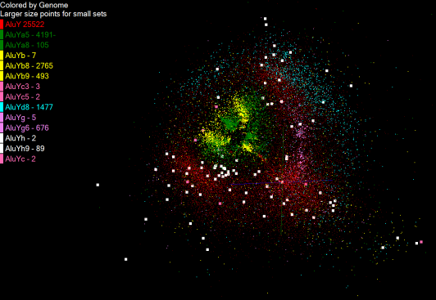
Gene Family from Alu Sequencing
1250 million distances
4 hours & 46 minutes
Calculate pairwise distances for a collection of genes (used for clustering, MDS)
O(N^2) problem
“Doubly Data Parallel” at Dryad Stage
Performance close to MPI
Performed on 768 cores (Tempest Cluster)
Processes work better than threads when used inside vertices
100% utilization vs. 70%
Notes:
1~180 lines without threading in DryadLINQ, with threading, it is about 400 lines
MPI ~500 lines
The Alu clustering problem [27] is one of the most challenging problems for sequencing clustering because Alus represent the largest repeat families in human genome. There are about 1 million copies of Alu sequences in human genome, in which most insertions can be found in other primates and only a small fraction (~ 7000) are human-specific. This indicates that the classification of Alu repeats can be deduced solely from the 1 million human Alu elements. Notable, Alu clustering can be viewed as a classical case study for the capacity of computational infrastructures because it is not only of great intrinsic biological interests, but also a problem of a scale that will remain as the upper limit of many other clustering problem in bioinformatics for the next few years, e.g. the automated protein family classification for a few millions of proteins predicted from large metagenomics projects. In our work here we examine Alu samples of 35339 and 50,000 sequences.

Slide 30
Hadoop/Dryad Model
Block Arrangement in Dryad
and Hadoop
Execution Model in Dryad
and Hadoop
Need to generate a single file with full NxN distance matrix

Slide 31


Slide 32


Slide 33
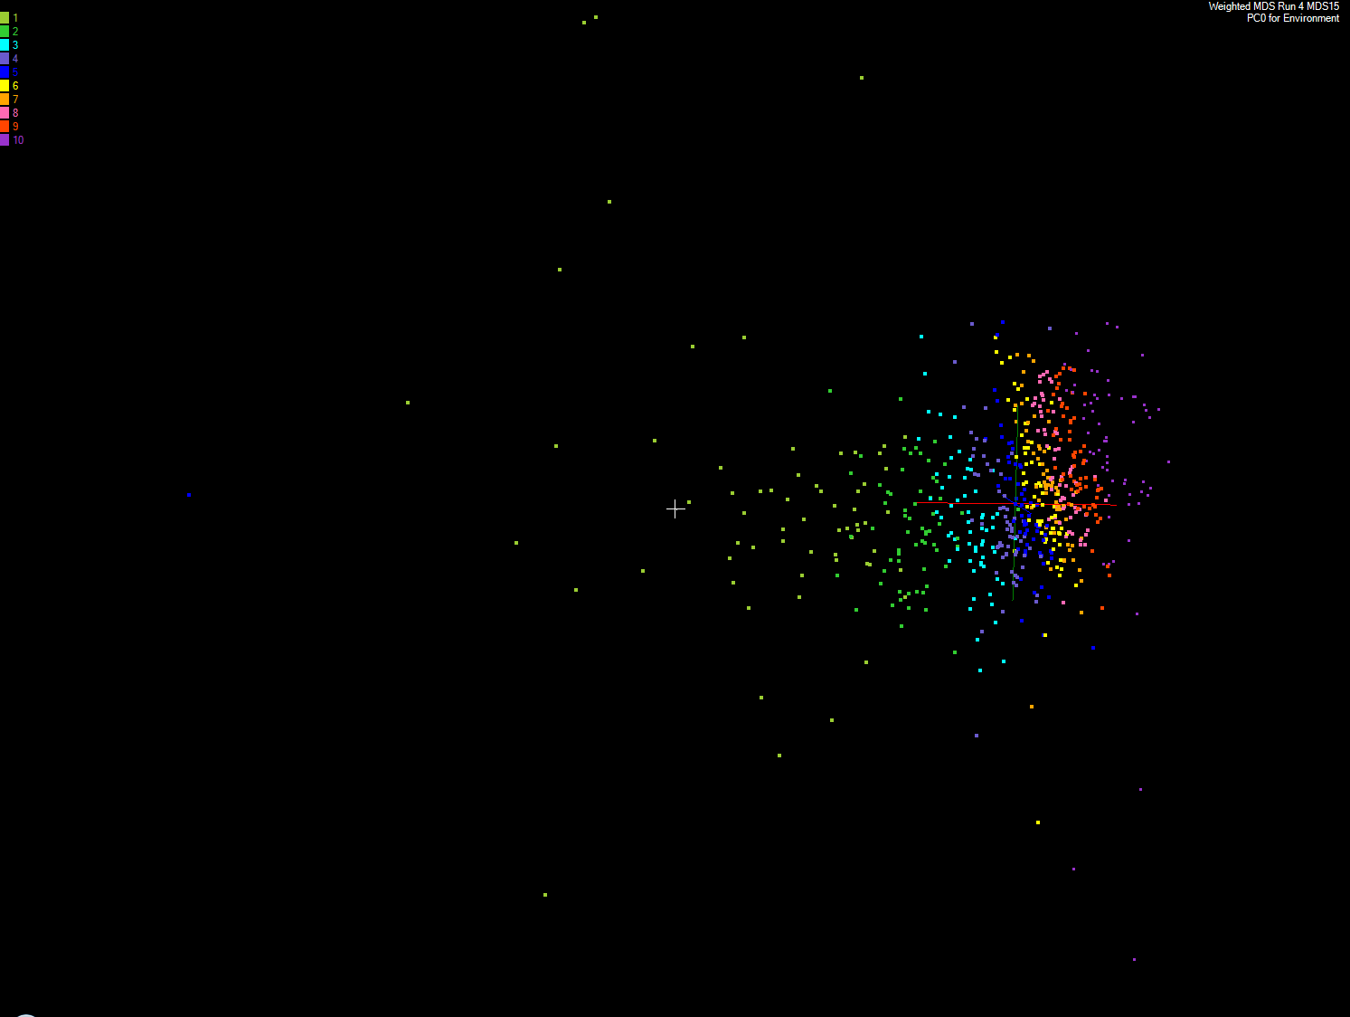
Apply MDS to Patient Record Data
and correlation to GIS properties
MDS and Primary PCA Vector
MDS of 635 Census Blocks with 97 Environmental Properties
Shows expected Correlation with Principal Component – color varies from greenish to reddish as projection of leading eigenvector changes value
Ten color bins used

Slide 34
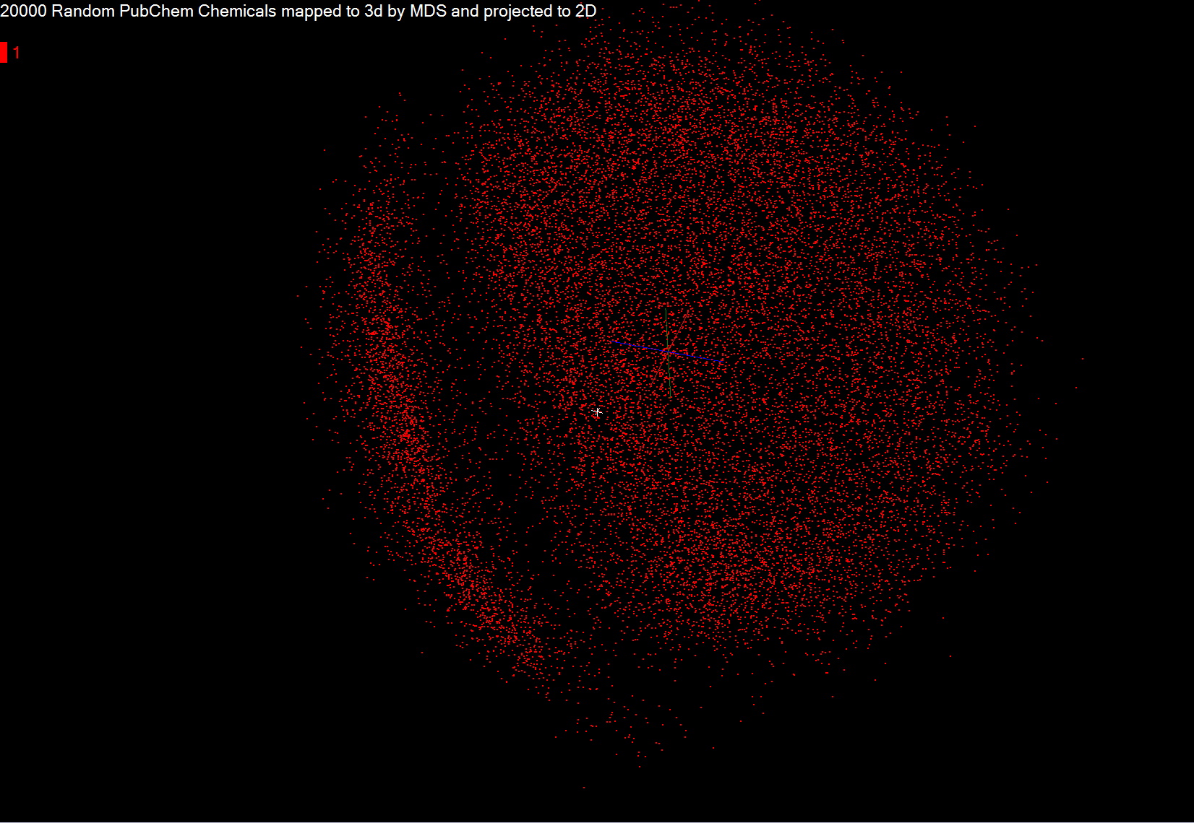

Slide 35
Pairwise Clustering
30,000 Points on Tempest
Clustering by Deterministic Annealing
MPI
Parallel Overhead
Thread
Thread
Thread
Thread
MPI
Thread
Thread
Thread
MPI
Parallelism
MPI

Slide 36
Dryad versus MPI for Smith Waterman
Flat is perfect scaling

Slide 37
Dryad Scaling on Smith Waterman
Flat is perfect scaling

Slide 38
Dryad for Inhomogeneous Data
Mean Length 400
Total
Time (ms)
Computation
Sequence Length Standard Deviation
Flat is perfect scaling – measured on Tempest
Notes:
Sensitive to small data set; load balance; 10k data size; ??? Labels computation, total

Slide 39
Hadoop/Dryad Comparison
Inhomogeneous Data
Dryad with Windows HPCS compared to Hadoop with Linux RHEL on IDataplex
Notes:
10k data size

Slide 40
Hadoop/Dryad Comparison
“Homogeneous” Data
Dryad
Hadoop
Time per Alignment (ms)
Dryad with Windows HPCS compared to Hadoop with Linux RHEL on Idataplex
Using real data with standard deviation/length = 0.1
Notes:
Real data; mean length of sequence is 300.

Slide 41
Block Dependence of Dryad SW-G
Processing on 32 node IDataplex
Dryad Block Size D | 128x128 | 64x64 | 32x32
Time to partition data | 1.839 | 2.224 | 2.224
Time to process data | 30820.0 | 32035.0 | 39458.0
Time to merge files | 60.0 | 60.0 | 60.0
Total Time | 30882.0 | 32097.0 | 39520.0
Smaller number of blocks D increases data size per block and makes cache use less efficient
Other plots have 64 by 64 blocking
Notes:
Cache effect

Slide 42


CAP3 - DNA Sequence Assembly Program
EST (Expressed Sequence Tag) corresponds to messenger RNAs (mRNAs) transcribed from the genes residing on chromosomes. Each individual EST sequence represents a fragment of mRNA, and the EST assembly aims to re-construct full-length mRNA sequences for each expressed gene.
Input files (FASTA)
GCB-K18-N01
\DryadData\cap3\cap3data
10
0,344,CGB-K18-N01
1,344,CGB-K18-N01
…
9,344,CGB-K18-N01
Cap3data.pf
V
V
Cap3data.00000000
\\GCB-K18-N01\DryadData\cap3\cluster34442.fsa
\\GCB-K18-N01\DryadData\cap3\cluster34443.fsa
...
\\GCB-K18-N01\DryadData\cap3\cluster34467.fsa
Output files
Input files
(FASTA)
IQueryable<LineRecord> inputFiles=PartitionedTable.Get <LineRecord>(uri);
IQueryable<OutputInfo> = inputFiles.Select(x=>ExecuteCAP3(x.line));
[1] X. Huang, A. Madan, “CAP3: A DNA Sequence Assembly Program,” Genome Research, vol. 9, no. 9, pp. 868-877, 1999.

Slide 43
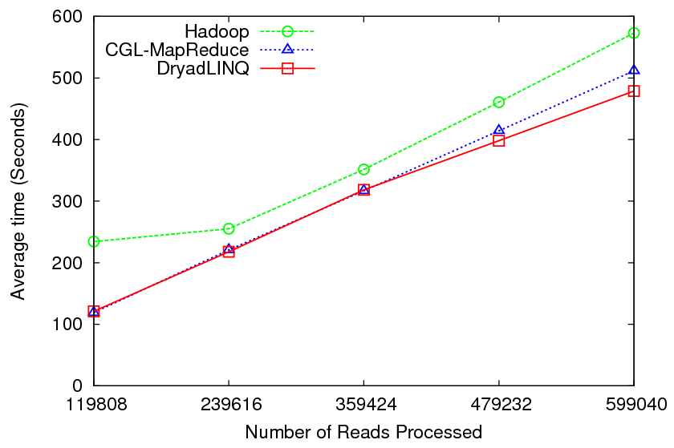
CAP3 - Performance

Slide 44
DryadLINQ on Cloud
HPC release of DryadLINQ requires Windows Server 2008
Amazon does not provide this VM yet
Used GoGrid cloud provider
Before Running Applications
  Create VM image with necessary software
    E.g. NET framework
  Deploy a collection of images (one by one – a feature of GoGrid)
  Configure IP addresses (requires login to individual nodes)
  Configure an HPC cluster
  Install DryadLINQ
  Copying data from “cloud storage”
  We configured a 32 node virtual cluster in GoGrid

Slide 45
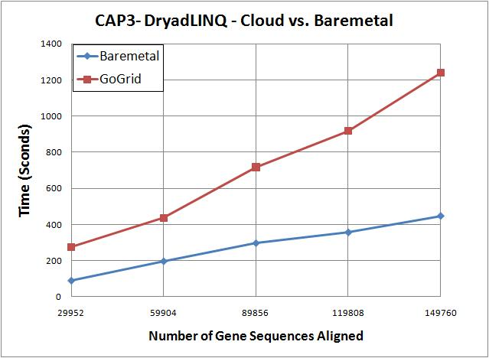
DryadLINQ on Cloud contd..
CAP3 works on cloud
Used 32 CPU cores
100% utilization of virtual CPU cores
3 times longer time in cloud than the bare-metal runs on different hardware
FutureGrid will allow us to repeat on single hardware
CloudBurst and Kmeans did not run on cloud
VMs were crashing/freezing even at data partitioning
  Communication and data accessing simply freeze VMs
  VMs become unreachable
We expect some communication overhead, but the above observations are more GoGrid related than to Cloud

Slide 46
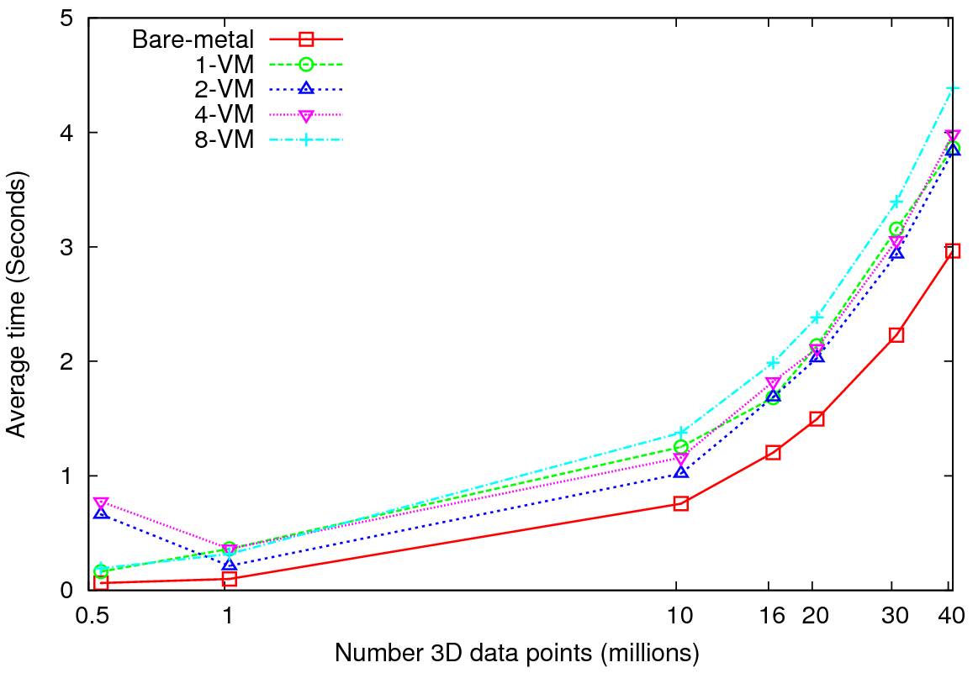
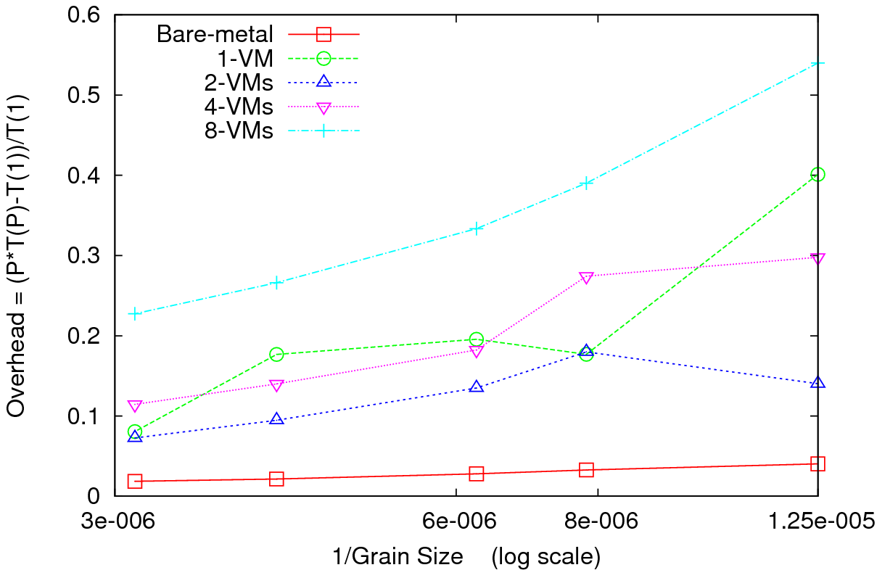
MPI on Clouds Kmeans Clustering
Performance – 128 CPU cores
Overhead
Perform Kmeans clustering for up to 40 million 3D data points
Amount of communication depends only on the number of cluster centers
Amount of communication << Computation proportional to the amount of data processed
At the highest granularity VMs show at least 3.5 times overhead compared to bare-metal
Extremely large overheads for smaller grain sizes
Notes:
16 nodes 8 cores

Slide 47
Application Classes
(Parallel software/hardware in terms of 5 “Application architecture” Structures)
1 | Synchronous | Lockstep Operation as in SIMD architectures
2 | Loosely Synchronous | Iterative Compute-Communication stages with independent compute (map) operations for each CPU. Heart of most MPI jobs
3 | Asynchronous | Compute Chess; Combinatorial Search often supported by dynamic threads
4 | Pleasingly Parallel | Each component independent – in 1988, Fox estimated at 20% of total number of applications | Grids
5 | Metaproblems | Coarse grain (asynchronous) combinations of classes 1)-4). The preserve of workflow. | Grids
6 | MapReduce++ | It describes file(database) to file(database) operations which has three subcategories. Pleasingly Parallel Map Only Map followed by reductions Iterative “Map followed by reductions” – Extension of Current Technologies that supports much linear algebra and datamining | Clouds
Notes:
CGL-MapReduce is an example of MapReduce++ -- supports MapReduce model with iteration (data stays in memory and communication via streams not files)

Slide 48
Applications & Different Interconnection Patterns
Map Only | Classic MapReduce | Ite rative Reductions MapReduce++ | Loosely Synchronous
CAP3 Analysis Document conversion (PDF -> HTML) Brute force searches in cryptography Parametric sweeps | High Energy Physics (HEP) Histograms SWG gene alignment Distributed search Distributed sorting Information retrieval | Expectation maximization algorithms Clustering Linear Algebra | Many MPI scientific applications utilizing wide variety of communication constructs including local interactions
- CAP3 Gene Assembly - PolarGrid Matlab data analysis | - Information Retrieval - HEP Data Analysis - Calculation of Pairwise Distances for ALU Sequences | Kmeans Deterministic Annealing Clustering - Multidimensional Scaling MDS | - Solving Differential Equations and - particle dynamics with short range forces
Input
iterations
Input
Input
map
map
map
Pij
reduce
Output
reduce
Domain of MapReduce and Iterative Extensions
MPI

Slide 49
Components of a Scientific Computing environment
Laptop using a dynamic number of cores for runs
  Threading (CCR) parallel model allows such dynamic switches if OS told application how many it could – we use short-lived NOT long running threads
  Very hard with MPI as would have to redistribute data
The cloud for dynamic service instantiation including ability to launch:
  Disk/File parallel data analysis
  MPI engines for large closely coupled computations
    Petaflops for million particle clustering/dimension reduction?
Analysis programs like MDS and clustering will run OK for large jobs with “millisecond” (as in Granules) not “microsecond” (as in MPI, CCR) latencies

Slide 50
Summary: Key Features of our Approach
Cloud technologies work very well for data intensive applications
Iterative MapReduce allows to build a complete system with single cloud technology without MPI
FutureGrid allows easy Windows v Linux with and without VM comparison
Intend to implement range of biology applications with Dryad/Hadoop
Initially we will make key capabilities available as services that we eventually implement on virtual clusters (clouds) to address very large problems
  Basic Pairwise dissimilarity calculations
  R (done already by us and others)
  MDS in various forms
  Vector and Pairwise Deterministic annealing clustering
Point viewer (Plotviz) either as download (to Windows!) or as a Web service
Note much of our code written in C# (high performance managed code) and runs on Microsoft HPCS 2008 (with Dryad extensions)
  Hadoop code written in Java

Slide 51
Project website www.infomall.org/SALSA
Technical Reports
Analysis of Concurrency and Coordination Runtime CCR and DSS for Parallel and Distributed Computing
High Performance Parallel Computing with Clouds and Cloud Technologies
Parallel Data Mining from Multicore to Cloudy Grids
Applicability of DryadLINQ to Scientific Applications

