Slide 1
4 Education Initiatives: Data Science, Informatics, Computational Science and Intelligent Systems Engineering; What succeeds?
National Academies Workshop on COLLABORATIVE GRADUATE TRAINING INITIATIVES IN HIGH-PERFORMANCE COMPUTING FOR THE SOLID EARTH SCIENCES
http://dels.nas.edu/GLOBAL/BESR/COSG
April 11, 2016
Geoffrey Fox
gcf@indiana.edu http://www.infomall.org
Department of Intelligent Systems Engineering
School of Informatics and Computing
Digital Science Center
Indiana University Bloomington

Slide 2
Variants of Applied Computer Science
Computational Science or Scientific Computing
  Large international effort starting ~25 years ago
  I tried 3 times (Caltech, Syracuse, FSU) and I failed; Some success by others including IUB (few students)
  Curriculum including HPC well understood
  Mainly graduate
  Are there enough jobs?
Informatics ~3 times Computer Science at IUB at undergraduate level
  Undergraduates get good jobs somewhat lower salary than Computer science
  Information technology as in Health informatics (data not simulation)
Data Science has exploded in interest
  IUB introduced Masters in Data Science in January 2015
  Recognized name for students and employees and plenty of jobs
  Curriculum varies in emphasis across universities but not difficult to design
HPC and Big Data in “Intelligent Systems” Engineering at IUB
  Modest 2-4 course HPC effort in Nanoengineering, Bioengineering, Computer Engineering; Big Data universal

Slide 3
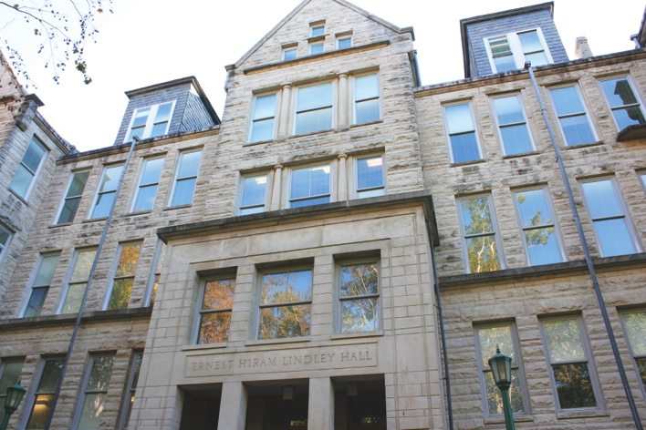
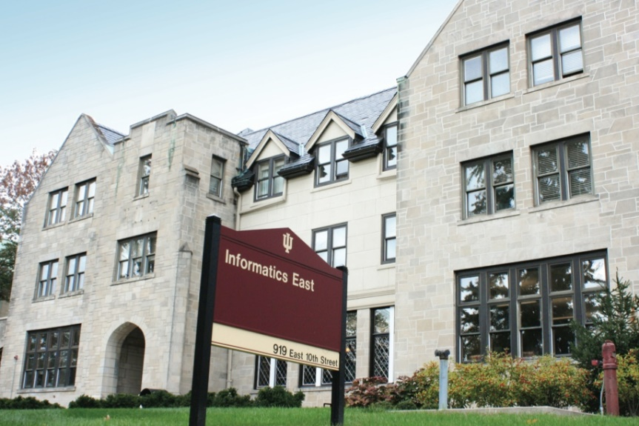
School of Informatics and Computing
(2014-2015)
Tenure-track Faculty 82
Students
Undergraduate 1,472
Master’s 754
Ph.D. 301
Female Undergraduates 22%
Female Graduate Students 48%
Data Science Masters is 36, 105, 290 enrolled for 13-14, 14-15 and 15-16

Slide 4
SOIC@IUB
Masters CS + HCI + Sec + Bio
Masters Data
Science

Slide 5
Some Lessons on HPC and Big Data
Equivalence HPC == Computational Science == Scientific Computing
Equivalence Big Data == Data Science
Big Data at least 10x larger in jobs and 100x larger in student interest than HPC
Data science web pages more popular than computer science at IUB
  Data science risen from 0 to 42% of SOIC@IUB grad appls in 2 years
Big Data and HPC both demand Computer Science – Application Domain collaboration
Industry leads data science and moves much faster than academia
President’s National Strategic Computing Initiative calls for Big Data – Exascale Convergence
  Includes Supercomputer Cloud hardware/software Integration
  (I think) clear how to do this but (unwisely?) largely ignored in HPC plans
  HPC on a doomed unsustainable path?
“HPC-ABDS” High Performance Computing Enhanced Apache Big Data Stack offers sustainable software (via Apache), rich industry software model and performance of HPC e.g. Apache workflow better than HPC variants?
Natural to integrate data and computational science education (not common?)

Slide 6
Computational Science
Computational science has important similarities to data science but with a simulation rather than data analysis flavor.
Although a great deal of effort went into with meetings and several academic curricula/programs, it didn’t take off
  In my experience not a lot of students were interested and
  The academic job opportunities were not great
Data science has more jobs; maybe it will do better?
Can we usefully link these concepts?
PS both use parallel computing!
In days gone by, I did research in particle physics phenomenology which in retrospect was an early form of data science using models extensively

Slide 7
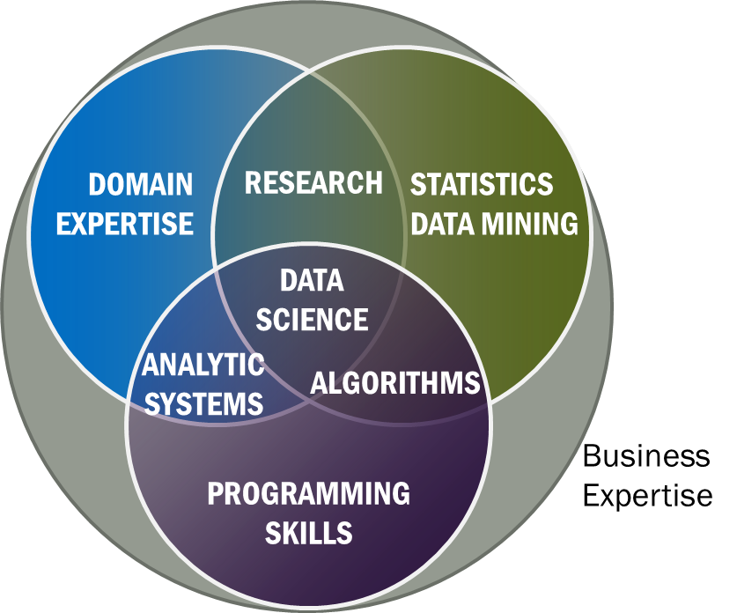
Data Science Definition from NIST Public Working Group
Data Science is the extraction of actionable knowledge directly from data through a process of discovery, hypothesis, and analytical hypothesis analysis.
A Data Scientist is a practitioner who has sufficient knowledge of the overlapping regimes of expertise in business needs, domain knowledge, analytical skills and programming expertise to manage the end-to-end scientific method process through each stage in the big data lifecycle.
Replace by applied math and modelling for computational science?
See Big Data Definitions in http://bigdatawg.nist.gov/V1_output_docs.php
Notes:
Big Data refers to digital data volume, velocity and/or variety whose management requires scalability across coupled horizontal resources
Data Science is the extraction of actionable knowledge directly from data through a process of discovery, hypothesis, and analytical hypothesis analysis.
A Data Scientist is a practitioner who has sufficient knowledge of the overlapping regimes of expertise in business needs, domain knowledge, analytical skills and programming expertise to manage the end-to-end scientific method process through each stage in the big data lifecycle.

Slide 8

McKinsey Institute on Big Data Jobs
http://www.mckinsey.com/mgi/publications/big_data/index.asp
There will be a shortage of talent necessary for organizations to take advantage of big data. By 2018, the United States alone could face a shortage of 140,000 to 190,000 people with deep analytical skills as well as 1.5 million managers and analysts with the know-how to use the analysis of big data to make effective decisions.
IU Data Science Decision Maker Path aimed at 1.5 million jobs. Technical Path covers the 140,000 to 190,000

Slide 9
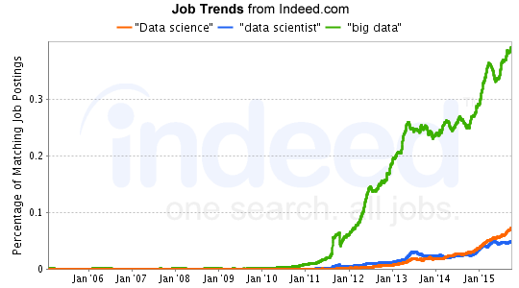
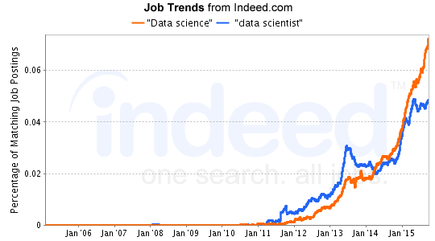
Job Trends
Charts Jan 6 2015
Big Data much larger than data science
19 May 2015 Jobs
3475 for “data science“
2277 for “data scientist“
19488 for “big data”
7 Dec 2015 Jobs
5014 for “data science“
2830 for “data scientist“
22388 for “big data”
http://www.indeed.com/jobtrends?q=%22Data+science%22%2C+%22data+scientist%22%2C+%22big+data%22%2C&l=

Slide 10
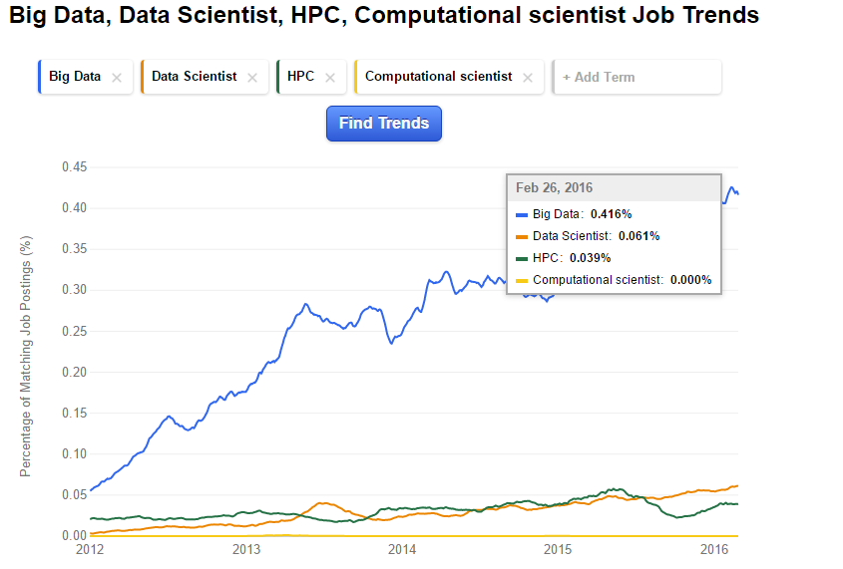
Its Jobs!
2012-2016
HPC ~constant
Big Data grows factor 10
Big Data
Deep Learning 0.01%
Bioengineering 0.01%
Internet of Things 0.03%
Informatics 0.12%
Computer Engineering 0.26%
Hadoop 0.28%
Simulation 0.29%
Information Technology 1.58%
Computer Science 2.4%
Engineer 4.14%
Design 8.71%
HPC

Slide 11
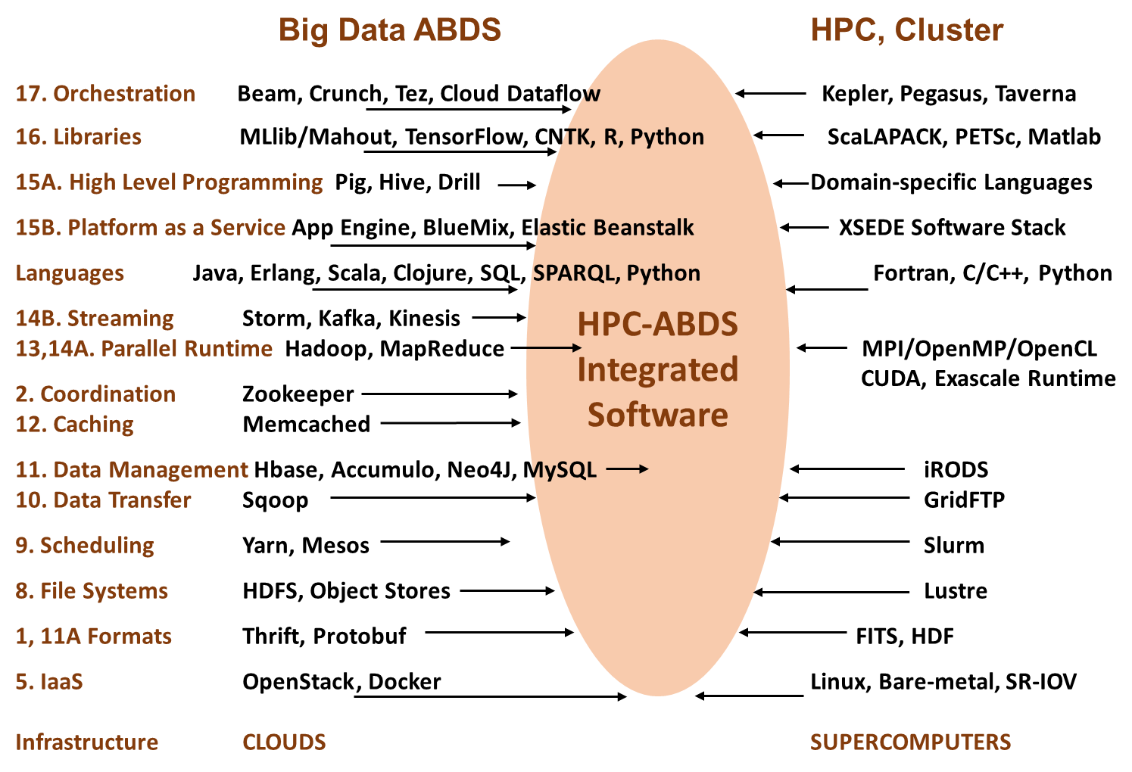

Slide 12
Big Data and (Exascale) Simulation Convergence II

Slide 13
School of Informatics and Computing

Slide 14

Background of the School
The School of Informatics was established in 2000 as first of
its kind in the United States.
Computer Science was established in 1971 and became part
of the school in 2005.
Library and Information Science
was established in 1951 and
became part of the school
in 2013.
Now named the School of
Informatics and Computing.
Data Science added January 2014
Engineering added Fall 2016

Slide 15
Undergraduate
Informatics
Applied CS on the IT (data) side
961 Undergrad (2.7 times number in CS)
95 Masters
110 PhD

Slide 16
Undergraduate
Computer Science
356 Undergraduate
311 Masters
161 PhD

Slide 17

SOIC Data Science Program
Cross Disciplinary Faculty – 31 in School of Informatics and Computing, a few in statistics and expanding across campus
Affordable online and traditional residential curricula or mix thereof
Masters, Certificate, PhD Minor in place; Full PhD being proposed
http://www.soic.indiana.edu/graduate/degrees/data-science/index.html
Note data science mentioned in faculty advertisements but unlike other parts of School, there are no dedicated faculty
It is around 10% of School looking at fraction of enrolled students summing graduate and undergraduate levels

Slide 18
3 Types of Data Science Students
Professionals wanting skills to improve job or “required” by employee to keep up with technology advances
Traditional sources of IT Masters
Students in non IT fields wanting to do “domain specific data science”

Slide 19
Basic Masters Course Requirements
One course from each of three technology areas
  I. Data analysis and statistics
  II. Data lifecycle (includes “handling of research data”)
  III. Data management and infrastructure
One course from (big data) application course cluster
Other courses chosen from list maintained by Data Science Program curriculum committee (or outside this with permission of advisor/ Curriculum Committee)
Capstone project optional
All students assigned an advisor who approves course choice.
Due to variation in preparation label courses
  Decision Maker
  Technical
Corresponding to two categories in McKinsey report – note Decision Maker had an order of magnitude more job openings expected

