Slide 1
Data Analytics with the Cloudmesh Multi-Cloud Interfaces for the NIST Big Data Reference Architecture
Gregor von Laszewski,
laszewski@gmail.com
https://laszewski.github.io/
https://cloudmesh.github.io/cloudmesh-manual/
You can contribute …
You can collaborate ….
You can hire us …. ;-)
PyData
Indianapolis
Oct 11, 2019
The pronunciation of my
lastname is as follows:
phonetic: fɒn lɑːʃɛfskiː
engl.: fon La-Chef-Ski
german: von La-Chef-Ski
or: Gregor Cloudmesh ;-)

Slide 2
Overview
NIST Big Data Reference Architecture
NIST BDRA
Interface
Reference Implementation
(Cloudmesh)
NIST Big Data Reference Architecture
NIST BDRA Interface (Volume 8)
Reference Implementation (Cloudmesh)
Analytics
Analytics Services (Cloudmesh)

Slide 3
Documents
https://bigdatawg.nist.gov/
https://bigdatawg.nist.gov/V2_output_docs.php
Currently has old volume
Instead look at
https://cloudmesh.github.io/cloudmesh-nist/nistvol8-2.epub
https://cloudmesh.github.io/cloudmesh-nist/nistvol8-2.pdf
Approved by NIST last week
Evolving Documents
https://laszewski.github.io/books
https://laszewski.github.io/
https://laszewski.github.io/book/cloud/

Slide 4
Acknowledgement
NSF for support of Comet (SDSC, Indiana University)
Members of the NSF comet project
NIST NBDRA WG members
Tuesday meetings and discussions have considerably contributed to this effort
We still need to add your names … please e-mail me at laszewski@gmail.com …
Indiana University Prior effort conducted as part of cloudmesh at
Gregor: A lot of things are done in his lacking free-time

Slide 5
NIST BDRA Documents
Volume Presentation Outline
Volume 1, Definitions
Volume 2, Taxonomy
Volume 3, Use Cases
Volume 6, Big Data Reference Architecture
Volume 4, Big Data Security and Privacy
Volume 8, Reference Architecture Interface
Reference Architecture Software Implementation Environment and Demonstration
We look for additional contributions
We look for verifications
Volume 7, Standards Roadmap
Volume 9, Adoption and Modernization

Slide 6
Current Working Group Influences
Interfaces
Use Cases
Vol 3
Architecture
Vol 8
Security & Privacy
Vol 3
Definitions Vol 1
Taxonomy Vol 2
Cloudmesh
& Cloudmesh Comet
Working Group Volumes
Cloudmesh
Cloudmesh Comet @ SDSC/IU

Slide 7
Volume 6: NIST Big Data Reference Architecture
INFORMATION VALUE CHAIN
Management Fabric
Security and Privacy Fabric
System Orchestrator
Big Data Application
DATA
Preparation/ Curation
Analytics
Visualization
DATA
Data Provider
Data Consumer
SW
Collection
Access
SW
DATA
SW
Big Data Framework Provider
IT VALUE CHAIN
Processing: Computing and Analytic
Batch
Interactive
Streaming
Platforms: Data Organization and Distribution
Messaging/Communications
Indexed Storage
Resource Management
File Systems
Infrastructures: Networking, Computing, Storage
Virtual Resources
Physical Resources
K E Y :
DATA
Big Data Information Flow
Service Use
SW
Software Tools and Algorithms Transfer

Slide 8
Document Structure
1
Interface Requirements
3
Specification Paradigm
4
Specifications
Introduction
2
Appendix
A
4.1
Data
4.3
Virtual Cluster
4.4
IaaS
Identity
4.2
Compute Services
4.5
Containers
4.6
Others to be added
4.7
Deployment
4.8
Map Reduce
4.9
Microservices

Slide 9
Volume 8 – Document Scope
Established operational interfaces
for management interactions and dataflow with needed resources between NBDRA components
Described and defined specific interfaces and the interactions
between NBDRA components
Developed a set of interfaces defined through examples
that can be used to create schema based definitions of objects that are manipulated through Big Data design patterns

Slide 10
Volume 8 – Content
Formalization of the interfaces defined by OpenAPI 3.x
Validate the interfaces
Verifying select use cases
Working with domain experts
to identify workflow and interactions among the NBDRA components and fabrics
Exploring and modeling interactions
within a small-scale, manageable, and well-defined confined environment
Aggregating the common data workflow and interactions
between NBDRA components and fabrics and package them into general interfaces.

Slide 11
Reference Architecture Software Implementation Environment and Demonstration
Cloudmesh provides a first reference implementation
Features include IaaS, Hadoop, and software stack deployment.
It was tested based on Application from Use Case document.
Code is hosted in github and is available.
Focus on Cloudmesh command shell and REST service as it is
Scriptable
Interpretable into other frameworks
Accessible through other frameworks via REST.

Slide 12
Phase 1: Interface Objects

Slide 13
Specification -> Reference implementation
1. Github
2. Specifications
3. Document Source
4. PDF
Semi-Automated Process
(Review is not automated, integration with NIST publication framework)
1. Specification
2. Cloudmesh schema
3. Schema
4. Rest Service
Vol 8. Specification
Cloudmesh schema generates …
… a valid schema from the specification
The schema is used to automatically generate a REST service

Slide 14
Design with OpenAPI 3.0
https://github.com/cloudmesh-community/book/blob/master/chapters/rest/swagger-introspection.md
Simple to understand
Encourages discussion
Generation of rest service can be automatized
Types are derived from types of the attributes

Slide 15
REST
“REST = REpresentational State Transfer.
architecture style for designing networked applications.
stateless, client-server, cacheable communications protocol.
REST is not a standard
It is not based on HTTP
(a) post data while creating and/or updating it,
(b) read data while making queries, and
(c) delete data.
Excerpt From: Gregor von Laszewski. “Cloud Computing.”

Slide 16
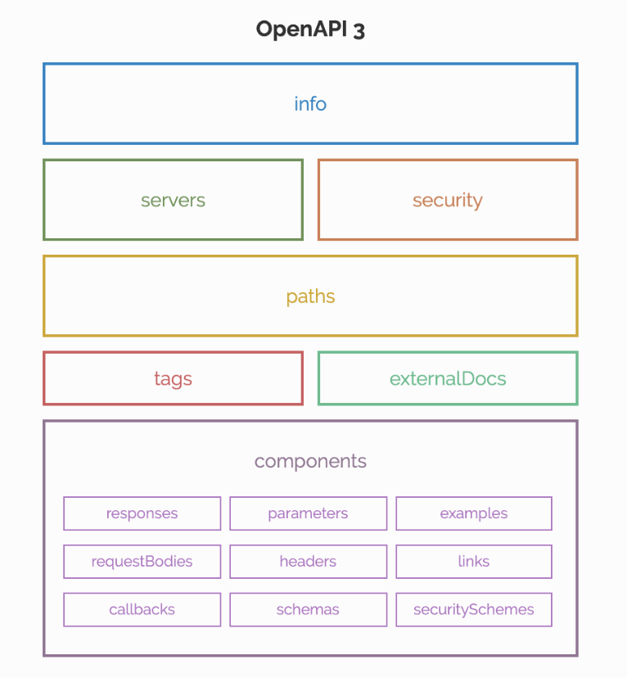
OpenAPI 3.0
REST services in YAML

Slide 17
Example: Get the cpuinfo
info:
title: cpuinfo
description: get cpuinfo as an example of using OpenAPI 3.0
license:
name: Apache 2.0
version: 0.0.1
servers:
- url: http://localhost:8080/cloudmesh

Slide 18
Path
paths:
/cpu:
get:
summary: Returns cpu information of the hosting server
operationId: cpu.get_processor_name
responses:
'200':
description: cpu info
content:
application/json:
schema:
$ref: "#/components/schemas/cpu"

Slide 19
Components
components:
schemas:
cpu:
type: "object"
required:
- "model"
properties:
model:
type: "string”
Excerpt From: Gregor von Laszewski. “Cloud Computing.”

Slide 20
The Code – its really simple
from flask import jsonify
import connexion
# Create the application instance
app = connexion.App(__name__, specification_dir="./")
# Read the yaml file to configure the endpoints
app.add_api("cpu.yaml")
# create a URL route in our application for "/"
@app.route("/")
def home():
msg = {"msg": "It's working!"}
return jsonify(msg)
if __name__ == "__main__":
app.run(port=8080, debug=True)
Excerpt From: Gregor von Laszewski. “Cloud Computing.”

Slide 21
Cloudmesh Arcitecture
Abstraction essential to Cloudmesh design
Abstractions at different levels and interaction points
IaaS
Container
HPC
PaaS
Virtual Cluster
Integration with Providers
IU OpenStack, NSF Chameleon cloud, NSF Comet, AWS, Azure, SLURM/XSEDE, …
Used by hundreds of users
Google

Slide 22
Deployment Abstractions
Possible interaction with different DevOps frameworks
Leveraging large DevOps community
Warning we found that there are many DevOps “templates” but not all of them are usable:
lack generality
do not work
too complex
not properly documented

Slide 23
Continuous Improvement vs. Continuous Deployment via DevOps
DevOps is integrated
Leads to improvement when not only targeting application but also deployment environment.

Slide 24
Simple Interface Usecase: Boot a vm on

Slide 25
Simple Interface Usecase: Boot & Provision

Slide 26
Cloudmesh VM Example
Gregor von Laszewski, laszewski@gmail.com

Slide 27
Cloudmesh Shell – Make Booting Simple
$ emacs cloudmesh.yaml
$ cms set cloud=NAME
$ cms vm boot
$ cms vm ssh
$ cms vm delete
Boot
Login
Management
cloudmesh.yaml
…

Slide 28
Cloudmesh Shell – Manage Hybrid Clouds
$ cms set cloud=aws
$ cms vm boot
$ cms set cloud=openstack
$ cms vm boot
$ cms set cloud=azure
$ cms vm boot
Boot Cloud B
Boot Cloud A
Boot Cloud C

Slide 29
Cloudmesh Hadoop Example (Improvement)
Gregor von Laszewski, laszewski@gmail.com

Slide 30
Cloudmesh Shell – Create a Hadoop Cluster
$ cms set cloud=openstack
$ cms cluster
- -name=hadoop_cluster
- -count=10
- -service=hadoop
$ cms cluster deploy
- -name=hadoop_cluster
Define cluster
Define hadoop Cluster
Set cloud
Deploy the cluster

Slide 31
More on Cloudmesh
Gregor von Laszewski, laszewski@gmail.com

Slide 32
Cloudmesh
Cloudmesh is a project to easily manage virtual machines in a multicloud environment.
With Cloudmesh, it is possible to use Azure, Amazon Web Services, and other clouds such as OpenStack.
Cloudmesh also provides an interface to manage thousands of jobs on High Performance Computing (HPC) clusters, such as XSEDE’s comet supercomputer

Slide 33
Hybrid Cloud
Cloud Computing has many different facets and offers the ability to leverage IaaS, PaaS and SaaS on resource and services offered by others.
However, some application require due to privacy concerns, cost, or functionality the use private clouds or a mix hosted at different providers.
This leads us to the term “hybrid cloud”.
Definition:
A hybrid cloud is a computing environment which uses a mix of on-premises, private cloud and third-party, public cloud services with orchestration between the two platforms. It can offer bare metal, traditional HPC as a service, or virtualized resources offered in a cloud.
von Laszewski, Gregor

Slide 34
Multicloud
A Multicloud is a cloud that uses services from more than one cloud provider.
Cloud providers can offer services in public or private clouds, thus a multicloud could be a hybrid cloud, but does not have to be.

Slide 35
Impact of Multiclouds
Capacity Federation
Technology Integration
Technology Federation
Technology Robustness
We explain the terms next

Slide 36
Multicloud: Motivations
Capacity Federation
Technology Integration
(use different technology in multiple clouds)
SaaS
Azure
AWS
Multicloud
PaaS Cloud, Cluster
Future Systems
Multicloud
IaaS
Chameleon Cloud
….
BareMetal
aaS
Oracle Cloud
Google
… aaS

Slide 37
Multicloud: Motivations
Technology Robustness
Technology Federation (use same technology in multiple clouds)
Azure
AWS
Azure
AWS
Multicloud
Multicloud
HP
Eucalyputus
Open Stack
Google

Slide 38
Some Requirements Multiclouds
Motivation
Requirements
Price Transparency
Availability
Fault Tolerance
Capacity
Resource Limitations
Features within the cloud
Hybrid Clouds
Independence:
Avoid vender lock in
Accessible
Ease of use
Integrated
Flexible
Support multiple user community types
Enduser
Administrator
Developers

Slide 39
Need for managed cloud services?
Hybrid cloud “brokerage” - managing services you use on clouds.
Centralized visibility and control.
Optimising cost/performance and staying “compliant”.
Hybrid Clouds
On Premise - eg: OpenStack
Public Clouds - eg: AWS, Azure, Google, IBM
Credential management & Access control across multiple clouds.
Policy based cataloguing & orchestration.

Slide 40
Virtual Directory
A virtual directory is a mashup of files that can be stored on multiple IaaS or PaaS
A file is identified by a filename and a to the user unique directory name
The file however is not a real file, but has a location in the cloud
A file could be cached locally and before accessed the file will be compared against the cloud location and it is fetched.

Slide 41
Virtual Directory
directory:
name:
parent:
files:
- file1
- filen
file:
name: file1
endpoint:
Aws
GUI to easily visualize
CLI command line tool to easily script
REST service
Provide ability to expose the functionality in a protable fashion
Python APIs
Provide functionality for the implementation
Used to implement the REST Service
Backend Database is MongoDB
Scheduler
Integration of a scheduler to automate file placement on Cloud Services
A Policy defines the scheduling if files to Resources
Azure
Google Drive
file:
name: filen
endpoint:
XSEDE
Box
Inputs
iCloud
REST
Service
Aws
VirtualBox
File
Put
Azure
Scheduler
Google Drive
XSEDE
Box
Policy
iCloud

Slide 42
Virtual Cluster
cluster:
name:
parent:
node:
- node1
- noden
node:
name: node1
endpoint:
Aws
GUI to easily visualize
CLI command line tool to easily script
REST service
Provide ability to expose the functionality in a portable fashion
Python APIs
Provide functionality for the implementation
Used to implement the REST Service
Backend Database is MongoDB
Scheduler
Integration of a scheduler to automate compute placement on Cloud Services
A Policy defines the scheduling if files to Resources
Azure
Google Compute
node:
name: noden
endpoint:
XSEDE
VirtualBox
Kubernetes
Inputs
Aws
Execution
Put
REST
Service
Azure
Scheduler
Google Drive
XSEDE
Box
Policy
iCloud

Slide 43
Additional Feature Summary
Abstractions
Compute, Task, Function, Data
Access
Command Shell & Line
API
REST via OpenAPI -> clients to many programming languages
Client Portal
Compute
VMs
Container,
Queuing Systems/Batch
Choreography
Groups, Workflows, PaaS
Provider Interfaces
OpenStack
Chameleon Cloud
Jetstream
XSEDE
HPC
Comet Virtualization (Infiniband, integrated into SLURM)
Azure
AWS
Google
Oracle
OpenStack

Slide 44
Integrated Access Interfaces
Integrated State Management!
E.g. you start a VM in the commandline, you can see it in the Web interface
Communication through a MongoDB database
Cloudmesh
Database
Cloudmesh API
Cloudmesh
Shell
Command Line
Cloudmesh
Client
Portal
Cloudmesh REST Services

Slide 45
Basic Usage
Command | Description
cms help | help
cms man | manual pages
cms script.cm | execute cm commands in script
cat script.cm | cms
cms set a =\”sentence with spaces\” | Use masked quotes

Slide 46
Cloud Commands
Cloud¶
Command | Description
cms image list | list images
cms flavor list | list flavors
cms vm list | list vms
cms vm boot | boot vm
cms vm boot –cloud=aws | boot vm on cloud aws
cms set cloud=aws | set default cloud to aws
(cms select image) | select interactively the default image (not implemented yet).
(cm select flavor) | select interactively the default flavor (not implemented yet).
(cm select cloud) | select interactively the default cloud (not implemented yet).

Slide 47
Cloud Refresh Commands
Cloud¶
Command | Description
cms image list --refresh | list images
cms flavor list --refresh | list flavors
cms vm list --refresh | list vms

Slide 48
Shell Commands
Command | Description
cms color on | sets the shell color
cms color off | switches off the color
cms refresh on | automatic refresh from the clouds
cms refresh off | data is only read from the database. Useful for managing thousands of VMs or limit your access to the cloud.
cms set a=xyx | declares a variable
cms set username=cloudmesh.profile.username | reads the variable from the cloudmesh.yaml file
cms echo $time | gets the time and store it in the variable time

Slide 49
Shell Commands
Command | Description
cms config set profile.username=gregor | Sets the variable in the yaml file cloudmesh. Will be prepended
cms config set aws.OS_TEST=test | Sest the OS_TEST in the cloud aws under credentials
cms config set cloudmesh.cloud.aws.credentials.OS_TEST=test | Same as previous command
cms config cat less | Shows the config file and masks the passwords
cms config get cloudmesh.profile | Prints the profile

Slide 50
HPC Commands (version 2/3, not yet available in 4)
Command | Description
cms help | Help
cm hpc queue <batch> | info about the queue <batch>
cm hpc info | information about the queues on the HPC resource
cm hpc run uname -a | runs the command uname
cm hpc run list | prints the ids of previously run jobs
cm hpc run list | prints the ids of previously run jobs
cm hpc run list 11 | prints the information regarding the job with the id 11

Slide 51
Cloudmesh Shell –Simple install for developer
$ mkdir cm
$ cd cm
$ pip install cloudmesh-installer
$ cloudmesh-installer git clone cloud
$ cloudmesh-installer install cloud -e
Prepare cm
Pip install installer
clone
install
(Activate venv)
…

Slide 52
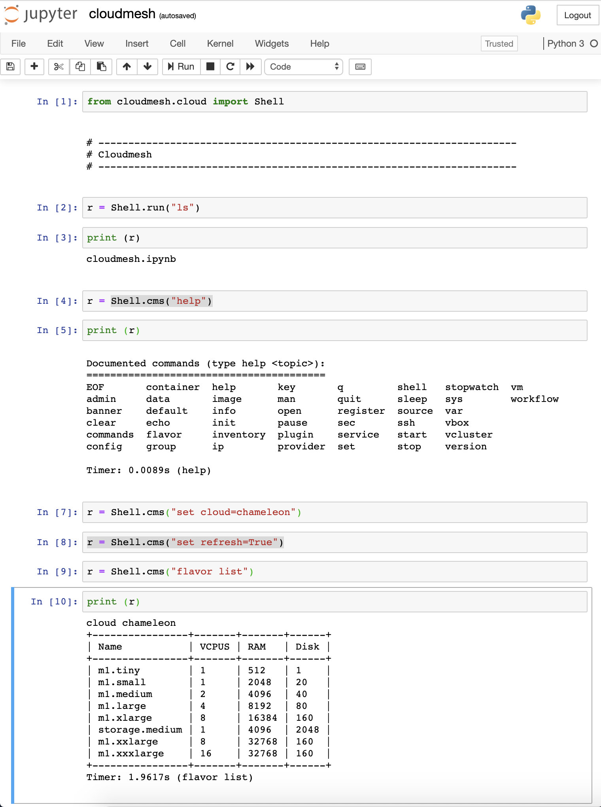
Jupyter Integration
Cloudmesh can easily be integrated into jupyter
The command shell is readily accessible via an API call

Slide 53
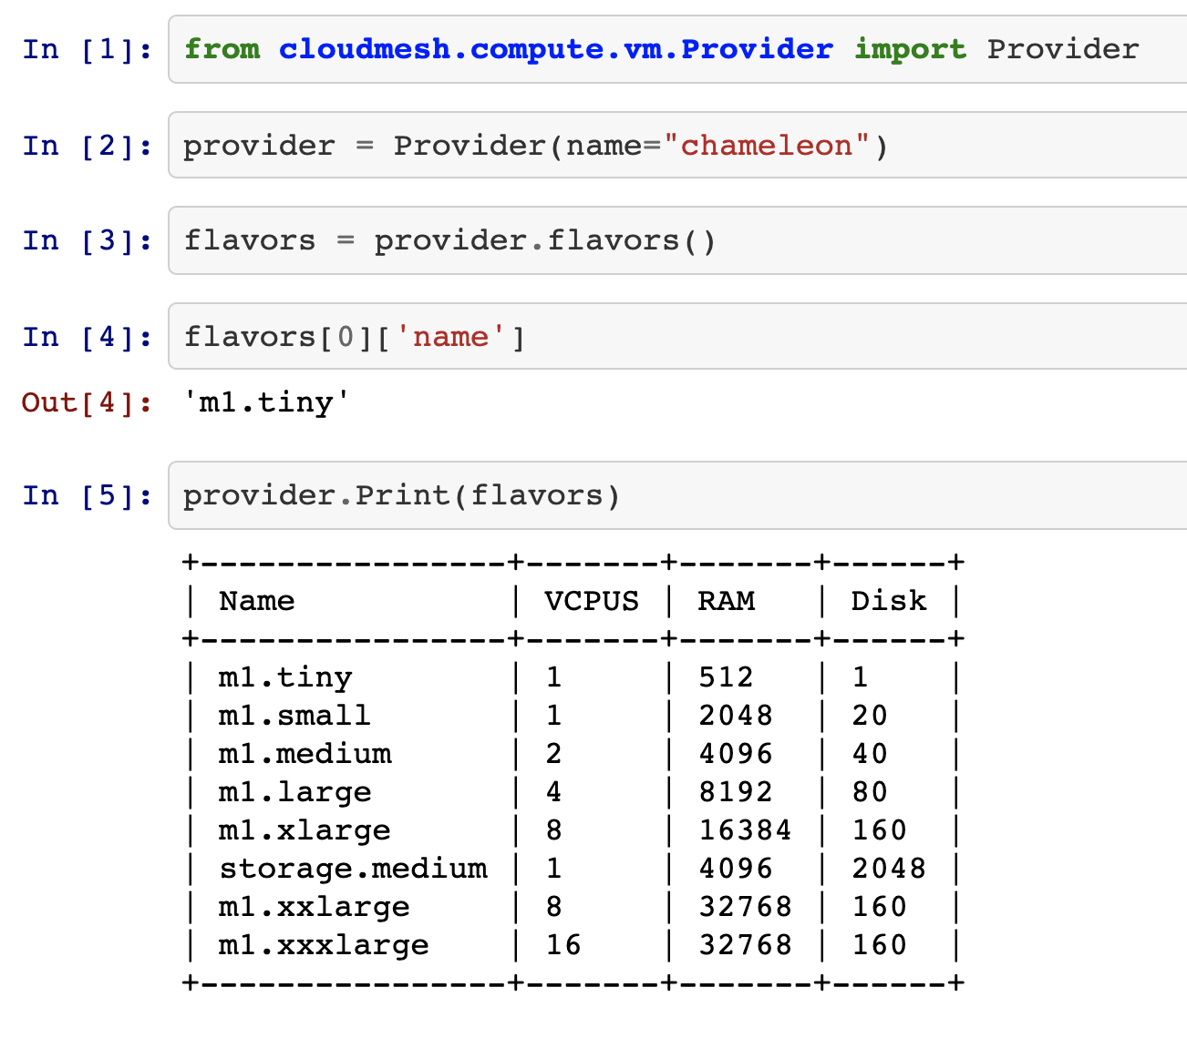
Simple API
Super simple API that allows integration with jupyter notebooks very easily

Slide 54
AI Service k-means
openapi: 3.0.2 info: title: Sample Pet Store App description: This is a sample server for a pet store. termsOfService: http://example.com/terms/ contact: name: API Support url: http://www.example.com/support email: support@example.com license: name: Apache 2.0 url: https://www.apache.org/licenses/LICENSE-2.0.html version: 0.0.1 servers: - url: http://localhost:8080/kmeans

Slide 55
Path
/upload: post: summary: upload input operationId: kmeans.upload_file requestBody: content: multipart/form-data: schema: type: object properties: file: type: string format: binary
responses: '200': description: upload ok content: application/json: schema: type: object properties: job_id: type: integer filename: type: string
additionalProperties: {}

Slide 56
Fit
/fit: post: summary: fit a kmeans model operationId: kmeans.kmeans_fit requestBody: content: application/json: schema: type: object properties: job_id: type: integer model_params: type: object additionalProperties: {}
responses: '200': description: labels of the provided points content: text/csv: schema: type: string format: binary

Slide 57
Fit
/predict: post: summary: predict using a model operationId: kmeans.kmeans_predict requestBody: content: multipart/form-data: schema: type: object properties: job_id: type: string file: type: string format: binary
responses: '200': description: successful completion content: text/csv: schema: type: string format: binary

Slide 58
How to find information: GitHub
Cloudmesh is distributed in multiple repositories
https://github.com/cloudmesh
Manual
https://github.com/cloudmesh/cloudmesh-manual
https://cloudmesh.github.io/cloudmesh-manual/
Cloudmesh Installer
https://github.com/cloudmesh/cloudmesh-installer
The Installer will install cloudmesh
Common: useful libraries to interact with the operating system
https://github.com/cloudmesh/cloudmesh-common
Cmd5: management of the cloudmesh namespace and the command shell
http://github.com/cloudmesh/cloudmesh-cmd5
sys: extending cloudmesh cmd5 with self defined commands in the cloudmesh namespace
https://github.com/cloudmesh/cloudmesh-sys
Configuration: management of the cloudmesh.yaml file
https://github.com/cloudmesh/cloudmesh-configuration
Cloud: extensions to interact with clouds while using compute resources such as virtual machines
https://github.com/cloudmesh/cloudmesh-cloud
Cloud: extensions to interact with clouds while using compute resources such as virtual machines
https://github.com/cloudmesh/cloudmesh-storage
Nist: OpenAPI specifications
https://github.com/cloudmesh/cloudmesh-nist

Slide 59
Others
Prototype for using workflows based on python functions
https://github.com/cloudmesh/cloudmesh-flow
IU: Access to IU Romeo with GPUs
https://github.com/cloudmesh/cloudmesh-iu
Command to add to cloudmesh elastic map reduce
https://github.com/cloudmesh/cloudmesh-emr
Command to add Redshift
https://github.com/cloudmesh/cloudmesh-redshift

Slide 60
References
von Laszewski, Fox et al. Accessing Multiple Clouds with Cloudmesh
http://dsc.soic.indiana.edu/publications/big09fp-laszewskiAFG.pdf
Diaz, von Laszewski, Wang, Fox. Abstract Image Management and Universal Image Registration for Cloud and HPC Infrastructures.
http://dsc.soic.indiana.edu/publications/imagemanagement.pdf
von Laszewski, Fox. The FutureGrid Testbed for Big Data
https://www.springer.com/cda/content/document/cda_downloaddocument/9781493919048-c1.pdf?SGWID=0-0-45-1490679-p176905848

