Slide 1
Understanding Big Data Applications and Architectures
1st JTC 1 SGBD Meeting
SDSC San Diego March 19 2014
Geoffrey Fox
Judy Qiu
Shantenu Jha (Rutgers)
gcf@indiana.edu
http://www.infomall.org
School of Informatics and Computing
Digital Science Center
Indiana University Bloomington

Slide 2
51 Detailed Use Cases: Contributed July-September 2013 Covers goals, data features such as 3 V’s, software, hardware
26 Features for each use case
http://bigdatawg.nist.gov/usecases.php
https://bigdatacoursespring2014.appspot.com/course (Section 5)
Government Operation(4): National Archives and Records Administration, Census Bureau
Commercial(8): Finance in Cloud, Cloud Backup, Mendeley (Citations), Netflix, Web Search, Digital Materials, Cargo shipping (as in UPS)
Defense(3): Sensors, Image surveillance, Situation Assessment
Healthcare and Life Sciences(10): Medical records, Graph and Probabilistic analysis, Pathology, Bioimaging, Genomics, Epidemiology, People Activity models, Biodiversity
Deep Learning and Social Media(6): Driving Car, Geolocate images/cameras, Twitter, Crowd Sourcing, Network Science, NIST benchmark datasets
The Ecosystem for Research(4): Metadata, Collaboration, Language Translation, Light source experiments
Astronomy and Physics(5): Sky Surveys including comparison to simulation, Large Hadron Collider at CERN, Belle Accelerator II in Japan
Earth, Environmental and Polar Science(10): Radar Scattering in Atmosphere, Earthquake, Ocean, Earth Observation, Ice sheet Radar scattering, Earth radar mapping, Climate simulation datasets, Atmospheric turbulence identification, Subsurface Biogeochemistry (microbes to watersheds), AmeriFlux and FLUXNET gas sensors
Energy(1): Smart grid

Slide 3
Would like to capture “essence of these use cases”
“small” kernels, mini-apps
Or Classify applications into patterns
Do it from HPC background not database view point
i.e. focus on cases with detailed analytics

Slide 4
What are “mini-Applications”
Use for benchmarks of computers and software (is my parallel compiler any good?)
In parallel computing, this is well established
Linpack for measuring performance to rank machines in Top500 (changing?)
NAS Parallel Benchmarks (originally a pencil and paper specification to allow optimal implementations; then MPI library)
Other specialized Benchmark sets keep changing and used to guide procurements
Last 2 NSF hardware solicitations had NO preset benchmarks – perhaps as no agreement on key applications for clouds and data intensive applications
Berkeley dwarfs capture different structures that any approach to parallel computing must address
Templates used to capture parallel computing patterns
I’ll let experts comment on database benchmarks like TPC

Slide 5
HPC Benchmark Classics
Linpack or HPL: Parallel LU factorization for solution of linear equations
NPB version 1: Mainly classic HPC solver kernels
MG: Multigrid
CG: Conjugate Gradient
FT: Fast Fourier Transform
IS: Integer sort
EP: Embarrassingly Parallel
BT: Block Tridiagonal
SP: Scalar Pentadiagonal
LU: Lower-Upper symmetric Gauss Seidel

Slide 6
7 Original Berkeley Dwarfs (Colella)
Structured Grids (including locally structured grids, e.g. Adaptive Mesh Refinement)
Unstructured Grids
Fast Fourier Transform
Dense Linear Algebra
Sparse Linear Algebra
Particles
Monte Carlo
Note “vaguer” than NPB

Slide 7
13 Berkeley Dwarfs
Dense Linear Algebra
Sparse Linear Algebra
Spectral Methods
N-Body Methods
Structured Grids
Unstructured Grids
MapReduce
Combinational Logic
Graph Traversal
Dynamic Programming
Backtrack and Branch-and-Bound
Graphical Models
Finite State Machines
First 6 of these correspond to Colella’s original.
Monte Carlo dropped
N-body methods are a subset of Particle
Note a little inconsistent in that MapReduce is a programming model and spectral method is a numerical method
Need multiple facets!

Slide 8
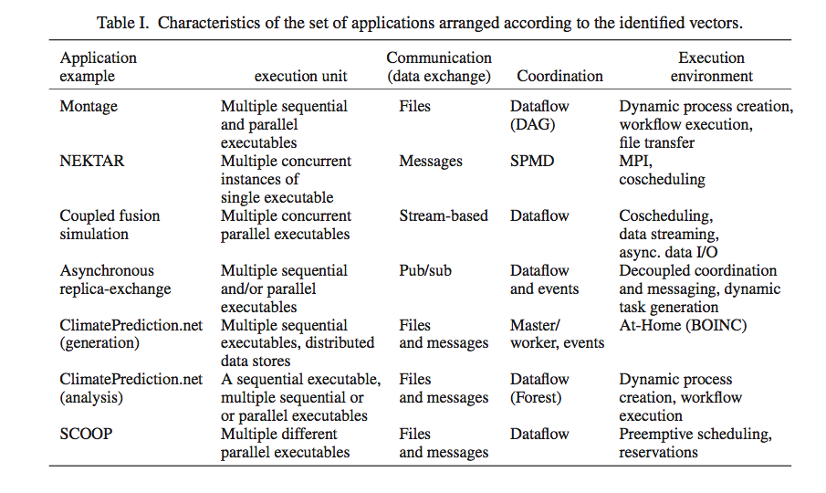
Distributed Computing MetaPatterns I Jha, Cole, Katz, Parashar, Rana, Weissman

Slide 9
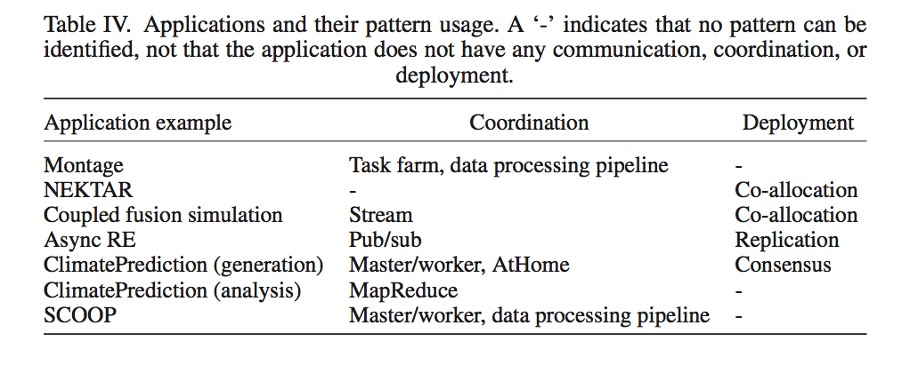
Distributed Computing MetaPatterns II Jha, Cole, Katz, Parashar, Rana, Weissman

Slide 10
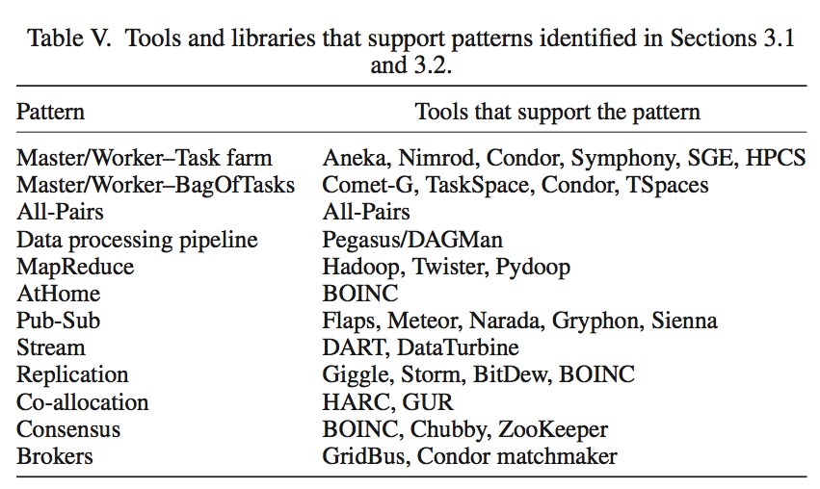
Distributed Computing MetaPatterns III Jha, Cole, Katz, Parashar, Rana, Weissman

Slide 11
Problem Architecture Facet of Ogres (Meta or MacroPattern)
Pleasingly Parallel – as in Blast, Protein docking, some (bio-)imagery
Local Analytics or Machine Learning – ML or filtering pleasingly parallel as in bio-imagery, radar images (really just pleasingly parallel but sophisticated local analytics)
Global Analytics or Machine Learning seen in LDA, Clustering etc. with parallel ML over nodes of system
SPMD (Single Program Multiple Data)
Bulk Synchronous Processing: well defined compute-communication phases
Fusion: Knowledge discovery often involves fusion of multiple methods.
Workflow (often used in fusion)
Notes:
Big dwarfs are Ogres
Implement Ogres in ABDS+

Slide 12
Core Analytics Facet of Ogres (microPattern)
Search/Query
Local Machine Learning – pleasingly parallel
Summarizing statistics
Recommender Systems (Collaborative Filtering)
Outlier Detection (iORCA)
Clustering (many methods),
LDA (Latent Dirichlet Allocation) or variants like PLSI (Probabilistic Latent Semantic Indexing),
SVM and Linear Classifiers (Bayes, Random Forests),
PageRank, (Find leading eigenvector of sparse matrix)
SVD (Singular Value Decomposition),
Learning Neural Networks (Deep Learning),
MDS (Multidimensional Scaling),
Graph Structure Algorithms (seen in search of RDF Triple stores),
Network Dynamics - Graph simulation Algorithms (epidemiology)
Global
Optimization
Matrix Algebra

Slide 13
Analytics Features Facet of Ogres
These core analytics/kernels can be classified by features like
(a) Flops per byte;
(b) Communication Interconnect requirements;
(c) Is application (graph) constant or dynamic
(d) Is communication BSP or Asynchronous
(e) Are algorithms Iterative or not?
(f) Are data points in metric or non-metric spaces

Slide 14
Application Class Facet of Ogres
(a) Search and query
(b) Maximum Likelihood,
(c) χ² minimizations,
(d) Expectation Maximization (often Steepest descent)
(e) Global Optimization (Variational Bayes)
(f) Agents, as in epidemiology (swarm approaches)
(g) GIS (Geographical Information Systems).

Slide 15
Data Source Facet of Ogres
(i) SQL,
(ii) NOSQL based,
(iii) Other Enterprise data systems (10 examples from Bob Marcus)
(iv) Set of Files (as managed in iRODS),
(v) Internet of Things,
(vi) Streaming and
(vii) HPC simulations.
Before data gets to compute system, there is often an initial data gathering phase which is characterized by a block size and timing. Block size varies from month (Remote Sensing, Seismic) to day (genomic) to seconds or lower (Real time control, streaming)
There are storage/compute system styles: Shared, Dedicated, Permanent, Transient
Other characteristics are need for permanent auxiliary/comparison datasets and these could be interdisciplinary implying nontrivial data movement/replication
Notes:
Big dwarfs are Ogres
Implement Ogres in ABDS+

Slide 16
Lessons / Insights
Ogres classify Big Data applications by multiple facets – each with several exemplars and features
Guide to breadth and depth of Big Data
Does your architecture/software support all the ogres?
Add database exemplars
In parallel computing, the simple analytic kernels dominate mindshare even though agreed limited
Section 5 of my class https://bigdatacoursespring2014.appspot.com/preview classifies 51 use cases with these facets

