Slide 1
HPC-ABDS: The Case for an Integrating Apache Big Data Stack with HPC
1st JTC 1 SGBD Meeting
SDSC San Diego March 19 2014
Judy Qiu
Shantenu Jha (Rutgers)
Geoffrey Fox
gcf@indiana.edu
http://www.infomall.org
School of Informatics and Computing
Digital Science Center
Indiana University Bloomington

Slide 2
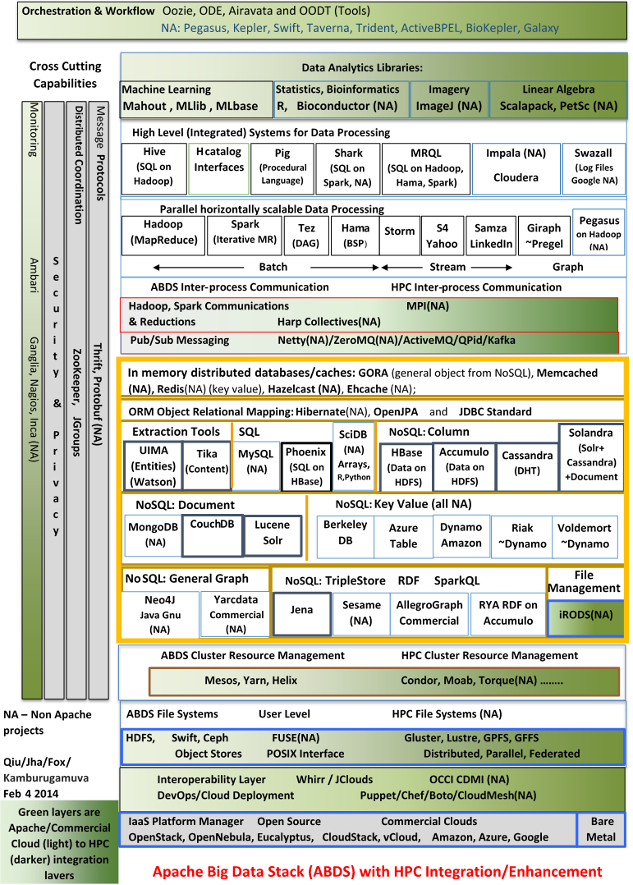
Enhanced
Apache Big Data Stack
ABDS
~120 Capabilities
>40 Apache
Green layers have strong HPC Integration opportunities
Goal
Functionality of ABDS
Performance of HPC

Slide 3
Broad Layers in HPC-ABDS
Workflow-Orchestration
Application and Analytics
High level Programming
Basic Programming model and runtime
  SPMD, Streaming, MapReduce, MPI
Inter process communication
  Collectives, point to point, publish-subscribe
In memory databases/caches
Object-relational mapping
SQL and NoSQL, File management
Data Transport
Cluster Resource Management (Yarn, Slurm, SGE)
File systems(HDFS, Lustre …)
DevOps (Puppet, Chef …)
IaaS Management from HPC to hypervisors (OpenStack)
Cross Cutting
  Message Protocols
  Distributed Coordination
  Security & Privacy
  Monitoring

Slide 6
Getting High Performance on Data Analytics (e.g. Mahout, R …)
On the systems side, we have two principles
  The Apache Big Data Stack with ~120 projects has important broad functionality with a vital large support organization
  HPC including MPI has striking success in delivering high performance with however a fragile sustainability model
There are key systems abstractions which are levels in HPC-ABDS software stack where Apache approach needs careful integration with HPC
  Resource management
  Storage
  Programming model -- horizontal scaling parallelism
  Collective and Point to Point communication
  Support of iteration
  Data interface (not just key-value)
In application areas, we define application abstractions to support
  Graphs/network
  Geospatial
  Images etc.

Slide 7
4 Forms of MapReduce
(a) Map Only
(b) Classic MapReduce
(c) Iterative MapReduce
(d) Loosely Synchronous
Input
Input
Iterations
Input
map
map
map
P_{ij}
reduce
reduce
Output
BLAST Analysis
Parametric sweep
Pleasingly Parallel
High Energy Physics (HEP) Histograms
Distributed search
Expectation maximization Clustering e.g. Kmeans
Linear Algebra, Page Rank
Classic MPI
PDE Solvers and particle dynamics
Domain of MapReduce and Iterative Extensions
Science Clouds
MPI
Giraph
MPI is Map followed by Point to Point or Collective Communication
– as in style c) plus d)

Slide 8

HPC-ABDS
Hourglass
HPC ABDS
System (Middleware)
120 Software Projects
System Abstractions/standards
Data format
Storage
HPC Yarn for Resource management
Horizontally scalable parallel programming model
Collective and Point to Point communication
Support of iteration
Application Abstractions/standards
Graphs, Networks, Images, Geospatial ….
High performance
Applications
SPIDAL (Scalable Parallel Interoperable Data Analytics Library) or High performance Mahout, R, Matlab …..

Slide 9
Integrating Yarn with HPC

Slide 10
We are sort of working on Use Cases with HPC-ABDS
Use Case 10 Internet of Things: Yarn, Storm, ActiveMQ
Use Case 19, 20 Genomics. Hadoop, Iterative MapReduce, MPI, Much better analytics than Mahout
Use Case 26 Deep Learning. High performance distributed GPU (optimized collectives) with Python front end (planned)
Variant of Use Case 26, 27 Image classification using Kmeans: Iterative MapReduce
Use Case 28 Twitter with optimized index for Hbase, Hadoop and Iterative MapReduce
Use Case 30 Network Science. MPI and Giraph for network structure and dynamics (planned)
Use Case 39 Particle Physics. Iterative MapReduce (wrote proposal)
Use Case 43 Radar Image Analysis. Hadoop for multiple individual images moving to Iterative MapReduce for global integration over “all” images
Use Case 44 Radar Images. Running on Amazon

Slide 11
Features of Harp Hadoop Plug in
Hadoop Plugin (on Hadoop 1.2.1 and Hadoop 2.2.0)
Hierarchical data abstraction on arrays, key-values and graphs for easy programming expressiveness.
Collective communication model to support various communication operations on the data abstractions.
Caching with buffer management for memory allocation required from computation and communication
BSP style parallelism
Fault tolerance with check-pointing

Slide 12
Architecture
MapReduce Applications
Map-Collective Applications
Application
MapReduce V2
Harp
Framework
YARN
Resource Manager

Slide 13
Performance on Madrid Cluster (8 nodes)
Increasing
Communication
Identical Computation
Note compute same in each case as product of centers times points identical

Slide 14
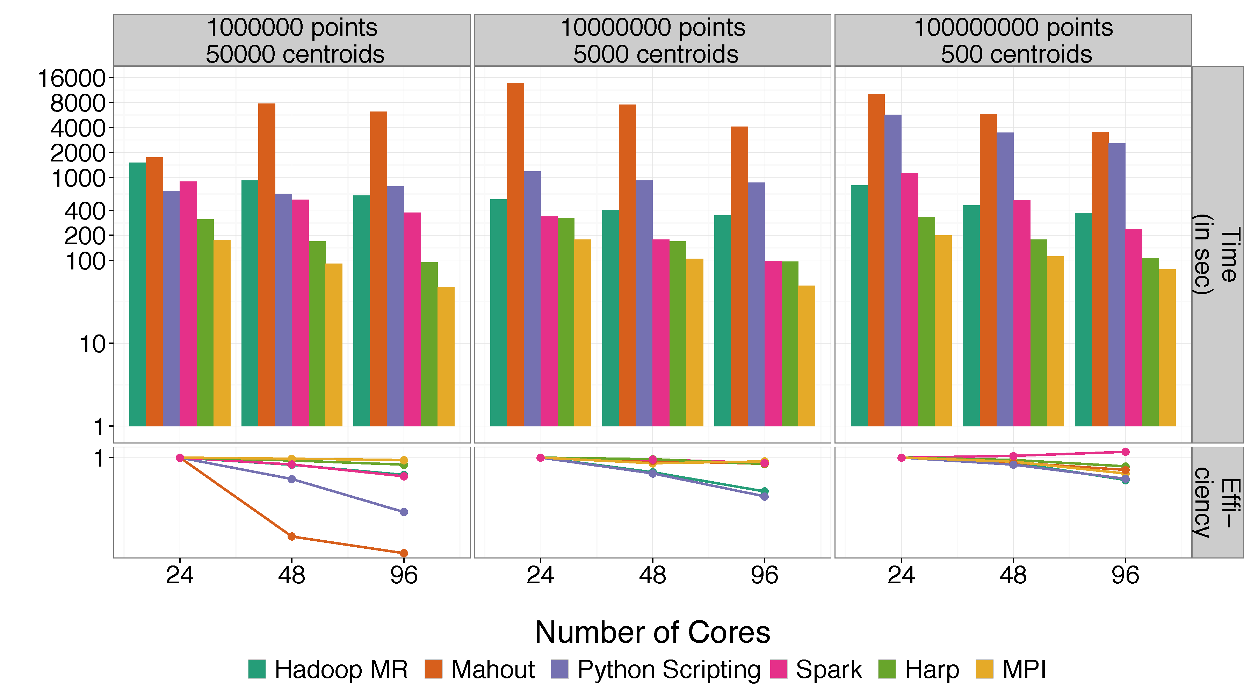
Mahout and Hadoop MR – Slow due to MapReduce
Python slow as Scripting
Spark Iterative MapReduce, non optimal communication
Harp Hadoop plug in with ~MPI collectives
MPI fastest as C not Java
Increasing
Communication
Identical Computation

Slide 15
Performance of MPI Kernel Operations
Pure Java as in FastMPJ slower than Java interfacing to C version of MPI

Slide 16
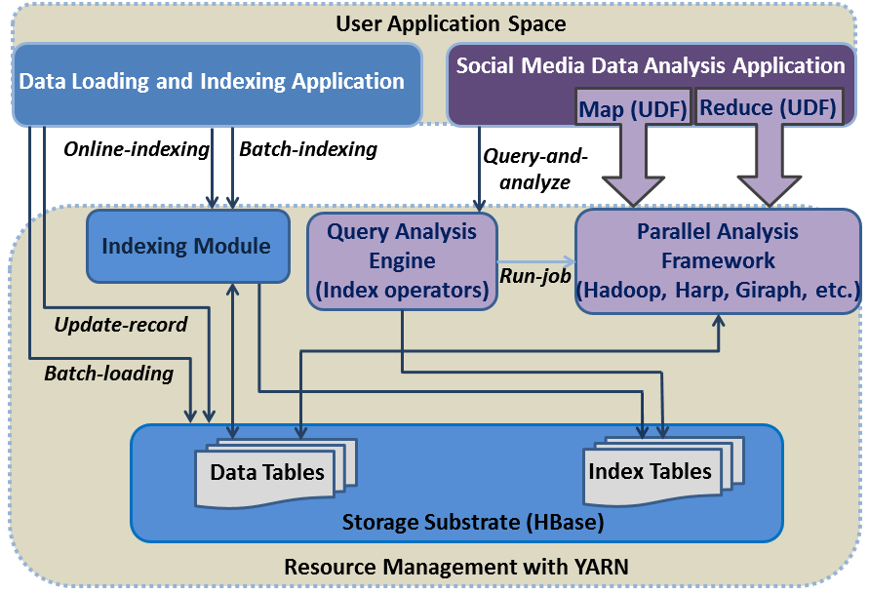
Use case 28: Truthy: Information diffusion research from Twitter Data
Building blocks:
  Yarn
  Parallel query evaluation using Hadoop MapReduce
  Related hashtag mining algorithm using Hadoop MapReduce:
  Meme daily frequency generation using MapReduce over index tables
  Parallel force-directed graph layout algorithm using Twister (Harp) iterative MapReduce

Slide 17
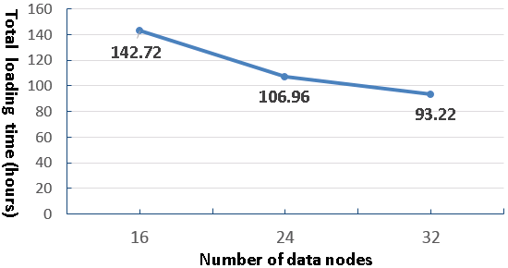
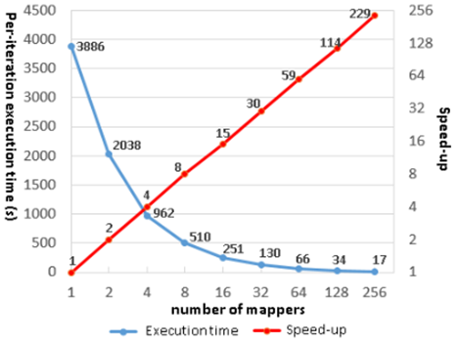
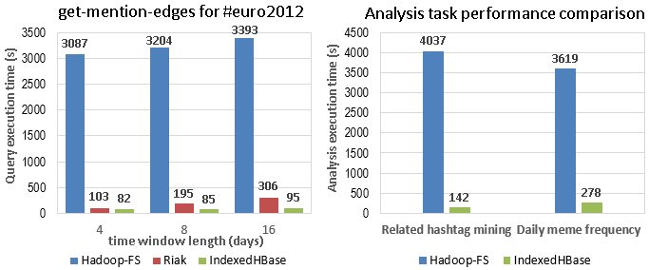
Use case 28: Truthy: Information diffusion research from Twitter Data
Two months’ data loading for varied cluster size
Scalability of iterative graph layout algorithm on Twister
Hadoop-FS not indexed

Slide 18
Pig Performance
Hadoop
Harp-Hadoop
Pig +HD1 (Hadoop)
Pig + Yarn

Slide 19
Lines of Code
 | Pig Kmeans | Hadoop Kmeans | Pig IndexedHBase meme-cooccur-count | IndexedHBase meme-cooccur-count
Java | ~345 | 780 | 152 | ~434
Pig | 10 | 0 | 10 | 0
Python / Bash | ~40 | 0 | 0 | 28
Total Lines | 395 | 780 | 162 | 462

Slide 20
DACIDR for Gene Analysis (Use Case 19,20)
  Deterministic Annealing Clustering and Interpolative Dimension Reduction Method (DACIDR)
  Use Hadoop for pleasingly parallel applications, and Twister (replacing by Yarn) for iterative MapReduce applications
  Sequences – Cluster → Centers
  Add Existing data and find Phylogenetic Tree
Pairwise Clustering
All-Pair Sequence Alignment
Streaming
Visualization
Multidimensional Scaling
Simplified Flow Chart of DACIDR

Slide 21
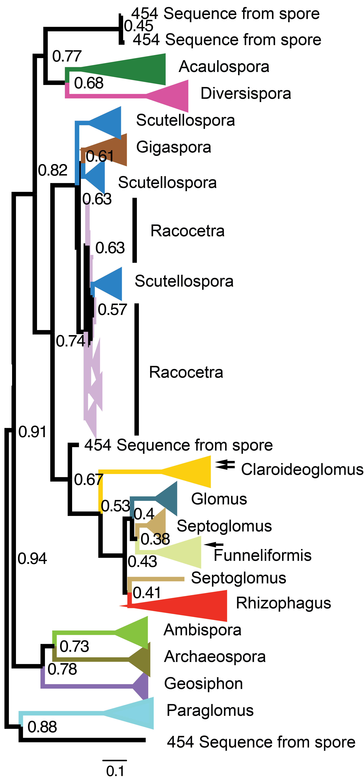
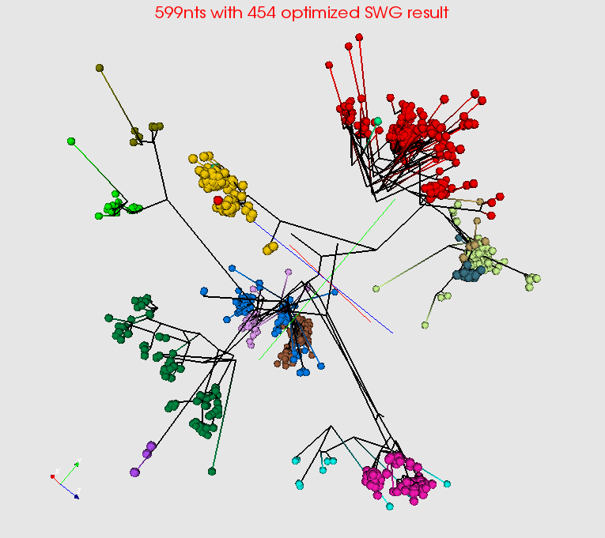
Summarize a million Fungi Sequences
Spherical Phylogram Visualization
Spherical Phylogram from new MDS method visualized in PlotViz
RAxML result visualized in FigTree.

Slide 22
Lessons / Insights
Integrate (don’t compete) HPC with “Commodity Big data” (Google to Amazon to Enterprise data Analytics)
  i.e. improve Mahout; don’t compete with it
  Use Hadoop plug-ins rather than replacing Hadoop
  Enhanced Apache Big Data Stack HPC-ABDS has 120 members – please improve!
HPC-ABDS+ Integration areas include
  file systems,
  cluster resource management,
  file and object data management,
  inter process and thread communication,
  analytics libraries,
  Workflow
  monitoring

