Slide 1
Big Data and Clouds: Challenges and Opportunities
NIST January 15 2013
Geoffrey Fox
gcf@indiana.edu
http://www.infomall.org http://www.futuregrid.org
School of Informatics and Computing
Digital Science Center
Indiana University Bloomington

Slide 2
Charge to Presenters
Discuss opportunities and challenges presented by the intersection of cloud and big data.
For example, on the opportunity side we have been thinking about the ability of cloud to make big data approaches feasible and cost-effective for small and medium enterprises and for the combination to enable new, data-as-a-service business models.
On the challenge side, we have been thinking about how “bring-the-computation-to-the-data-rather-than-the-data-to-the-computation” approaches could work in cloud environments and what quality metrics and measurement methods could work across heterogeneous data types of uncertain provenance, including methods for quality discovery.
These are just examples and we are very interested in hearing your take on the intersection of cloud and big data.

Slide 3
Some Topics
Curricula
Consensus on Architecture and value of clouds
High Performance Library
FutureGrid

Slide 4
Education and Training
Microsoft says there will be 14 million cloud jobs around the world by 2015
McKinsey says that there will up to 190,000 nerds and 1.5 million extra managers needed in Data Science by 2018 in USA
Many more jobs than simulation (third paradigm) where computational science not very successful as curriculum
Need curricula to educate people to use/design Clouds running Data Analytics processing Big Data to solve problems in X-Informatics (X= Bio…LifeStyle…Policy…Wealth)
Cover Data curation/management, Analytics (algorithms), run-time (MapReduce, Workflow, NOSQL), Applications
Not many courses aimed at any one aspect of this; let alone everything and their integration
Look at Massive Open Online Courses (MOOCs)

Slide 5
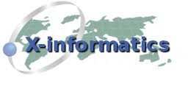
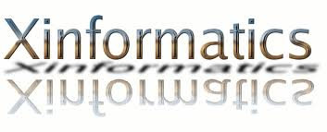
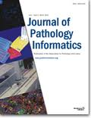
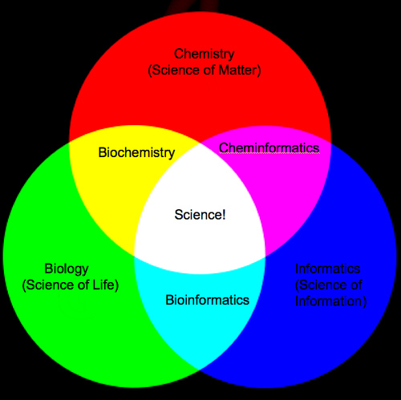
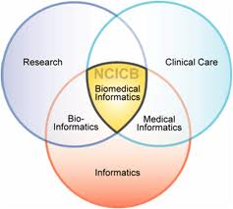
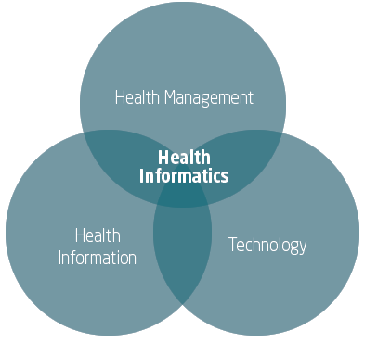
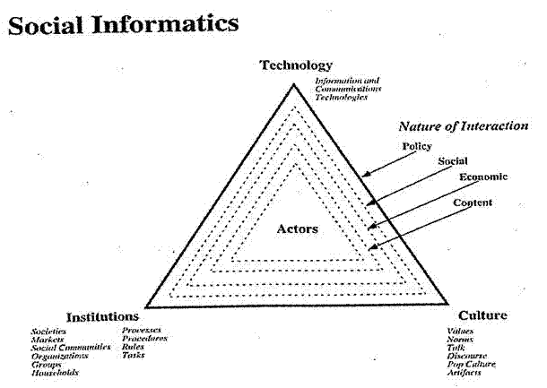
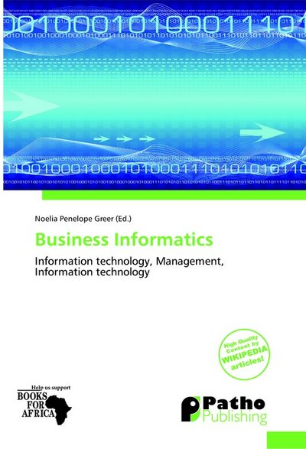

Slide 6
Clouds for Scientific Data Analysis
There has been plenty of trials and several successes from particle physics (LHC) data analysis to genome sequencing
MapReduce/NOSQL with Iterative extensions good for data intensive problems which have very different communication requirements from large scale simulations
Large collective communication v. smallish local messages
However no agreement on good data architecture or even requirements for this either in cloud or on conventional HPC style systems
No agreement on value of commercial clouds as cost effective solution
Need to generate a consensus on data architectures as exists for simulations
Exascale discussion builds on agreed principles

Slide 7
Data Analytics Futures?
Better algorithms contribute as much as better hardware in HPC
PETSc and ScaLAPACK and similar libraries very important in supporting parallel simulations
Need equivalent Data Analytics libraries
Include datamining (Clustering, SVM, HMM, Bayesian Nets …), image processing, information retrieval including hidden factor analysis (LDA), global inference, dimension reduction
Many libraries/toolkits (R, Matlab) and web sites (BLAST) but typically not aimed at scalable high performance algorithms
Should support clouds and HPC; MPI and MapReduce
Iterative MapReduce an interesting runtime; Hadoop has many limitations
Need a coordinated Academic Business Government Collaboration to build robust algorithms that scale well
Propose to build community to define & implement SPIDAL or Scalable Parallel Interoperable Data Analytics Library

Slide 8
FutureGrid offers
Computing Testbed as a Service
FutureGrid Uses
Testbed-aaS Tools
Provisioning
Image Management
IaaS Interoperability
NaaS, IaaS tools
Expt management
Dynamic IaaS NaaS
Devops
CS Research Use e.g. test new compiler or storage model
Class Usages e.g. run GPU & multicore
Applications
Software
(Application
Or Usage) SaaS
Cloud e.g. MapReduce
HPC e.g. PETSc, SAGA
Computer Science e.g. Compiler tools, Sensor nets, Monitors
FutureGrid Usages
Computer Science
Applications and understanding Science Clouds
Technology Evaluation including XSEDE testing
Education & Training
Platform PaaS
Infra
structure
IaaS
Software Defined Computing (virtual Clusters)
Hypervisor, Bare Metal
Operating System
Network
NaaS
Software Defined Networks
OpenFlow GENI

Slide 9
FutureGrid key Concepts
FutureGrid is an international testbed modeled on Grid5000
Supporting international Computer Science and Computational Science research in cloud, grid and parallel computing (HPC)
The FutureGrid testbed provides to its users:
A flexible development and testing platform for middleware and application users looking at interoperability, functionality, performance or evaluation
FutureGrid is user-customizable, accessed interactively and supports Grid, Cloud and HPC software with and without VM’s
A rich education and teaching platform for classes
Offers OpenStack, Eucalyptus, Nimbus, OpenNebula, HPC (MPI) on same hardware moving to software defined systems; classic HPC and Cloud storage

Slide 10
4 Use Types for FutureGrid TestbedaaS
285 approved projects (1500 users) January 13 2013
USA(80%), China, India, Pakistan, lots of European countries
Industry, Government, Academia
Training Education and Outreach (14.7%)
Semester and short events; interesting outreach to HBCU
Computer science and Middleware (56%)
Core CS and Cyberinfrastructure; Interoperability (3.3%) for Grids and Clouds; Open Grid Forum OGF Standards
Computer Systems Evaluation (8.8%)
XSEDE (TIS, TAS), OSG, EGI; Campuses
New Domain Science applications (20.5%)
Life science highlighted (10.6%), Non Life Science (9.9%)
Will emphasize Data Science and more experimentation by Government and Industry; integration with GENI; Standards testbeds

