Slide 1
Cloudmesh Microservices for Making Analytics as Services
Gregor von Laszewski
laszewski@gmail.com
Disclaimer, sound has not been updated on all slides yet

Slide 2
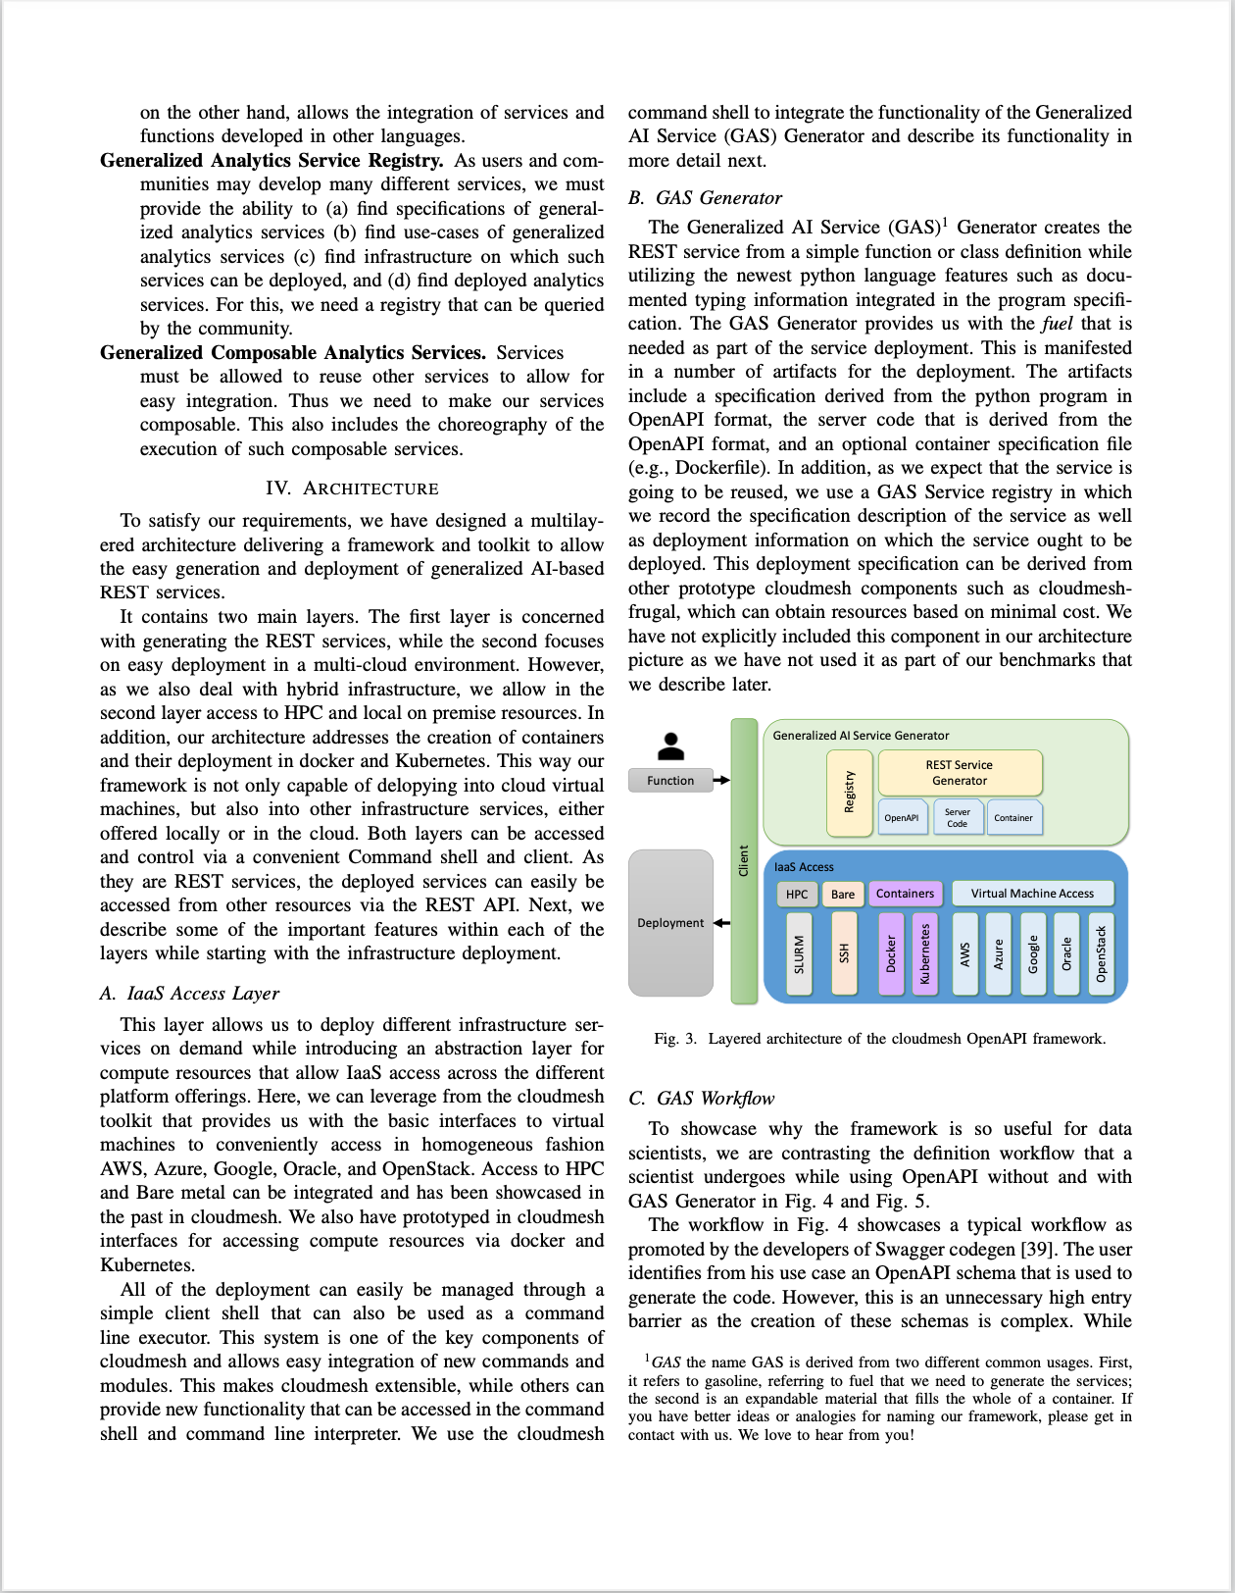
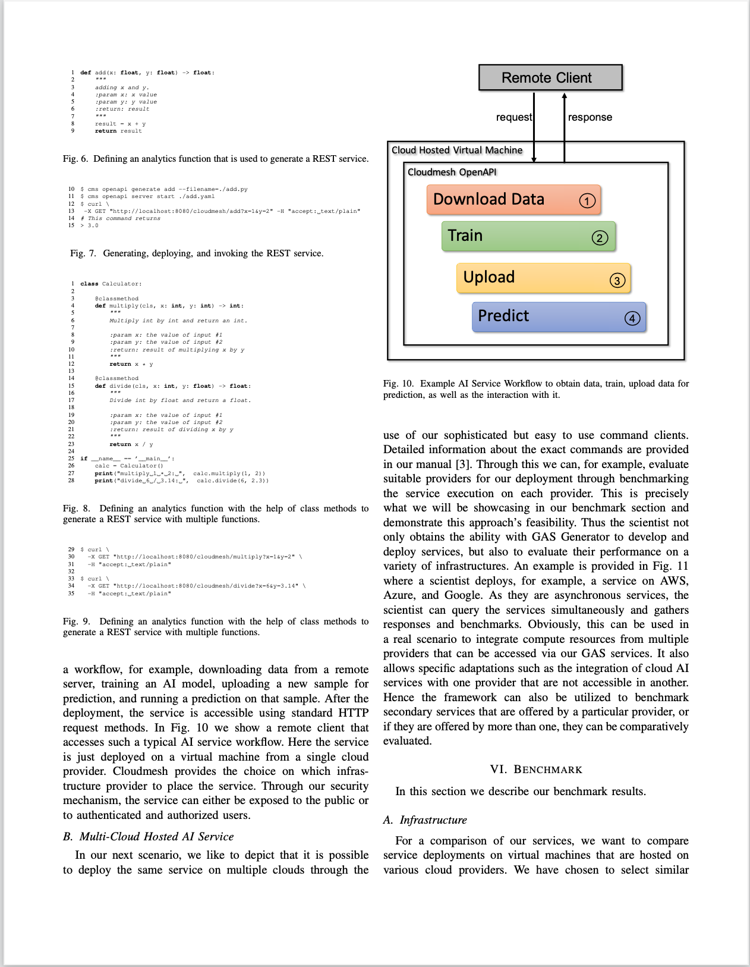
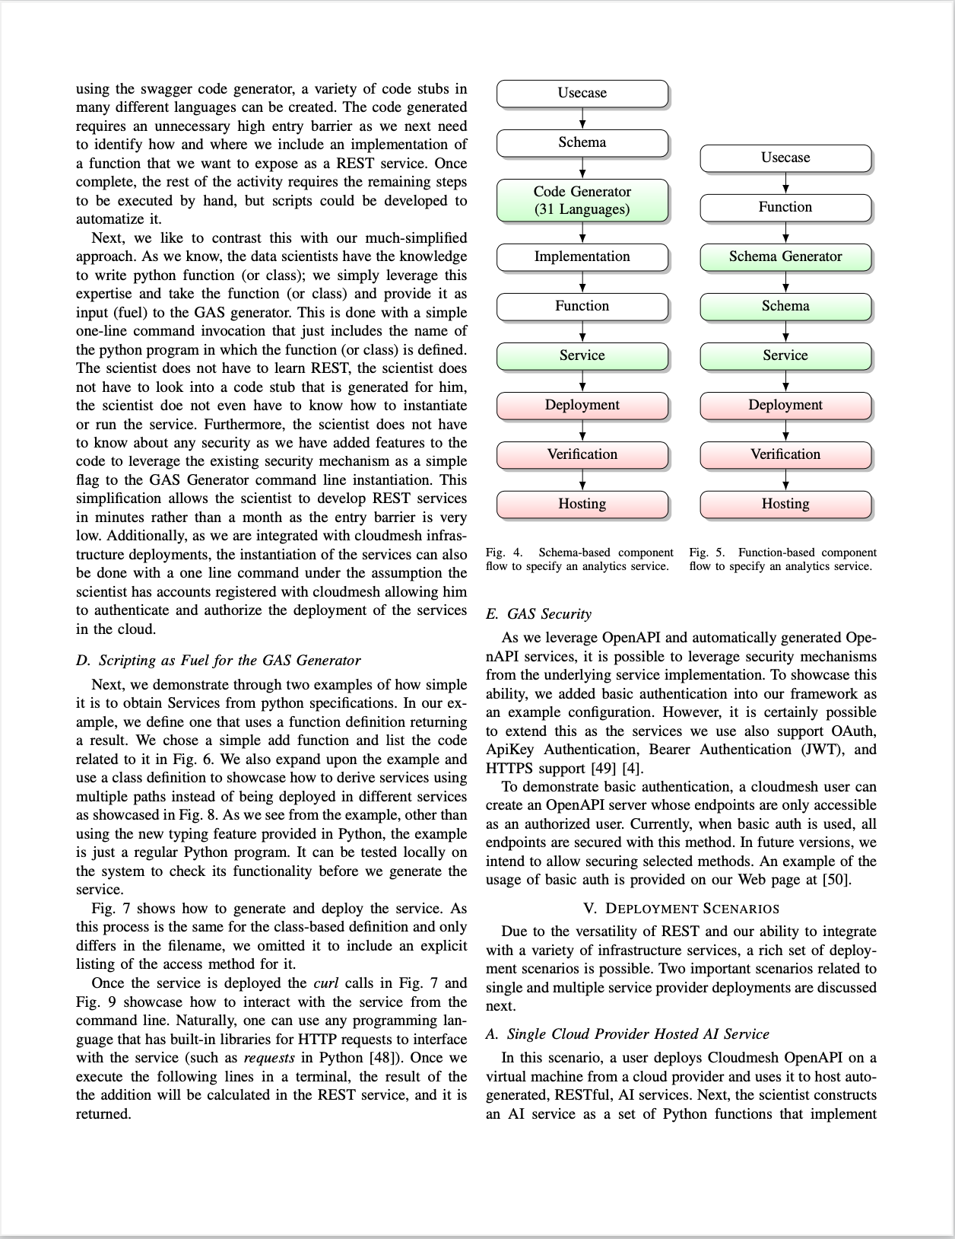
Newest Article
https://github.com/laszewski/laszewski.github.io/raw/master/papers/vonLaszewski-openapi.pdf

Slide 3
BigData Analysis on Multicloud: Motivations
Capacity Federation
Technology Integration
SaaS
Analytics X
AWS
PaaS Cloud, Cluster
NLP
Azure
Multicloud
Future Systems
IaaS
Time Series
Multicloud
Chameleon Cloud
Other
BareMetal
aaS
….
Google
Oracle
HPC
… aaS
HPCaaS

Slide 4
Big Data Analysis on Multicloud: Motivations
Service Robustness
Technology Federation
Compute Services
Containers
Virtual Machines
HPC
Azure
AWS
Multicloud
Multicloud
Azure
AWS
HP
Eucalyputus
Open Stack
Oracle
Google

Slide 5
Some Requirements
Motivation
Requirements
Price Transparency
Availability
Fault Tolerance
Capacity
Resource Limitations
Features within the cloud
Hybrid Clouds
Independence:
Avoid vender lock in
Accessible
Ease of use
Integrated
Flexible
Support multiple user community types
Enduser
Administrator
Developers

Slide 6
Goals: Cloudmesh
Goal develop a mashup of cloud services to build a service mesh for analysis
Functionality
IaaS Mesh
Compute – VMs
Aws, Azure, OpenStack, Google, Oracle, …
Containers (Docker, Kubernetes)
local / SSH
SLURM
Create a virtual cluster from them
Data - Aws, Azure, OpenStack, Google, Box, (github), (iCloud),
Create a virtual directory that can store files as mashup everywhere
Service Generator
Take Python function and deliver OpenAPI spec and service automatically
Backend
Deliver functionality them through a Python API
Deliver functionality them through Commandline and a Shell
Deliver REST Services through OpenAPI
This allows other language interfaces to be delivered
Virtual Cluster
Virtual Directory
REST Service + OpenAPI
Easy Access

Slide 7
Cloudmesh Layered Architecture View
Makes use of advanced cyber infrastructure and platforms
Has deployment features
Exposes functionality through
API
CLI
REST
(Client Portal)
Integration of AI as a composable items (functions and messaging between them)
Simple use and deploy from the commandline
cms cloud=AWS
cms vm start
Easy expandable
cms sys command generate NAME
generates a command with name

Slide 8
Cloudmesh Virtual Directory
directory:
name:
parent:
files:
- file1
- filen
file:
name: file1
endpoint:
Aws
Azure
GUI to easily visualize
CLI command line tool to easily script
REST service
Provide ability to expose the functionality in a portable fashion
Python APIs
Provide functionality for the implementation
Used to implement the REST Service
Backend Database is MongoDB
Scheduler
Integration of a scheduler to automate file placement on Cloud Services
A Policy defines the scheduling if files to Resources
Google Drive
file:
name: filen
endpoint:
XSEDE
Box
iCloud
Inputs
Aws
VirtualBox
File
Put
Azure
REST
Service
Scheduler
Google Drive
XSEDE
Box
Policy
iCloud

Slide 9
Cloudmesh Virtual Cluster
cluster:
name:
parent:
node:
- node1
- noden
node:
name: node1
endpoint:
Aws
Azure
GUI to easily visualize
CLI command line tool to easily script
REST service
Provide ability to expose the functionality in a portable fashion
Python APIs
Provide functionality for the implementation
Used to implement the REST Service
Backend Database is MongoDB
Scheduler
Integration of a scheduler to automate compute placement on Cloud Services
A Policy defines the scheduling if files to Resources
Google Compute
node:
name: noden
endpoint:
XSEDE
VirtualBox
Kubernetes
Inputs
Aws
Execution
Put
Azure
REST
Service
Scheduler
Google Drive
XSEDE
Box
Policy
iCloud

Slide 10
Cloudmesh Shell – Super Simple to Boot VM
$ cms set cloud=NAME
$ cms vm boot
$ cms vm ssh
$ cms vm delete
Prepare defaults
Boot
Login
Management
cloudmesh.yaml
…

Slide 11
Cloudmesh Shell – Simple to Manage Hybrid Clouds
$ cms set cloud=aws
$ cms vm boot
$ cms set cloud=chameleon
$ cms vm boot
$ cms set cloud=azure
$ cms vm boot
Boot Cloud B
Boot Cloud A
Boot Cloud C

Slide 12
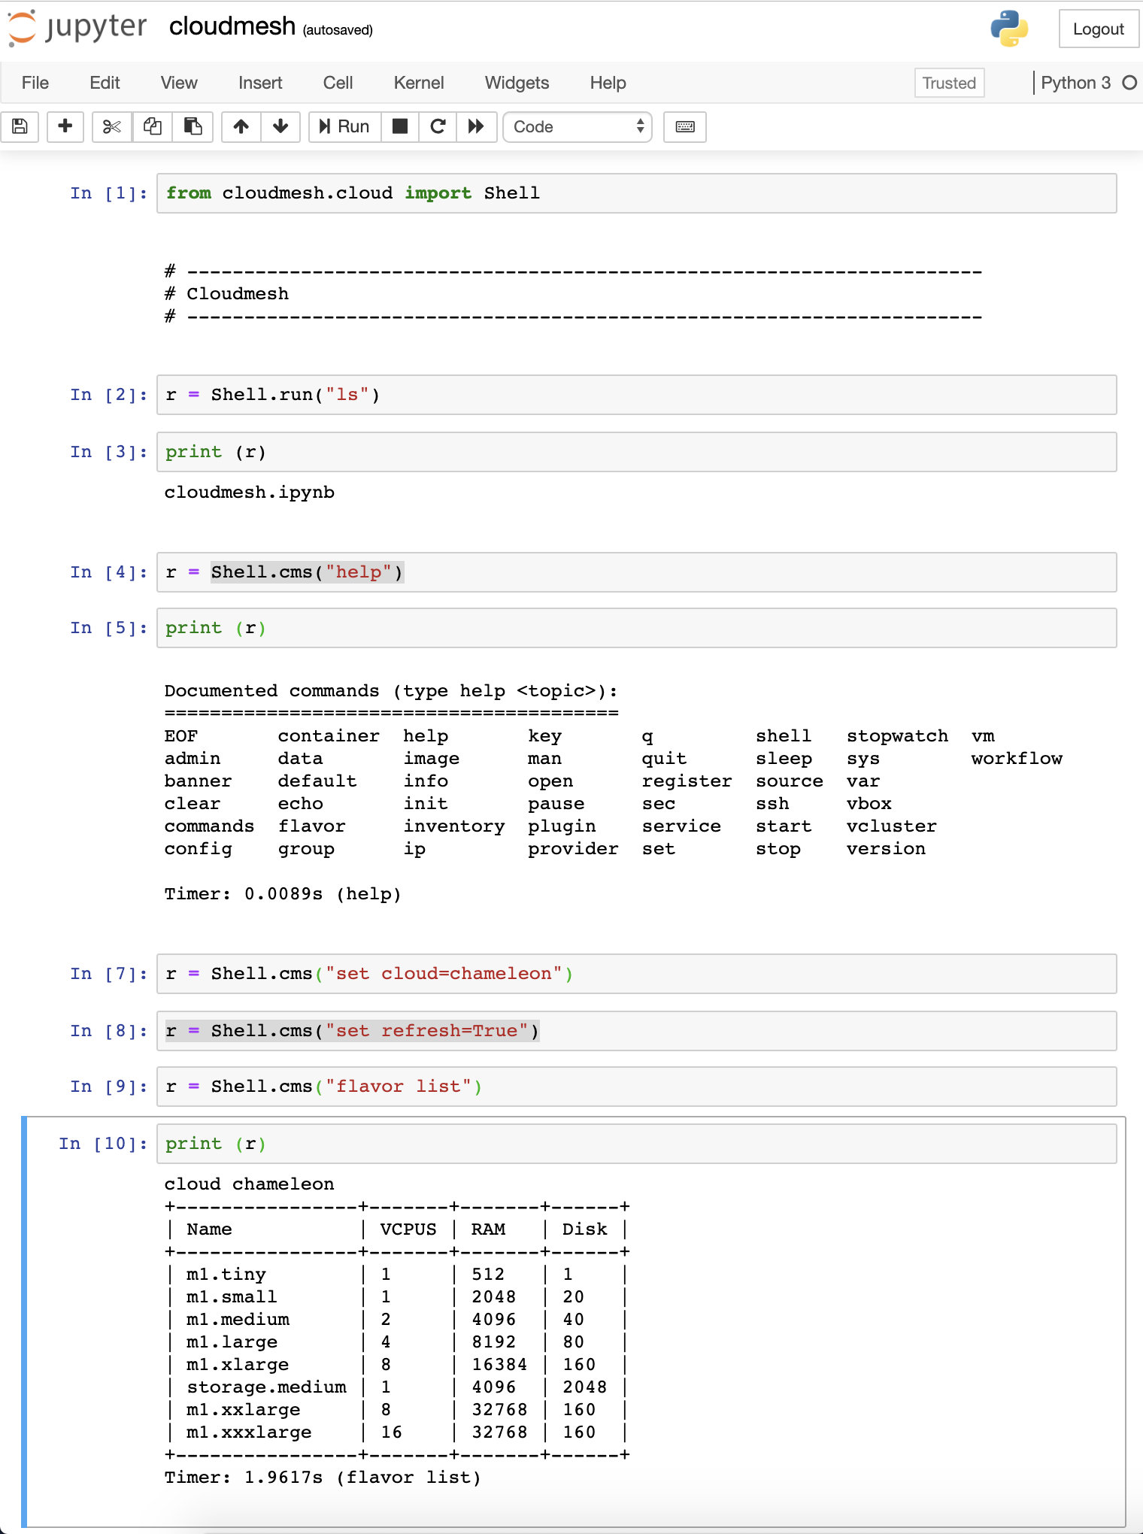
Jupyter Integration
Cloudmesh can easily be integrated into jupyter
The command shell is readily accessible via an API call

Slide 13
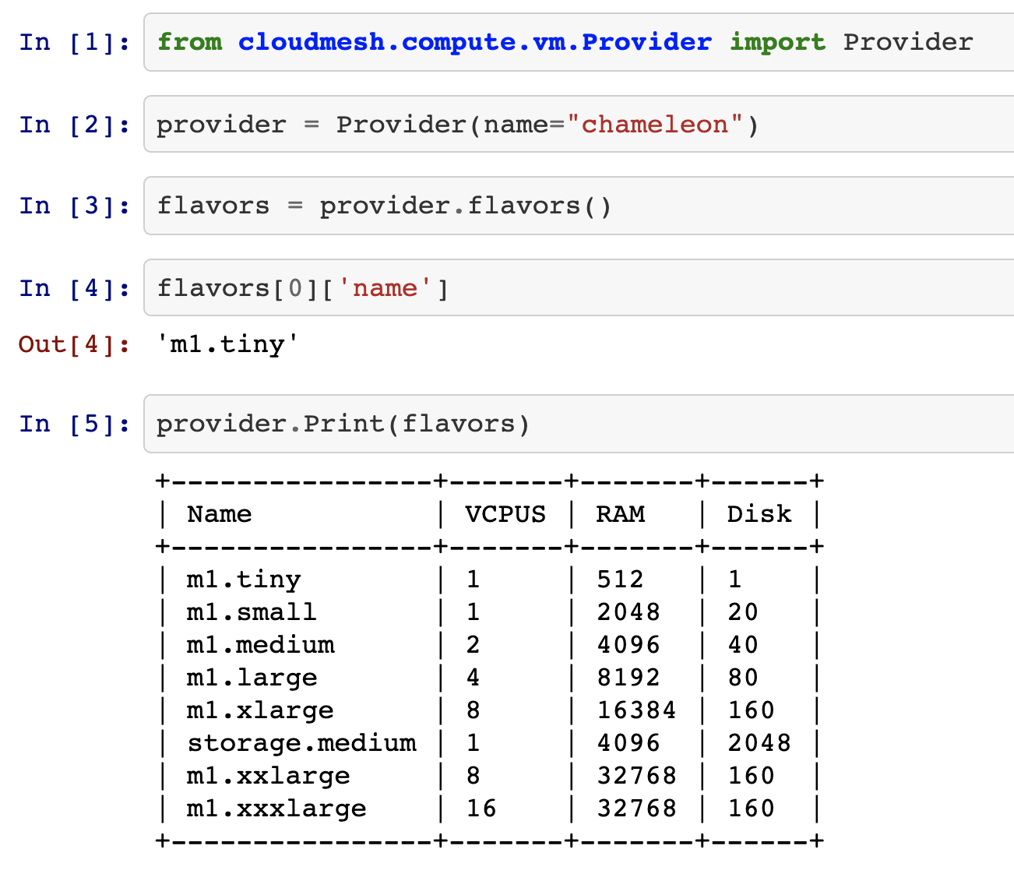
Simple API
Super simple API that allows integration with jupyter notebooks very easily

Slide 14
Cloudmesh Microservices
https://github.com/cloudmesh/cloudmesh-openapi
Microservice architecture:
structures an application as a collection of services that are
Maintainable
Testable
Loosely coupled
Independently deployable
Project a clear functionality
Problem:
While working with professionals, researchers, and students, entry-level is still to high for manys

Slide 15
Automated Microservice Generation
Python Program
Function
Class
OpenAPI
YAML
Microservice
Python
OpenAPI enhanced
Documentation
Security
Data integration
Python documentation

Slide 16
Generating Analytics Services from Python

Slide 17
Super simple to Generate a Microservice
Manual page
cms help openapi
Generate the Yaml file
cms openapi generate get_processor_name --filename=./tests/server-cpu/cpu.py

Slide 18
Simple Python Program as a Function
import …
def get_processor_name() -> str:
""" The name of the processor
:return: the name of the processor
"""
command = "cat /proc/cpuinfo" all_info = subprocess.check_output(
command, shell=True).strip().decode() for line in all_info.split("\n"):
p = re.sub(".*model name.*:", "", line, 1)
return jsonify(pinfo)

Slide 19
Generated YAML file
Server code is automatically generated
Can be started with cloudmesh openapi
command easily
Can be managed with the command
(start stop register)

Slide 20
Issue a Request
curl -X GET "http://localhost:8080/cloudmesh/get_processor_name"
-H "accept: text/plain"
127.0.0.1 - - [07/Oct/2020 14:10:04] "GET /cloudmesh/get_processor_name HTTP/1.1" 200 -
{"model":"Intel(R) Core(TM) i7-7920HQ CPU @ 3.10GHz"}

Slide 21
Automated Documentation
Open http://localhost:8080/cloudmesh/ui

Slide 22
Summary
Cloudmesh Multicloud Management
Managing multicloud compute resources
Managing multicloud data resources
Cloudmesh OpenAPI
Create easily many services from just puthon functions no need to be a software architect,
Inexperienced users can do it in a day (minutes)
Cloudmesh Multicloud Management could be used to host the rest service in a cloud
Restservice can naturally be also hosted on singularity or kubernetes

Slide 23
How to find information: GitHub
Cloudmesh is distributed in multiple repositories
https://github.com/cloudmesh
Manual
https://github.com/cloudmesh/cloudmesh-manual
https://cloudmesh.github.io/cloudmesh-manual/
Cloudmesh OpenAPI
https://github.com/laszewski/laszewski.github.io/raw/master/papers/vonLaszewski-openapi.pdf
Nist: OpenAPI specifications
https://github.com/cloudmesh/cloudmesh-openapi

